Slide 1
Information Security Chapter 1&2 BS-CS-VI VVEEK-02 & 03 Lectures

Slide 2
C.I.A. triangle or Security Objectives
Confidentiality
“Preserving authorized restriction on information access and disclosure, including means for protecting personal privacy and proprietary information.”
Integrity
“Guarding against improper information modification or destruction, and includes ensuring information non-repudiation and authenticity.”
Availability
“Ensuring timely and reliable access and use of information.”
- 2 -

Slide 3
CIA TRIAD (Video)
https://www.youtube.com/watch?v=rwigKjEsdTc
- 3 -

Slide 4
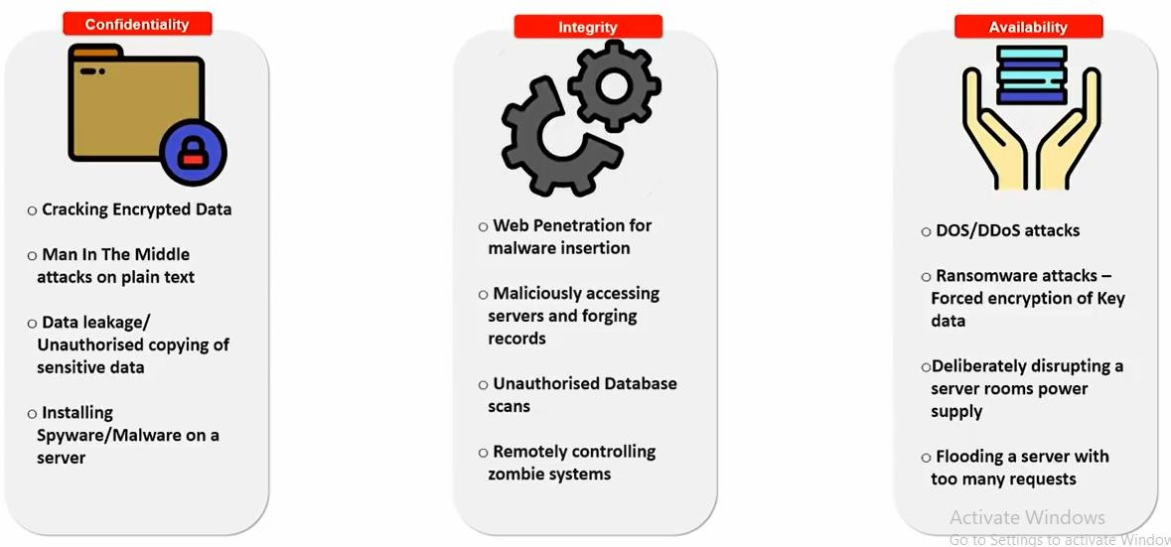
Attacks on CIA
DoS (Denial of Service) attacks overwhelm a system with excessive requests from a single source, while DDoS (Distributed Denial of Service) attacks originate from multiple compromised devices, making them harder to mitigate.
Spyware and Malware are both types of malicious software that can harm computers, networks, and user data. Malware is broad term for any software designed to damage, disrupt, or gain unauthorized access to systems.
Spyware is a type of malware that secretly gathers information about a user’s activities without their knowledge. It can track keystrokes, browsing history, login credentials, and personal data.
4

Slide 5
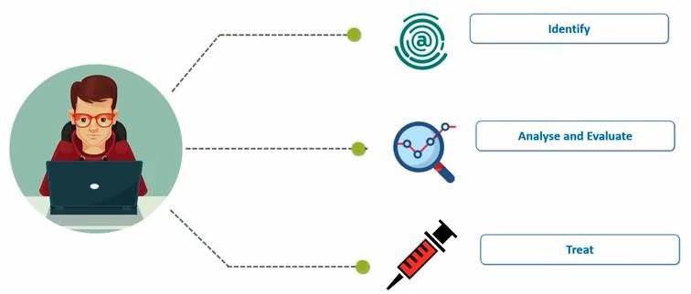
Steps to Fix a Crime
5

Slide 6
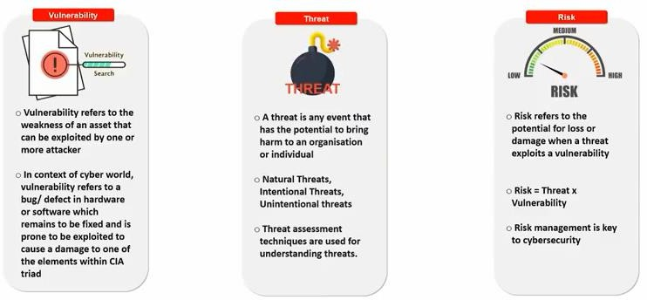
Vulnerability, Threat & Risk
6

Slide 7
How Seriously Should You Take Threats to Network Security?
Which group do you belong to?
“No one is coming after my computer.”
“The sky is falling!”
Middle ground.
7

Slide 8
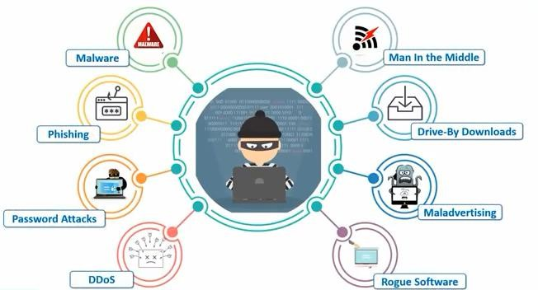
Cyber Attacks
1.Phishing – Fraudulent attempts to steal sensitive information via fake emails or websites. (e.g., Spear Phishing, Email Scams)
2.Password Attack – Unauthorized access attempts using stolen or guessed passwords. (e.g., Brute Force, Credential Stuffing)
3.Malvertising & Rogue Software – Fake ads or software that deliver malware. (e.g., Fake Antivirus, Pop-up Scams)
39

Slide 9
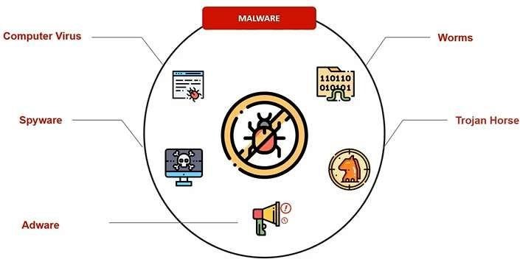
Malware
Malicious software disguised as legitimate to trick users into installing it.
Malicious software disguised as legitimate to trick users into installing it.
Key Difference: Trojans require user action to execute, while worms spread autonomously.

Slide 10
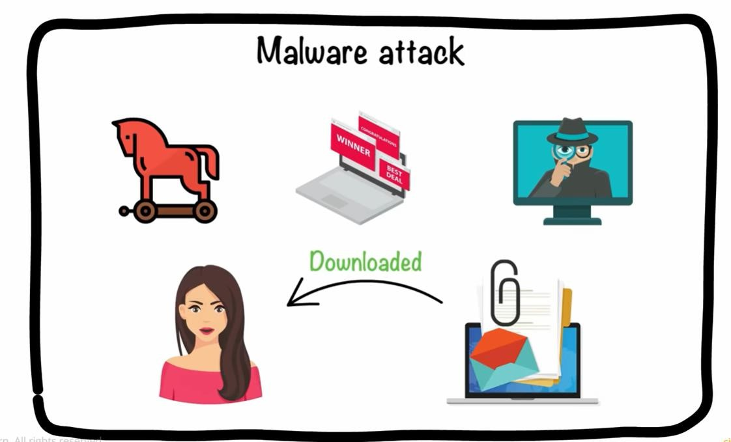

Slide 11
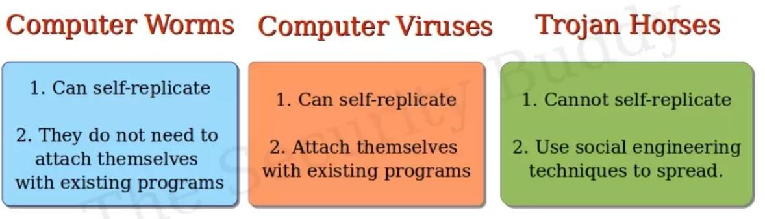

Slide 12
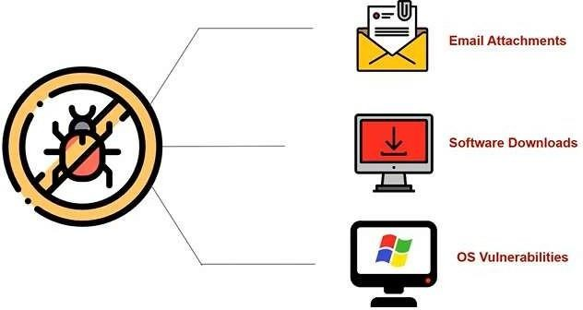
How Malware

Slide 13
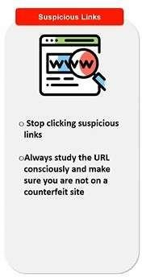
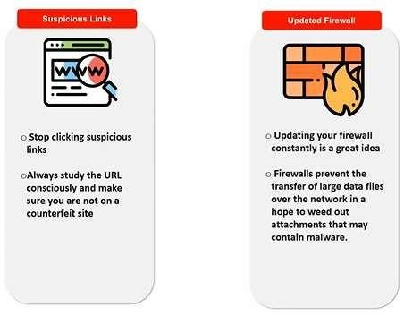
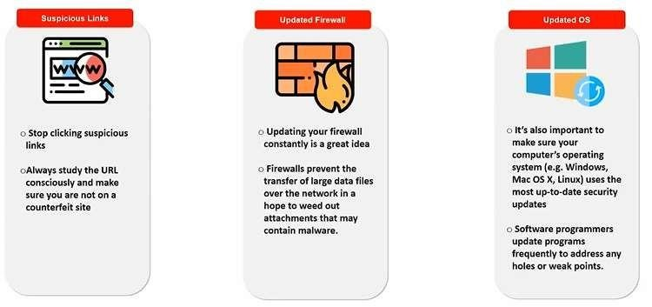
How to Stop?

Slide 14
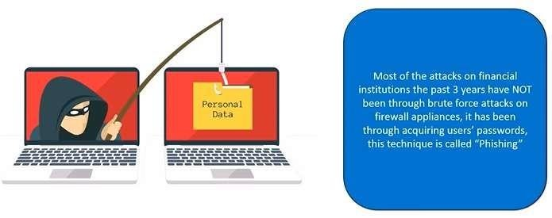
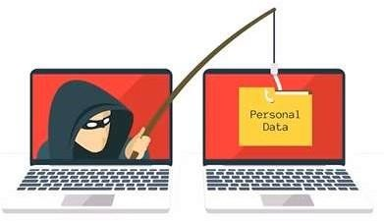
Phishing Attack

Slide 15
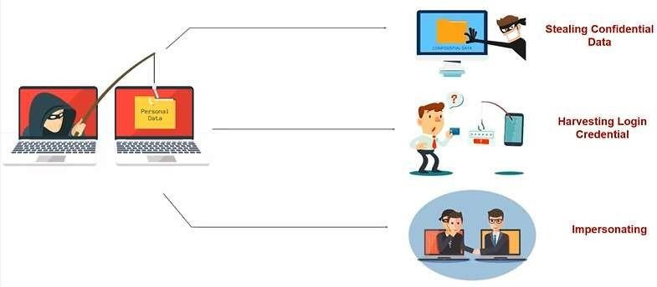
What is Phishing used for?
40

Slide 16
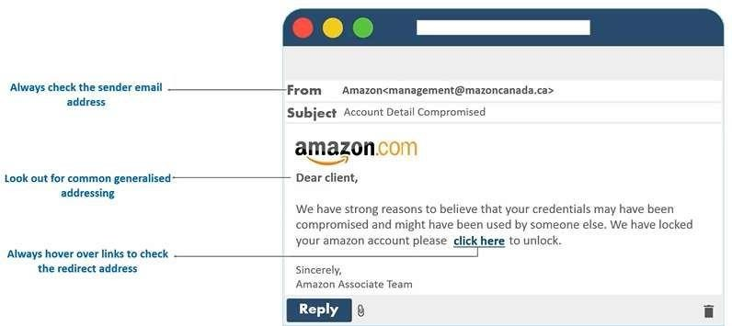
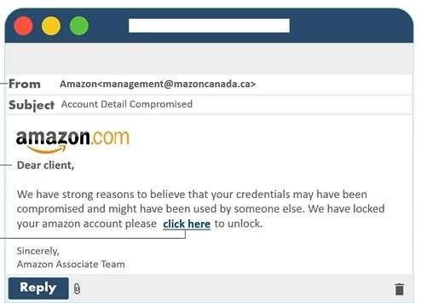
Phishing Awareness

Slide 17
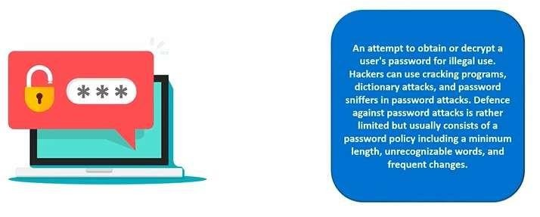
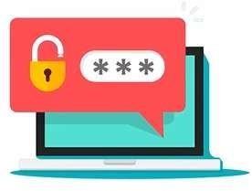
Password Attacks

Slide 18
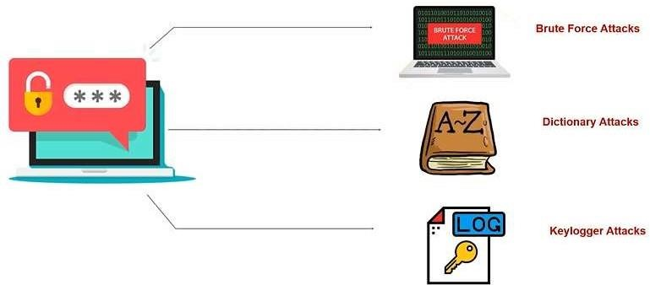
Types of Password Attacks
A Brute Force Attack is a hacking method where attackers systematically try all possible passwords or encryption keys until they find the correct one.
How It Works:
Repeated login attempts using trial-and-error.
Automated tools generate and test millions of combinations.
Targets weak passwords and unprotected systems.
🔹 Examples:
Dictionary Attack – Using a list of common passwords.

Slide 19
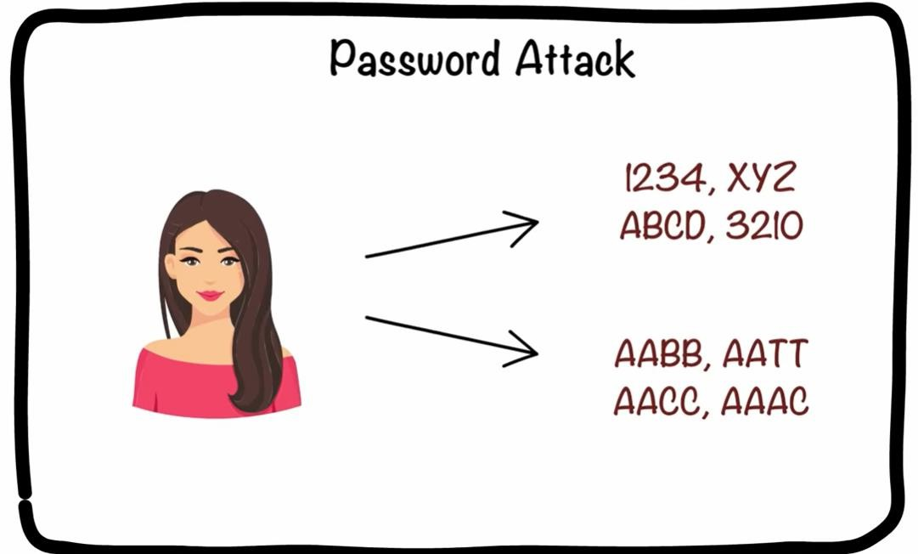

Slide 20
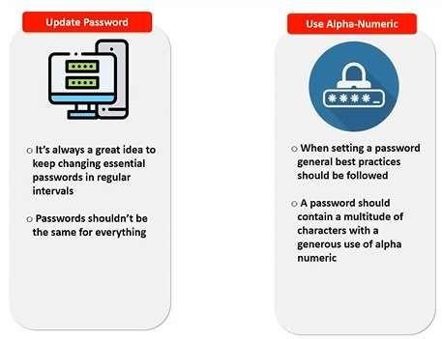
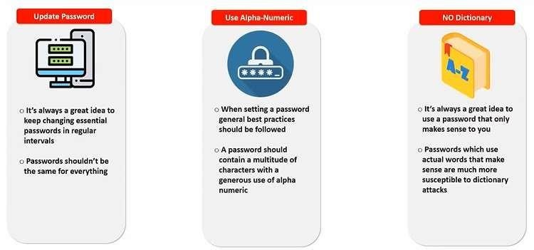
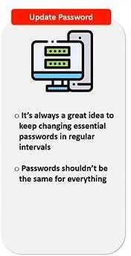
Stop Password Attacks

Slide 21
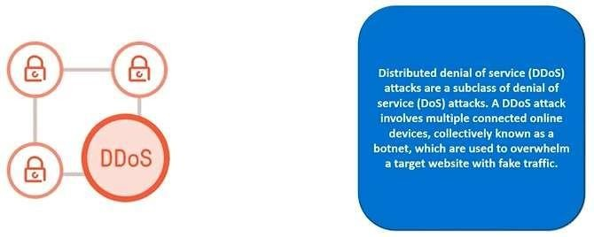
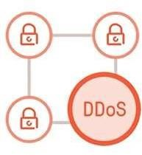
Distributed Denial of Services (DDoS)

Slide 22

Denial of Service Attacks
The attacker does not intrude into the system but just blocks access by authorized users.
55

Slide 23
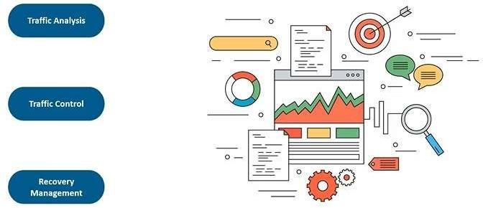
Prevention

Slide 24
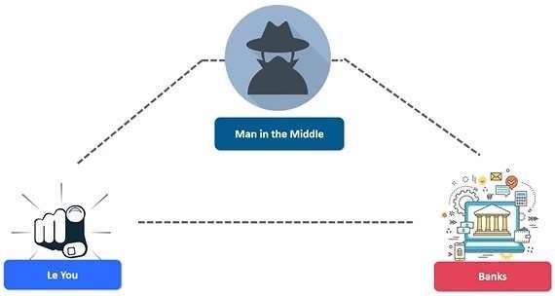
Man in the Middle

Slide 25
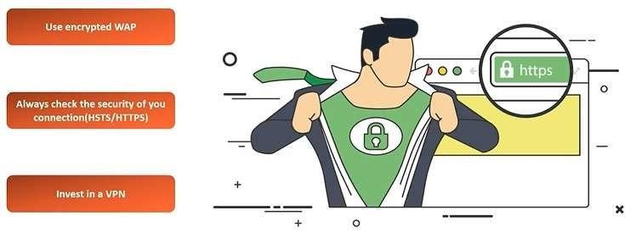
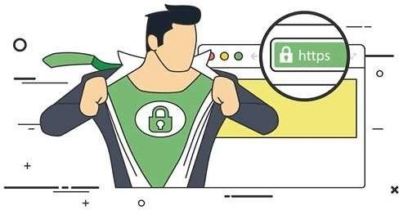
Prevent MITM
Wireless Application Protocol)

Slide 26
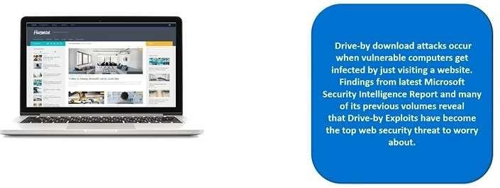
Drive-by Download
50

Slide 27
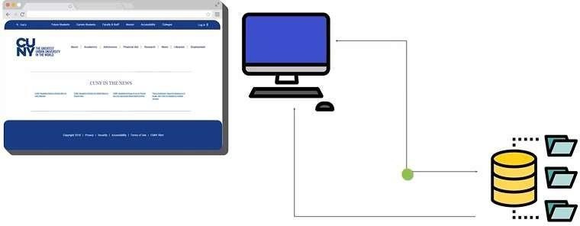
How it work?

Slide 28
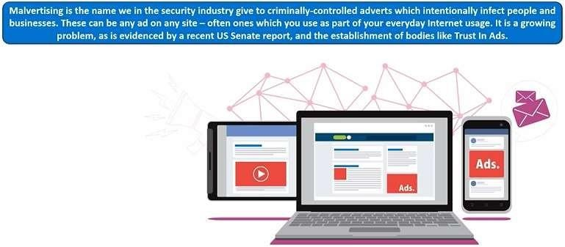
Malvertising

Slide 29
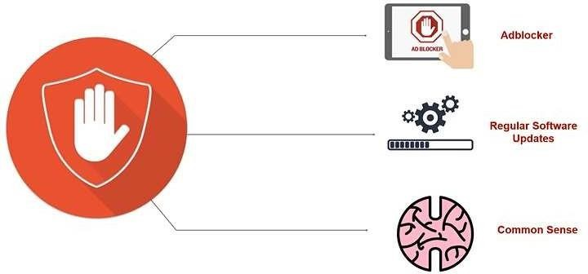
Prevention

Slide 30
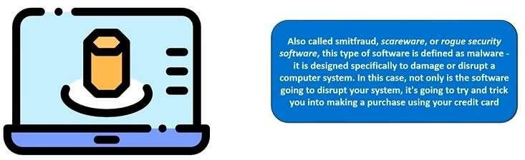
Rogue Software

Slide 31
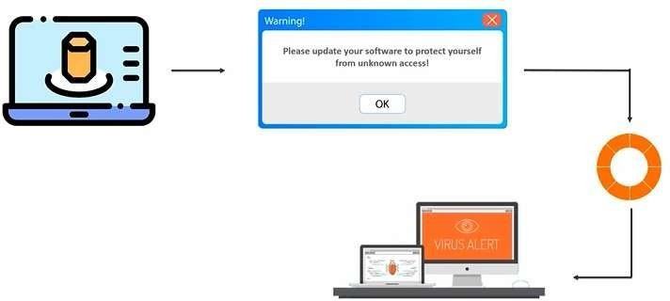
Propagation
Propagation refers to the process of spreading, transmitting, or distributing something, depending on the context.
🔹 Common Uses of Propagation:
Network & Malware Propagation – The way viruses, worms, and malware spread across systems. (e.g., Email Worms, USB Infections)

Slide 32
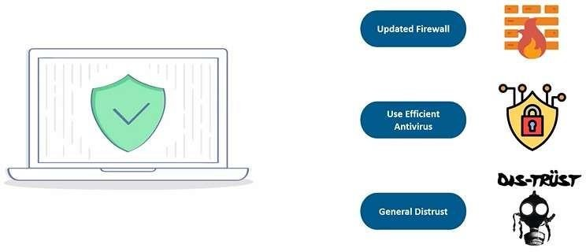
Prevention

Slide 33
Web Attacks
The attacker attempts to breach a web application. Common attacks of this type are SQL injection
67

Slide 34
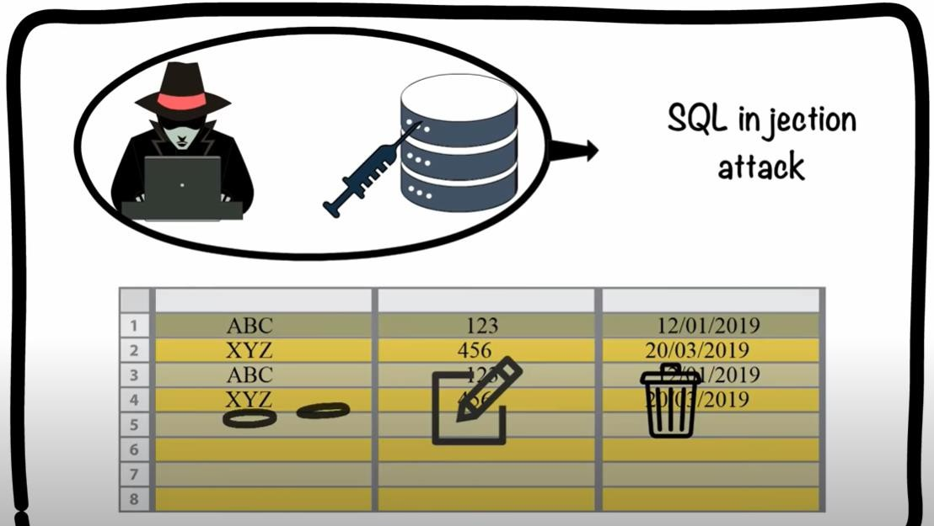

Slide 35
Session Hijacking
This is a complex attack that involves actually taking over an authenticated session.
35

Slide 36
DNS Poisoning
This involves altering DNS records on a DNS server to redirect client traffic to malicious websites, usually for identity theft.
36

Slide 37
Cyber Crime?
????
Cybercrime, or computer-oriented crime, is a crime that involves a computer and a network. The computer may have been used source of a crime, or it may be the target.

Slide 38
Classification of Cyber Crimes
Insider Attack:
Person with authorized system access
Dissatisfied or unhappy inside employees or contractors
Motive could be revenge or greed
Well aware of the policies, processes, IT architecture and weakness of the security system
Comparatively easy for a insider attacker to steel sensitive information, crash the network, etc.
Could be prevented by using IDS/IPS (IDS (Intrusion Detection & Prevention System)
External Attack:
Hired by an insider or an external entity to the organization
Organization not only faces financial loss but also the loss of reputation
Attackers usually scan and gathering information
Keeps regular eye on the log and carefully analyzing these firewall logs
IDS/IPS can also protect from external attackers

Slide 39
Classification of Cyber Crimes (Cont.)
Cyber attacks can also be classified as:
Unstructured attacks
Generally person who don't have any predefined motives to perform the cyber attack
Try to test a tool readily available over the internet
Structure attacks:
Performed by highly skilled and experienced people
Motives of these attacks are clear in their mind
Access to sophisticated tools and technologies to gain access to other networks without being noticed
Expertise to develop or modify the existing tools to satisfy their purpose
Usually performed by professional criminals, by a country on other rival countries, politicians to damage the image of the rival person or the country, terrorists, rival companies, etc.
60

Slide 40
Reasons for Commission of Cyber Crimes
Money:
People are motivated towards committing cyber crime is to make quick and easy money.
Revenge:
Take revenge with other person/organization/society/caste or religion
Defaming its reputation or bringing economical or physical loss.
This comes under the category of cyber terrorism.
Fun:
The amateur do cyber crime for fun.
Recognition:
It is considered to be pride if someone hack the highly secured networks
Anonymity:
Anonymity that a cyber space provide motivates the person to commit cyber crime
Cyber Espionage:
At times the government itself is involved in cyber trespassing to keep eye on other person/network/country

Slide 41
Kinds of Cyber Crimes
Cyber Stalking
Stalking, harassing, threatening someone, or defame a person
The behavior includes false accusations, threats, sexual exploitation to minors, monitoring, etc.
Child Pornography
Possessing image or video of a minor (under 18), engaged in sexual conduct.
Forgery and Counterfeiting
Produce counterfeit which matches the original document
Not possible to judge the authenticity of the document
Software Piracy and Crime related to IPRs: (Intellectual Property Rights)
An illegal reproduction and distribution
Cyber Terrorism
Use of computer resources to intimidate or force government, the civilian population or any segment thereof in furtherance of political or social objectives
Phishing
Acquiring personal and sensitive information of an individual via email
Vishing (voice phishing), Smishing
■

Slide 42
Kinds of Cyber Crimes (Cont.)
Computer Vandalism
Physical destroying computing resources using physical force or malicious code
Computer Hacking
Modifying computer hardware and software to accomplish a goal
Simply demonstrations of the technical ability, to sealing, modifying or destroying information for social, economic or political reasons

Slide 43
Kinds of Cyber Crimes (Cont.)
Creating and distributing viruses over internet
Spreading of an virus can cause business and financial loss
Spamming
Sending of unsolicited and commercial bulk message
Spams not only irritate the recipients and overload the network but also waste the time and occupy the valuable memory space
Cross Site Scripting
Injecting a malicious client side script into a trusted website
Malicious script gets access to the cookies and other sensitive information and sent to remote servers
Online Auction Fraud
Online auction fraud schemes which often lead to either overpayment of the product or the item is never delivered
Cyber Squatting
Reserving the domain names of someone else's trademark
Sell it afterwards at higher price
■

Slide 44

Basic Security Terminology
Hackers (General Term) 🖥️
A hacker is someone skilled in computer programming, networking, and security, who can exploit or protect systems. Hackers can be ethical or malicious.
White Hat Hackers (Ethical Hackers)
Work legally to test and improve cybersecurity.
Help organizations by finding and fixing vulnerabilities.
Often hired as penetration testers or security experts.
Example: Ethical hackers working for companies like Google or Microsoft.
Black Hat Hackers (Malicious Hackers)
Break into systems illegally for personal gain, destruction, or espionage.
Involve in data theft, malware attacks, and financial fraud.
Example: Cybercriminals launching ransomware attacks.
Gray Hat Hackers (Neutral Hackers)
Operate between white hat and black hat ethics.
Find vulnerabilities without permission but often report them instead of exploiting them.
May still break laws but not always for harmful intent.
Example: A hacker discovering a system flaw and notifying the company without prior approval.
Script Kiddies (Unskilled Hackers)
Use pre-made hacking tools and scripts without deep technical knowledge.
Often hack for fun, fame, or minor attacks like defacing websites or running small-scale DDoS attacks.
Example: A teenager using a hacking tool to break into a school’s system.
People:
Hackers
White hats
Black hats
Gray hats
Script kiddies
Ethical hackers/Sneakers
44

Slide 45
Basic Security Terminology (cont.)
Activities
Authentication
Auditing
45

Slide 46
Network Security Paradigms
How will you protect your network?
CIA Triangle
Least Privileges
Perimeter security approach
Layered security approach
Proactive versus reactive
Hybrid security method
46

Slide 47
How Do Legal Issues Impact Network Security?
The Computer Security Act of 1987
OMB Circular A-130
See www.alw.nih.gov/Security/FIRST/papers/ legal/statelaw.txt for state computer laws
Health Insurance Portability and Accountability Act of 1996, HIPAA
47

Slide 48
Online Security Resources
CERT
www.cert.org
Microsoft Security Advisor
www.microsoft.com/security/default.mspx
F-Secure
www.f-secure.com
SANS
www.sans.org
48

