Slide 1
LR Parser
Presenter: Sagar Chhabriya
Compiler Construction Presentation: LR Parser
Nov 27, 2025
Instructor: Muhammad Haris

Slide 2
Agenda
Definition of Parser
Ways of generating Parse Trees
Classification of Parsers
Numerical with Solution

Slide 3
Parser
A parser is a program that generates a parse tree for the given string, if the string is generated from the underlying grammar.
HL Code → x = a + b * c;
Converted Code → id = id + id * id; → Feed into Parser → Parse Tree
If this particular string can be generated from the underlying grammar, then the parser program generates a parse tree.

Slide 4
Generation of Parse Tree
Top Down approach
Bottom up approach

Slide 5
Classification of Parsers
Parsers
Top Down Parser
Bottom-up Parser
(Shift-Reduce Parser)
With Backtracking
Without
Backtracking
Operator Precedence Parsers
LR Parsers
LR(0), SLR(1), LALR(1), CLR(1)
Brute Forcing
Recursive Descent
Parsers
Predictive
Parsers
LL(1), LL(k)
Notes:
Except for the operator precedence parser all the other parsers are unable to handle the ambiguous grammar so apart from this particular parser for all the different parsers we will have to use unambiguous CFGs

Slide 6
LR(0) Parser
Step 1: Augment the Grammar and number/label it
Step 2: Draw DFA Diagram
Step 3: Parsing Table
Step 4: Stack Implementation
Step 5: Parse Tree

Slide 7
Numerical
E → BB
B → cB | d
String: ccdd$

Slide 8
Step 1: Augment and Label
Numerical
  E → BB
  B → cB | d
Augment and Label
  E’ → E
  E → BB
  B → cB | d
0
1
2
3

Slide 9
Step 2: Draw DFA Diagram
I₁
I₅
E’ → E .
E → B B .
B
E
I₀
I₂
E → B . B
B
c
B → c . B
B → . c B | . d
E’ → . E
B → . c B | . d
c
d
E → . B B
I₃
d
c
B → . cB | .d
B → c . B
B → d .
d
B → . c B | . d
B
I₆
I₄
c
B → c B .
B → d .
d
Notes:
DFA: Deterministic Finite Automaton
dot is the state/position of parser

Slide 10
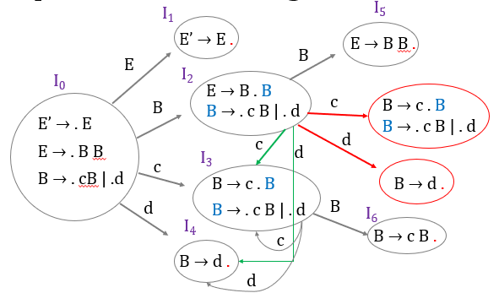
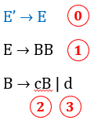
Step 3: Parsing Table
State | Action |  |  | Goto
 | c | d | $ | B | E
I₀ | S3 | S4 |  | 2 | 1
I₁ |  |  | Accept
I₂ | S3 | S4 |  | 5
I₃ | S3 | S4 |  | 6
I₄ | R3 | R3 | R3
I₅ | R1 | R1 | R1
I₆ | R2 | R2 | R2

Slide 11
Step 4: Stack Implementation
State | Action |  |  | Goto
 | c | d | $ | B | E
I₀ | S3 | S4 |  | 2 | 1
I₁ |  |  | Accept
I₂ | S3 | S4 |  | 5
I₃ | S3 | S4 |  | 6
I₄ | R3 | R3 | R3
I₅ | R1 | R1 | R1
I₆ | R2 | R2 | R2
Stack | Input | Action
$0 | ccdd$ | Shift c → S3
$0c3 | cdd$ | Shift c → S3
$0c3c3 | dd$ | Shift d → S4
$0c3c3d4 | d$ | Reduce B → d
$0c3c3B6 | d$ | Reduce B → cB
$0c3B6 | d$ | Reduce B → cB
$0B2 | d$ | Shift d → S4
$0B2d4 | $ | Reduce B → d
$0B2B5 | $ | Reduce E → BB
$0E1 | $ | Accept

Slide 12
Step 5: Parse Tree
Stack | Input | Action
$0 | ccdd$ | Shift c → S3
$0c3 | cdd$ | Shift c → S3
$0c3c3 | dd$ | Shift d → S4
$0c3c3d4 | d$ | Reduce B → d
$0c3c3B6 | d$ | Reduce B → cB
$0c3B6 | d$ | Reduce B → cB
$0B2 | d$ | Shift d → S4
$0B2d4 | $ | Reduce B → d
$0B2B5 | $ | Reduce E → BB
$0E1 | $ | Accept
E
/ \
B B
/ \ \
c B d
/ \
c B
\
d

Slide 13
Thank You

