Slide 1
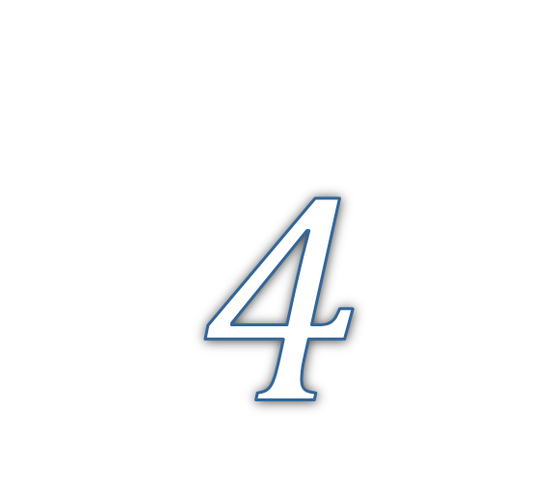
Personality and Values
© 2009 Prentice-Hall Inc. All rights reserved.
4-<number>

Slide 2
Chapter Learning Objectives
After studying this chapter, you should be able to:
  Define personality, describe how it is measured, and explain the factors that determine an individual’s personality.
  Describe the Myers-Briggs Type Indicator personality framework and assess its strengths and weaknesses.
  Identify the key traits in the Big Five personality model.
  Demonstrate how the Big Five traits predict behavior at work.
  Identify other personality traits relevant to OB.
  Define values, demonstrate their importance, and contrast terminal and instrumental values.
  Compare generational differences in values, and identify the dominant values in today’s workforce.
  Identify Hofstede’s five value dimensions of national culture.
© 2009 Prentice-Hall Inc. All rights reserved.
4-<number>

Slide 3
What is Personality?
The dynamic organization within the individual of those psychophysical systems that determine his unique adjustments to his environment. - Gordon Allport.
  The sum total of ways in which an individual reacts and interacts with others, the measurable traits a person exhibits
Measuring Personality
  Helpful in hiring decisions
  Most common method: self-reporting surveys
  Observer-ratings surveys provide an independent assessment of personality – often better predictors
© 2009 Prentice-Hall Inc. All rights reserved.
4-<number>

Slide 4

Personality Determinants
Heredity
  Factors determined at conception: physical stature, facial attractiveness, gender, temperament, muscle composition and reflexes, energy level, and bio-rhythms
  This “Heredity Approach” argues that genes are the source of personality
  Twin studies: raised apart but very similar personalities
  Parents don’t add much to personality development
  There is some personality change over long time periods
© 2009 Prentice-Hall Inc. All rights reserved.
4-<number>

Slide 5

Personality Traits
Enduring characteristics that describe an individual’s behavior
  The more consistent the characteristic and the more frequently it occurs in diverse situations, the more important the trait.
Two dominant frameworks used to describe personality:
  Myers-Briggs Type Indicator (MBTI®)
  Big Five Model
© 2009 Prentice-Hall Inc. All rights reserved.
4-<number>

Slide 6
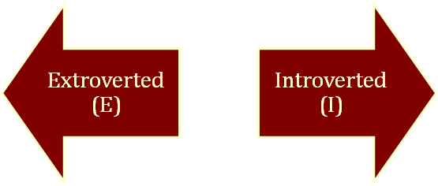
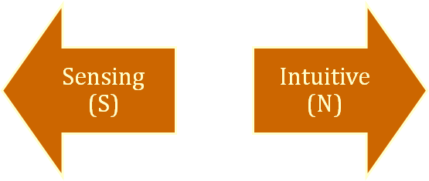
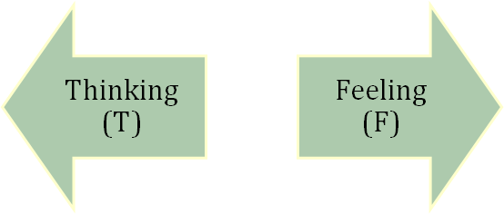
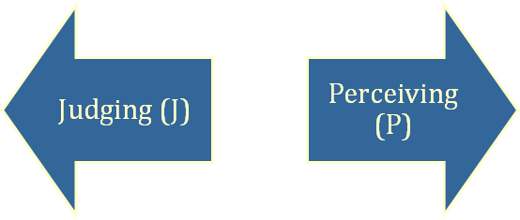
The Myers-Briggs Type Indicator
Most widely used instrument in the world.
Participants are classified on four axes to determine one of 16 possible personality types, such as ENTJ.
Sociable and Assertive
Quiet and
Shy
Practical and
Orderly
Unconscious
Processes
Use Reason
and Logic
Uses Values & Emotions
Want Order
& Structure
Flexible and Spontaneous
© 2009 Prentice-Hall Inc. All rights reserved.
4-<number>

Slide 7
The Types and Their Uses
Each of the sixteen possible combinations has a name, for instance:
  Visionaries (INTJ) – original, stubborn, and driven.
  Organizers (ESTJ) – realistic, logical, analytical, and businesslike.
  Conceptualizer (ENTP) – entrepreneurial, innovative, individualistic, and resourceful.
Research results on validity mixed.
  MBTI® is a good tool for self-awareness and counseling.
  Should not be used as a selection test for job candidates.
© 2009 Prentice-Hall Inc. All rights reserved.
4-<number>

Slide 8
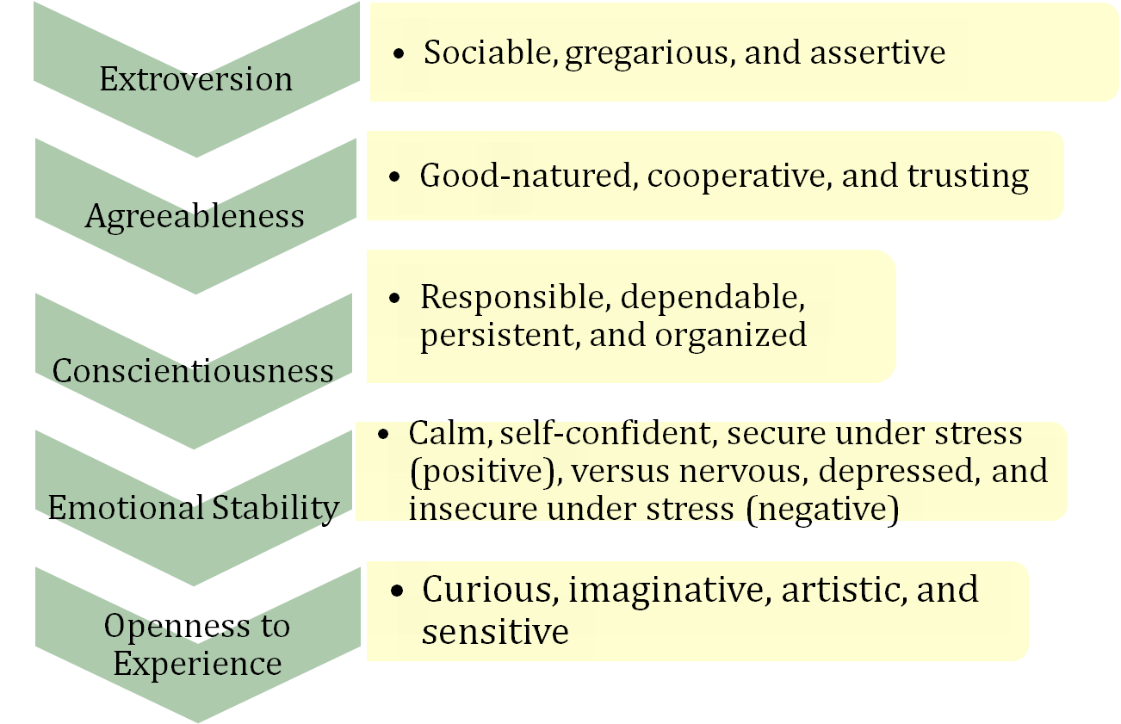
The Big Five Model of Personality Dimensions
© 2009 Prentice-Hall Inc. All rights reserved.
4-<number>

Slide 9
How Do the Big Five Traits Predict Behavior?
Research has shown this to be a better framework.
Certain traits have been shown to strongly relate to higher job performance:
  Highly conscientious people develop more job knowledge, exert greater effort, and have better performance.
  Other Big Five Traits also have implications for work.
    Emotional stability is related to job satisfaction.
    Extroverts tend to be happier in their jobs and have good social skills.
    Open people are more creative and can be good leaders.
    Agreeable people are good in social settings.
See E X H I B I T 4–2
© 2009 Prentice-Hall Inc. All rights reserved.
4-<number>

Slide 10

Other Personality Traits Relevant to OB
Core Self-Evaluation
  The degree to which people like or dislike themselves
  Positive self-evaluation leads to higher job performance
Machiavellianism
  A pragmatic, emotionally distant power-player who believes that ends justify the means.
  High Machs are manipulative, win more often, and persuade more than they are persuaded. Flourish when:
    Have direct interaction
    Work with minimal rules and regulations
    Emotions distract others
Narcissism
  An arrogant, entitled, self-important person who needs excessive admiration.
  Less effective in their jobs.
© 2009 Prentice-Hall Inc. All rights reserved.
4-<number>

Slide 11
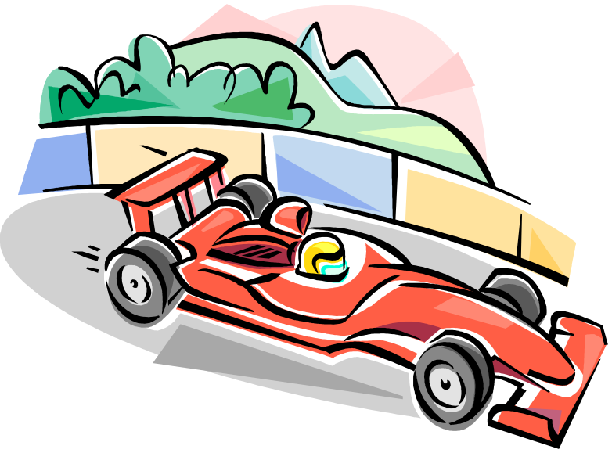
More Relevant Personality Traits
Self-Monitoring
  The ability to adjust behavior to meet external, situational factors.
  High monitors conform more and are more likely to become leaders.
Risk Taking
  The willingness to take chances.
  May be best to align propensities with job requirements.
  Risk takers make faster decisions with less information.
© 2009 Prentice-Hall Inc. All rights reserved.
4-<number>

Slide 12
Even More Relevant Personality Traits
Type A Personality
  Aggressively involved in a chronic, incessant struggle to achieve more in less time
    Impatient: always moving, walking, and eating rapidly
    Strive to think or do two or more things at once
    Cannot cope with leisure time
    Obsessed with achievement numbers
  Prized in North America but quality of the work is low
  Type B people are the complete opposite
Proactive Personality
  Identifies opportunities, shows initiative, takes action, and perseveres to completion
  Creates positive change in the environment
© 2009 Prentice-Hall Inc. All rights reserved.
4-<number>

Slide 13
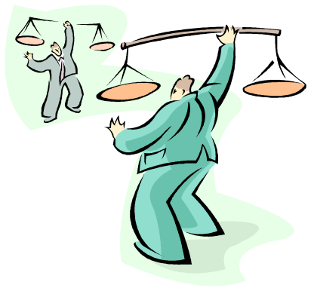
Values
Basic convictions on how to conduct yourself or how to live your life that is personally or socially preferable – “How To” live life properly.
Attributes of Values:
  Content Attribute – that the mode of conduct or end-state is important
  Intensity Attribute – just how important that content is.
Value System
  A person’s values rank ordered by intensity
  Tends to be relatively constant and consistent
© 2009 Prentice-Hall Inc. All rights reserved.
4-<number>

Slide 14

Importance of Values
Provide understanding of the attitudes, motivation, and behaviors
Influence our perception of the world around us
Represent interpretations of “right” and “wrong”
Imply that some behaviors or outcomes are preferred over others
© 2009 Prentice-Hall Inc. All rights reserved.
4-<number>

Slide 15
Classifying Values – Rokeach Value Survey
Terminal Values
  Desirable end-states of existence; the goals that a person would like to achieve during his or her lifetime
Instrumental Values
  Preferable modes of behavior or means of achieving one’s terminal values
People in same occupations or categories tend to hold similar values
  But values vary between groups
  Value differences make it difficult for groups to negotiate and may create conflict
© 2009 Prentice-Hall Inc. All rights reserved.
4-<number>

Slide 16
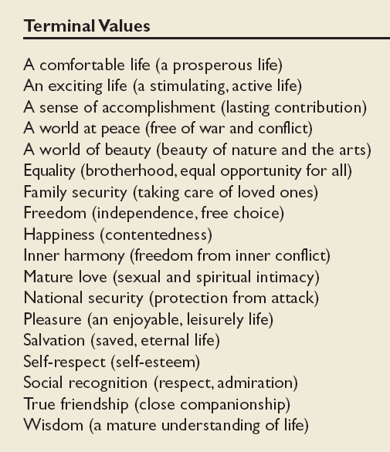
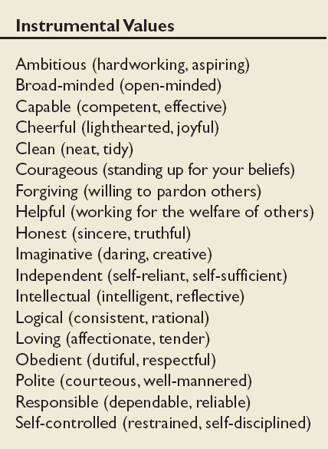
Values in the Rokeach Survey
E X H I B I T 4–3
© 2009 Prentice-Hall Inc. All rights reserved.
4-<number>

Slide 17
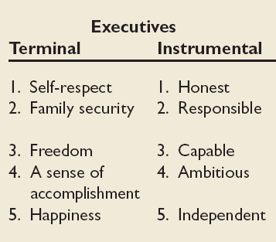
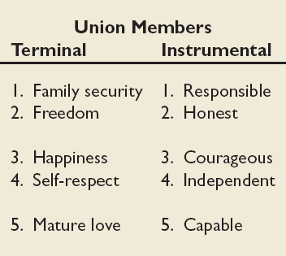
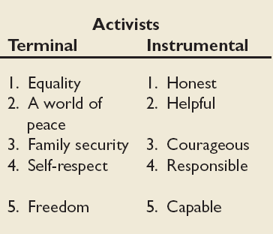

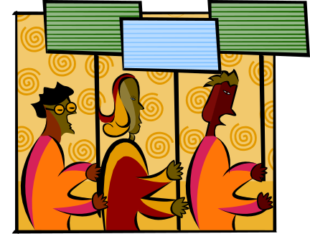
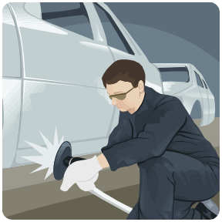
Value Differences Between Groups
Source: Based on W. C. Frederick and J. Weber, “The Values of Corporate Managers and Their Critics: An Empirical Description and Normative Implications,” in W. C. Frederick and L. E. Preston (eds.) Business Ethics: Research Issues and Empirical Studies (Greenwich, CT: JAI Press, 1990), pp. 123–44.
E X H I B I T 4–4
© 2009 Prentice-Hall Inc. All rights reserved.
4-<number>

Slide 18
Generational Values
Cohort | Entered Workforce | Approximate Current Age | Dominant Work Values
Veterans | 1950-1964 | 65+ | Hard working, conservative, conforming; loyalty to the organization
Boomers | 1965-1985 | 40-60s | Success, achievement, ambition, dislike of authority; loyalty to career
Xers | 1985-2000 | 20-40s | Work/life balance, team-oriented, dislike of rules; loyalty to relationships
Nexters | 2000-Present | Under 30 | Confident, financial success, self-reliant but team-oriented; loyalty to both self and relationships
E X H I B I T 4–5
© 2009 Prentice-Hall Inc. All rights reserved.
4-<number>

Slide 19
Linking Personality and Values to the Workplace
Managers are less interested in someone’s ability to do a specific job than in that person’s flexibility.
Person-Job Fit:
  John Holland’s Personality-Job Fit Theory
    Six personality types
    Vocational Preference Inventory (VPI)
  Key Points of the Model:
    There appear to be intrinsic differences in personality between people
    There are different types of jobs
    People in jobs congruent with their personality should be more satisfied and have lower turnover
© 2009 Prentice-Hall Inc. All rights reserved.
4-<number>

Slide 20
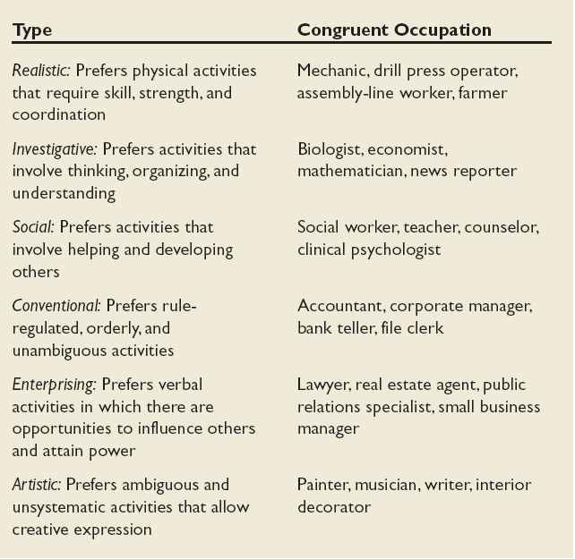
Holland’s Personality Typology & Occupations
E X H I B I T 4–7
© 2009 Prentice-Hall Inc. All rights reserved.
4-<number>

Slide 21
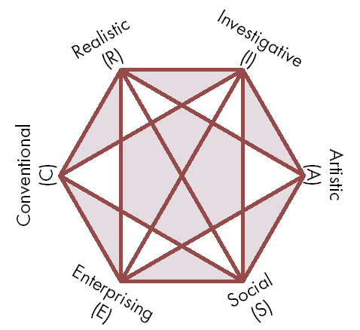
Relationships Among Personality Types
The closer the occupational fields, the more compatible.
The further apart the fields, the more dissimilar.
Need to match personality type with occupation.
Source: Reprinted by special permission of the publisher, Psychological Assessment Resources, Inc., from Making Vocational Choices, copyright 1973, 1985, 1992 by Psychological Assessment Resources, Inc. All rights reserved.
E X H I B I T 4–8
© 2009 Prentice-Hall Inc. All rights reserved.
4-<number>

Slide 22
Still Linking Personality to the Workplace
In addition to matching the individual’s personality to the job, managers are also concerned with:
Person-Organization Fit:
  The employee’s personality must fit with the organizational culture.
  People are attracted to organizations that match their values.
  Those who match are most likely to be selected.
  Mismatches will result in turnover.
  Can use the Big Five personality types to match to the organizational culture.
© 2009 Prentice-Hall Inc. All rights reserved.
4-<number>

Slide 23

Global Implications
Personality
  Do frameworks like Big Five transfer across cultures?
    Yes, but the frequency of type in the culture may vary.
    Better in individualistic than collectivist cultures.
Values
  Values differ across cultures.
  Hofstede’s Framework for assessing culture – five value dimensions:
    Power Distance
    Individualism vs. Collectivism
    Masculinity vs. Femininity
    Uncertainty Avoidance
    Long-term vs. Short-term Orientation
© 2009 Prentice-Hall Inc. All rights reserved.
4-<number>

Slide 24
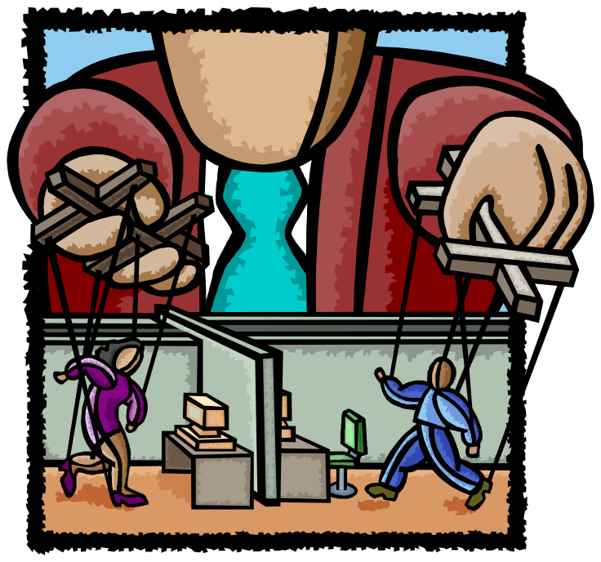
Hofstede’s Framework: Power Distance
The extent to which a society accepts that power in institutions and organizations is distributed unequally.
  Low distance
    Relatively equal power between those with status/wealth and those without status/wealth
  High distance
    Extremely unequal power distribution between those with status/wealth and those without status/wealth
See E X H I B I T 4–6
© 2009 Prentice-Hall Inc. All rights reserved.
4-<number>

Slide 25
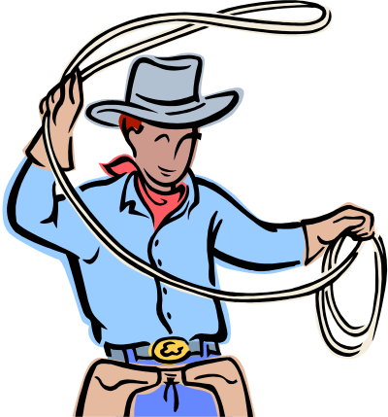

Hofstede’s Framework: Individualism
Individualism
  The degree to which people prefer to act as individuals rather than a member of groups
Collectivism
  A tight social framework in which people expect others in groups of which they are a part to look after them and protect them
  Versus
© 2009 Prentice-Hall Inc. All rights reserved.
4-<number>

Slide 26


Hofstede’s Framework: Masculinity
Masculinity
  The extent to which the society values work roles of achievement, power, and control, and where assertiveness and materialism are also valued
Femininity
  The extent to which there is little differentiation between roles for men and women
  Versus
© 2009 Prentice-Hall Inc. All rights reserved.
4-<number>

Slide 27
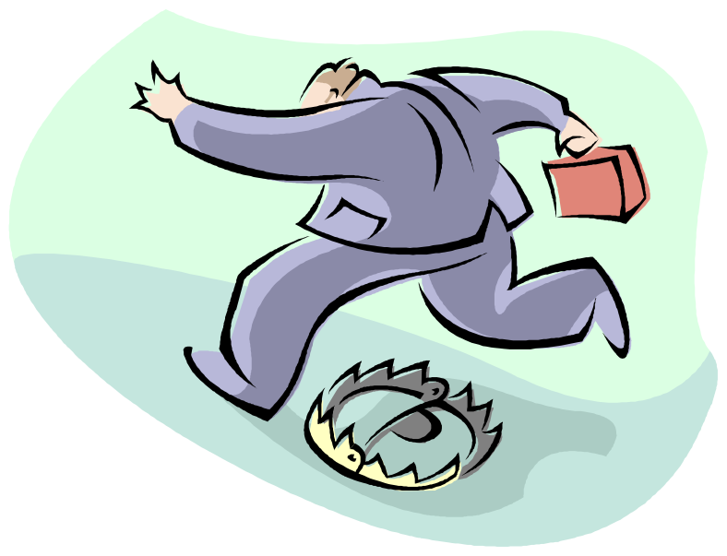
Hofstede’s Framework: Uncertainty Avoidance
The extent to which a society feels threatened by uncertain and ambiguous situations and tries to avoid them
High Uncertainty Avoidance:
Society does not like ambiguous situations and tries to avoid them.
Low Uncertainty Avoidance:
Society does not mind ambiguous situations and embraces them.
© 2009 Prentice-Hall Inc. All rights reserved.
4-<number>

Slide 28
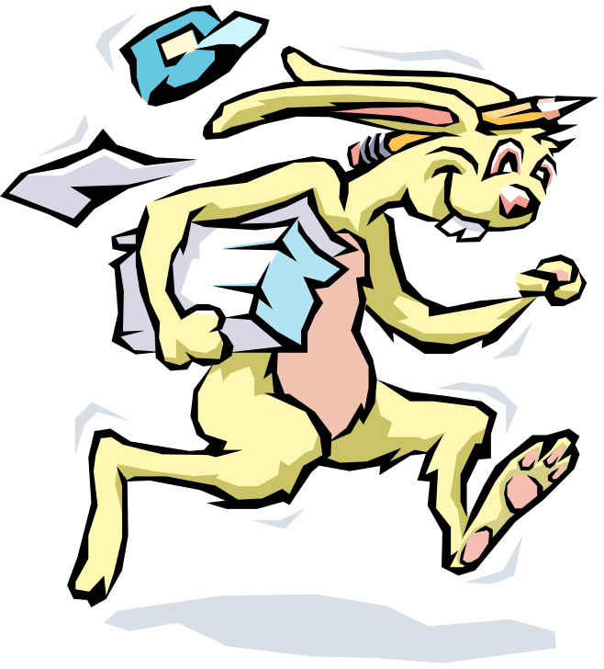
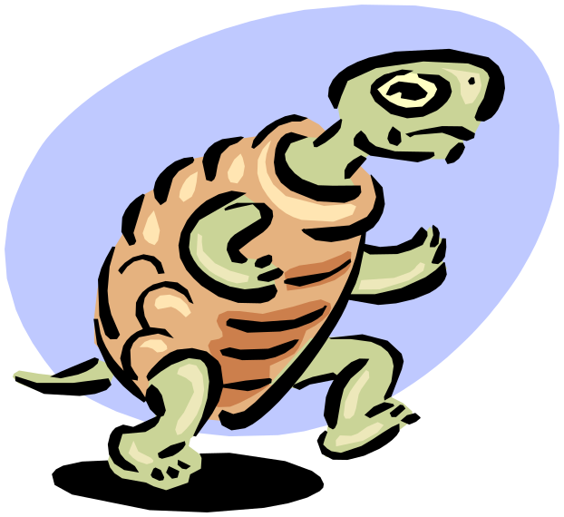
Hofstede’s Framework: Time Orientation
Long-term Orientation
  A national culture attribute that emphasizes the future, thrift, and persistence
Short-term Orientation
  A national culture attribute that emphasizes the present and the here and now
© 2009 Prentice-Hall Inc. All rights reserved.
4-<number>

Slide 29
Hofstede’s Framework: An Assessment
There are regional differences within countries
The original data is old and based on only one company
Hofstede had to make many judgment calls while doing the research
Some results don’t match what is believed to be true about given countries
Despite these problems it remains a very popular framework
© 2009 Prentice-Hall Inc. All rights reserved.
4-<number>

Slide 30
GLOBE Framework for Assessing Cultures
Global Leadership and Organizational Behavior Effectiveness (GLOBE) research program.
  Nine dimensions of national culture
Similar to Hofstede’s framework with these additional dimensions:
  Humane Orientation: how much society rewards people for being altruistic, generous, and kind.
  Performance Orientation: how much society encourages and rewards performance improvement and excellence.
© 2009 Prentice-Hall Inc. All rights reserved.
4-<number>

Slide 31
Summary and Managerial Implications
Personality
  Screen for the Big Five trait of conscientiousness
  Take into account the situational factors as well
  MBTI® can help with training and development
Values
  Often explain attitudes, behaviors, and perceptions
  Higher performance and satisfaction achieved when the individual’s values match those of the organization.
© 2009 Prentice-Hall Inc. All rights reserved.
4-<number>

Slide 32

All rights reserved. No part of this publication may be reproduced, stored in a retrieval system, or transmitted, in any form or by any means, electronic, mechanical, photocopying, recording, or otherwise, without the prior written permission of the publisher. Printed in the United States of America.
Copyright ©2009 Pearson Education, Inc. Publishing as Prentice Hall

