Slide 1

Motivation Concepts
17th Edition
© 2009 Prentice-Hall Inc. All rights reserved.
6-<number>

Slide 2
Chapter Learning Objectives
After studying this chapter, you should be able to:
  Describe the three elements of motivation.
  Identify four early theories of motivation and evaluate their applicability today.
  Apply the predictions of Cognitive Evaluation theory to intrinsic and extrinsic rewards.
  Compare and contrast goal-setting theory and Management by Objectives.
  Contrast reinforcement theory and goal-setting theory.
  Demonstrate how organizational justice is a refinement of equity theory.
  Apply the key tenets of expectancy theory to motivating employees.
  Compare contemporary theories of motivation.
  Explain to what degree motivation theories are culture-bound.
© 2009 Prentice-Hall Inc. All rights reserved.
6-<number>

Slide 3

Defining Motivation
The result of the interaction between the individual and the situation.
The processes that account for an individual’s intensity, direction, and persistence of effort toward attaining a goal – specifically, an organizational goal.
Three key elements:
  Intensity – how hard a person tries
  Direction – effort that is channeled toward, and consistent with, organizational goals
  Persistence – how long a person can maintain effort
© 2009 Prentice-Hall Inc. All rights reserved.
6-<number>

Slide 4

Early Theories of Motivation
These early theories may not be valid, but they do form the basis for contemporary theories and are still used by practicing managers.
Maslow’s Hierarchy of Needs Theory
  Alderfer’s ERG (Existence, Relatedness, and Growth)
McGregor’s Theory X and Theory Y
Herzberg’s Two-Factor Theory
McClelland’s Theory of Needs
© 2009 Prentice-Hall Inc. All rights reserved.
6-<number>

Slide 5
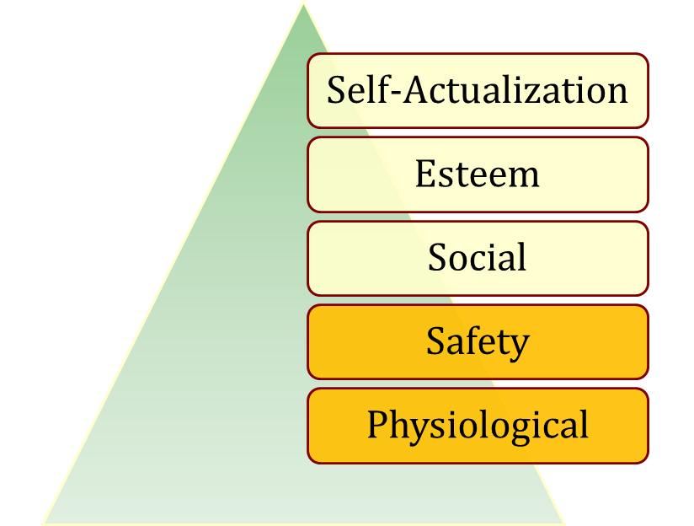
Maslow’s Hierarchy of Needs
There is a hierarchy of five needs. As each need is substantially satisfied, the next need becomes dominant.
Assumptions
  Individuals cannot move to the next higher level until all needs at the current (lower) level are satisfied
  Must move in hierarchical order
Higher Order
Internal
Lower Order
External
See E X H I B I T 6-1
© 2009 Prentice-Hall Inc. All rights reserved.
6-<number>

Slide 6
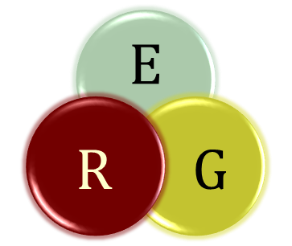
Alderfer’s ERG Theory
A reworking of Maslow to fit empirical research.
Three groups of core needs:
  Existence (Maslow: physiological and safety)
  Relatedness (Maslow: social and status)
  Growth (Maslow: esteem and self-actualization)
Removed the hierarchical assumption
  Can be motivated by all three at once
Popular, but not accurate, theory
© 2009 Prentice-Hall Inc. All rights reserved.
6-<number>

Slide 7
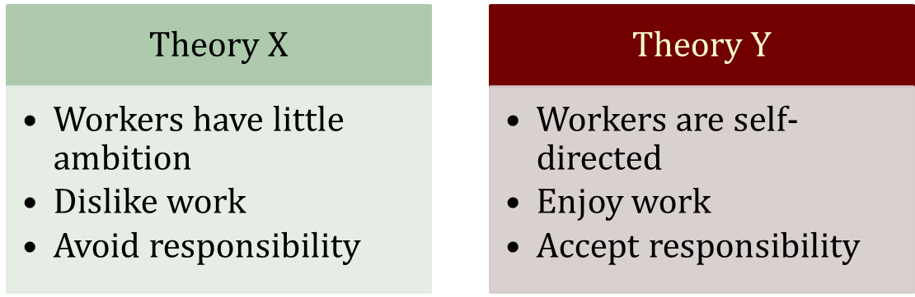
McGregor’s Theory X and Theory Y
Two distinct views of human beings: Theory X (basically negative) and Theory Y (positive).
  Managers used a set of assumptions based on their view
  The assumptions molded their behavior toward employees
No empirical evidence to support this theory.
© 2009 Prentice-Hall Inc. All rights reserved.
6-<number>

Slide 8
Herzberg’s Two-Factor Theory
A theory that relates intrinsic factors to job satisfaction and associates extrinsic factors with dissatisfaction.
Also called motivation-hygiene theory.
© 2009 Prentice-Hall Inc. All rights reserved.
6-<number>

Slide 9
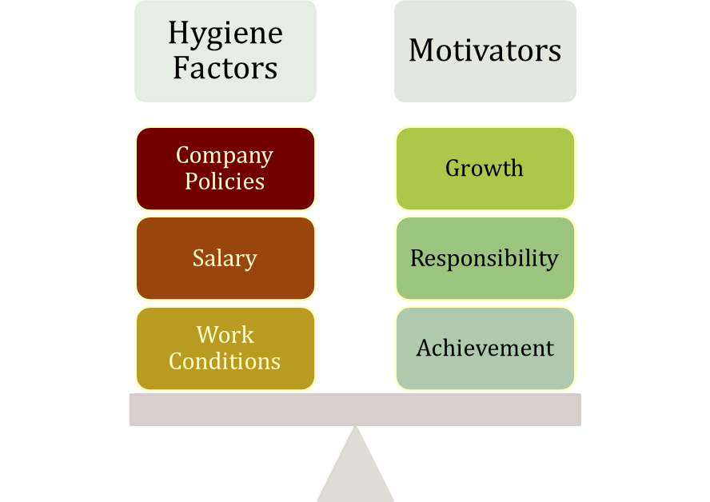
Herzberg’s Two-Factor Theory
Key Point: Satisfaction and dissatisfaction are not opposites but separate constructs
Extrinsic and Related to Dissatisfaction
Intrinsic and Related to Satisfaction
See E X H I B I T S 6-2 and 6-3
© 2009 Prentice-Hall Inc. All rights reserved.
6-<number>

Slide 10
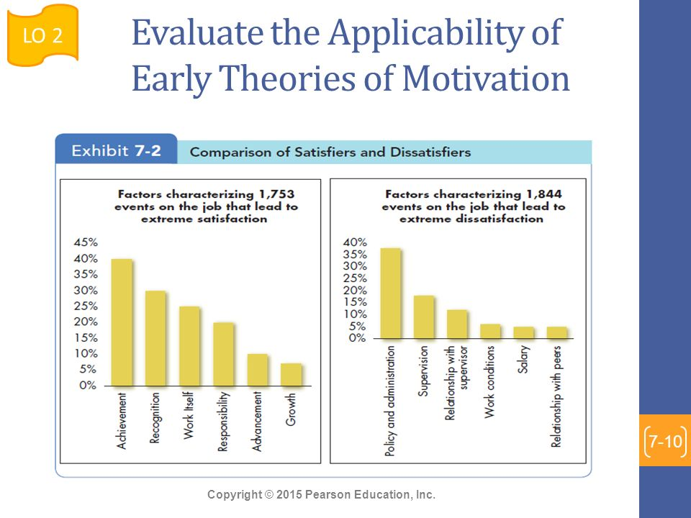
© 2009 Prentice-Hall Inc. All rights reserved.
6-<number>

Slide 11
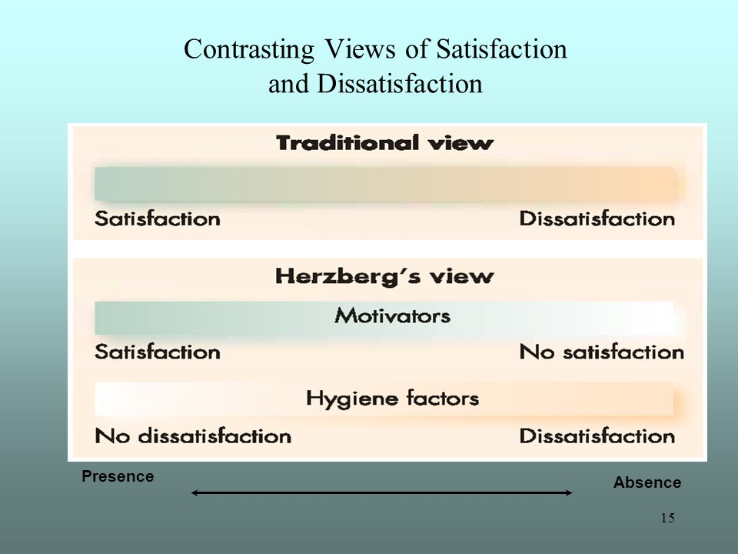
© 2009 Prentice-Hall Inc. All rights reserved.
6-<number>

Slide 12

Criticisms of Two-Factor Theory
Herzberg says that hygiene factors must be met to remove dissatisfaction. If motivators are given, then satisfaction can occur.
Herzberg is limited by his procedure
  Participants had self-serving bias
Reliability of raters questioned
  Bias or errors of observation
No overall measure of satisfaction was used
Herzberg assumed, but didn’t research, a strong relationship between satisfaction and productivity
© 2009 Prentice-Hall Inc. All rights reserved.
6-<number>

Slide 13
McClelland’s Three Needs Theory
  A theory that states achievement, power, and affiliation are three important needs that help explain motivation.
Need for Achievement (nAch)
  The drive to excel, to achieve in relation to a set of standards, to strive to succeed
Need for Power (nPow)
  The need to make others behave in a way that they would not have behaved otherwise
Need for Affiliation (nAff)
  The desire for friendly and close interpersonal relationships
People have varying levels of each of the three needs.
  Hard to measure
© 2009 Prentice-Hall Inc. All rights reserved.
6-<number>

Slide 14
Performance Predictions for High nAch
People with a high need for achievement are likely to:
  Prefer to undertake activities with a 50/50 chance of success, avoiding very low- or high-risk situations
  Be motivated in jobs that offer high degree of personal responsibility, feedback, and moderate risk
  Not necessarily make good managers – too personal a focus. Most good general managers do NOT have a high nAch
  Need high level of nPow and low nAff for managerial success
Good research support, but it is not a very practical theory
© 2009 Prentice-Hall Inc. All rights reserved.
6-<number>

Slide 15

Contemporary Theories of Motivation
Self-determination theory
Cognitive Evaluation Theory
Goal-Setting Theory
  Management by Objectives (MBO)
Self-Efficacy Theory
  Also known as Social Cognitive Theory or Social Learning Theory
Reinforcement Theory
Equity Theory
Expectancy Theory
© 2009 Prentice-Hall Inc. All rights reserved.
6-<number>

Slide 16
Self-determination theory
https://www.youtube.com/watch?v=3sRBBNkSXpY
© 2009 Prentice-Hall Inc. All rights reserved.
6-<number>

Slide 17
Self-determination theory
A theory of motivation that is concerned with the beneficial effects of intrinsic motivation and the harmful effects of extrinsic motivation.
“It’s strange,” said Marcia. “I started work at the Humane Society as a volunteer. I put in 15 hours a week helping people adopt pets. And I loved coming to work. Then, 3 months ago, they hired me full-time at $11 an hour. I’m doing the same work I did before. But I’m not finding it as much fun.”
© 2009 Prentice-Hall Inc. All rights reserved.
6-<number>

Slide 18
Cognitive Evaluation Theory
https://www.youtube.com/watch?v=6L3W_223nYg
© 2009 Prentice-Hall Inc. All rights reserved.
6-<number>

Slide 19
Cognitive Evaluation Theory
Providing an extrinsic reward for behavior that had been previously only intrinsically rewarding tends to decrease the overall level of motivation
Major Implications for work rewards
  Intrinsic and extrinsic rewards are not independent
  Extrinsic rewards decrease intrinsic rewards
  Pay should be noncontingent on performance
  Verbal rewards increase intrinsic motivation; tangible rewards reduce it
Self-concordance
  When the personal reasons for pursuing goals are consistent with personal interests and core values (intrinsic motivation), people are happier and more successful
See E X H I B I T 6-4
© 2009 Prentice-Hall Inc. All rights reserved.
6-<number>

Slide 20
Locke’s Goal-Setting Theory
Basic Premise:
  That specific and difficult goals, with self-generated feedback, lead to higher performance
Difficult Goals:
  Focus and direct attention
  Energize the person to work harder
  Difficulty increases persistence
  Force people to be more effective and efficient
Three personal factors influence the goals–performance relationship: goal commitment, task characteristics, and national culture.
Relationship between goals and performance depends on:
  Goal commitment (the more public the better!)
  Task characteristics (simple, well-learned)
  Culture (best match is in North America)
© 2009 Prentice-Hall Inc. All rights reserved.
6-<number>

Slide 21
Goal Commitment
Goal-setting theory assumes an individual is committed to the goal and determined not to lower or abandon it. The individual (1) believes he or she can achieve the goal and (2) wants to achieve it.
Task Characteristics
Goals themselves seem to affect performance more strongly when tasks are simple rather than complex, well learned rather than novel, independent rather than interdependent, and on the high end of achievable.
National Culture
Setting specific, difficult, individual goals may have different effects in different cultures. In collectivistic and high-power-distance cultures, achievable moderate goals can be more motivating than difficult ones.
© 2009 Prentice-Hall Inc. All rights reserved.
6-<number>

Slide 22
Promotion focus
A self-regulation strategy that involves striving for goals through advancement and accomplishment.
Prevention focus
A self-regulation strategy that involves striving for goals by fulfilling duties and obligations.
© 2009 Prentice-Hall Inc. All rights reserved.
6-<number>

Slide 23

Implementation: Management by Objectives
Management by objectives (MBO) A program that encompasses specific goals, participatively set, for an explicit time period, with feedback on goal progress.
MBO is a systematic way to utilize goal-setting.
Goals must be:
  Tangible
  Verifiable
  Measurable
Corporate goals are broken down into smaller, more specific goals at each level of organization.
Four common ingredients to MBO programs:
  Goal specificity
  Participative decision making
  Explicit time period
  Performance feedback
© 2009 Prentice-Hall Inc. All rights reserved.
6-<number>
See E X H I B I T 6-5

Slide 24
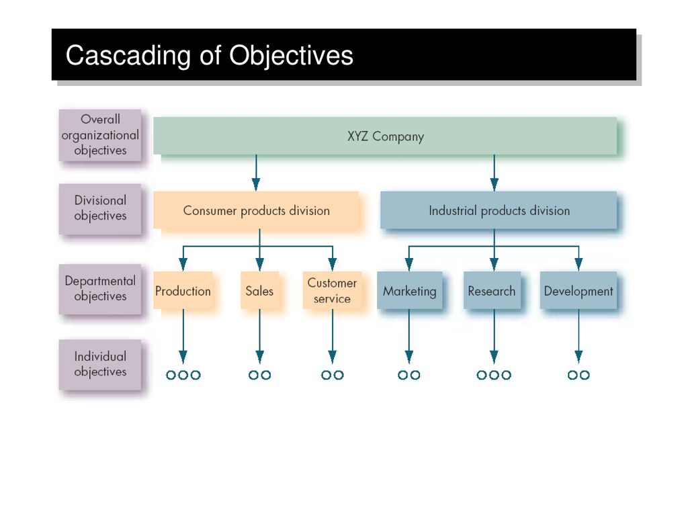
© 2009 Prentice-Hall Inc. All rights reserved.
6-<number>

Slide 25
Goal-Setting and ethics
The relationship between goal-setting and ethics is quite complex: If we emphasize the attainment of goals, what is the cost?
The answer is probably found in the standards we set for goal achievement. For example, when money is tied to goal attainment, we may focus on getting the money and become willing to compromise ourselves ethically.
© 2009 Prentice-Hall Inc. All rights reserved.
6-<number>

Slide 26
Bandura’s Self-Efficacy Theory
Self-efficacy theory, also known as social cognitive theory or social learning theory, refers to an individual’s belief that he or she is capable of performing a task. The higher your self-efficacy, the more confidence you have in your ability to succeed.
So, in difficult situations, people with low self-efficacy are more likely to lessen their effort or give up altogether, while those with high self-efficacy will try harder to master the challenge.
© 2009 Prentice-Hall Inc. All rights reserved.
6-<number>

Slide 27
Bandura’s Self-Efficacy Theory
An individual’s belief that he or she is capable of performing a task.
  Higher efficacy is related to:
    Greater confidence
    Greater persistence in the face of difficulties
    Better response to negative feedback (work harder)
  Self-Efficacy complements Goal-Setting Theory.
Increased Confidence
Given Hard Goal
Higher Performance
Higher Self-Set Goal
See E X H I B I T 6-6
© 2009 Prentice-Hall Inc. All rights reserved.
6-<number>

Slide 28
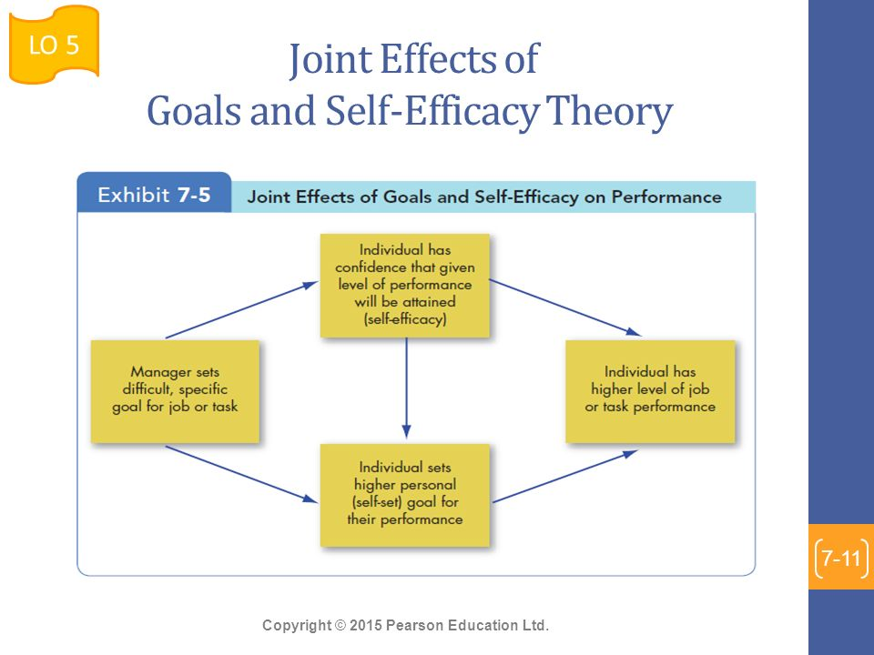
© 2009 Prentice-Hall Inc. All rights reserved.
6-<number>

Slide 29

Increasing Self-Efficacy
Enactive mastery
  Most important source of efficacy
  Gaining relevant experience with task or job
  “Practice makes perfect”
Vicarious modeling
  Increasing confidence by watching others perform the task
  Most effective when observer sees the model to be similar to him- or herself
Verbal persuasion
  Motivation through verbal conviction
  Pygmalion and Galatea effects - self-fulfilling prophecies
Arousal
  Getting “psyched up” – emotionally aroused – to complete task
  Can hurt performance if emotion is not a component of the task
© 2009 Prentice-Hall Inc. All rights reserved.
6-<number>

Slide 30

Reinforcement Theory
A theory that says that behavior is a function of its consequences.
Similar to Goal-Setting Theory, but focused on a behavioral approach rather than a cognitive one.
  Behavior is environmentally caused
  Thought (internal cogitative event) is not important
    Feelings, attitudes, and expectations are ignored
  Behavior is controlled by its consequences – reinforcers
  Is not a motivational theory but a means of analysis of behavior
  Reinforcement strongly influences behavior but is not likely to be the sole cause
© 2009 Prentice-Hall Inc. All rights reserved.
6-<number>

Slide 31
Operant Conditioning/behaviorism and reinforcement
B. F. Skinner, one of the most prominent advocates of operant conditioning, demonstrated that people will most likely engage in desired behaviors if they are positively reinforced for doing so; rewards are most effective if they immediately follow the desired response; and behavior that is not rewarded, or is punished, is less likely to be repeated.
Behaviorism
A theory that argues that behavior follows stimuli in a relatively unthinking manner.
© 2009 Prentice-Hall Inc. All rights reserved.
6-<number>

Slide 32
Social-learning theory and reinforcement
Individuals can learn by being told or by observing what happens to other people, as well as through direct experience.
Four processes determine their influence on an individual:
1. Attentional processes.
2. Retention processes.
3. Motor reproduction processes.
4. Reinforcement processes.
© 2009 Prentice-Hall Inc. All rights reserved.
6-<number>

Slide 33
Attentional processes.
People learn from a model only when they recognize and pay attention to its critical features. We tend to be most influenced by models that are attractive, repeatedly available, important to us, or similar to us.
2. Retention processes.
A model’s influence depends on how well the individual remembers the model’s action after the model is no longer readily available.
3. Motor reproduction processes.
After a person has seen a new behavior by observing the model, watching must be converted to doing. This process demonstrates that the individual can perform the modeled activities.
4. Reinforcement processes.
Individuals are motivated to exhibit the modeled behavior if positive incentives or rewards are provided. Positively reinforced behaviors are given more attention, learned better, and performed more often.
© 2009 Prentice-Hall Inc. All rights reserved.
6-<number>

Slide 34

Equity theory/organizational Justice
A theory that says that individuals compare their job inputs and outcomes with those of others and then respond to eliminate any inequities.
When ratios are equal: state of equity exists – there is no tension as the situation is considered fair
  When ratios are unequal: tension exists due to unfairness
    Under rewarded states cause anger
    Overrewarded states cause guilt
  Tension motivates people to act to bring their situation into equity
See E X H I B I T 6-7
© 2009 Prentice-Hall Inc. All rights reserved.
6-<number>

Slide 35
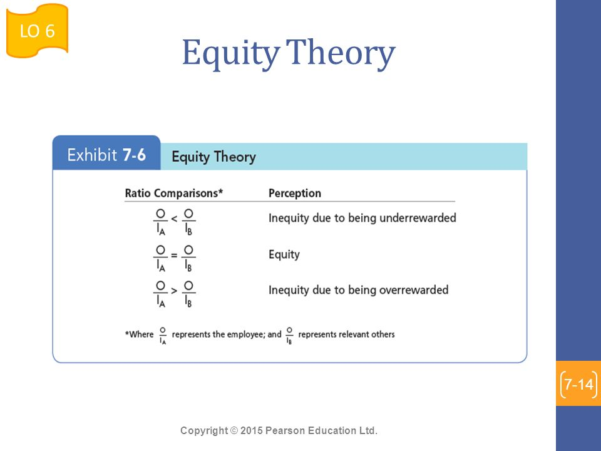
© 2009 Prentice-Hall Inc. All rights reserved.
6-<number>

Slide 36

Equity Theory’s “Relevant Others”
Can be four different situations:
  Self-Inside
    The person’s experience in a different job in the same organization
  Self-Outside
    The person’s experience in a different job in a different organization
  Other-Inside
    Another individual or group within the organization
  Other-Outside
    Another individual or group outside of the organization
© 2009 Prentice-Hall Inc. All rights reserved.
6-<number>

Slide 37
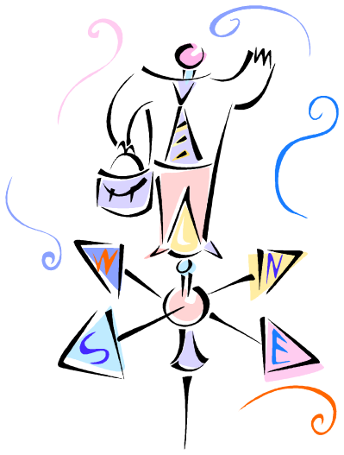
Reactions to Inequity
Based on equity theory, employees who perceive inequity will make one ofsix choices:
Employee behaviors to create equity:
  Change inputs (slack off)
  Change outcomes (increase output)
  Distort/change perceptions of self
  Distort/change perceptions of others
  Choose a different referent person
  Leave the field (quit the job)
© 2009 Prentice-Hall Inc. All rights reserved.
6-<number>

Slide 38
1. Change inputs (exert less effort if underpaid or more if overpaid).
2. Change outcomes (individuals paid on a piece-rate basis can increase their
pay by producing a higher quantity of units of lower quality).
3. Distort perceptions of self (“I used to think I worked at a moderate pace,
but now I realize I work a lot harder than everyone else”).
4. Distort perceptions of others (“Mike’s job isn’t as desirable as I thought”).
5. Choose a different referent (“I may not make as much as my brother-in-law, but I’m doing a lot better than my Dad did when he was my age”).
6. Leave the field (quit the job).
© 2009 Prentice-Hall Inc. All rights reserved.
6-<number>

Slide 39
Propositions relating to inequitable pay:
  Paid by time:
    Overrewarded employees produce more
    Under rewarded employees produce less with low quality
  Paid by quality:
    Overrewarded employees give higher quality
    Under rewarded employees make more of low quality
© 2009 Prentice-Hall Inc. All rights reserved.
6-<number>

Slide 40
Justice and Equity Theory
Organizational justice
An overall perception of what is fair in the workplace, composed of distributive, procedural, informational, and interpersonal justice.
Distributive justice
Perceived fairness of the amount and allocation of rewards among individuals.
Procedural justice
The perceived fairness of the process used to determine the distribution of rewards.
Informational justice
The degree to which employees are provided truthful explanations for decisions.
Interpersonal justice
The degree to which employees are treated with dignity and respect.
See E X H I B I T 6-8
© 2009 Prentice-Hall Inc. All rights reserved.
6-<number>

Slide 41
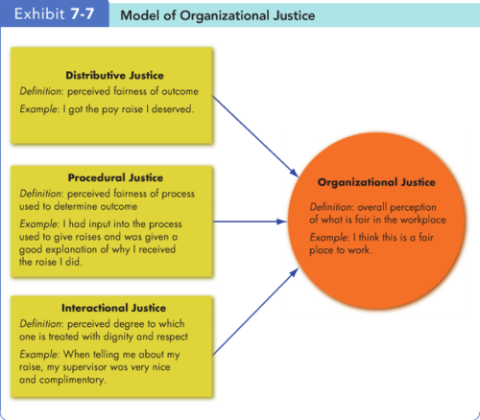
© 2009 Prentice-Hall Inc. All rights reserved.
6-<number>

Slide 42
Justice outcomes
When employees feel fairly treated, they respond in a number of positive ways.
Higher levels of task performance and citizenship behaviors
Lower levels of counterproductive behaviors.
Ensuring Justice
Culture and Justice
© 2009 Prentice-Hall Inc. All rights reserved.
6-<number>

Slide 43
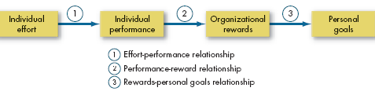
Vroom’s Expectancy Theory
A theory that says that the strength of a tendency to act in a certain way depends on the strength of an expectation that the act will be followed by a given outcome and on the attractiveness of that outcome to the individual.
Expectancy of performance success
Instrumentality of success in getting reward
Valuation of the reward in employee’s eyes
See E X H I B I T 6-9
© 2009 Prentice-Hall Inc. All rights reserved.
6-<number>

Slide 44
1. Effort–performance relationship.
The probability perceived by the individual that exerting a given amount of effort will lead to performance.
2. Performance–reward relationship.
The degree to which the individual believes performing at a particular level will lead to the attainment of a desired outcome.
3. Rewards–personal goals relationship.
The degree to which organizational rewards satisfy an individual’s personal goals or needs and the attractiveness of those potential rewards for the individual
© 2009 Prentice-Hall Inc. All rights reserved.
6-<number>

Slide 45
Job Engagement
Job engagement The investment of an employee’s physical, cognitive, and emotional energies into job performance.
© 2009 Prentice-Hall Inc. All rights reserved.
6-<number>

Slide 46
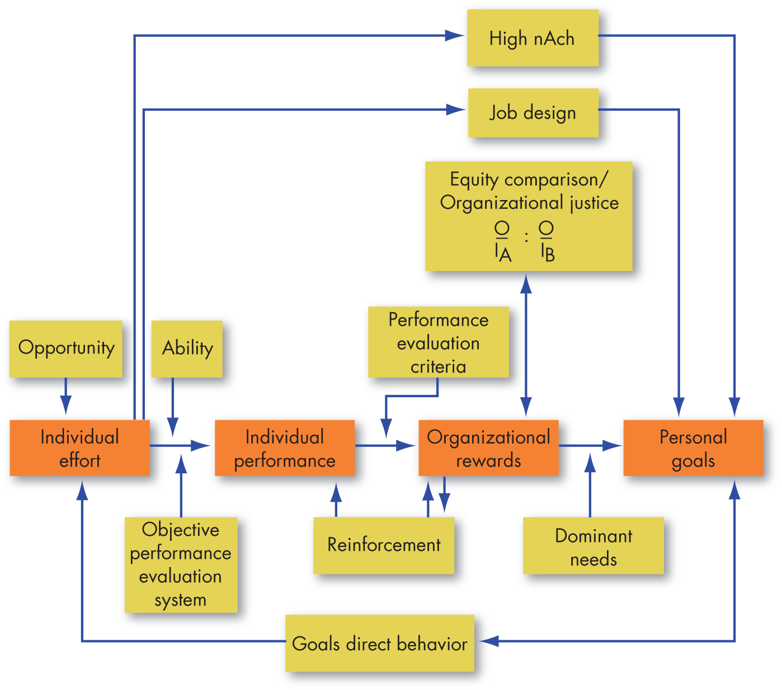
Integrating Contemporary Theories of Motivation
© 2009 Prentice-Hall Inc. All rights reserved.
6-<number>

Slide 47

Global Implications
Motivation theories are often culture-bound.
  Maslow’s Hierarchy of Needs Theory
    Order of needs is not universal
  McClelland’s Three Needs Theory
    nAch presupposes a willingness to accept risk and performance concerns – not universal traits
  Adams’ Equity Theory
    A desire for equity is not universal
    “Each according to his need” – socialist/former communists
Desire for interesting work seems to be universal.
  There is some evidence that the intrinsic factors of Herzberg’s Two-Factor Theory may be universal
© 2009 Prentice-Hall Inc. All rights reserved.
6-<number>

Slide 48
Summary and Managerial Implications
Need Theories (Maslow, Alderfer, McClelland, Herzberg)
  Well known, but not very good predictors of behavior
Goal-Setting Theory
  While limited in scope, good predictor
Reinforcement Theory
  Powerful predictor in many work areas
Equity Theory
  Best known for research in organizational justice
Expectancy Theory
  Good predictor of performance variables but shares many of the assumptions as rational decision making
© 2009 Prentice-Hall Inc. All rights reserved.
6-<number>

