Slide 1
Software

Slide 2
Software
Software is a set of programs that instructs the computer about the tasks to be performed.
Software tells the computer how the tasks are to be performed.
Different sets of software can be loaded on the same hardware to perform different kinds of tasks.
you can not usually touch the computer software.
However, you may be able to read the set of instructions.

Slide 3
SOFTWARE EXAMPLES

Slide 4
What is a Computer Program
A computer program, is a set of instructions, written to perform a specified task with a computer.
The computer does what the program tells it to do.
A computer program is stored as a file on the computer's hard drive. When the user runs the program, the file is read by the computer, and the processor reads the data in the file as a list of commands or instructions.

Slide 5
Types of software
1.System software
2.Application software
What is system software:
System software consists of the programs that control or maintain the operations of the computer and its devices.
OR
System software provides basic functionality to the computer. Consists of the programs that control the operations of the computer and its devices.
OS Serves as the interface between the user, the application software, and the computer's hardware.

Slide 6
System software
System software is required for the working of computer itself.
The user of computer does not need to be aware about the functioning of system software, while using the computer.
Types of System Software 1. Operating system
2. Utility Program

Slide 7
What is an Operating system (OS) ?
An operating system is a kind of software which allocates and de allocates computer system resources in a efficient ,fair and secure manner.
An operating system (OS) is a set of programs containing instructions that work together to coordinate all the activities among computer hardware resources.
Operating system is system software that controls and coordinates the use of hardware among the different application software and users.

Slide 8
O.S
An operating system is a program designed to run other programs on a computer.
A computer’s operating system is its most important program.
OS intermediates between the user of computer and the computer hardware. The user gives a command and the OS translates the command into a form that the machine can understand and execute
It is considered the backbone of a computer, managing both software and hardware resources.

Slide 9
Functions of Operating System
Booting
The process of starting or restarting a computer is called booting.
When we start our Computer then there is an operation which is performed automatically by the Computer which is also Booting.
In the Booting, System will load all the Files those are needed for running a system.

Slide 10
user interface
A user interface controls how you enter data and instructions and how information is displayed on the screen.
It serves as junction between a user and a computer program.
Two types of interface
1.Graphical user interface (GUI)
2. Command-line interface

Slide 11
Graphical user interface (GUI)
With a graphical user interface (GUI), you interact with menus and visual images.
Menu: a set of commands from which you can choose
Icon: a small image that represents a program, an instruction, a file, or some other object

Slide 12
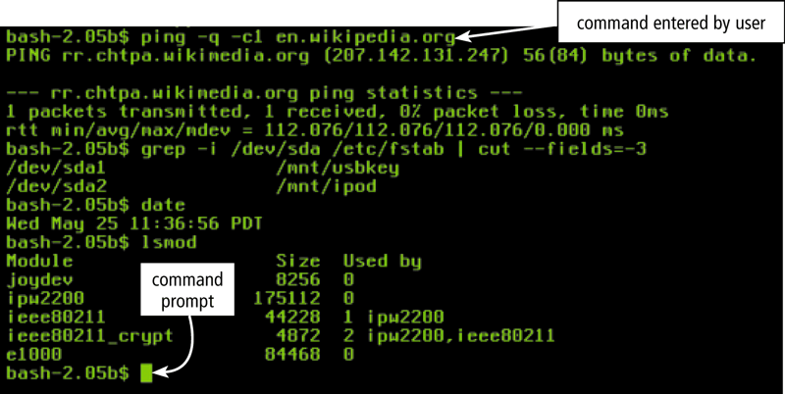
Command-line interface
Allows you to type keywords or press special keys on the keyboard to enter data and instructions.
Set of commands you use to interact with the computer is called the command language.

Slide 13
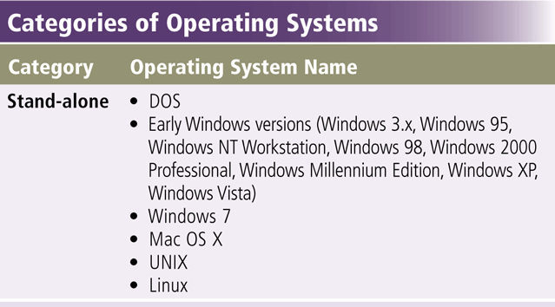

Slide 14
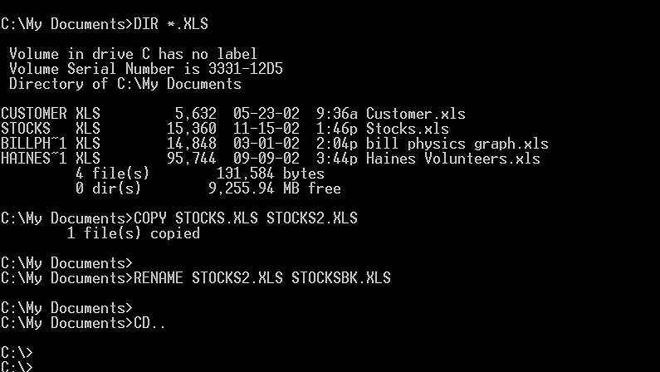
What is DOS (Disk Operating System)?
Refers to single user operating systems developed in the early 1980s for personal computers
Two more widely used versions were PC-DOS and MS-DOS, both developed by Microsoft
Used a command line interface.
commands entered by user

Slide 15
What is Windows XP?
Microsoft Windows XP was introduced in 2001.
It is Fast & reliable Windows operating system.
The two primary versions of Windows XP are Windows XP Home Edition and Windows XP Professional.

Slide 16
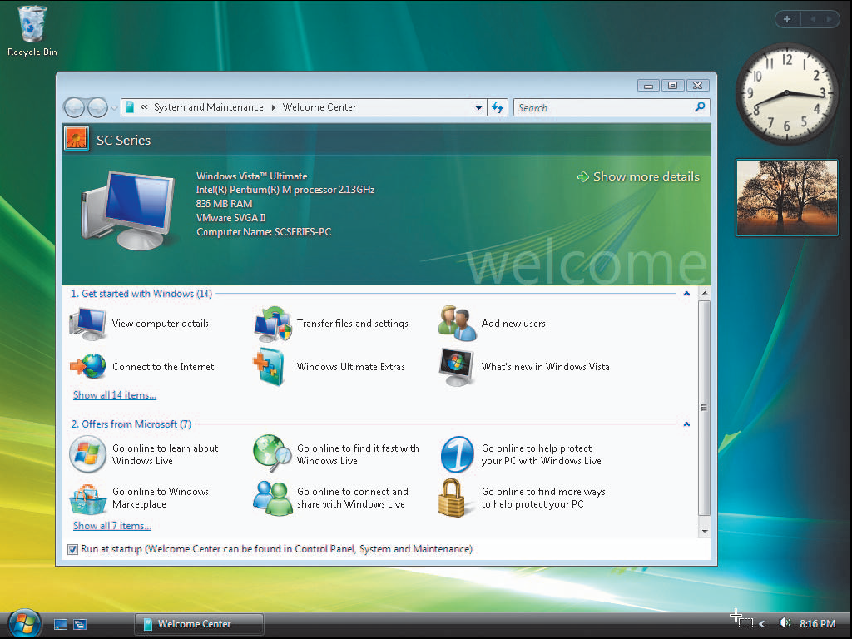
What is Windows Vista?
Successor to Windows XP, containing a new interface and new / enhanced features.
Windows Vista was introduced in 2007.
Available in several editions, grouped into Home and Business categories

Slide 17
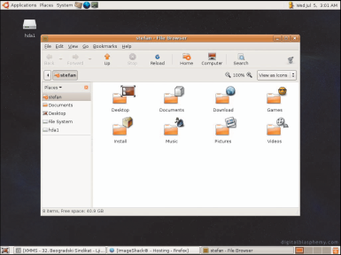
What is UNIX?
It is a multi-user, multi-tasking operating system.
Used by power users because of its flexibility and power
UNIX systems also have a graphical user interface (GUI) similar to Microsoft Windows which provides an easy to use environment
There are many different versions of UNIX, although they share common similarities.
The most popular varieties
of UNIX are Sun Solaris,
and MacOS X.
Available for computers
of all sizes
UNIX was introduced
in 1970’S.

Slide 18

What is Linux?
Popular, free, multitasking UNIX-type operating system
Open-source software code is available to public
Both a stand-alone and a network operating system
Popular Linux OS
distributions include
Fedora, Red Hat &
Ubuntu.
LINUX was introduced
in 1991.

Slide 19
Utility Programs
What is a utility program?
A type of system software that performs a specific task.
It is small program that that performs system maintenance and management.
Usually related to managing a computer, its devices, or its programs.
Also called a utility
Most operating systems include several utility programs

Slide 20
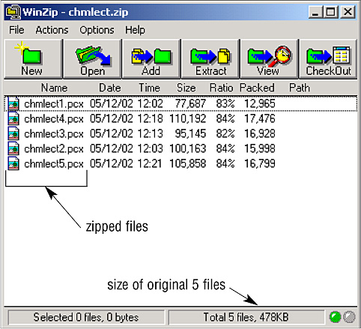
What is a file compression utility?
compressed file
Reduces the size of a file
Compressed files
Take up less storage space than the original files
Sometimes called zipped files
Usually have a .zip extension
You must uncompress a compressed file to use it
Two popular utilities are Winrar and WinZip®

Slide 21
Antivirus utility
An antivirus utility is a program that prevents,
detects, and removes viruses from a computer's
memory or storage devices.
A virus is a program that copies itself into other
programs and spreads through multiple computers
Some viruses destroy or corrupt data
Antivirus must be up to date in order to work
properly.
Antivirus scans files and directories to detect,
and remove software viruses.
Popular antivirus utilities are:
Avg antivirus, Norton,Nod32,

Slide 22
What is an uninstaller?
Removes an application, as well as any associated entries in the system files
When an application is installed, the operating system records information it uses to run the software in the system files
The uninstaller removes this information

Slide 23
Application Software
Programs that perform specific tasks for users
Also called a software application or an application
Several reasons to use application software
Application software may be a single program or a set of programs.
As a productivity/ business tool
To assist with graphics and multimedia projects
To support household activities, for personal business, or for education
To facilitate communications

Slide 24
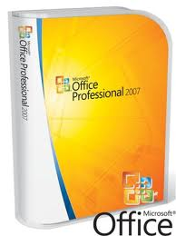
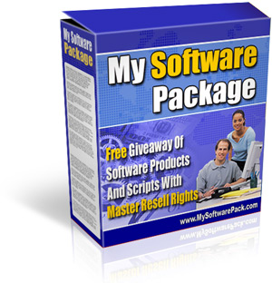
What is a software package?
A set of programs that are written for a specific purpose and provide the required functionality is called software package.
A specific software product, such as Microsoft office
Available through retail, shareware, freeware.

Slide 25
Productivity software
Productivity software is software that assists people in becoming more effective and efficient while performing daily activities.
Productivity software includes applications such as:
Word processing,
Spreadsheet,
Database,
Presentation graphics,
Personal information manager,
Accounting, and
Project management.

Slide 26


What is word processing software?
Allows users to create and manipulate documents that contain text and graphics.
One of the most widely used types of application software
Popular word processing software includes Microsoft Word, Lotus WordPro, and Corel WordPerfect.

Slide 27
What are the stages of developing a document?
editing
process of making changes to a document’s existing content
formatting
changing the appearance of a document
creating
developing the document by entering text or numbers, inserting graphical images, and performing other tasks using an input device
saving
process of copying a document from memory to a storage medium such as a floppy disk or hard disk
printing
process of sending a file to a printer to generate output on a medium such as paper

Slide 28
What are headers and footers?
header
Header
Text that appears at the top of each page
Productivity Software
Productivity software is software that assists people in becoming more effective and efficient while performing daily activities. Productivity software includes applications such as word processing, spreadsheet, database, presentation graphics, personal information manager, software suite, accounting, and project management.
Footer
Text that appears at the bottom of each page
May include
Page numbers
Company names
Report titles
Dates
footer
Page 3.9

Slide 29
What is spreadsheet software?
Allows you to organize data in rows and columns
Performs calculations on this data
Rows and columns collectively called a worksheet
Popular spreadsheet software include Microsoft Excel, Lotus 1-2-3, and Corel Pro.

Slide 30
How is a spreadsheet organized?
Data is organized vertically into columns identified by letters
columns
Data is organized horizontally into rows identified by numbers
A cell is the intersection of a column and row identified by the column letter and row number
ex. A19
rows
cell

Slide 31
Advantages of Spreadsheet
Easy to make changes and corrections to data on the worksheet.
The rest of the worksheet is recalculated whenever data on a worksheet changes.
Operation is fast with the help of built-in functions.
Calculation is always accurate, provided that data and formulae entered are correct.
Easy to create different kinds of charts, or to change chart types.
Information on charts is updated automatically whenever related data on the worksheet changes.

Slide 32
What is presentation software?
Allows you to create documents called presentations
Sometimes called a slide show
Can be displayed on a large monitor or on a projection screen
Popular presentation software includes Microsoft PowerPoint, Corel Presentations, and Lotus Freelance Graphics.

Slide 33
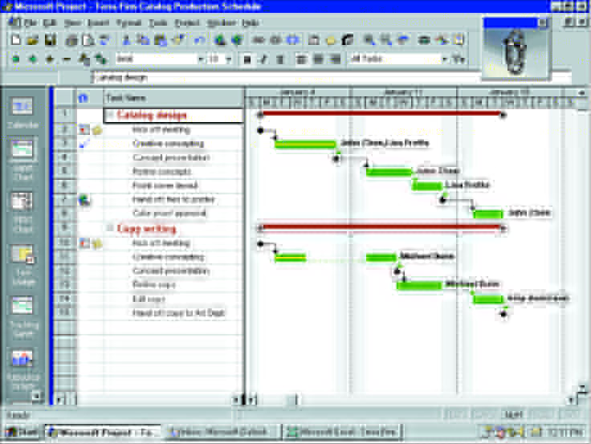
What is project management software?
Project management software is used to plan, schedule, track, and analyze the events, resources, and costs of a project.
Project management software helps users such as a general contractor, or a publisher, to complete a project on time and within budget.
One of the most popular project management software is Microsoft Project.

Slide 34
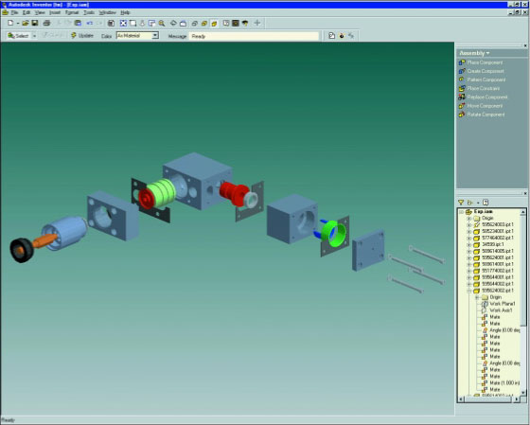
What is computer-aided design (CAD)?
Computer-aided designed (CAD) software is mainly used for creating engineering, architectural, and scientific drawings.
Three-dimensional (3-D) CAD programs even allow users to rotate designs of 3-D objects in order to view them from different angles.
Popular CAD software includes Autodesk AutoCAD and Microsoft Visio Technical

Slide 35
What is educational software
Educational software is designed to teach a particular skill about any subject.
Computer-based training (CBT) is a type of education in which students learn by using and completing exercises with instructional software
Also called computer-aided instruction

Slide 36
What software facilitates communication?
Communications software consists of programs that help to establish a connection to another computer or network, and manage the transmission of data, instructions, and information between computers and other devices.
Software related to communications includes:
E-mail software
Web browser
Chat room software
Instant messenger
Videoconferencing software

Slide 37
THANK YOU

