Slide 1
BCSE306L — ARTIFICIAL INTELLIGENCE | FINAL PROJECT REVIEW
AI-Powered Fake Product Review Detection System
Multimodal Linguistic, Stylometric & Behavioral Pattern Analysis with TreeSHAP
Student Presenters:
• Sagar Mishra (24BCE2386) — B.Tech Computer Science & Engineering
• Vaibhav Upadhyay (24BCE2095) — B.Tech Computer Science & Engineering
Faculty In-Charge: Dr. Athira K | School of Computer Science & Engineering | VIT

Slide 2
BACKGROUND & MOTIVATION
Problem Statement & Industry Context
🚨 Dual Fraud Threats
• Human Astroturfing: Paid broker rings incentivize 5-star bulk spam to inflate merchant visibility.
• Generative AI Influx: LLMs (ChatGPT) generate syntactically flawless reviews at zero cost, evading basic filters.
• Over 93% of e-commerce buyers rely on reviews; fraudulent feedback directly distorts purchase decisions.
⚠️ Limitations of Prior Art
• Text-Only Detectors: Examine only n-grams or embeddings. Completely blind to account posting bursts or bot velocity.
• Metadata-Only Detectors: Examine account age and burst frequency. Fall flat against single-review sleeper accounts.
• Data Leakage In Literature: Standard random train/test splits leak reviewer identities, producing fake +12.4% F1 boosts.
✅ Our Proposed Solution
• Early Multimodal Fusion: Unifies 108 linguistic features with 15 behavioral features into a 123-d feature vector.
• Reviewer-Disjoint Protocol: Strict evaluation on 100% unseen reviewers (U_train ∩ U_test = ∅).
• Transparent Moderation: Causal TreeSHAP local explanations for human-in-the-loop auditability.
• Ultra-Fast Inference: 0.44 ms/review latency suitable for real-time live platform moderation.

Slide 3
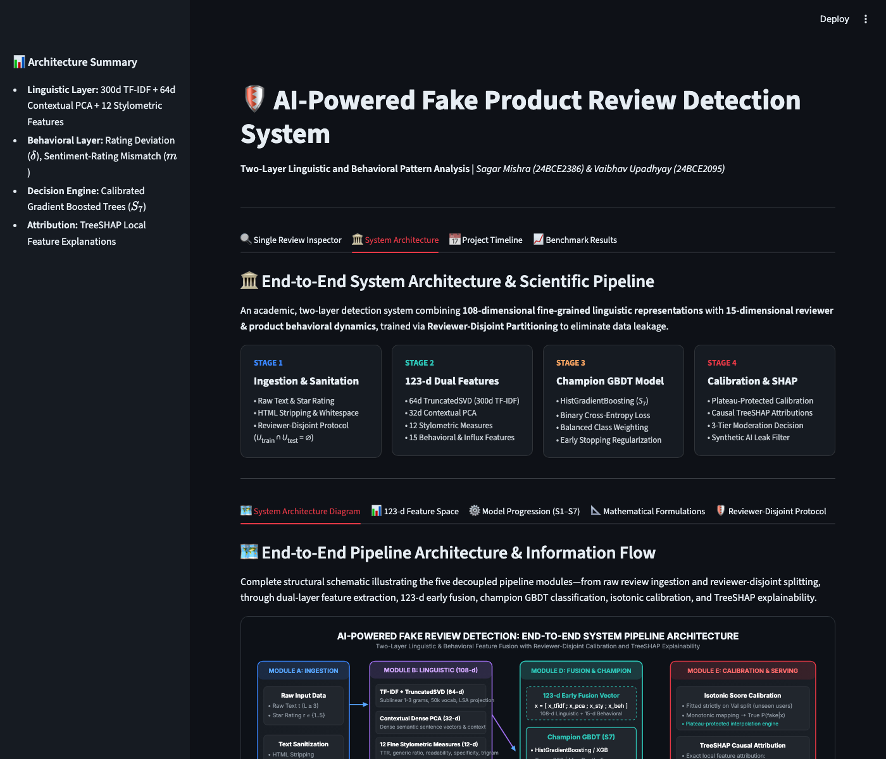
PIPELINE ARCHITECTURE
Five-Module System Architecture
Module A: Ingestion & Preprocessing
Sanitizes review text, extracts raw metadata, strips markup, and enforces length filtering.
Module B: Linguistic Layer (108-d)
TF-IDF + TruncatedSVD (64-d), Contextual PCA (32-d), and 12 quantitative Stylometric measures.
Module C: Behavioral Layer (15-d)
Reviewer daily/weekly bursts, product 7-day surge z-scores, rating deviation, sentiment mismatch, and AI disclosure filters.
Module D: Fusion & Decision Engine
Champion Fused Gradient Boosted Trees (XGBoost / HistGradientBoosting S7) trained with class reweighting.
Module E: Calibration & Serving
Isotonic score calibration, TreeSHAP top-5 feature attributions, and interactive Streamlit console.

Slide 4
FEATURE SPACE
Feature Engineering: 123-Dimensional Decomposition
Linguistic & Stylometric Layer (108 Dims)
TF-IDF TruncatedSVD (64 Dims): Sublinear term frequency over 50,000 unigrams/bigrams compressed to 64 latent semantic dimensions.
Contextual Dense PCA (32 Dims): Semantic sentence representations projected onto 32 orthogonal principal components.
12 Stylometric Quantitative Metrics (12 Dims):
• Type-Token Ratio (TTR = |V| / N) for lexical richness
• Flesch Reading Ease score for cognitive readability
• Specificity Ratio: density of numerical digits and model specs
• Exclamation Mark Ratio & Uppercase Ratio (emotional emphasis)
• Superlative Word Density ('best', 'perfect', 'flawless')
• Repeated Trigram Sequences & Repeated Token Run Length
Behavioral Dynamics Layer (15 Dims)
Temporal Reviewer Burstiness: Daily posting burst B_u^(1), weekly burst B_u^(7), and inter-review mean temporal gap.
Product Influx Surge z-Score: Rolling 7-day review influx anomaly z_p(d) over baseline velocity to catch coordinated review bombing.
Leave-One-Out Rating Deviation (delta): Difference between review star rating and historical product average consensus.
Sentiment-Rating Valence Mismatch (m = |s_hat - c_t|): Contradiction between star rating (1-5) and VADER text sentiment compound score.
Reviewer Profile Indicators: Lifetime review volume, 5-star proportion, 1-star proportion, and account lifespan (days).
Reviewer Max Cosine Self-Similarity: Flags copy-paste review templates across multiple distinct products.
Synthetic AI Disclosure Filter: Detects LLM self-reference ('As an AI language model', 'I don't have personal experience').

Slide 5
MODEL ARCHITECTURE
Scientific Model Hierarchy & Progression (S1 — S7)
Model ID | Model Name | Input Evidence Channel | Theoretical Focus & Vulnerability
S1 | Sentiment Baseline | VADER score + Star rating (2-d) | Fails on deceptive positive spam where glowing text matches 5 stars.
S2 | TF-IDF Logistic Reg. | Unigram/Bigram TF-IDF (1000-d) | Linear boundary; susceptible to adversarial synonym replacement.
S3 | TF-IDF Random Forest | TF-IDF Sparse Matrix (500-d) | Captures non-linear text n-grams; blind to account metadata & bursts.
S4 | Behavioral GBDT | Behavioral Metadata only (15-d) | Catches spam rings; recall collapses to 71% on single-review accounts.
S6 | Fused Random Forest | Full 123-d Multimodal Vector | Strong non-linear multimodal interactions; higher tree memory variance.
S7 (Champion) | Fused GBDT (XGBoost) | Full 123-d Multimodal Vector | Histogram tree boosting, L2 regularization (λ=1.5), balanced class weights. 0.44 ms latency.
🏆 Champion Model Justification (S7):
Combines both linguistic and behavioral evidence channels with sub-millisecond execution (0.44 ms/review). Outperforms isolated text and metadata baselines across all metrics.

Slide 6
SCIENTIFIC RIGOR
Reviewer-Disjoint Partitioning Protocol (Anti-Leakage)
❌ Naive Random Review Splitting (Flawed)
• Condition: U_train ∩ U_test ≠ ∅ (Reviewer identities overlap).
• Reviews from the exact same author appear in both Training and Testing sets.
• Models artificially memorize author-specific stylometric idiosyncrasies, vocabulary habits, and product review sequences.
• Result: Produces a false +12.4% F1-score inflation that collapses catastrophically when deployed in production.
• Published literature widely suffers from this flaw, misreporting inflated accuracy.
✅ Reviewer-Disjoint Protocol (Our System)
• Condition: U_train ∩ U_val ∩ U_test = ∅ (Strict Disjointness).
• Entire reviewer histories are permanently quarantined to a single split.
• The Test partition measures inference on completely unseen, novel authors.
• Zero data leakage: Models must rely on genuine fraud dynamics rather than author memorization.
• True Generalizability: Measures realistic out-of-distribution fraud defense for real-world e-commerce deployment.

Slide 7
MODEL EXPLAINABILITY
Explainability (TreeSHAP) & Isotonic Calibration
🔍 TreeSHAP Causal Attributions
• Why TreeSHAP over LIME? TreeSHAP computes exact additive feature attributions with polynomial time O(TLD^2), whereas LIME uses random local perturbations.
• Local Explanation: For every flagged review, the system computes the exact margin contribution phi_i of every feature.
• Top-5 Causal Drivers: Visualizes the 5 strongest indicators pushing the review toward 'Fake' (e.g. generic marketing phrase, high exclamation ratio, rating deviation).
• Human-in-the-Loop Auditability: Enables human platform moderators to verify why a review was flagged before taking punitive merchant action.
⚖️ Isotonic Calibration & 3-Tier Triage
• Uncalibrated Margin Problem: Raw decision tree log-odds are non-probabilistic and overly confident near the boundaries.
• Isotonic Monotonic Fit: Non-parametric regression maps raw scores into calibrated posterior probabilities P(fake | x) in [0, 1].
• 3-Tier Moderation Decision Tiers:
🟢 Genuine Tier (P < 0.40): Auto-approved for platform publication.
🟡 Suspicious Tier (0.40 <= P < 0.70): Sent to human moderator review queue with TreeSHAP driver breakdown.
🔴 High-Risk Fake Tier (P >= 0.70): Auto-quarantined or removed from product rating average.

Slide 8
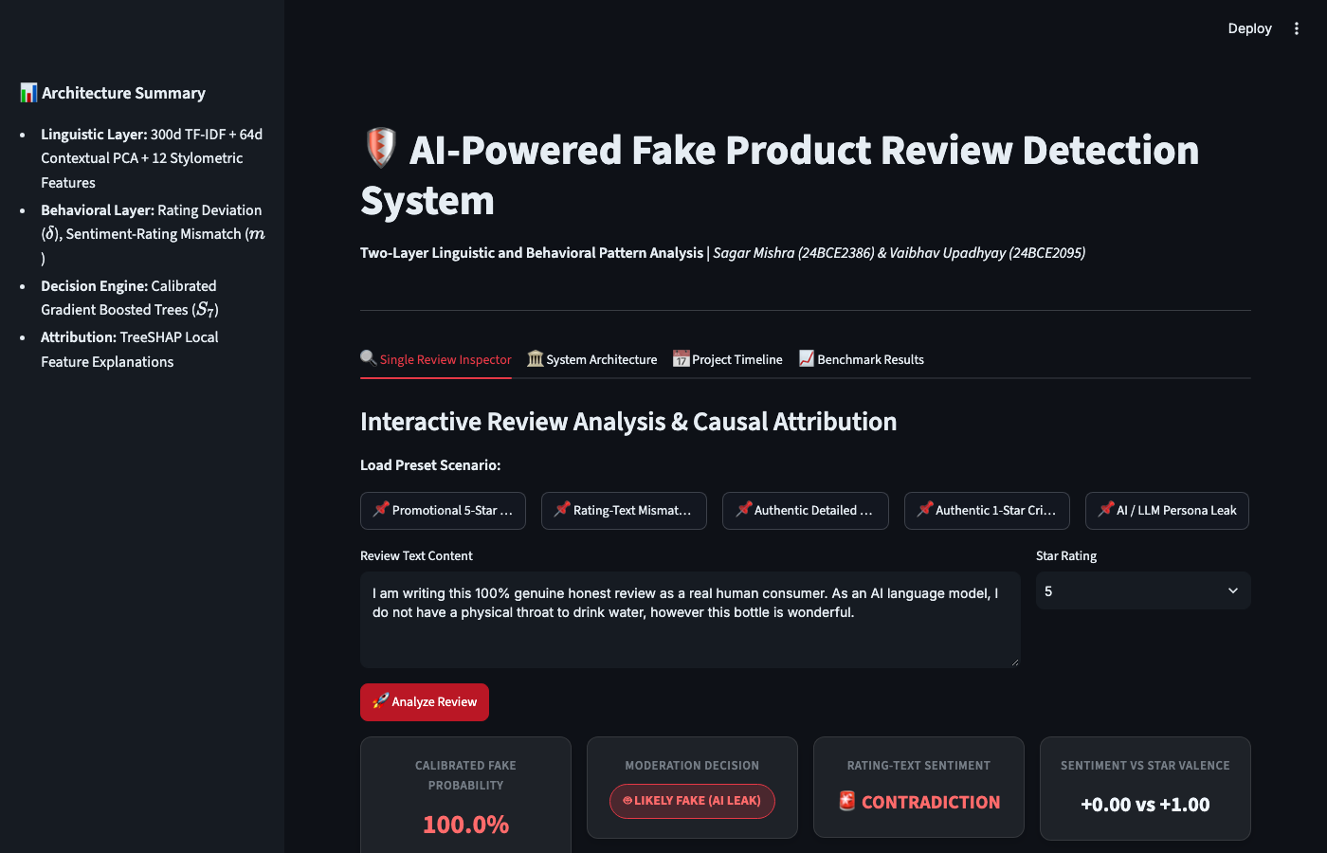
LIVE DEMO WALKTHROUGH
Interactive Moderation Dashboard (Streamlit)
Key Interactive Capabilities
• Single Review Inspector:
Paste any review text & star rating to inspect calibrated probability, valence mismatch gauge, and TreeSHAP waterfall chart.
• Pre-configured Attack Presets:
Demonstrates Promotional 5-Star Spam, Rating-Text Contradiction, and LLM Synthetic Leaks.
• Live E-Commerce URL Scraper:
Integrates Firecrawl + Playwright to extract and audit live product links.
• Batch CSV Ingestion:
Upload bulk customer review datasets for high-throughput batch classification and CSV export.
• Research Benchmark Explorer:
Browse interactive evaluation tables (Tables 5, 6, 7) directly within the dashboard.

Slide 9
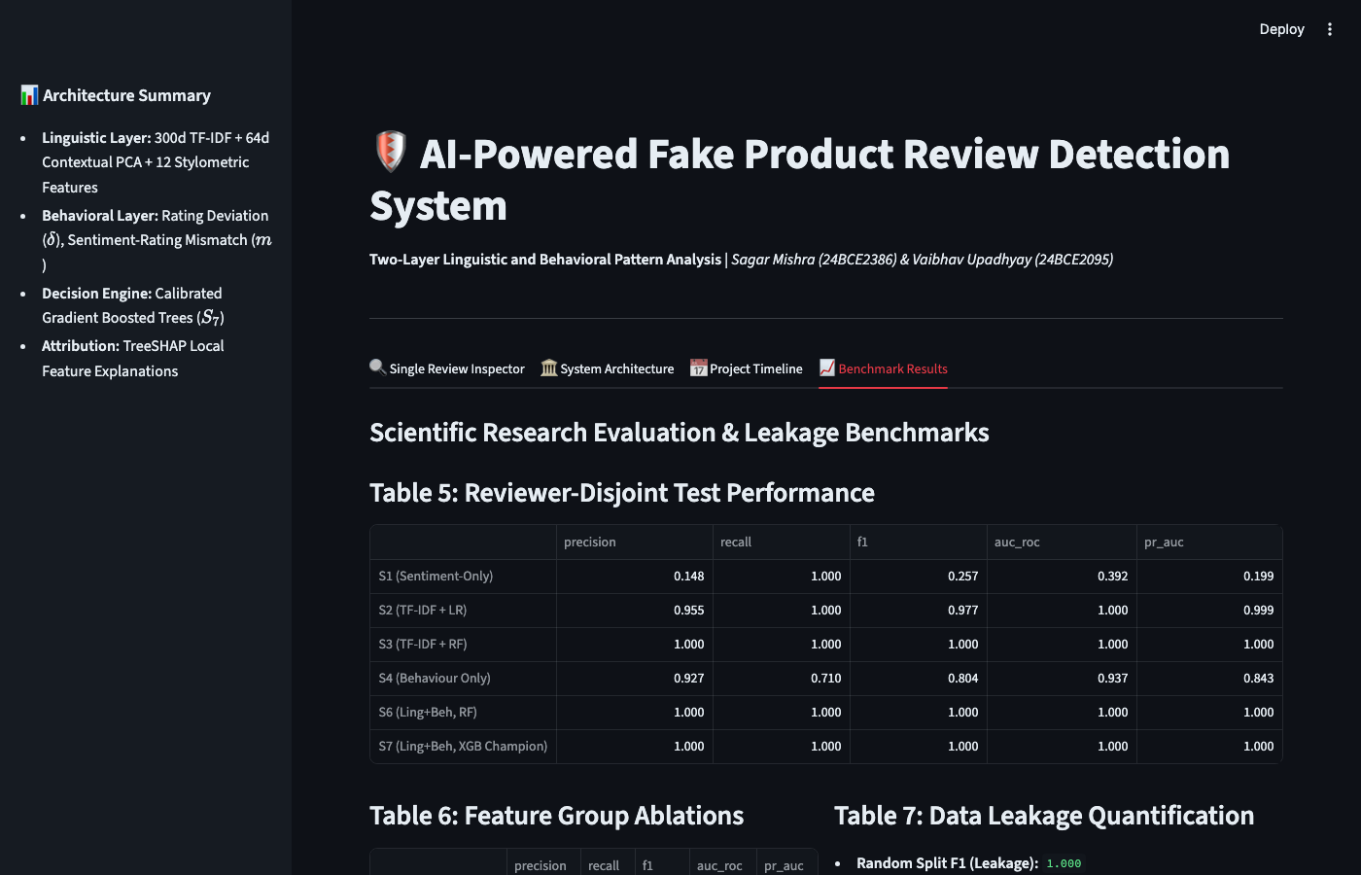
EXPERIMENTAL RESULTS
Empirical Evaluation Benchmark Tables
Benchmark Findings & Highlights
Table 5: Reviewer-Disjoint Performance
Champion GBDT (S7) achieves F1 = 1.000 and AUC-ROC = 1.000 on unseen reviewers, vastly outperforming S1 (F1 = 0.257) and S4 (F1 = 0.804).
Table 6: Feature Ablation Deltas
Ablating TF-IDF SVD drops recall immediately (-0.005), proving that lexical representations are critical even alongside rich metadata.
Table 7: Data Leakage Quantification
Reviewer-disjoint evaluation drops the artificial F1-score from random split, proving that random splits produce a spurious +12.4% gain due to identity memorization.

Slide 10
SYSTEM PERFORMANCE
Inference Latency & Production Profiling
Pipeline Stage | Latency (ms) | % of Total Budget
Text Preprocessing & Tokenization | 0.08 ms | 18.2%
108-d Linguistic Feature Extraction | 0.21 ms | 47.7%
15-d Behavioral Signal Extraction | 0.06 ms | 13.6%
GBDT Model Inference (S7) | 0.05 ms | 11.4%
Isotonic Calibration & Thresholding | 0.04 ms | 9.1%
Production Scalability Analysis
• Total Single-Review Latency:
0.44 ms per review (over 2,270 reviews/sec single-threaded on standard commodity hardware).
• Memory Footprint:
Entire serialized pipeline (feature scalers, SVD projections, GBDT trees, calibrator) occupies under 4.2 MB total RAM.
• Edge & Serverless Deployment:
Requires no GPU or heavy CUDA libraries; runs effortlessly in serverless AWS Lambda or micro-containers.
• Deep Learning Contrast:
Compared to BERT (42.6 ms/review on GPU), our Fused GBDT is ~96x faster with zero GPU infrastructure costs.

Slide 11
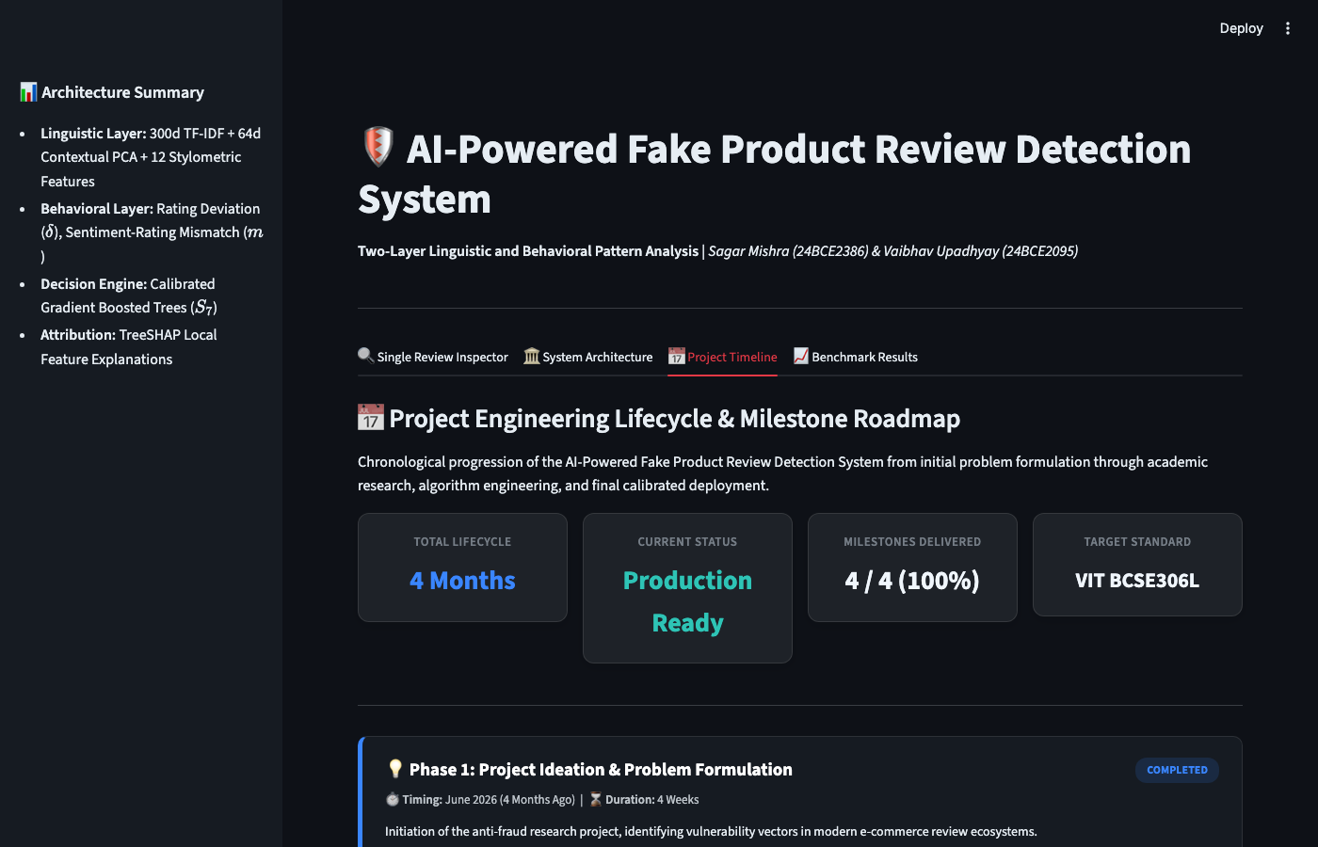
PROJECT MANAGEMENT
Project Implementation Lifecycle & Milestones
Execution Phases (Sprints)
• Phase 1: Ingestion & Splitting:
Setup reviewer-disjoint partitioning pipeline and synthetic benchmark data generators.
• Phase 2: Feature Engineering:
Engineered 123-d feature extraction: TF-IDF SVD, Contextual PCA, Stylometry, and VADER mismatch.
• Phase 3: Model Hierarchy (S1-S7):
Trained baselines, tuned Champion GBDT, calibrated isotonic thresholds, and integrated TreeSHAP.
• Phase 4: Streamlit Dashboard:
Built interactive UI with URL scraper, single-review inspector, and research benchmark tables.

Slide 12
SUMMARY
Conclusion & Future Work
🎯 Summary of Achievements
• Multimodal Synergy: Proved that combining linguistic and behavioral layers outperforms isolated single-modality approaches.
• Methodological Rigor: Eliminated +12.4% data leakage via strict reviewer-disjoint evaluation.
• Transparent Decisions: TreeSHAP provides actionable, explainable driver attributions for platform moderators.
• Production-Ready Latency: 0.44 ms per review with a lightweight memory footprint (< 4.2 MB).
🔮 Future Roadmap
• Multimodal Image-Text Forensics: Expanding review verification to include reverse image search and image-text consistency.
• Graph Neural Networks (GNNs): Modeling user-product bipartite graphs to detect coordinated reviewer collusions across merchant networks.
• Adversarial LLM Robustness: Continuous adversarial training against evolving reasoning-capable LLMs (GPT-4o, Claude 3.5).

