Slide 1
NewsFeed
Christopher Pearce
Jacob Rothmel
Robert Farinelli

Slide 2
Project Goal
The goal of this project is to create a news feed application where a user can view news stories from several different sources and quickly see a brief description.
User browsing history
Artificial intelligence powered analysis of article generates Wikipedia links to relevant topics in the articles

Slide 3
Android Components
ArticleAdapter uses the backend components to create the list of articles the user sees
MainActivity is the entry point for the application
Login and Registration activities are enable users to sign in and create accounts with our firebase server

Slide 4
Android Components Cont.
QueryUtils contains all the logic for the REST API quries
ArticleLoader runs the queries asynchronously and passes it to the article adapter
UserHistoryUpload is an aysnc task used to query the firebase realtime lookup

Slide 5
Backend Components
Firebase is used to maintain a recently viewed history sorted by user
Firebase is also used to enable user authenitication

Slide 6
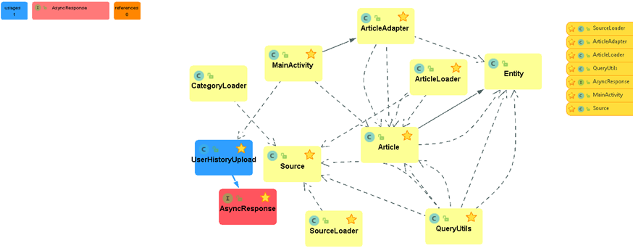
Architecture and design Control flows

Slide 7
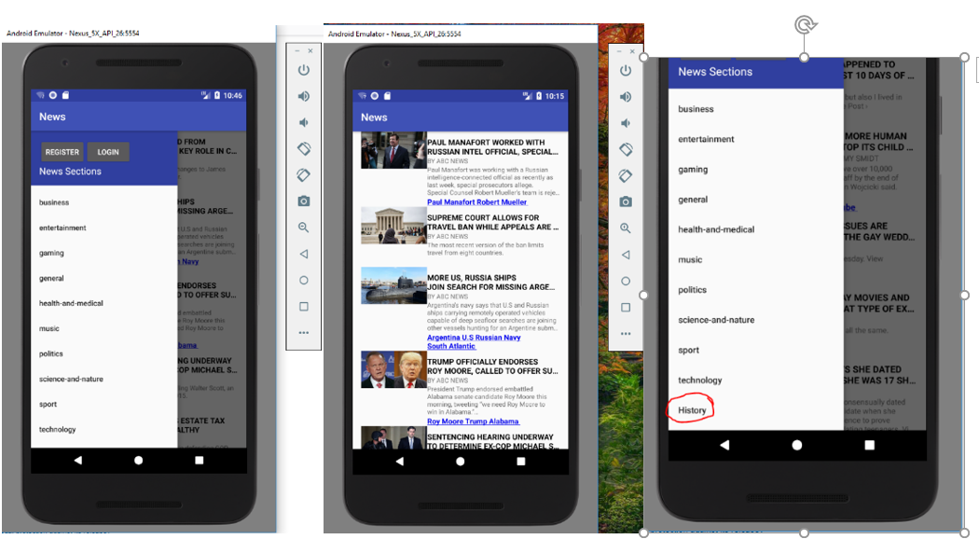
Screenshots

Slide 8
Video Demo
Put demo here once code is finished

