Slide 1
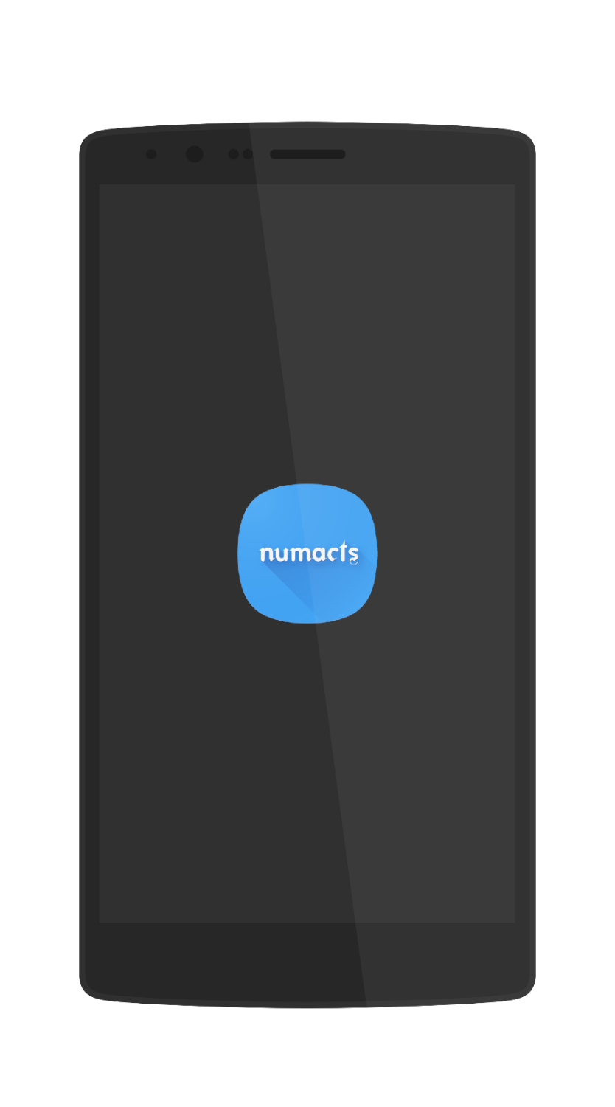
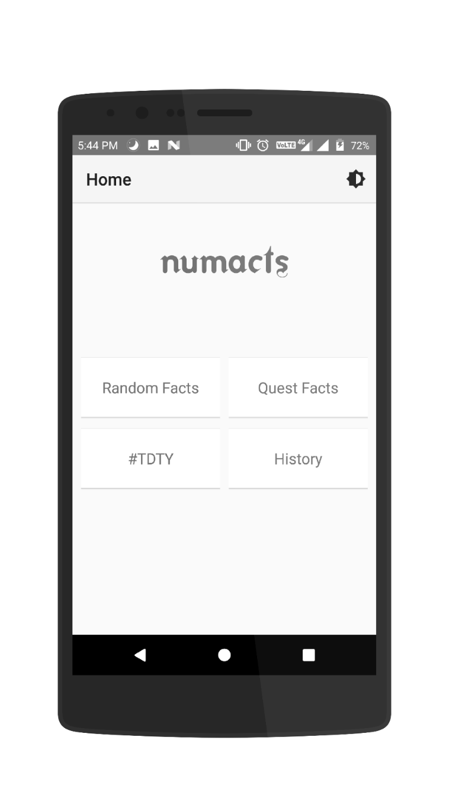
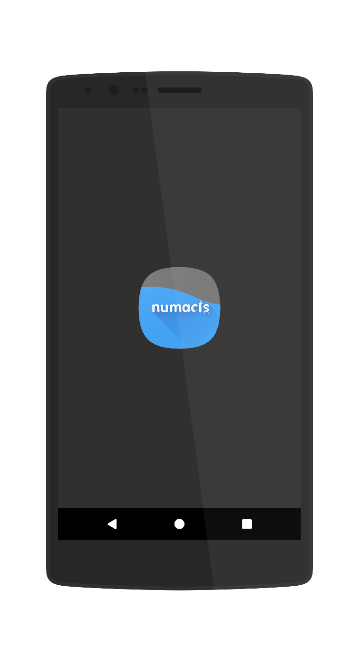
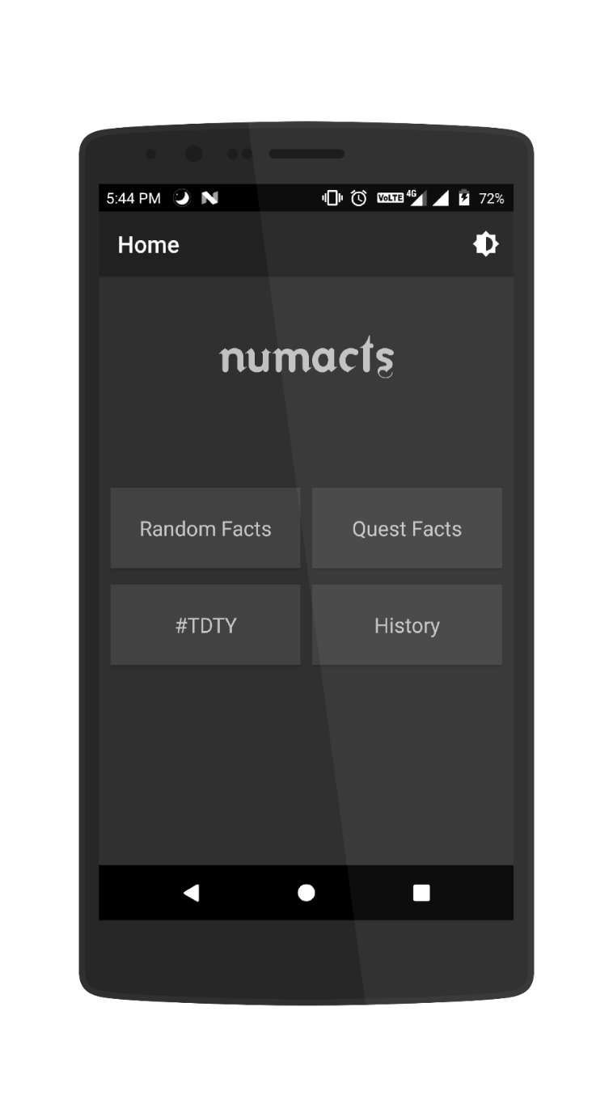
numacts
Number + facts

Slide 2

Home Screen

Slide 3
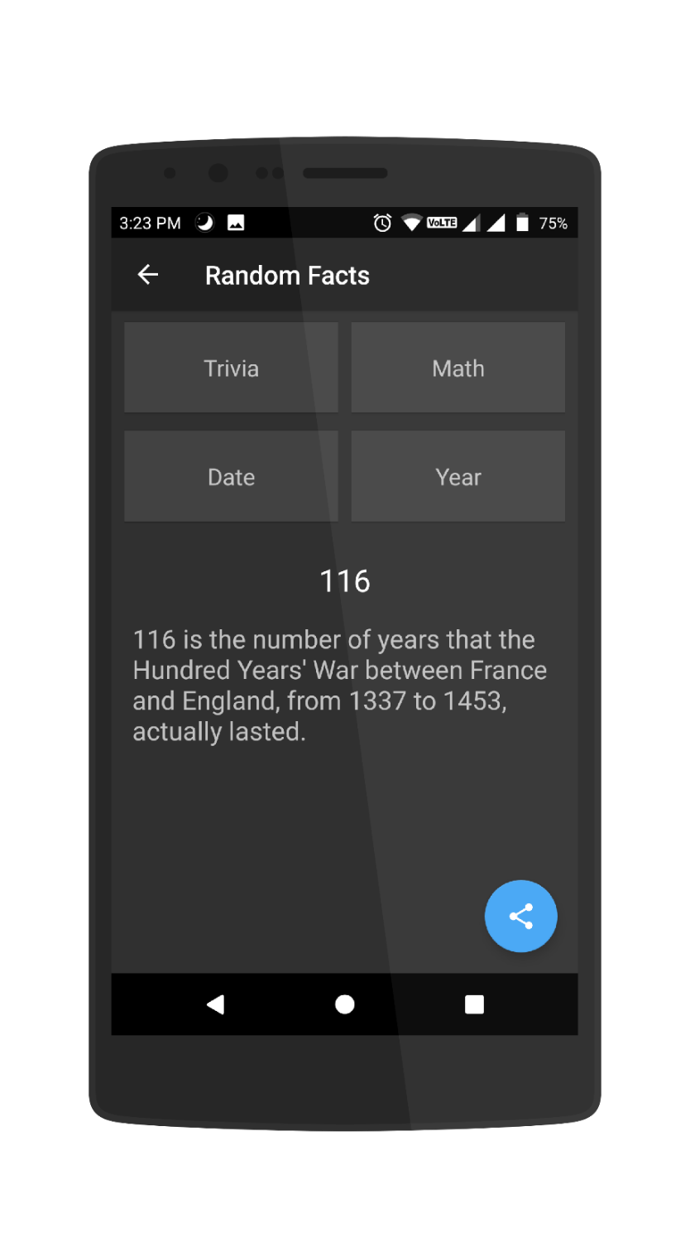
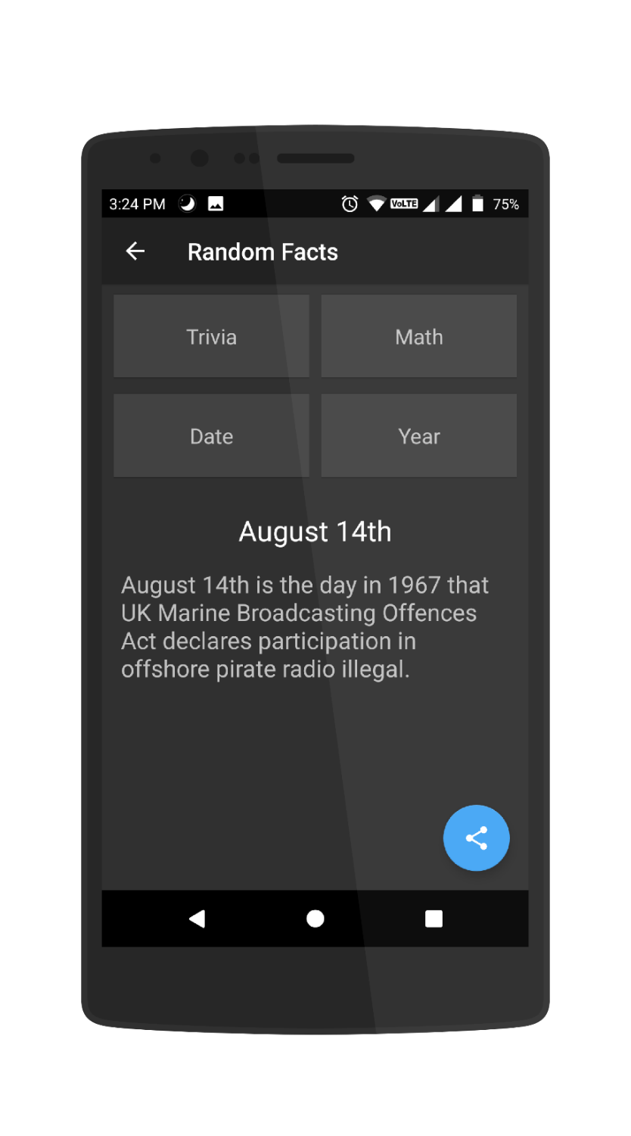
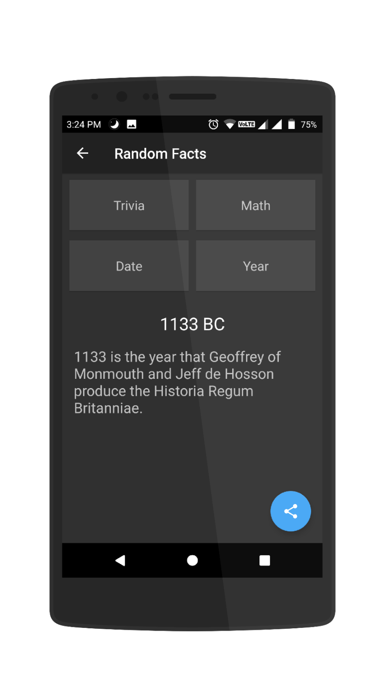
Random Facts

Slide 4
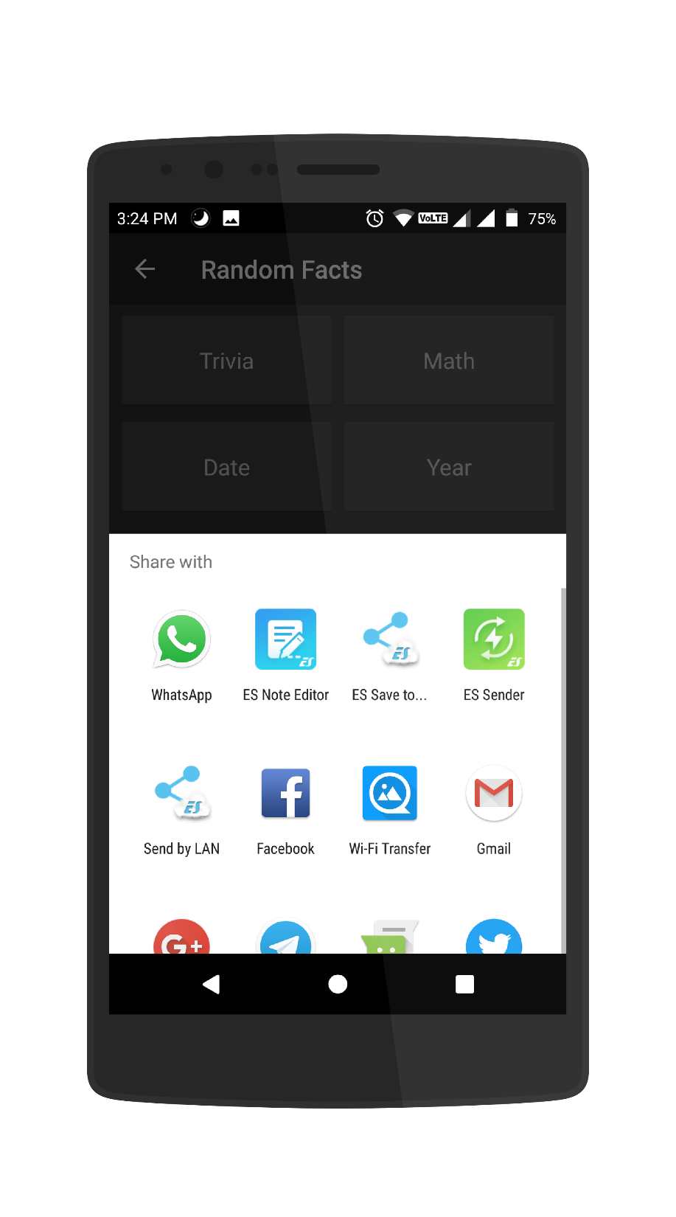
Share Option

Slide 5
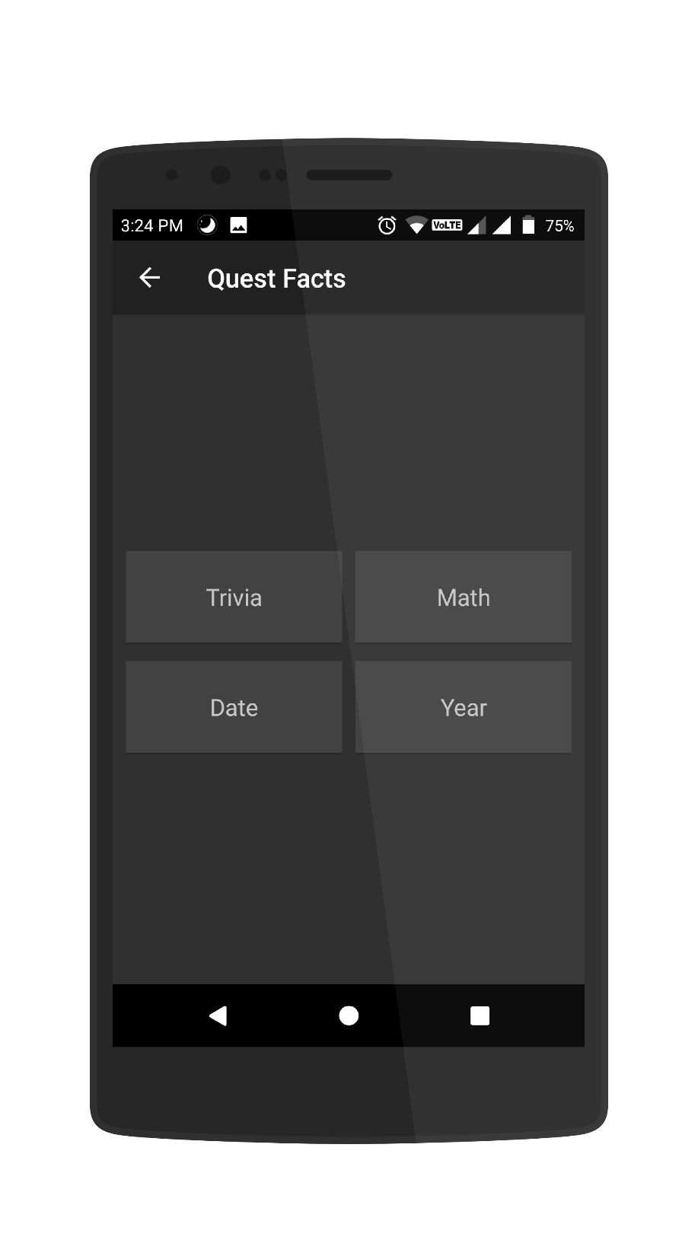
Quest Facts

Slide 6
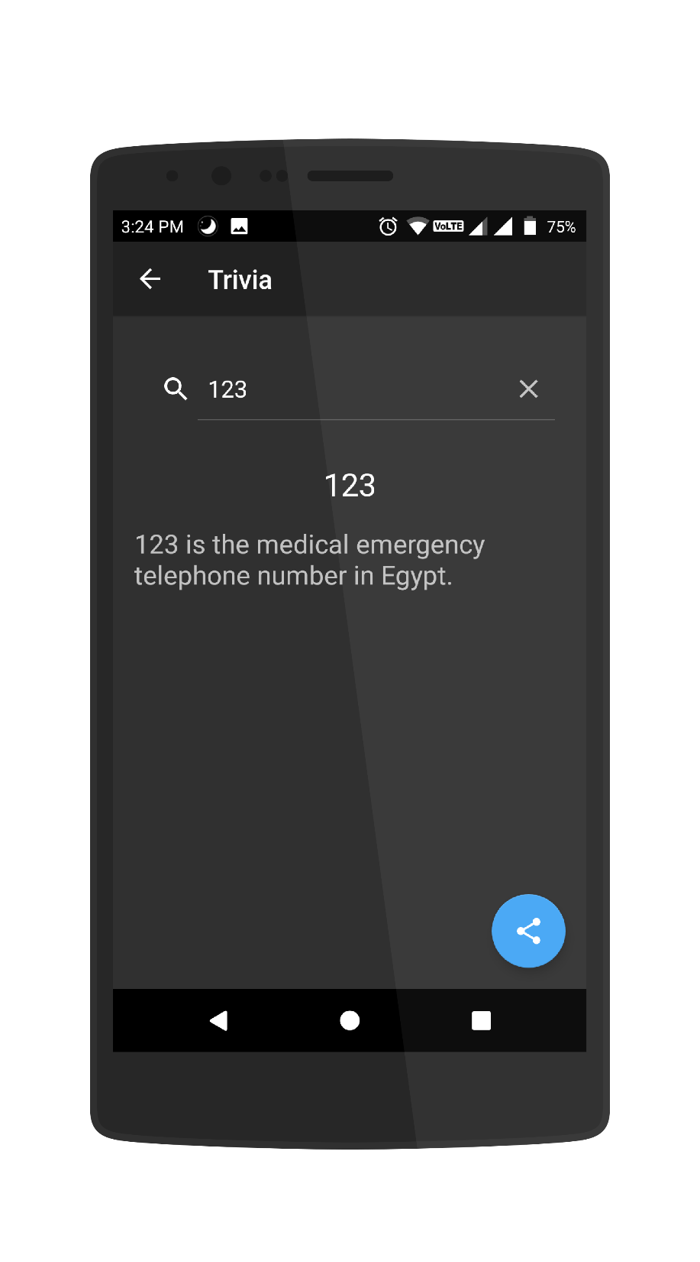
Trivia Quest Fact

Slide 7

Math Quest Fact

Slide 8
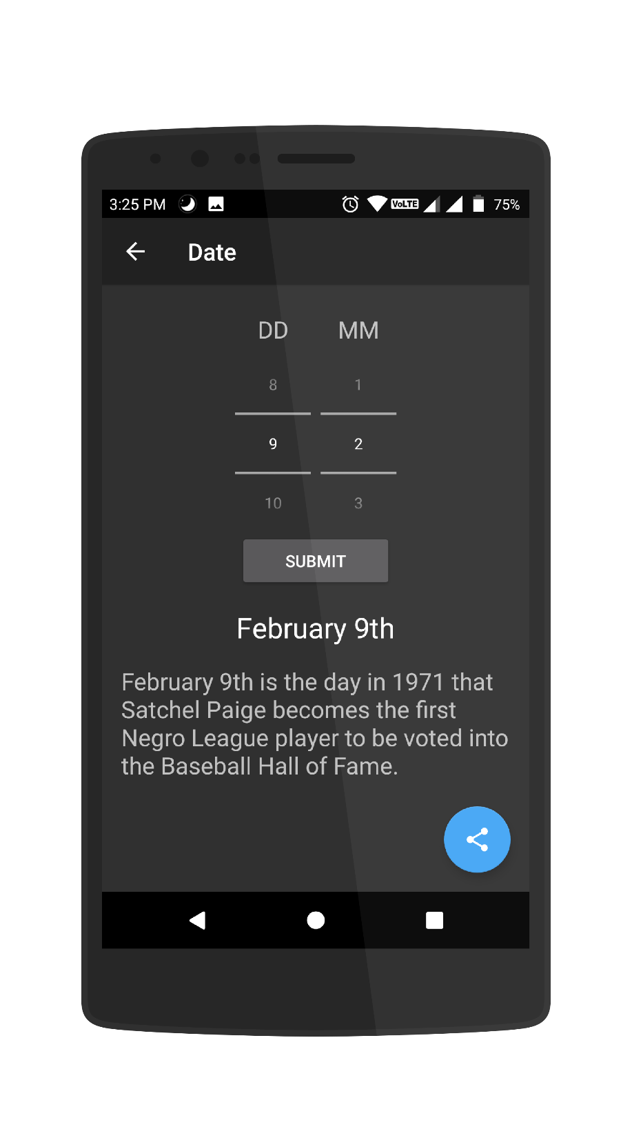
Date Quest Fact

Slide 9
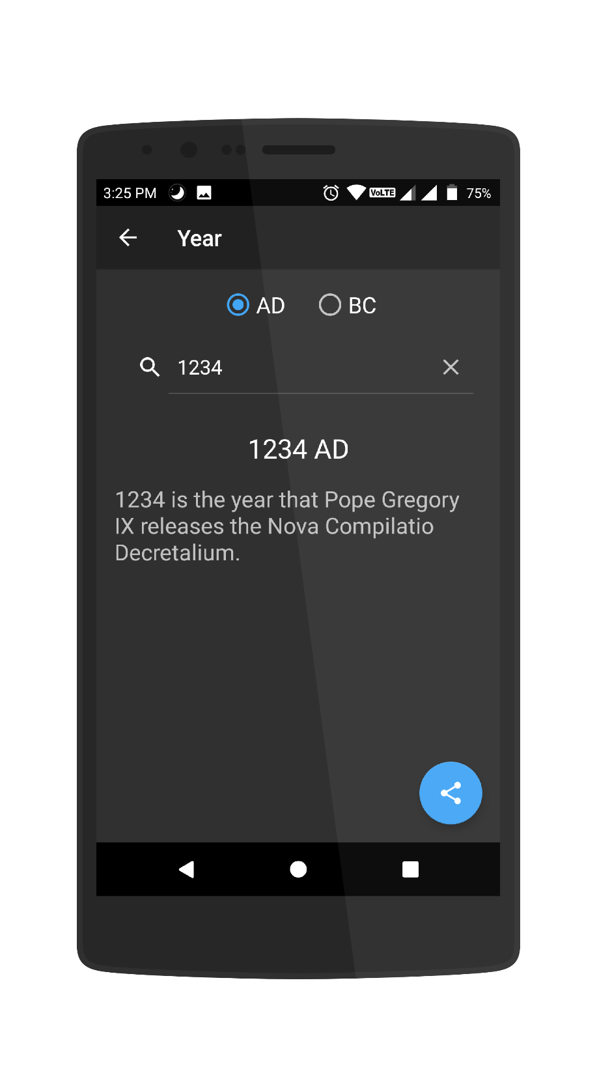
Year Quest Fact

Slide 10
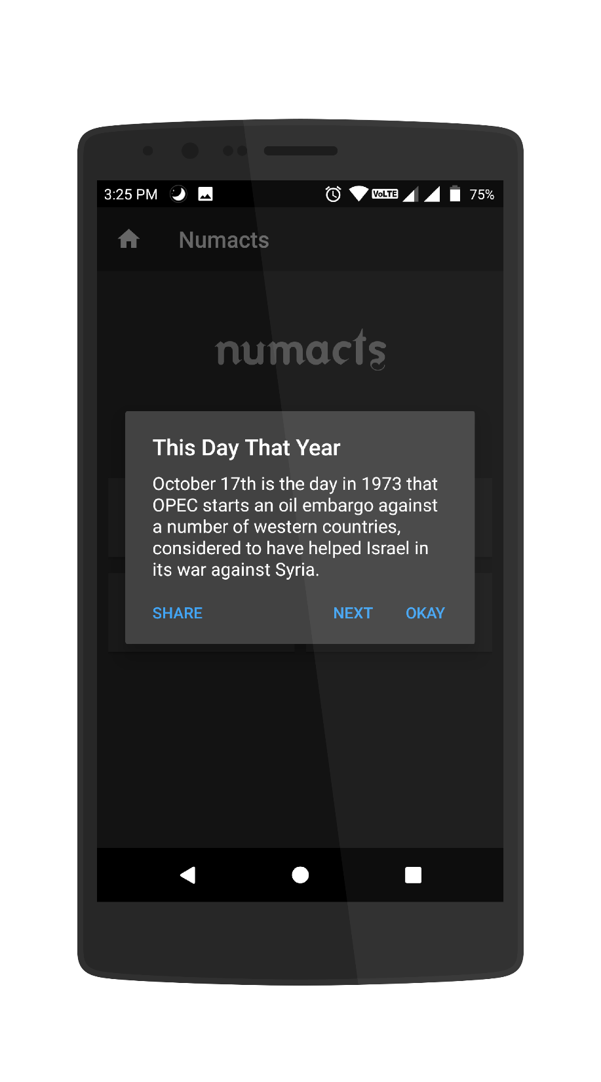
This Day That Year
With #TDTY get to know
what happened today but
in that year

Slide 11
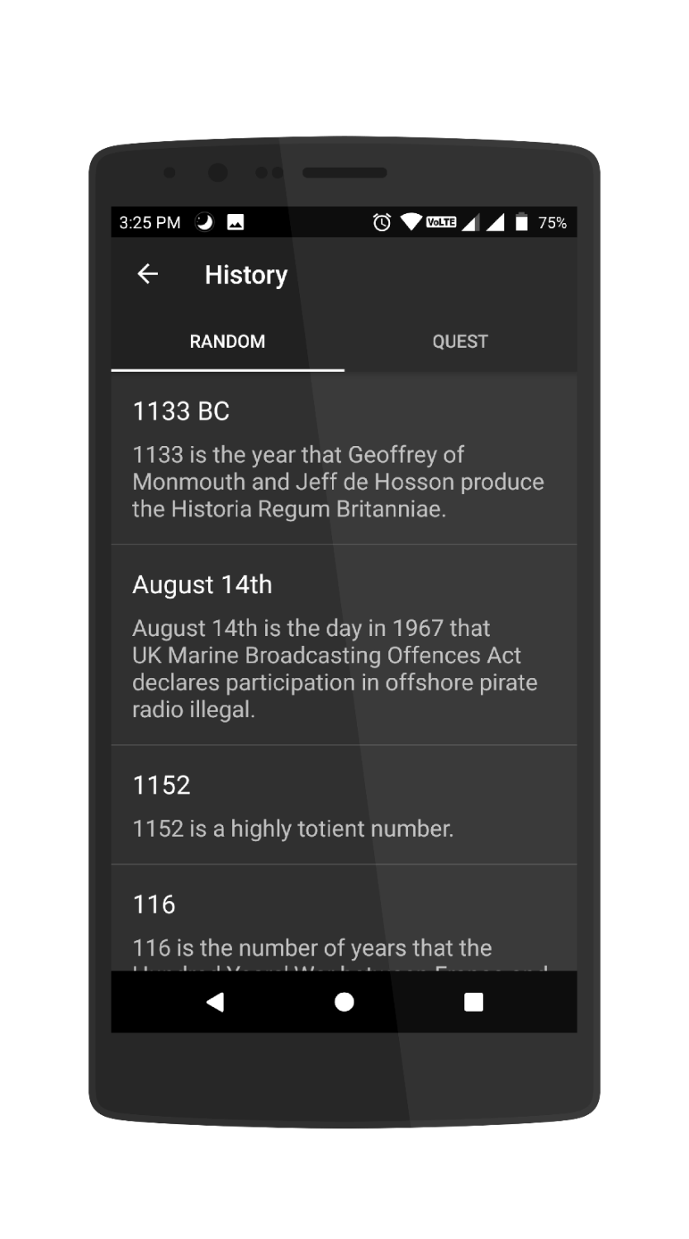
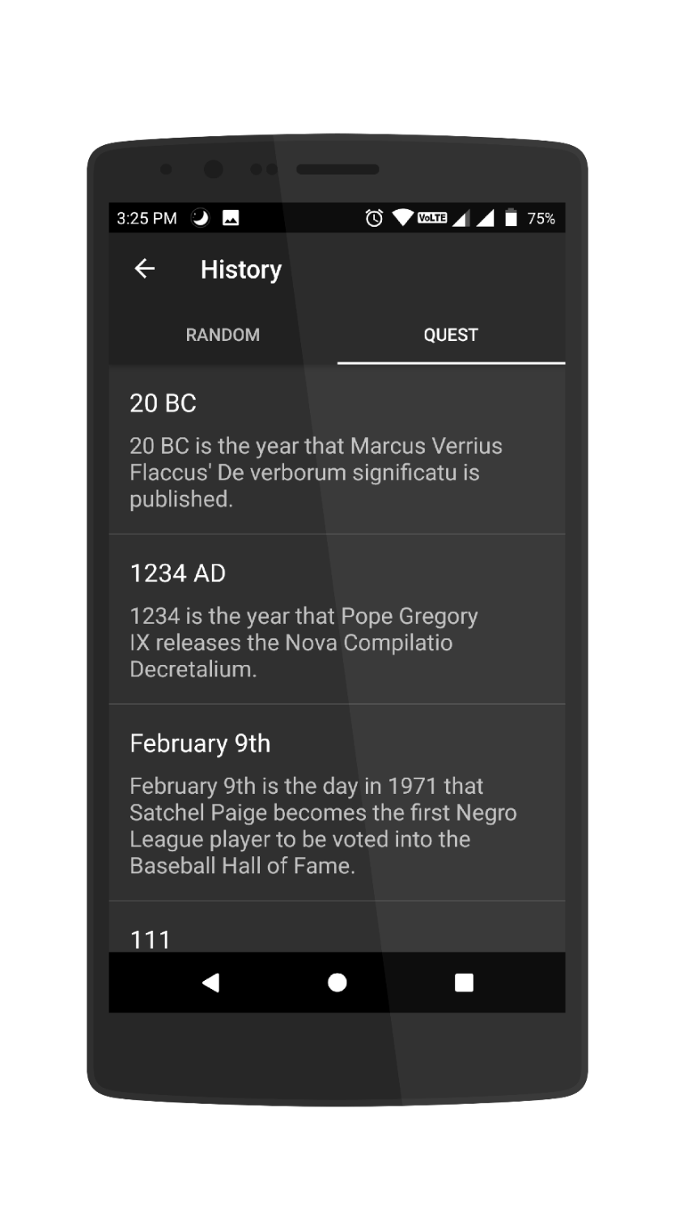
History

Slide 12
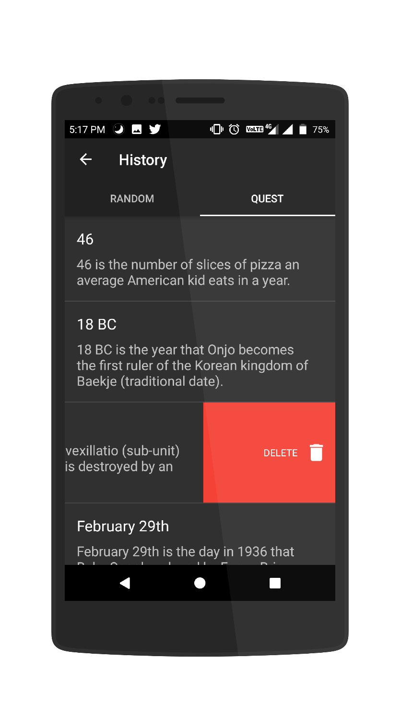
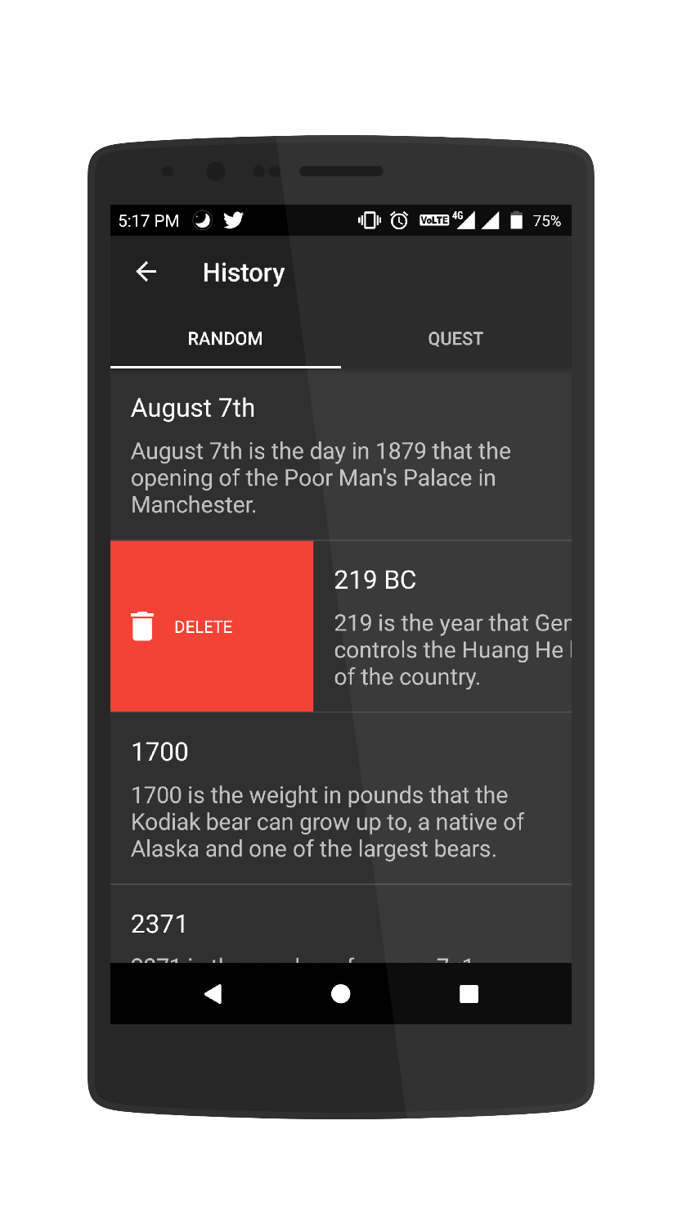
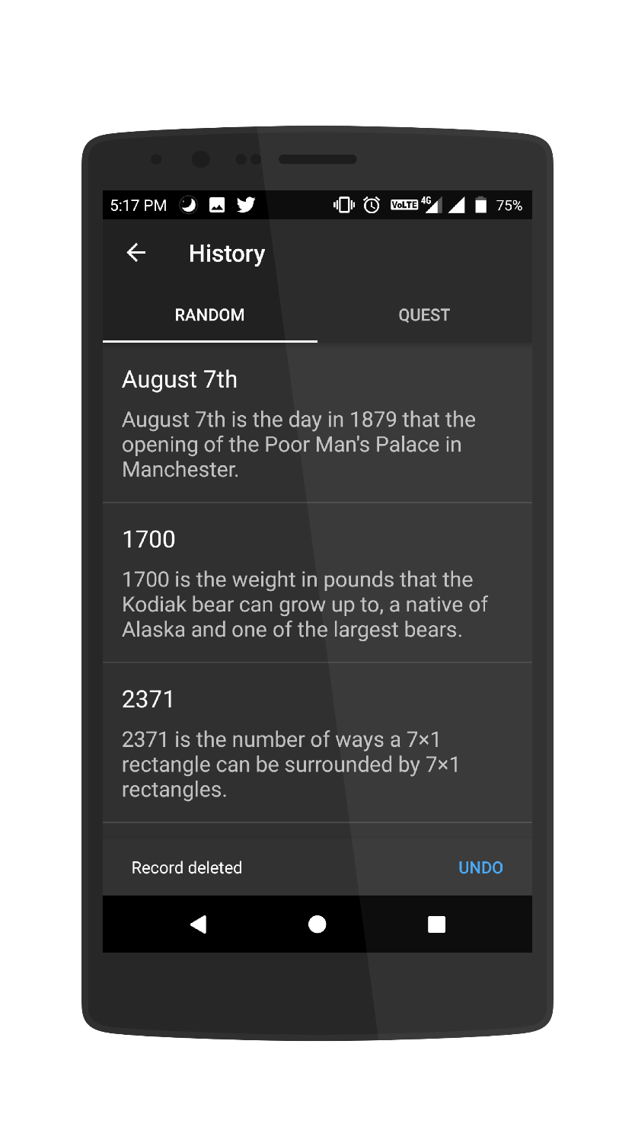
Swipe to delete from history

Slide 13


Multiple Theme Support

Slide 14

Animated Splash Icon
(wave effect)

Slide 15
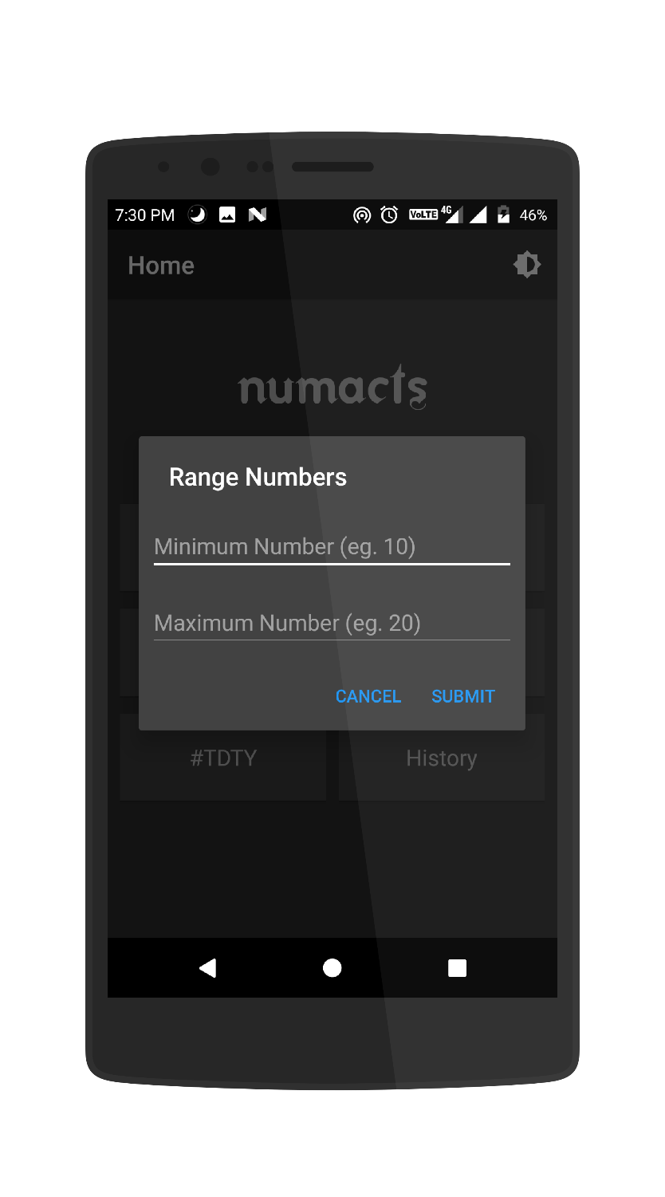
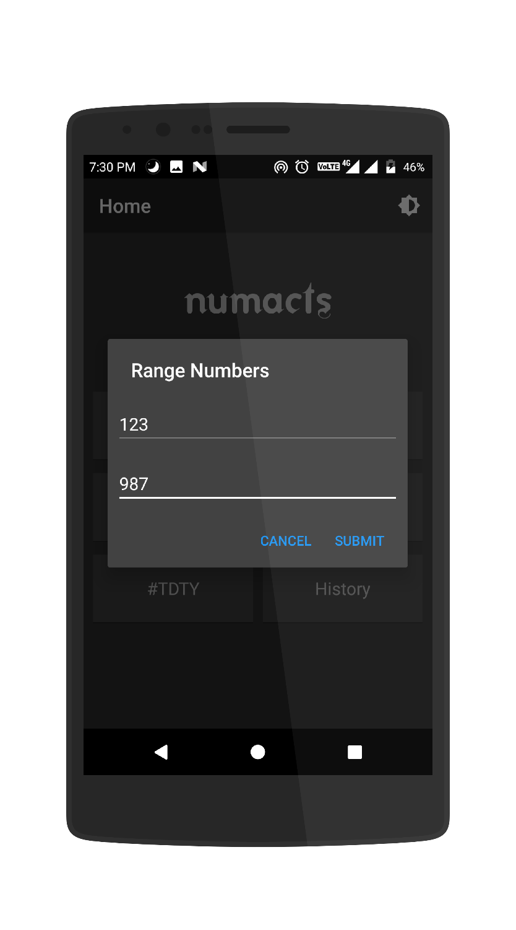
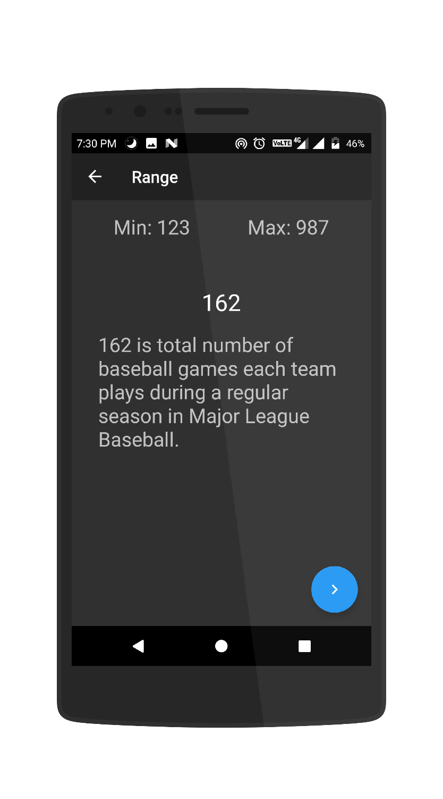
Fact in a range

Slide 16


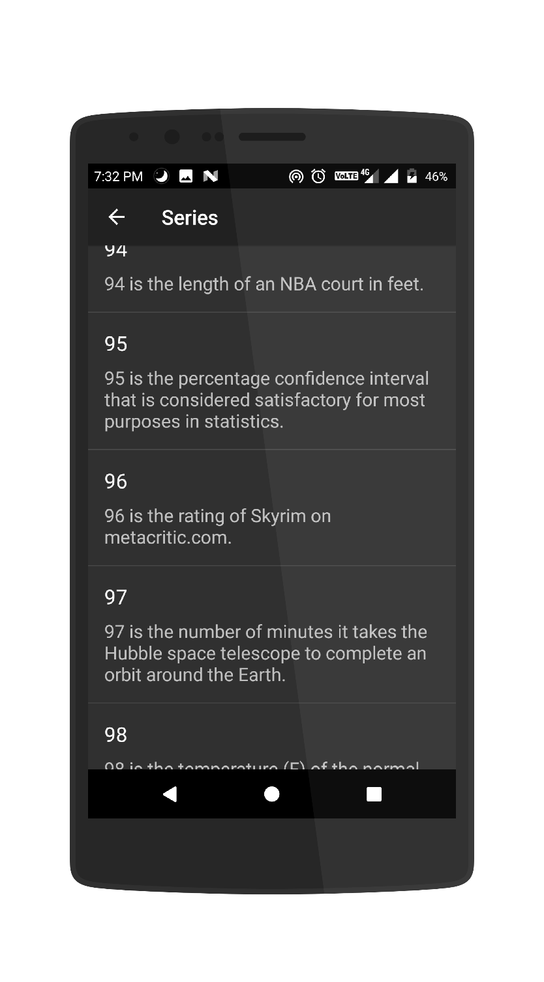
Series of facts

Slide 17
Miscellaneous Features
Attractive and enhancing UI
Animated splash screen icon
Multiple theme support (light and dark)
Facts in a range
Series of facts
Saved records in history
Works on Android Oreo (latest)
Less than 3 MB APK Size
User friendly message for network failures and errors
Fast fetching of facts with the help of JSON and Retrofit

Slide 18
Submitted by
Thank You
MD Danish Ansari

