Slide 1
Unsupervised Word Sense Disambiguation on top of word2vec
Sagar B Dollin, 2020HCS7012,
MSc. Cognitive Science, IIT Delhi

Slide 2
Motivation
Like unisense vectors, sense-specific vectors should be closely aligned to words in that sense. (Chen et al., 2014; Huang et al., 2012; Le and Mikolov, 2014; Neelakantan et al., 2015)
Main reference:
title={A Simple Approach to Learn Polysemous Word Embeddings}, author={Yifan Sun and Nikhil Rao and Weicong Ding}
Link: https://arxiv.org/abs/1707.01793v1

Slide 3
Approach
This model is built on top of Gensim word2vec
The vector embeddings of word2vec are uni-sense, we will call them as base embeddings
Our aim is to construct contextual embeddings, which can be constructed using the base embeddings

Slide 4


How to construct Contextual Embeddings?
Example:
I was sitting by the side of the River bank.
I need to withdraw my savings from the bank.
Notice, how the context changes the meaning of the word in the above examples.

Slide 5
Contextual Embeddings
bank1 =W[sitting,bank]*base_vector(sitting) + W[side,bank]*base_vector(side) + W[River,bank]*base_vector(river)
and,
bank2 = W[need,bank]*base_vector(need) + W[withdraw,bank]*base_vector(withdraw) + W[savings,bank]*base_vector(savings)
Here,
W[contex_word,target_word] defines the relevance of that context word.
W = 1 , means high relevance
W=0, means no relevance

Slide 6
Visualizing contextual embedding
Target =
w1*
+
w2*
+
w3*
+
...
base_vector1
base_vector2
base_vector3

Slide 7
But What is W?
A Matrix W of V*V dimensions where V is the total vocabulary of the selected corpus. In the paper above, W[i,j] is defined as,
W[i,j]=co-occurence of words i and j /(freq._of_word_i * freq_of_word_j)
Equations apart, W is a relevance matrix that tells how relevant a context is for a target word.
In example 1, river is more relevant to bank than other context words.

Slide 8
So to sum up!
contextual embedding of a word as a linear combination of its contexts.(Yifan Sun et al.)

Slide 9
Project details
Python programming language
Base model : Gensim word2vec
Trained on wiki-corpus
Evaluation : SCWS(Stanford’s Contextual Word Similarities)
Source(dataset/test set) : Richard Socher - Improving Word Representations Via Global Context And Multiple Word Prototypes.
My Project available on : https://github.com/SagarDollin/unsupervised_WSD_on_top_of_word2vec

Slide 10
Evaluation and results
The model was evaluated on SCWS test set.
This is a test set that has two (word,context) pairs and have a similarity measure between two words annotated by human readers, based on the context.
Result: The predicted similarity scores (cosine similarity) and ground-truth ranking have an Average Difference = 0.27 (Inaccuracy measure)
Accuracy measure = 1 – 0.27 = 0.73 (approx)

Slide 11
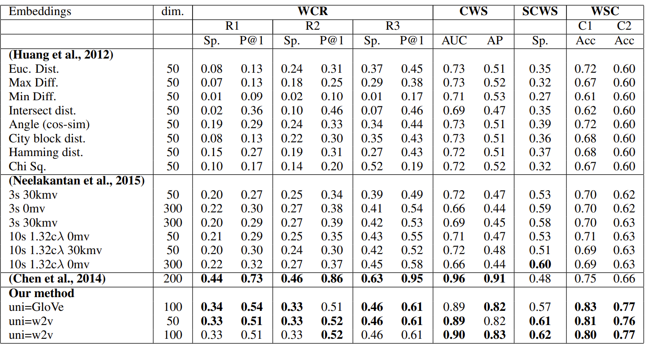
Compare the evaluation results with original paper (Yifan Sun et al.)
Note that, here in the image, our method refers to the method used by Yifan sun et al
In the image SCWS scores are in Spearman correlation metric. I used accuracy measure : (1-(avg_diff) )
If we want to compare Acuuracies, we can compare the accuracy I got for SCWS and the Accuracy the original paper’s authors got for CWS.
My accuracy is 0.73 i.e., 73%(SCWS) where as their accuracy is (89-90%) for CWS
Image source : A Simple Approach to Learn Polysemous Word Embeddings

