Slide 1

Profit Maximization of Flanges
Team Members :
Prabhat Gupta (001268013)
Sagar Ghiya (001282525)
Shloka Shah (001284708)
Varun Ozarkar (001264099)
Yash Dhabalia (001222881)
Faculty Advisor :
Prof. Md. Noor-E-Alam
Teaching Assistant :
Prateek Khade
Deterministic Operations Research ( OR 6205 ) – Master of Science - Industrial Engineering

Slide 2
About The Company : G N Altech
Manufacturer of High Precision Aluminium and Iron components.
Implement techniques like 5S and Lean for production.
Manufactures of Flanges, Housing for gear drive, Housing for electrical motors, Fluid valves and pumps.

Slide 3
Problem Description
Aim is to maximize the profit of the flanges produced, with limited resources available.
Limitation : limited quantity of time available.
7 different types of Flanges.
Processes : Material Handling, Casting, Heat Treatment, Quality Check-1, Machining, Quality Check-2, Anti-rust Coating and Packaging.

Slide 4
Demand and Availability
Flange Type | Minimum | Maximum
Flat Faced | 15 | 45
Lap Joint | 15 | 22
Blind | 15 | 40
Slip-on | 15 | 45
Socket Weld | 15 | 30
Threaded | 15 | 25
Weld-Neck | 15 | 35
Material Handling | 120
Casting | 400
Heat Treatment | 380
QC-1 | 120
Machining | 360
QC-2 | 180
Anti-rust Coating | 240
Packaging | 160

Slide 5
Data Table
 | Raw Material Handling | Casting | Heat Treatment | QC-1 | Machining | QC-2 | Anit-rust Coating | Packaging | Profit ( $ )
Product | Time required for production of each flange in minutes
1 | 0.20 | 3.56 | 2.30 | 0.35 | 3.00 | 2.00 | 1.30 | 0.14 | 3.75
2 | 0.18 | 2.04 | 1.55 | 0.15 | 3.30 | 1.10 | 1.39 | 0.16 | 5.80
3 | 0.40 | 4.30 | 3.50 | 0.55 | 3.30 | 1.40 | 2.43 | 0.49 | 9.50
4 | 0.20 | 3.48 | 2.00 | 0.20 | 2.00 | 1.50 | 3.53 | 0.25 | 3.90
5 | 0.45 | 2.33 | 2.00 | 0.40 | 2.30 | 1.00 | 1.58 | 0.10 | 4.85
6 | 0.20 | 3.20 | 3.40 | 1.30 | 4.46 | 2.53 | 1.56 | 0.36 | 6.05
7 | 0.30 | 4.33 | 2.55 | 0.35 | 3.07 | 1.58 | 2.02 | 0.47 | 5.00
Total time availability (min) | 120 | 400 | 380 | 120 | 360 | 180 | 240 | 160

Slide 6
Mathematical Modelling : Assumptions
No consideration of down time and change over time.
Setup time included in process time.
7 types of flanges produced :
X1 : Number of flanges of Type-1 (Flat faced flange)
X2 : Number of flanges of Type-2 (Lap joint flange)
X3 : Number of flanges of Type-3 (Blind flange)
X4 : Number of flanges of Type-4 (Slip-on flange)
X5 : Number of flanges of Type-5 (Socket weld flange)
X6 : Number of flanges of Type-6 (Threaded flange)
X7 : Number of flanges of Type-7 (Weld-neck flange)
Profit per flange in Dollars ( $ ) :
P1 : Profit margin for flange Type-1
P2 : Profit margin for flange Type-2
P3 : Profit margin for flange Type-3 P4 : Profit margin for flange Type-4
P5 : Profit margin for flange Type-5
P6 : Profit margin for flange Type-6
P7 : Profit margin for flange Type-7

Slide 7
Assumptions
Processes being used during production :
Raw material handling
Casting
Heat Treatment
Quality Check - 1
Machining
Quality Check - 2
Coating
Packaging

Slide 8
Parameters :
Time taken for each type of flange to pass through one process.
Profit obtained on each type of flange.
Total time available for each process in a given day.
Variables :
Quantity of flanges produced in a given day (X1, X2,…,X7)
Objective Function :
Max. Profit : P1*X1 + P2*X2 + P3*X3 + P4*X4 + P5*X5 + P6*X6 + P7*X7
So, Max. Profit : 3.75*X1 + 5.80*X2 + 9.50*X3 + 3.90*X4 + 4.85*X5 + 6.05*X6 + 5.00*X7

Slide 9
Subject to Constraints : Time Availability
0.20*X1 + 0.18*X2 + 10.40*X3 + 0.20*X4 + 0.45*X5 + 0.20*X6 + 0.30*X7 <= 120 ;
3.56*X1 + 2.04*X2 + 4.30*X3 + 3.48*X4 + 2.33*X5 + 3.20*X6 + 4.33*X7 <= 400 ;
2.30*X1 + 1.55*X2 + 3.50*X3 + 2.00*X4 + 2.00*X5 + 3.40*X6 + 2.55*X7 <= 380 ;
0.35*X1 + 0.15*X2 + 0.55*X3 + 0.20*X4 + 0.40*X5 + 1.30*X6 + 0.35*X7 <= 120 ;
3.00*X1 + 3.30*X2 + 3.30*X3 + 2.00*X4 + 2.30*X5 + 4.46*X6 + 3.07*X7 <= 360 ;
2.00*X1 + 1.10*X2 + 1.40*X3 + 1.50*X4 + 1.00*X5 + 2.53*X6 + 1.58*X7 <= 180 ;
1.30*X1 + 1.39*X2 + 2.43*X3 + 3.53*X4 + 1.58*X5 + 1.56*X6 + 2.02*X7 <= 240 ;
0.14*X1 + 0.16*X2 + 0.49*X3 + 0.25*X4 + 0.10*X5 + 0.36*X6 + 0.47*X7 <= 160 ;

Slide 10
Subject to Constraints : Demand Fluctuation
15 <= X1 <= 45;
15 <= X2 <= 22;
15 <= X3 <= 40;
15 <= X4 <= 45;
15 <= X5 <= 30;
15 <= X6 <= 25;
15 <= X7 <= 35;
X1, X2, X3, X4, X5, X6, X7 are all integers.

Slide 11
AMPL Implementation : Model File
set P ;
set Q ;
param a{ j in P,i in Q};
param b{ i in Q} ;
param c{ j in P};var x{ j in P} integer;
maximize z: sum{j in P} c[j]*x[j];
subject to constraints{i in Q}:sum{ j in P}a[j,i]*x[j] <=b[i];
subject to limit{ j in P} : x[j]>=0;

Slide 12
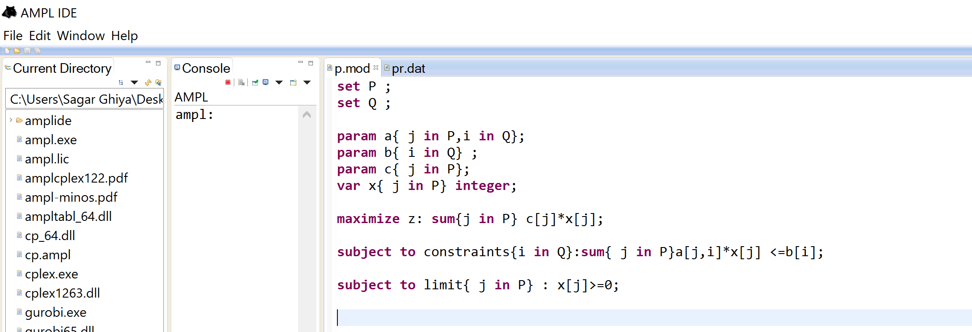
Model File :

Slide 13
AMPL Implementation : Data File
data;
set P:= 1 2 3 4 5 6 7;
set Q:= l m n o p q r s t u v w x y z a b c d e f g ;
param a: l m n o p q r s t u v w x y z a b c d e f g :=
1 0.20 3.56 2.30 0.35 3.00 2.00 1.30 0.14 1 -1 0 0 0 0 0 0 0 0 0 0 0 0
2 0.18 2.04 1.55 0.15 3.30 1.10 1.39 0.16 0 0 1 -1 0 0 0 0 0 0 0 0 0 0
3 0.40 4.30 3.50 0.55 3.30 1.40 2.43 0.49 0 0 0 0 1 -1 0 0 0 0 0 0 0 0
4 0.20 3.48 2.00 0.20 2.00 1.50 3.53 0.25 0 0 0 0 0 0 1 -1 0 0 0 0 0 0
5 0.45 2.33 2.00 0.40 2.30 1.00 1.58 0.10 0 0 0 0 0 0 0 0 1 -1 0 0 0 0
6 0.20 3.20 3.40 1.30 4.46 2.53 1.56 0.36 0 0 0 0 0 0 0 0 0 0 1 -1 0 0
7 0.30 4.33 2.55 0.35 3.07 1.58 2.02 0.47 0 0 0 0 0 0 0 0 0 0 0 0 1 -1;
param c := 1 3.75 2 5.80 3 9.50 4 3.90 5 4.85 6 6.05 7 5.00 ;
param b := l 120 m 400 n 380 o 120 p 360 q 180 r 240 s 160 t 45 u -15 v 22 w -15 x 40 y -15 z 45 a -15 b 30 c -15 d 25 e -15 f 35 g -15 ;

Slide 14
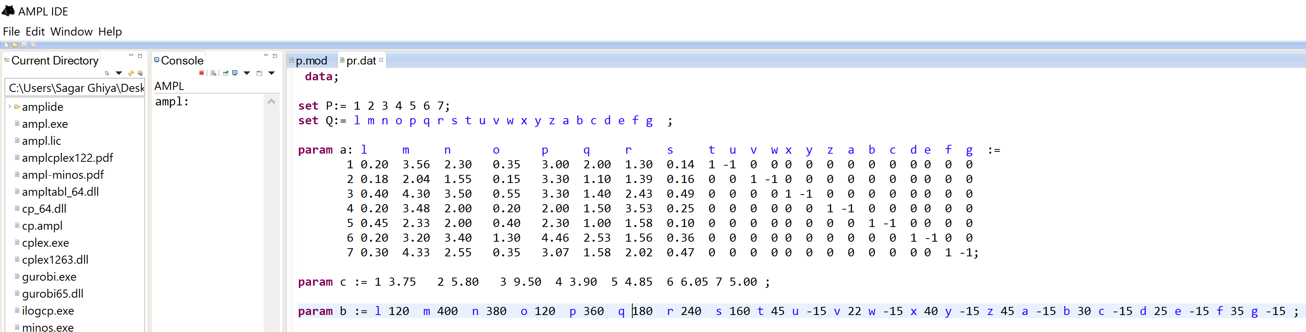
Data File :

Slide 15
PC Description
RAM : 16 GB
Processor : 6 GEN Intel i7 (3.6 GHz)
Memory : 1 TB HDD / 128 GB SSD
OS : Windows 10, 64 bit, x64 based processor

Slide 16
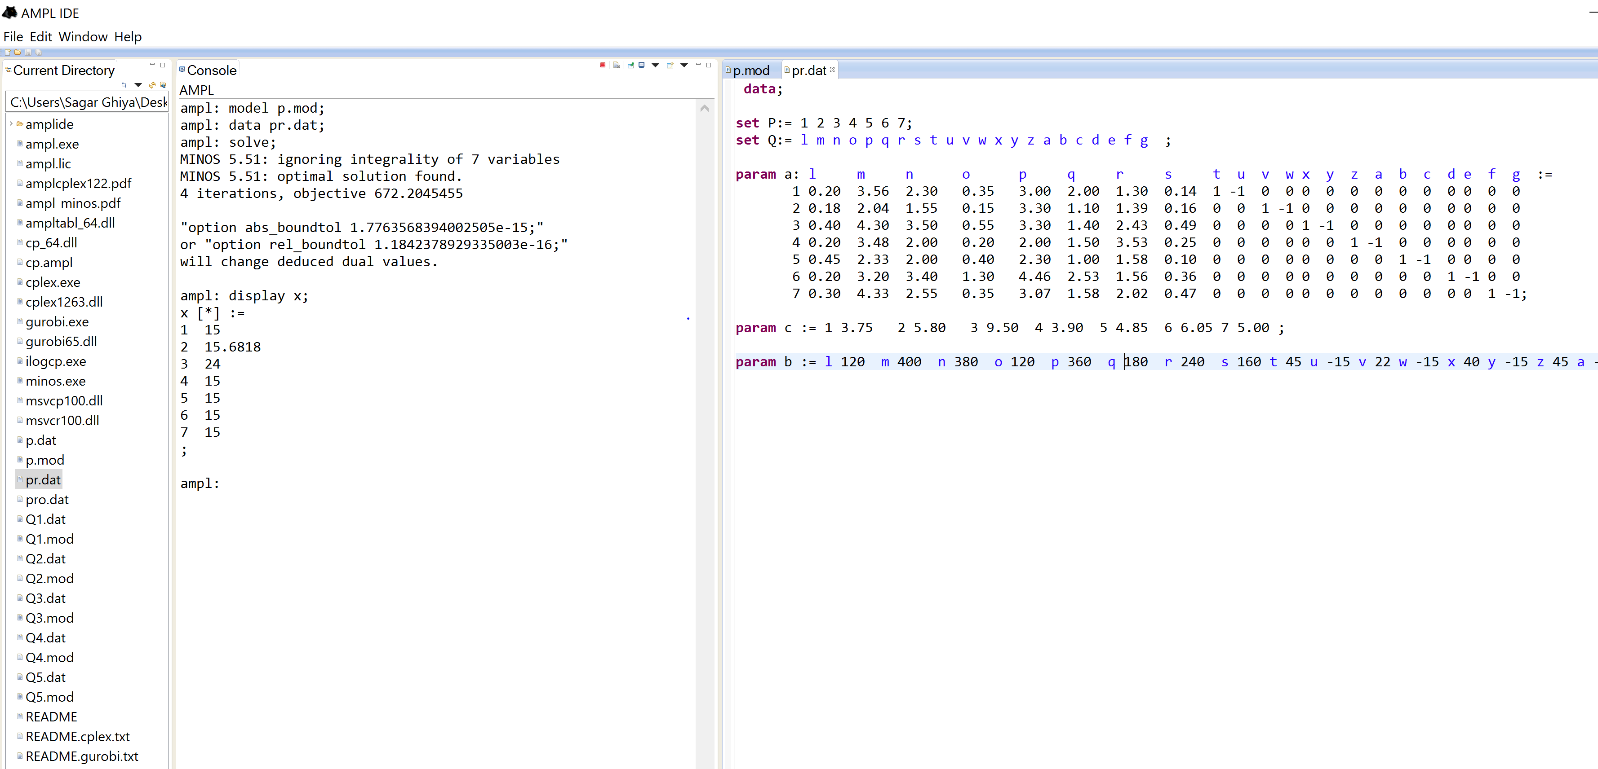
AMPL Implementation
Using MINOS
Even after putting Integer constraint in the model file, we get non-integer values.
This is because, MINOS solver doesn’t solve integer programs.

Slide 17
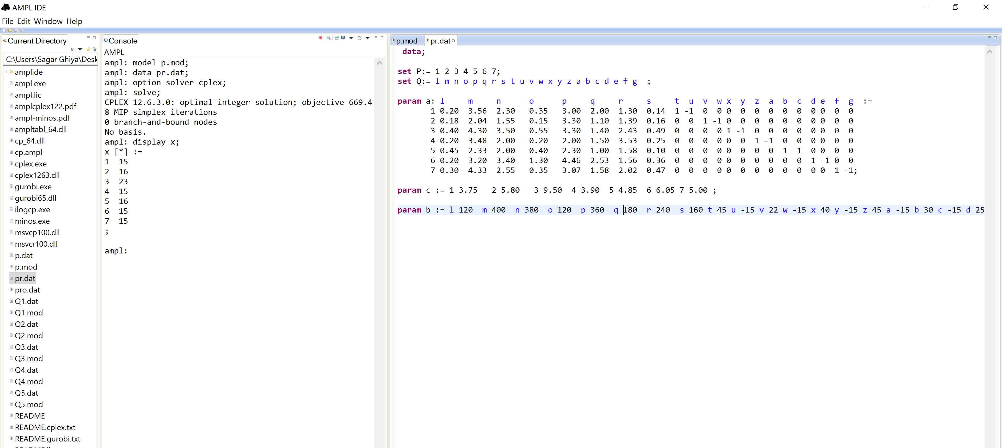
AMPL Implementation
Using CPLEX
CPLEX solver gives solution with integer values.

Slide 18
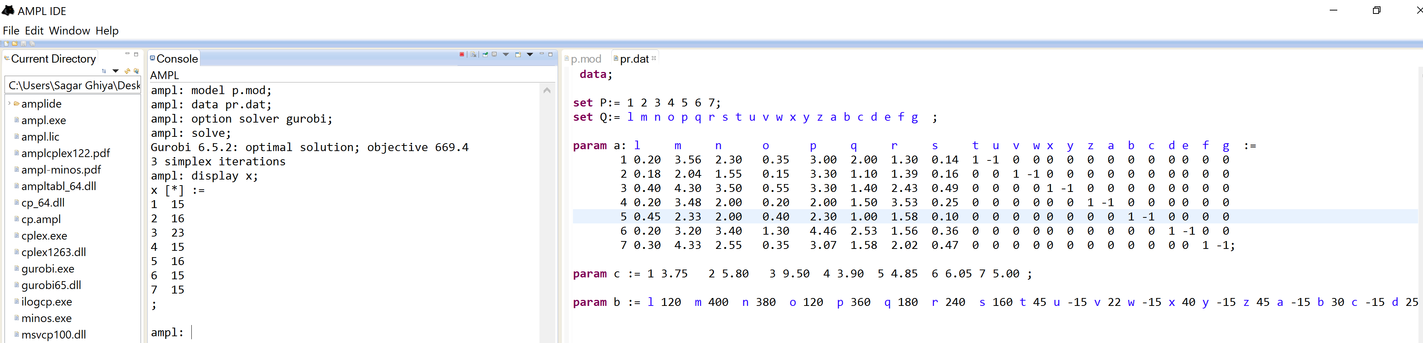
AMPL Implementation
Using GUROBI
GUROBI solver also gives solution with integer values.

Slide 19
Comparison between CPLEX and GUROBI
Both CPLEX and GUROBI give the same solution.
It is claimed that GUROBI is faster than CPLEX.
Also, GUROBI is better at finding Integer feasible solutions.
But since our data-set is not large, it doesn’t matter whether CPLEX or GUROBI is used.
Both the solvers take same time to give the solution.

Slide 20
Results
Optimal solution gives us $669.4 Profit with values:
X1=15, X2=16, X3=23, X4=15, X5=16, X6=15, X7=15
Process | 1 | 2 | 3 | 4 | 5 | 6 | 7 | 8 | Total time(minutes)
Availability | 120 | 400 | 380 | 120 | 360 | 180 | 240 | 160 | 1960
Used | 32 | 387 | 291 | 54 | 353 | 180 | 230 | 34 | 1561
Surplus | 88 | 13 | 89 | 66 | 7 | 0 | 10 | 126 | 399

Slide 21
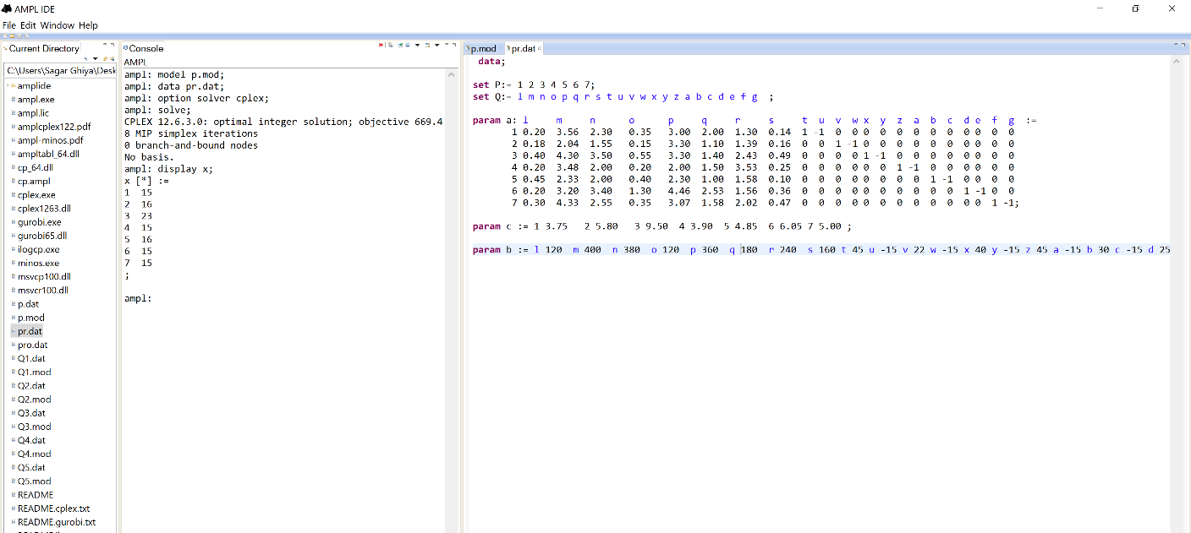
Sensitivity Analysis
Sensitivity Analysis is a technique used to determine how different values of an independent variable impact a particular dependent variable under a given set of assumptions.
Original Execution

Slide 22
Case 1 : Change in Profit
Objective Function Value | P1 | X1 | X2 | X3 | X4 | X5 | X6 | X7
639.4 | 1.75 | 15 | 16 | 23 | 15 | 16 | 15 | 15
688.15 | 5 | 15 | 16 | 23 | 15 | 16 | 15 | 15
847.3 | 15 | 21 | 16 | 15 | 15 | 15 | 15 | 15
1582.3 | 50 | 21 | 16 | 15 | 15 | 15 | 15 | 15

Slide 23
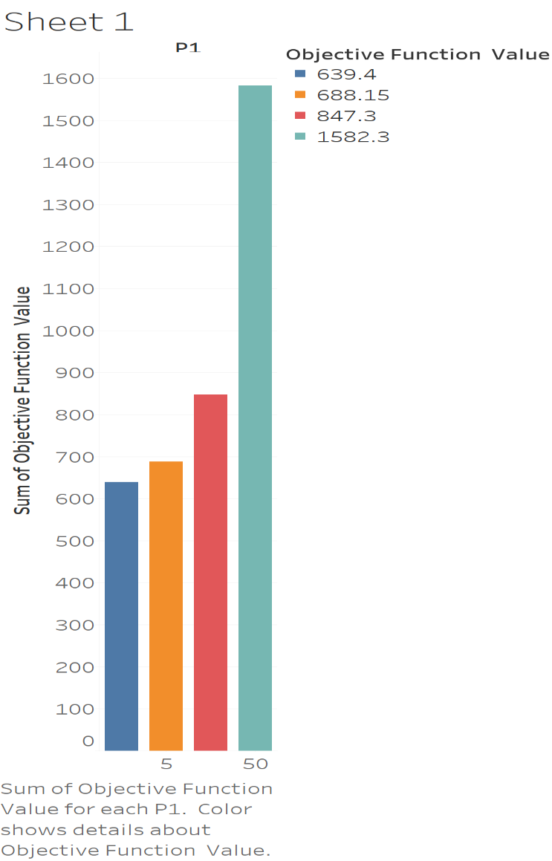
With the increase in profit, objective function value increases.

Slide 24
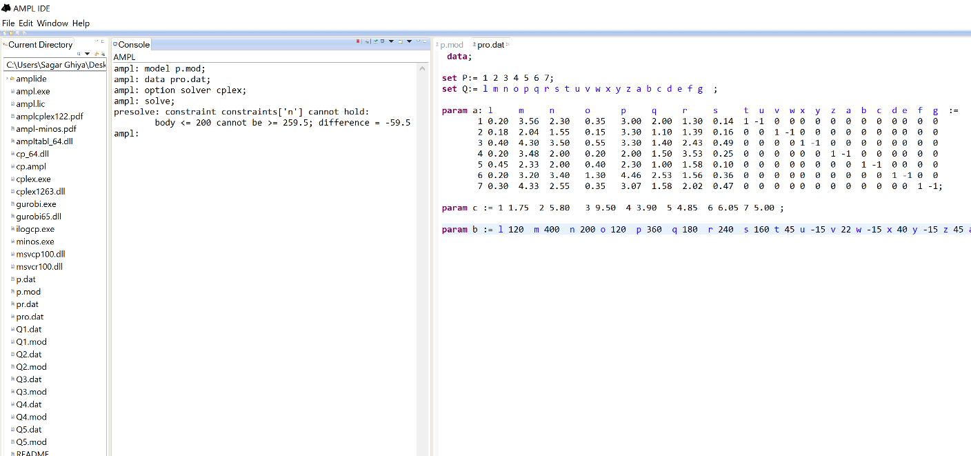
Case 2 : Change in total time available for Flange Type -1
Total Time Available for P3( in min) | Objective Function Value | X3 | P3
380 | 639.4 | 23 | 9.5
280 | 617.4 | 16 | 9.5
260 | 552.75 | 15 | 9.5

Slide 25
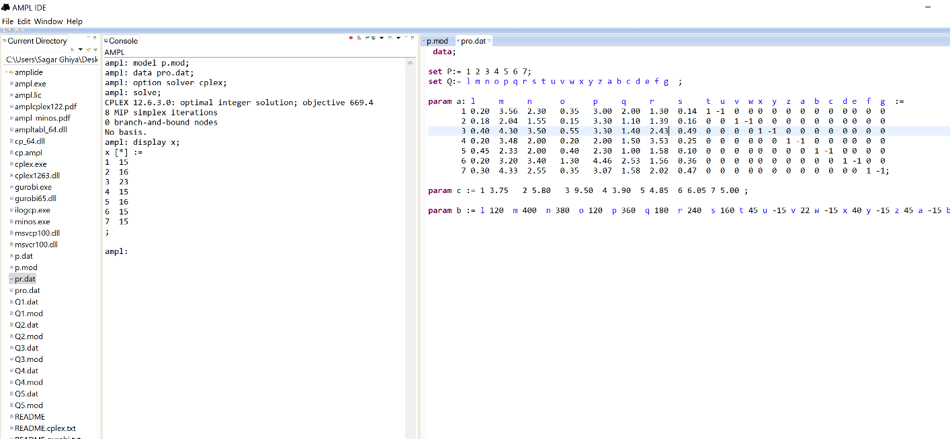
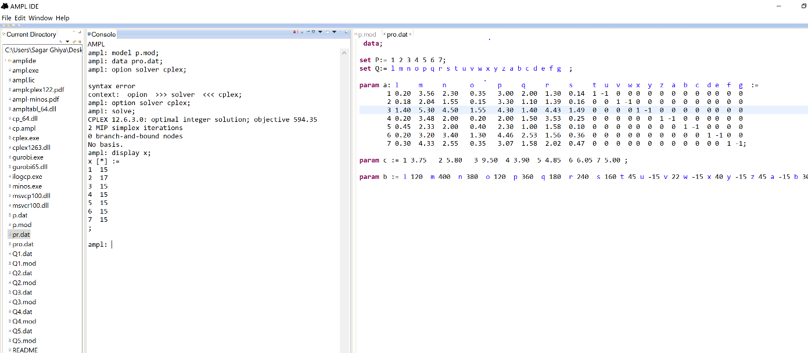
Case 3 : Change in time consumed by Flange in Process 3 (Heat Treatment)
This is the normal condition which displays our original solution with value of objective function and decision variables.
Let us consider a situation when time for process 3 increases by 1 min for each type of flange due to some problem.

Slide 26
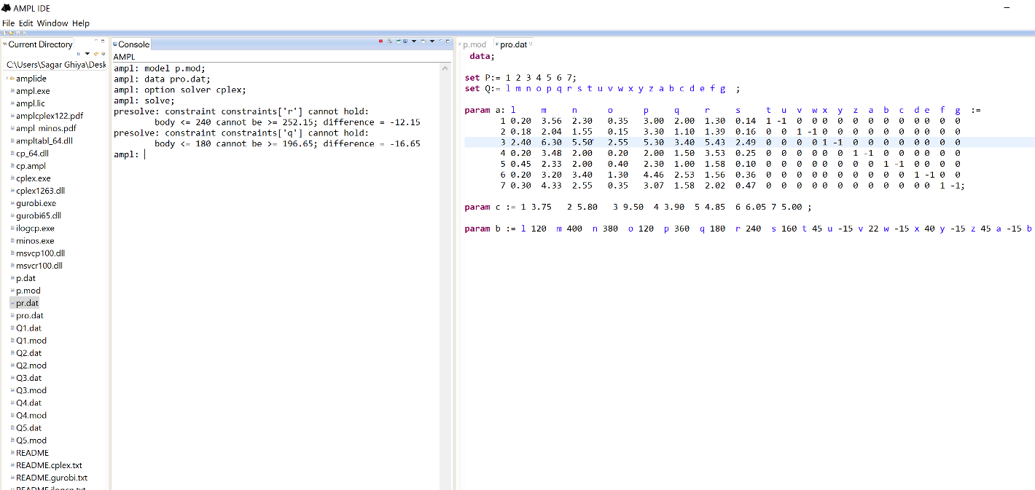
If we further increase the time by 2 min from our original problem(as highlighted above), we observe that the solution is infeasible.
This is because, even if all the products take their minimum value, the time constraint will not be satisfied.

Slide 27
Conclusion
After implementing the entire project in AMPL and performing sensitivity analysis, we make following suggestions for company G.N. Altech to increase its profits:-
We observed that none of the products manufactured have reached their maximum value, that is, product manufactured of each type has never meet its maximum demand.
This is because of the limitation of time resource. So if company can increase the time each machine works, profit will increase as quantities produced will increase.
Also the company must work on increasing the efficiency of their machines. More efficient machines will take less time to manufacture each flange and hence profit will increase.
One obvious conclusion is that the company should focus more on producing products which have higher profit margin.

Slide 28
Bibliography
The AMPL Book
Operations Research, Applications and Algorithms (4th edition)
G.N.Altech Company Website (www.gn-altech.com)
www.wikipedia.com

Slide 29
Thank You

