Slide 1
DIGITAL PORTFOLIO
KV Monish
20 BAI 10053

Slide 2
SUBJECT KNOWLEDGE
The curriculum offers a wealth of fascinating and relevant subjects for the future, filled with valuable knowledge. The addition of AI/ML to the curriculum provides extensive exposure and learning opportunities, contributing significantly to our depth of understanding.
Semester 1 & 2:
Introduction to problem solving
Discrete mathematics and graph theory
Calculus and laplace transforms
OOP’s with C++
Engineering physics

Slide 3
SUBJECT KNOWLEDGE
Semester 3 & 4:
Design Analysis of Algorithms
Database Management System
Logic and Language Structure
Operating System
Data Structures and Algorithms
Computer Architecture and Organisation
Applied Machine Learning
Computer Vision

Slide 4
SUBJECT KNOWLEDGE
Semester 5 & 6:
Theory of Computation
Engineering Design
Natural Language Processing
Computer Networks
Data Visualization
Human Computer Interaction
Introduction to Drones
Semester 7:
Data Mining
Artificial Neural Networks
Data Science
Deep Learning
Reinforcement Learning

Slide 5
PROJECT KNOWLEDGE
Advanced Fraudulent Detection Security Camera
Aimed at enhancing the intelligence and efficiency of general security cameras, enabling them to proficiently detect and identify suspicious activities using motion sensing.
Components:
Motion Sensing and Fraudulent Activity Detection
Face Verification and Recognition
Voice-Command-Activated Personal Assistant
Advanced Computer Vision for Precise Movement Detection
Skills Developed:
Computer Vision

Slide 6
PROJECT KNOWLEDGE
2. Pre and Post Disease Diagnoses with Analysis
An advanced disease detection system leveraging the power of Random Forests and regression algorithms, enabling accurate symptom-based analysis, comprehensive remedy suggestions, and precautionary measures.
Components:
Data Collection and Preprocessing
Feature Extraction
Model Training
Symptom-Based Analysis
Remedy Suggestions and Precautionary Measures
Skills Developed:
Machine Learning

Slide 7
PROGRAMMING KNOWLEDGE
C++
User experience
JAVA
PYTHON
SQL

Slide 8
cv
Passionate B.Tech. (CSE) student with a strong interest in Machine Learning, Data Analysis, Product Development, or Product Management within the IT sector.
EDUCATION
B. Tech (CSE) AI/ML | Pursuing
VIT Bhopal
12th | 2020
Presidency School, Bengaluru South, CBSE
10th | 2018
BGSIRS, Bengaluru, CBSE

Slide 9
Skills & expertise
DBMS
Machine Learning
Project Management
Product Development
Project Development

Slide 10
INTERNSHIP
PRODUCT MANAGER
COMPANY : BANAO Technologies
JD: Product Manager
Worked with various clients on the development of their business portfolio. Generated innovative ideas and solutions for clients. Managed Social media handles and their time schedule.

Slide 11
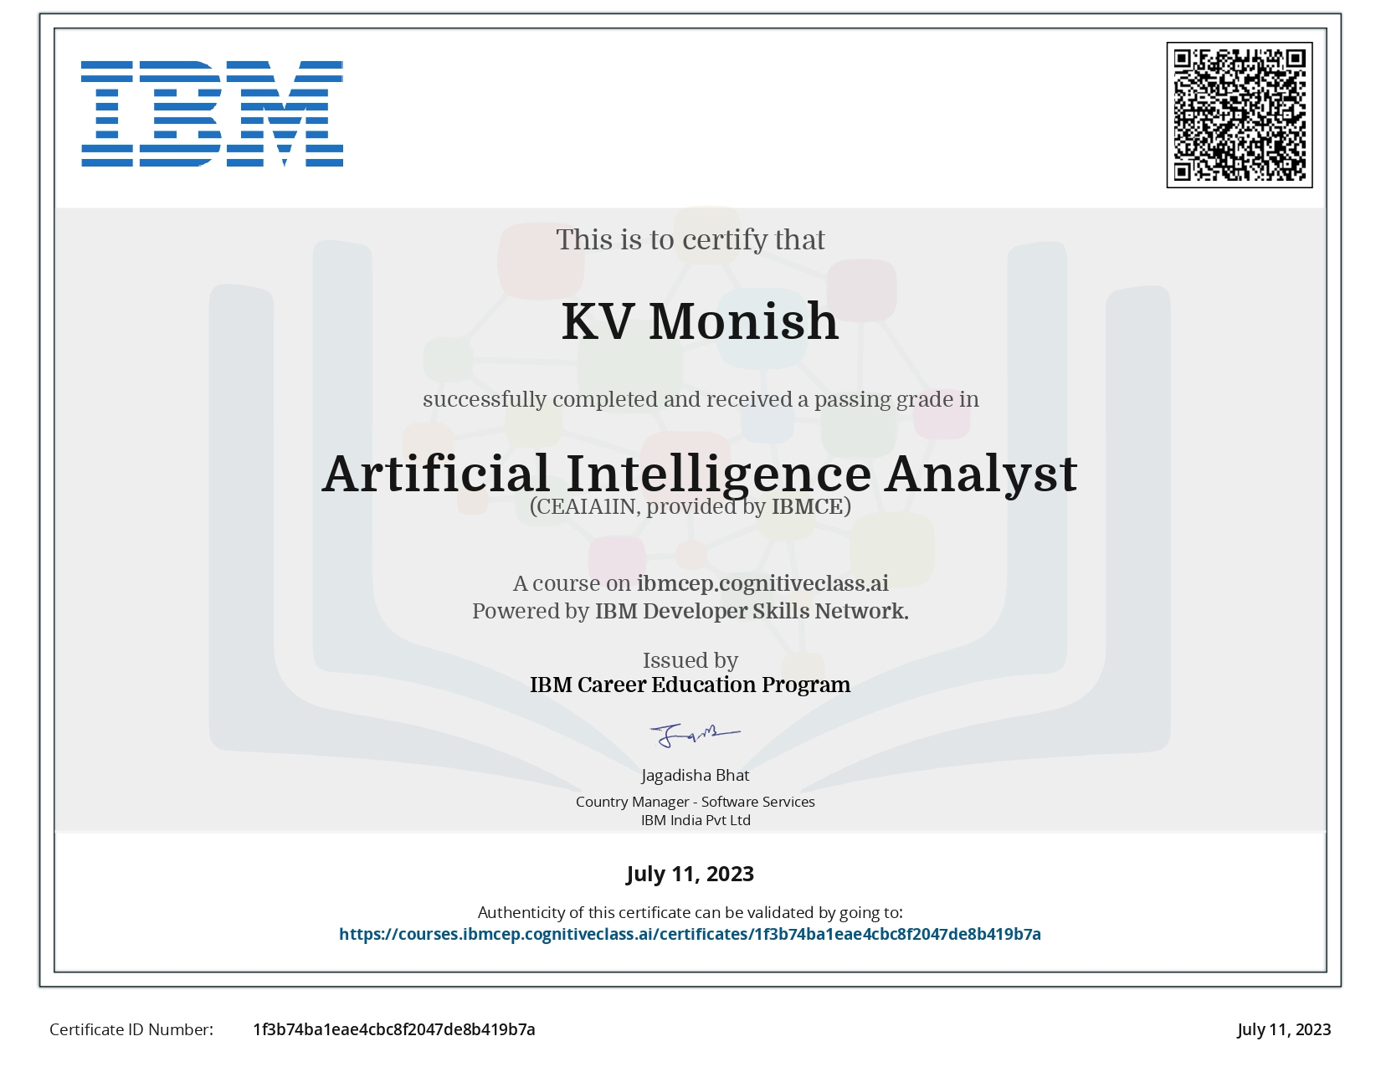
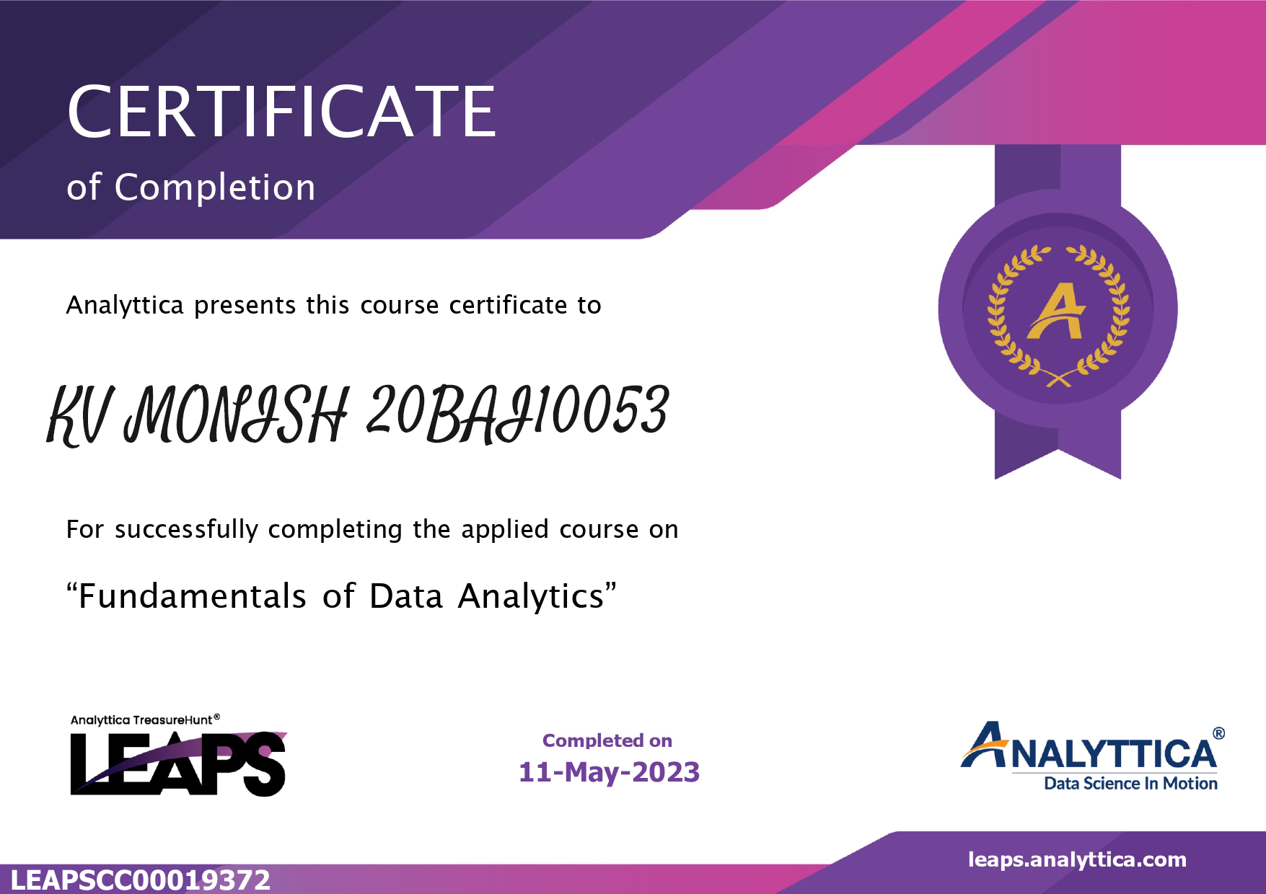
Certifications

Slide 12

Contact
Linkedin:
Kv-monish-35034a1b3
GitHub:
github.com/KvMonish

