Slide 1
DIGITAL PORTFOLIO
ARYAN SINGH RAJPUT
20BAI10177

Slide 2
SUBJECT KNOWLEDGE
• Introduction to Problem Solving and Programming (CSE1021)
• Fundamentals in AI & ML (CSA2001)
• Object Oriented Programming with C++ (CSE2001)
• Applied Machine Learning in Python (CSA4008)
• Computer Architecture & Organization (CSE2003)
• Computer Networks (CSE3006)
• Reinforcement Learning (CSA3003)
• Convex Optimization (CSA3002)
• Artificial Neural Network (CSA4002)
• Deep Learning (CSA4004)
• Natural Language Processing (CSA4006)
• Data Structures & Algorithms (CSE2002)
• Theory of Computation & Compiler Design (CSE2004)
• Database Management Systems (CSE3001)

Slide 3
• Operating System (CSE3003)
• Design & Analysis of Algorithms (CSE3004)
• Engineering Design (DSN2096)
• Electric Circuits And Systems (EEE1001)
• Digital Logic Design (ECE2002)
• Applied Linear Algebra (MAT3002)
• Discrete Mathematics And Graph Theory (MAT2002)
• Calculus And Laplace Transforms (MAT1001)
• Logic And Language Structure (HUM1012)
• Ethics And Values (HUM1001)
• Technical Writing And Composition (ENG2001)
• Communication for Technical Professionals (ENG1001)

Slide 4
• Introduction to Computation Chemistry (CHY1005)
• Environmental Science (CHY1002)
• Statistical Inference and Series of Functions (MAT3017)
• Stochastic Process (MAT3016)
• Engineering Physics (PHY1001)
• Programming For Computing Engineers (PLA1001)
• Programming For Engineers (PLA1002)
• Logic And Problem Solving For Engineers (PLA1003)
• Soft Skills for Engineers – I (SST1002)
• Soft Skills for Engineers – II (SST2002)

Slide 5
PROJECT KNOWLEDGE
NSL-KDD prediction CNN ( April 2023 )
The intrusion detection project centers around addressing the persistent issue of system intrusions, a challenge that has existed for quite some time.
Inspired by research such as the paper titled "Intrusion Detection System for NSL-KDD Dataset Using Convolutional Neural Networks" authored by Yalei Ding and Yuqing Zhai, I devised a CNN model tailored to the task.
GitHub - https://github.com/Aryan4261/NSL-KDD_prediction_CNN

Slide 6
RED LIGHT EYE ( MAY 2022 )
Developed an ML-based system for automatic detection of number plates on vehicles violating red lights, enabling efficient and reliable traffic management.
Technology: TensorFlow OCR, Keras and CV2.
GitHub - https://github.com/Aryan4261/Traffic_eye

Slide 7
PROGRAMMING LANGUAGE
Programming languages learnt in B.Tech :-
– Python
– C++
– SQL

Slide 8
CV
PORTFOLIO LINK : PORTFOLIO

Slide 9
ABOUT MYSELF
I am a final year Computer Science and Engineering student at VIT Bhopal who is passionate about learning new technology.
A wanderluster, footballer, fueled by a passion for cutting-edge technology and a deep appreciation for all things automotive.

Slide 10
EDUCATION
Gwalior Glory High School, Gwalior ( Class X, 2017-18)
Pragati Vidya Peeth, Gwalior ( Class XII, 2019-20)
Vellore Institute of Technology, Bhopal (2020-Ongoing) – B.Tech CSE with specialization in Artificial Intelligence and Machine Learning

Slide 11
TECHNICAL SKILLS
C++, Python, OpenCV, TensorFlow, Numpy, Pandas.
NodeJS, jQuery, ExpressJS, HTML, CSS.
Excel, SQL, Power BI, Tableau.
GitHub : https://github.com/Aryan4261

Slide 12
WORK EXPERIENCE
S.P. TOUR & TRAVELS AGENCY (Web Application Developer Intern Mar 2022 – July 2022)
The task was to produce a UI design for the company as well as a fully responsive Front-End component. After a month of working on it and gathering suggestions to make it more appealing, I have finally created a proper responsive website.
Highlights of my work on this project include:
• HTML/CSS and JavaScript were used to design and construct a completely working web app.
• Push notification feature was used to guarantee timely policy review.
• SQL and with use of MailChimp we collect the record of our users.

Slide 13
WORK EXPERIENCE
SMART-BRIDGE EDUCATION SERVICE PVT LTD (EXTERNSHIP)
Salesforce Developer May 2023 – July 2023
Built a customer relationship management application for colleges and universities that includes scheduling, reporting, grade management, attendance monitoring, and student information management.
This system can be used by schools to streamline their administrative processes, improve communication between staff and students, and enhance the overall learning experience for students.

Slide 14
SOFT SKILLS
Communication
Interpersonal Skills
Time and Project Management

Slide 15
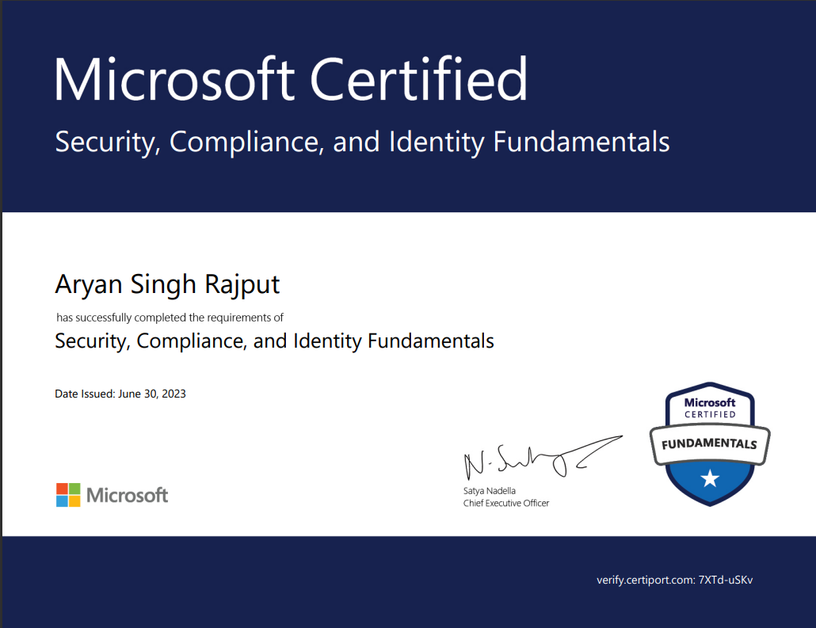
CERTIFICATIONS

Slide 16
PERSONAL INFORMATION
LinkedIn - https://www.linkedin.com/in/aryan-singh-rajput-a45539214/
Mail ID - aryan.singh2020@vitbhopal.ac.in

