Slide 1
DIGITAL PORTFOLIO
SHREY KHANDUJA
20BAI10194

Slide 2
SUBJECT KNOWLEDGE
Introduction to Problem Solving and Programming (CSE1021) [Python, Problem Solving, Fundamental Algorithms, Factoring Methods, Array Techniques]
Fundamentals in AI & ML (CSA2001) [Problem Solving Approach to Typical AI problems, Knowledge Representation, Software Agents and Prolog, Introduction to ML]
Object Oriented Programming with C++ (CSE2001) [Object Oriented Approach, Classes and Objects, Polymorphism and Inheritance, Exception handling]
Applied Machine Learning in Python (CSA4008) [Supervised/Unsupervised Learning, Ensemble Learning, Reinforcement Learning]
Computer Architecture & Organization (CSE2003) [Computer Architecture, Data Representation, Memory System, External Storage Systems]
Computer Networks (CSE3006) [Networking and its layers, Principles of Networking Applications, Network Security]
Reinforcement Learning (CSA3003) [Introduction to RL, Probability Primer, Prediction & Control by DP]
Convex Optimization (CSA3002) [Introduction to optimization, Convex Optimization: Algorithms and Applications]

Slide 3
Artificial Neural Network (CSA4002) [Introduction to Neural Networks, Learning Process, Single/Multi Layer Perceptron's]
Deep Learning (CSA4004) [Intro to DL, Machine Learning, Advanced Neural Networks, Optimization on Deep Models]
Natural Language Processing (CSA4006) [Knowledge in Speech and Language Processing, Morphology And Finite-State Transducers, Syntax Parsing]
Data Structures & Algorithms (CSE2002) [Introduction to Algorithm and Data Structures, Sorting and Searching, List, Stack and Queue, Trees and Hashing]
Theory of Computation & Compiler Design (CSE2004) [NFA, DFA, Context Free Grammar, Parsing, Turing Machines]
Database Management Systems (CSE3001) [Introduction to Database system, Relational Models, PL/SQL, Transaction Management]
Operating System (CSE3003) [Basic of Operating System and Its Structures, Process and Threads, Processor Scheduling and Deadlocks, Memory and Storage Management]
Design & Analysis of Algorithms (CSE3004) [Advanced algorithmic analysis, Problem solving strategies, Geometric algorithms]
Engineering Design (DSN2096) [Design Thinking for Innovation, Engineering Design Approaches, Prototyping and Visualization]

Slide 4
Electric Circuits And Systems (EEE1001) [Electric Circuits, AC Circuits Analysis & Magnetic Circuits. Digital and Logical Systems]
Digital Logic Design (ECE2002) [Digital Logic Design Fundamentals, Combinational Logic DesignRegisters, Counters & FSMs]
Applied Linear Algebra (MAT3002) [Linear Equations and Matrices, Vector Spaces and Subspaces, Linear Transformations]
Discrete Mathematics And Graph Theory (MAT2002) [Set Theory and Boolean Algebra, Predicate Calculus, Fundamentals of graphs, Matrix representation of graphs]
Calculus And Laplace Transforms (MAT1001) [Partial derivatives, Multiple Integrals, Vector Calculus, Differential equations]
Logic And Language Structure (HUM1012) [Introduction to Natural Language Processing, Syntax and Semantics Interface in Natural Language, Logic in Natural Language and understanding Natural Language semantics]
Ethics And Values (HUM1001) [Theories of Ethics, Role of employees and Ethics in work place, Corporate Governance and Ethics]
Technical Writing And Composition (ENG2001) [Fundamentals of Writing, Writing Practices, Professional & Business Correspondence]
Communication for Technical Professionals (ENG1001) [Dynamics of Communication, Rules and Usage of Language, Strategic Reading]

Slide 5
Introduction to Computation Chemistry (CHY1005) [Quantum Chemistry, Potential Energy Surfaces, Molecular Dynamics]
Environmental Science (CHY1002) [Ecosystem, Biodiversity, Environmental pollution and climate change, Natural Resources ]
Statistical Inference and Series of Functions (MAT3017) [Estimation, Methods of Estimation, Testing of Hypothesis, Sequences]
Stochastic Process (MAT3016) [Introduction to Stochastic Processes, Classification of States and Chains, Markov Processes with Discrete State Space]
Engineering Physics (PHY1001) [Quantum Physics, Nanophysics, Laser]
Programming For Computing Engineers (PLA1001) [Object and Class, Data types, Basic I / O, Decision Making, Loop Control, String, Date, Array, Inheritance]
Programming For Engineers (PLA1002) [Object and Class, Control statements, Association and Modifier]
Logic And Problem Solving For Engineers (PLA1003) [Logic Basics, Data interpretation, Verbal basics, Logic - Time]
Soft Skills for Engineers – I (SST1002) [Introspection / Self-Management, Resume Writing, Social Interaction, Building Verbal Ability]
Soft Skills for Engineers – II (SST2002) [Communication, Interview Skills, Art of Questioning, Team Dynamics]

Slide 6
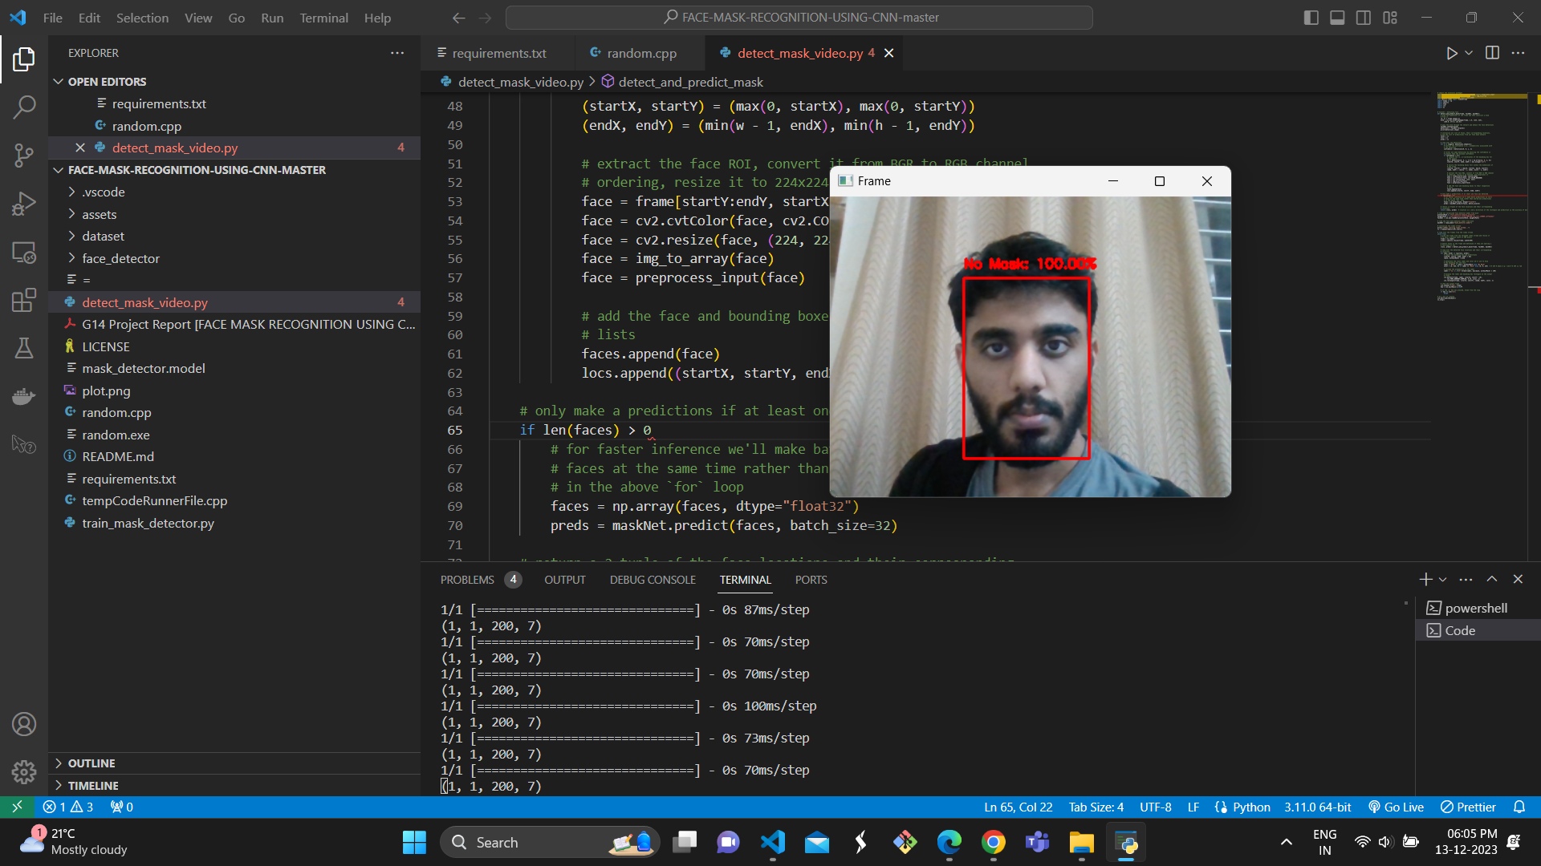
PROJECT KNOWLEDGE
Face Mask Recognition Using CNN
Face Mask Recognition Using CNN is a project that uses Convolutional Neural Networks to detect whether a person is wearing a mask or not. The model is trained on a dataset of 1500+ images of people wearing masks and 1500+ images of people not wearing masks. (Accuracy: 97%)
Technology Used: : Python, CNN (Convolution Neural Networks), OpenCV.
GitHub: GitHub - ShreyKhanduja/FACE-MASK-RECOGNITION-USING-CNN

Slide 7
Duplicate Semantic Questions Identifier
A project to find weather the given questions are same are not semantically speaking, using Natural Language Processing techniques.
Technology: NLP, Pickle, Scikit Learn, Natural Language Toolkit (NLTK)
Github: https://github.com/ShreyKhanduja/Duplicate-Semantic-Questions-Identifier
Dataset Link: https://www.kaggle.com/c/quora-question-pairs

Slide 8
PROGRAMMING KNOWLEDGE
These are the programming languages learnt in B.Tech :-
Python
Java
C++
SQL

Slide 9
CV

Slide 10
ABOUT MYSELF
I am a final year Computer Science and Engineering student at VIT Bhopal who Likes to describe himself as a Passionate, Driven and Collaborative tech enthusiast.
I have made projects in various domains like, Computer Vision, Neural Networks, Geographic Information System, Recommender Systems, etc. I’m certified by Microsoft in security compliance and identity fundamentals (sc-900).
Also I have volunteered as the Lead Machine Learning Engineer at Omdena where i have worked with 50 collaborators from around the world to build CanopyWatch – Enhancing Deforestation Monitoring and Conservation in the Congo Basin

Slide 11
EDUCATION
Gwalior Glory High School, Class X, Grade: 8.4/10, (2016-2017)
Silver Bells School, Class XII, Grade: 84.2%, (2018-2019)
Vellore Institute of Technology - Bhopal, B.Tech CSE with specialization in Artificial Intelligence and Machine Learning, Grade: 8.61/10 (2020-Ongoing)

Slide 12
TECHNICAL SKILLS
Artificial Intelligence
Machine Learning
Coding (C++ & Python)
DBMS, OS, OPPs
Python, C, C++, SQL (MySQL), MongoDB, JavaScript, HTML/CSS, Flask, Node.js, jQuery, WordPress, Git
GitHub: https://github.com/ShreyKhanduja

Slide 13
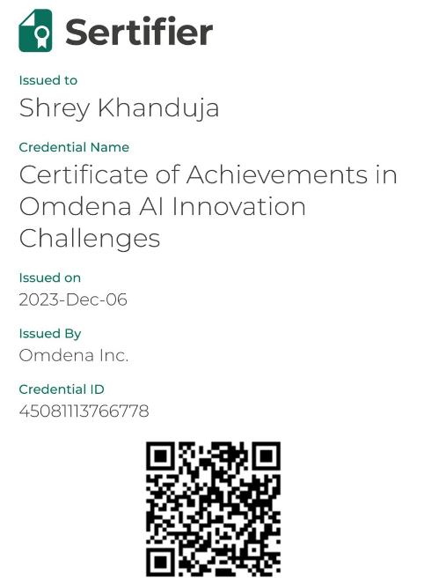
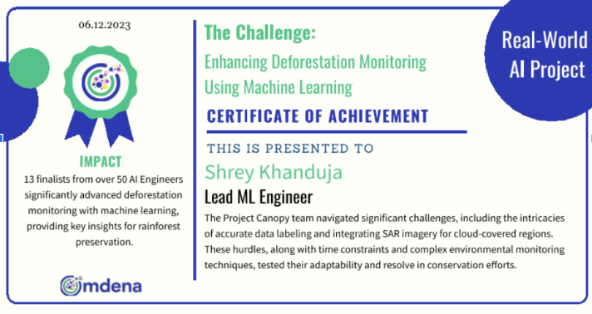
WORK EXPERIENCE
Omdena (Lead ML Engineer, September 23 – November 23)
Volunteered in the development of the next iteration of “www.projectcanopy.org”, an application that combines satellite imagery and CNN to detect deforestation in the Congo Basin rainforest.
Co-lead Data Preprocessing task, our team rasterized labels into masks, and tiled the masks with their corresponding satellite images into small patches to be fed into the machine learning pipeline.

Slide 14
SOFT SKILLS
Communication
Interpersonal Skills
Time and Project Management

Slide 15
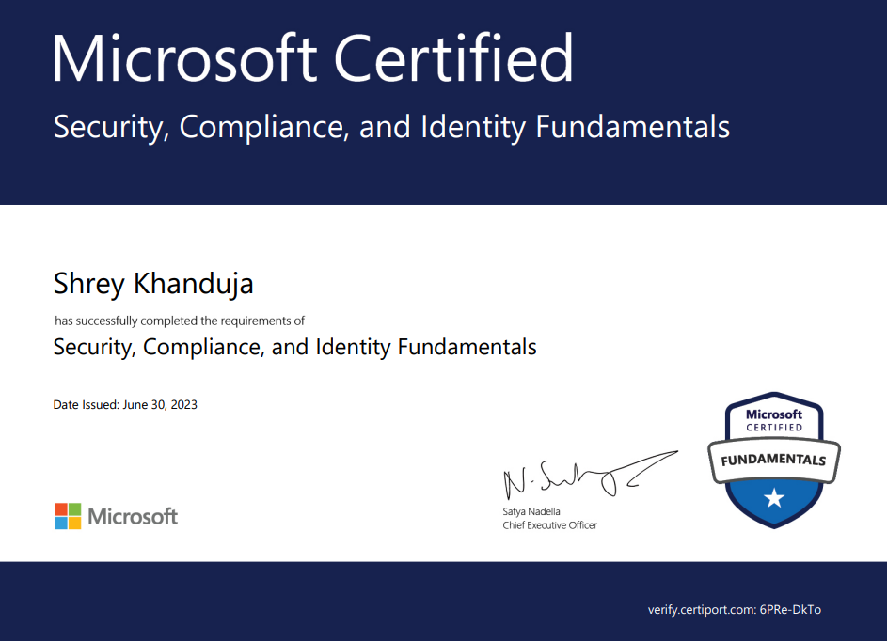
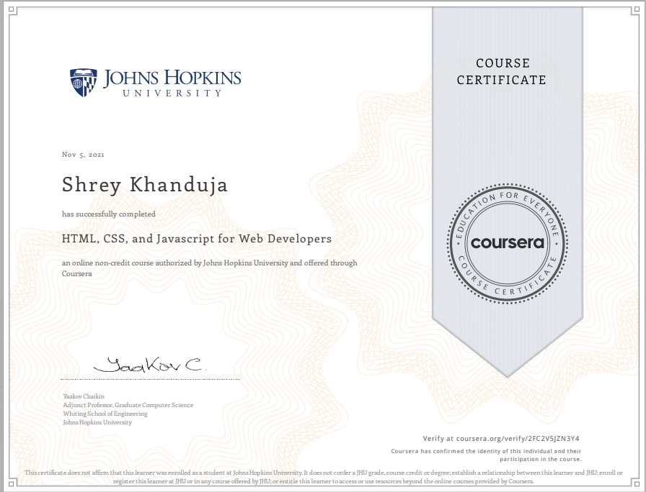
CERTIFICATIONS
Security Compliance and Identity Fundamentals (sc-900)
HTML, CSS, and Javascript for Web Developers

Slide 16
PERSONAL INFORMATION
LinkedIn Profile
https://www.linkedin.com/in/shrey-khanduja/
Mail ID
shrey.khanduja2020@vitbhopal.ac.in
Personal Website
https://shreykhanduja.wordpress.com

