Slide 1


Python Utility Application using Tkinter
G-33
MINI-PROJECT PRESENTATION
on
by
Sagar Makol– 1900300130087
Vansh Mudgal– 1900300130118
Himank Sharma– 1900300130043
UNDER THE SUPERVISION OF
Mr. Binu Kuriakose Vargis
INDERPRASTHA ENGINEERING COLLEGE , GHAZIABAD, UTTAR PRADESH
AFFILIATED TO DR. A.P.J. ABDUL KALAM TECHNICAL UNIVERSITY .LUCKNOW, UTTAR PRADESH
(SESSION: 2020 - 2021)

Slide 2
INTRODUCTION
Whenever you need to convert a value from one unit to another, you have to either look up on the Internet or have to remember the conversion values of each unit by heart. This is also not viable in case of currency since the prices changes every second.
This project serves as a decent solution to the problem and offers a large variety of day-to-day conversions.

Slide 3
OBJECTIVES
Provide facility of Currency Conversion
Provide facility of Temperature Conversion
Provide facility of Length Conversion
Provide facility of Area Conversion
Provide facility of Weight Conversion

Slide 4
WHY PYTHON ?
Versatile, easy to read and fast to develop
Has all the libraries one can imagine
You Can Do More with Less Code

Slide 5
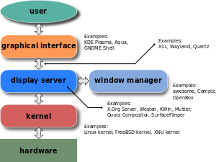
INTRODUCTION TO GUI
The graphical user interface(GUI) is a form of user interface that allows users to interact with electronic devices through graphical icons and audio indicator such as primary notation, instead of text-based user interfaces, typed command labels or text navigation.
The advantage of a GUI is a stark improvement in useability for the average person. The features of a graphical user interface leverage familiar metaphors, such as drag-and-drop for transferring files, and use familiar icons, such as a trash bin for deleted files, creating an environment in which computer operations are intuitive and easily mastered without any prior practice or knowledge of computing machinery or languages.

Slide 6
INTRODUCTION TO TKINTER LIBRARY
Tkinter is the standard GUI library for Python. Python when combined with Tkinter provides a fast and easy way to create GUI applications. Tkinter provides a powerful object-oriented interface to the Tk GUI toolkit.
Creating a GUI application using Tkinter is an easy task. All you need to do is perform the following steps :
Import the Tkinter module.
Create the GUI application main window.
Add one or more of the above-mentioned widgets to the GUI application.
Enter the main event loop to take action against each event triggered by the user.

Slide 7
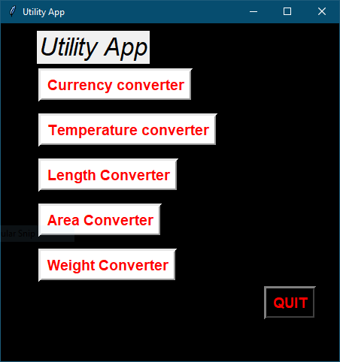
MODULES OF THE PROJECT
The project consists of the following modules :
Currency Convertor
Temperature Convertor
Length Convertor
Area Convertor
Weight Convertor

Slide 8
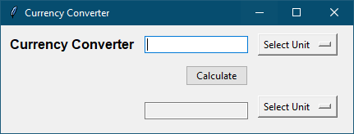
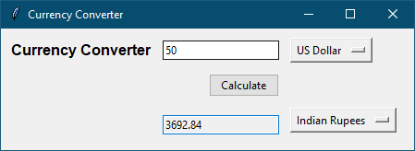
Currency Convertor
Asks the user for 3 inputs
Input unit
Input amount
Output unit
Displays the result in desired unit

Slide 9
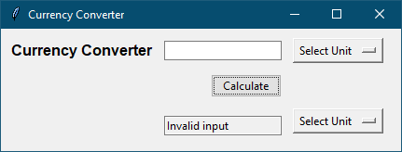
Currency Convertor
In case of no input, error is displayed

Slide 10
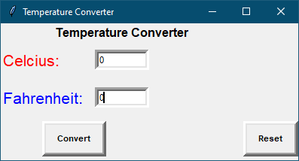
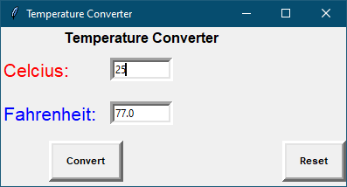
Temperature Convertor
Asks for either input in Celsius or Fahrenheit
Displays the result in desired unit

Slide 11
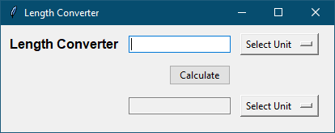
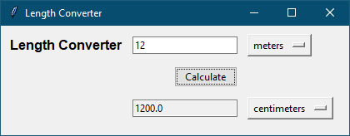
Length Convertor
Asks the user for 3 inputs
Input unit
Input amount
Output unit
Displays the result in desired unit

Slide 12
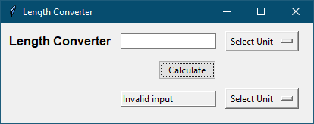
Length Convertor
In case of no input, error is displayed

Slide 13
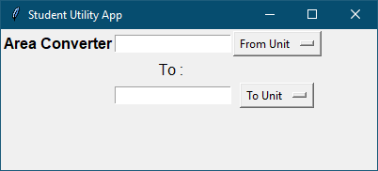
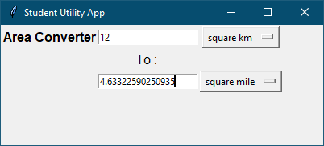
Area Convertor
Asks the user for 3 inputs
Input unit
Input amount
Output unit
Displays the result in desired unit

Slide 14

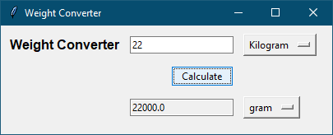
Weight Convertor
Asks the user for 3 inputs
Input unit
Input amount
Output unit
Displays the result in desired unit

Slide 15

Weight Convertor
In case of no input, error is displayed

Slide 16

Quit Button
Pressing the “QUIT” button exits the application

Slide 17
CHALLANGES
It was tedious to gather all the required information about the Python and Tkinter library functions.
We got stuck at some situations where the inputs needed to be converted from strings to numeric expressions.
Since it was the first time for us working with Python, we faced some issues handling values.

Slide 18
ACCOMPLISHMENTS
Our project holds good in its current state and we will try to increase its functionality.
It works efficiently and brings a solution for our problem statement.

Slide 19
SCOPE
Our work can be extended by inculcating more conversion scales.
We can also extend the accuracy of the conversions.
Another extension of an in-built calculator with basic arithmetic and scientific functions can also be introduced.

Slide 20
SYSTEM REQUIREMENTS
Hardware Requirements
x86 64-bit CPU (Intel / AMD architecture)
4 GB RAM
5 GB free disk space
Software Requirements
Modern Operating System:
Microsoft Windows 8 or later
Python versions: 3.7.X or above
PyCharm: Python IDE
Browser Compatibility
Any modern web browser like Google Chrome, Mozilla Firefox etc

Slide 21
REFERENCES
Official Python documentation
https://docs.python.org/3.9/
Official Tkinter library documentation
https://docs.python.org/3/library/tkinter.html#module-tkinter
Python - GUI programming using Tkinter by TutorialsPoint
https://www.tutorialspoint.com/python/python_gui_programming.htm

Slide 22
THANK YOU !

