Slide 1


Ticket Booking System Using PHP
MINI-PROJECT PRESENTATION
on
by
Gaurav Lohani- 1900300130035
Himank Sharma– 1900300130043
Sagar Makol– 1900300130087
Vansh Mudgal– 1900300130118
INDERPRASTHA ENGINEERING COLLEGE , GHAZIABAD, UTTAR PRADESH
AFFILIATED TO DR. A.P.J. ABDUL KALAM TECHNICAL UNIVERSITY .LUCKNOW, UTTAR PRADESH
(SESSION: 2021 - 2022)

Slide 2
INTRODUCTION
The Ticket Booking In PHP is a simple reservation system for buses and trains. The project contains the admin side and the user side. The admin can view and manage the bus and train schedule, view the booked tickets.
The users are the clients who want to search and reserve the bus or train ticket suitable for them. A user has to log in first to make the reservation. If he/she has not registered, they can register first and then log in. A user can search for available tickets for a particular city pair and book tickets in the class of their choice. This project is a very simple project that saves time and money for the customer as well as the travel company thereby making bus and train travel more customer-centric.

Slide 3
OBJECTIVES
The project is aimed to make a Online Ticket Booking Portal that can any Citizen use to book tickets [Both Train and Bus] online and their data can be maintain computerized on a Server.
Provide facility of reservation system for buses and trains.
Provide facility of managing the bus and train schedule, view the booked tickets.

Slide 4
SYSTEM DESIGN
BUS TICKET
TRAIN TICKET
TICKET BOOKING SYSTEM
REGISTER
ADMIN SIGN IN
USER SIGN IN

Slide 5
SYSTEM REQUIREMENTS
Hardware Requirements
x86 64-bit CPU (Intel / AMD architecture)
4 GB RAM
5 GB free disk space
Software Requirements
Xampp Server / Control Panel
Browser Compatibility
Any modern web browser like Google Chrome, Mozilla Firefox etc

Slide 6
TECHNOLOGIES USED
HTML
CSS
JavaScript
PHP
Xampp Server
MySQL

Slide 7
IMPLEMENTATION

Slide 8
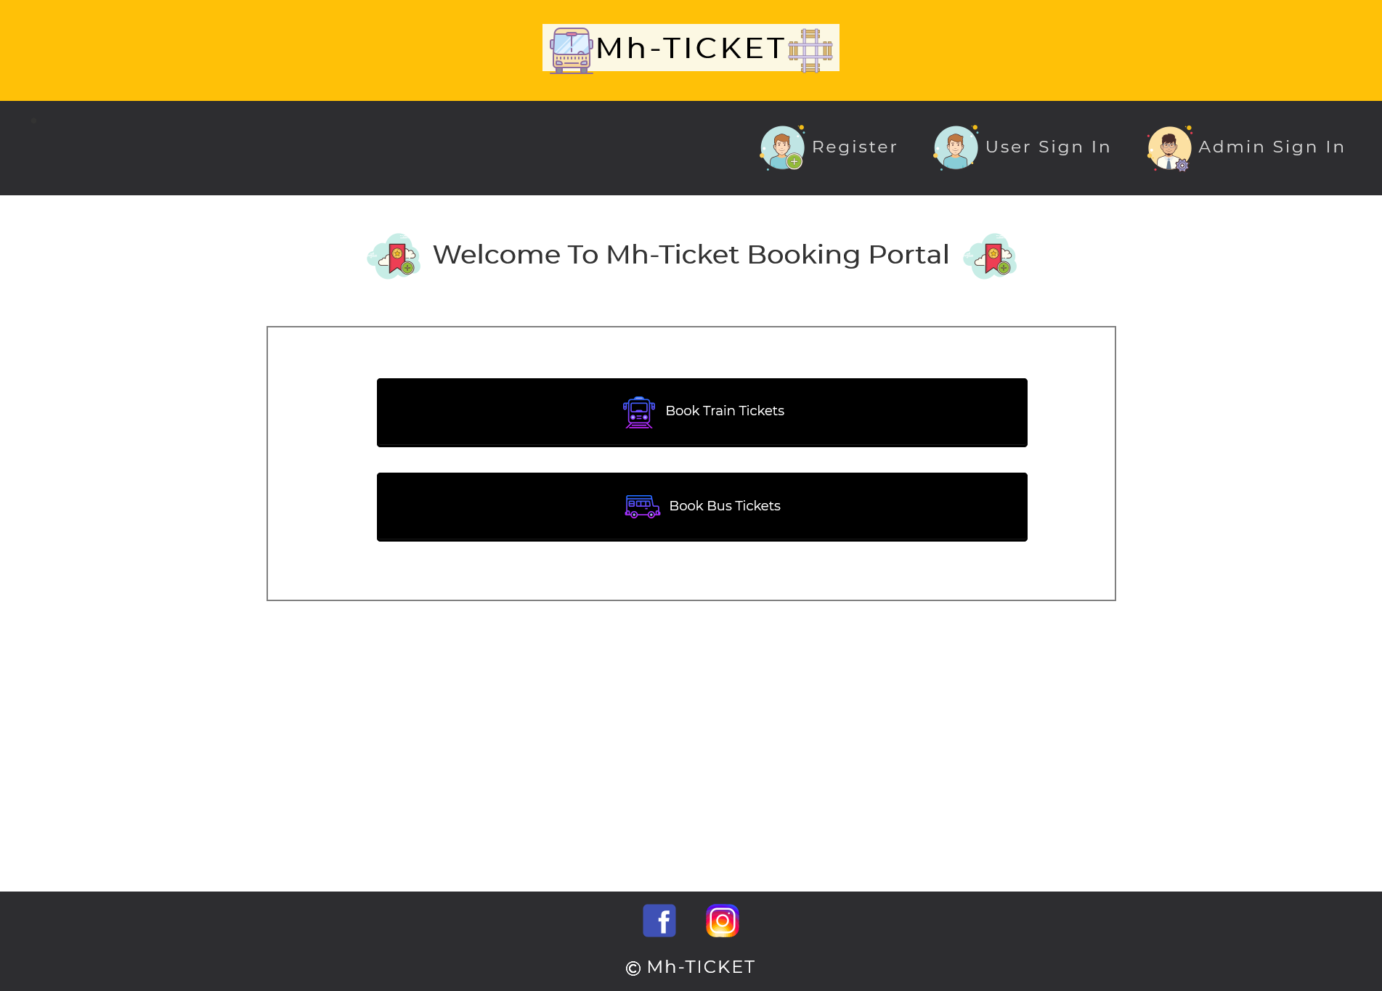
HOME PAGE

Slide 9
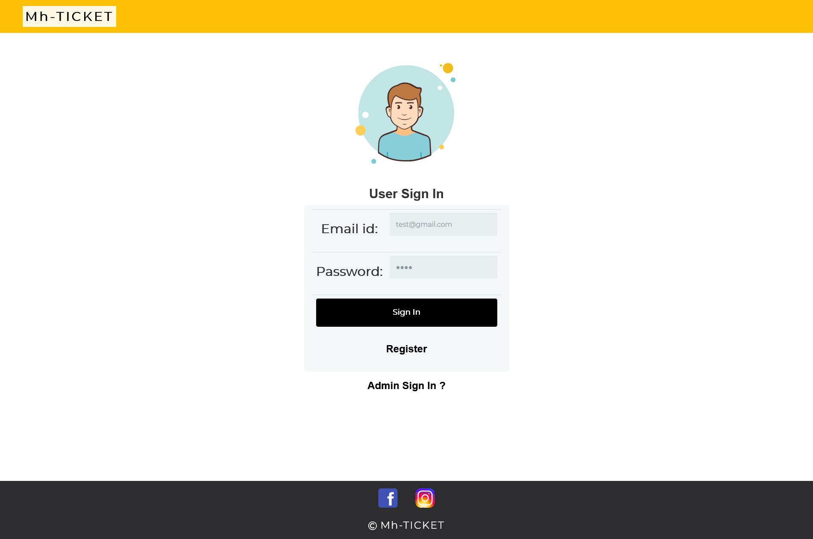
USER SIGN IN

Slide 10
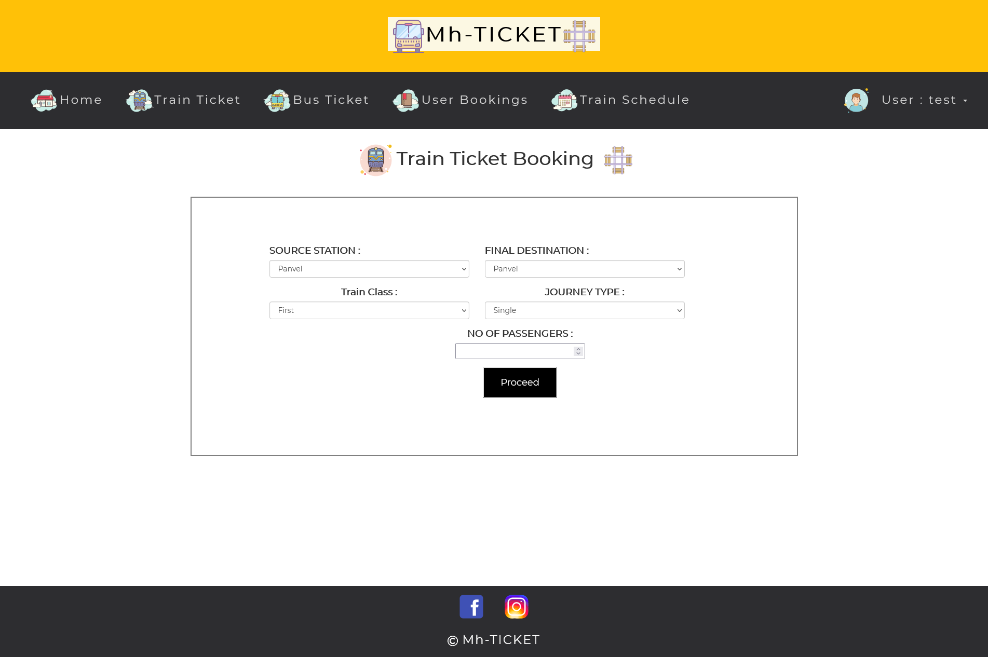
USER – TRAIN BOOKING

Slide 11
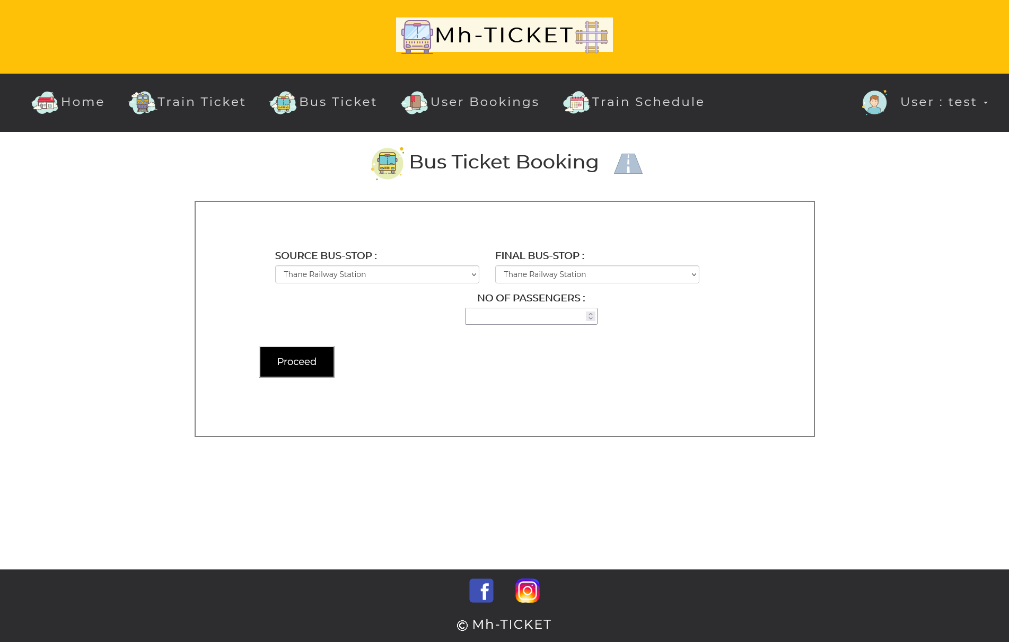
USER – BUS BOOKING

Slide 12
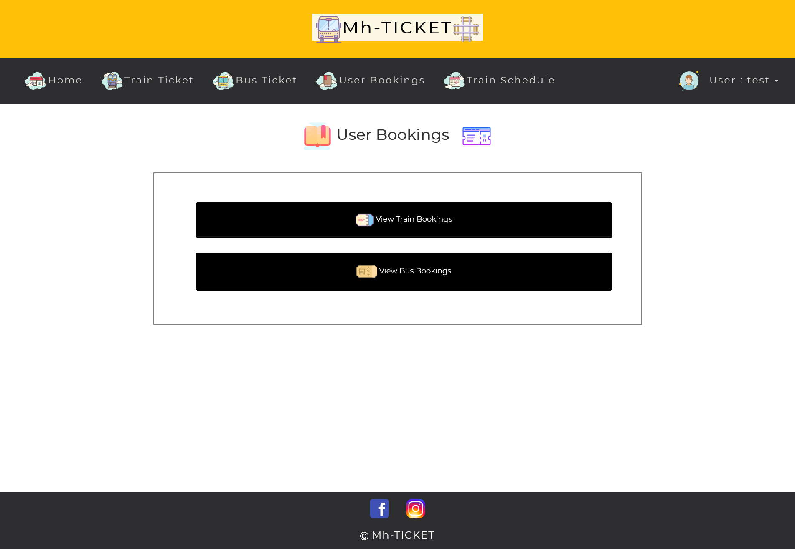
USER – SEE BOOKINGS MADE BY USER

Slide 13
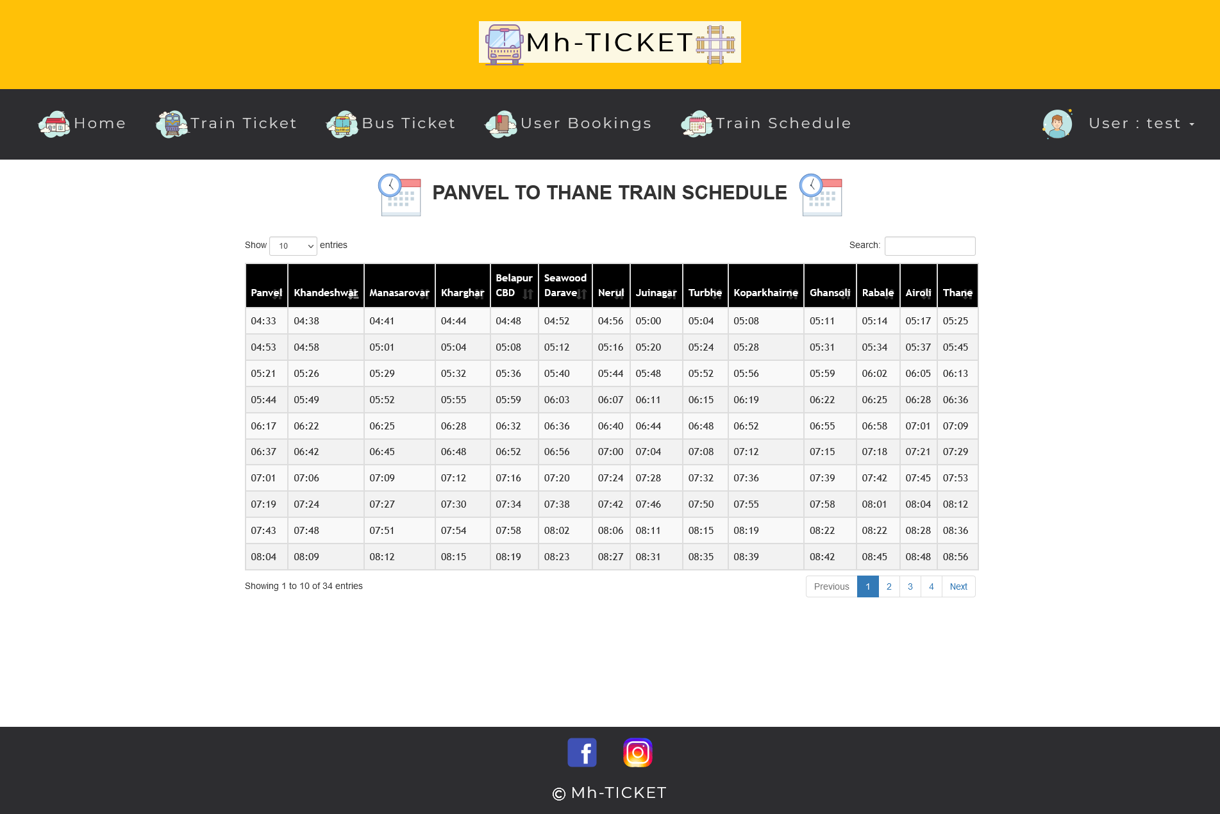
USER – TRAIN SCHEDULE

Slide 14
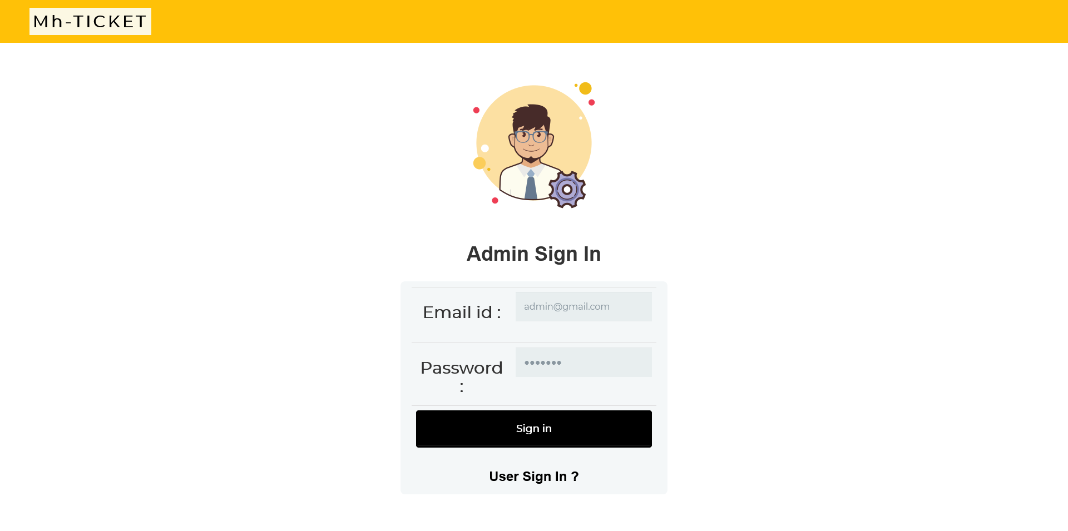
ADMIN SIGN IN

Slide 15
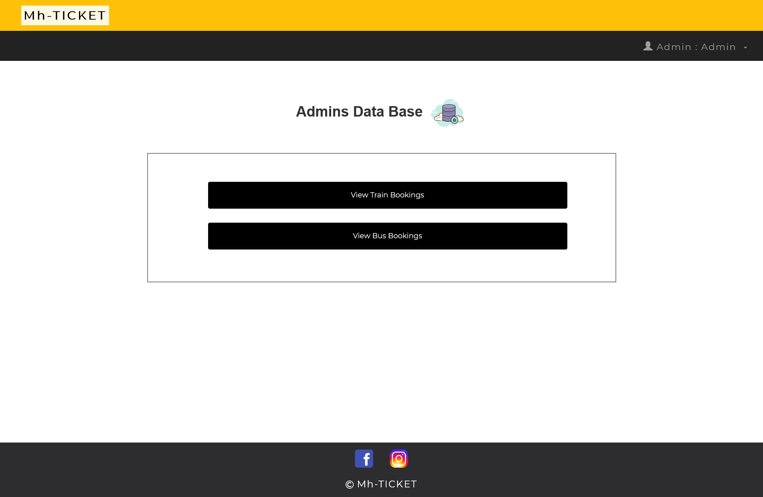
ADMIN – HOME PAGE

Slide 16
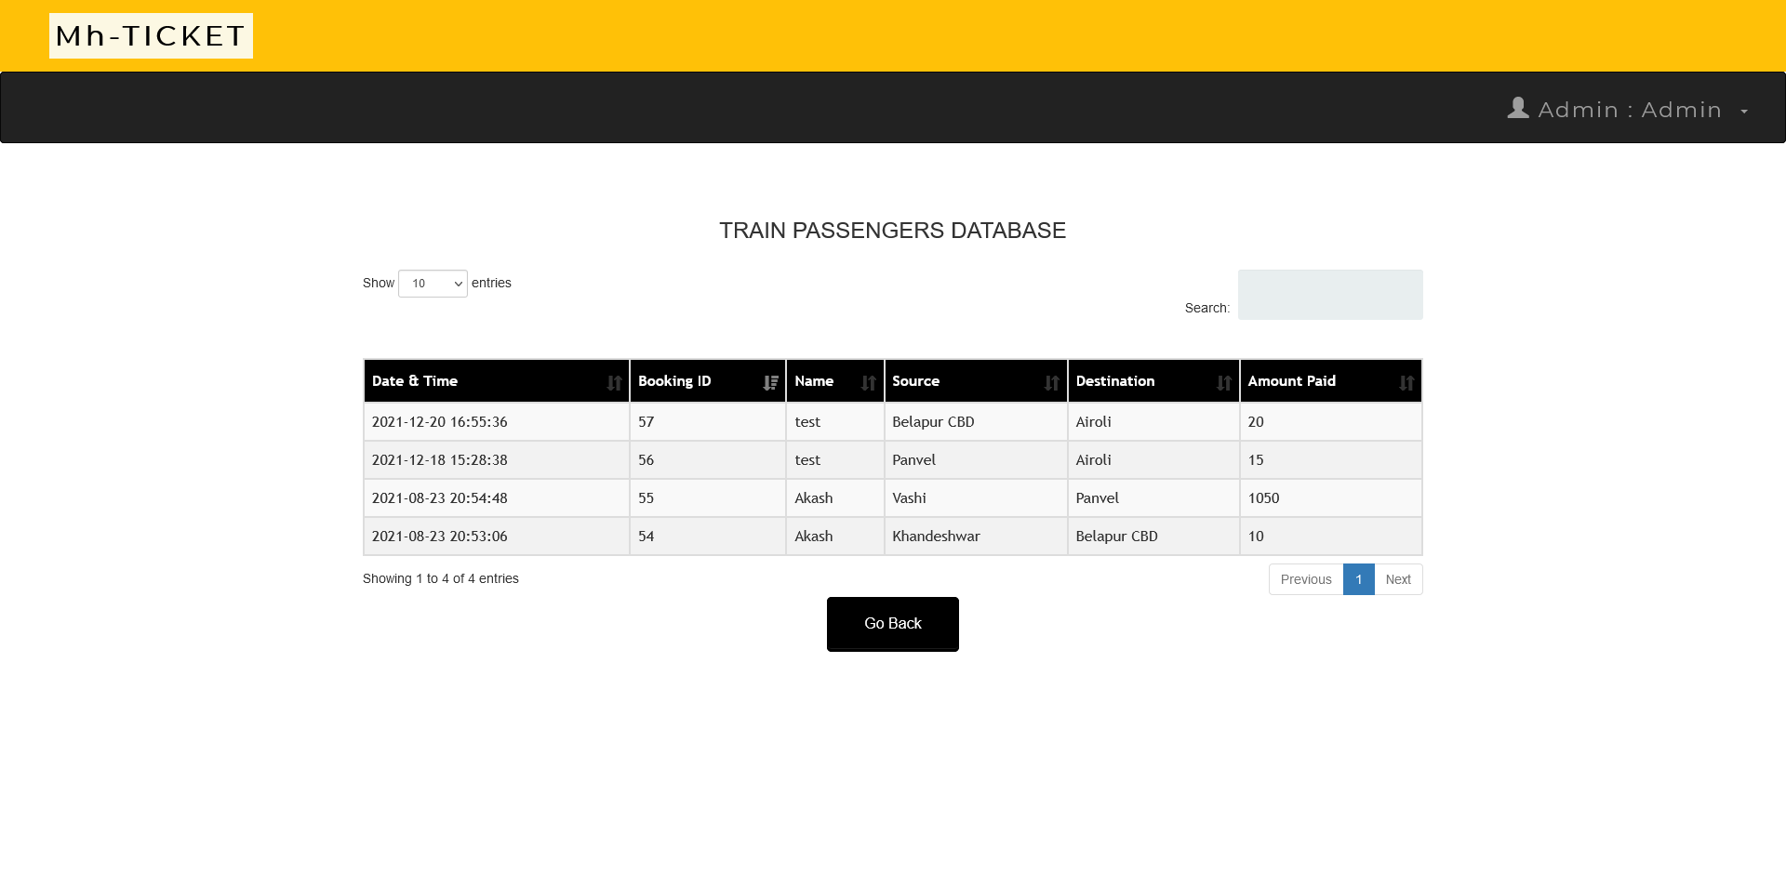
ADMIN – TRAIN BOOKING DB

Slide 17
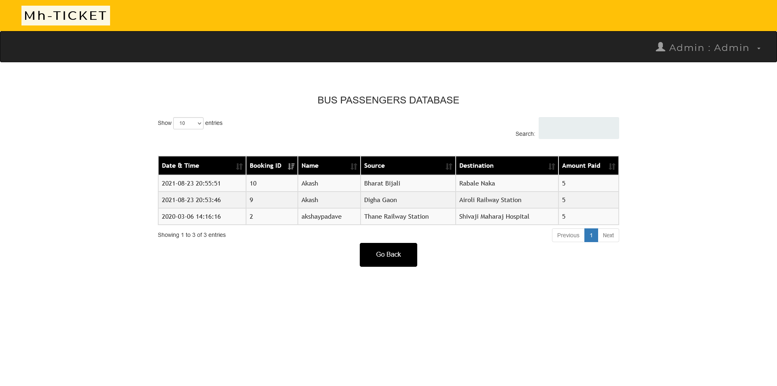
ADMIN – BUS BOOKING DB

Slide 18
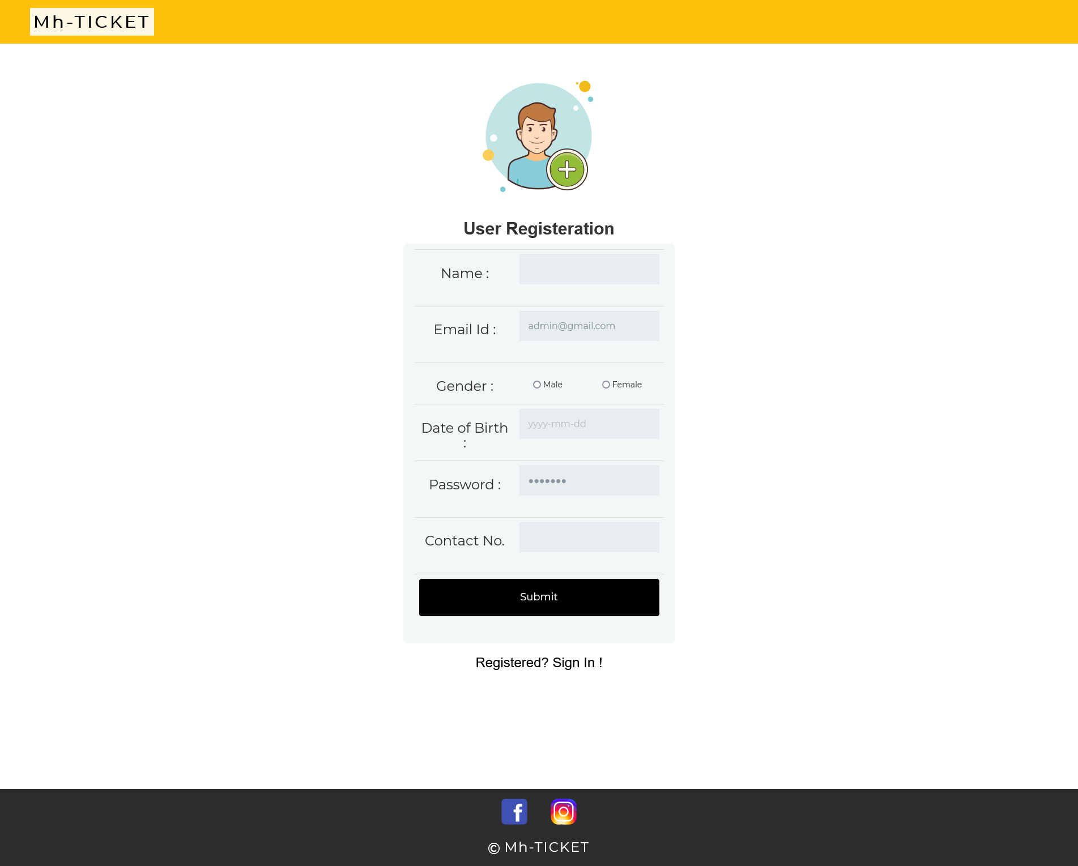
REGISTER

Slide 19
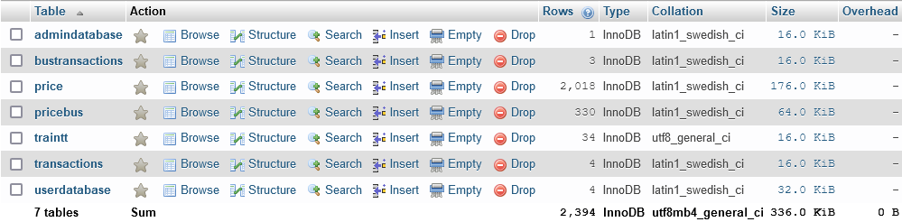
DATABASE STRUCTURE

Slide 20
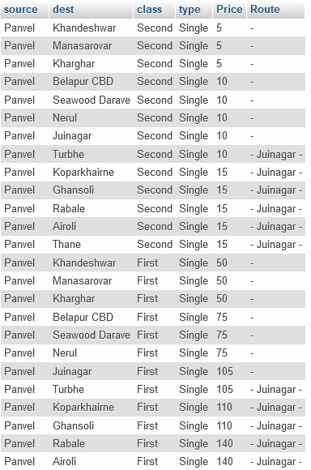
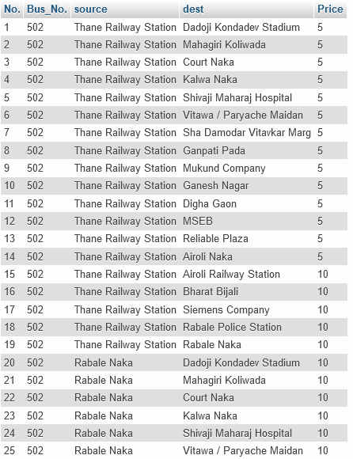
DATABASE STRUCTURE

Slide 21
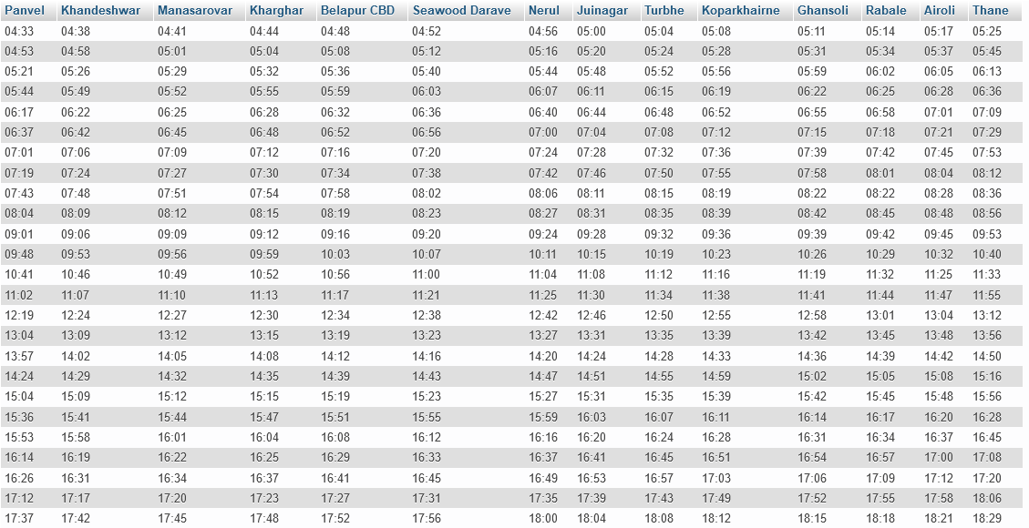
DATABASE STRUCTURE

Slide 22
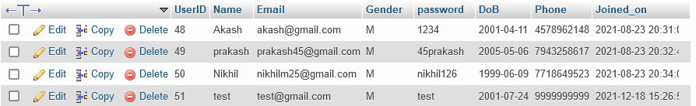
DATABASE STRUCTURE

Slide 23
CHALLENGES
One needs to know about the PHP framework to use the built-in PHP functionalities. If one does not know about it, they will be forced to write additional codes.
Scalability issues were encountered. The challenge of scalability relates to how you want your application to develop over time. If you want your application built right today, you’ll need to know as much as possible about what you need it to do in the future.
Performance was also one of the issues. No user likes slow load times. And this can have real consequences for your business. If your application is slow, users won’t wait. They’ll leave.

Slide 24
ACCOMPLISHMENTS
The project is aimed to make a Online Ticket Booking Portal that any Citizen can use to book tickets [Both Train and Bus] online and their data can be maintain computerized on a Server.
This system can be used for Ticket Booking in Maharashtra.

Slide 25
SCOPE
Another module for calculating profitability can be introduced in the admin side.
More locations can be added.
Better UI can be constructed to provide seamless experience to smartphone users.

Slide 26
REFERENCES
Official PHP documentation
https://www.php.net/manual/en/tutorial.php
W3schools Tutorial
https://www.w3schools.com/php/

Slide 27
THANK YOU !

