Slide 1

SAMSUNG PRISM · GEN AI HACKATHON 2026
LOCUS
Citation-First Clinical Intelligence Platform
Theme ID — 04: Streaming Live RAG
Team Name — Team Kraken
College Name — VITV / VIT Vellore
REGISTERED MEMBERS
Sagar Negi - 25BIT0090
Kartik Yadav - 25BEC0087
Anuj Bohra - 25BDS0090
Kavish Malhotra - 25BDS0065
Submission GitHub link
https://github.com/SagarNegi1/Locus
Medical document intake · source-backed facts · human verification

Slide 2
Theme
04 — Streaming Live RAG
What the theme asks for
How LOCUS maps the idea
Understand whether an evolving utterance needs retrieval.
Split one natural request into multiple implied queries.
Fuse and rerank retrieved evidence into one grounded answer.
Use new details to refine the previous answer instead of restarting.
Keep memory session-scoped and retrieval inspectable.
Evidence corpus
Uploaded medical PDFs become the active evidence source.
Multi-intent structure
Facts are grouped by diagnoses, medications, labs, allergies, procedures and timeline items.
Grounding
Every important fact carries confidence + source page + normalized bounding box.
Refinement
A later detail should filter or update only affected facts while preserving valid evidence.

Slide 3
Existing Solutions & Gaps
Why ordinary document AI is not enough for a clinical workflow.
Typical AI summary
Current LOCUS foundation
Current scope and next steps
• One opaque answer
• Weak or missing source traceability
• User must manually hunt through the PDF
• New details often trigger a full rerun
• Difficult to review safely in clinical contexts
• Structured extraction instead of free-form summary
• Confidence labels on extracted facts
• Page-aware / box-aware source metadata
• Overview, Records, Timeline, Insights and Review surfaces
• Duplicate detection and validation checks
• Current document intake uses uploaded medical PDFs.
• Live transcript retrieval and incremental refinement are planned extensions.
• Full-duplex retrieval performance has not been demonstrated in this presentation.
• Accuracy and latency benchmarks are not reported here.

Slide 4
Our Solutions & Architecture Diagram
Simple, inspectable pipeline from document intake to source verification.
Upload
Screen
Extract
Store
Review
Verify
PDF + SHA-256
duplicate check
medical / patient /
legibility checks
Gemini structured
facts + confidence
Supabase records +
source metadata
timeline + insights +
verification queue
PDF page +
bounding box
Evidence contract
document_id · source page · normalized bounding box · confidence · structured category · reviewer state
Design choice
Keep the pipeline measurable and human-verifiable instead of hiding retrieval and evidence behind a heavy autonomous-agent loop.

Slide 5
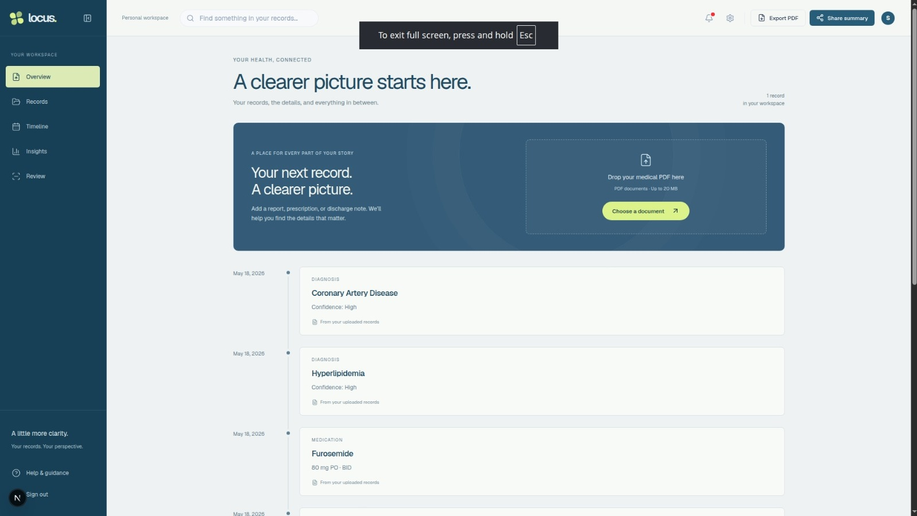
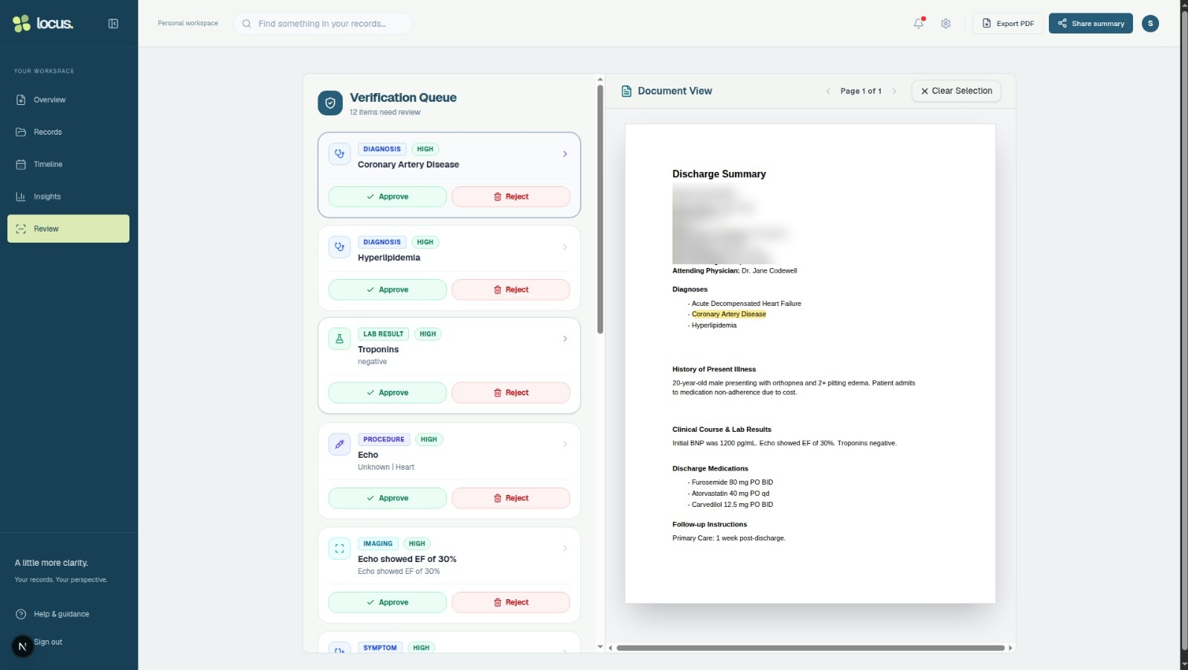
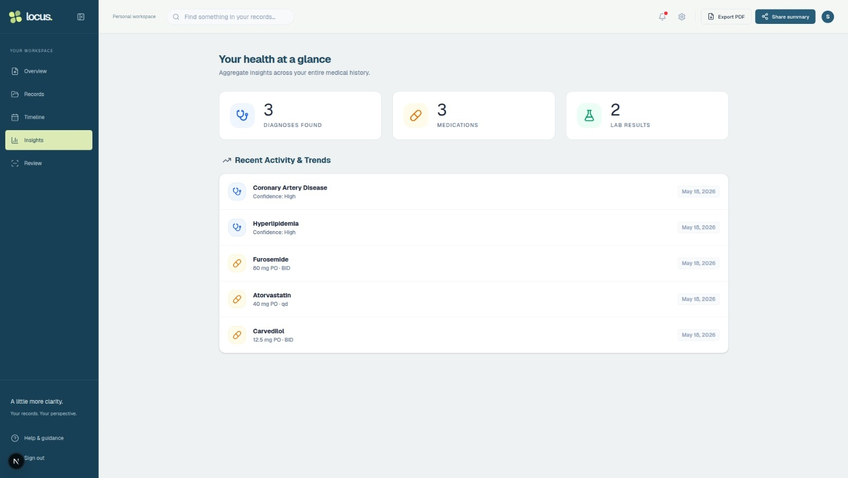
Demo & Product Walkthrough
1 Overview / Upload
Upload a synthetic PDF and inspect extracted records.
2 Review / Verify
Open a fact and verify it against the source PDF.
3 Insights / Trends
Show aggregated diagnoses, medications and lab results.

Slide 6
Tools and tech stack used
Current repository: SagarNegi1/Locus
Frontend
UI
AI
Data
Documents
Next.js App Router
React · TypeScript
Tailwind CSS
Radix / shadcn-style
Motion · Lucide
responsive dashboard
Google Gemini
@google/genai
structured JSON extraction
Supabase Auth
PostgreSQL
Storage
react-pdf / PDF.js
Google Document AI
jsPDF / AutoTable
AI-assisted development disclosure
The team used Gemini, Antigravity and ChatGPT/Codex for planning, coding assistance, repository review and documentation. Team members are responsible for validating the final submission.

Slide 7
Impact & Use case
A citation-first workflow for scattered medical records.
User problem
LOCUS workflow
Intended impact
Medical history is scattered across lab reports, prescriptions, discharge summaries, imaging PDFs and notes. Manually reconstructing a reliable timeline is slow, and opaque AI summaries are difficult to trust.
Upload → validate → extract structured facts → organize into Timeline → summarize in Insights → Review confidence + source evidence → manage Records → export/share only after human verification.
LOCUS aims to reduce repeated document reading by organizing medical records and connecting extracted facts to their source evidence. Clinical accuracy and user benefits require further evaluation.

Slide 8
Innovation highlights, results and limitations
What is distinctive today — and what we do not overclaim.
Innovation highlights
Evidence shown in final demo
• Citation-first fact cards
• Confidence labels + page / bounding-box metadata
• SHA-256 duplicate PDF detection
• Wrong-patient / non-medical / legibility checks
• Overview, Records, Timeline and Insights workspace
• Verification Queue with approve/reject + source PDF
• Time-bound sharing, export and deletion flows
• Valid PDF upload and structured processing
• Timeline / Insights extracted facts
• Verification Queue + source-document click-through
• Duplicate / invalid-upload handling
• Records + share/export flows where verified
• Final README / AI disclosure / release tag
Limitations
• Hackathon prototype — not a medical device
• AI output can be incomplete or incorrectly cited
• No real patient data in the public demo
• Accuracy and latency benchmarks are not reported in this presentation.
• Full-duplex streaming RAG remains a planned extension.

Slide 9
What’s next
Turn the citation-first foundation into a fully measured Streaming Live RAG workflow.
Finalize evidence navigation
Verify source-page navigation and citation behavior across multi-page PDFs.
1
Add live transcript / replay path
Start retrieval as soon as enough context is available; preserve session-only state.
2
Add multi-query retrieval +
fusion
Split compound requests, retrieve in parallel, deduplicate and rerank evidence.
3
Implement delta refinement
When a new constraint arrives, update only affected claims and keep valid evidence.
4
Measure + package
Evaluate groundedness, retrieval recall, latency and cost using recorded test runs.
5

Slide 10
Brownie points slide( differentiation)
Why LOCUS is more than another document-summary UI.
Click-to-verify evidence
Deterministic duplicate control
🔎
A reviewer can move from a fact directly back to its source page / region.
♻
SHA-256 duplicate detection blocks repeated uploads before expensive processing.
Structured clinical schema
Human-in-the-loop review
▦
Facts are typed into diagnoses, medications, labs, allergies, procedures, vitals, codes and more.
✓
Confidence, source metadata and review workflows keep clinicians/users in control.
Safety-oriented input screening
Time-bound sharing
⚑
↗
Non-medical, wrong-patient, poor-legibility and unsupported-language inputs can be rejected or flagged.
Read-only share links can expire after 24 hours, 3 days or 7 days in the current UI.

Slide 11
Checklist- Updated on Public GitHub
Source code
YES
https://github.com/SagarNegi1/Locus
README + reproducible setup
YES
README.md + requirement.txt
Presentation
YES
VITV_TeamKraken_Submission_FINAL.pptx
AI disclosure
YES
AI_DISCLOSURE.md
Demo video (≤ 5 min)
YES
GOOGLE DRIVE LINK
Release tag
AFTER FINAL COMMIT
PRISM_GENAI_HACKATHON_Y2026

Slide 12
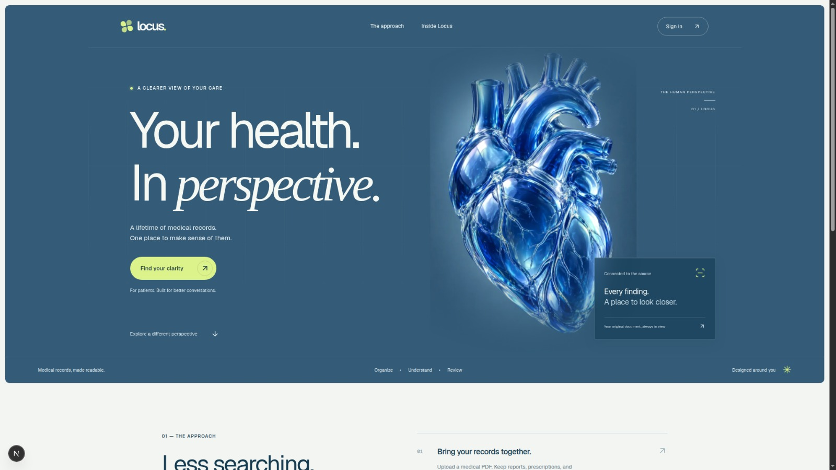
Thank you
LOCUS
Theme 04 — Streaming Live RAG
Team Kraken · VITV / VIT Vellore
https://github.com/SagarNegi1/Locus
Citation-first medical intelligence
Source-backed facts · Human verification · Latest LOCUS UI

