Slide 1
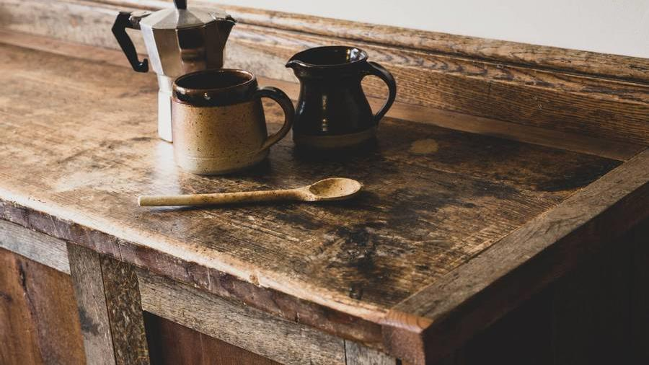
Analysis of Starbucks Drink Prices, Profits, and Stocks
Alexander Nguyen
CSC 4780
Sagar Patel
CSC 4780

Slide 2

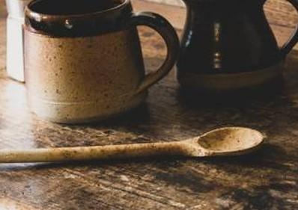
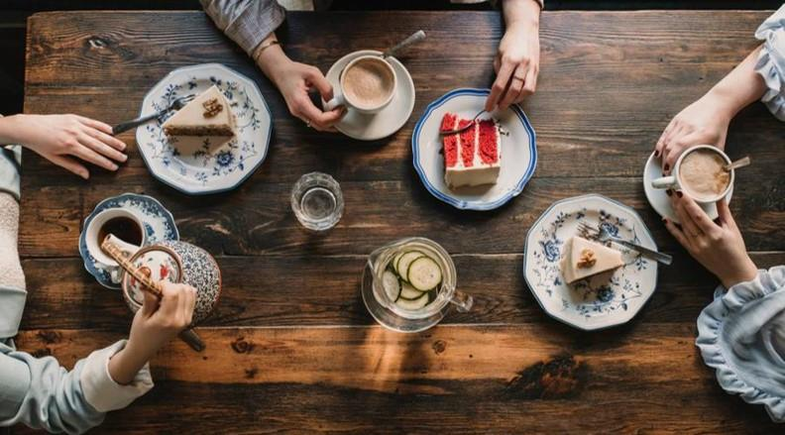
Agenda
Introduction
Data
Data Visualization
Data Training
Data Testing
Conclusion

Slide 3

Introduction
Starbucks. The largest coffee business in the world beating out 2nd place by over $20 billion in revenue in the past year. With a reputation for having one of the most stable stocks on the market, we have compiled and analyzed data. We will see if it is true!

Slide 4
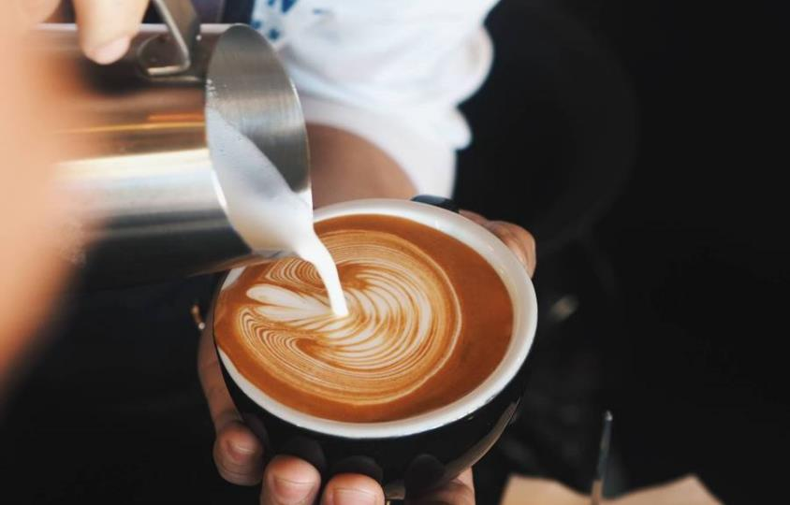

Data

Slide 5
Data
Our data is compiled from online websites
Starbucks
US Inflation Calculator
Macrotrends
Fast Food Menu Prices
Information about menu prices, common ingredient prices, and inflation rates
Target feature: Stock Direction (upward or downward trend)

Slide 6
Data Visualization

Slide 7


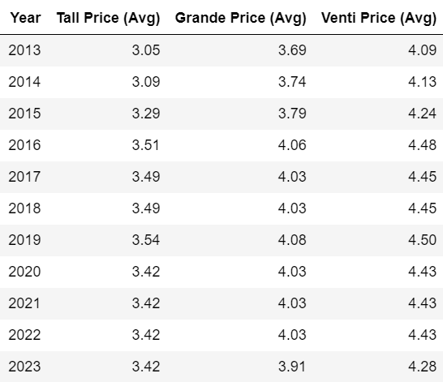
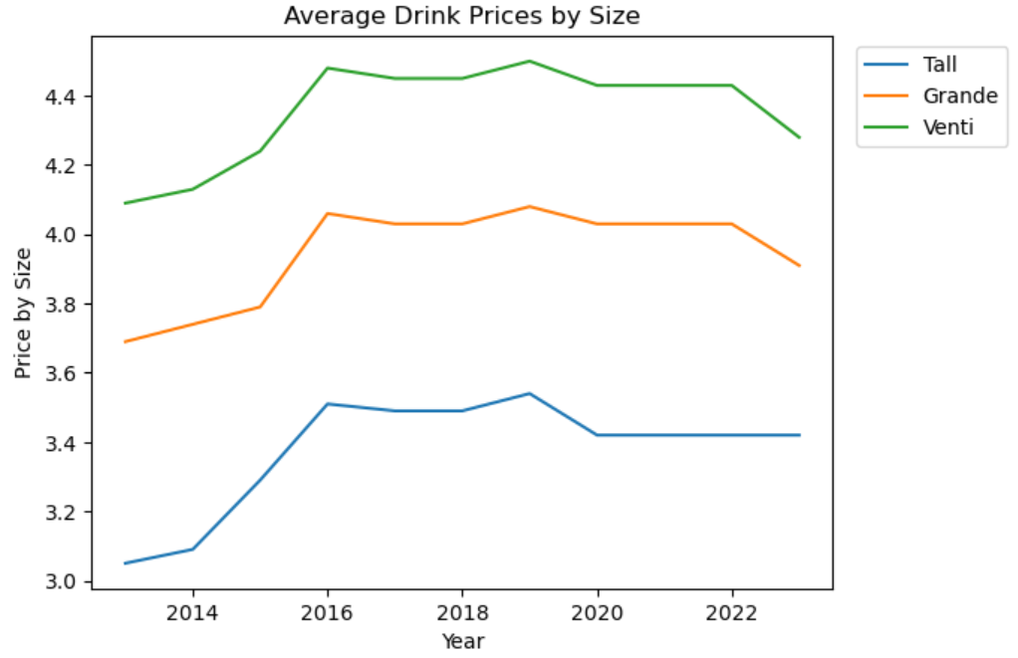
Average Drink Prices

Slide 8
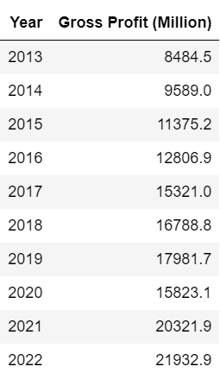
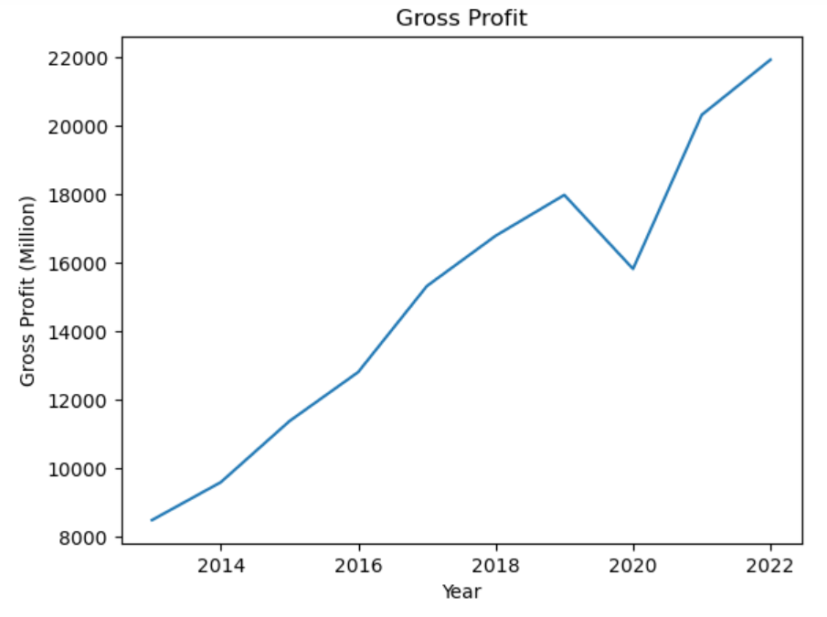
Gross Profit

Slide 9
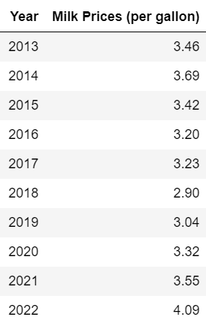
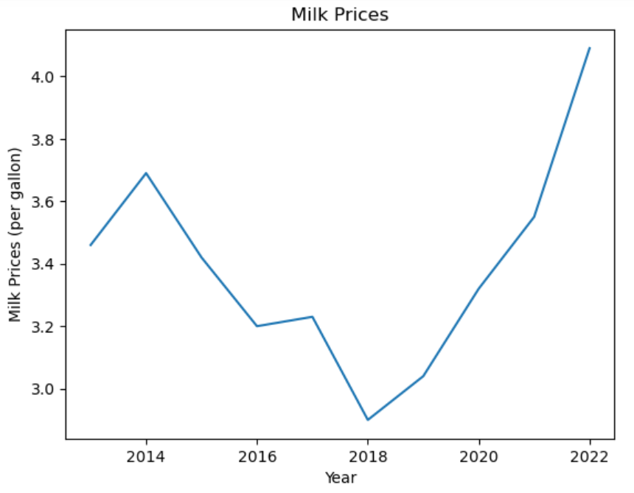
Milk Prices

Slide 10
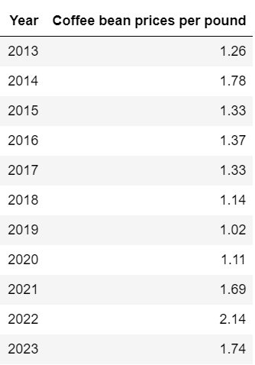
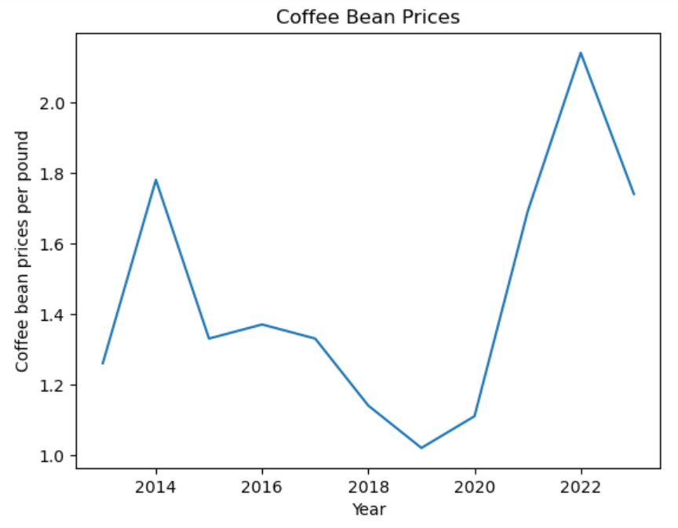
Coffee Bean Prices

Slide 11
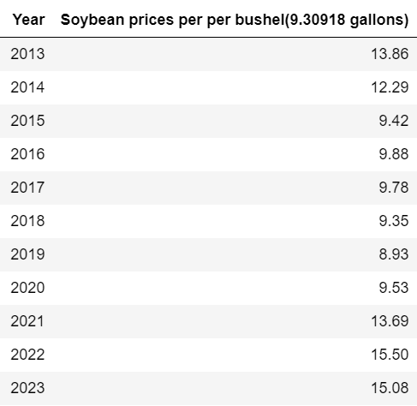
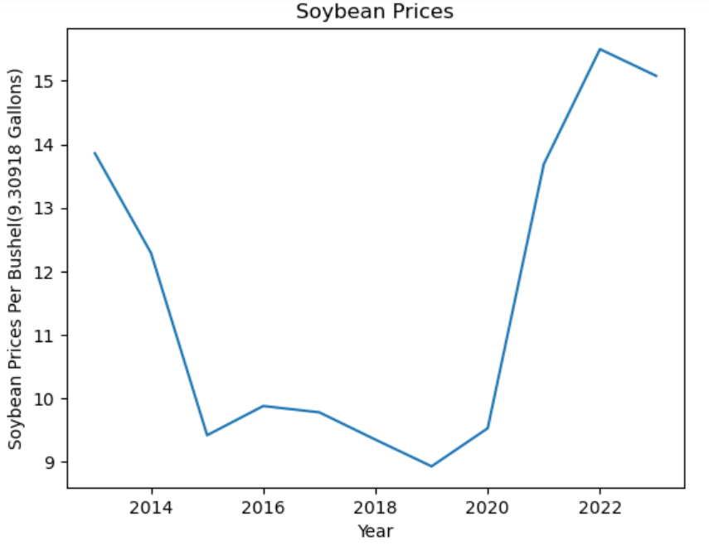
Soybean Prices

Slide 12
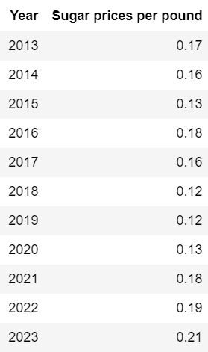
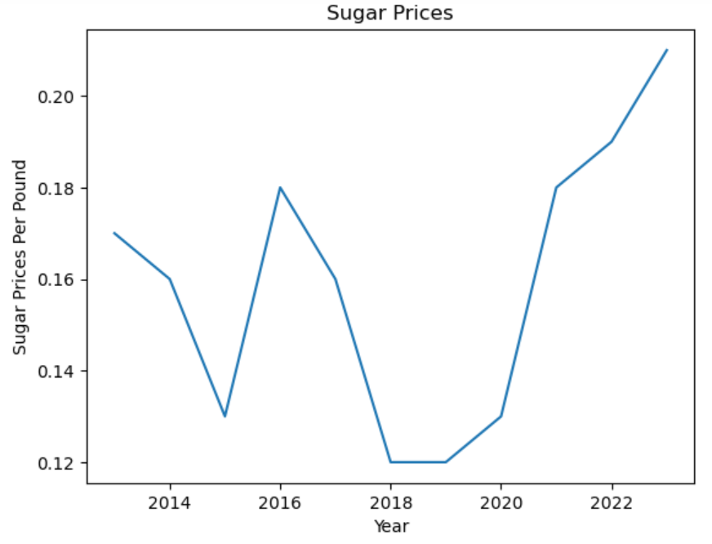
Sugar Prices

Slide 13
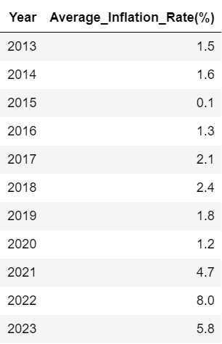
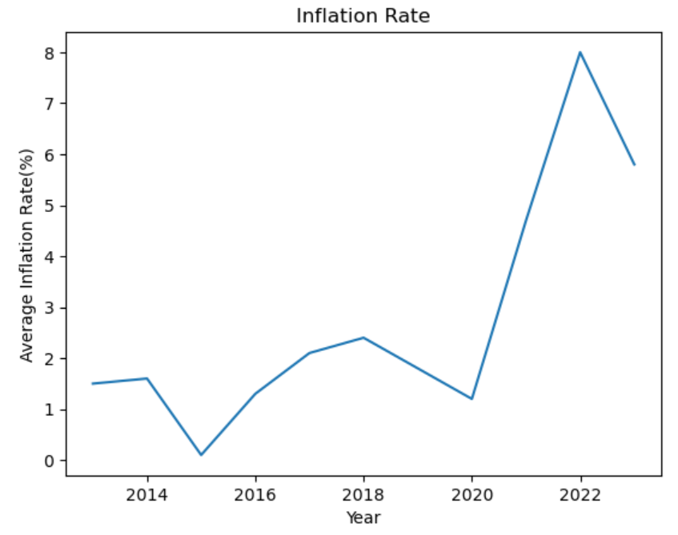
Inflation Rate

Slide 14
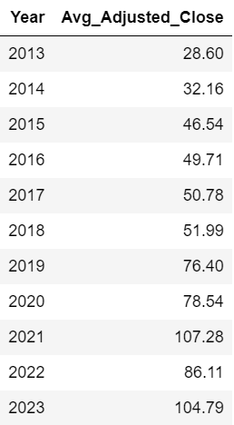
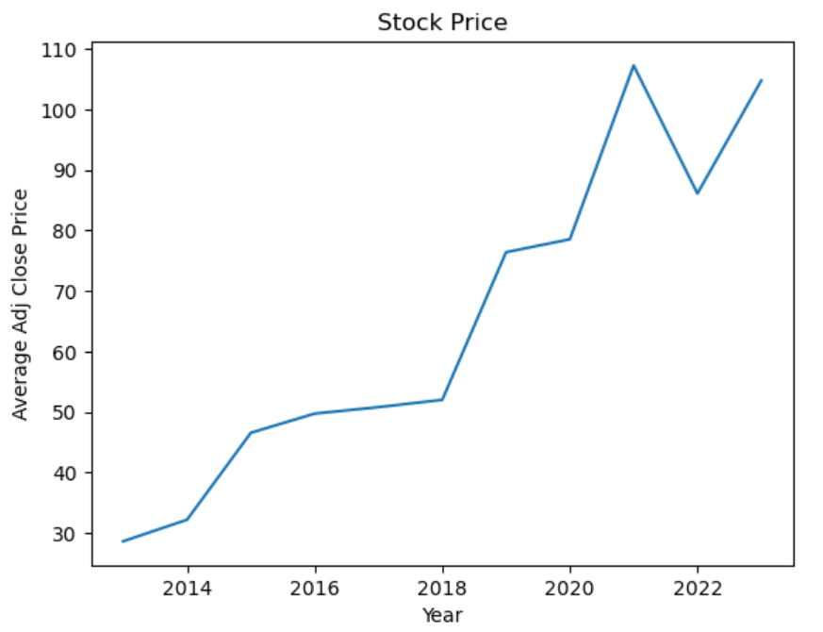
Stock Prices

Slide 15
Data Training

Slide 16
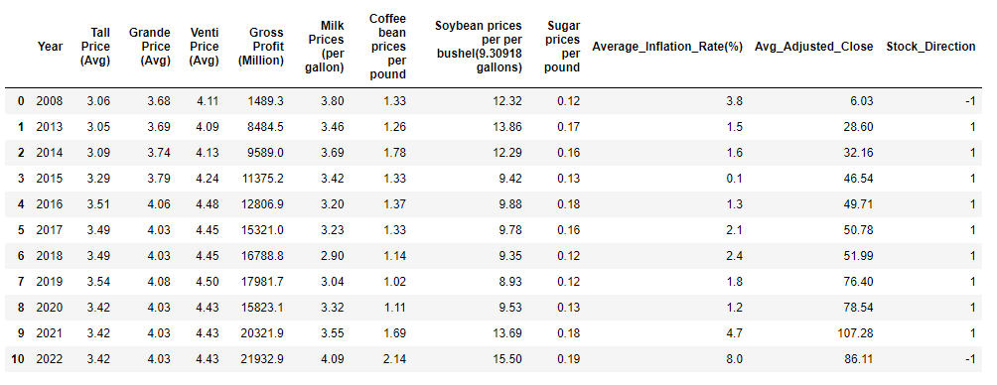
Data Training
Normalization
Since all our separate data tables shared a common primary key, ‘Year’, we merged the data into one large data table
Still maintaining a single primary key, ‘Year’
The dataset remains normalized in BCNF

Slide 17
Data Training
Expected Outcome/Target Value
In order to train our dataset, we need an expected outcome, ‘Stock_Direction’, to determine the accuracy of our training model.
1 = Stock Price increased from previous year
-1 = Stock Price decreased from previous year

Slide 18
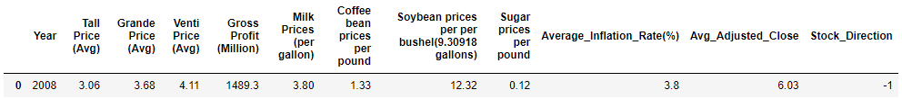
Data Training
Expected Outcome/Target Value
NOTE: Some data for ‘Year’ = 2008 was extrapolated due to lack of existing data
A trendline was produced on both the ‘Average Drink Prices’ plot and ‘Gross Profit’ plot
2008 was the last year stock price decreased from the previous year
2008 was selected for this reason in order to meet the conditions of the chosen training model

Slide 19
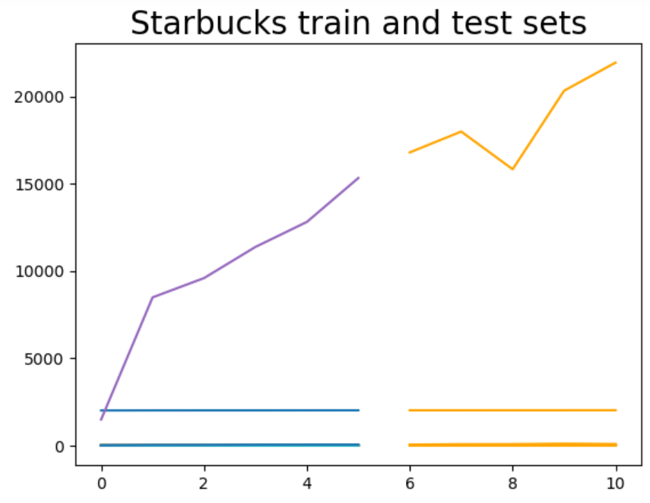
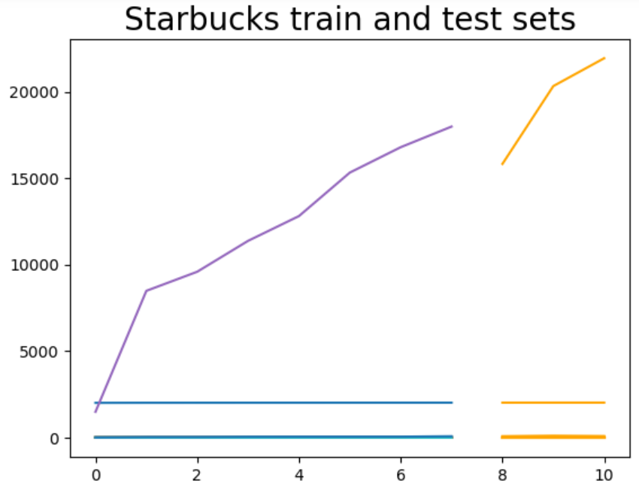
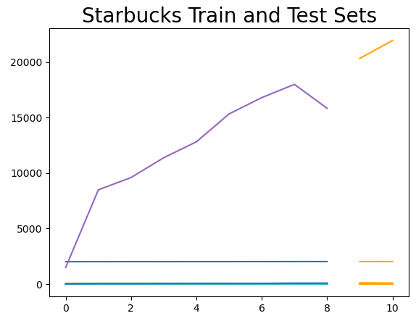
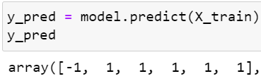
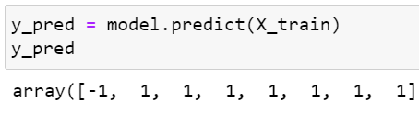
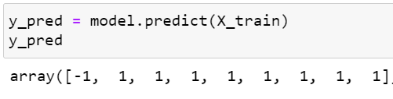
Data Training (Logistics Regression Model)
50-50 Split: 100%
70-30 Split: 100%
80-20 Split: 100%

Slide 20
Data Testing

Slide 21
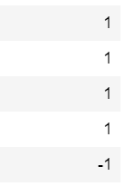
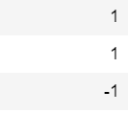




Data Training (Logistics Regression Model)
50-50 Split: 80%
70-30 Split: 67%
80-20 Split: 50%

Slide 22

Conclusion
Again, we want to take note that some data for 2008 needed to be extrapolated, and it may not necessarily be the exact data that would have been reported for the 2008 fiscal year. As a result, this may have presented a bias while training our dataset.
Nonetheless, through this study, we conclude that Starbucks is indeed deserving of its reputation. 2008 was dubbed “The Great Recession” and 2022 was the beginning of another economic downturn. Even during these years, the stock price of Starbucks held at a reasonable rate and has steadily increased in all other years.

Slide 23
Q & A

Slide 24

Thank you

