Slide 1

Analysis of Starbucks Drink Prices, Profits, and Stocks
Alexander Nguyen
CSC 4780
Sagar Patel
CSC 4780

Slide 2



Agenda
Introduction
Data
Data Visualization
Topic four

Slide 3

Introduction
Starbucks. The largest coffee business in the world beating out 2nd place by over $20 billion in revenue. With a reputation for having one of the most stable stocks on the market, we have compiled and analyzed data. Now we will see if it is true!

Slide 4


Data

Slide 5
Data
Our data is compiled from online websites
Starbucks
US Inflation Calculator
Macrotrends
Fast Food Menu Prices
Information about menu prices, common ingredient prices, and inflation rates

Slide 6
Data Visualization

Slide 7


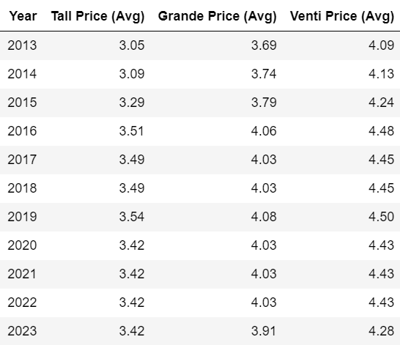
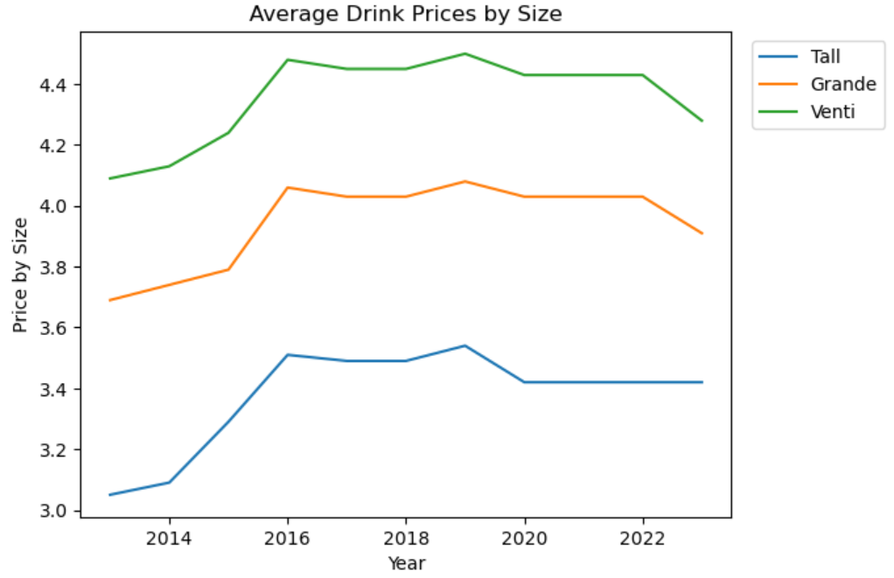
Average Drink Prices

Slide 8
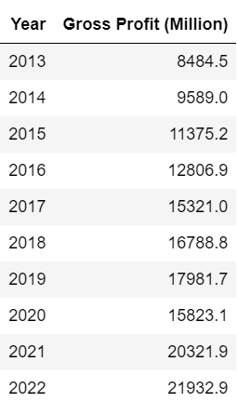
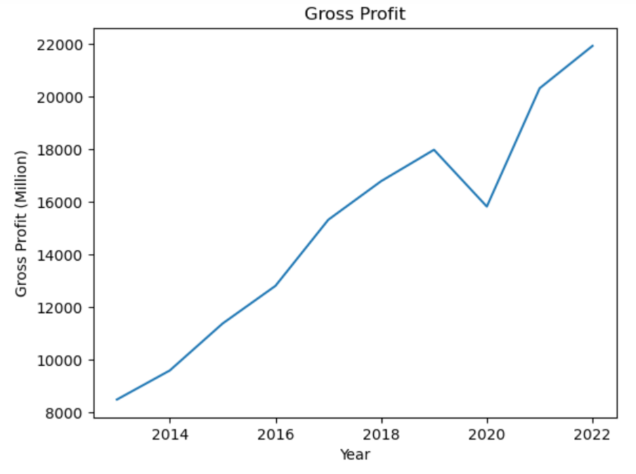
Gross Profit

Slide 9
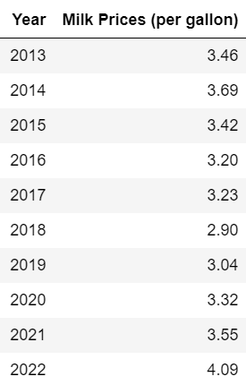
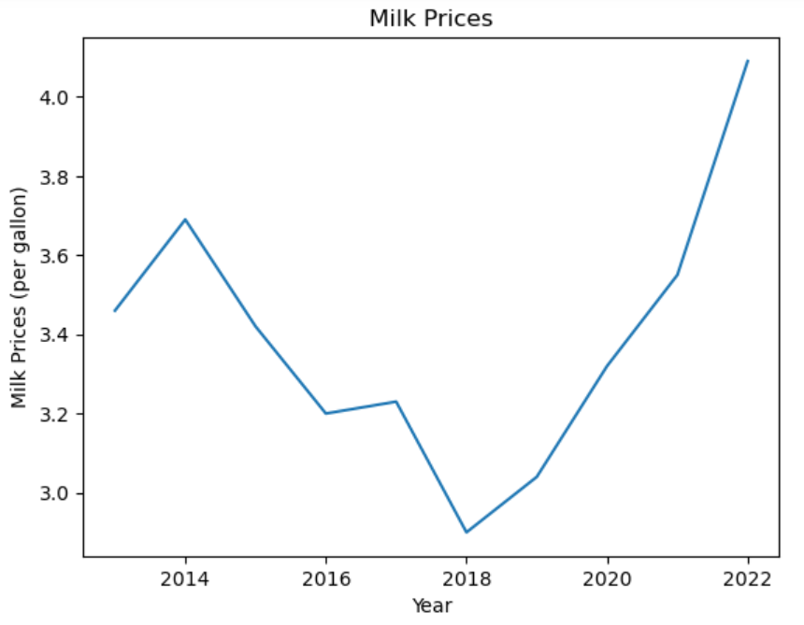
Milk Prices

Slide 10
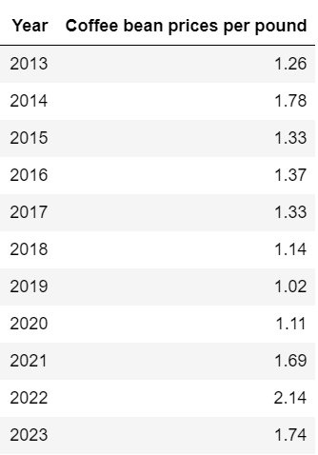
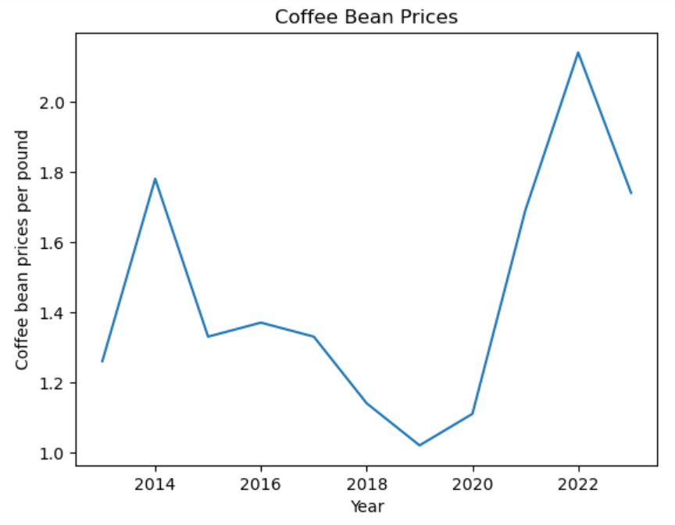
Coffee Bean Prices

Slide 11
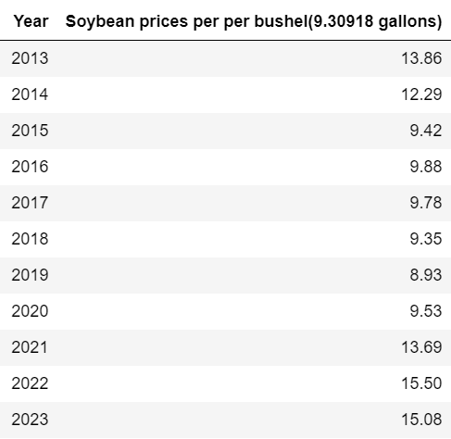
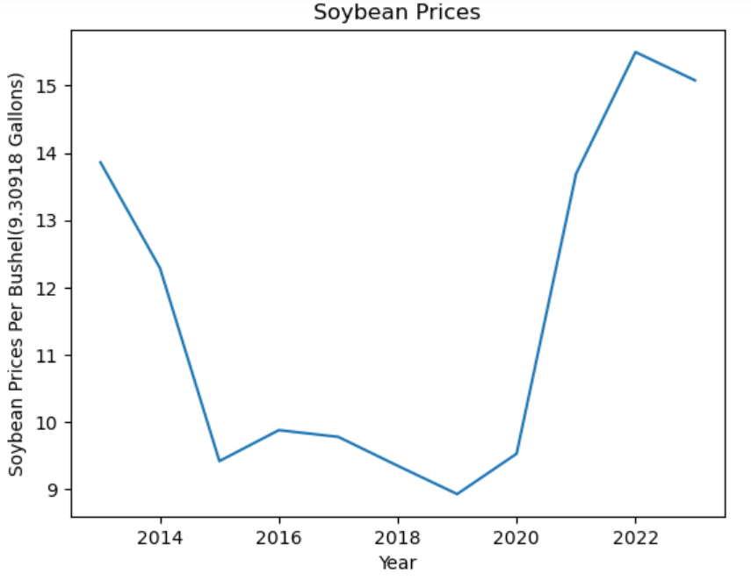
Soybean Prices

Slide 12
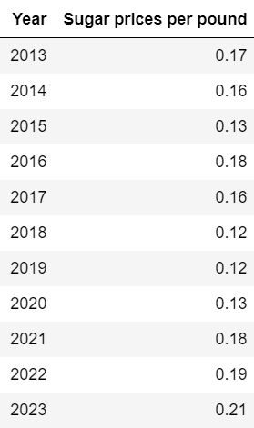
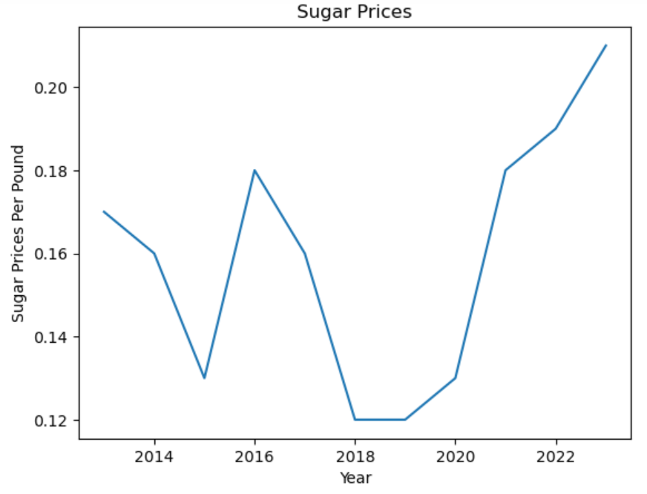
Sugar Prices

Slide 13
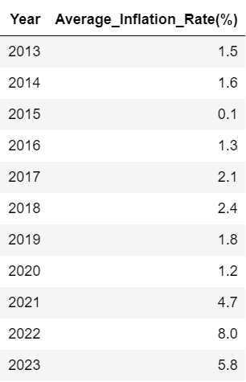
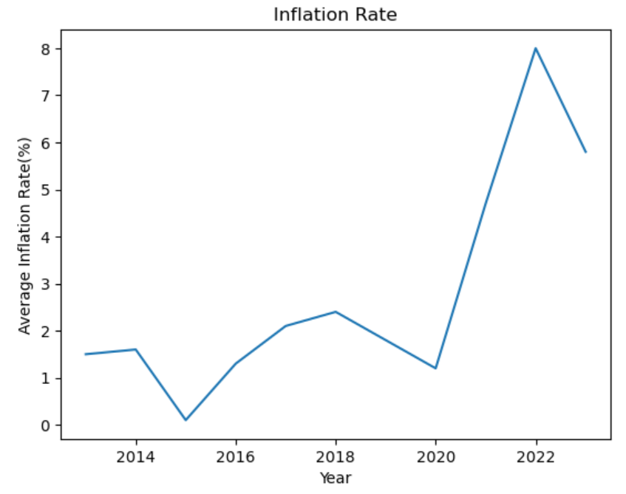
Inflation Rate

Slide 14
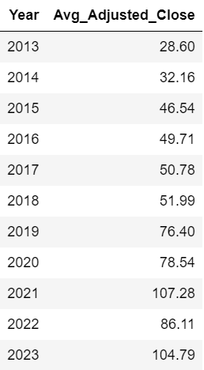
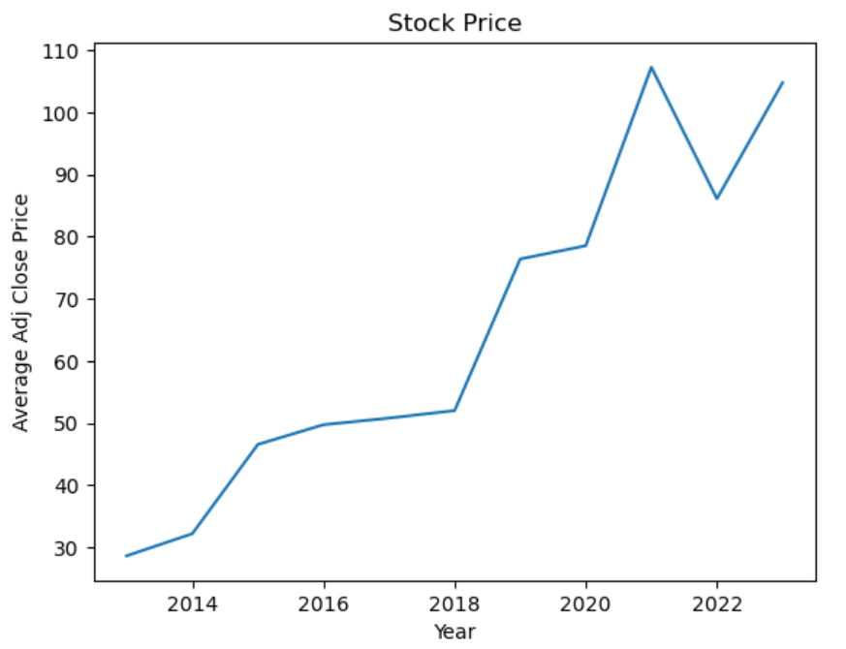
Stock Prices

Slide 15


The way to get started is to quit talking and begin doing.
Walt Disney
20XX
15

Slide 16
Timeline
Title
To start a presentation, go to the Slide Show tab, and select From Beginning.
Title
Title
To display Presenter view, in Slide Show view, on the control bar at the bottom left select the three dots, and then Show Presenter View.
Title
Title
During your presentation, the speaker notes are visible on your monitor, but aren't visible to the audience.
The Notes pane is a box that appears below each slide. Tap it to add notes.
If you don’t see the Notes pane or it is completely minimized, click Notes on the task bar across the bottom of the PowerPoint window.

Slide 17
Content
Subtitle
Subtitle
Add text, images, art, and videos.
Add transitions, animations, and motion.
Save to OneDrive, to get to your presentations from your computer, tablet, or phone.
Open the Design Ideas pane for instant slide makeovers.
When we have design ideas, we’ll show them to you right there.

Slide 18
Additional content
Subtitle
Subtitle
Subtitle
Add text, images, art, and videos.
Add transitions, animations, and motion.
Save to OneDrive, to get to your presentations from your computer, tablet, or phone.
Open the Design Ideas pane for instant slide makeovers.
When we have design ideas, we’ll show them to you right there.
This PowerPoint theme uses its own unique set of colors, fonts, and effects to create the overall look and feel of these slides.
PowerPoint has tons of themes to give your presentation just the right personality.

Slide 19

Summary
With PowerPoint, you can create presentations and share your work with others, wherever they are. Type the text you want here to get started. You can also add images, art, and videos on this template. Save to OneDrive and access your presentations from your computer, tablet, or phone.

Slide 20

Thank you

