Slide 1
HMS BACKEND

Slide 2
Client – Server Architecture
SERVER
CLIENT
Request
Android
Database
Desktop App
Data Exchange
JSON , XML
REST APIS
PostMan
Response
Web App
Web Server

Slide 3
Service Registry
Eureka Server
http://192.168.41.01:9091/
Service Registry
Eureka Client
HMS Service
Registered
http://192.168.41.01:9092/
Eureka Client
Resource Service
Track all the information of services
http://service-name/
http://192.168.41.01:8761/

Slide 4
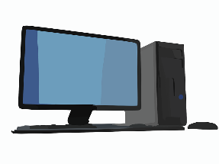
Microservices
HMS Service
My SQL
API Gateway
Resource Service
Client
MongoDB
GitLab
Config Service
Service Registry

Slide 5
Spring Tier Architecture Diagram -
Spring Security
Controllers
Data Transfer Objects
Services
Data Access Object ( Repository )
Entities
Database

Slide 6
Resources for Hospital Management System
User
Address
Employee
Patient
Doctor
Health History
Resources
Medicine

Slide 7
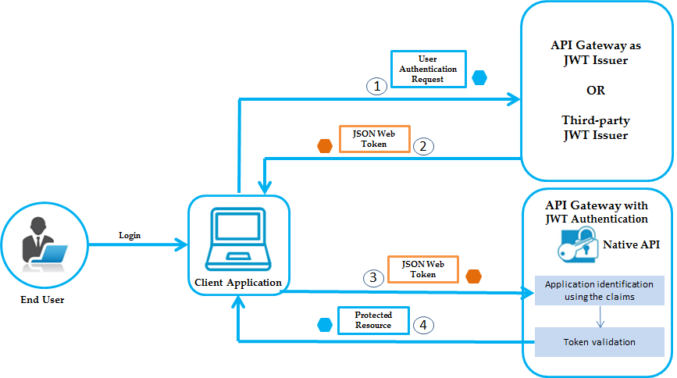
JWT Token Based Auth

Slide 8
