Slide 1
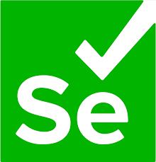
SELENIUM C#: PROJECT TO AUTOMATE TEST

Slide 2
OUR TEAM
SAGAR PRAMOD
ANIT ANGEL
ANIE JOSHAN
GAYTRI

Slide 3

About Our Projects
01
02
03
Unit Testing in Selenium C#
Using NUnit Framework
BDD with SpecFlow
BDD | Gherkin | SpecFlow | Feature Files
Simple C# Project
Student Management System

Slide 4
Topics Covered :
Unit Testing with NUnit Framework
Unit Testing with MSTest Framework
BDD with SpecFlow Framework
Project Dependencies
Parametrizing/Data Driven Testing
Parallel Execution
Reporting using Living Doc
Design Pattern: Page Object Model

Slide 5

Unit Testing in Selenium C# Using NUnit Framework

Slide 6
NUnit is an open-source unit testing framework in C#
NUnit testing for Selenium automation is widely used due to the following advantages over other test frameworks:
Annotations used in NUnit help in speeding up test development & execution as tests can be executed with numerous input values.
Provides you the ability to run your test cases in parallel.

Slide 7
Test Case 1 : Automate User Registration Process
Test Scenarios
http://automationpractice.com/index.php
Test Case 4 : Verify error messages for entering incorrect values in fields
Positive Scenario
Steps to Automate:
1. Open this URL http://automationpractice.com/index.php
2. Click on sign in link.
3. Enter your email address in 'Create and account' section.
4. Click on Create an Account button.
5. Enter your Personal Information, Address and Contact info.
6. Click on Register button.
7. Validate that user is created.
Negative Scenario
Steps to Automate:
1. Open this URL http://automationpractice.com/index.php
2. Click on sign in link.
3. Enter email address and click Register button.
4. Enter incorrect values in fields like., enter numbers in first and last name, city field etc. and enter alphabets in Mobile no, Zip postal code etc., and click on 'Register' button.
5. Verify that error messages for respective fields are displaying
Test Case 2 : Verify invalid email address error
Test Case 3 : Verify error messages for mandatory fields
Negative Scenario
Steps to Automate:
1. Open this URL http://automationpractice.com/index.php
2. Click on sign in link.
3. Enter invalid email address in the email box and click enter.
4. Validate that an error message is displaying saying "Invalid email address."
Negative Scenario
Steps to Automate:
1. Open this URL http://automationpractice.com/index.php
2. Click on sign in link.
3. Enter email address and click Register button.
4. Leave the mandatory fields (marked with *) blank and click Register button.
5. Verify that error has been displayed for the mandatory fields.

Slide 8
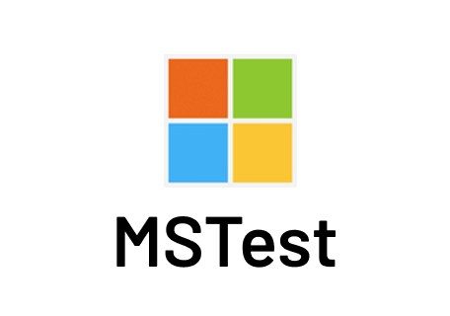
Unit Testing in Selenium C# Using MSTest Framework

Slide 9
The MSTest framework reinforces unit testing in Visual Studio by using the classes and members in Microsoft.VisualStudio.TestTools.UnitTesting namespace when you are coding unit tests.
MSTest is a number-one open-source test framework that is shipped along with the Visual Studio IDE.
It provides the facility to test the code without using any third-party tool. It helps in writing effective unit tests using MSTest framework to test software applications

Slide 10
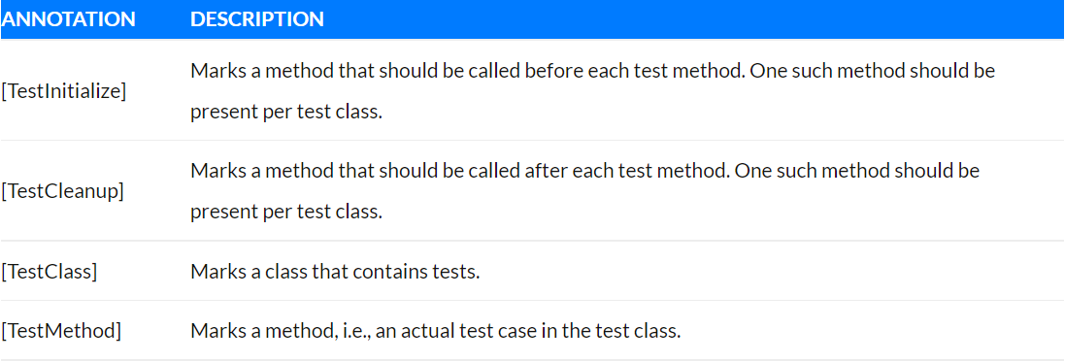
Annotations in MSTest
The primary role of annotations in a test framework is to inform the underlying framework on how the source code should be interpreted. Once the code is compiled, a DLL (Dynamic Link Library) is generated, which can be executed using the console or a GUI
In this MSTest tutorial, we will cover the most frequently used MSTest framework annotations:

Slide 11

BDD with SpecFlow
Feature Files | Gherkin | Step Definition

Slide 12
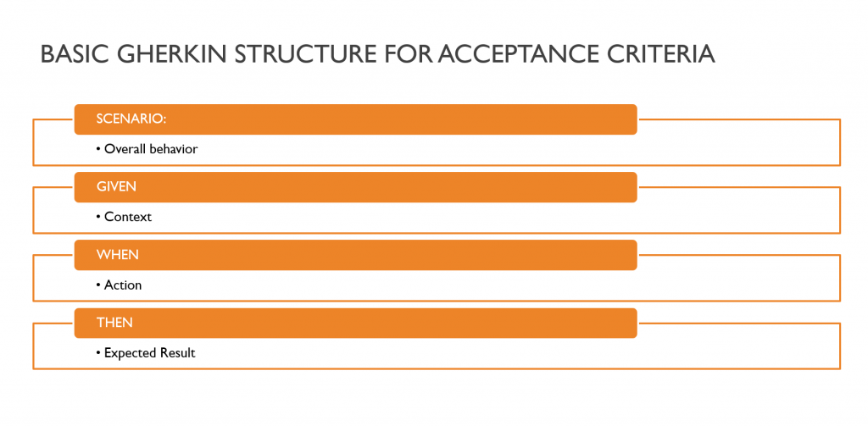
Tools like SpecFlow allow Gherkin scenarios to be automated for acceptance testing.
A domain specific language which helps us to write our application behavior in a readable format.

Slide 13
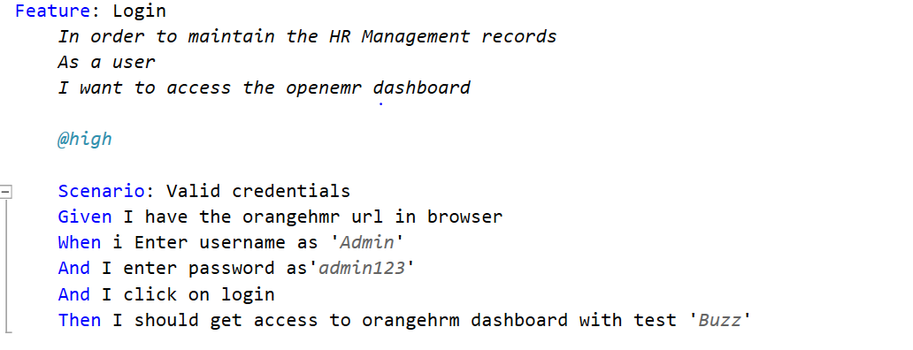
ACTUAL SYNTAX
Demo site we have used : https://opensource-demo.orangehrmlive.com/
To write the test statement in plain English language we need to use some predefined keywords.
For example : Given , When , Then , And, But

Slide 14
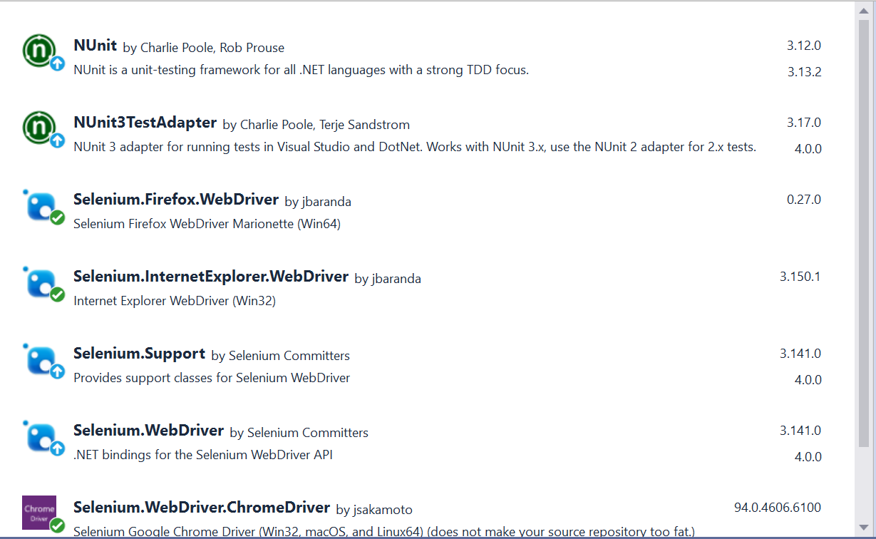
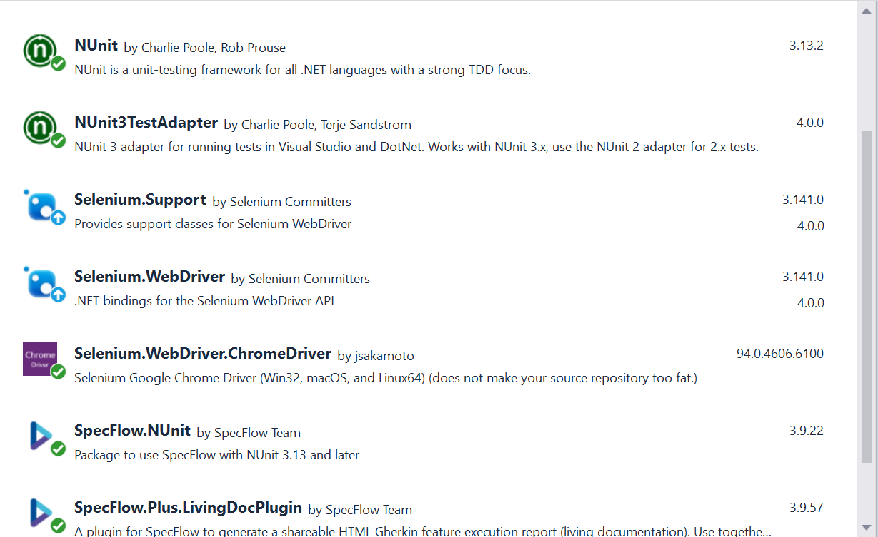
Project Dependencies:

Slide 15
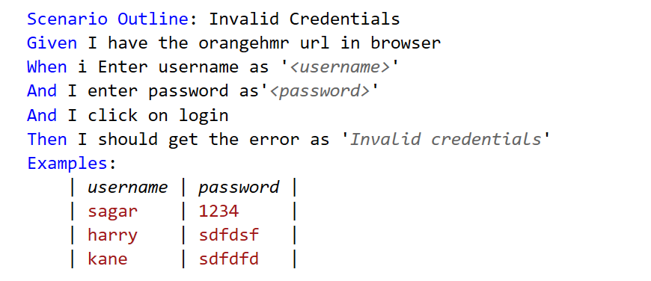
Parametrizing / Data Driven Testing
( Using Scenario Outline)
Scenario Outline - This is used to run the same scenario for 2 or more different set of test data. E.g. In our scenario, if you want to register another user you can data drive the same scenario twice
Examples - All scenario outlines have to be followed with the Examples section. This contains the data that has to be passed on to the scenario.

Slide 16
Selenium C# : Cross Browser Parallel Execution
Benefits of Running parallel execution in selenium
It saves execution effort.
We can cover a number of tests.
We can perform cross-browser testing which as well will make the application more stable.
If you are running scripts parallelly then it will help you to increase ROI (return of Investment)
To configure our project to run the test parallelly, we can add below code in assemblyinfo.cs file:
using NUnit.Framework;
[assembly:Parallelizable(ParallelScope.Fixtures)]
[assembly: LevelOfParallelism(2)]

Slide 17
Selenium C# : Design Pattern (Page Object Model)
Page Object is a Design Pattern which has become popular in test automation for enhancing test maintenance and reducing code duplication.
The Page Object Design Pattern provides the following advantages:
There is a clean separation between test code and page specific code such as locators and layout.
There is a single repository for the services or operations offered by the page rather than having these services scattered throughout the tests

Slide 18
Selenium C# : Reporting using Living Doc
IMPROVING TEAMWORK WITH SPECFLOW+ LIVINGDOC
SpecFlow is an excellent Behavior-Driven Development test framework for .NET. Recently, SpecFlow released a new reporting tool called SpecFlow+ LivingDoc, which generates living documentation for features.
It combines all scenarios from all SpecFlow feature files into one central HTML report. The report looks crisp and professional. It is filterable and can optionally show test results.

