Slide 1
Medical Emergency Handling
PIP2001 Capstone Project
VIVA-VOCE
Batch Number: G20
Roll Number | Student Name
20211CSE0661 | SAGAR
20211CSE0652 | BINUSHRI MD
20211CSE0664 | ROOPASHREE A
20211CSE0852 | KEERTHANA MV
Under the Supervision of,
Dr. Shanmugarathinam
Professor
School of Computer Science and Engineering
Presidency University
Name of the Program: BTech CSE
Name of the HoD: Dr. Blessed Prince P/Dr. Robin Rohit / Dr. Asif Mohammed H B
Name of the Program Project Coordinator: Mr. Amarnath J L/ Dr Jayanthi K
Name of the School Project Coordinators: Dr. Sampath A K / Dr. Abdul Khadar A / Mr. Md Ziaur Rahman

Slide 2
Introduction
Medical emergencies, ranging from accidents and heart attacks to strokes, can occur unexpectedly Medical emergencies are critical events that demand immediate attention and coordinated action to save lives. Unfortunately, delays, inefficiencies, and lack of accessibility often hinder effective responses, especially in regions with limited healthcare infrastructure. Our app, Medical Emergency Handling, aims to address these challenges through a user-friendly platform offering features such as primary aid instructions, ambulance and hospital location services via Google Maps, helpline support, and easy access to medicines through Flipkart Health+. By leveraging technology, we aim to enhance the responsiveness and reliability of medical emergency management. and require swift action to prevent severe health outcomes or fatalities. In India, millions face unnecessary delays due to inadequate resources, poor coordination, and lack of public awareness regarding immediate response measures.

Slide 3
Literature Review
General
For a Medical Emergency Handling System, the literature survey focuses on reviewing research papers, articles, and case studies that discuss emergency response systems, technologies, and methodologies. Below is a structured overview:
Emergency Medical Services (EMS) Systems
Study Title: "Performance Metrics for Emergency Medical Services Systems"
Authors: X et al.
Key Insights:
Discusses performance indicators like response time, survival rates, and patient satisfaction.
Highlights the importance of time management in pre-hospital care.
Suggests integrating GPS and real-time data tracking for improved service delivery.
Study Title: "Challenges in Urban Emergency Medical Services in Developing Countries“
Authors: Y et al. o
Key Insights:
Identifies resource constraints and coordination challenges in urban areas.
Recommends adopting mobile health technologies and low-cost solutions.

Slide 4
Literature Review
Real-Time Data Sharing and Communication Systems
Study Title: "Real-Time Communication for Emergency Medical Services"
Authors: D et al.
Key Insights:
Explores cloud-based platforms for data sharing between ambulances and hospitals.
Demonstrates
the benefits of real-time updates for emergency response teams.
Study Title: "Role of 5G Networks in Enhancing EMS Systems"
Authors: E et al.
Key Insights:
Discusses the potential of 5G for faster communication in EMS.
Explores applications like video streaming for remote medical guidance.

Slide 5
Research Gaps Identified
Inefficient Resource Allocation:
Challenge: Ambulances and hospitals are not efficiently allocated based on real-time availability and proximity
Impact: Critical time is wasted in locating the nearest available resources, leading to poorer patient outcomes..
Proposed Solution: The app’s integration with real-time location services ensures optimal resource allocation.
Lack of Communication Between Stakeholders:
Challenge: Poor coordination between emergency service providers, such as hospitals, ambulances, and helplines, disrupts the chain of care.
Impact: Miscommunication can lead to overlapping tasks, delays, or incomplete care delivery
Proposed Solution: The app provides a centralized communication hub for seamless interaction between users, ambulances, and hospitals.
Unavailability of Feedback Mechanisms:
Challenge: Emergency service providers rarely collect user feedback, making it difficult to identify and rectify shortcomings.
Impact: The lack of feedback loops hampers continuous improvement and quality assurance in emergency services.
Proposed Solution: A built-in feedback system in the app ensures user insights are collected and used for service enhancements.

Slide 6
Research Gaps Identified
4. Low Awareness of Emergency Protocols:
Challenge: A significant portion of the population lacks basic knowledge of emergency protocols and first-aid procedures.
Impact: People are often unable to provide immediate help during emergencies, leading to preventable complications or fatalities.
Proposed Solution: The app includes tutorials and awareness campaigns to educate users on essential first-aid techniques and emergency protocols.
5. Hesitation in Seeking Help:
Challenge: Cultural stigmas, fear of costs, or distrust in healthcare systems often deter people from seeking emergency help.
Impact: This results in delayed responses, worsened health conditions, and higher mortality rates.
Proposed Solution: By offering free emergency resources and building trust through verified services, the app encourages users to seek help without hesitation.

Slide 7
Objectives
Emergency Navigation: Provide users with real-time directions to the nearest hospital with the most suitable facilities, considering traffic conditions.
Provide real-time hospital proximity based on location.
Display available medical facilities and specialized treatment options.
Ensure access to critical resources like medicines and blood.
Minimize decision-making delays during medical emergencies.
Incorporate User Feedback on the app's functionality and usability, allowing for ongoing improvements.

Slide 8
Proposed Methodology
1. Requirement Gathering and Analysis: Identify key features such as real-time location tracking, hospital proximity, facility information, and user-friendly design.
- Analyze user needs and emergency response requirements.
2. Technology Stack : Google Maps API for real-time location tracking and proximity-based search for medical facilities. - Implement MongoDB for storing facility information and user data securely.
3. Application Design: Design a user-friendly interface using Figma.
- Focus on simple navigation, easy access to emergency features, and real-time updates.
4. Development: - Front-End: Develop the mobile interface using Android Studio.
- Back-End: Build server-side logic using Java/Kotlin for managing user data, real-time updates, and integration with APIs.
- Google Maps API Integration: Implement Google Maps API to display real-time location, nearby hospitals, and navigation routes.

Slide 9
Proposed Methodology
5. Database Integration: - Create a database of hospitals and healthcare facilities with detailed information on services, contact details, and proximity.
- Implement secure data handling practices for user privacy.
6. Testing: - Perform Unit Testing to validate each function individually.
- User Acceptance Testing to ensure the app meets user expectations.
- Test the app’s performance, usability, and reliability under various emergency scenarios.
7. Deployment and Maintenance: - Deploy the application on Google Play Store
- Set up a feedback loop for continuous improvements and bug fixes.
8. User Feedback and Updates: - Collect user feedback to enhance features and improve user experience.
- Regularly update the hospital database and refine the app based on feedback and changing needs.

Slide 10
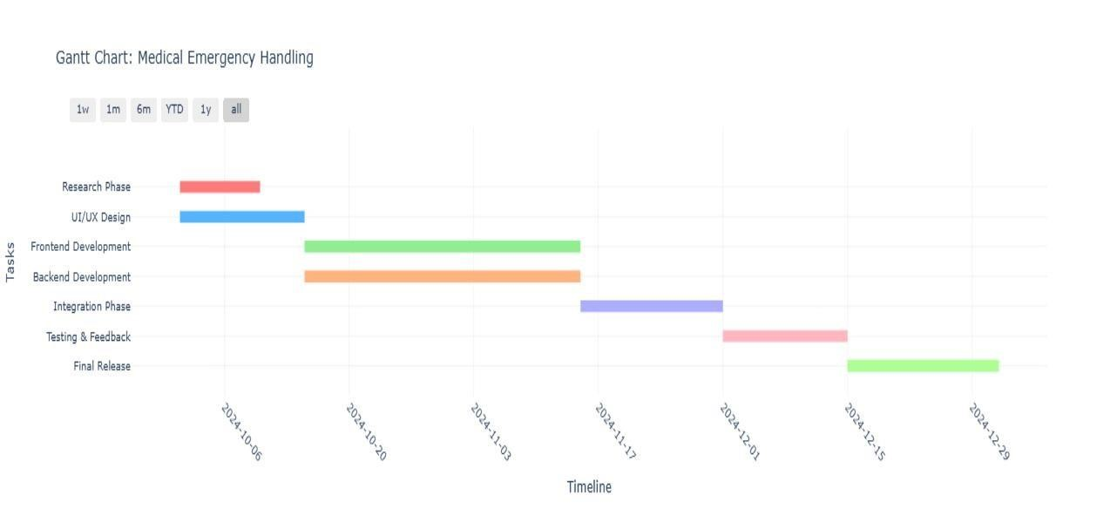
Timeline of Project

Slide 11
Outcomes
1. Faster Emergency Response.
2. Accurate Hospital Information
3. Efficient Navigation
4. User-Friendly Interface
5. Improved Communication with Hospitals
6. Enhanced Healthcare Access
7. Scalability

Slide 12
Conclusion
The Medical Emergency Handling project successfully achieved its objectives by providing real-time aid instructions, ambulance and hospital location services, and helpline support, further enhanced by the integration with Flipkart Health+ for seamless medicine accessibility. It significantly reduced emergency response times with a user-friendly interface, while multilingual support and offline functionality improved accessibility in rural and underserved areas. Leveraging technologies like Google Maps and API integration demonstrated the potential of existing tools, and real-time data sharing enabled efficient communication during critical situations. This project highlights the potential for future enhancements to expand its impact and scalability in healthcare delivery.

Slide 13
Github Link
The Github link provided should have public access permission.
Github Link
https://github.com/SagarRB123/Medical-Emergency-Handling

Slide 14
References
Leila Gholamhosseini, Farahnaz Sadoughi, Aliasghar Safaei, “Hospital Real-Time Location System (A Practical Approach in Healthcare): A Narrative Review Article”, Iran J Public Health, Vol. 48, No.4, Apr 2019, pp.593-602.
Ganapathi Shankar, Dr. D. Subba Rao, “Domain Specific Search of Nearest Hospital and Healthcare Management System”, International Journal of Advanced Technology and Innovation Research, ISSN 2348–2370 Vol.07,Issue.10, August-2015, Pages:1726-1729.
Rahul A, Satish Babu G, Manoj Kumar S, Nitish K, Mr. Shobit Tembhre, “Hospital Finder Application”, International Journal of Research Publication and Reviews, Vol 5, no 1, pp 1621-1624 January 2024.
Shivam Bajpai, Tushar Modi, Vatsalya Vinay Sinha, Vidhi Jaiswal, “Implementation of Hospital-Finder”, International Journal of Research Publication and Reviews, Vol 4, no 4, pp 3344-3346, April 2023.
Syed Farzana, Kanakam Sasikalyan, Jasti Manikanta, Kommalapati Manoj, Choppara Prasanth, “Hospital Locator and Bed Availability Detector for Emergency Cases”, International Research Journal of Engineering and Technology, Volume: 09, Issue: 12, Dec 2022.

Slide 15
References
D Tharun, Chandan BM, Shashank Y.C, Dhanush. R, “Hospital Finder App”, International Journal of Research Publication and Reviews, Vol 5, no 1, pp 1904-1910, January 2024.
Ajay Kumar G, Akash Aman, Avinash Kumar, Harshith L,” GPS Based Android Application for Healthcare Dissemination ”, International Research Journal of Engineering and Technology, e-ISSN: 2395 -0056, p-ISSN: 2395-0072, Volume: 04, Issue: 04, Apr -2017.
E. Neelima, Chirudeep, Supriyo Saha, Tarrunee, “Health Care Connect: A Comprehensive Hospital Management System”, International Research Journal of Engineering and Technology, e-ISSN: 2395-005, Volume: 11, Issue: 03, Mar 2024
Ujwal K C, Srividhya Ravichandran,” Optimizing Hospital-Patient Interactions through Advanced Machine Learning and NLP Methodologies”, International Research Journal of Engineering and Technology, e-ISSN: 2395-0056, Volume: 10, Issue: 11, Nov 2023.
Prof Shobha MS, Pooja Shantaprasad Utagi, OK Anagha, Deepa M Shidnekoppa, Arjun Arun Nambiar, “Hospital Finder Android Application”, International Research Journal of Modernization in Engineering Technology and Science, e-ISSN: 2582-5208, Volume:06, Issue:01, January-2024.

Slide 16
Pseudocode
User Registration and Authentication:
Function registerUser(username, password, medicalHistory):
If usernameExists(username):
Return "Username already taken.“
hashedPassword = hashPassword(password)
saveUserToDatabase(username, hashedPassword, medicalHistory)
Return "Registration successful.“
Function loginUser(username, password):
user = fetchUserFromDatabase(username)
If user is None:
Return "User not found.“
If verifyPassword(password, user.hashedPassword):
initiateUserSession(user)
Return "Login successful."
Else: Return "Incorrect password."

Slide 17
Pseudocode
Emergency Ambulance Request:
Function requestEmergencyAmbulance(userId):
user = fetchUserFromDatabase(userId)
userLocation = getCurrentLocation(user)
nearestAmbulance = findNearestAvailableAmbulance(userLocation)
If nearestAmbulance is not None:
dispatchAmbulance(nearestAmbulance, userLocation) sendMedicalHistoryToHospital(user.medicalHistory)
Return "Ambulance dispatched successfully."
Else:
Return "No available ambulances nearby."

Slide 18
Pseudocode
First Aid Instruction Retrieval:
Function getFirstAidInstructions(emergencyType):
firstAidDatabase = {
"heart attack": "Call emergency services immediately. Chew and swallow an aspirin unless allergic...", "burns": "Cool the burn under running water for at least 10 minutes. Do not apply ice...",
"stroke": "Use the FAST method: Face drooping, Arm weakness, Speech difficulty, Time to call emergency services...",
// Additional emergency types and instructions
}
instructions = firstAidDatabase.get(emergencyType)
If instructions is not None:
Return instructions
Else:
Return "No instructions available for this emergency type."

Slide 19
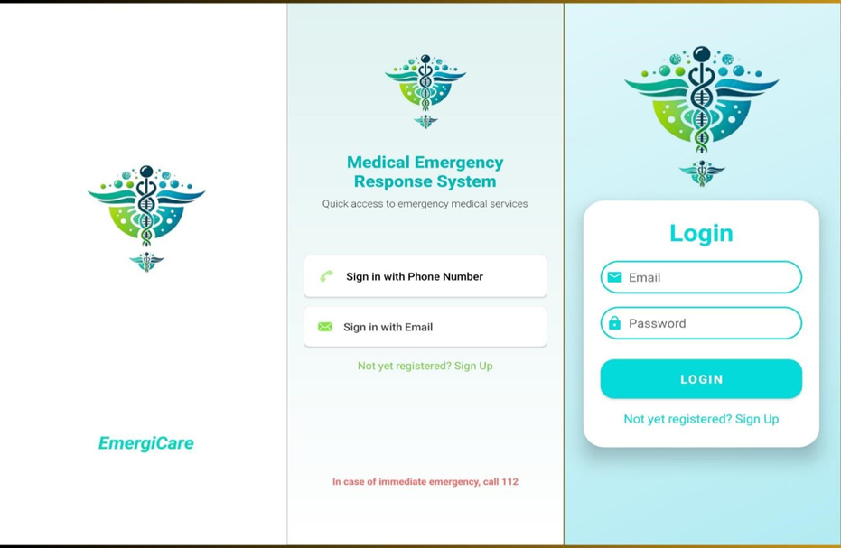
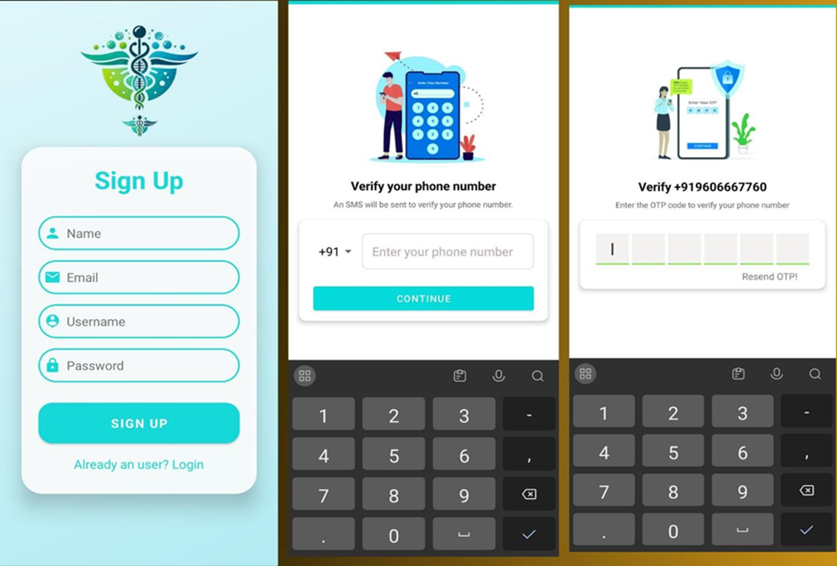
Screenshots

Slide 20
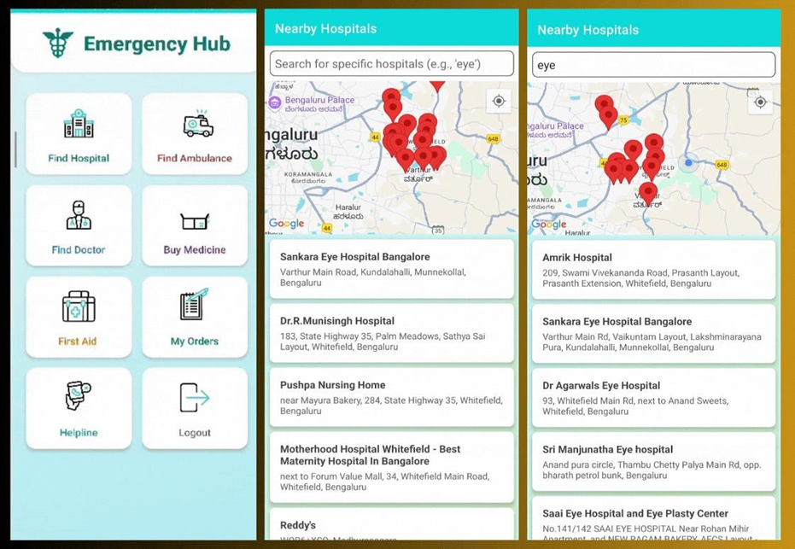
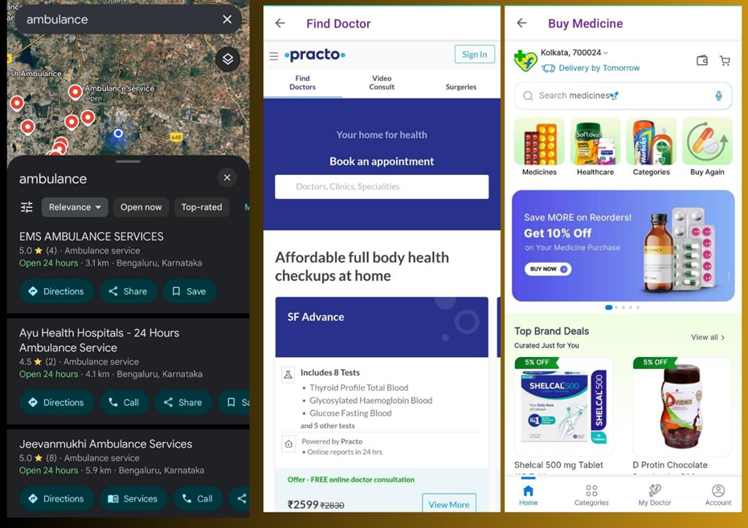
Screenshots

Slide 21
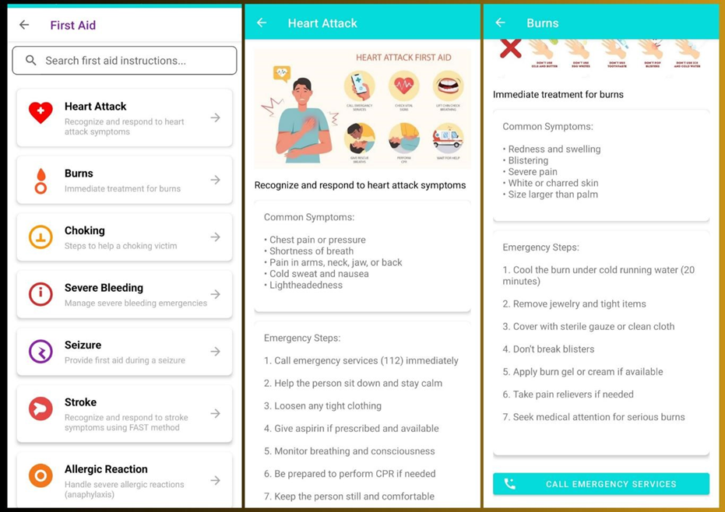
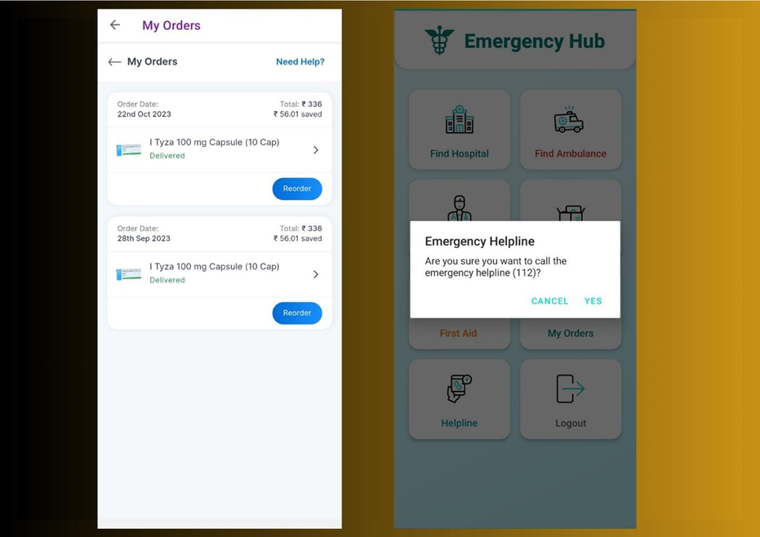
Screenshots

Slide 22
Thank You

