Slide 1
Project Evalution-2 Automatic Input through Webcam Guide: Prof.Vinay Joshi

Slide 2
What We have Completed…??
We are now able to detect the face and eyes through web-cam successfully.
Tools and Algorithms:
Haarcascade
OpenCV

Slide 3
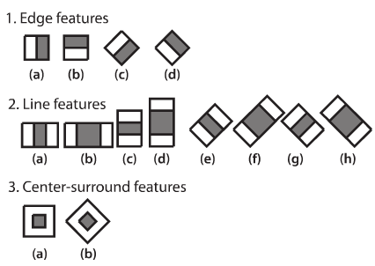
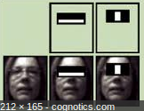
Explanation:

Slide 4
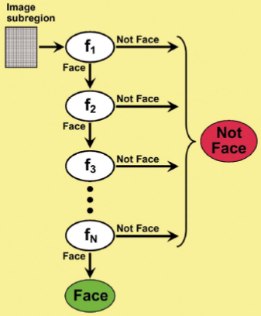
Explanation
Instead of applying all the 6000 features on a window, group the features into different stages of classifiers and apply one-by-one. (Normally first few stages will contain very less number of features). If a window fails the first stage, discard it. We don't consider remaining features on it. If it passes, apply the second stage of features and continue the process.

Slide 5
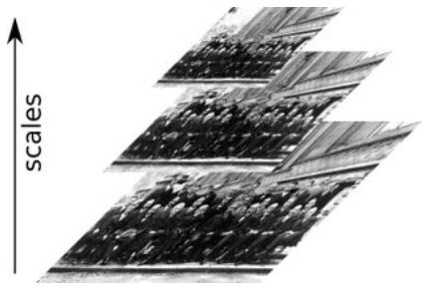
Our Part
We converted the Image to GrayScale
gray = cv2.cvtColor(img, cv2.COLOR_BGR2GRAY)
CascadeClassifier.detectMultiScale() to find faces or eyes
Image : Matrix of the type CV_8U containing an image where objects are detected.
ScaleFactor : Parameter specifying how much the image size is reduced at each image scale.(we used 1.03)

Slide 6
Results

Slide 7
What we are Doing Now…???
Face Reconization using Local Binary Histogram Pattern
Capture Dataset 100 Different Images of user
Come with a Pattern based on it.
Validate the user based on the recorded pattern.

Slide 8
