Slide 1
IBM University Engagement Project Submission
“ Exploring the Power of Agentic AI with IBM Granite and LangFlow ”

Slide 2

Project Title – Predictive Maintenance of Industrial Machinery
Domain of Project – ( Industrial & Study )
Student Name | Recent Passport Photo | Email ID | Mobile number [WhatsApp]
SAGAR SHARMA |  | Sagarsharma131006@gmail.com | +91-9812559948

Slide 3
Problem Statement -
Problem Statement : Predictive Maintenance of Industrial Machinery
The Challenge :
Develop a predictive maintenance model for a fleet of industrial machines to anticipate failures before they occur. This project will involve analyzing sensor data from machinery to identify patterns that precede a failure. The goal is to create a classification model that can predict the type of failure (e.g., tool wear, heat dissipation, power failure) based on real-time operational data. This will enable proactive maintenance, reducing downtime and operational costs.
The Objective :
To design and implement a machine learning model that can predict machine failures before they occur using historical and real-time sensor data.
Analyze Industrial Sensor Data - To study and process machine operational parameters such as temperature, rotational speed,
torque, and tool wear to identify patterns associated with equipment failures.
Classify Different Failure Types - To accurately identify and classify various failure categories including Tool Wear Failure, Heat
Dissipation Failure, Power Failure, Overstrain Failure, and Random Failures.
Enable Proactive Maintenance - To provide early warnings of potential failures, allowing maintenance teams to take preventive
actions before machine breakdowns occur.
Reduce Equipment Downtime - To minimize unplanned shutdowns and production interruptions by predicting failures in advance
and scheduling maintenance effectively.
Improve Operational Efficiency - To enhance machine performance, productivity, and resource utilization through data-driven
maintenance decisions.
Optimize Maintenance Costs - To reduce unnecessary maintenance activities and repair expenses by performing maintenance
only when required.

Slide 4

Technology Used
Tech Stack :
1) IBM Watsonx.ai AutoAI
2) IBM Cloud
3) Python
4) Scikit-learn
5) XGBoost
6) LightGBM
7) Snap ML
8) Lale
9) Jupyter Notebook
I used: IBM Watsonx.ai AutoAI + IBM Cloud + Python + Scikit-learn + XGBoost + LightGBM + Snap ML
Description :
This project uses IBM Watsonx.ai AutoAI on IBM Cloud to automatically build, train, and optimize machine learning models for predictive maintenance. The dataset is processed using Python, and AutoAI evaluates multiple algorithms such as XGBoost, LightGBM, Random Forest, and Snap ML to select the best-performing model. The final model is deployed as a web service on IBM Cloud for prediction.

Slide 5

Proposed Solution -
Proposed Solution: AI-Powered Predictive Maintenance System.
The proposed solution is an intelligent machine learning-based predictive maintenance system designed to anticipate equipment failures before they occur. The system analyzes real-time and historical sensor data collected from industrial machinery, including parameters such as temperature, rotational speed, torque, tool wear, and operational conditions.
The solution leverages IBM Watsonx.ai AutoAI to automate data preprocessing, feature engineering, model selection, and hyperparameter optimization. By identifying patterns associated with machine degradation and failures, the system can accurately predict potential breakdowns and classify different failure types.
The system consists of the following key modules:
Data Collection Module - Collects machinery sensor data including temperature, rotational speed, torque, tool wear, and machine operating conditions.
Data Processing & Feature Engineering Module - Cleans and preprocesses the collected data, handles missing values, and transforms features into a suitable format for model training.
Machine Learning Prediction Module - Uses IBM Watsonx.ai AutoAI to train and optimize multiple machine learning models. The best-performing model is selected automatically for failure prediction.
Failure Classification Module - Predicts different types of machine failures such as:
Heat Dissipation Failure
Power Failure
Overstrain Failure
Tool Wear Failure
Random Failure

Slide 6
Component Used -
1) Dataset Input Component Loads historical and real-time sensor data from industrial machines, including temperature, rotational speed, torque, and tool wear.
2) Data Preprocessing Component Cleans the dataset, handles missing values, removes inconsistencies, and prepares data for machine learning.
3) Feature Engineering Component Extracts and transforms important features from sensor data to improve prediction accuracy.
4) Machine Learning Model Component Trains and evaluates predictive models to identify potential machine failures before they occur.
5) Failure Prediction Component Predicts whether a machine is likely to fail and classifies the type of failure.
6) Maintenance Alert Component Generates early warning alerts and maintenance recommendations to reduce downtime and prevent unexpected breakdowns.
7) Performance Evaluation Component Measures model performance using metrics such as Accuracy, Precision, Recall, and F1-Score.

Slide 7
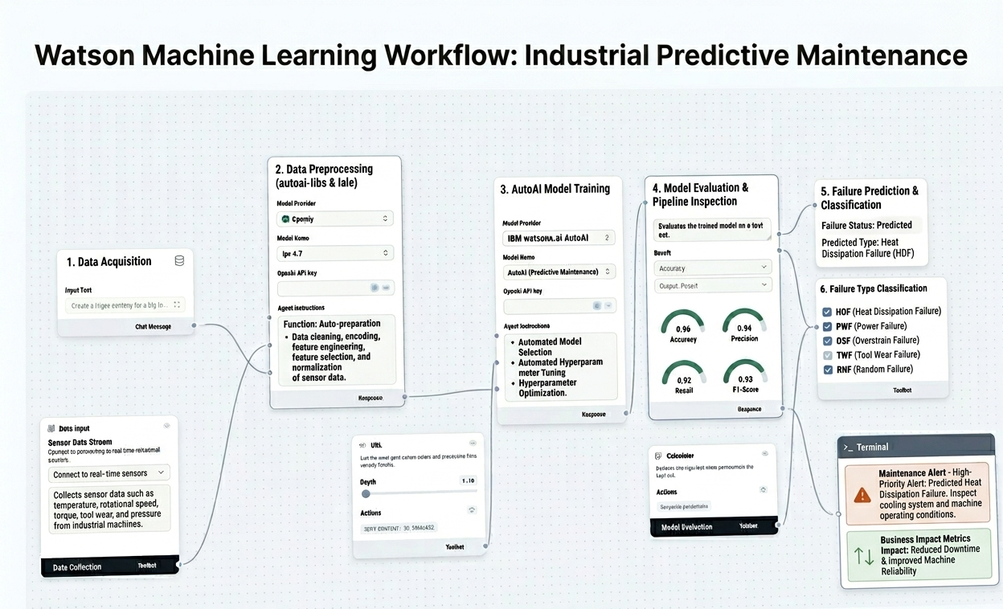
Machine Learning Workflow :

Slide 8

Role of Agentic AI in Predictive Maintenance :
Agentic AI as the Intelligent Core: Agentic AI acts as the central intelligence of the Predictive Maintenance System, enabling autonomous monitoring and analysis of industrial machinery. It continuously processes sensor data to assess machine health and detect abnormal operating conditions.
Real-Time Data Analysis: The system analyzes critical machine parameters such as temperature, rotational speed, torque, pressure, and tool wear. By identifying hidden patterns and trends, it can recognize early signs of equipment degradation and potential failures.
Automated Prediction and Decision-Making: Using IBM watsonx.ai AutoAI, the AI agent automatically performs data preprocessing, feature engineering, model selection, and optimization. This allows the system to generate accurate predictions and classify different types of machine failures.
Proactive Maintenance and Alerts: The AI agent provides real-time alerts and maintenance recommendations whenever a high risk of failure is detected. This enables maintenance teams to take preventive actions before a breakdown occurs, reducing unexpected downtime.
Business Impact and Benefits: By transforming traditional reactive maintenance into a proactive strategy, Agentic AI helps reduce maintenance costs, improve operational efficiency, increase equipment reliability, and extend the lifespan of industrial machinery. Overall, it enables smarter, data-driven decision-making for industrial operations.

Slide 9
Technologies Used:
1. IBM watsonx.ai AutoAI -
IBM watsonx.ai AutoAI is used to automatically preprocess data, engineer features, select the best machine learning algorithms, and optimize model performance. It accelerates the development of accurate predictive maintenance models without requiring extensive manual tuning.
2. IBM Cloud -
IBM Cloud provides a secure and scalable environment for storing data, training machine learning models, and deploying prediction services. It enables reliable access to predictive maintenance solutions from anywhere.
3. Python -
Python is used for data manipulation, preprocessing, exploratory data analysis, and integrating machine learning workflows. Its extensive libraries make it ideal for predictive maintenance applications.
4. Machine Learning Algorithms -
Algorithms such as XGBoost, LightGBM, Random Forest, and Snap ML are utilized by AutoAI to identify patterns in sensor data and predict machine failures before they occur.
5. Industrial Sensor Data -
The system uses machinery sensor data including temperature, rotational speed, torque, pressure, and tool wear to evaluate equipment health and detect potential failures.
6. Jupyter Notebook -
Jupyter Notebook is used for data analysis, model training, visualization, and testing. It provides an interactive environment for developing and evaluating predictive maintenance solutions.
7. Predictive Maintenance Model -
The trained predictive model continuously evaluates machine conditions, classifies failure types, and generates early maintenance alerts, reducing downtime and improving operational efficiency.

Slide 10
Novelty and Uniqueness
Novelty :
AI-Driven Predictive Maintenance: Unlike traditional maintenance approaches that rely on fixed schedules or manual inspections, this solution uses machine learning to predict failures before they occur, enabling proactive maintenance.
Automated Model Development with AutoAI: The system leverages IBM watsonx.ai AutoAI to automatically perform data preprocessing, feature engineering, model selection, and hyperparameter optimization, significantly reducing development time and improving prediction accuracy.
Failure Type Classification: The solution not only predicts whether a machine is likely to fail but also identifies the specific type of failure, helping maintenance teams take targeted corrective actions.
Uniqueness :
Real-Time Equipment Health Monitoring: The system continuously analyzes sensor data such as temperature, rotational speed, torque, and tool wear to provide real-time insights into machine conditions.
Early Warning and Maintenance Alerts: It generates intelligent alerts before a failure occurs, reducing unexpected downtime and preventing costly production interruptions.
Data-Driven Maintenance Decisions: Instead of relying on reactive maintenance strategies, the solution enables industries to make informed maintenance decisions based on predictive analytics and machine health trends.
Scalable and Industry-Oriented Solution: The framework can be applied across various industrial sectors, making it adaptable to different machinery types and operational environments.
Cost Reduction and Increased Reliability: By preventing unexpected breakdowns and optimizing maintenance schedules, the solution helps reduce maintenance costs, improve productivity, and extend equipment lifespan.

Slide 11

Git Hub Link :
·https://github.com/SagarSharma131006/ML_Project
·
·
·
This Photo by Unknown Author is licensed under CC BY-NC

Slide 12
Future Scope
1. Real-Time IoT-Based Monitoring
In the future, the system can be integrated with IoT-enabled sensors and connected devices to continuously collect live machine data. This will enable real-time monitoring of equipment health and instant detection of abnormal operating conditions, allowing industries to take preventive actions before failures occur.
2. Intelligent Maintenance Automation
The solution can be enhanced to automatically generate maintenance schedules, work orders, and maintenance recommendations based on predicted machine conditions. This will reduce manual intervention, improve resource utilization, and ensure timely maintenance activities.
3. Industry 4.0 and Smart Factory Integration
The predictive maintenance system can be integrated with Industry 4.0 technologies, ERP systems, and smart factory platforms. This integration will enable centralized monitoring, automated decision-making, and intelligent asset management across entire industrial facilities.
·
·
·

Slide 13


This Photo by Unknown Author is licensed under CC BY-NC

