Slide 1

Seasonal Agriculture Performance Analysis
Sagar Sharma
Panipat Institute of Engineering and Technology
AICTE STU ID : STU688dcbd0133971754123216

Slide 2

PROBLEM STATEMENT
Agricultural activities are influenced by seasonal variations in environmental conditions, farming practices, resource availability and market conditions, causing performance to differ from one season to another.
Raw agricultural data does not clearly reveal how performance changes across seasons or what patterns exist within different seasonal conditions.
This project analyzes a seasonal agriculture dataset to identify meaningful patterns, trends, relationships and variations in agricultural performance across the Kharif, Rabi and Zaid seasons.

Slide 3
Project Description Analysis of 4,000 farm records across 8 states, 10 districts, 8 crops, 3 seasons and 4 irrigation methods, covering environmental conditions, farming inputs and economic outcomes, to uncover seasonal patterns in agricultural performance.
Cleaned missing Rainfall, Soil Moisture and Yield values using season-wise medians
Compared Yield and Profit across Kharif, Rabi and Zaid using boxplots and summary statistics
Examined environmental conditions, resource usage and economic outcomes season by season
Studied correlations between environmental/input factors and Yield
Compared performance across crops, states and irrigation methods within each season
Applied a one-way ANOVA test to check whether seasonal differences are statistically significant
Derived evidence-based key findings and recommendations, documented fully in a Jupyter Notebook

Slide 4

WHO ARE THE END USERS?
Farmers deciding which crops to grow in which season
Agricultural policymakers and government agriculture departments, for seasonal planning support
Agri-fintech and crop insurance companies, for seasonal risk assessment
Agronomists and researchers studying seasonal performance patterns
Agri-business and supply chain planners forecasting seasonal production

Slide 5

Technology Used
Python — core programming language for the analysis
Pandas, NumPy — data cleaning and manipulation
Matplotlib, Seaborn — data visualization
SciPy (stats module) — one-way ANOVA statistical testing
Jupyter Notebook — documentation and analysis environment

Slide 6
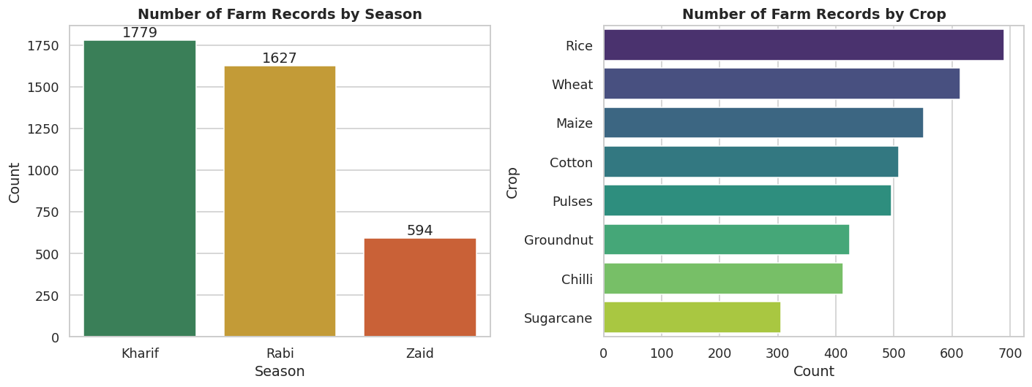
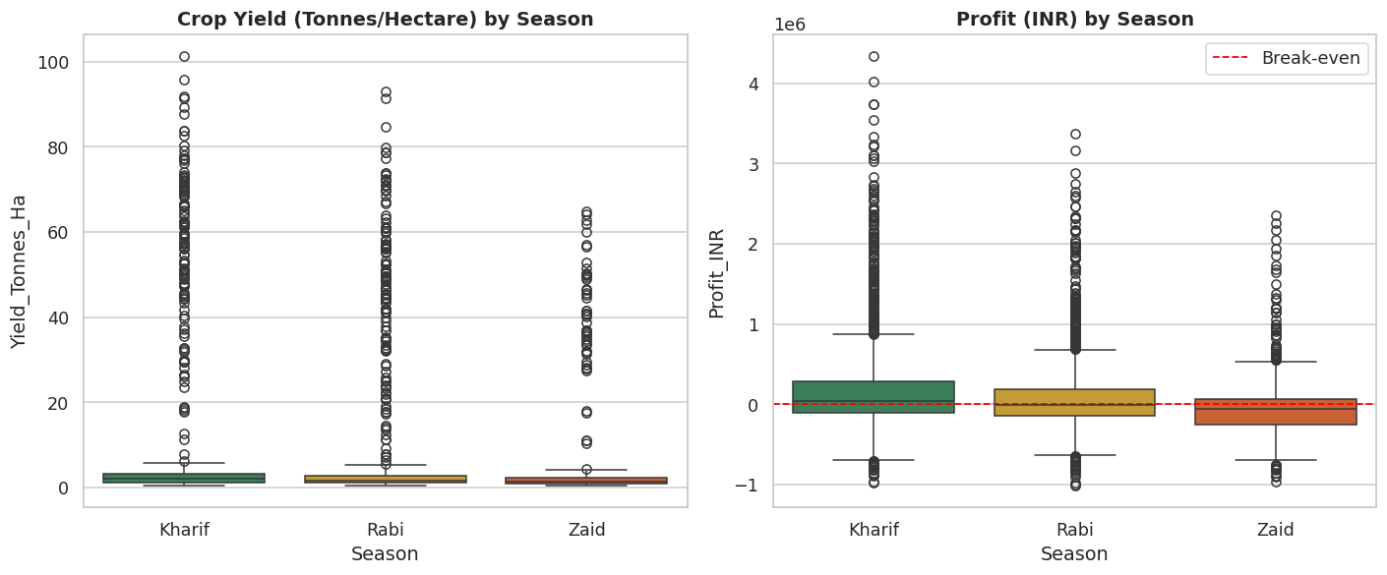
RESULTS
Zaid has far fewer farm records (594) than Kharif (1,779) or Rabi (1,627)
Yield dips only slightly, but Profit turns negative in Zaid

Slide 7
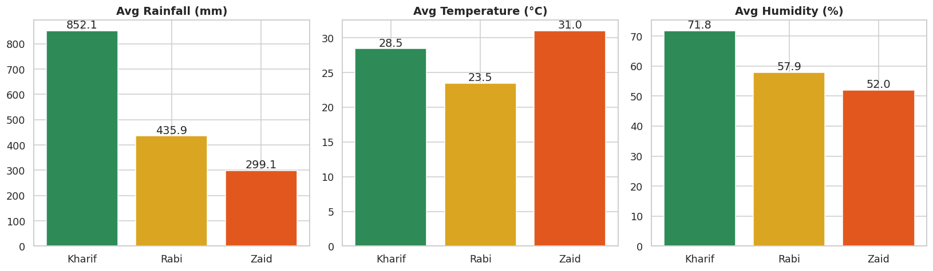
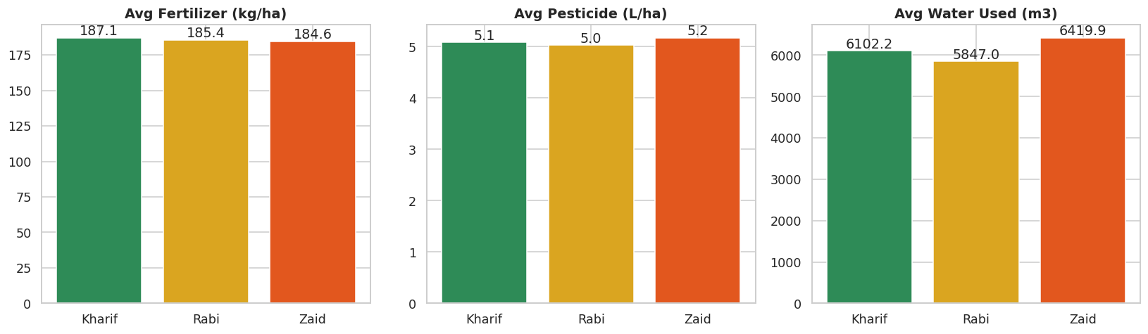
RESULTS
Kharif has the highest rainfall and humidity of the 3 seasons
Fertilizer, pesticide and water use stay nearly flat across seasons

Slide 8
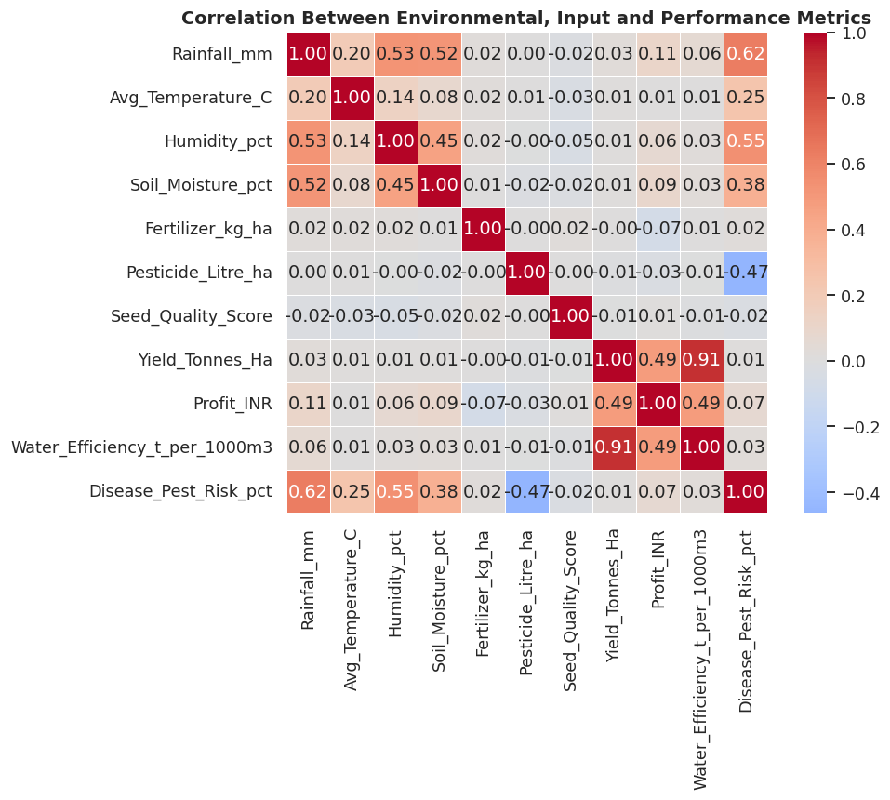
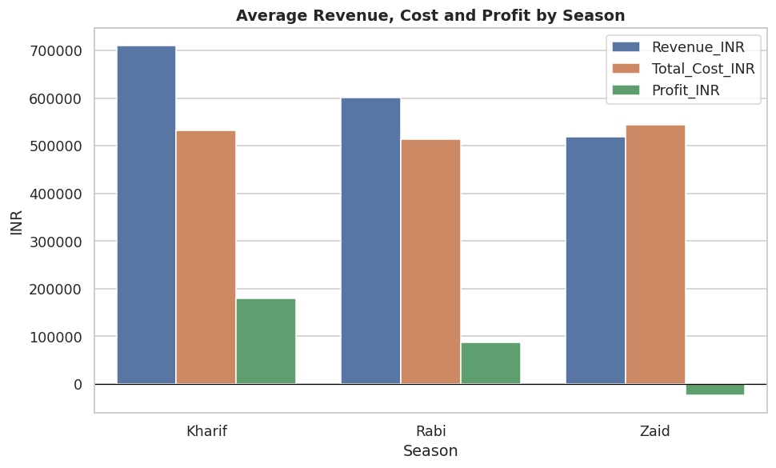
RESULTS
Revenue falls faster than cost across seasons, driving Zaid into a loss
Individual factors show weak linear correlation with Yield alone

Slide 9
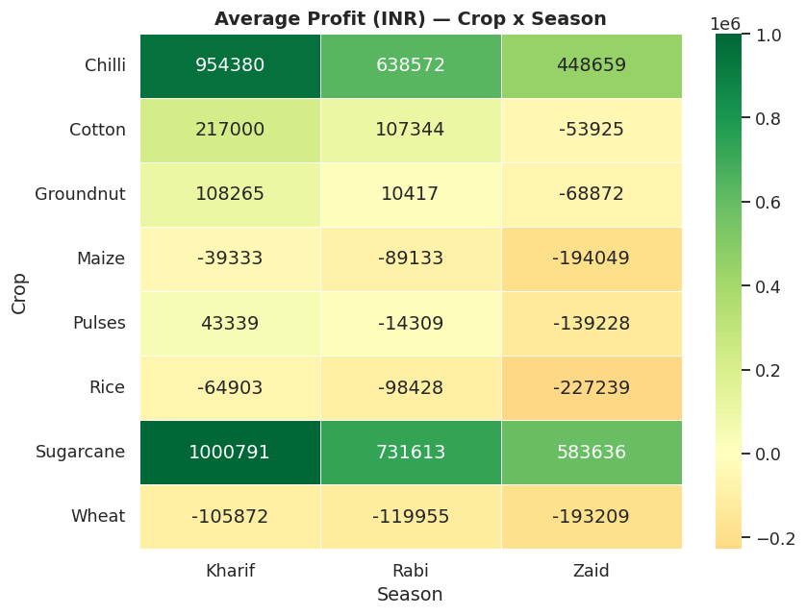
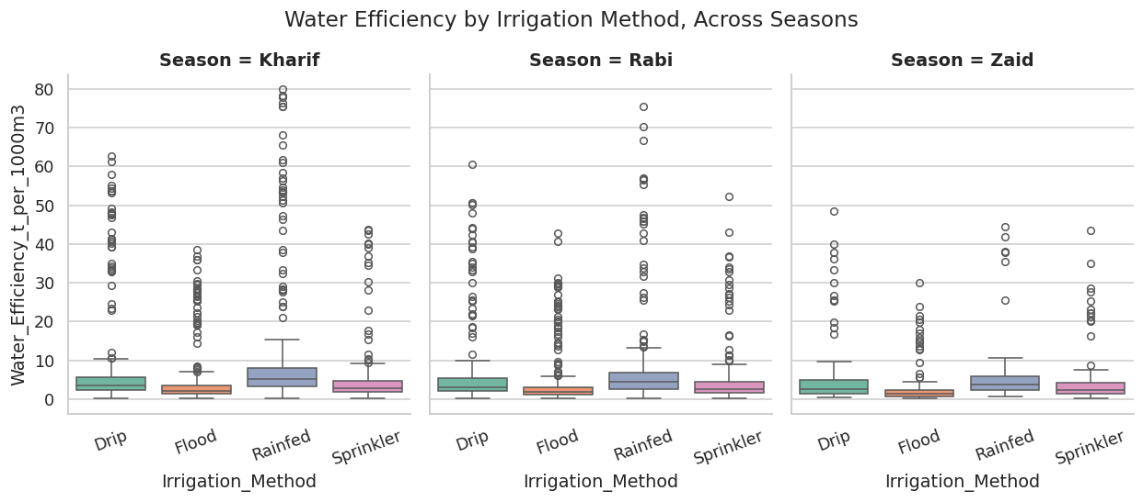
RESULTS
Rainfed shows the highest water efficiency across all seasons
Sugarcane and Chilli stay profitable in every season

Slide 10
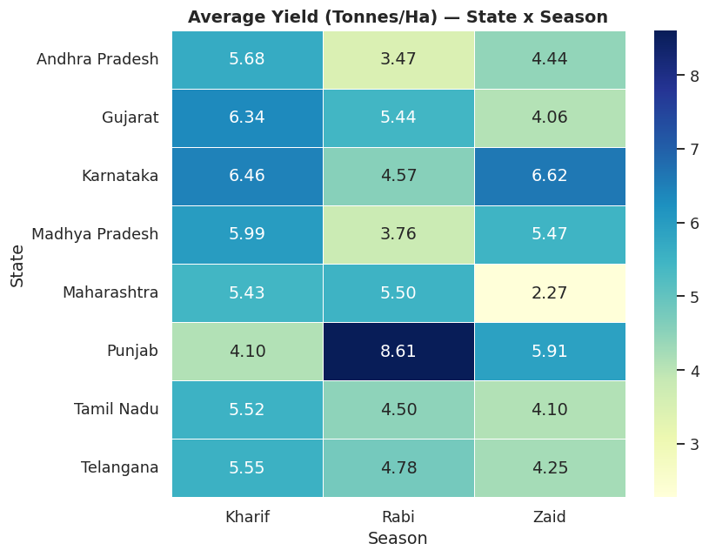
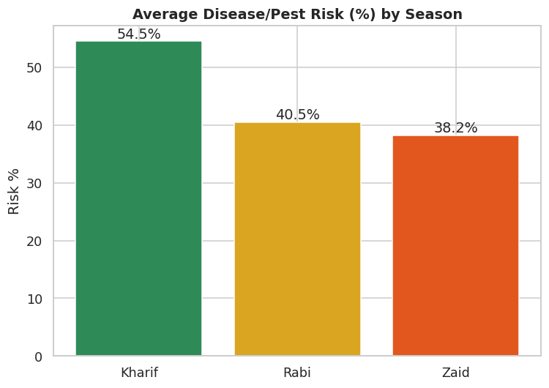
RESULTS
Disease/pest risk is highest in Kharif despite better rainfall
Season affects each state differently (e.g. Punjab peaks in Rabi, Maharashtra dips in Zaid)
One-way ANOVA: Profit differs significantly across seasons (p < 0.001); the Yield difference is not statistically significant (p = 0.21)

Slide 11
Future scope
Build a multivariate/ML model (e.g. Random Forest) to predict Yield and Profit, since individual factors show weak linear correlation on their own
Extend the dataset to more states, crops and multiple years to study seasonal trends over time
Integrate live weather API data for real-time seasonal risk alerts
Build a farmer-facing dashboard recommending the most profitable crop per season and region
Study the cost-structure drivers behind Zaid season losses in more depth

Slide 12
GitHub Link
Complete project code, dataset and Jupyter Notebook are available on GitHub:
https://github.com/SagarSharma131006/VI_Internship_Major_Project
Repository: Seasonal-Agriculture-Performance-Analysis
Seasonal_Agriculture_Performance_Analysis.ipynb — fully executed notebook with cleaning, EDA, ANOVA and conclusions
seasonal_agriculture_performance_dataset.csv — source dataset used for the analysis

Slide 13

VOIS Course completion certificate - Course name- Data Visualization

Slide 14
Thank you
Sagar Sharma
Panipat Institute of Engineering and Technology
sagarsharma131006@gmail.com
linkedin.com/in/sagar-sharma-148b1a3a4
github.com/SagarSharma131006/VI_Internship_Major_Project

