Slide 1


Topic :- Electronic Waste recycling
Malnad College of Engineering ,Hassan
(An autonomous Institution affiliated to VTU, Belagavi)
2023-24
Tackling India’s Next Big Problem
UNDER THE GUIDANCE OF:
Mr.Ravikumar D
BE,M.Tech
Assistant Professor
BY:
Sagar C R 4MC21CS126

Slide 2
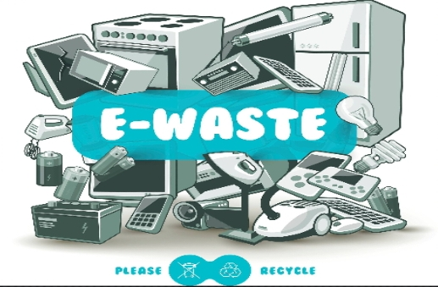
Project on e-waste management

Slide 3

Vision and mission and statemenT
Vision:
Creating a Cleaner,Greener the future by leading the way in small E-waste management,Ensuring environmental Protection and Fostering sustainable growth for communities.

Slide 4

Mission :
Collect Responsibly: We gather electronic waste (like old phones and computers) carefully and safely. Recycle Efficiently: We use smart methods to turn e-waste into useful materials without harming the environment. Educate Everyone: We teach people about the importance of managing e-waste properly to keep our planet healthy.
Create Jobs: We provide opportunities for people to work in e-waste management, helping communities grow.

Slide 5
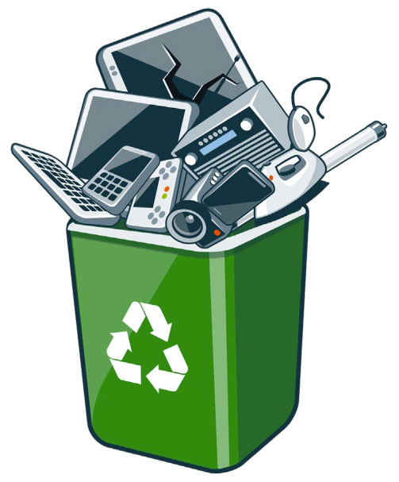
What Is e-waste ?
E-waste is electronic products that are unwanted, not working, and nearing or at the end of their “useful life.” Computers, televisions, VCRs, stereos, copiers, and fax machines are everyday electronic products.
Electronic waste or e-waste refers to discarded electric appliances.
Each year, about 50 to 60 million tons of e-waste are generated, equivalent to only 2-3% of annual global waste .

Slide 6
Importance of e-waste recycling :-
Decrease Raw Material Demand
Reclaiming estimable elements from the recycling process can help to decrease the demand for raw materials. It helps conserve essential natural resources.
Reduce Greenhouse Gas Emissions
You might be unaware of the reality that using a recycled substance can decrease greenhouse gas emissions. It is mainly produced while manufacturing new products, which result in increasing global warming and climate change.
Support Non-renewable Recycling
The increasing demand for modern appliances means a range of elements and other non-renewable sources must be excavated and concocted.
Reduce Costs
E-waste recycling is undoubtedly good for the environment but also good for brands. Most countries have incentivized e-waste recycling by lifting the price of dropping or ultimately preventing it.
and many more…

Slide 7
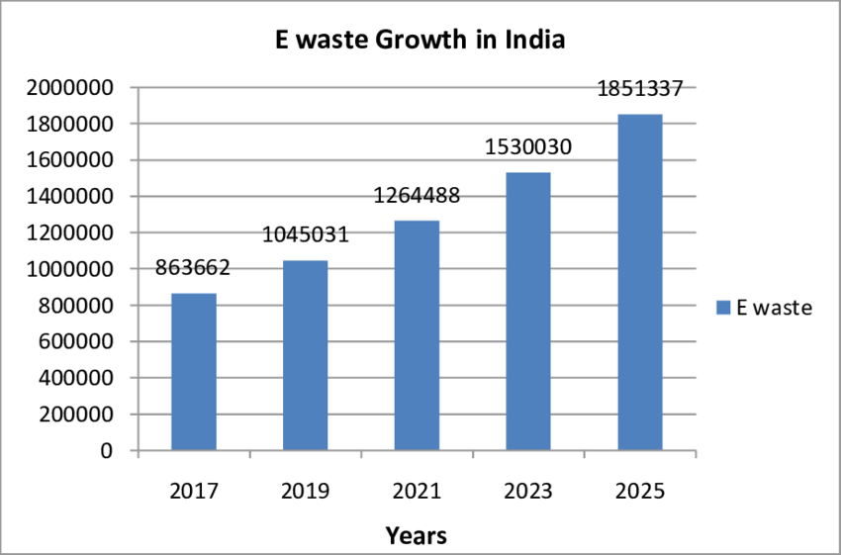
Market Analysis :-
India generates about 1.85 million tonnes of e-waste annually.
India ranks fifth in the world among top e-waste producing countries.
95 per cent of India's e-waste comes from the unorganised sector.

Slide 8
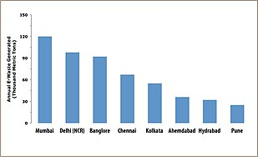
In India, the amount of e-waste generated differs by state. The three states that produce the most e-waste are as follows: Maharashtra, Tamil Nadu and Andhra Pradesh.
Market size : The potential market for e-waste recycling services for small scale industry in india is estimated at INR of 1.5 crores by 2025.
Target Demographics: Industries like IT, telecommunications, and consumer electronics contribute significantly in India.

Slide 9
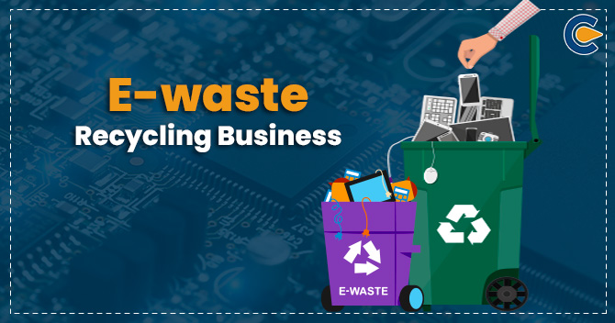
Business Model :-
We collects e-waste from businesses and individuals, processes it in our advanced facilities, and sells recovered materials.
Revenue Streams: How to get an income?
Service fees from businesses, resale of recovered materials.
partnerships with Indian electronics manufacturers.

Slide 10




Partnerships:
Collaborating with major Indian electronics retailers for responsible disposal and recycling.
Indian electronics retailers are like most e-commerce companies :-
Amazon
Apple
Croma
Reliance digital

Slide 11
Environmental impacts :-
The process used to recycle and dispose of e-waste in India have led to a number of harmful environmental impacts.
As a result, improper recycling and disposal techniques, air, water and soil throughout much of India is now contaminated with toxic e-waste byproducts.
Which may effect the health of local communities.
Contribution of recycle of e-waste :
Aim is to reduce the carbon footprints by 20% through responsible recycling.
Providing manufacturers with recycled metals that can be used to make new products.
Protecting human and environmental health by keeping those devices out of landfills.

Slide 12
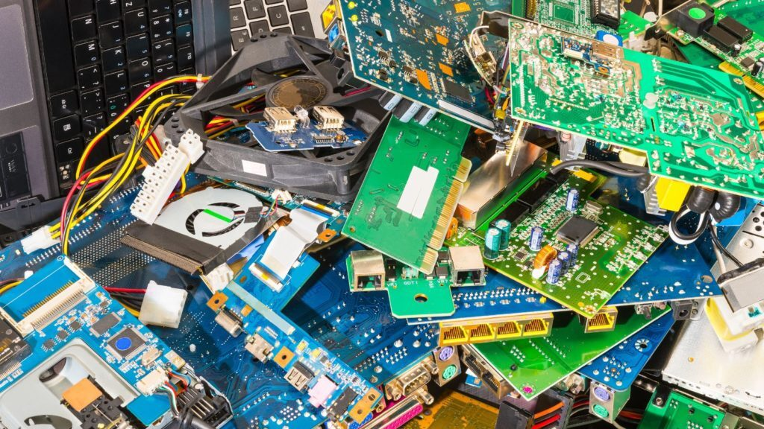
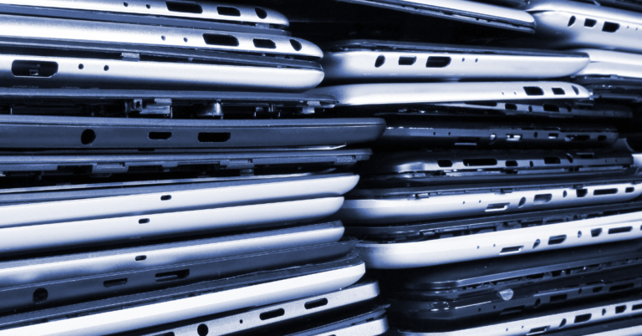
Technology and Process :-
Collection:
e-waste does not belong to general waste when disposing of e-waste, you need to bring it to a designated collection place, usually a special recycling bin, a certified collection site, or major electronics retailers.
Sorting:
The first step in processing e-waste involves manual sorting to extract specific items, such as batteries and bulbs, for their own processing. During this stage, certain items may be dismantled by hand to recover valuable materials or components for reuse.
Magnetic separation:
The e-waste is shredded and subjected to magnetic separation to extract ferrous metals like iron and steel, while non-ferrous metals are separated using eddy currents.

Slide 13
Materials that can be extracted and re-used include:
precious metals such as gold, silver, copper, platinum, rhodium, or ruthenium.
critical raw materials such as cobalt, palladium, indium, or antimony.
noncritical metals such as aluminum and iron.
Innovation: Implementing a AI
Integration of AI for automated sorting and identification of recyclable components, considering the unique challenges in India.
Efficiency:
Achieving higher recycling rates compared to traditional methods, especially for commonly used electronic items in India.

Slide 14
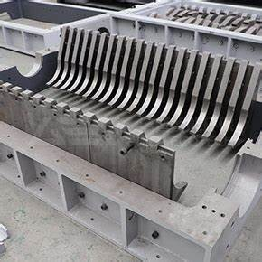
Equipment needed for recycle :
High-capacity shredders, magnetic separators, and advanced material recovery units suitable for Indian e-waste.
High-capacity shredders is used to crash the materials obtained from collection of e waste
Magnetic separators is used to separate a magnetic and non magnetic substances

Slide 15

Social Impact :
Job Creation : By this e waste management it create 50 jobs and more in local Indian communities.
Community Benefits: Engaged in community clean-up initiatives and sponsored local environmental awareness programs in Indian cities.
Education Initiatives: Conducting workshops on responsible e-waste disposal in Indian schools and communities.

Slide 16
Risks and Strategy to solve the risk
Market Competition:
Risk: Increased competition in the market can impact market share and profitability.
Strategy: Continuous market analysis in India allows the business to stay informed about market trends and competitors' actions.
Changes in Indian Regulations:
Risk: Regulatory changes in India can pose challenges in business operations.
Strategy: A flexible business model that can quickly adapt to changes in Indian regulations is crucial.

Slide 17
Thank you

