Slide 1

Resume Analyser and Career Recommendation System using NLP
Presented by
Name of the Guide: Dr. A.Ushasree
GOTTAPU KAVYA | 245621737090
SAGARIKA SANGAYIPETA | 245621737117
AKSHARA PENTEWAR | 245621737112

Slide 2
ABSTRACT
The recruitment process is often slowed down by manual resume screening and poor candidate-role matching. This project presents an offline, automated resume screening and career recommendation system using NLP techniques like Transformers, SpaCy, NLTK, and Streamlit. It extracts key resume data such as skills, roles, and keywords, then recommends missing skills, relevant courses, certifications, and LinkedIn job links. Additional features include resume/interview tips videos, resume scoring with justification, predicted career fields, and estimated experience levels.
For administrators, the system offers a password-protected dashboard to post/delete job listings, manage applicants with select/reject options, view interactive charts (field prediction, resume score, user stats), and export data via CSV. It also includes job selection and apply buttons to enhance user interaction. Overall, it significantly reduces manual effort, improves accuracy, and enhances candidate-job alignment.

Slide 3
Problem Statement
In big organizations where the applicant number is massive. Each recruiter takes time to manually assess and analyze the resumes of all applicants, which usually run in the thousands, in order to pick out the best candidates for the job. The problem we focus on solves the problem of recruitment or hiring which brings up another hurdle in the recruiting process. The task proposes an AI-based Resume Parser and Analyzer using Natural Language Processing (NLP) techniques.

Slide 4
Literature Survey
S.no | Year | Authors | Paper Title | Methodology | Performance Metrics
1. | 2023 | Sroison, P. and Chan, J.H., 2023 | Resume parser with natural language processing | Uses NLP techniques like NER and regex for extracting key details from resumes. | Accuracy of resume parsing and correctness of extracted fields.
2. | 2023 | Lokesh, S. et al., 2022 | Automated Resume Screening Using Natural Language Processing | Uses S-BERT and cosine similarity for ranking resumes based on relevance to job descriptions. | Accuracy (resume-job matching precision) and efficiency (time saved vs. manual screening).
3. | 2023 | Lakshmi Padmaja, D., Vishnuvardhan, Ch., Rajeev, G., Nitish Sanjeev Kumar, K., 2023 | Smart Resume Analyser: A Case Study using RNN-based Keyword Extraction | Employs RNN-based keyword extraction to parse and analyze resumes for skill and job-role matching. | Success rate (85%) for correct role matching and parsing efficiency.
4. | 2020 | Aggarwal, A. et al., 2020 | Resume Screening | Combines NLP and PyResParser to extract structured data from resumes using RNNs. | Accuracy of information extraction and job-role relevance.
5. | 2023 | Mankawade, A. et al., 2023 | Resume analysis and job recommendation | Implements deep learning models (e.g., BERT) for parsing resumes and generating skill recommendations. | Precision and recall for resume-job matching and skill predictions.

Slide 5
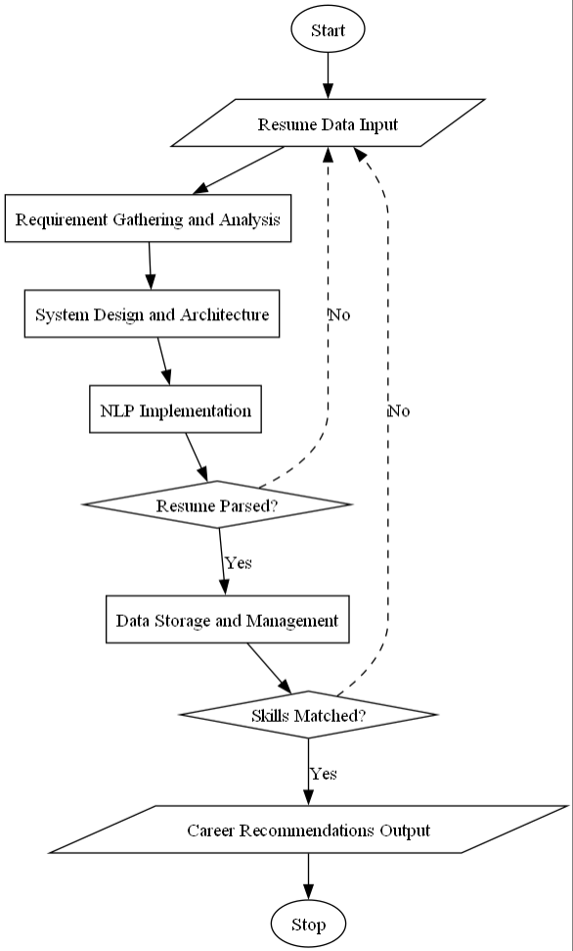
METHODOLOGY

Slide 6
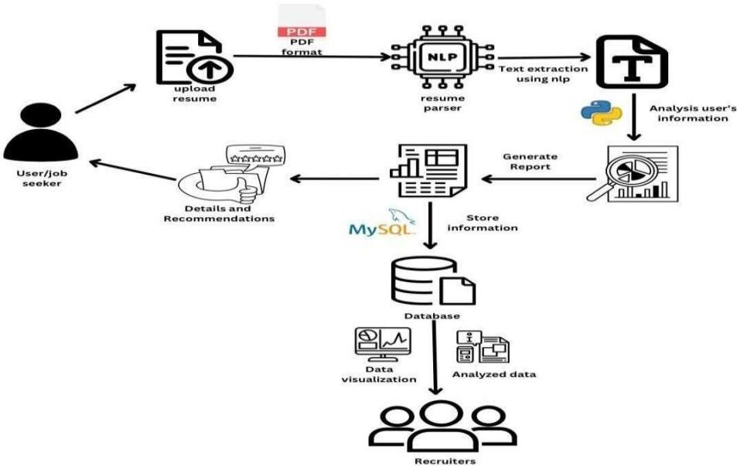
SYSTEM ARCHITECTURE

Slide 7
REQUIREMENTS
SOFTWARE REQUIREMENTS
Operating System : Windows 10/11, Linux, or macOS
Coding Language : Python 3.8 or higher
Editor : Visual Studio Code / PyCharm
HARDWARE REQUIREMENTS
Processor : Intel Core i3 or higher (Core 2 Duo minimum)
RAM : 4 GB (1 GB minimum)
Hard Disk : 10–20 GB free space

Slide 8
TECHNOLOGIES USED
Frontend/Interface : Streamlit
Programming Language : Python
Natural Language Processing : SpaCy, NLTK, Transformers
Data Handling and Processing : Pandas, NumPy
Data Visualization : Matplotlib, Seaborn, Plotly
Machine Learning : Scikit-learn, Joblib
Web Scraping/API Access : Requests, BeautifulSoup
Database : MySQL or SQLite
Editor : Visual Studio Code / PyCharm
Resume Scoring and Matching : Custom logic and NLP-based keyword matching
Export Functionality : CSV, OpenPyXL

Slide 9
SAMPLE CODE
import streamlit as st
import nltk
import spacy
import PyPDF2
import time
nltk.download('stopwords')
spacy.load('en_core_web_sm')
import pandas as pd
import base64, random
import matplotlib.pyplot as plt
from pyresparser import ResumeParser
from streamlit_tags import st_tags
connection = pymysql.connect(host='localhost', user='root', password='1533@sQl', db='cv')
cursor = connection.cursor()
cursor.execute("""
CREATE TABLE IF NOT EXISTS job_postings (
job_id INT AUTO_INCREMENT PRIMARY KEY,

Slide 10
connection = pymysql.connect(host='localhost', user='root', password='1533@sQl', db='cv')
cursor = connection.cursor()
cursor.execute("""
CREATE TABLE IF NOT EXISTS job_postings (
job_id INT AUTO_INCREMENT PRIMARY KEY,
job_title VARCHAR(100),
company_name VARCHAR(100),
required_skills TEXT
)""")
cursor.execute("""
CREATE TABLE IF NOT EXISTS applications (
app_id INT AUTO_INCREMENT PRIMARY KEY,
job_id INT,
name VARCHAR(100),
email VARCHAR(100),
resume_skills TEXT,
status VARCHAR(20) DEFAULT 'Pending',
domain VARCHAR(100),
experience_level VARCHAR(50),
FOREIGN KEY(job_id) REFERENCES job_postings(job_id)
)""")
connection.commit()

Slide 11
st.subheader("📄 View All Jobs Posted")
max_app_id = 0
cursor.execute(f"ALTER TABLE applications AUTO_INCREMENT = {max_app_id + 1}")
connection.commit()
# Now delete the job posting
cursor.execute("DELETE FROM job_postings WHERE job_id = %s", (job_id,))
connection.commit()
st.success("Job and associated applicants deleted successfully.")
if st.button("Clear Applicants Data"):
job_id = jobs[int(selected_job_str.split('.')[0]) - 1][0]
cursor.execute("SELECT COUNT(*) FROM applications WHERE job_id =
cand_level = "Fresher"
st.markdown('''<h4 style='text-align: left; color: #d73b5c;'>You are at Fresher level!</h4>''',
unsafe_allow_html=True)
elif num_pages == 2:
cand_level = "Intermediate"
st.markdown('''<h4 style='text-align: left; color: #1ed760;'>You are at intermediate level!</h4>''',
unsafe_allow_html=True)
elif num_pages >= 3:
cand_level = "Experienced"
run()

Slide 12
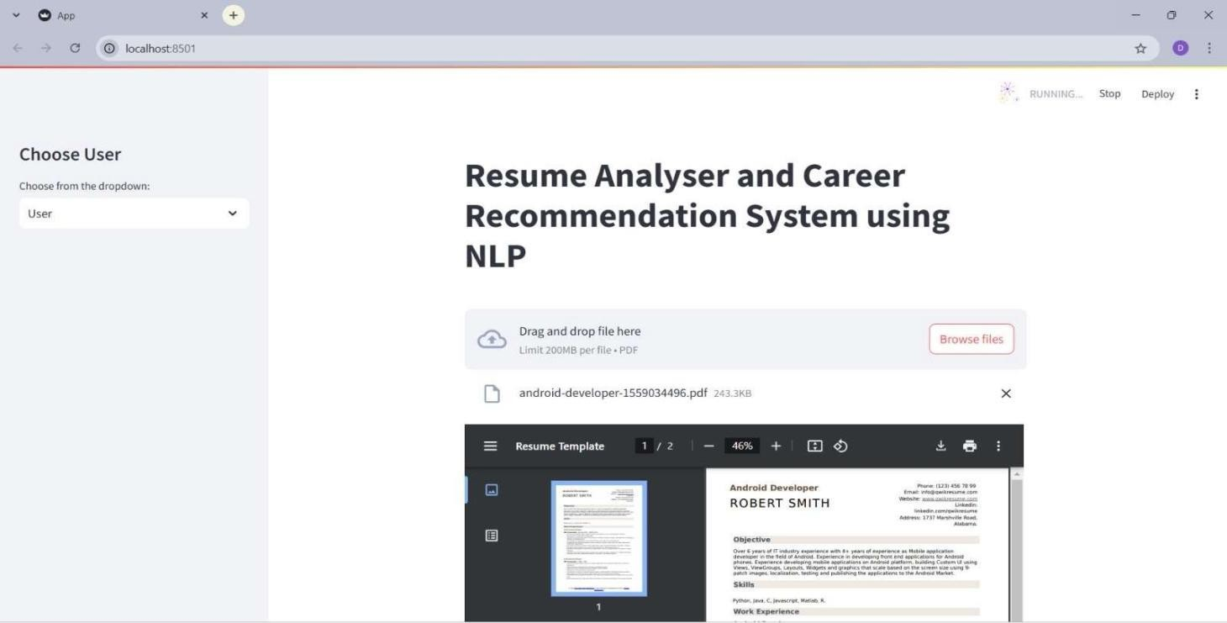
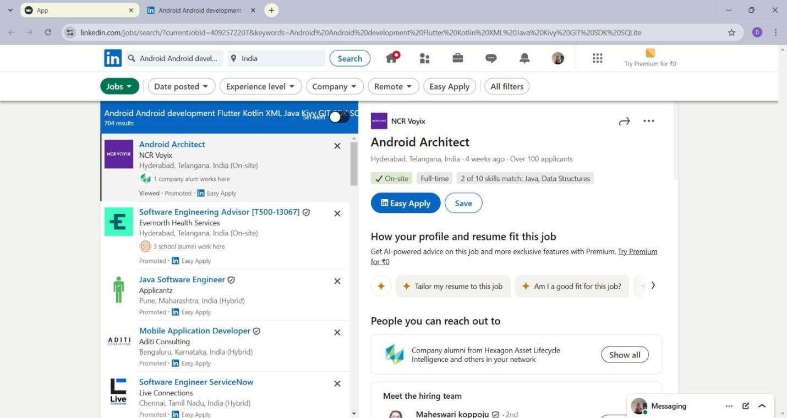
RESULTS
User Data and Skills Extraction
Job Finding Based on the extracted Skills

Slide 13
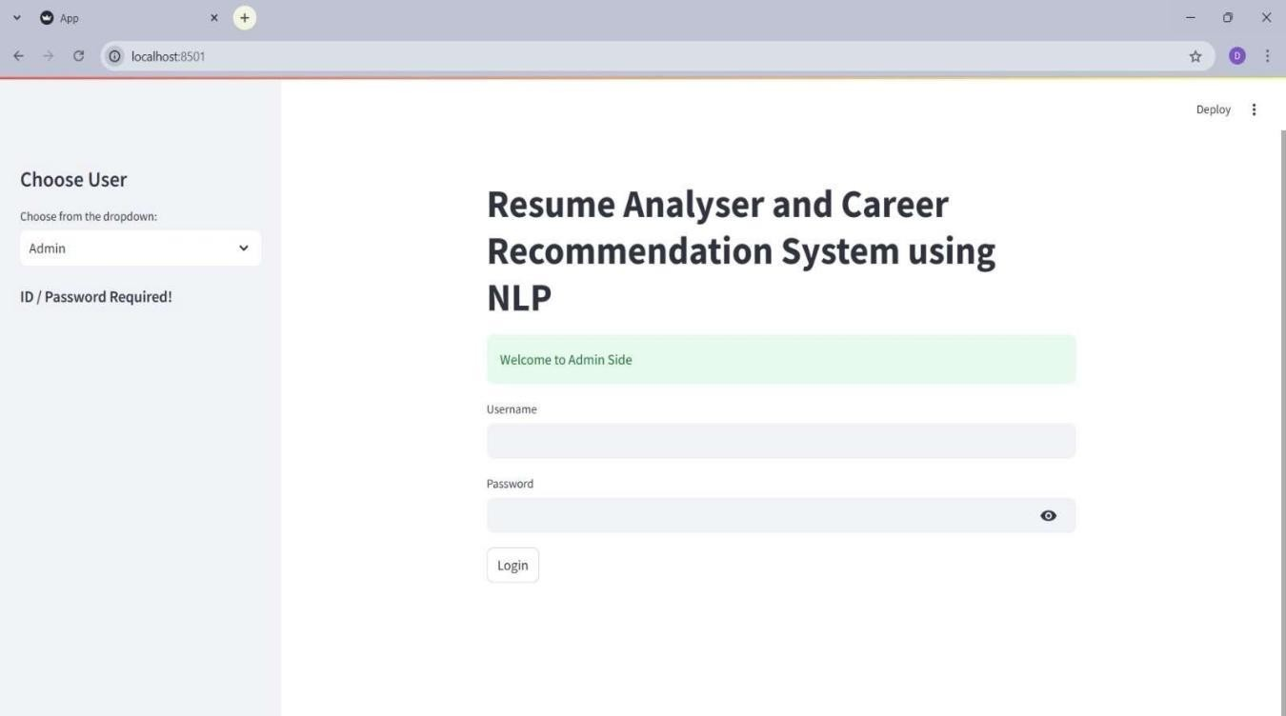
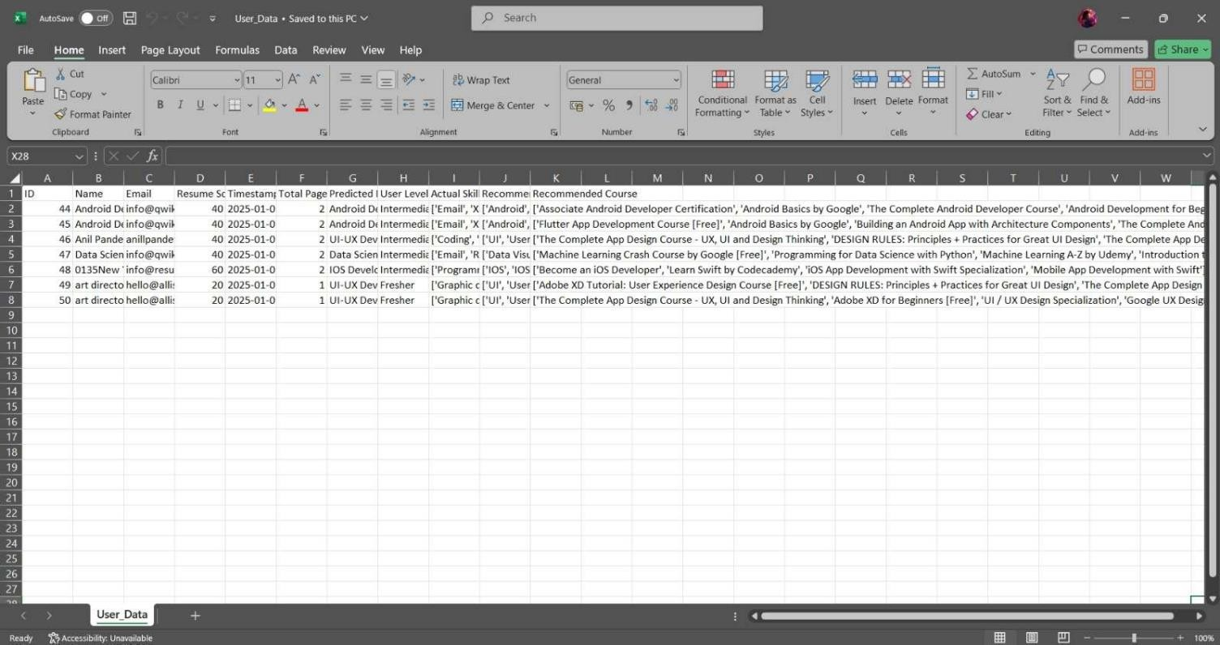
RESULTS
Admin login page
Downloaded User Report

Slide 14
CONCLUSION
The 'Resume Analyzer and Career Recommendation System Based on NLP' is the kind which can be used as a good, friendly, and time-saving tool by both the applicants and recruiters. It scans resumes automatically, extracting data from them and re-arranging them in machine- readable form. To candidates, it provides personalized recommendations, prediction of the job position, and professional recommendations to enhance their resume along with enabling them to make informed career choices. The recruiters, on their part, are aided by quicker, real-time processing, categorization, and evaluation of resumes. The system also helps organizations, schools, and recruitment agencies by delivering useful feedback that empowers and complements their recruitment process.

Slide 15
REFERENCES
[1]Sroison, P. and Chan, J.H., 2023. Resume parser with natural language processing. Authorea Preprints.
[2]"Automated Resume Screening Using Natural Language Processing", International Journal of Emerging Technologies and Innovative Research (www.jetir.org | UGC and issn Approved), ISSN:2349-5162, Vol.10, Issue 3, page no. ppf100-f104, March-2023.
[3]Sruthi, P., Adithya, P.N.V.K.G., Suleman, M.D., Kunal, P. and Gairola, S.P., 2023. Smart Resume Analyser: A Case Study using RNN-based Keyword Extraction. In E3S Web of Conferences (Vol. 430, p. 01023). EDP Sciences.
[4]Aggarwal, A., Jain, S., Jha, S. and Singh, V.P., Resume Screening.
[5]Mankawade, A., Pungliya, V., Bhonsle, R., Pate, S., Purohit, A., & Raut, A. (2023, April).Resume analysis and job recommendation. In 2023 IEEE 8th International Conference for Convergence in Technology (I2CT) (pp. 1-5). IEEE.

