Slide 2
Problem Definition
The objective is to identify the shopper’s likelihood to return to the store next week (Sun-Sat) And purchase less than 3 units based on their past shopping behavior
Given each observations is the trip to the retail store
The data contains all trips for a sample of shoppers from 3/20/2015 – 3/26/2016
The tool used for solving this problem: R

Slide 3
Preparing and pre-processing the data
Extracting the data and getting the basic understandings of the data by going through the different data fields.
datascience<-read.csv("/Users/sagarikadutta/Downloads/data_science_challenge_samp_18.csv")
Preparing the guidelines and steps to follow to build the predictive model
Viewing the dataset and checking the data fields structures in R:
View(datascience)
str(data science)

Slide 4
Analyzing the data
In the given problem, we are predicting the shopper’s likelihood to return to the next week
A predictor or target variable has to be constructed that will predict an ordered value
that are ‘1’ if the shopper will return next week
And ’0’ if the shopper will not return next week

Slide 5
Data Cleaning
Checking Missing Values, NA, NaNs, and Infinites in the dataset
sum(sapply(datanew,is.na)) -> 0
sum(sapply(datanew,is.nan)) ->0
sum(sapply(datanew,is.infinite))->0
Checking for the outliers in the dataset by creating the histogram for each fields
hist(datascience$cust_id,main="Customer_id Of Customers",xlab="customer_id")
hist(datascience$order_date,"years",main="Order date Of Customers",xlab="orderdate")
hist(datascience$lane_number,main="Lane number Of Customers",xlab="lane number")
hist(as.numeric(datascience$total_spend)/100,main="Total spend Of Customers",xlab="Total spend")
hist(datascience$units_purchased,mai="Units Purchased",xlab="Units Purchased")
There are no outliers in the given data,

Slide 6
Pre- Processing the data
Changing from factor to numeric of total spend
datascience$total_spend<-as.numeric(datascience$total_spend)/100
options(digits=9)
datascience$total_spend<-as.character(datascience$total_spend)
datascience$total_spend<-as.numeric(datascience$total_spend)
Removing column from data where date is more than 03-26-2016
As given in the problem, we need to analyze the data restricted to the given period, so we remove those columns
library(dplyr)
datascience<-datascience[datascience$order_date>="2015-03-20" & datascience$order_date<="2016-03-26",]
Ordering the dataset
datascience<-datascience[order(datascience$cust_id,datascience$order_date),]

Slide 7
Feature Engineering
Creating Features for this predictive model:
Generating new feature that analyses the difference between minimum date and the recent date per customer id
This feature help us to understand after how many days the shopper is making a trip to the retail store from the initial date
library(dplyr)
datascience<-datascience%>% mutate(order_date = as.Date(order_date, "%m/%d/%Y"))
mindate<-datascience %>% group_by(cust_id) %>% summarise(min_date=min(order_date))
datascience<-merge(datascience,mindate,by="cust_id")
order_date<-as.POSIXct(datascience$order_date)
min_date<-as.POSIXct(datascience$min_date)
diffmindate<-difftime(datascience$min_date,datascience$order_date)
diffmindate<-(-1)*diffmindate/(60*60*24)

Slide 8
Feature Engineering
Generating week number as per the problem statement: (Sun-Sat)
We generate the week number for the dataset which will be used further to generate the most recent week of the shopper’s visit
library(lubridate)
weeknumber<-epiweek(datascience$order_date)
library(dplyr)
datascience<-datascience %>% group_by(cust_id) %>%
mutate(WeekDifference = c(0, diff(weeknumber))) (* here if the initial week is 0 and the difference between the consecutive weeks are calculated which will help us further to generate the target variable)
Genarating the frequency of the visit of the shopper:
The frequency of the shopper determines if the shopper will return next week to the shop ultimately determines the past shopping behavior
library(sqldf)
frequency<-sqldf("SELECT cust_id, count(*) as 'frequencyofvisit'
from datascience group by cust_id")
datascience<-merge(datascience,frequency,by="cust_id")

Slide 9
Feature engineering and Target variable
Generating the most recent week visit by the shopper
This field determine how recent is the visit of the shopper and likely to visit next week
recency<-sqldf("SELECT cust_id,round((372-(diffmindate))/7,0) as 'recent week' from datascience")
datanew<-cbind.data.frame(datascience,recency)
This is new data generated combining all the features: datanew
TARGET VARIABLE : Based on data and the field generated about the consecutive week difference, if there is visit in next week then it is ‘1’ else it is ‘0’

Slide 10
Probability Model
.Since we need to predict likelihood of shopper’s return to store in next week, we choose probability model : Multinomial Logistic Regression Model
This model predicts outcomes that can either be 0 or 1 which is the requirement of our problem that is the dependent variable is nominal with 2 levels
Considering the features from our dataset which can influence the shopper’s visit that are as follow:
units_purchased: the units purchased influence as large amount of units_purchased determines shopper’s behavior and more likely to come to store next week
recent week: Recent week visit decreases the chances of visit for next week
frequencyofvisit: if the frequency of visit is more in past weeks, shopper is less likely to visit next week
total spend: if the total spend is more this too determine shopper’s behavior and he is more likely to come to next week
Code Snippet:
library(nnet)
prob.model=multinom(formula= Targetv~units_purchased+datanew$`recent week`+frequencyofvisit,data=datanew)
coeff=summary(prob.model)$coefficients
std=summary(prob.model)$standard.errors

Slide 11
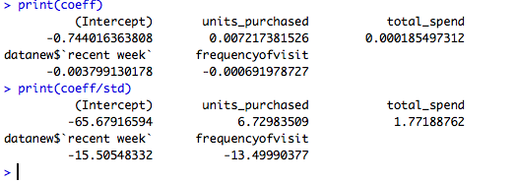
Probability model analysis
 | As we can see the results from our analysis, the recent week is negatively associated with target variable that is more recently the shopper visit the store, the less likely to visit next week Based on coeff/std, we analyze those fields whose ratio is above 2 or below 2: Thus, we consider these parameters: units_purchased frequencyofvisit recent week

Slide 12
Creating Regression model using this analysis
As mentioned in problem, the units purchased should be less than 3 units:
Considering this criteria and only those shoppers who visited next week in the previous dataset , we build regression model using the variables which we found important in Multinomial Logistic Regression Model:
up=which(datanew$units_purchased<=3)
datanew.model=lm(formula=Targetv~frequencyofvisit+units_purchased+`recent week`,data= datanew[up,])

Slide 13
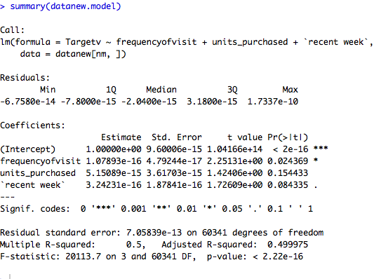
REGRESSION MODEL ANALYSIS
 | frequencyofvisit is statistically significant R-squared is 0.49. The accuracy of model is around 49% To improve the accuracy of the model, we use ensemble technique to boost this model.

Slide 14
GrADIENT BOOSTING MODEL
Boosting is an ensemble method to improve the accuracy of the given classifier by combining single classifiers
In gradient boosting, it train many models sequentially
Each new model minimizes the loss function(y=ax+b+e e:error) using Gradient Descent method
Code: set.seed(3421)
index=sample(2,nrow(datanew),replace=TRUE,prob=c(0.6,0.4))
train=datanew[index==1,]
test=datanew[ind==2,]
library("gbm")
gbmModel = gbm(formula =Targetv~frequencyofvisit+train$`recent week`+diffmindate, distribution = "bernoulli",data = train, n.trees = 2500,shrinkage = .01,n.minobsinnode =20)

Slide 15
Cross Validation and Analysis of boosting Model
For Cross-Validation:
Iteration 1:
best.iter.1 <- gbm.perf(gbmModel,method="cv")
gbm.predict.1 <- as.matrix(predict.gbm(gbmModel,as.data.frame(train),best.iter.1))
Changing the ntrees , shrinkage, n.minobsinnode values ,developing gbmModel2
Iteration 2:
best.iter.2 <- gbm.perf(gbmModel2,method="cv")
gbm.predict.2 <- as.matrix(predict.gbm(gbmModel2,as.data.frame(train),best.iter.2))
The cross-validation provides us best iteration value and parameter tuning

Slide 16
RECOMMENDATION
The target variable data should be added in the dataset which can decrease the complexity of the problem
Additional metrics columns can also be added such as income of the customer,
distance , mode of reaching the retail store

