Slide 1
Energy Consumption Analytics for eSC
IST687: Final Project

Slide 2
01
Project Scope

Slide 3

Project Scope
We've partnered with eSC, an innovative energy supplier committed to sustainable power distribution.
Our mission is to present a data-driven energy consumption analytics service that not only aligns with the fight against global warming but also equips your company with the foresight to manage energy demand during peak seasons.
This summer, as temperatures rise, our analytics will be pivotal in optimizing energy usage. By adopting our service, you can ensure reliability in your energy supply without the hefty investment of constructing new facilities, all while championing environmental stewardship.
Let's collaborate to turn the tide on energy consumption, meeting demands smartly and sustainably.

Slide 4
02
Project Data
Data obtained and encrypted

Slide 5
Main subjects of the degree
Weather Dataset
Metadata
Weather patterns of every hour of Carolinas.
Description of the Data
Energy Dataset
Has Information about building characteristics and County.
Types of energy consumption of houses
Static House Data

Slide 6
03
Cleaning Data
Cleaning of Housing, Energy and Weather Data

Slide 7

Cleaning Process
We decided to clean our data with respect to the building id range and on the counties we chose to read the data on.
Multiple columns were read and based on the energy data columns which we felt relevant to move forward for further analysis were determined and further worked upon.
Collaborative factors helped us create further visualizations and calculative analytics for energy consumption.

Slide 8
04
Merged Data Analysis
Housing_data + Energy_usage_data
Weather_data + Energy_usage_data

Slide 9

Merged Data Report
After merging the housing data with energy data with respect to column names bldg_id and three counties ("G4500730", "G4500850", "G4500910“), we came across a new dataset. This merged dataset helps us study the energy consumptions for specific building ID’s and with respect to different counties.
Depending on the energy consumption of each factors mentioned in the energy consumption data the visuals represented gives us a statistical analysis for the same.
Electricity and natural gas are significantly more prevalent as fuel sources, with all other types of fuels contributing only a small fraction of the overall energy consumption.

Slide 10
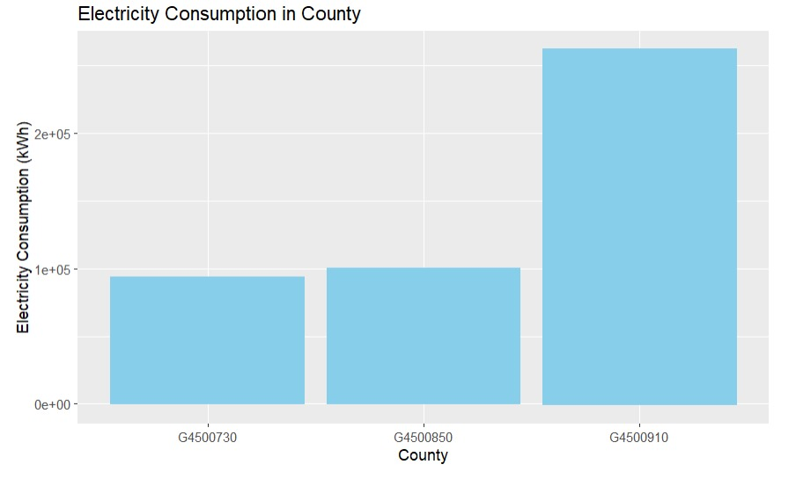
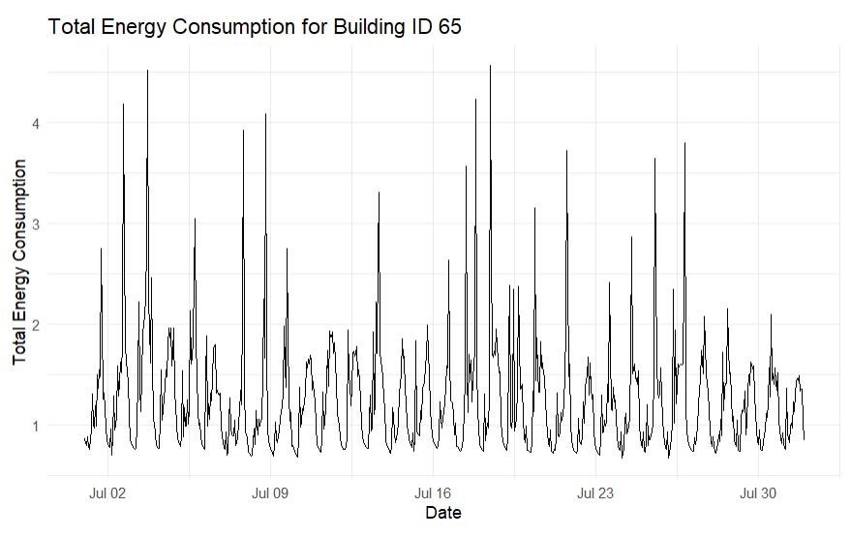
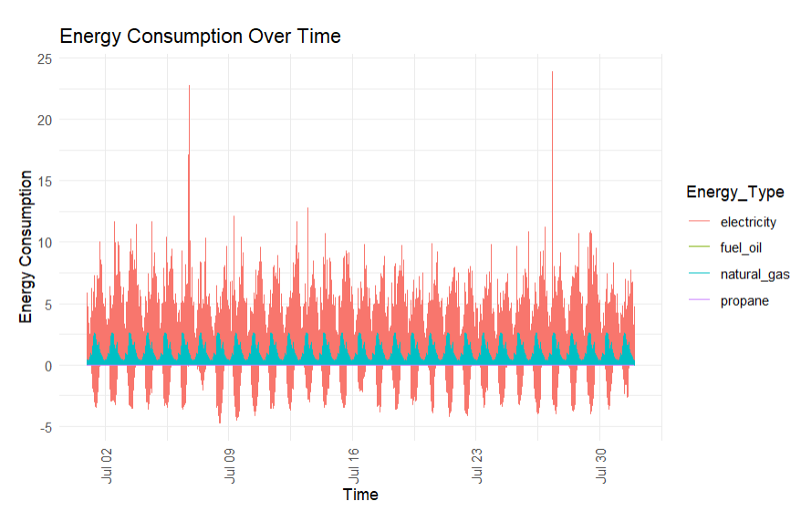
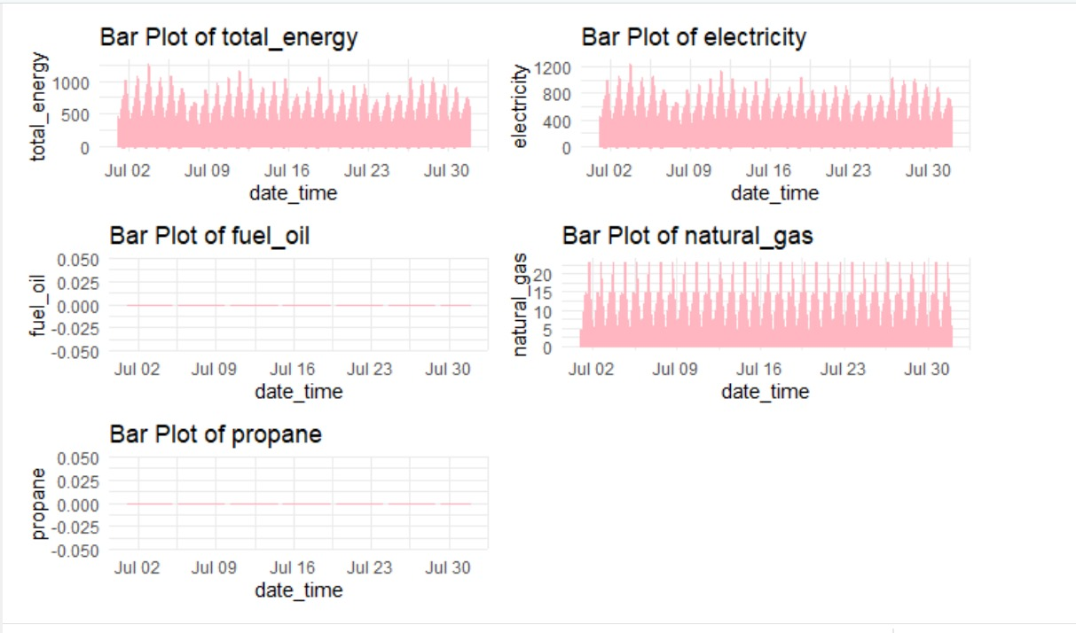

Slide 11
05
Predicitve Models used
SVM and GLM

Slide 12

Predicitive Models used
We chose to use Generalized Linear Models (GLM) because they are flexible with various types of data, from counts to categories, and provide clear insights into how different factors influence outcomes. This makes GLMs particularly useful for understanding and communicating the impact of each variable.
We also utilized Support Vector Machines (SVM) because they are exceptionally effective in managing complex datasets that include many features. SVMs are robust against overfitting, making them reliable even when the data has far more dimensions than samples. This robustness is crucial for ensuring that our model's predictions are accurate and trustworthy across different scenarios.
Together, these models allow us to extract and present precise and actionable insights from our data, enhancing our decision-making process.

Slide 13
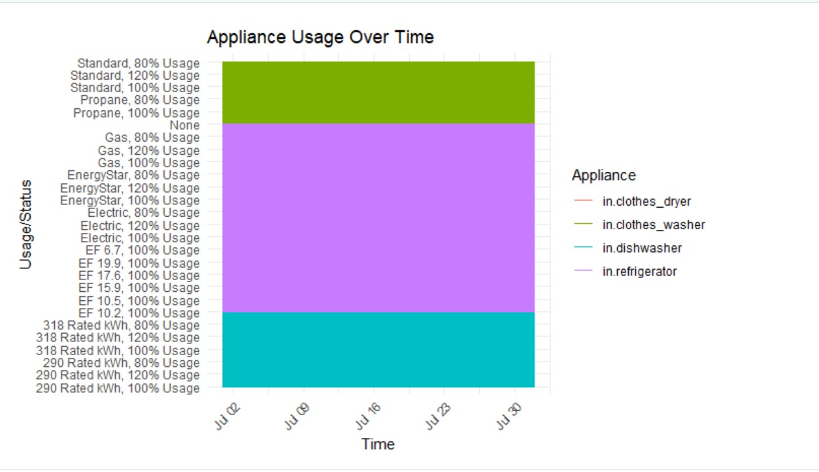
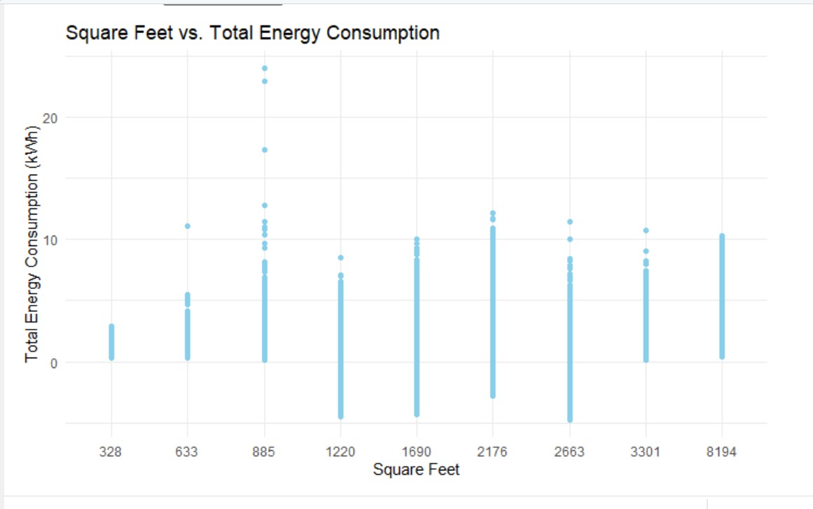
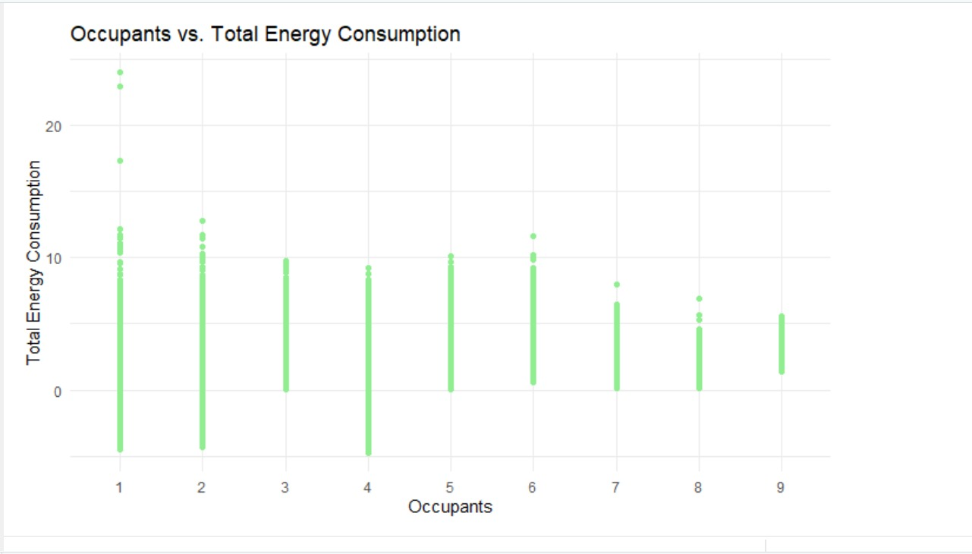

Slide 14
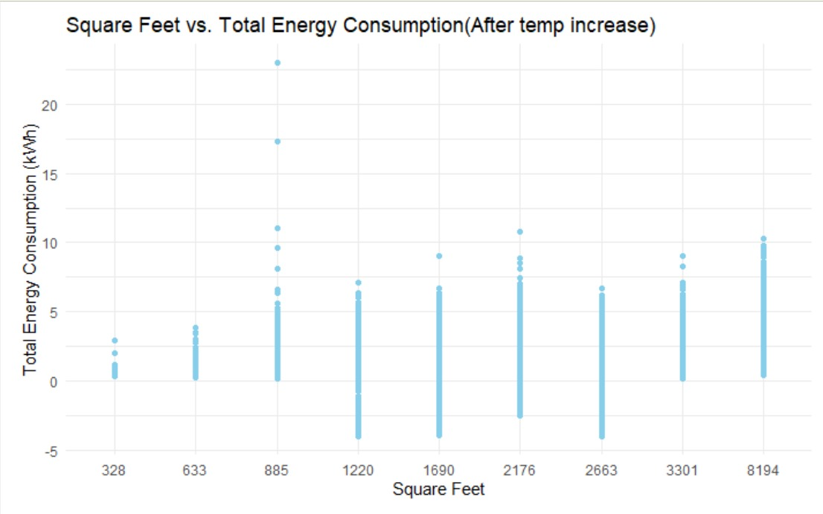
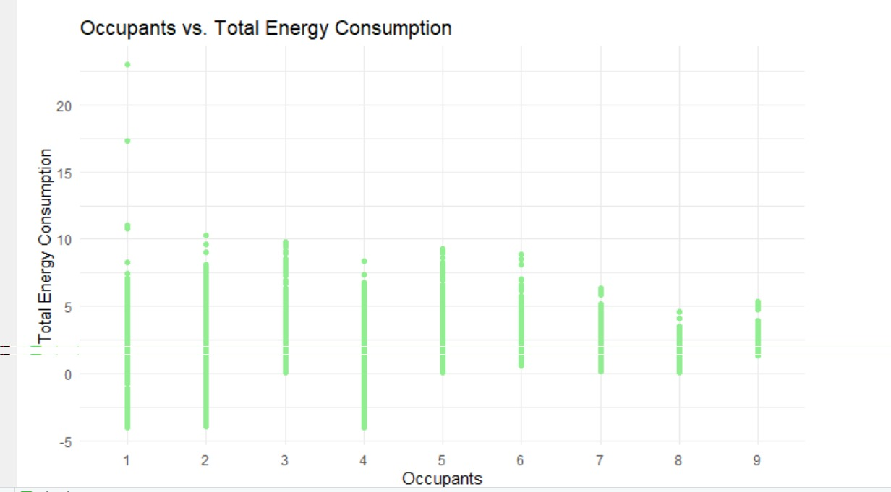
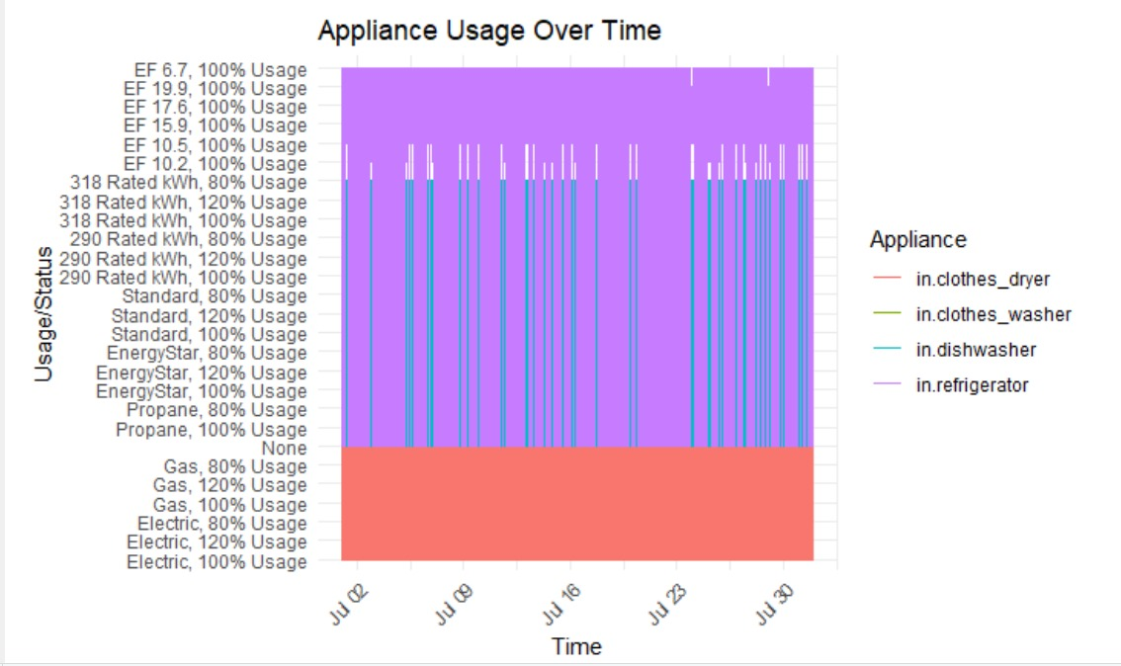
Prediction Model Reports
Generalized Linear Model (GLM): RMSE 0.525502728958794
Support Vector Machine Model (SVM): RMSE 0.0783938804664028
5 degrees Warmer Chart

Slide 15
Cost Saving Approach
Smart Thermostats:
Install programmable or smart thermostats to regulate heating and cooling based on occupancy schedules and preferences.
Set temperature setbacks during periods when occupants are away or asleep to reduce energy consumption.
Potential savings with smart thermostats 10% to 23% :
1,100 kWh to 2,530 kWh

Slide 16

Predictive model Reports
35%
SVM model
35%
GLM model
30%
Shiny App

Slide 17
Thanks!
Do you have any questions?

