Slide 1
Streets & Safety: Infrastructure Insights from Syracuse Open Data
Syracuse Civic Data Project
Ward-Level Pavement Analysis
Sagarika Shinde, Research Analyst
Syracuse University

Slide 2
The Problem
Question: How do pavement conditions vary across Syracuse?
Why it matters:
• Street quality affects safety and mobility
• Residents experience infrastructure directly
• Open data should be understandable and useful

Slide 3
Why Syracuse Should Care
Infrastructure maintenance impacts daily life
Data-driven insights support planning
Transparent analysis helps residents and city officials understand patterns

Slide 4
The Approach
Data Used:
Syracuse Pavement Ratings (2022 - 2024)
Syracuse Fire Hydrant Inventory
Goal: Transform raw municipal data into clear insights

Slide 5
Analytical Approach
1. Standardized multi-year pavement datasets
2. Combined datasets into a unified analysis table
3. Aggregated metrics at the ward level
4. Generated visualizations to explore patterns

Slide 6
System Architecture
Raw Data → Cleaning → Aggregation → Metrics → Visualizations
Pipeline ensures reproducible processing from raw datasets to dashboard-ready outputs

Slide 7
Data Quality Assessment
Checks performed:
Missing value inspection
Rating range validation
Schema consistency across years
Aggregation verification

Slide 8
LLM Integration & Validation
LLMs used for:
Summarization of analytical findings
Documentation assistance
Validation:
All numeric outputs verified against ground truth calculations
No automated conclusions without human review

Slide 9
Key Findings
Pavement conditions vary across wards
Some wards contain higher shares of poorly rated segments
Infrastructure conditions are not evenly distributed

Slide 10
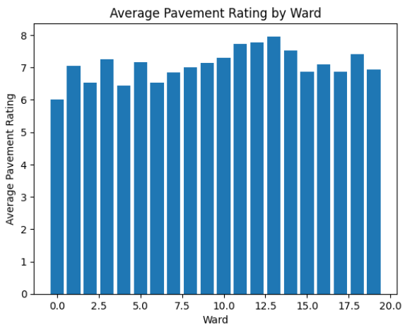
Visual Insights
Key visualizations include:
1. Average pavement rating by ward

Slide 11
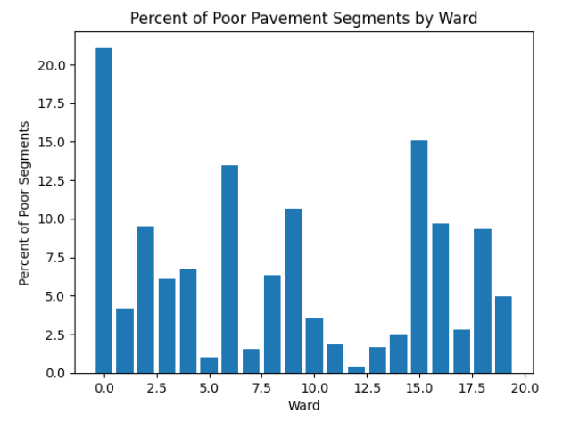
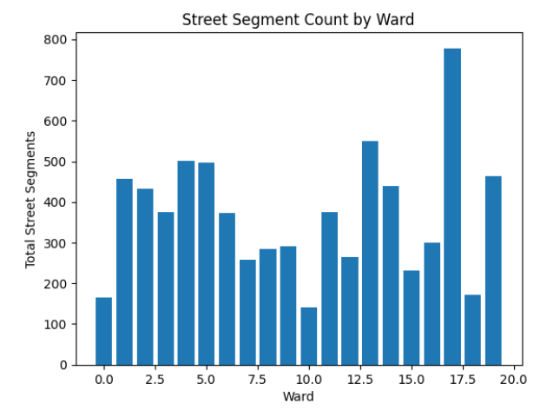
2. Percent of poorly rated segments
3. Distribution of street segments

Slide 12
Limitations
Pavement ratings represent inspection snapshots
Hydrant counts indicate presence, not response capability
Ward-level aggregation limits neighborhood-level insight

Slide 13
Future Work
Possible extensions:
Neighborhood-level spatial analysis
Additional infrastructure datasets
Public dashboard for city officials and residents
Open data becomes most valuable when translated into accessible tools.

