Slide 1







Capstone Project
Giorgia Scalera
19.11.2022

Slide 2



OUTLINE
Executive Summary
Introduction
Methodology
Results
Visualization – Charts
Dashboard
Discussion
Findings & Implications
Conclusion
Appendix

Slide 3

EXECUTIVE SUMMARY
Data Collection
Data Manipulation
Data Handling
Data Analysis
Data Visualization

Slide 4

INTRODUCTION
Data collection using Python libraries

Slide 5

METHODOLOGY
parsed and scraped sources using Python libraries BeautifulSoup request.
matplotlib and seaborn libraries

Slide 6
RESULTS

Slide 7
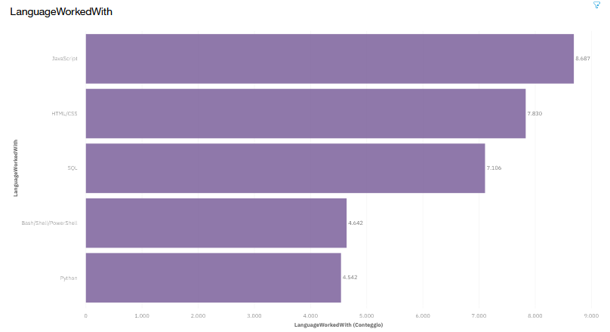
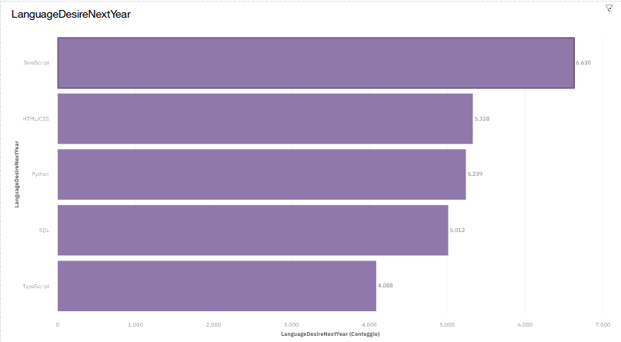
PROGRAMMING LANGUAGE TRENDS
Current Year
Next Year

Slide 8
PROGRAMMING LANGUAGE TRENDS - FINDINGS & IMPLICATIONS
Findings
HTML / Javascript persist in the top position
Python is moving up
SQL is moving down
Implications
Eduction and market should still focus on HTML and Javascript skill
Data analysis is more and more crucial
SQL is going to be replaced by alternative languages

Slide 9
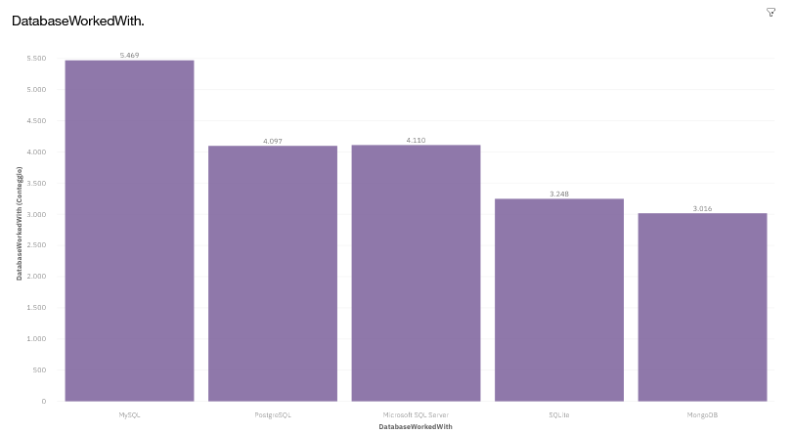
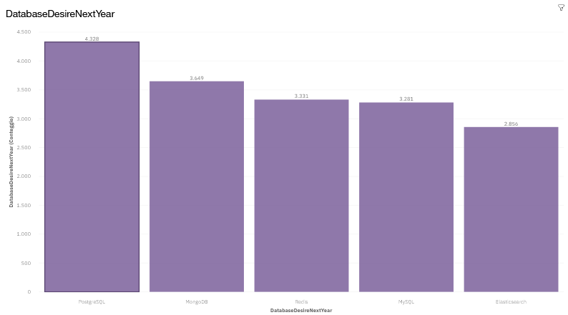
DATABASE TRENDS
Current Year
Next Year

Slide 10
DATABASE TRENDS - FINDINGS & IMPLICATIONS
Findings
SQL databases are losing preferences
Implications

Slide 11

DASHBOARD
https://eu-de.dataplatform.cloud.ibm.com/dashboards/6c119b82-c805-410b-9296-481b1358da12/view/413ad40838ab158961b3dce407c87e547935735dbabb840a84d77b4908322497f36b42c4c87d1f5ad315566af6bd145cca

Slide 12
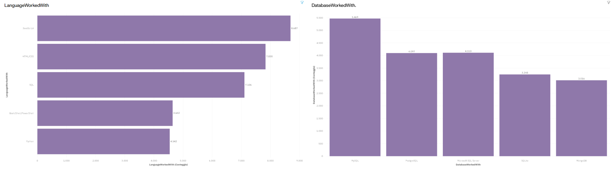
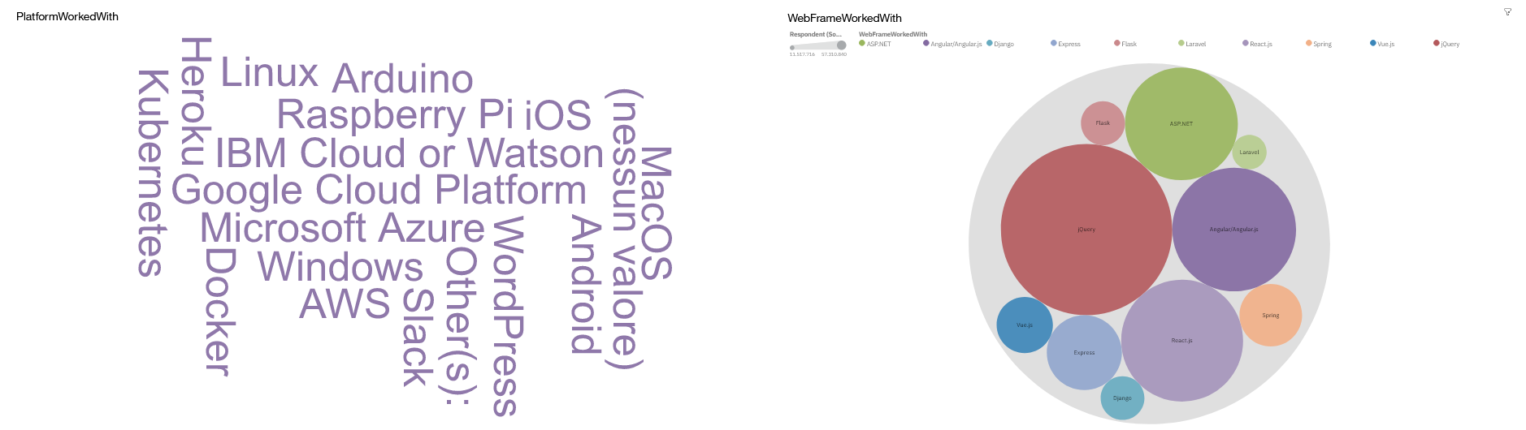
DASHBOARD TAB 1
Screenshot of dashboard tab 1 goes here

Slide 13
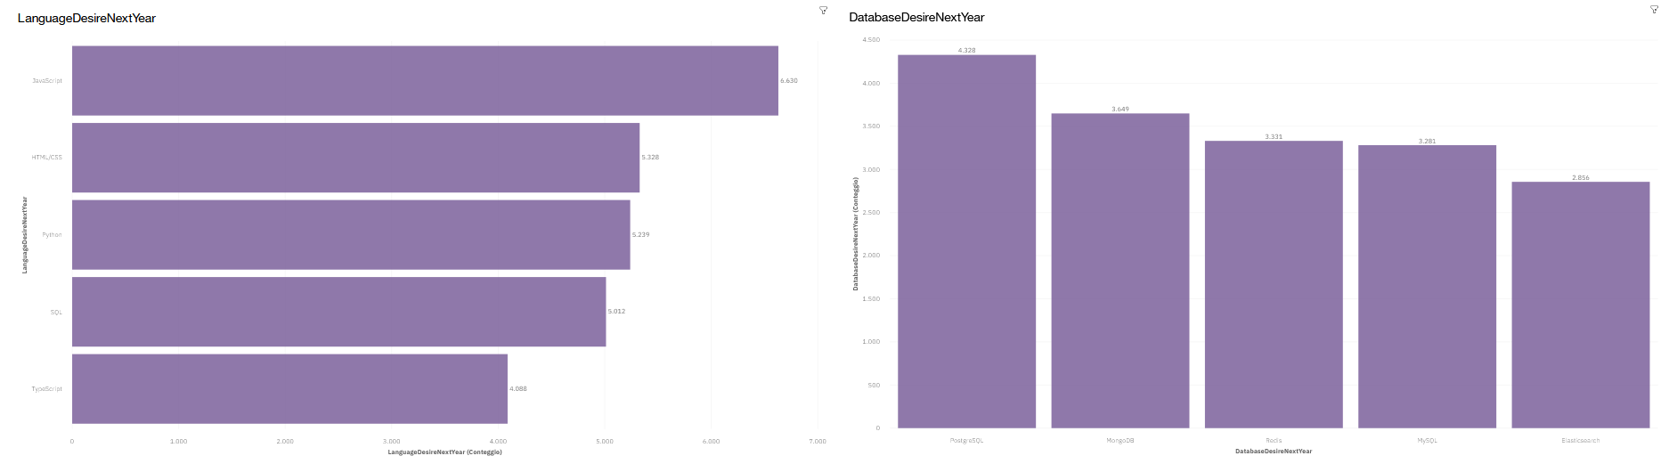
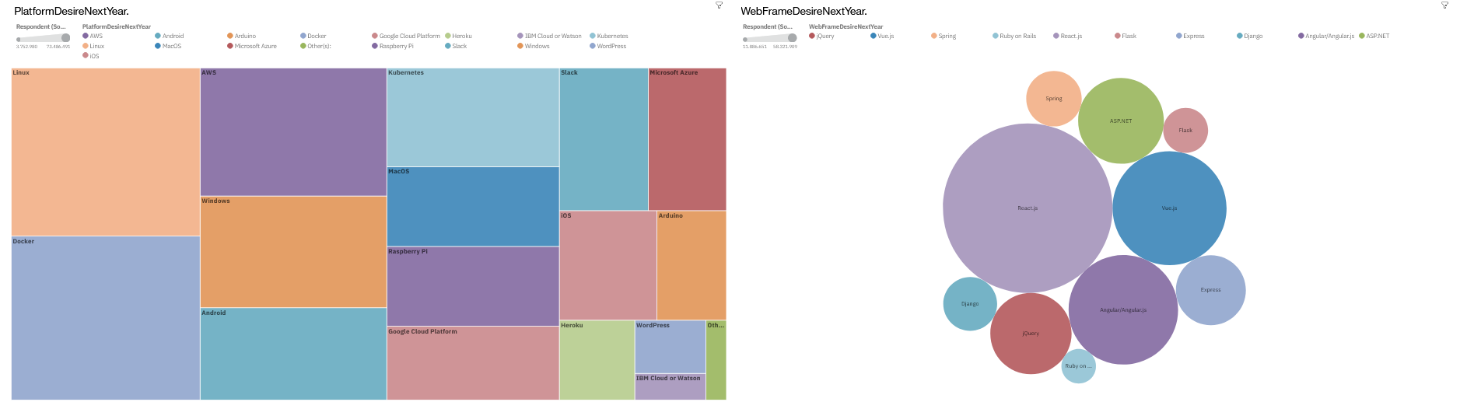
DASHBOARD TAB 2
Screenshot of dashboard tab 2 goes here

Slide 14
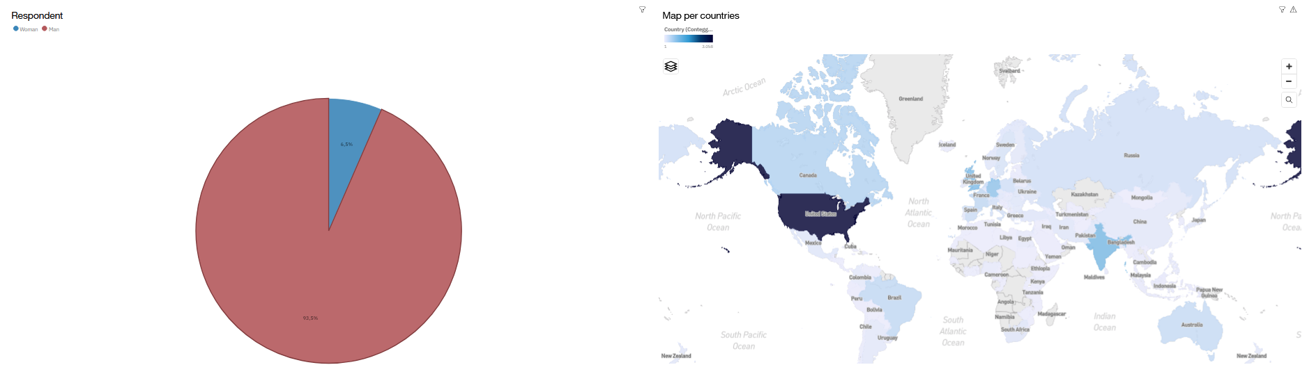
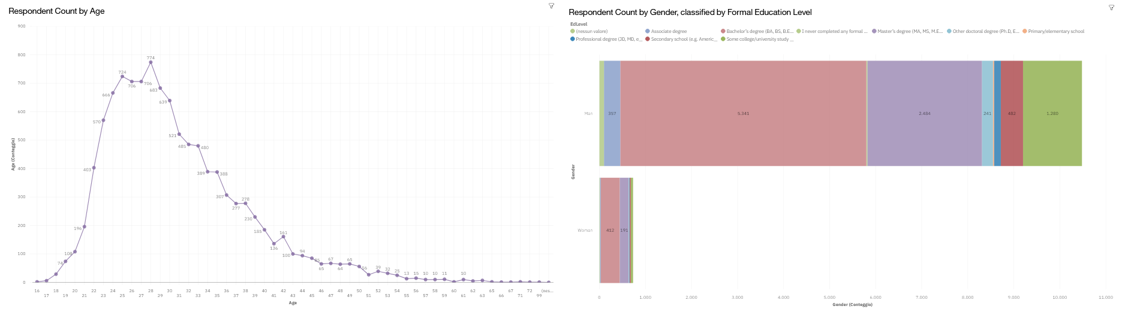
DASHBOARD TAB 3
Screenshot of dashboard tab 3 goes here

Slide 15
DISCUSSION
Data have been parsed and scraped from different sources using Python libraries BeautifulSoup request.
Exploratory data analysis has been conducted using matplotlib and seaborn libraries

Slide 16
OVERALL FINDINGS & IMPLICATIONS
Findings
New languages are going to replace historical languages
Woman are represented by a very small %
Bachelor education is the education level mostly followed
Implications
Companies need to be oriented to new strategies
Initiative should be taken to rebalance the gender gap
Higher education grant specialized worker ready on the market

Slide 17

CONCLUSION
Point 1
Point 2
Point 3
Point 4

Slide 18

APPENDIX
Include any relevant additional charts, or tables that you may have created during the analysis phase.

Slide 19
JOB POSTINGS
In Module 1 you have collected the job posting data using Job API in a file named “job-postings.xlsx”. Present that data using a bar chart here. Order the bar chart in the descending order of the number of job postings.

Slide 20
POPULAR LANGUAGES
In Module 1 you have collected the job postings data using web scraping in a file named “popular-languages.csv”. Present that data using a bar chart here. Order the bar chart in the descending order of salary.

