Slide 1

PROJECT DEMO
Name: Sagar Khanvilkar
Class: Msc. Cyber Security
Roll No: 05
Project Guide: Prof. Sagar Mehta

Slide 2

Website - Vulnerability Assessment Penetration Testing
Introduction
How does Online voting System works? (flow chart) basic working of it’s website
Software/ Hardware requirements
Pentesting using Bruteforce attack
Conclusion/Future work

Slide 3

Introduction
ONLINE VOTING SYSTEM ” is an online voting management system, where an authorized voters can give his\her vote online without going to any physical polling station.
A voter can use his\her voting right online without any difficulty, Just by registering themselves. After registration they need to mainly complete sign in ,to access Candidate’s voter page.
Every Candidates that registered have unique aadhar UID’s, and every UID’s are saved in an.encrypted format.
I have Pentested this management system by using Burpsuite, in order to demonstrate you. How an automated bruteforce attack can be vulnerable to crack username and password of Candidates, and admin panel
If any invalid/wrong details are submitted, then the citizen is not registered to vote.

Slide 4
Software Requirements
Hardware Requirements
Operating System | Windows 8 or above
Framework | Visual Studio Code
Client side technologies | HTML, css, php, JavaScript
Server side technologies | Xampp
Database | Mysql
For Testing | Burpsuite tool and DVWA Metasploit
Processor type | Intel core i3 Or higher
RAM | minimum 4 GB
Storage | 256 GB(Recommended)
Processor speed | 8GHz Or higher

Slide 5
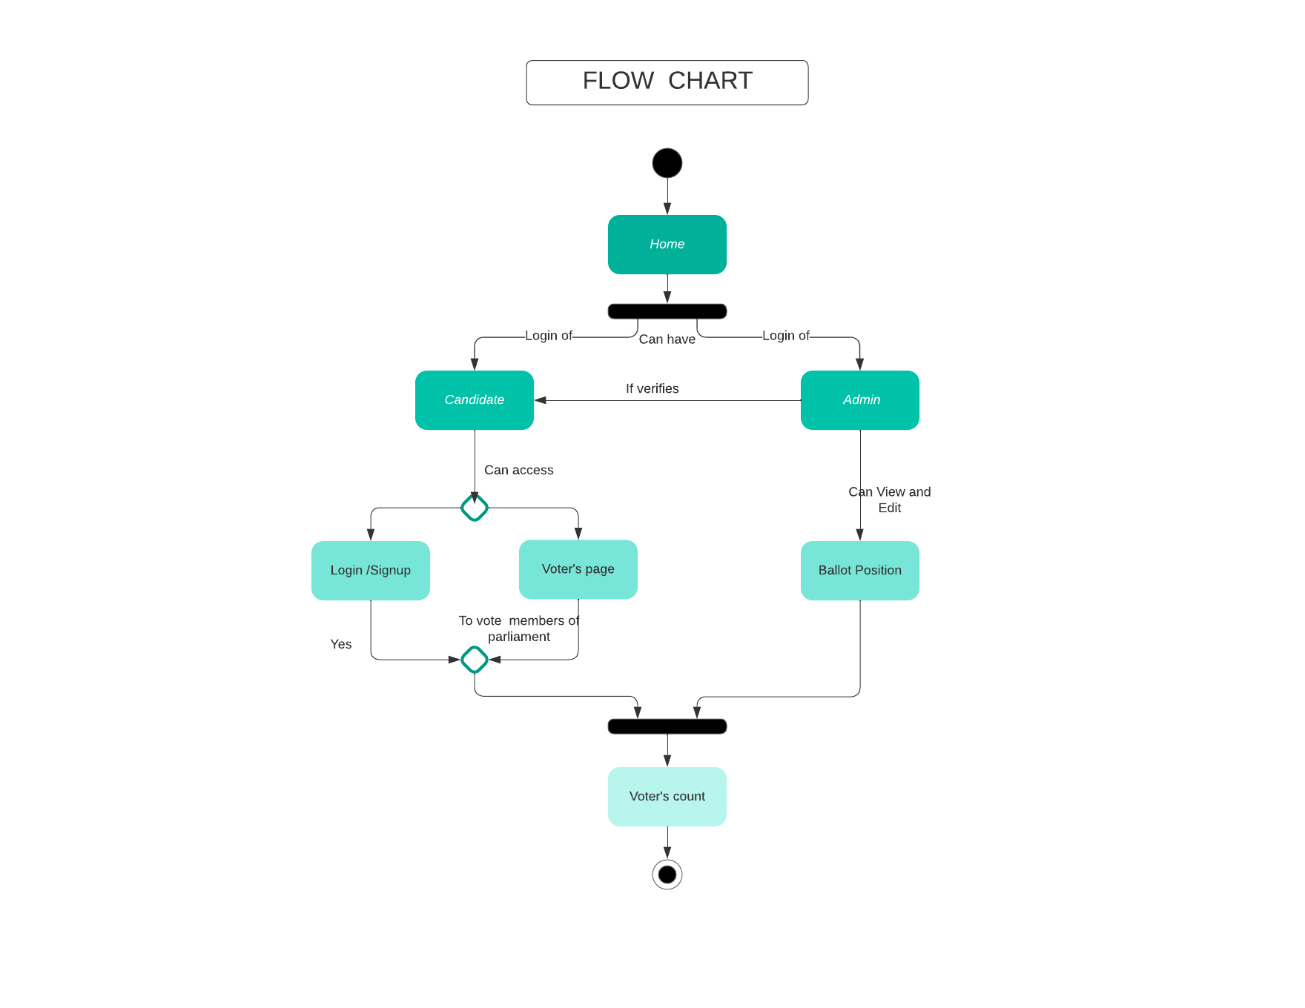
How does Online voting System works? (flow chart) basic working of it’s website

Slide 6
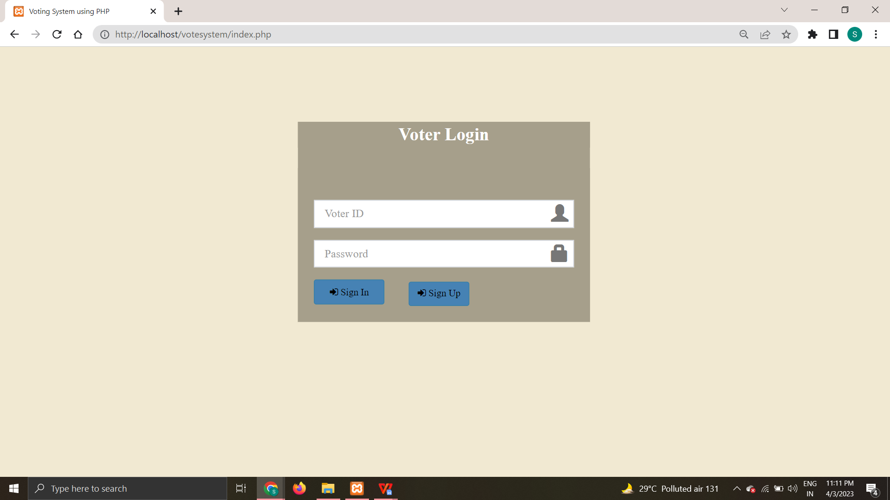
User View

Slide 7
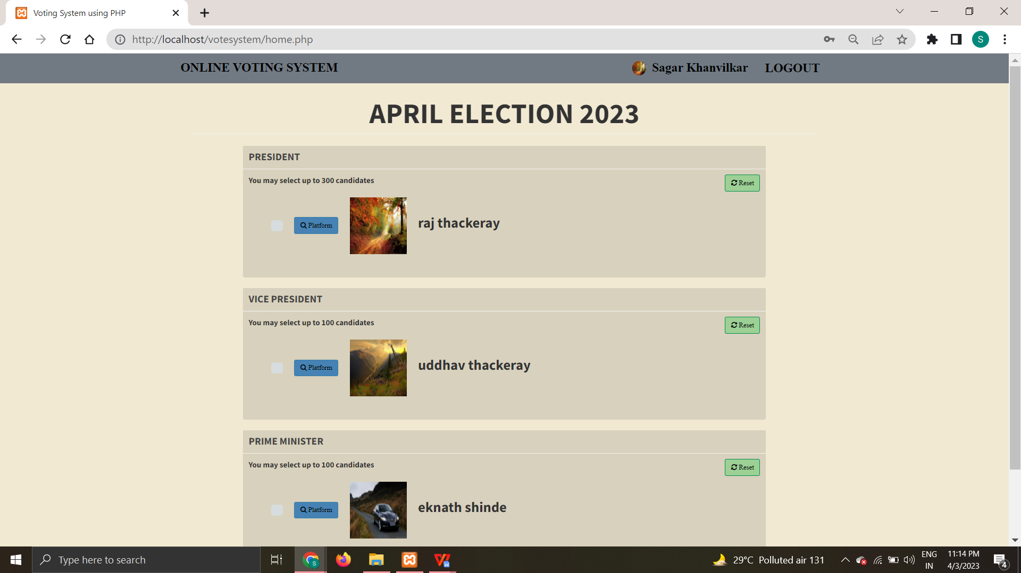
User Dashbord Voting View

Slide 8
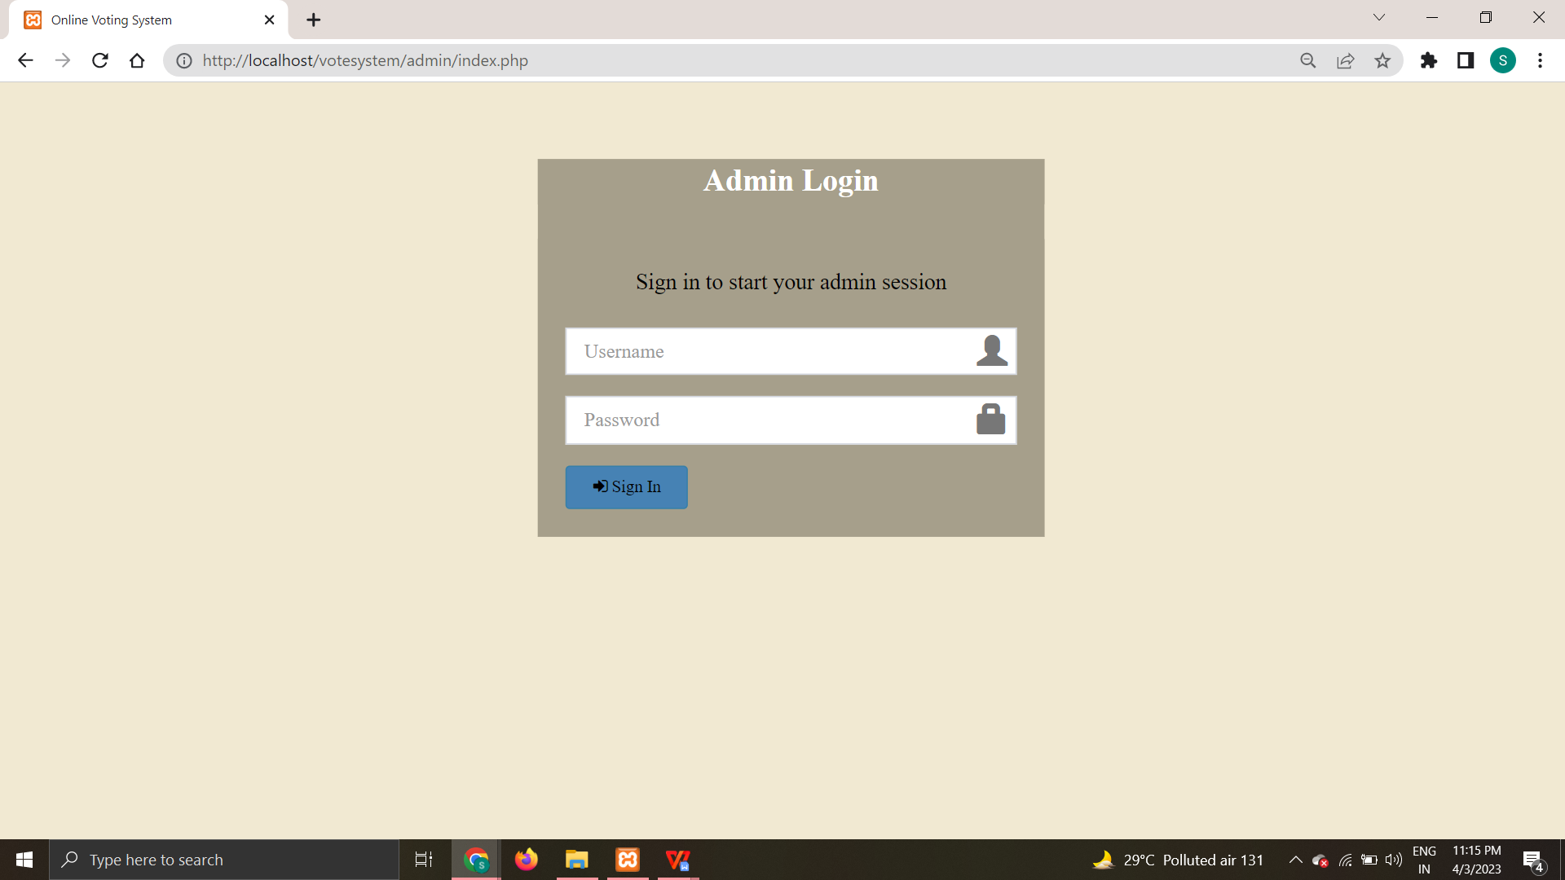
Admin Login Panel:

Slide 9
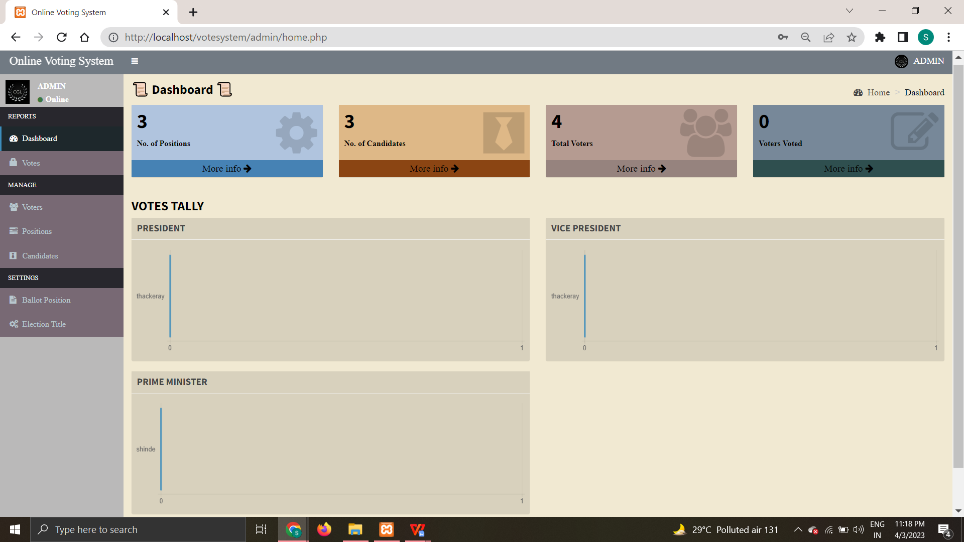
Admin Dashboard View:

Slide 10
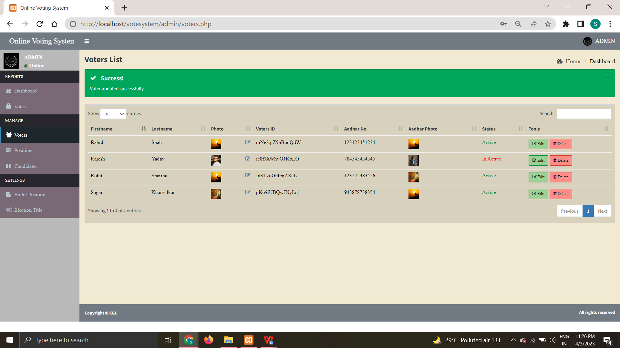
Admin access control over voters:

Slide 11
Test cases:
Srno | TestCases | ExpectedResult | Status | Output | TestResult
1 | Website isproperly or not | Website should work absolutely Fine. | Performed | Yes, It is working | Success
2 | Using brute force attack, able to crack username and password | Able to harvest username and password of user | Performed | Yes, automated login is working | Success
3 | Candidate can login and can vote Successfully | Should be able to login Successfully | Performed | Able todetect | Success
4 | Admin is able to see ballot positions | Should be able to see positions | Performed | Able to see ballot position | Success
5 | Every Aadhar Card No. Encrypt and unique | Every UID should be unique and of 12 digit | Performed | Able to detect | Success

Slide 12
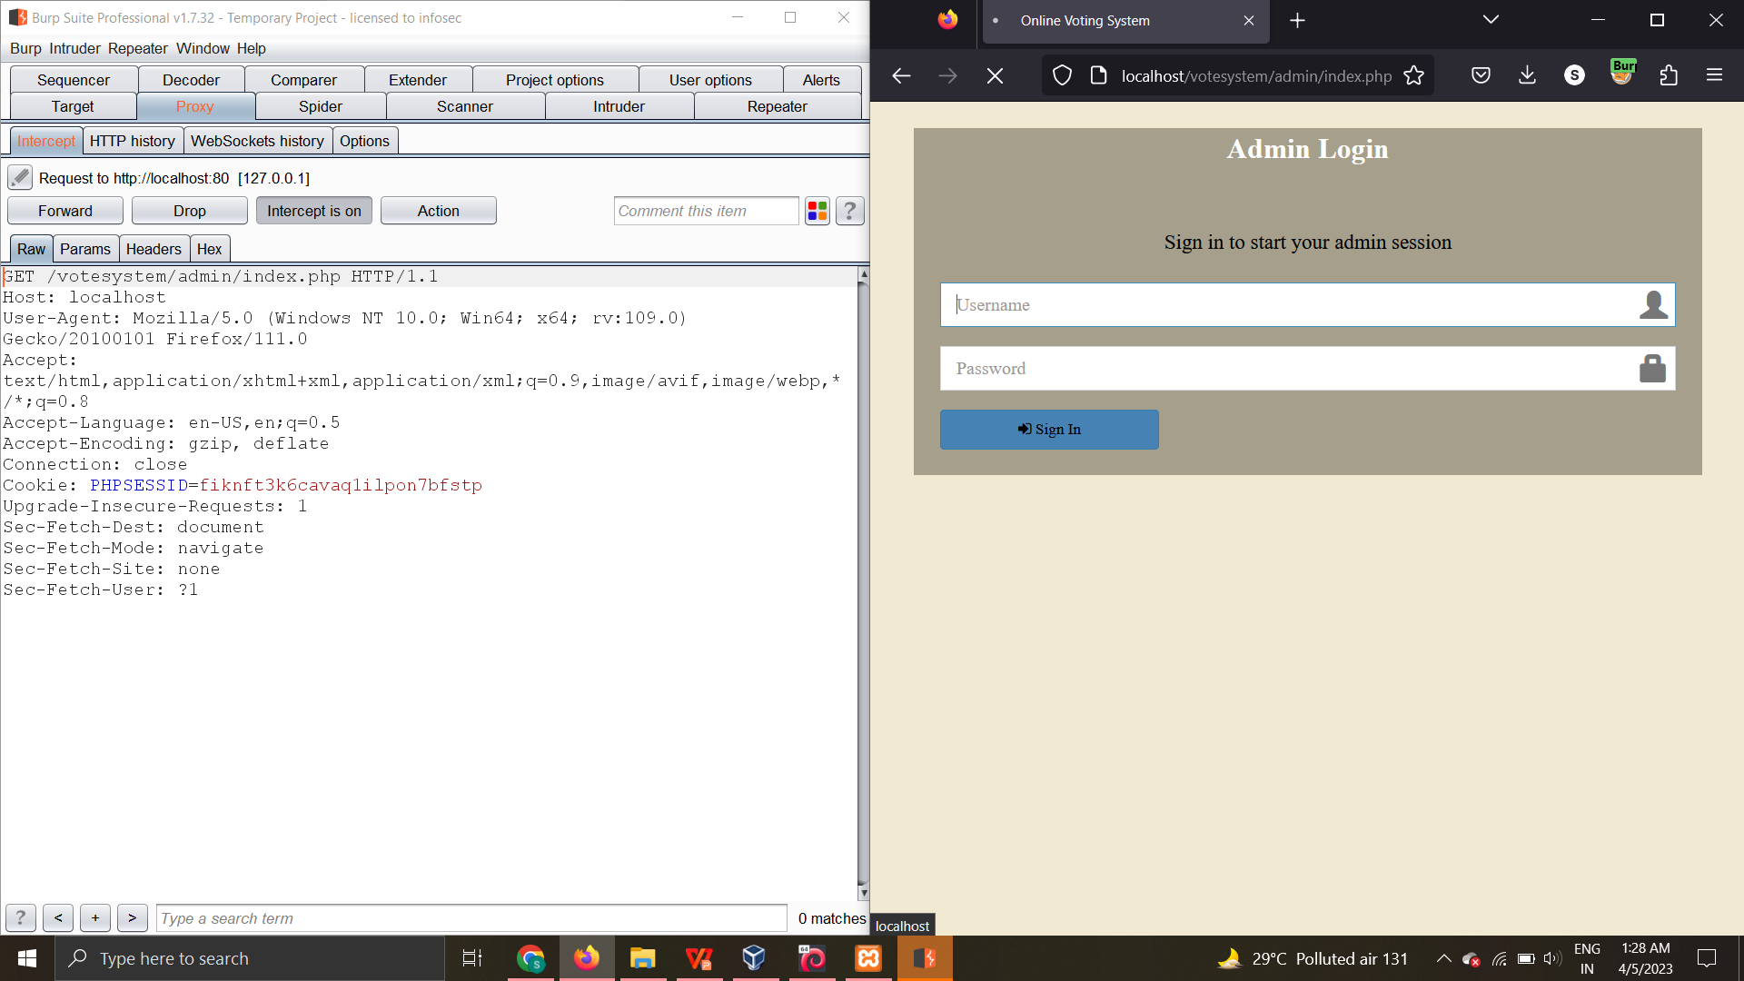
Penetration testing

Slide 13
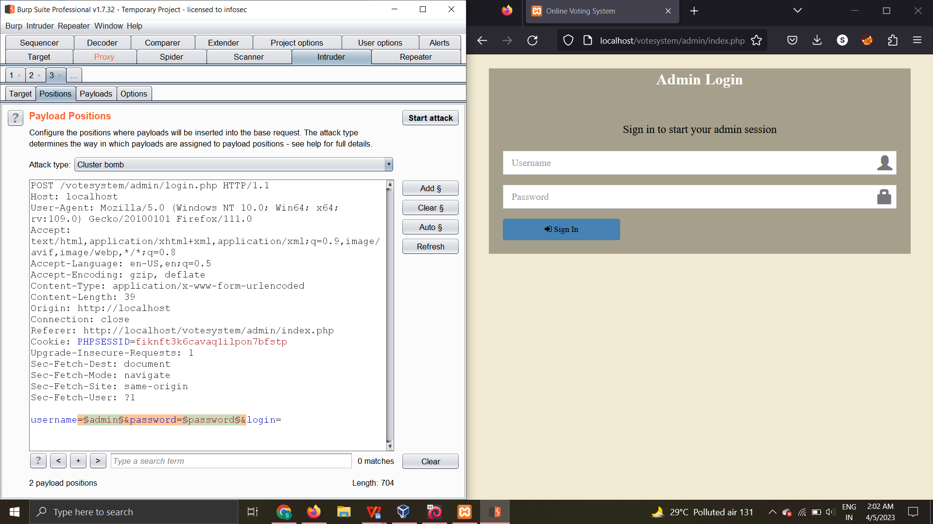

Slide 14
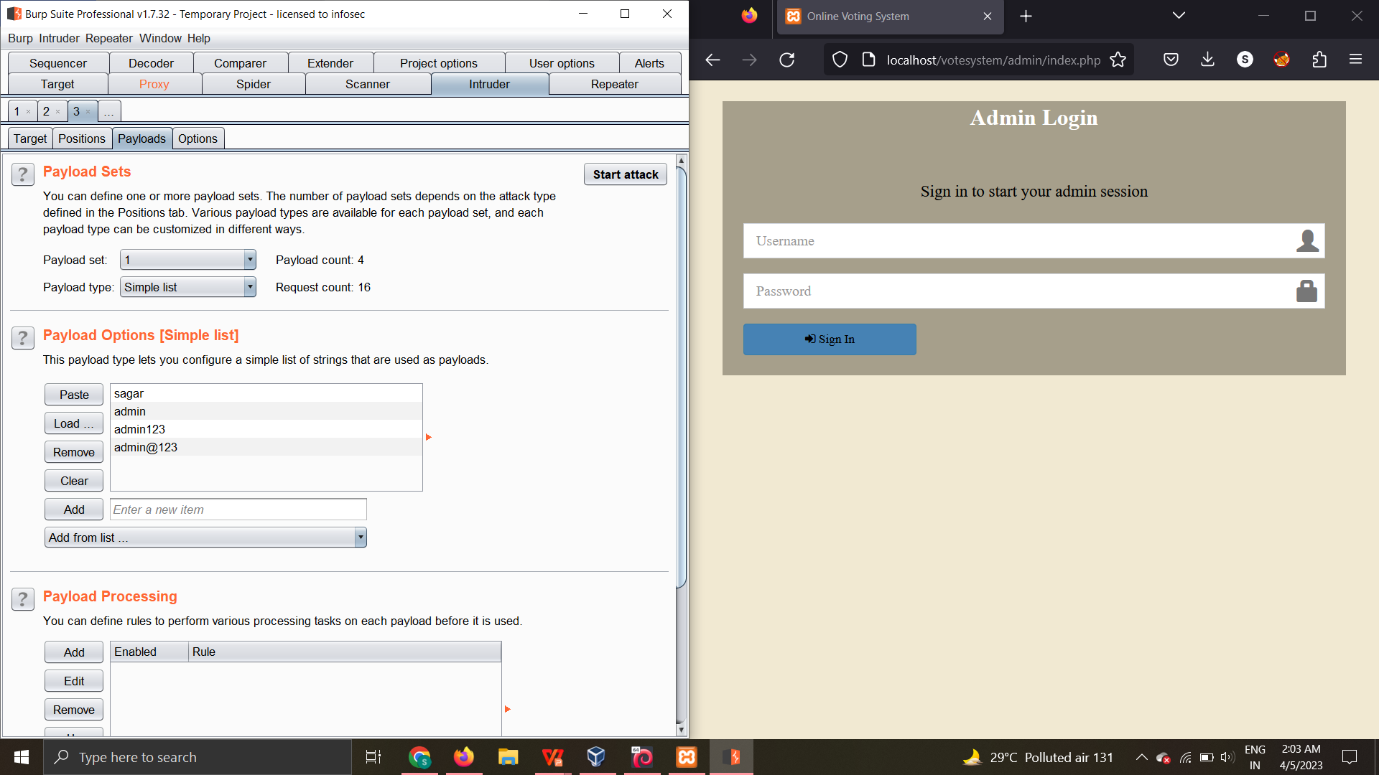

Slide 15
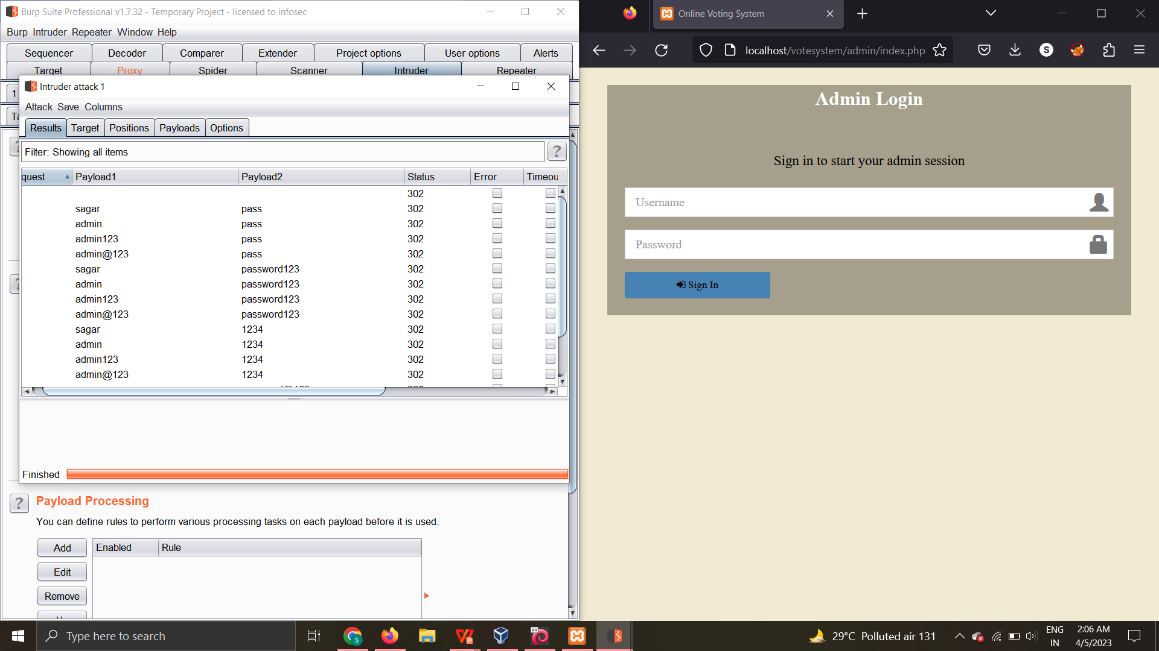

Slide 16
DVWA BruteForce Attack

Slide 17
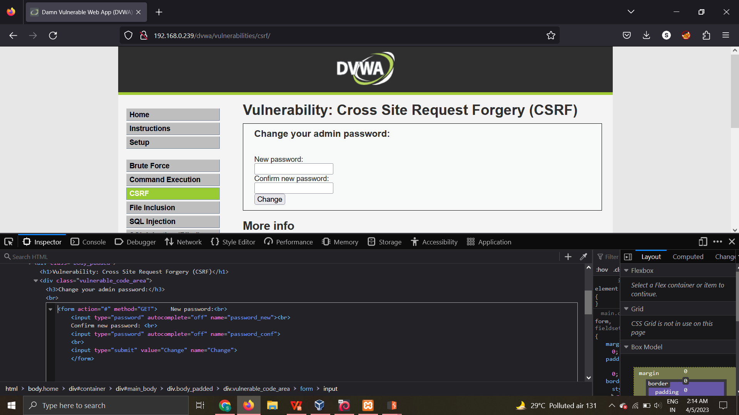
DVWA Brute Force Attack

Slide 18
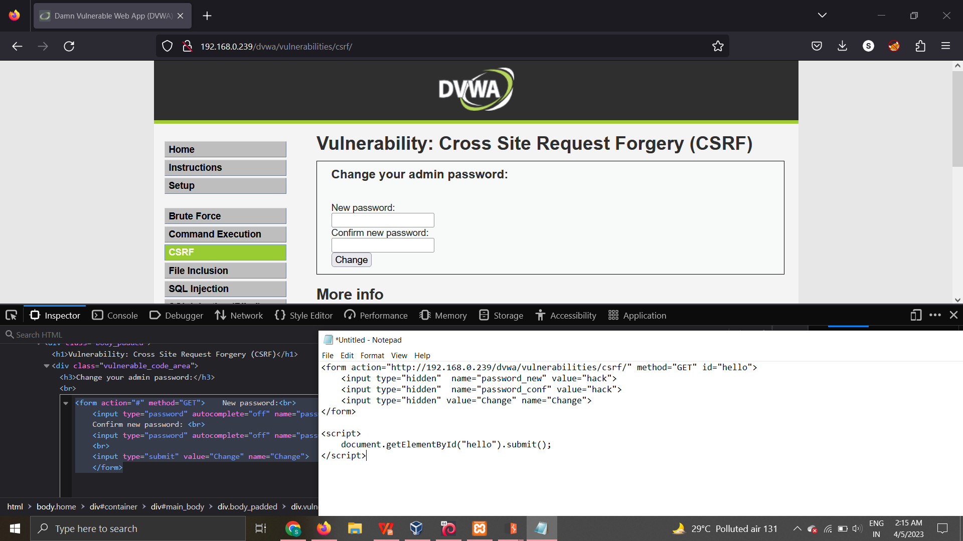

Slide 19
CONCLUSION :
The voting system proposed by us is far more secure and efficient than the traditional voting system. Delays in results and vote manipulation are easily avoided in this system. The most notable aspect of our project is the use of two-factor authentication, which allows for easier and more precise voter verification. For the same reason, whenever a user registers, he or she must provide his or her voter id, which allows for easier verification of both voters and candidates. The proposed online system is expected to increase the transparency and reliability of the current electoral system.
Future Enhancements:
This Website involves almost all the features of the online voting system
But the future implementation I would like to go will be for Voters to direct scan their Votes with Scanners and can vote without touching ballot machine.

Slide 20


