Slide 1
Supermarket Sales Analysis
Presented by: [Sagar Kanojiya]
Date: 25/04/2025

Slide 2
Objective
To analyze supermarket sales performance with a focus on Total Revenue trends across different locations, times, and product types.

Slide 3
Data Source & Tools Used
- Data: Supermarket sales Myanmar
- Columns: Date, Product Line, City, Total(Revenue),Customer Type
- Tool: Power BI for visualization
- Goal: Reveal actionable insights using Total Revenue as the key metric

Slide 4
Dashboard Overview
The Power BI dashboard provides interactive insights into Total Revenue across cities, product lines, payment types, and time. It helps identify high-performing segments and revenue trends.

Slide 5
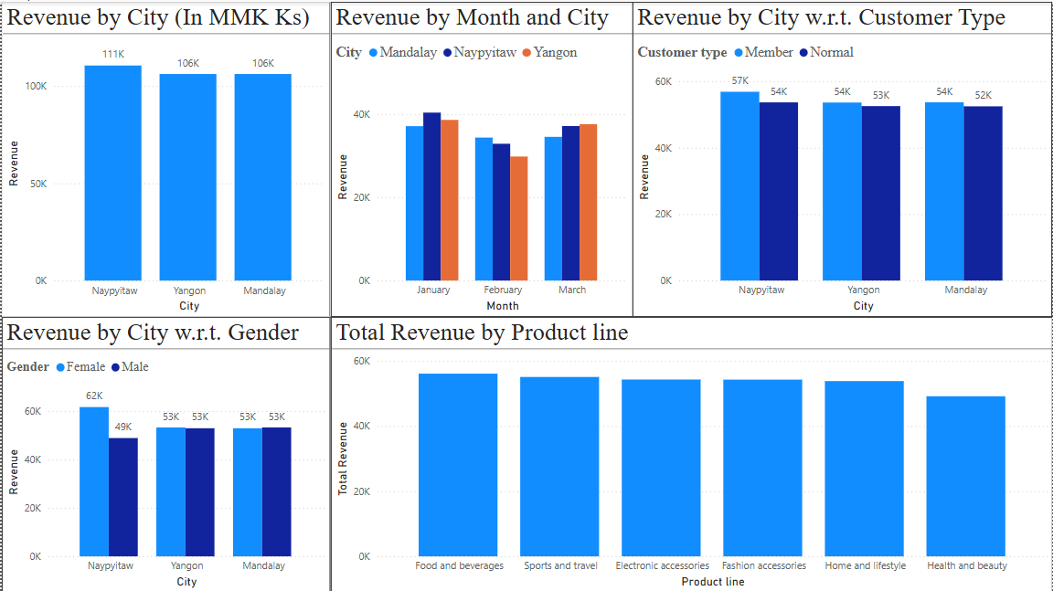

Slide 6
Key Insight: Total Revenue Trends
- City Naypyitaw generates the highest total revenue
- Product Line Food and Beverages is the most profitable
- Peak revenue observed on weekends.

Slide 7
Business Recommendations
- Increase inventory of best-selling product lines in top cities
- Launch weekend discount campaigns

Slide 8
Thank You
Summary: Power BI was used to analyze and visualize supermarket sales data, focusing on Total Revenue.
Looking forward to discussing how these insights can drive business decisions.

