Slide 1
File Searching Program
Sagar Laud

Slide 2
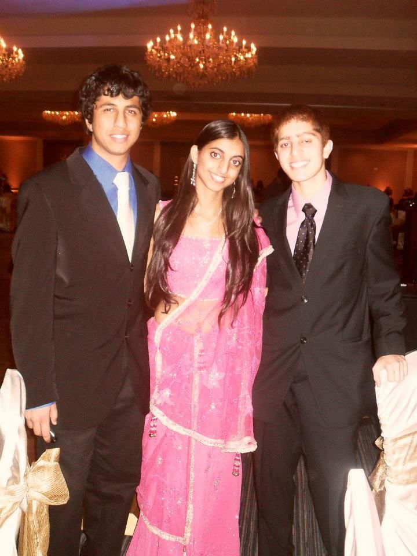
About Me
My name is Sagar Laud
I like to play soccer, solve puzzles (Rubik’s Cubes), play basketball, and many other things.
I’m a CS major and I really enjoy coding in general

Slide 3
The Idea
The idea came primarily as a result of wanting the functionality of Windows Explorer
I however wanted something that was text based as opposed to using any form of graphics
I found this program useful/entertaining simply because it was completely text based.
The part I liked the most/found the most interesting is that it asks for user input using “raw_input.”
This allows it to be more of a game and makes it more fun

Slide 4
The Code
I utilized multiple modules including the OS and SYS modules.
These modules allowed me to perform tasks that I would not have been able to otherwise perform quickly
I particularly spent a lot of time and effort on the concept of being able to “drop back” a directory.

Slide 5
Interesting Code
This is the code I used to “drop back” a directory:
elif choice == '2':
if len(os.path.abspath('.'))>3: #Cause it will be C:\\ and one is escaped
parentpathList = os.path.abspath(path).split('\\')[:-1]
main('\\'.join(parentpathList))
return
This code first makes sure that the program isn’t already at the C directory. Then, it converts the current path into a list and by splitting it at ‘\\’. After this, it takes all of the items in the list but the last item and joins them into a new path.

Slide 6
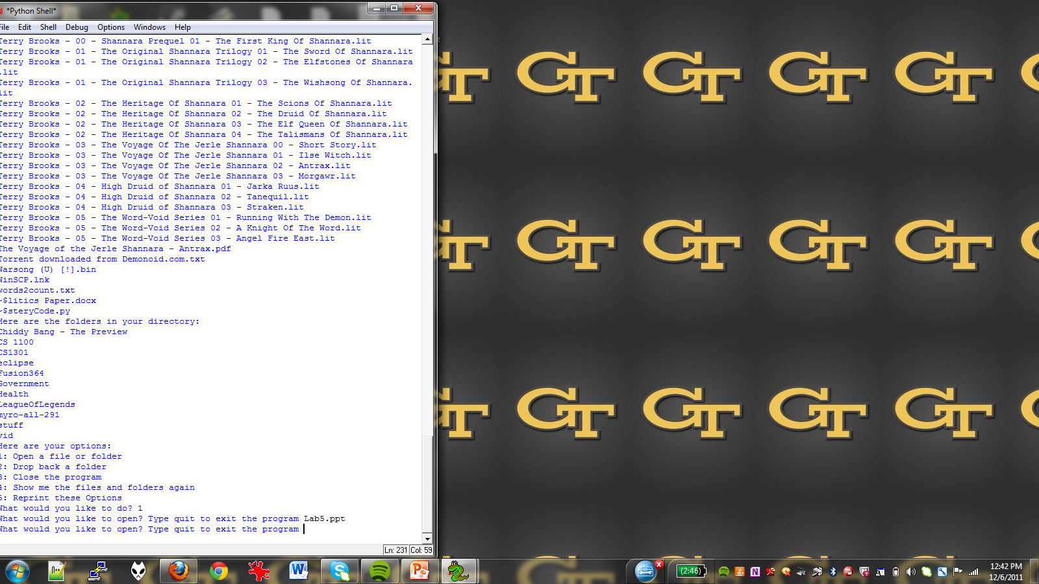
The Program
Here’s a picture of the program.

Slide 7
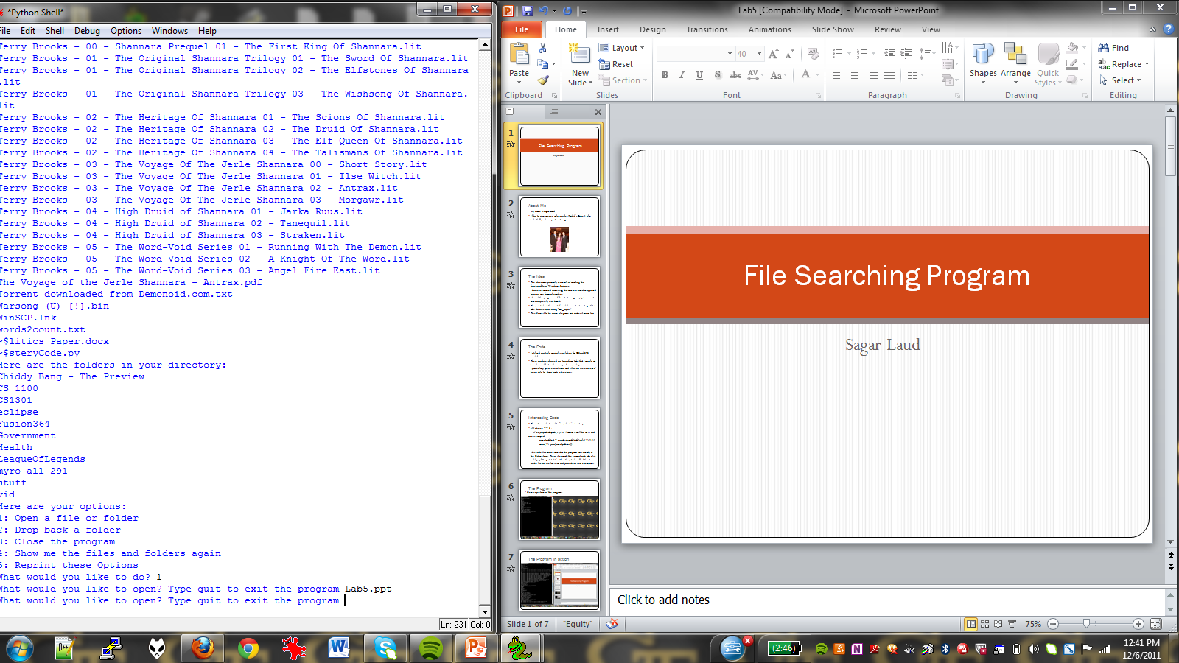
The Program in action

