Slide 1


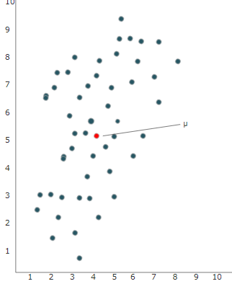
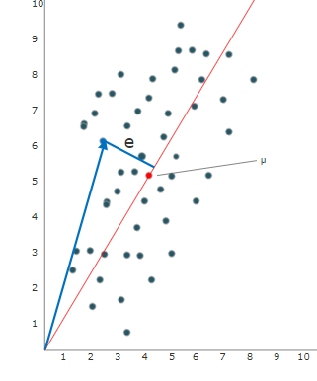
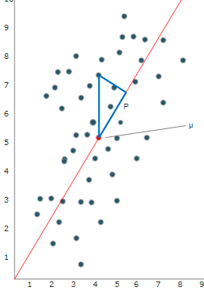
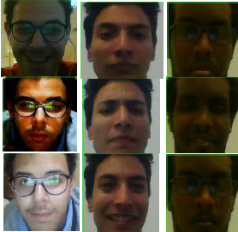

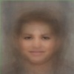




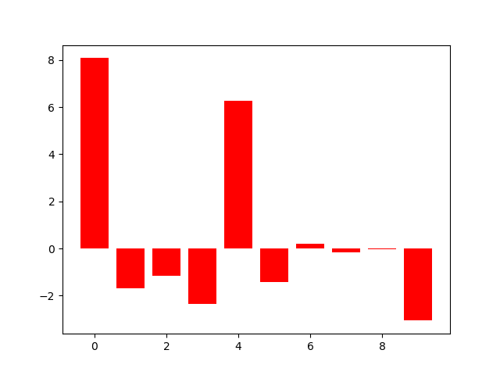
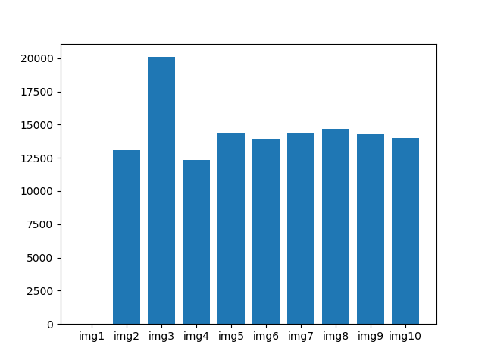
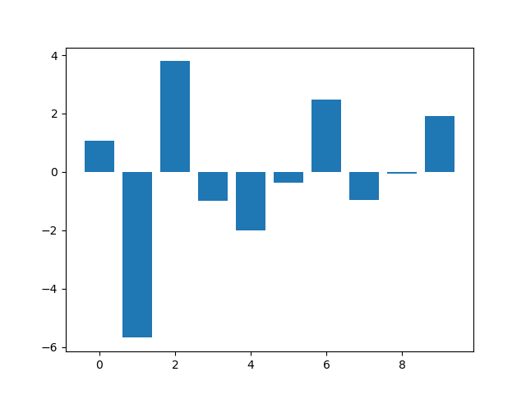
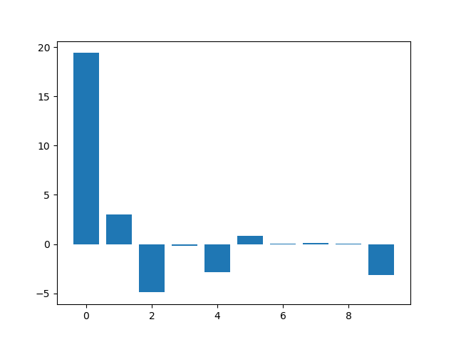
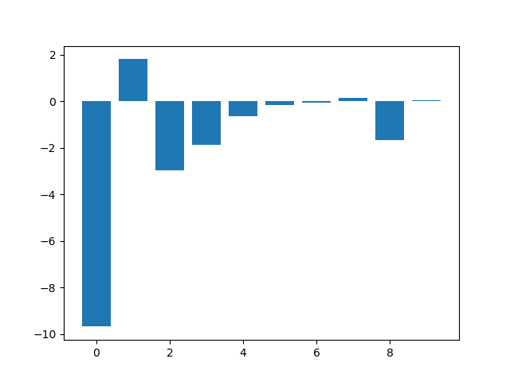








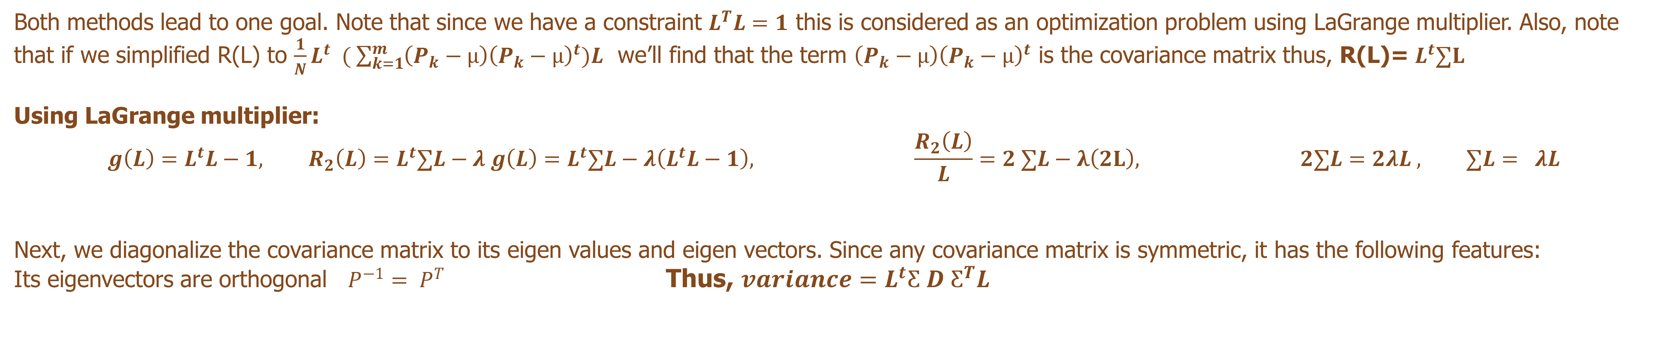
Face Recognition & Image compression using
PCA
Linear Algebra :: Dr. Mohamed El beltagy By :: Gad | Mohamed | Rawan | Ahmed
ABSTRACT
INTRODUCTION
Human beings can detect and recognize faces skillfully even when conditions like face expression, lighting condition, or viewing angle change. In this paper, we describe a procedure for facial recognition using PCA and SVD after explaining both concepts thoroughly. To validate our theoretical results, we develop a facial recognition application that are efficient even under the change of the mentioned conditions using linear dimensionality reduction techniques.
PCA chooses the best principle component that represents datapoints. This is done using one of two methods:
Reducing squared-distance-error, shown on Fig. 2 $J\left(L\right)=\sum_{k=i}^{m}{{\left\|\left(X_{k}−µ\right)−L^{t}\left(X_{k}−µ\right)L \right\|}^{2}}$
Maximize the variance projection of datapoints, shown on Fig. 3: $R\left(L\right)=\sum_{k=1}^{m}{\frac{1}{N}{\left\|L^{t}(P_{k}−µ\right\|}^{2}}$Where, $P=µ+{\left(P−µ\right)}^{2}$
figure (1) figure(2) figure(3)
METHODOLOGY
Both methods lead to one goal. Note that since we have a constraint $L^{T}L=1$ this is considered as an optimization problem using LaGrange multiplier. Also, note that if we simplified R(L) to $\frac{1}{N}L^{t} ( \sum_{k=1}^{m}{\left(P_{k}−µ\right){\left(P_{k}−µ\right)}^{t})L}$ we’ll find that the term $\left(P_{k}−µ\right){\left(P_{k}−µ\right)}^{t}$ is the covariance matrix thus, R(L)= $L^{t}∑L$
Using LaGrange multiplier:
$$g\left(L\right)=L^{t}L−1, R_{2}\left(L\right)=L^{t}∑L−λ g\left(L\right)=L^{t}∑L−λ\left(L^{t}L−1\right), \frac{R_{2}\left(L\right)}{L}=2 ∑L−λ\left(2L\right), 2∑L=2λL , ∑L= λL$$
Next, we diagonalize the covariance matrix to its eigen values and eigen vectors. Since any covariance matrix is symmetric, it has the following features:
Its eigenvectors are orthogonal $P^{−1}= P^{T}$ Thus, $variance=L^{t}Ƹ D Ƹ^{T}L$
flattening
Eigenvectors & Eigenvalues
The variance equations show that the variance of any eigenvector is itself the eigenvalue of that same eigenvector. So, if we want the principle component that shows the most details of the data, we choose the eigenvector corresponding to the highest eigenvector and so on.
Data Matrix (NxD)
Covariance Matrix (NxN)
Dataset (N images)
figure (4)
Mean Face
RESULTS
Projection on eigenvectors
Distance between target and dataset
Here we use PCA in two ways: as a feature extraction tool and as a dimensionality reduction tool.
Feature extraction for face recognition
Dimensionality reduction for image compression
New Image
We replaced the real weights of an image (which are represented by the pixels of that image) with the weights of that image on the eigenvectors we obtained. The two images are nearly identical. And the compression factor is 83:4000 or 0.02. And this factor can be further improved using integer or byte values instead of float numbers to reach 11: 2000 or 0.005.
figure (5)
REFERENCES
[1] Kutz, J. (2013). Data-driven modeling and scientific computation. Oxford [etc.]: Oxford U.P.
[2] Turk, M. and Pentland, A. (1991). Eigenfaces for Recognition. Journal of Cognitive Neuroscience, 3(1), pp.71-86.
[3] Learnche.org. (2019). 6.5.2. Geometric explanation of PCA — Process Improvement using Data. [online] Available at: https://learnche.org/pid/latent-variable-modelling/principal-component-analysis/geometric-explanation-of-pca [Accessed 31 Mar. 2019].
[4] Brownlee, J. (2019). How to Calculate Principal Component Analysis (PCA) from Scratch in Python. [online] Machine Learning Mastery

