Slide 1


Face Recognition & Image compression using PCA
Linear Algebra :: Dr. Mohamed El-beltagy
By :: Gad | Mohamed | Rawan | Ahmed

Slide 2
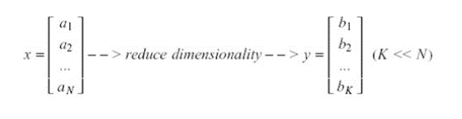
Dimensionality reduction
What ?
why ?
Solving scalability problems,
especially in data driven applications
Eliminates redundancy in data
Boosts performance

Slide 3
Dimensionality reduction approaches
Feature selection
Feature extraction
From N-dimensional space, choose K important variables to keep and eliminate the rest.
Introduce new variables by combining weights of original variables.
Temp. | mood | Clouds | Rain
50 | 25% | 50% | 34%
40 | 30% | 90% | 86%
20 | 80% | 13% | 6%
Temp. | mood | Clouds | Rain
50 | 25% | 50% | 34%
40 | 30% | 90% | 86%
20 | 80% | 13% | 6%
Temp. | Clouds
50 | 50%
40 | 90%
20 | 13%
Principle component 1 | Principle component 2
42.243891 | 22.89531%
13.842397 | 54.43899%
24.523913 | 73.53428%

Slide 4
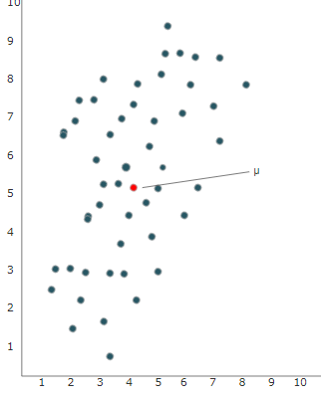
PCA approaches
PCA reduce dimensions of data while retaining as much information as possible

Slide 5
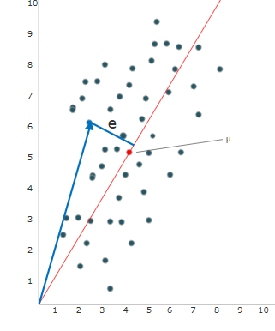
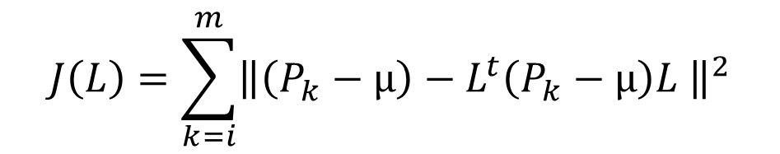

PCA approaches
1 Reducing squared distance error
$$J\left(L\right)=\sum_{k=i}^{m}{{\left\|\left(P_{k}−µ\right)−L^{t}\left(P_{k}−µ\right)L \right\|}^{2}}$$
Calculate J(L) for every point $P_{k}$ on each proposed principle component L
Our goal is to minimize J(L)

Slide 6
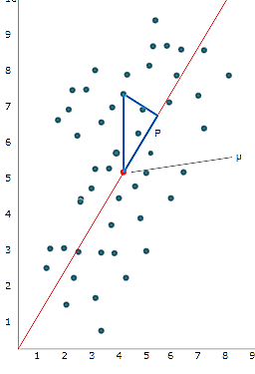
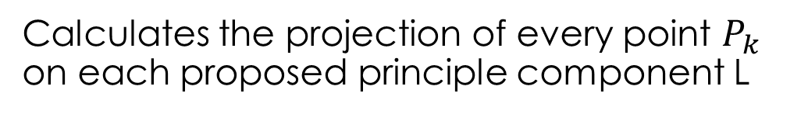
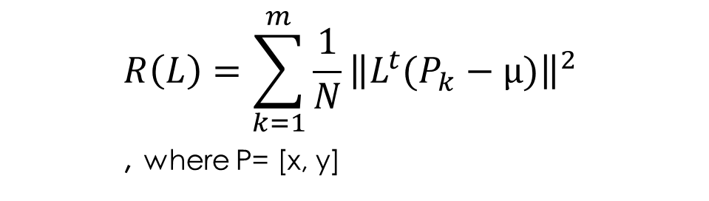
PCA approaches
2 Maximizing projection on L
$$R\left(L\right)=\sum_{k=1}^{m}{\frac{1}{N}{\left\|L^{t}(P_{k}−µ)\right\|}^{2}}$$
, where P= [x, y]
Calculates the projection of every point $P_{k}$ on each proposed principle component L
Our goal is to maximize R(L)

Slide 7
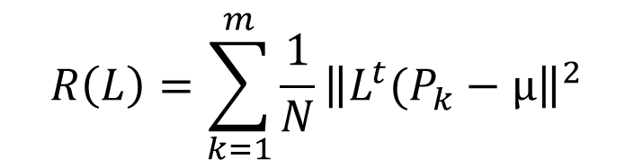
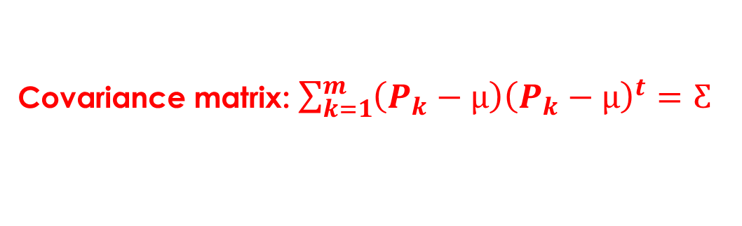



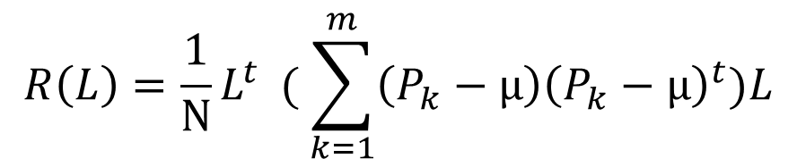
PCA approaches
Using either of these methods and the constraint : $L^{t}L=1$, this becomes an optimization problem that can be solved using LaGrange multiplier.
$$R\left(L\right)=\sum_{k=1}^{m}{\frac{1}{N}{\left\|L^{t}(P_{k}−µ\right\|}^{2}}$$
$$R\left(L\right)=\frac{1}{N}L^{t} ( \sum_{k=1}^{m}{\left(P_{k}−µ\right){\left(P_{k}−µ\right)}^{t})L}$$
Covariance matrix: $\sum_{k=1}^{m}{\left(P_{k}−µ\right){\left(P_{k}−µ\right)}^{t}=Ƹ}$
$g\left(L\right)=L^{t}L−1=0$
$R\left(L\right)=L^{t}ƸL$

Slide 8
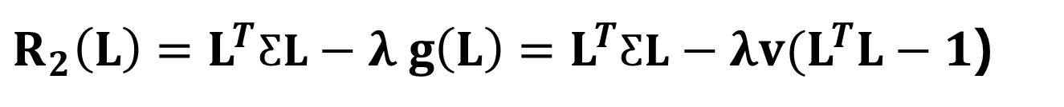

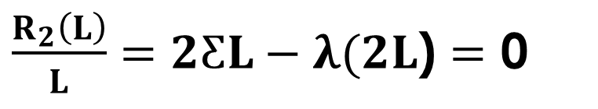



Calculating PCA
$R_{2}\left(L\right)=L^{T}ƸL−λ g\left(L\right)=L^{T}ƸL−λv(L^{T}L−1$)
$\frac{R_{2}\left(L\right)}{L}=2ƸL−λ(2L$) $=$ 0
Eigenvalues &
Eigenvectors Eq.
$ƸL=λ L$
$${λ= L}^{T}ƸL$$
$$Diagonalizing Ƹ$$
$${variance= L}^{T}P D P^{T}L$$

Slide 9
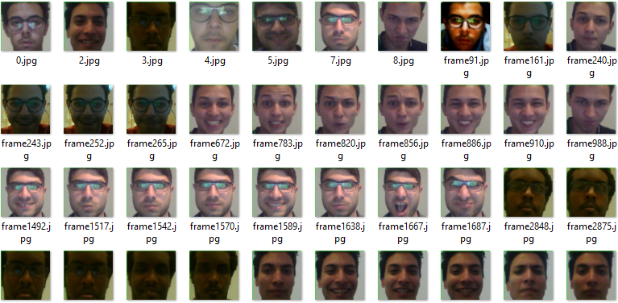

Face recognition
$$step 1$$
Collecting the dataset
Different lighting conditions
Different expressions
alignment

Slide 10
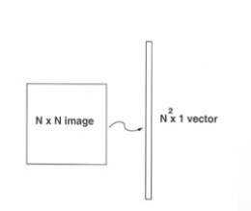

Face recognition
$$step 2$$
Convert to data matrix
1- flattening dataset images
2- stacking images in a matrix
Images stacked as rows
Images stacked as columns

Slide 11



Face recognition
$$step 3$$
Calculate the mean face
$$step 4$$
use PCA to calculate new principle component

Slide 12
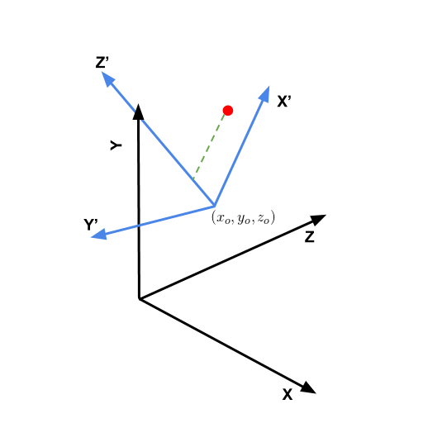



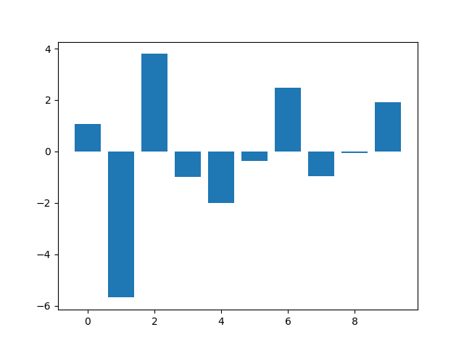
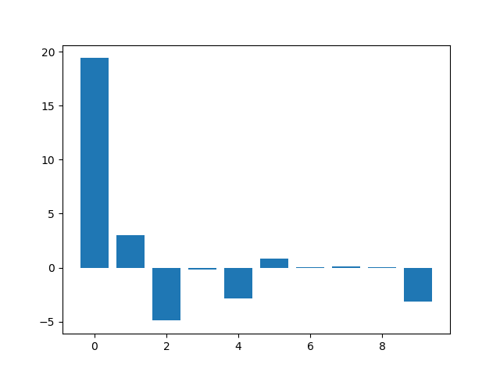
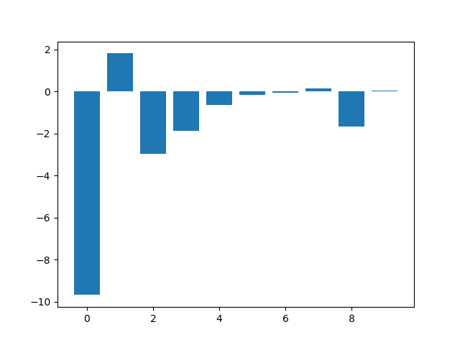

Face recognition
$$FINAL STEP$$
CALCULATING PROJECTIONS ON PRINCIPLE COMPONENTS
How would you transform the red point from one basis to another ?
weights of each image on the new principle components

Slide 13
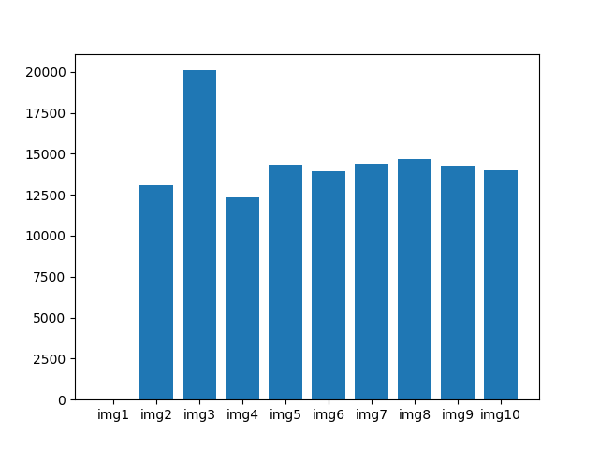

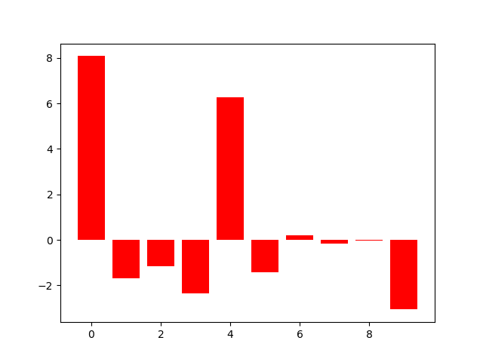

Face recognition
$$RESULTS$$
The distance between the weights of the test image and the weights of the dataset images is calculated and the closest dataset image to the test image is chosen as the result.
New Image
Euclidian distance between weights
of test image and dataset images

Slide 14
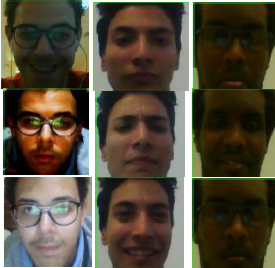
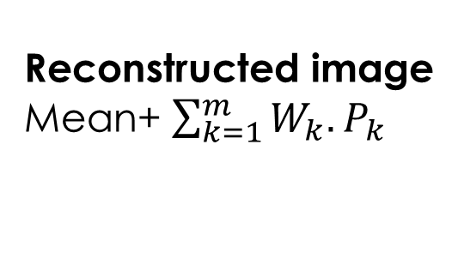
Image compression
$Save principle component weigths instead of original weights$
-16571.219583033726 | -631.1624561549116 | 460.39344337822087 | -49.35521313145287 814.5558967934074 | 1607.1961839924008 | -29.42958282181341 | -348.2856359247719
-2998.643644290159 | -1149.415231328402 | 347.2606338586602 | 478.51662982411204 | …
weights
Principle
components
Reconstructed image
Mean+ $\sum_{k=1}^{m}{W_{k}.P_{k}}$

