Slide 1

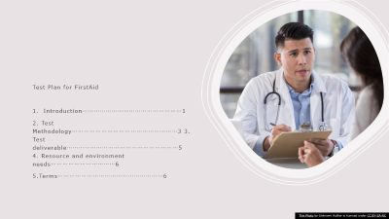
FIRST AID
AID TO SAVE LIFE

Slide 2

Test Plan for FirstAid
Introduction……………………………………………1
2. Test Methodology………………………………………………3 3. Test deliverable…………………………………………………5 4. Resource and environment needs……………………………6
5.Terms………………………………………………6
This Photo by Unknown Author is licensed under CC BY-SA-NC

Slide 3

1.Introduction
This test document includes test methodology, test deliverable, resource and environment and Terms for testing task. In this system testing we will be going to test the admin system of the Firstaid.
Scope - In Scope In this testing we are going to test functionally of SUT. • New salary calculator • Function for updating salary record. • Employee record tracking system • Function for updating employees’ record. • Allocation of paid and volunteering work –
Out Scope Following aspect are out of scope for this testing. • Load Capacity • Security • Scalability
2. Quality Objective Our main objective of this testing is to make sure admin can track the records of employees and they do not have to calculate the salaries manually. New system should be able to do the both the activities automatically.
This Photo by Unknown Author is licensed under CC BY

Slide 4

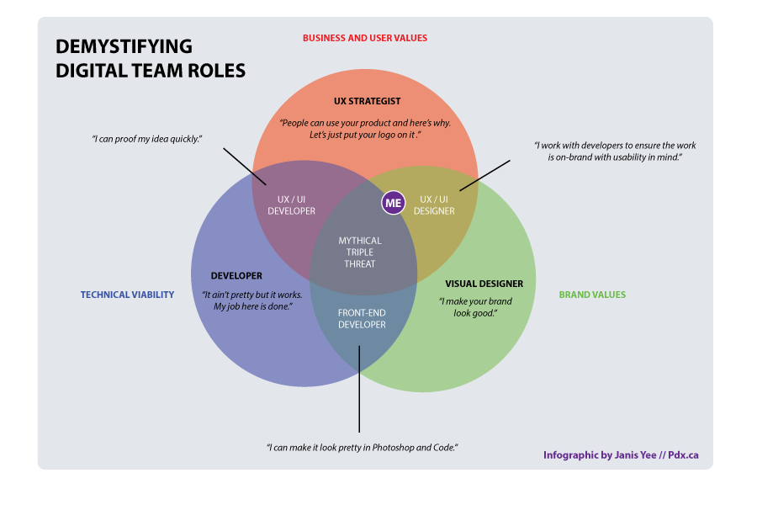
3. Role and Responsibility Sr No. Name Responsibility
1 Dhwani Review test case and review and approve issues
2 Chinab Prepare test scenarios
3 Dheeraj Prepare test cases and environment
4 Sagar Execute test case and report the issues
2.Test Methodology
1.Test Level Functional Testing Unit Integration System Acceptance Testing Non-Functional Testing Performance Usability Testing Testing In Functional testing we are going to test all the functions the systems. After that in integration testing and system testing. After completing all testing, we will going to do the Acceptance Testing. In non-functional testing we will going to test the performance of the system in certain conditions and we will also going to test the usability if the system. We will be using selenium with chrome web drivers to perform test cases for testing
This Photo by Unknown Author is licensed under CC BY-SA
This Photo by Unknown Author is licensed under CC BY-SA-NC

Slide 5
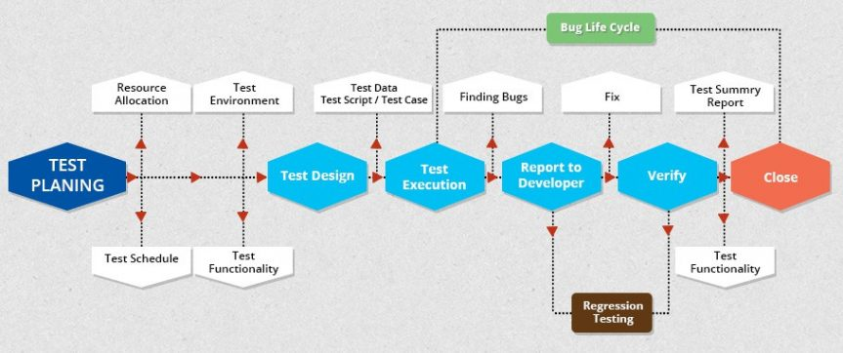
2. Suspension Criteria and Resumption Requirements –
Suspension Criteria: Test will be suspend ended if the we are not getting the required output for the unit tests. Other scenario is if the system is giving constant error while doing integration testing. - Resumption Criteria: Testing will be resumed after fixing the problems with unit testing and integration testing
3. Test completeness Criteria for test completeness: • 100% defined test coverage • All test case execution • All bugs are fixed
4. Project task and estimation and schedule TASK Estimated effort (a) Create the test specification 100 mh (b) Perform test execution 50 mh (c) Test report 10 mh (d) Test delivery 10 mh TOTAL 170 mh
This Photo by Unknown Author is licensed under CC BY-SA

Slide 6
3.Test Deliverables Before Testing phase • Test plans document • Test cases documents • Test Design specifications
During testing phase • Test Data • Test Trace-ability Matrix - Error logs and execution logs
After testing phase • Test reports • Release notes

Slide 7
4.Resource and environment Needs Testing Tools No Tool Description 1 Computer 3 computer with Windows 10, RAM 4 GB
Test Environment Test Computer Setup: • Installation of visual studio • Installation of selenium • Installation of chrome drivers for selenium • Internet Connection Bug report setup: • Microsoft excel and word
5.Terms/Acronyms No Term Description
SRS Software requirment Specification 2 SUT Software under test

Slide 8

BUSINESS REQUIRMENTS
BR-1 Customer want to introduce new employee recode keeping
BR-2 They need payroll calculator
BR-3 They need function which can correct payroll errors rapidly
BR-4 They need to know employee’s time contribution with sister charity
FUNCTIONAL REQUIRMENTS FR-1 Easy employee record keeping model like lotaCo’s Record keeping Model FR-2 Build Record modification Function FR-3 Build Payroll Calculator with employee ID, Hours , Hourly salary FR-4 Integrate Paid work and volunteering work option in payroll calculator FR-5 Build Payroll modification Function FR-5 Integrate report dashboard for employee’s contribution (paid and volunteer )
NON-FUNCTIONAL REQUIRMENTS NFR-1 Payroll and record modification should apply the changes instantly

