Slide 1

HASHICORP - VAULT
RISE OF THE CONTAINERS

Slide 2
Part-1 – Basics of Vault
First we will try to cover a basic understanding of vault.
Common problems that are faced while managing secrets | 05
Key features of Vault | 06
Vault Workflow | 07
Demo | 08
Vault – Seal / Unseal | 09
© 2022 Thoughtworks

Slide 3
Part-2 – Using Vault in Kubernetes
In this part we will understand how Vault is used in Kubernetes
Understanding Dynamic Admission controller | 13
Understanding Vault sidecar and Init containers | 14
DEMO | 15
© 2022 Thoughtworks

Slide 4
Part-1 – Basics of Vault

Slide 5
What are the most common problems that are faced while managing secrets?
Where are your secrets stored?
Who has access to secrets?
Who accessed which secret and when?
How to rotate secrets?
How do we revoke access to secrets?

Slide 6
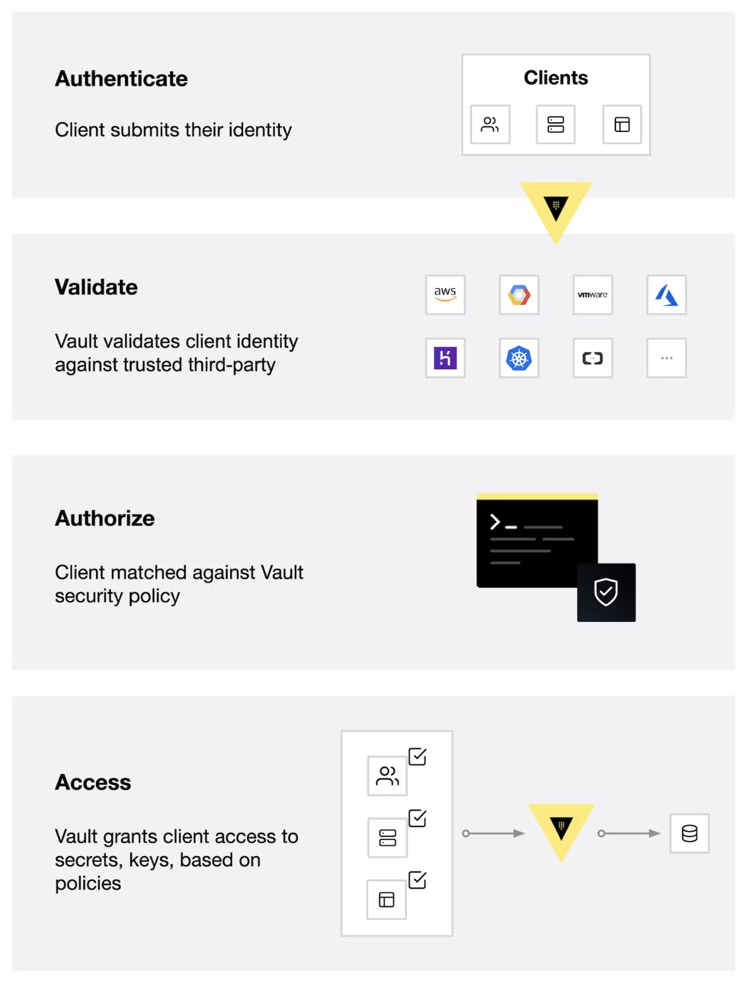
Vault Workflow
Authenticate: Authentication in Vault is the process by which a client supplies information that Vault uses to determine if they are who they say they are. Once the client is authenticated against an auth method, a token is generated and associated to a policy.
Validation: Vault validates the client against third-party trusted sources, such as Github, LDAP, AppRole, and more.
Authorize: A client is matched against the Vault security policy. This policy is a set of rules defining which API endpoints a client has access to with its Vault token. Policies provide a declarative way to grant or forbid access to certain paths and operations in Vault.
Access: Vault grants access to secrets, keys, and encryption capabilities by issuing a token based on policies associated with the client’s identity. The client can then use their Vault token for future operations

Slide 7
Key Features of Vault
Vault takes credentials and centralizes them so that they are defined in one location, which reduces unwanted exposure to credentials. It also makes sure that users, apps, and systems are authenticated and explicitly authorized to access resources, while also providing an audit trail that captures and preserves a history of clients' actions
Secure Secret Storage
Static and Dynamic Secrets
Data Encryption
Leasing and Renewal
Revocation
© 2022 Thoughtworks
Notes:
The key features of Vault are:
Secure Secret Storage: Arbitrary key/value secrets can be stored in Vault. Vault encrypts these secrets prior to writing them to persistent storage, so gaining access to the raw storage isn't enough to access your secrets. Vault can write to disk, Consul, and more.
Dynamic Secrets: Vault can generate secrets on-demand for some systems, such as AWS or SQL databases. For example, when an application needs to access an S3 bucket, it asks Vault for credentials, and Vault will generate an AWS keypair with valid permissions on demand. After creating these dynamic secrets, Vault will also automatically revoke them after the lease is up.
Data Encryption: Vault can encrypt and decrypt data without storing it. This allows security teams to define encryption parameters and developers to store encrypted data in a location such as a SQL database without having to design their own encryption methods.
Leasing and Renewal: All secrets in Vault have a lease associated with them. At the end of the lease, Vault will automatically revoke that secret. Clients are able to renew leases via built-in renew APIs.
Revocation: Vault has built-in support for secret revocation. Vault can revoke not only single secrets, but a tree of secrets, for example all secrets read by a specific user, or all secrets of a particular type. Revocation assists in key rolling as well as locking down systems in the case of an intrusion.

Slide 8
Part-1 – DEMO

Slide 9
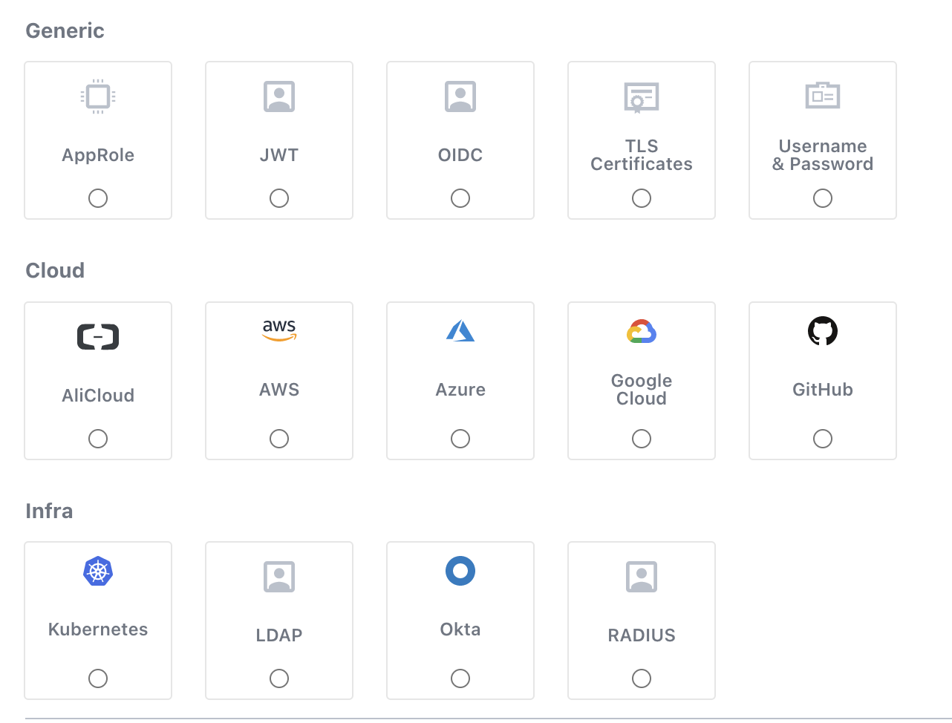
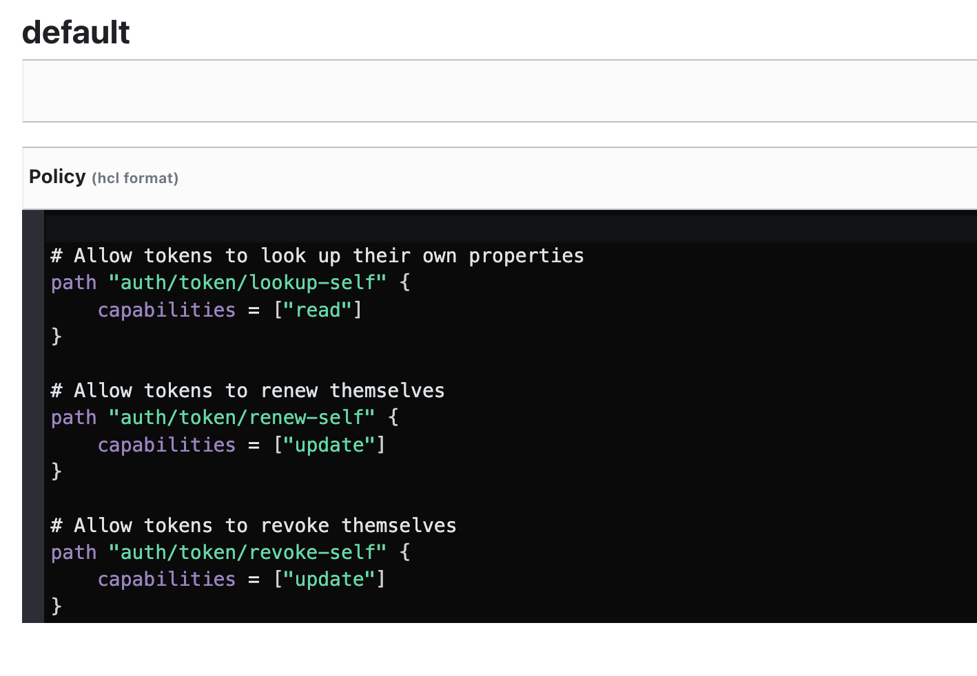
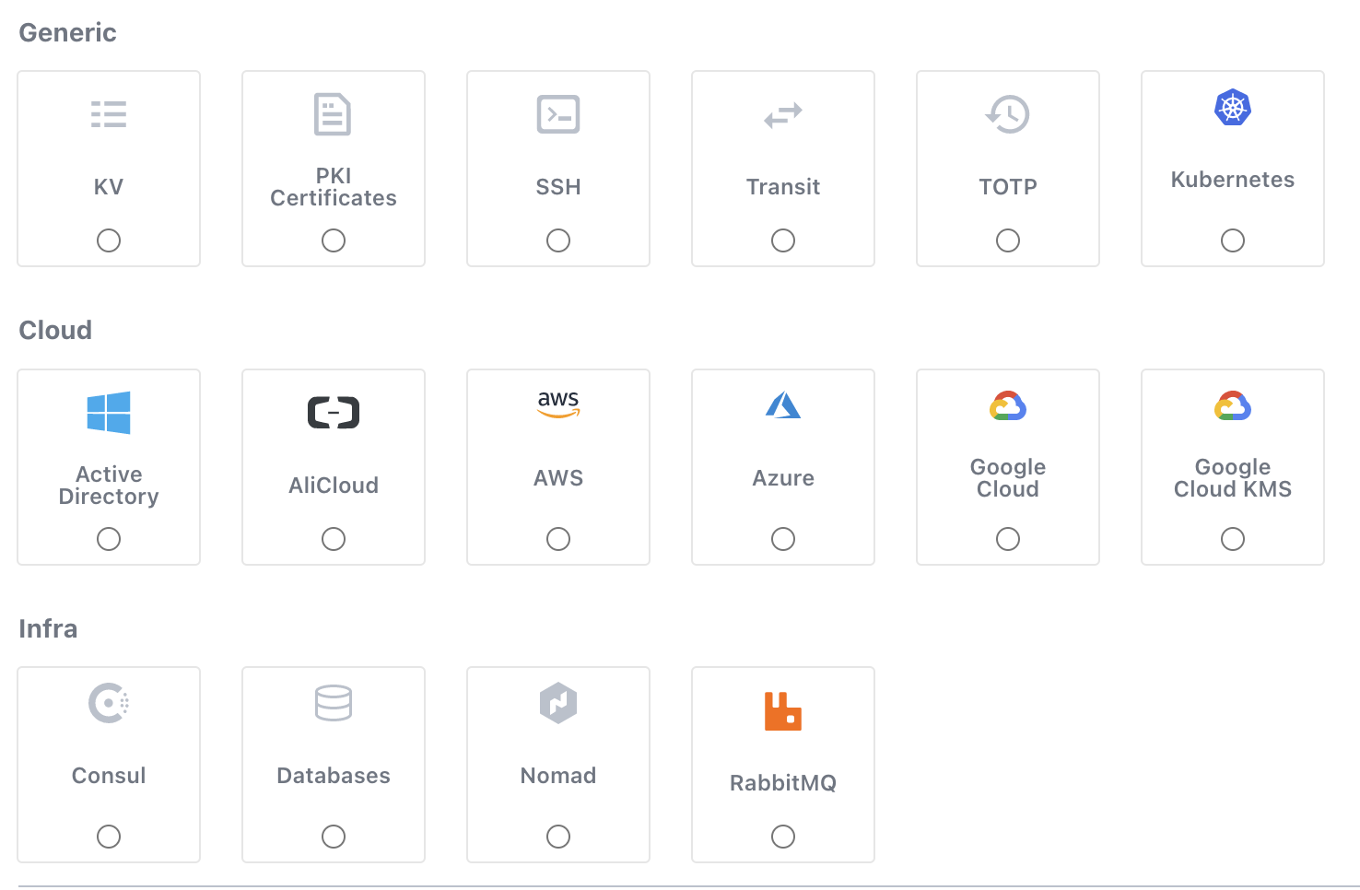
Summary
Authenticate
Authorise
Secret
Types of Authentication Supported
Using Policies to Authorise
Types of Secret Supported

Slide 10
Vault – Seal / Unseal - 1
VAULT DATA
ENCRYPTED BY
Encryption Key
ENCRYPTED BY
ENCRYPTED BY
UNSEAL KEY
ROOT KEY
Most Vault data is encrypted using the encryption key in the keyring
The keyring is encrypted by the root key
The root key is encrypted by the unseal key.
Notes:
Whenever vault is started it does know where the secrets are stored but cannot decrypt them.
The data stored by Vault is encrypted. Vault needs the encryption key in order to decrypt the data. The encryption key is also stored with the data (in the keyring), but encrypted with another encryption key known as the root key.
most Vault data is encrypted using the encryption key in the keyring; the keyring is encrypted by the root key; and the root key is encrypted by the unseal key.

Slide 11
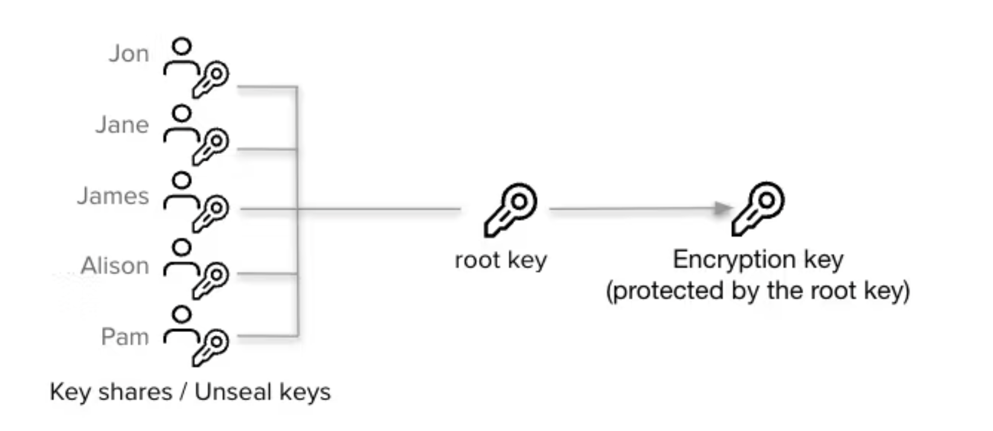
Vault – Seal / Unseal - 2
Notes:
The default Vault config uses a Shamir seal. Instead of distributing the unseal key as a single key to an operator, Vault uses an algorithm known as Shamir's Secret Sharing to split the key into shards

Slide 12
Quick Summary of Part -1
Created Secrets
Fetched Secrets
Created Token
Created Policies
Assigned Policies
Understood the concept of unseal key

Slide 13
Part-2 – Using Vault in Kubernetes

Slide 14
How K8s works
Manifest
Notes:
Based on the Annotation the pod definition is changed and a init container or side car container is added.

Slide 15

How K8s works
Manifest
K8s Control Pane
Notes:
Based on the Annotation the pod definition is changed and a init container or side car container is added.

Slide 16
How K8s works
Manifest
K8s Control Pane
Executes the Manifest
Notes:
Based on the Annotation the pod definition is changed and a init container or side car container is added.

Slide 17
How K8s works with Dynamic Admission Controller
Manifest
Notes:
Based on the Annotation the pod definition is changed and a init container or side car container is added.

Slide 18
How K8s works with Dynamic Admission Controller
Manifest
K8s Control Pane
Notes:
Based on the Annotation the pod definition is changed and a init container or side car container is added.

Slide 19
How K8s works with Dynamic Admission Controller
Manifest
K8s Control Pane
Modify the manifest
Notes:
Based on the Annotation the pod definition is changed and a init container or side car container is added.

Slide 20
How K8s works with Dynamic Admission Controller
Manifest
K8s Control Pane
Modify the manifest
Dynamic Admission Controller
Notes:
Based on the Annotation the pod definition is changed and a init container or side car container is added.

Slide 21
How K8s works with Dynamic Admission Controller
Manifest
K8s Control Pane
Modify the manifest
Executes the Manifest
Dynamic Admission Controller
Notes:
Based on the Annotation the pod definition is changed and a init container or side car container is added.

Slide 22
How K8s works with Dynamic Admission Controller Example
Manifest
POD: nginx:latest
Notes:
Based on the Annotation the pod definition is changed and a init container or side car container is added.

Slide 23
How K8s works with Dynamic Admission Controller Example
Manifest
K8s Control Pane
POD: nginx:latest
Notes:
Based on the Annotation the pod definition is changed and a init container or side car container is added.

Slide 24
How K8s works with Dynamic Admission Controller Example
Manifest
K8s Control Pane
Modify the manifest
POD: nginx:latest
Dynamic Admission Controller
Notes:
Based on the Annotation the pod definition is changed and a init container or side car container is added.

Slide 25
How K8s works with Dynamic Admission Controller Example
Manifest
K8s Control Pane
Modify the manifest
Executes the Manifest
POD: nginx:latest prometheus:latest
Dynamic Admission Controller
Notes:
Based on the Annotation the pod definition is changed and a init container or side car container is added.

Slide 26
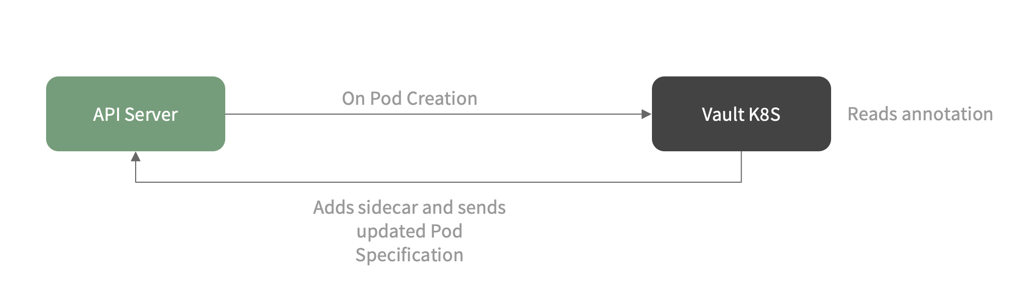
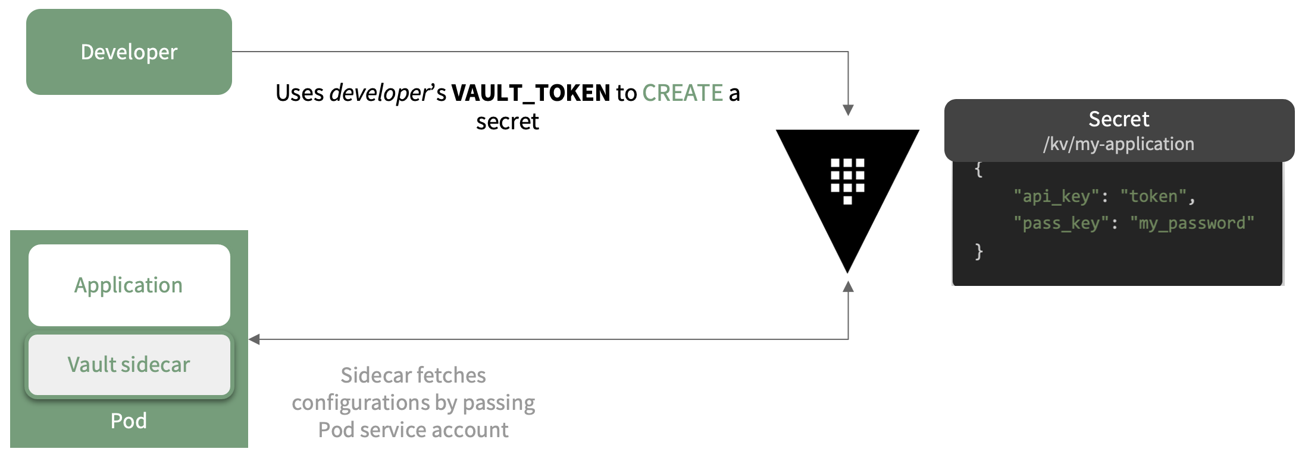
How Vault uses Dynamic Admission Controllers
Vault uses DAC to create an init container and a sidecar container inside the pod to handle the secrets
There is an init container which runs before the main container is initialized and fetches the secret. If this process fails, the main container is not started
The side car containers is basically to sync any changes in the secrets so that you do not have to redeploy the changes

Slide 27
How K8s works with Dynamic Admission Controller with Vault
Manifest
K8s Control Pane
Modify the manifest
Executes the Manifest
POD: nginx:latest
vault-agent-injector
Notes:
Based on the Annotation the pod definition is changed and a init container or side car container is added.

Slide 28
How K8s works with Dynamic Admission Controller with Vault
Manifest
K8s Control Pane
Modify the manifest
Executes the Manifest
POD: nginx:latest vault-init-container vault-sidecar-container
vault-agent-injector
Notes:
Based on the Annotation the pod definition is changed and a init container or side car container is added.

Slide 29
Part-2 – DEMO

Slide 30
Thank you
Sagar Trivedi

