Slide 1

Bank Management System

Slide 2
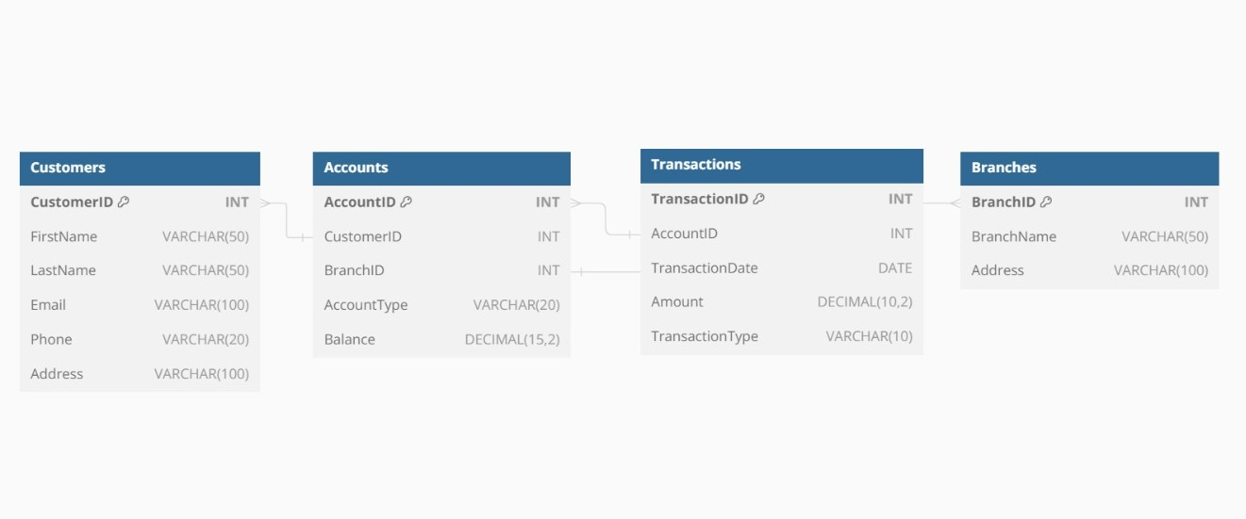
ER- DIAGRAM

Slide 3
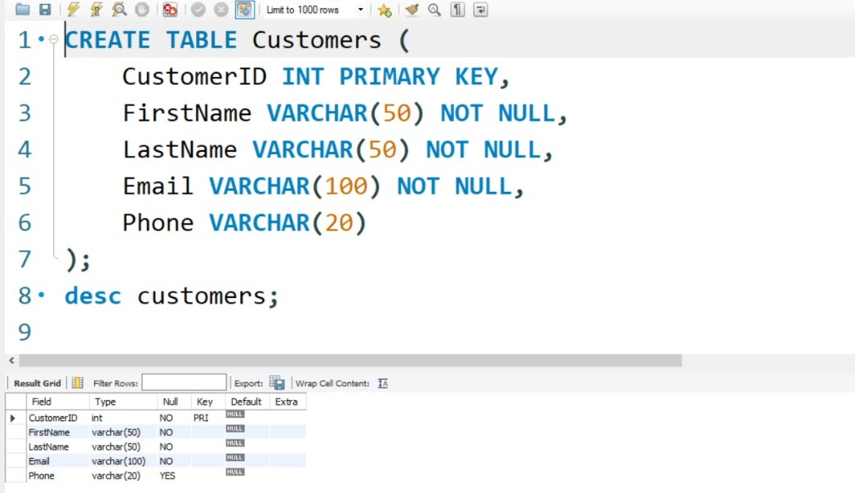
STRUCTURE OF TABLE
Structure of Customer Table -
SYNTAX: DESC Customers;

Slide 4
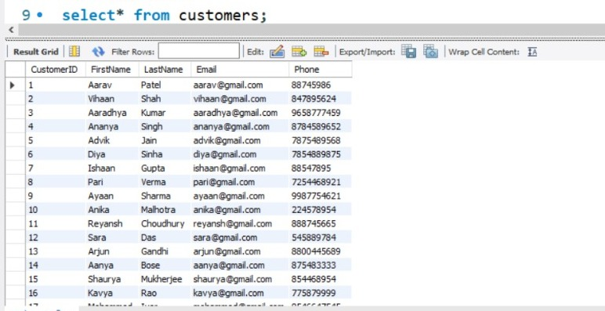
STRUCTURE OF TABLE
Content of Customer Table -
SYNTAX: select* from customers;

Slide 5
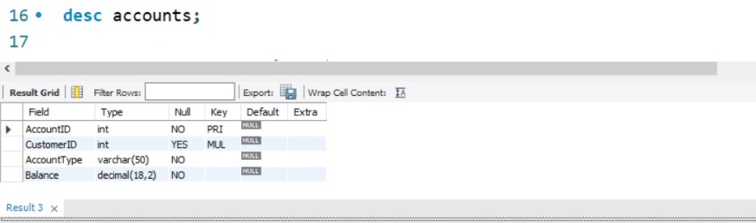
STRUCTURE OF TABLE
Structure of Accouns Table
SYNTAX: desc accounts;

Slide 6
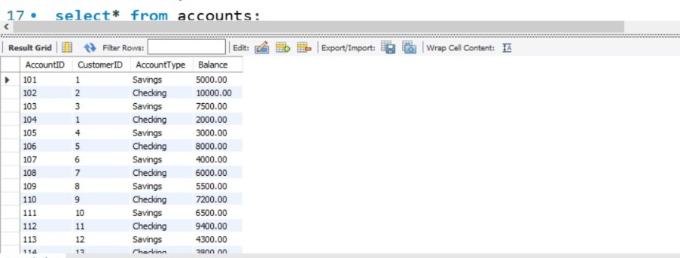
STRUCTURE OF TABLE
Content Of Accounts Table -
SYNTAX: Select* from accounts;

Slide 7
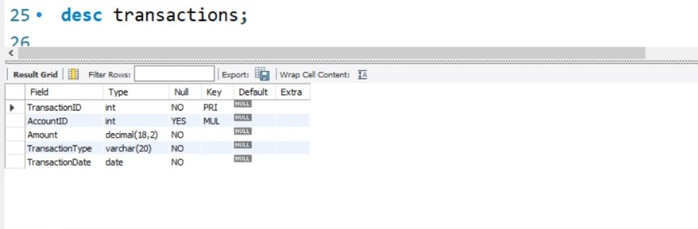
STRUCTURE OF TABLE
Structure of Transaction Table -
SYNTAX: DESC TRANSACTION;

Slide 8
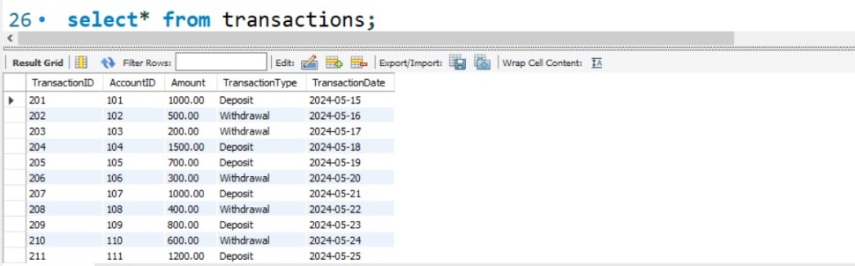
STRUCTURE OF TABLE
Content of Transaction Table
SYNTAX: Select* from transactions;

Slide 9
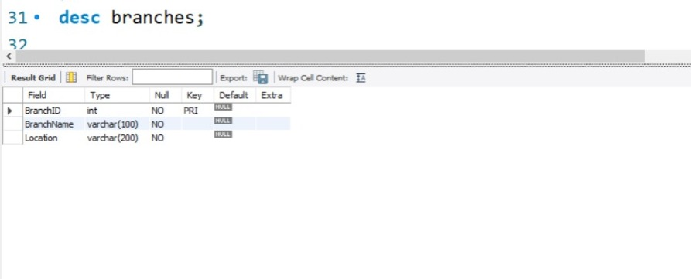
STRUCTURE OF TABLE
Structure Of Branches Table -
SYNTAX: Desc Branches;

Slide 10
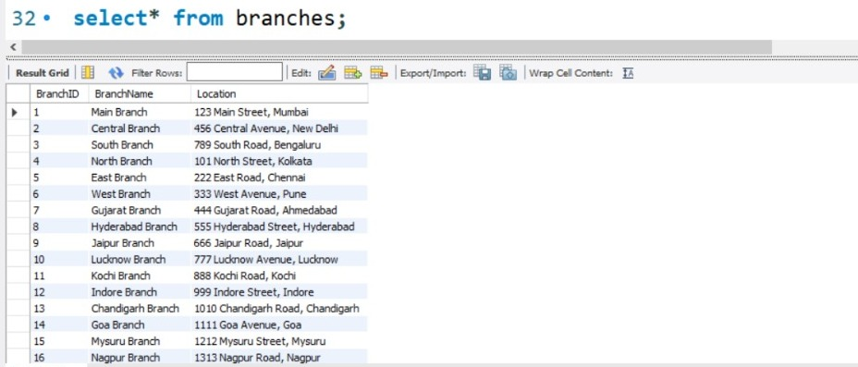
STRUCTURE OF TABLE
Contents Of Branches Table
SYNTAX: Select * from Branches;

Slide 11
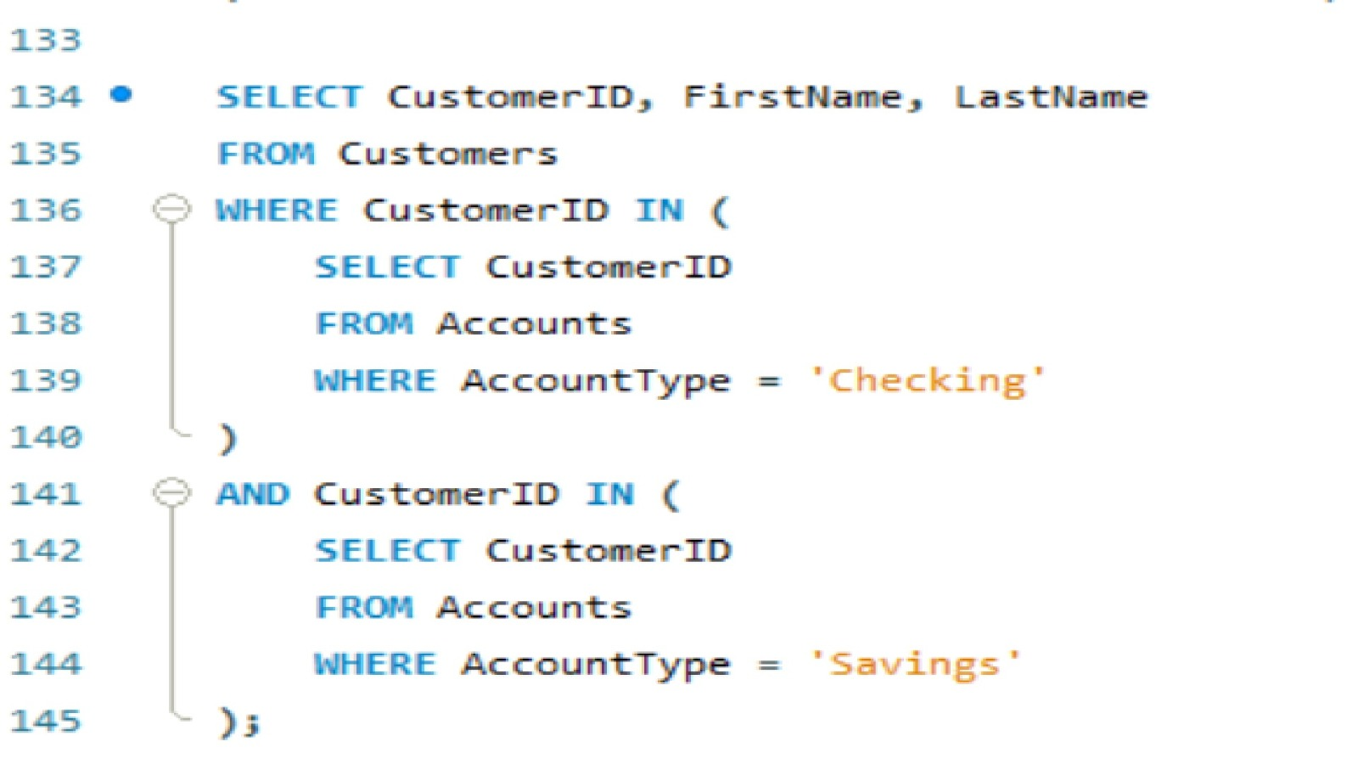
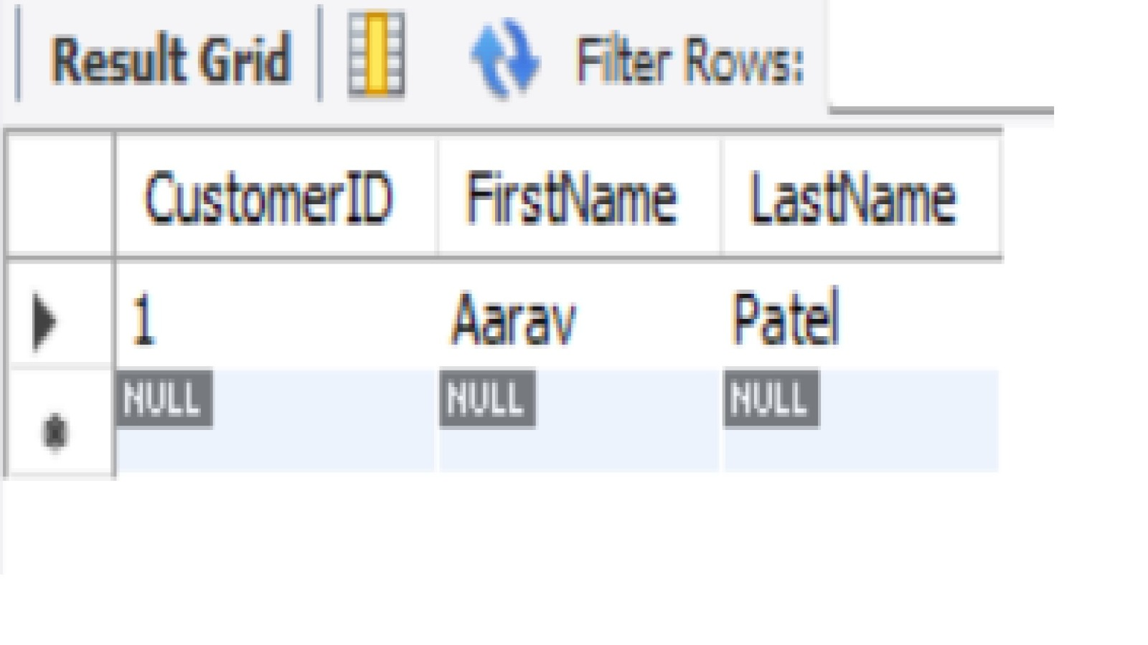
SUBQUERIES
SYNTAX - SELECT CustomerID, FirstName, LastNameFROM CustomersWHERE CustomerID IN ( SELECT CustomerID FROM Accounts WHERE AccountType = 'Checking')AND CustomerID IN ( SELECT CustomerID FROM Accounts WHERE AccountType = 'Savings');
Retrieve customers who have both a checking and a savings account.

Slide 12
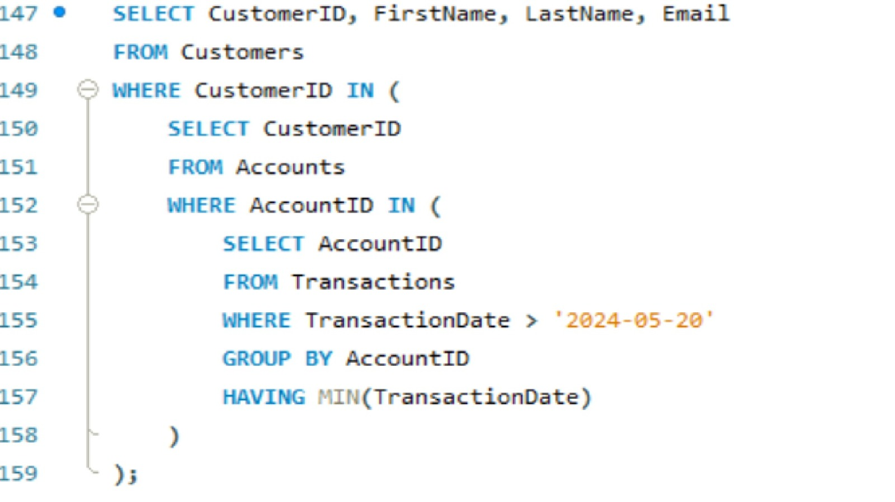
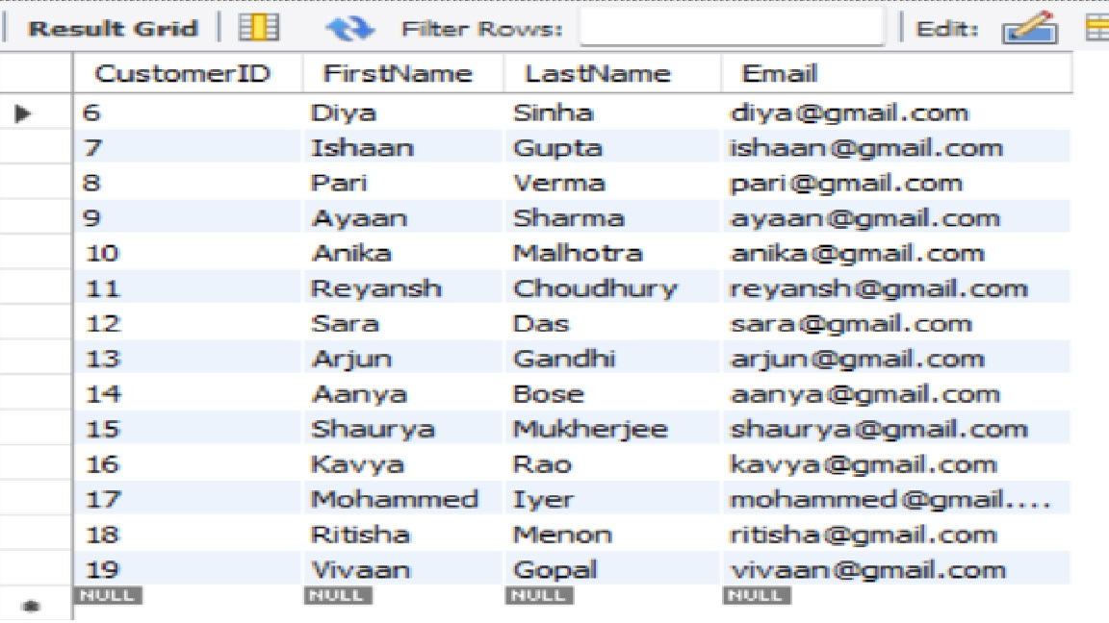
SUBQUERY -
SYNTAX-SELECT CustomerID, FirstName, LastName, EmailFROM CustomersWHERE CustomerID IN ( SELECT CustomerID FROM Accounts WHERE AccountID IN ( SELECT AccountID FROM Transactions WHERE TransactionDate > '2024-05-20' GROUP BY AccountID HAVING MIN(TransactionDate) ) );

Slide 13
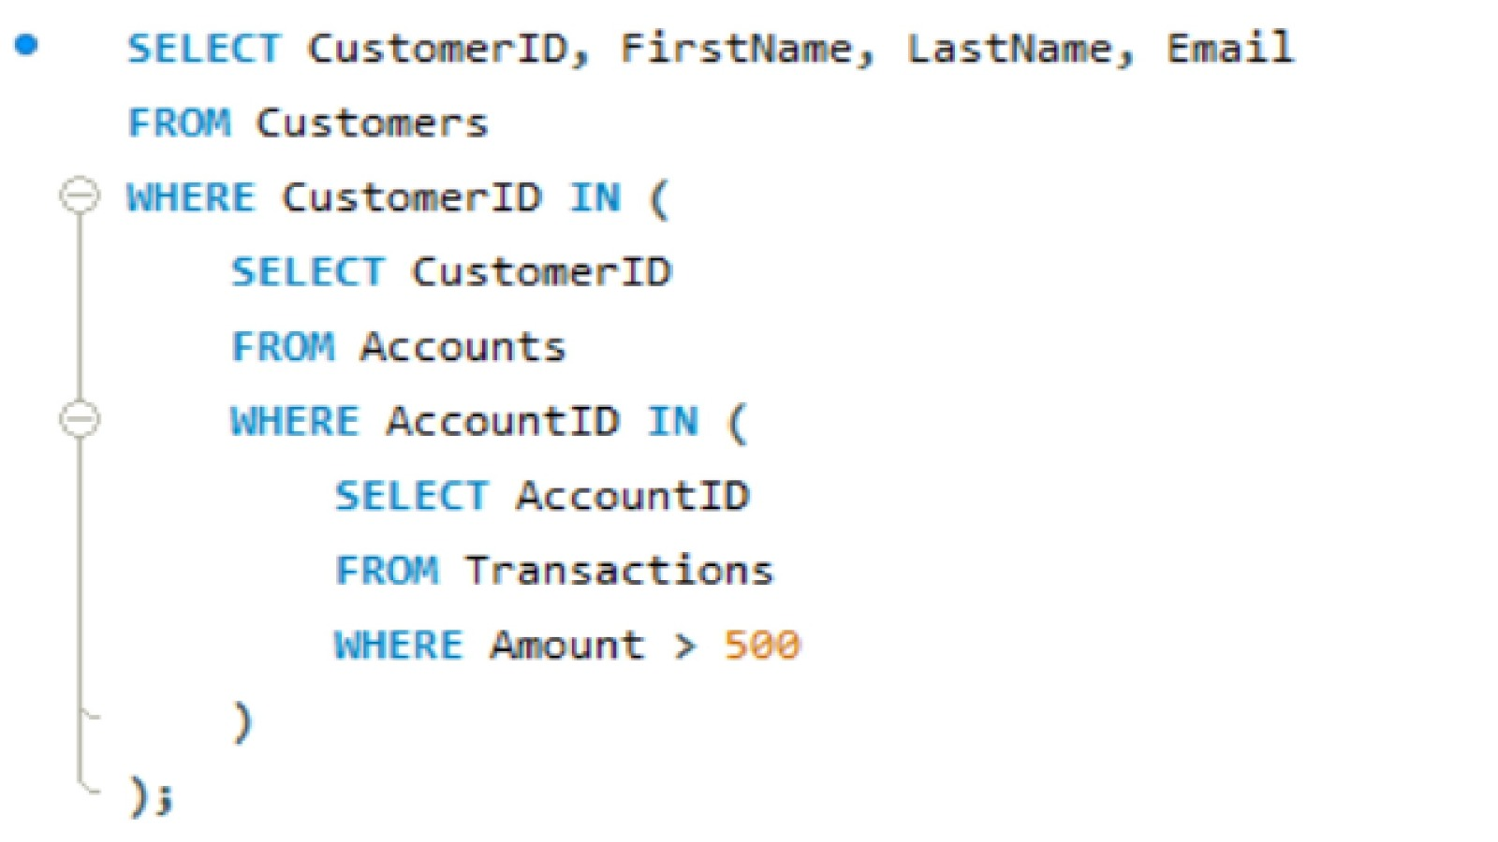
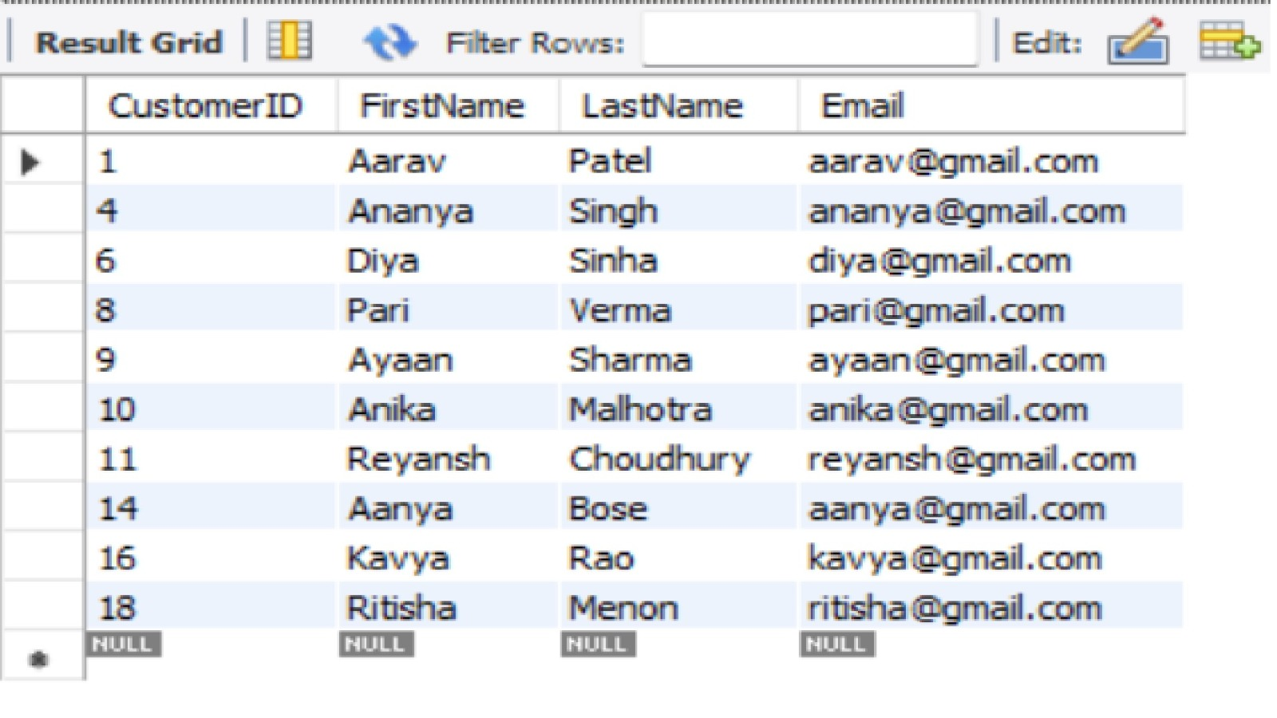
SUBQUERY -
SELECT CustomerID, FirstName, LastName, EmailFROM CustomersWHERE CustomerID IN ( SELECT CustomerID FROM Accounts WHERE AccountID IN ( SELECT AccountID FROM Transactions WHERE Amount > 500 ));
Find the customers who have made a transaction of more than ₹500 on any of their accounts.

Slide 14
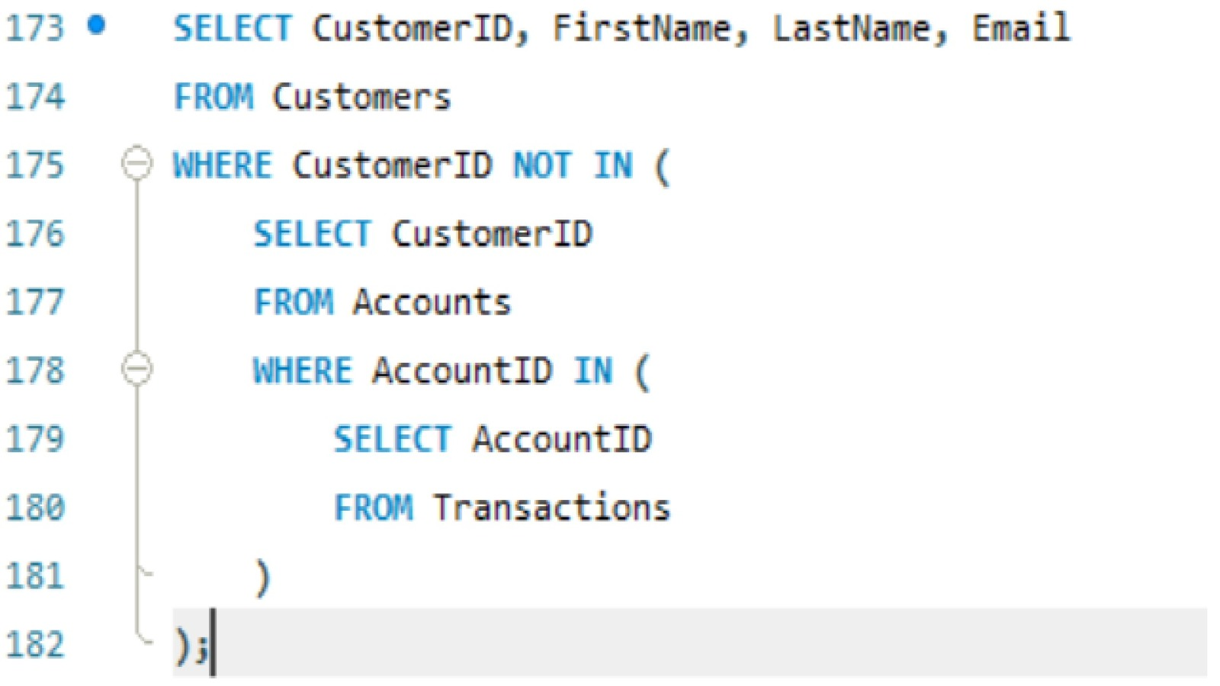
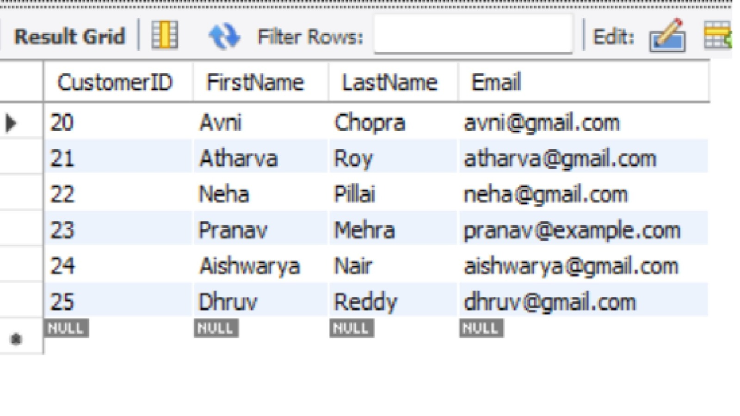
SUBQUERY -
SYNTAX - SELECT CustomerID, FirstName, LastName, EmailFROM CustomersWHERE CustomerID NOT IN ( SELECT CustomerID FROM Accounts WHERE AccountID IN ( SELECT AccountID FROM Transactions ));
Find customers who have not made any transactions.

Slide 15
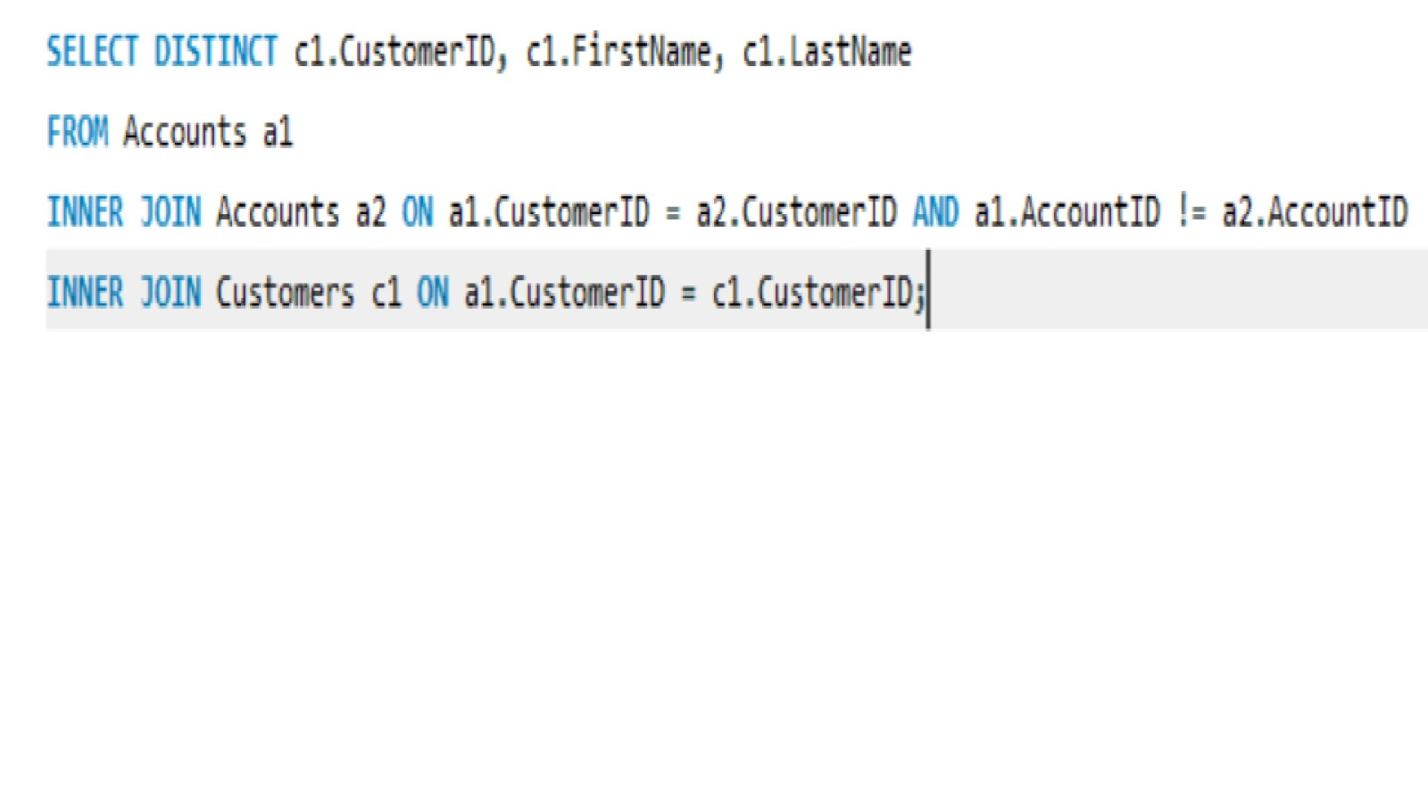
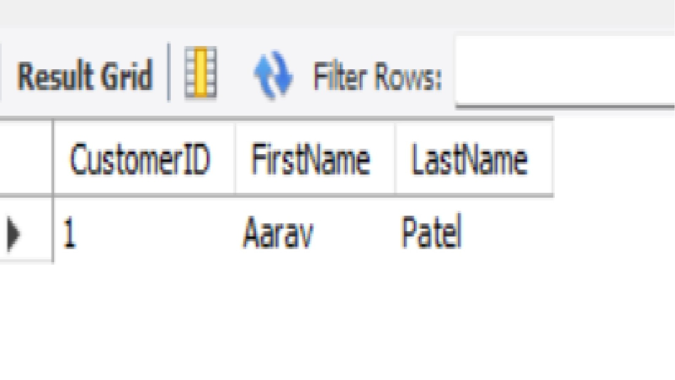
JOINS -
SYNTAX - SELECT DISTINCT c1.CustomerID, c1.FirstName, c1.LastNameFROM Accounts a1INNER JOIN Accounts a2 ON a1.CustomerID = a2.CustomerID AND a1.AccountID != a2.AccountIDINNER JOIN Customers c1 ON a1.CustomerID = c1.CustomerID;
Find customers who have accounts in more than one branch.

Slide 16
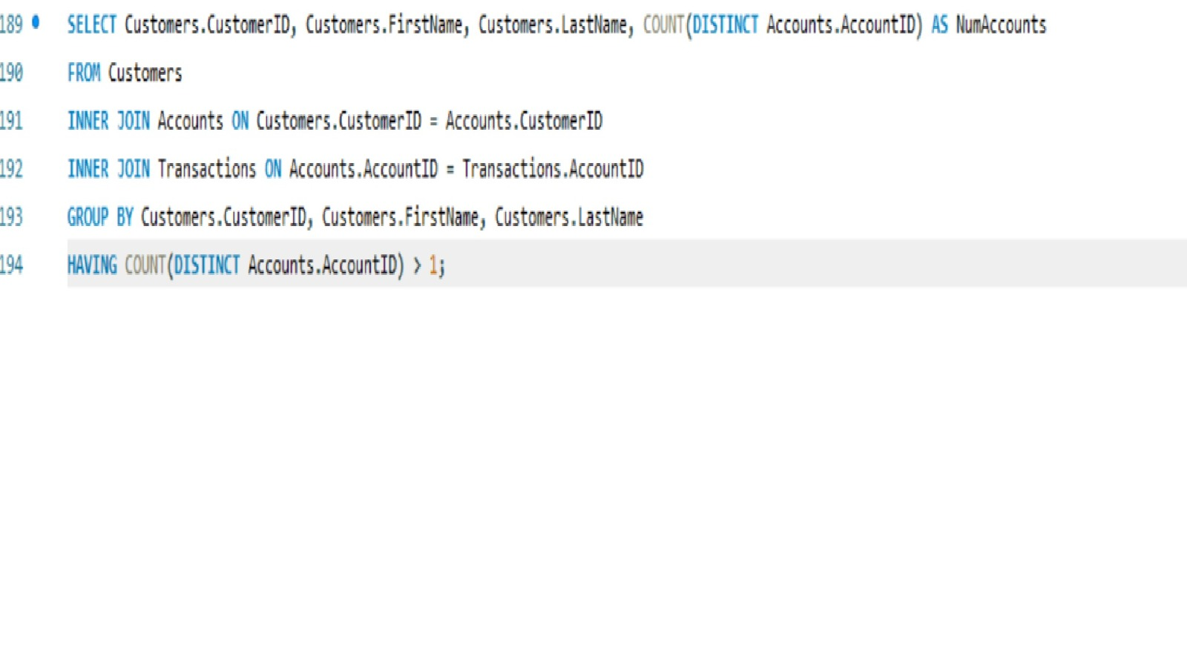
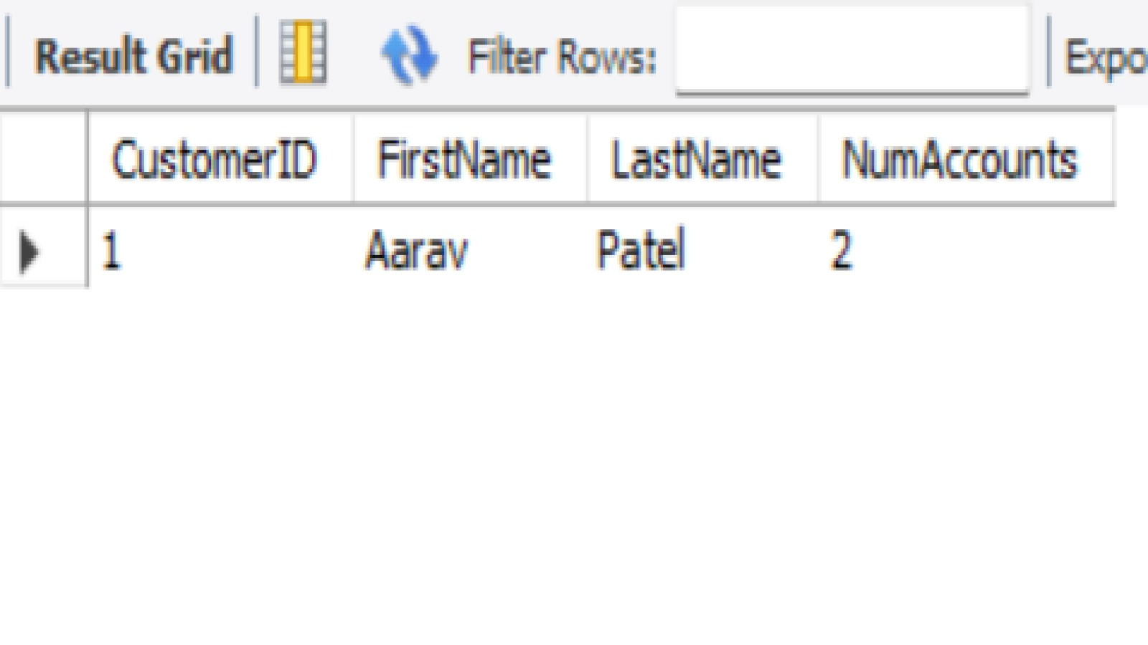
JOINS
SYNTAX - SELECT Customers.CustomerID, Customers.FirstName, Customers.LastName, COUNT(DISTINCT Accounts.AccountID) AS NumAccountsFROM CustomersINNER JOIN Accounts ON Customers.CustomerID = Accounts.CustomerIDINNER JOIN Transactions ON Accounts.AccountID = Transactions.AccountIDGROUP BY Customers.CustomerID, Customers.FirstName, Customers.LastNameHAVING COUNT(DISTINCT Accounts.AccountID) > 1;
Find customers who have made transactions in multiple accounts.

Slide 17
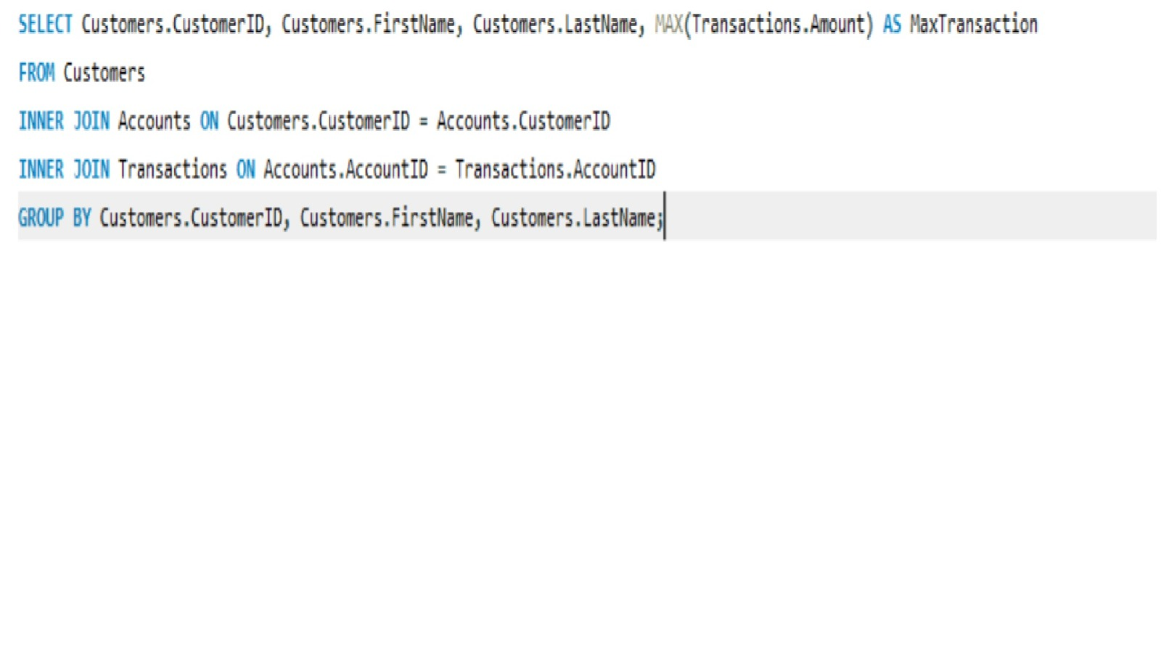
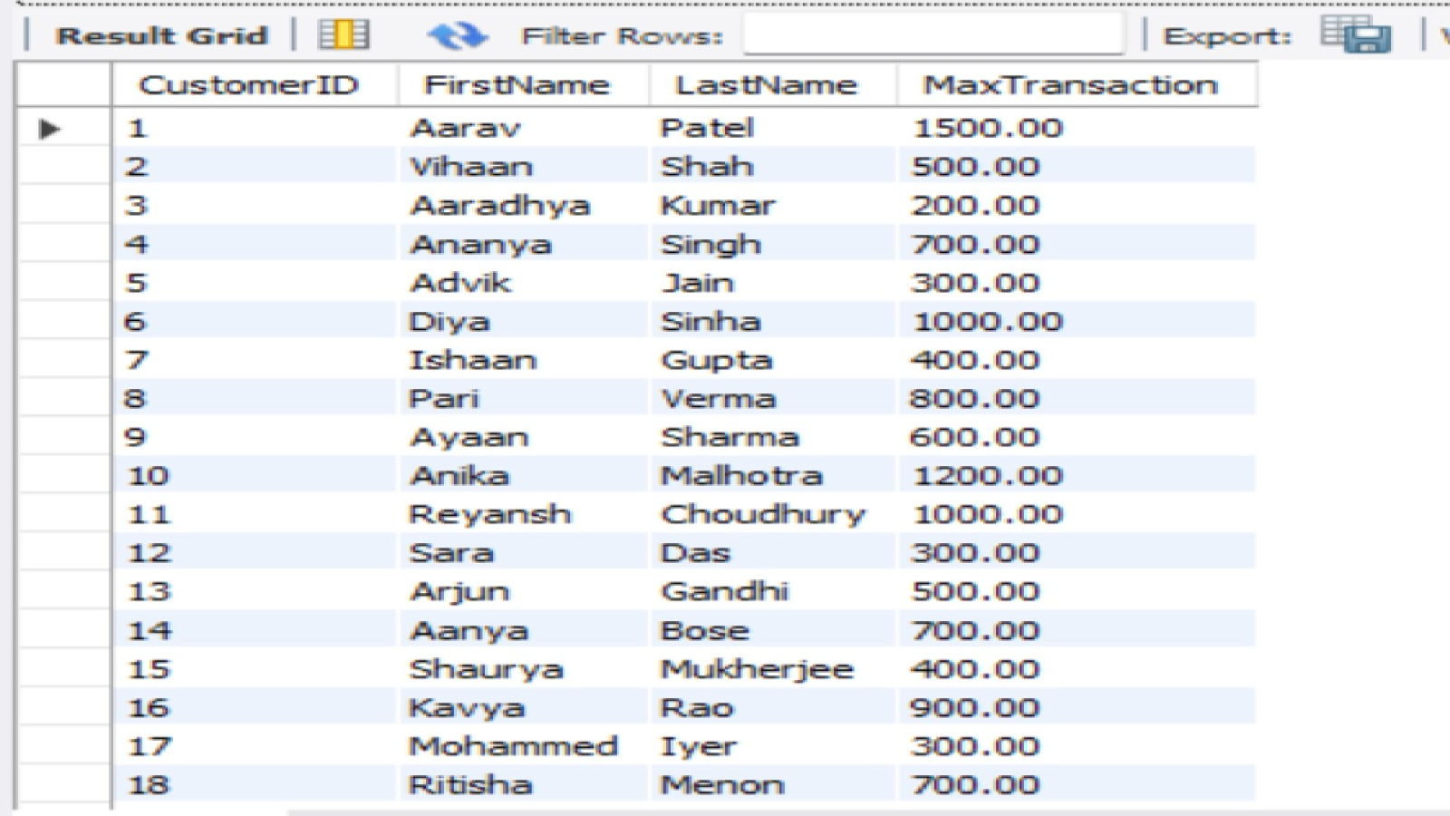
JOINS
SYNTAX-SELECT Customers.CustomerID, Customers.FirstName, Customers.LastName, MAX(Transactions.Amount) AS MaxTransactionFROM CustomersINNER JOIN Accounts ON Customers.CustomerID = Accounts.CustomerIDINNER JOIN Transactions ON Accounts.AccountID = Transactions.AccountIDGROUP BY Customers.CustomerID, Customers.FirstName, Customers.LastName;
Retrieve the list of customers with their highest transaction amount.

Slide 18
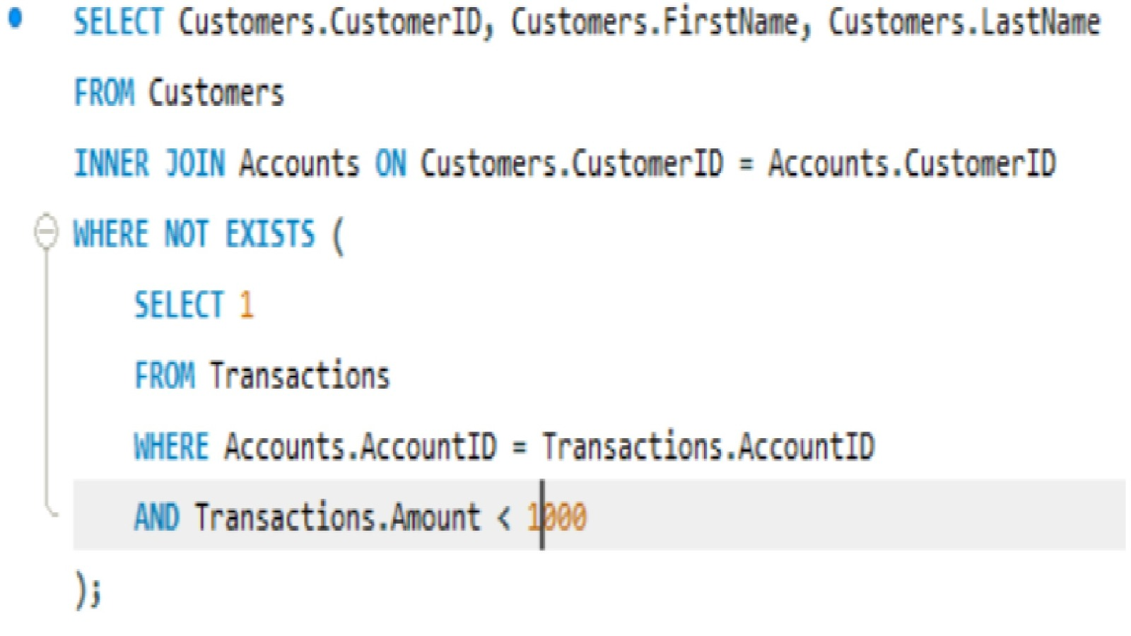
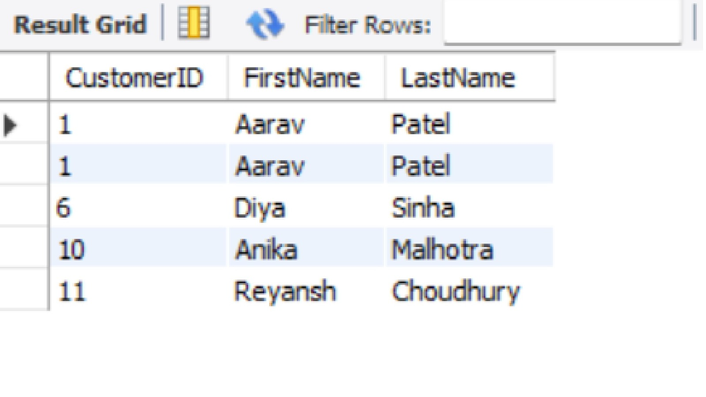
JOINS
SYNTAX - SELECT Customers.CustomerID, Customers.FirstName, Customers.LastNameFROM CustomersINNER JOIN Accounts ON Customers.CustomerID = Accounts.CustomerIDWHERE NOT EXISTS ( SELECT 1 FROM Transactions WHERE Accounts.AccountID = Transactions.AccountID AND Transactions.Amount < 1000);
Retrieve customers whose accounts have never gone below a balance of 1000 units.

Slide 19
PREPARED BY :
Sagar Kanji Waghela
IT VEDANT

Slide 20
THANKYOU !!

