Slide 1



DEFORESTATION PREDICTOR
SAGAR SANTOSH YADAV
B.K.BIRLA COLLEGE, KALYAN(AUTONOMOUS)
5144980
STU6854f3562c1911750397782

Slide 2

Learning Objectives
End-to-End Machine Learning: Executed the complete ML workflow, from data cleaning and EDA to model training. Learned to select the correct model type (Classification vs. Regression) for a given problem.
Critical Model Evaluation: Mastered in-depth model evaluation using precision, recall, and confusion matrices. Gained crucial experience in error analysis to diagnose model failures beyond surface-level accuracy scores.
ML Operations (MLOps) & Deployment: Acquired hands-on skills in software engineering for ML, using Git/GitHub for version control and successfully deploying a live model to a cloud platform (Hugging Face Spaces).
GOAL
Source :
www.freepik.com/

Slide 3
Tools and Technology used :
1.Development Environment:
Jupyter Notebook: Used for initial data exploration, visualization, and rapid prototyping of models.
Visual Studio Code (VS Code): Used as the primary code editor for writing and organizing the final Python scripts (train_model.py, app_gradio.py).
2.Data Science & Machine Learning:
Python: The core programming language for the entire project.
Pandas: Used for data loading, cleaning, and manipulation.
Scikit-learn: The essential machine learning library used for training the Logistic Regression model and for preprocessing tasks.
Matplotlib & Seaborn: Used for data visualization and creating plots during the Exploratory Data Analysis (EDA).
3.Web UI & Deployment:
Gradio: The Python library used to rapidly create and serve the interactive web user interface for the model.
Hugging Face Spaces: The cloud platform used for free, permanent hosting and deployment of the Gradio application.
4.Version Control & Model Persistence:
GitHub: Used for version control and to save the project's code repository online.
Joblib: Used to save the trained machine learning model, allowing it to be easily loaded into the application for predictions.

Slide 4
Methodology
1. Data Preparation & Exploration:
Data Loading: The initial deforestation.csv dataset was loaded using Pandas.
Preprocessing: Key data cleaning steps were performed, including converting date columns, one-hot encoding categorical variables (Region, Country), and scaling numerical features for the linear model.
Exploratory Data Analysis (EDA): The cleaned dataset was visualized using Matplotlib and Seaborn to identify key trends, correlations, and feature distributions. This phase was crucial for understanding the factors driving deforestation.
2. Model Development & Iteration:
Initial Approach (Regression): A RandomForestRegressor was first trained to predict the amount of forest loss. This model was rejected due to high error rates on individual predictions, despite strong overall metrics.
Pivoting to Classification: The project goal was refined to predict if a deforestation event would occur.
Final Model Training: A LogisticRegression model was trained on the preprocessed data to classify areas as high-risk (1) or low-risk (0).
3. Model Evaluation:
Quantitative Analysis: The Logistic Regression model was rigorously evaluated on an unseen test set using a full suite of classification metrics, including accuracy, precision, recall, and a confusion matrix.
Error Analysis: Individual prediction errors were examined to confirm the model's reliability and ensure it performed well on critical cases, unlike the initial regression attempt.

Slide 5
Methodology
4. Model Serialization:
Saving Artifacts: The final, validated LogisticRegression model, along with its corresponding data StandardScaler and column structure, were saved to disk using joblib. This "containerized" the model, making it portable and ready for deployment.
5. UI Development & Deployment:
Interface Creation: A user-friendly web interface was rapidly built using the Gradio Python library to make the model accessible to non-technical users.
Cloud Deployment: The complete application, including the Gradio UI and the saved model artifacts, was deployed to Hugging Face Spaces, providing a permanent, public URL for live predictions.

Slide 6
Problem Statement:
Conservation efforts to combat illegal deforestation are often reactive, responding to damage only after it has occurred due to the immense challenge of monitoring vast, remote territories.
This project aims to solve this by building a proactive machine learning model that analyzes diverse environmental and geographical data to predict if a specific area is at high risk of a future deforestation event, enabling authorities to take preventative action before the forest is lost.

Slide 7
Solution:
This project solves the problem by creating a complete, data-driven system that shifts deforestation monitoring from a reactive to a proactive process.
1. A Highly Accurate Predictive Model:
A Logistic Regression model was trained on 30+ environmental and geographical features.
The model achieves 97% accuracy in predicting whether a specific area will experience a deforestation event.
Crucially, it identifies 92% of all actual deforestation events (high recall), ensuring critical threats are not missed.
2. An Accessible and Interactive Tool:
The trained model is not just code; it has been integrated into a user-friendly web interface using the Gradio library.
This interface allows non-technical users, such as conservation officers, to input data for a specific area and receive an instant risk assessment.
3. An Interactive Application:
The entire application is deployed on Hugging Face Spaces, providing a permanent and publicly accessible URL.
This transforms the model from a local script into a live, shareable tool that can be used by anyone, anywhere, to get real-time deforestation risk predictions.
GitHub Link : https://github.com/Sagaryadav2006/DEFORESTATION
UI Link : https://huggingface.co/spaces/Sagaryadav2006/Deforestation-prediction-model

Slide 8
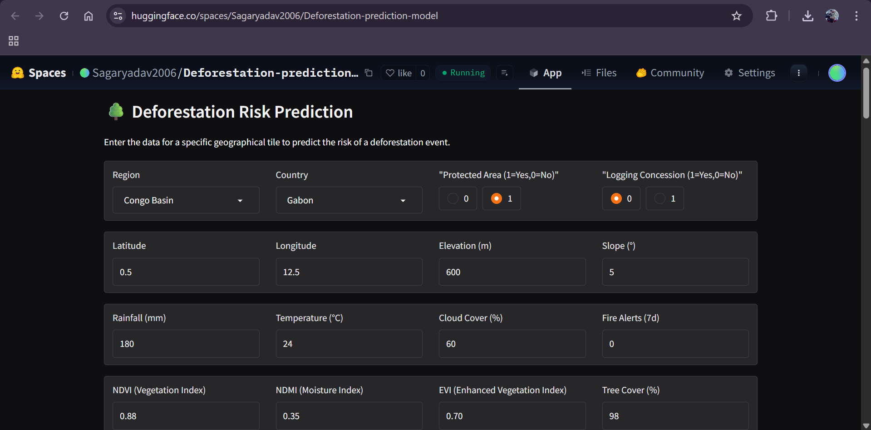
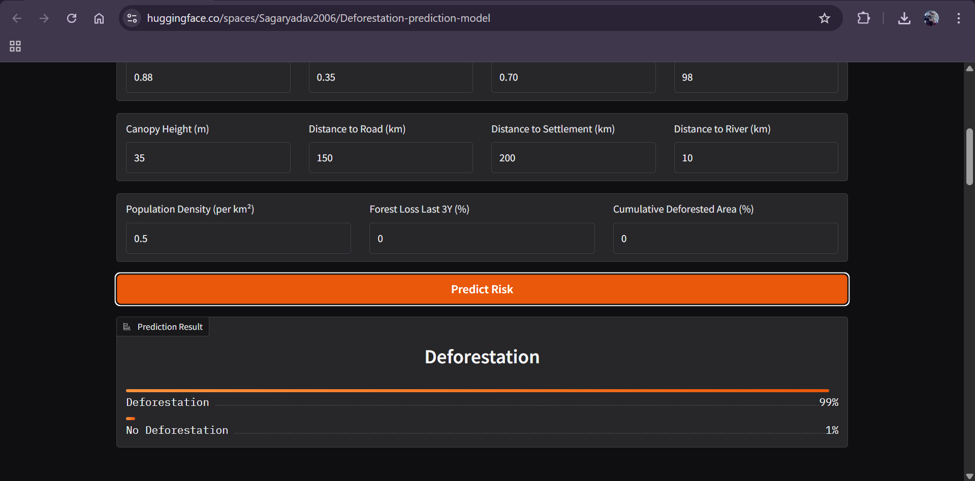
Screenshot of Output:

Slide 9
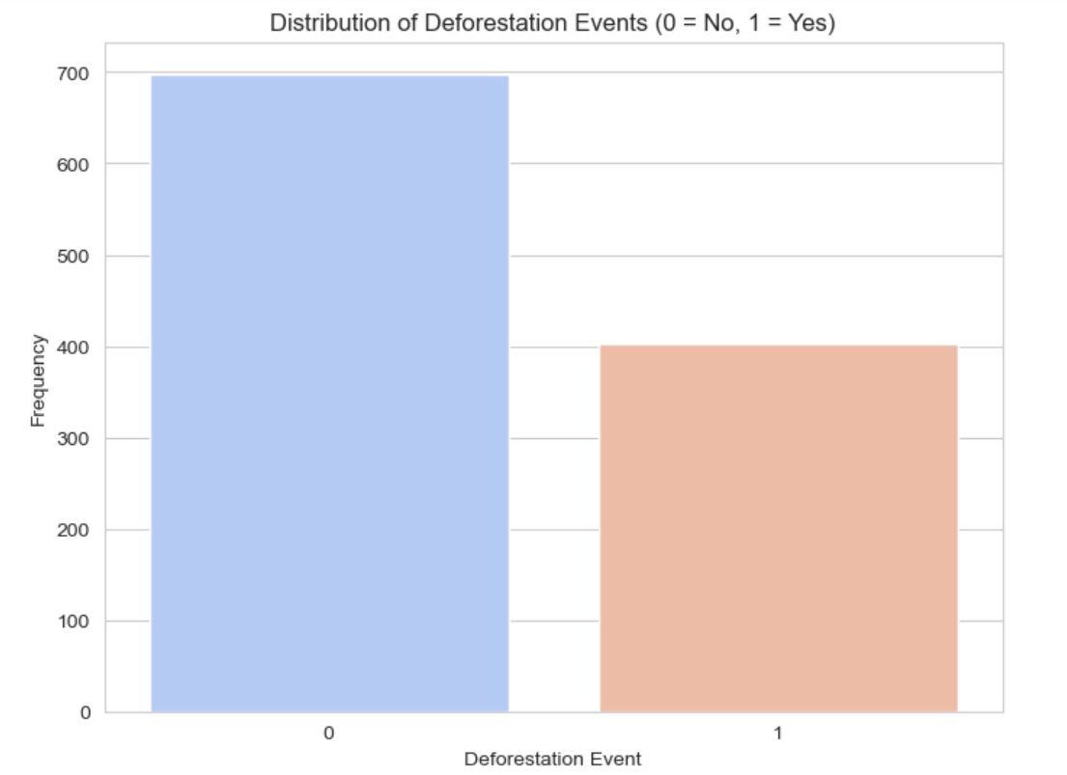
Screenshot of Output:
This bar chart shows that within the dataset, actual deforestation events (class 1) are less frequent than areas with no deforestation (class 0), highlighting an imbalance between the two categories.

Slide 10
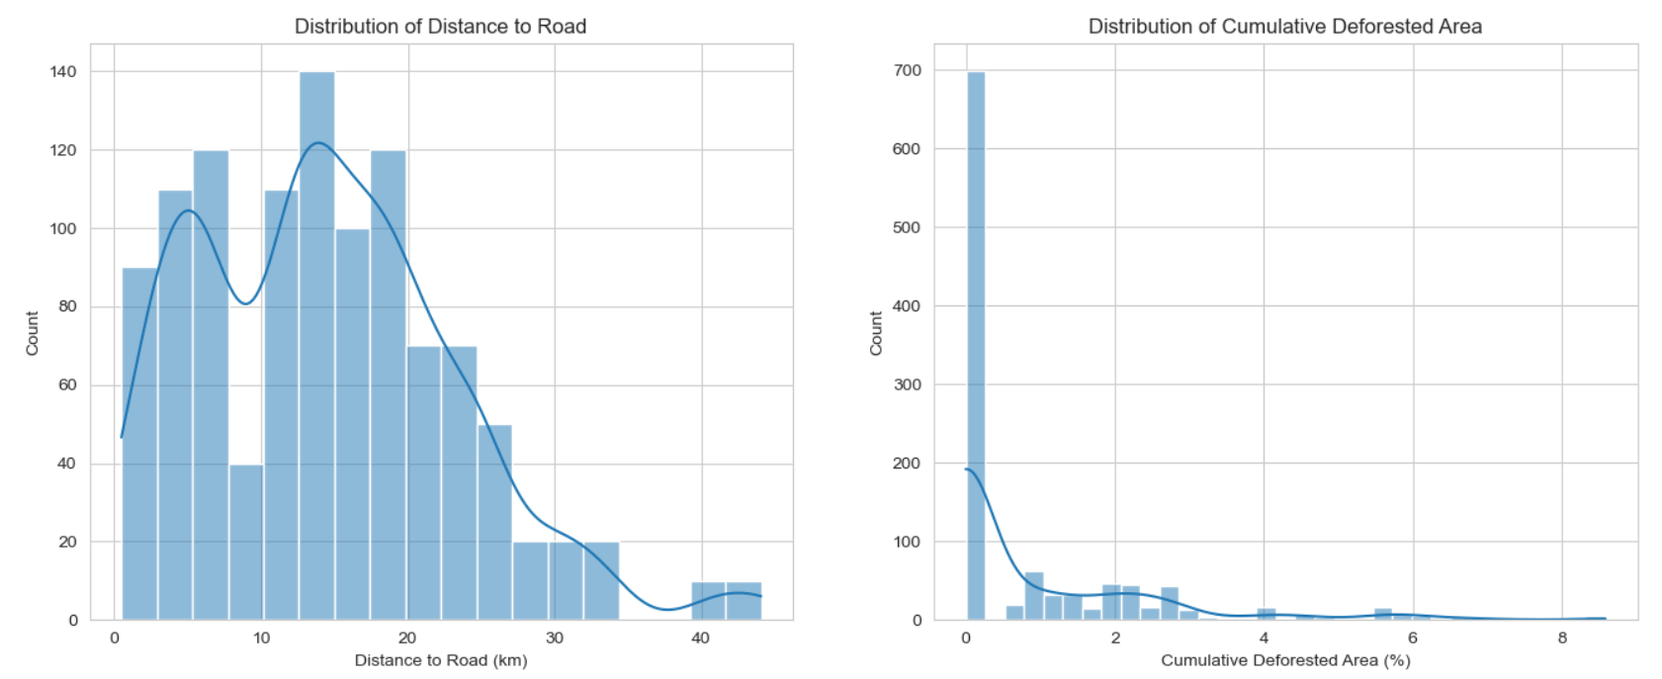
Screenshot of Output:
The "Distance to Road" chart indicates that human activity is spread out, with clusters of activity at various distances from roads rather than just one central area.
The "Cumulative Deforested Area" chart reveals that most of the land being analyzed has not experienced significant prior deforestation, suggesting that new deforestation events are most likely to occur in areas that were previously largely untouched.

Slide 11
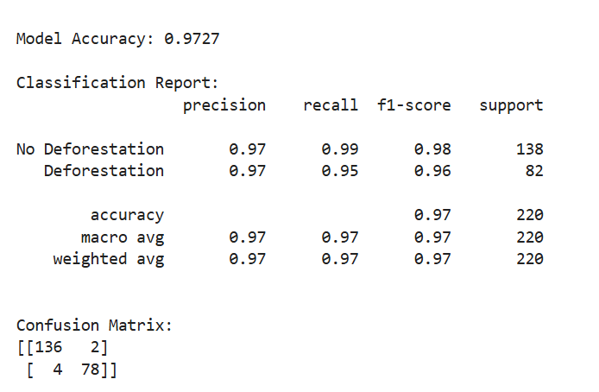
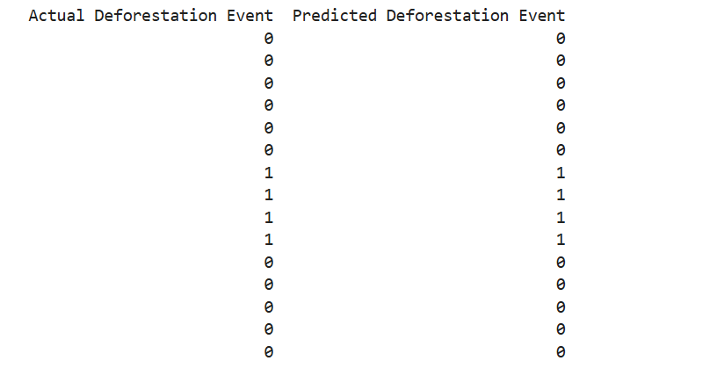
Screenshot of Output:
This output summarizes the model's high performance, with an overall accuracy of 97.27% and strong precision and recall scores for predicting both "Deforestation" and "No Deforestation" classes.
This output shows a direct comparison for a sample of the data, with the model's binary prediction (0 or 1) listed next to the actual outcome.

Slide 12
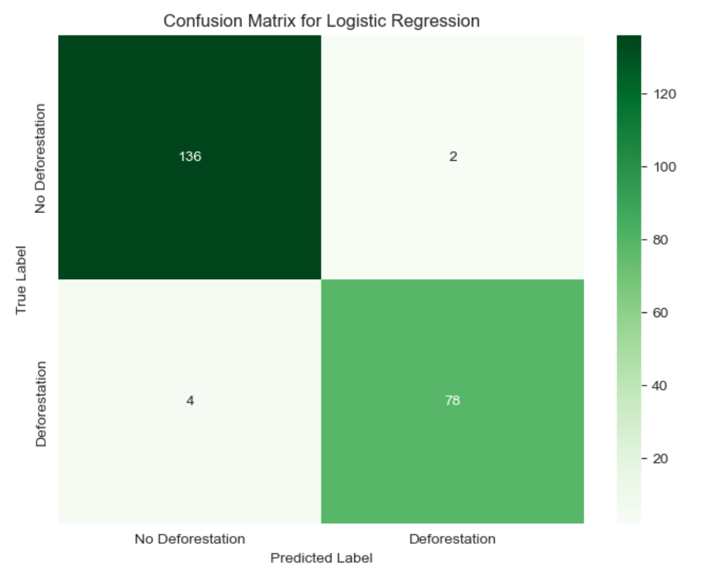
Screenshot of Output:
This heatmap visually represents the model's classification accuracy, showing it correctly identified 136 "No Deforestation" cases and 78 "Deforestation" cases, while making only 6 incorrect predictions in total.

Slide 13
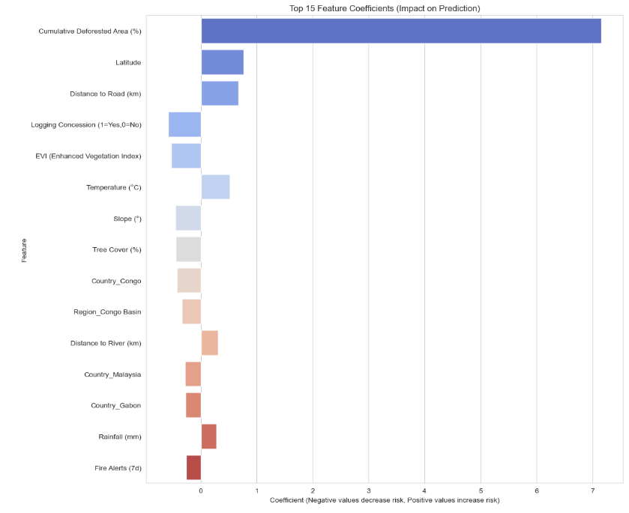
Screenshot of Output:
This bar chart ranks the top 15 factors influencing the model's predictions, identifying "Cumulative Deforested Area" as the feature that most increases the predicted risk of deforestation.

Slide 14
Conclusion:
A Valuable Tool Was Built: The project delivered a reliable early-warning system for deforestation, achieving 97% accuracy with a Logistic Regression model that is both trustworthy and effective.
Critical Lessons Were Learned: The initial failure of a more complex regression model provided a crucial lesson in error analysis, highlighting that high-level metrics can be deceptive and that model choice must be rigorously validated against real-world performance.
From Code to Live Application: The final model was not just a script but was successfully deployed as a permanent, interactive web application on Hugging Face Spaces, making it an accessible tool for anyone to use. The project confirms that it is possible to build and deploy a high-impact environmental monitoring tool using accessible, open-source technology.

Slide 15
Future Scope & Next Steps:
1. Model Enhancement & Automation:
Integrate Real-Time Data: Connect the model to a live satellite imagery feed to automatically analyze new areas without manual data entry.
Continuous Retraining (CI/CD for ML): Implement a system to periodically retrain the model on the latest data to adapt to new deforestation patterns and prevent model drift.
Explore Advanced Models: Experiment with more complex models like Gradient Boosting (XGBoost) or simple Neural Networks to potentially capture more nuanced patterns and improve accuracy further.
2. Application & Feature Expansion:
Develop an Interactive Dashboard: Create a more advanced user interface (using Streamlit or Dash) with an interactive map. Users could click on a region to see its risk score and historical data visualizations.
Implement an Automated Alert System: Create a backend process that runs daily, analyzes high-priority zones, and automatically sends email or SMS alerts to conservation authorities when the model predicts a high-confidence deforestation event.
3. Deeper Impact Analysis:
Socio-Economic Correlation: Use the model's predictions to analyze the socio-economic drivers of deforestation. By mapping high-risk areas against data on local economies, poverty levels, or policy changes, the tool could provide insights for targeted social and economic interventions.

