Slide 1
Interactive Digital Portfolio
CAPSTONE PROJECT
Presented By:
Sagar Santosh Yadav
B.K. Birla College , Kalyan(Autonomous)
BSc Data Science

Slide 2
OUTLINE
Problem Statement (Should not include solution)
System Development Approach (Technology Used)
Algorithm & Deployment (Step by Step Procedure)
Result
Conclusion
Future Scope(Optional)
References

Slide 3
Problem Statement
Many developers struggle to present their skills and projects in an engaging way. A traditional resume lacks interactivity and visual appeal. This project solves that by creating a dynamic, personalized portfolio website. It will include sections like About Me, Skills, Projects, and Contact with smooth navigation and animations.

Slide 4
System Approach
Frontend Technologies :
HTML5: Used for the webpage's core structure and content layout.
CSS3: Applied via Tailwind CSS for all styling, including responsive design, visual effects, and color schemes.
JavaScript: Implemented interactivity, such as the smooth-scroll navigation and a dynamic mobile menu.
Design Approach :
User Interface: Focused on a clean, professional, and visually appealing design.
Responsiveness: Ensured the portfolio is fully responsive and looks great on any device.
Modular Code: Structured the code into distinct, easy-to-manage sections.

Slide 5
Algorithm & Deployment
Frontend Design :
Layout with HTML and CSS: The portfolio's layout was constructed using HTML5 to define the structure of each section (<section>). CSS, leveraging Tailwind's grid and flexbox utilities, was used to organize content into clean grids for the skills and projects, and to create the card-based design.
Interactive Features :
JavaScript Functions: The portfolio uses JavaScript to enable smooth scrolling navigation and a responsive mobile menu. This provides a user-friendly way to move between sections.
Animations: CSS animations were added to elements as you scroll, creating a modern and dynamic feel. On hover, the skill and project cards display subtle visual effects, making the interface more engaging.
Testing :
Cross-browser Compatibility: The code was developed to be compatible with modern web standards, ensuring it functions correctly across different web browsers.
Mobile Responsiveness: The design was made to be fully responsive. Using CSS media queries and Tailwind's responsive classes, the layout adapts seamlessly to various screen sizes, from mobile phones to desktops.
Deployment :
Hosting: The project is a static website, which makes it perfect for free hosting services like Vercel or Netlify. I used Vercel for deployment, which is a great choice for a static site.

Slide 6
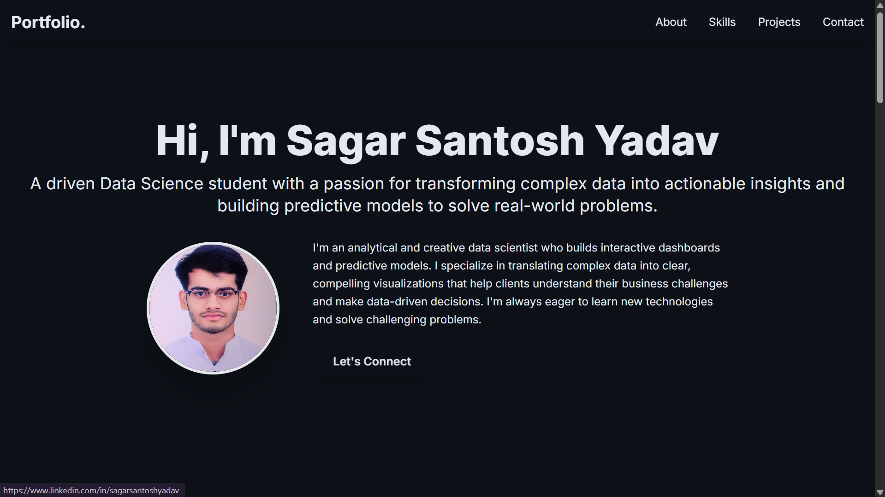
Result
GitHub Link: https://github.com/Sagaryadav2006/my_portfolio
Portfolio Link: https://my-portfolio-nine-nu-51.vercel.app/

Slide 7
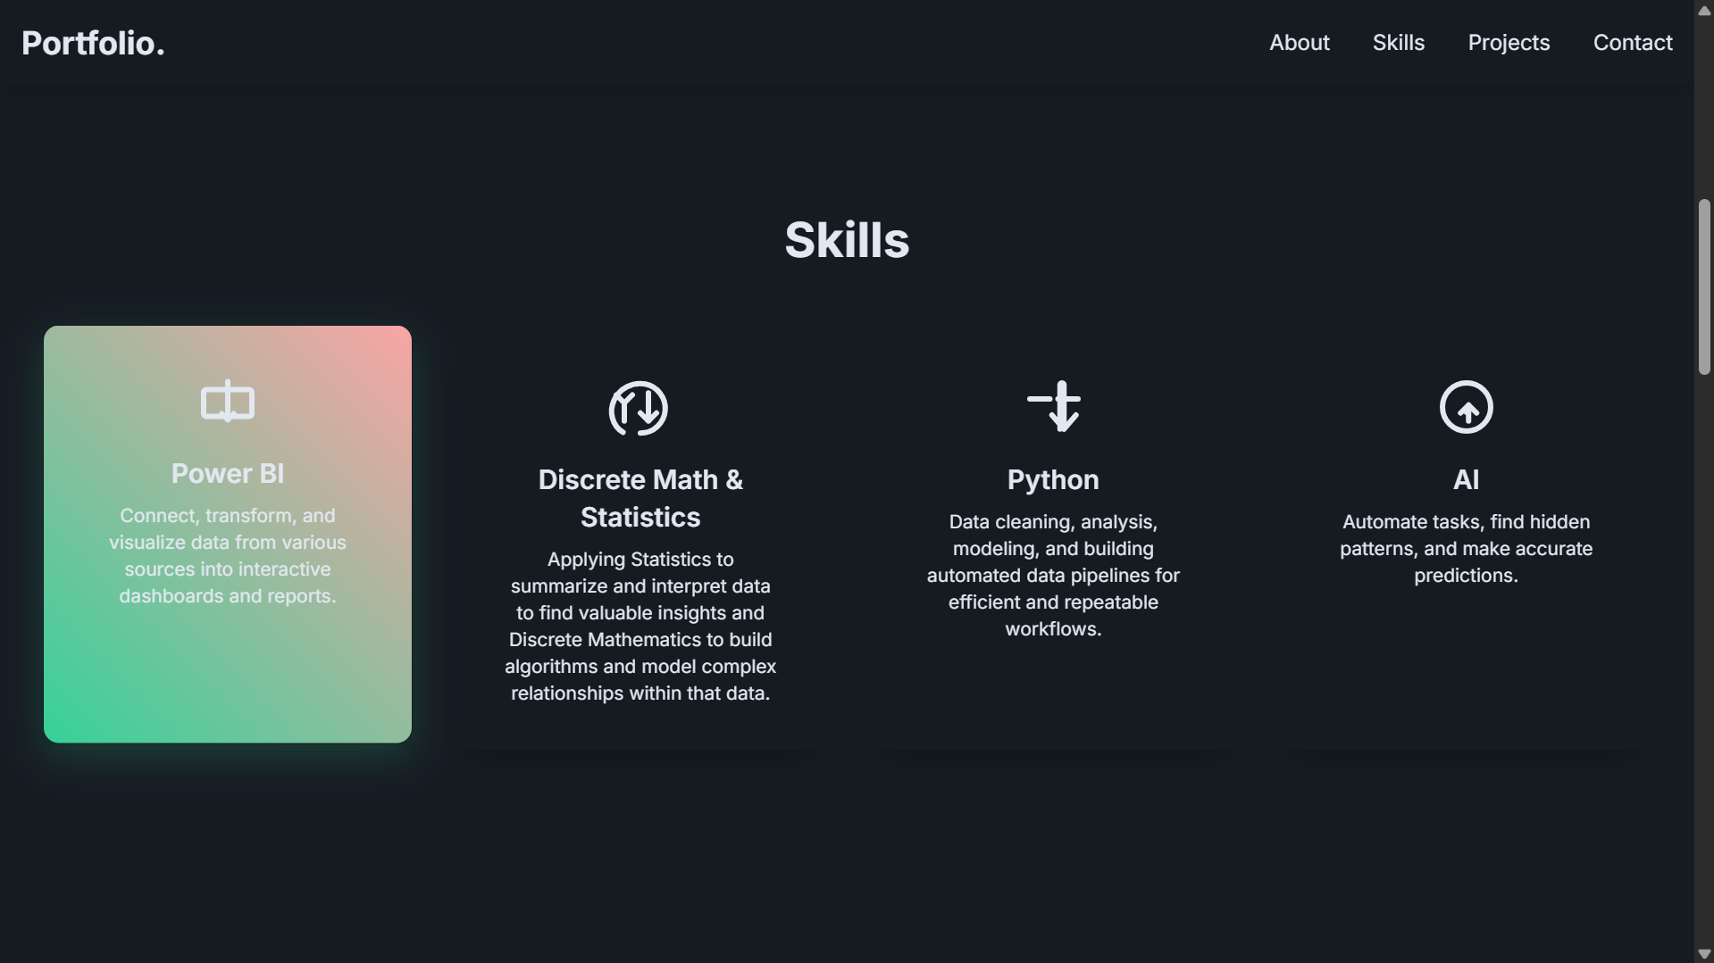
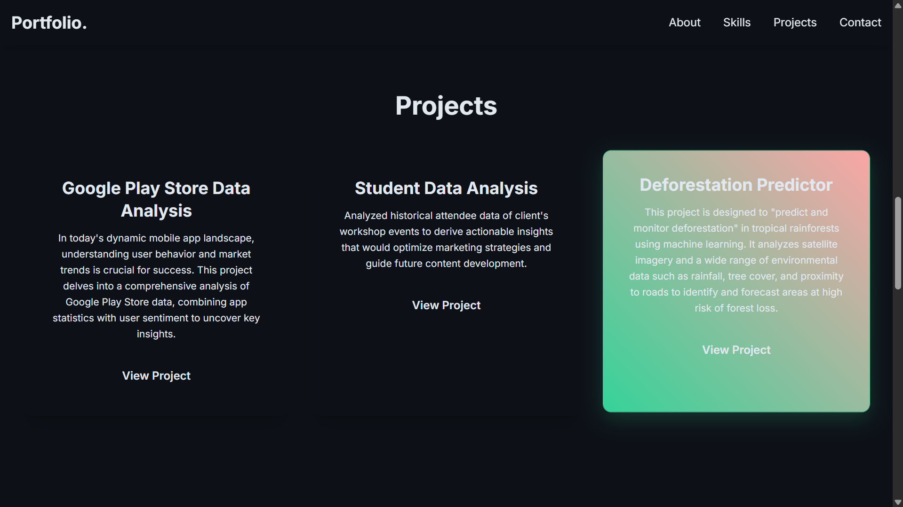
Result

Slide 8
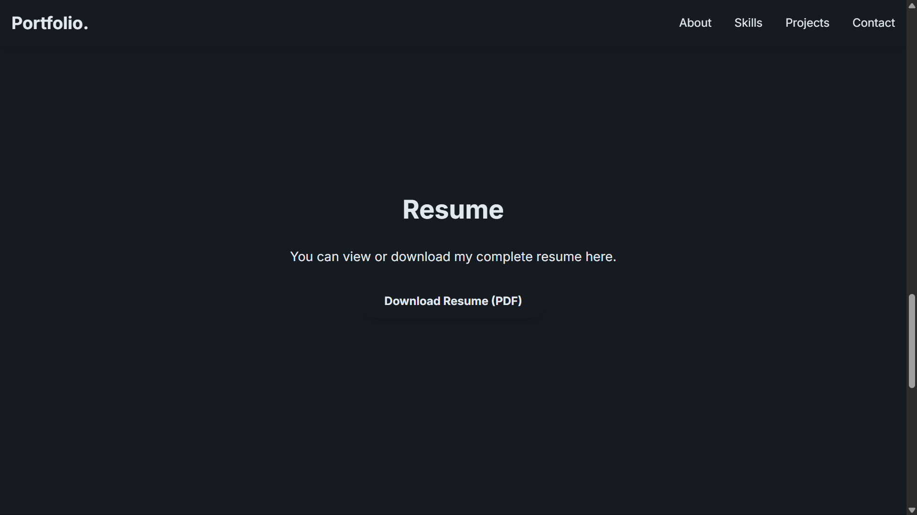
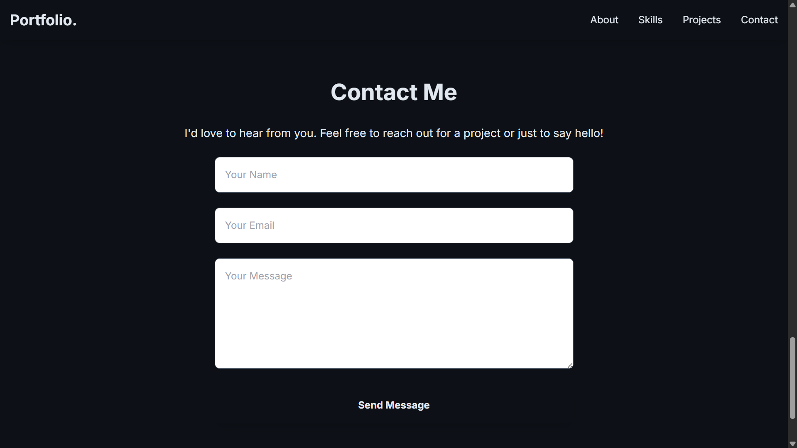
Result

Slide 9
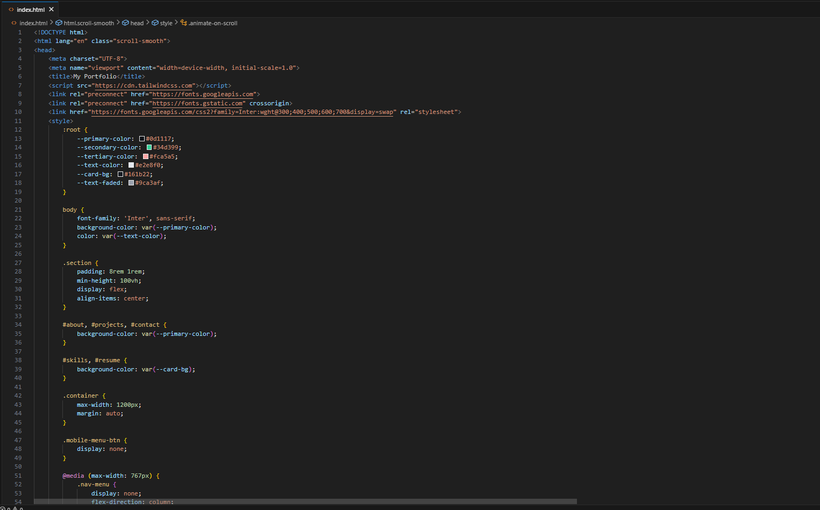
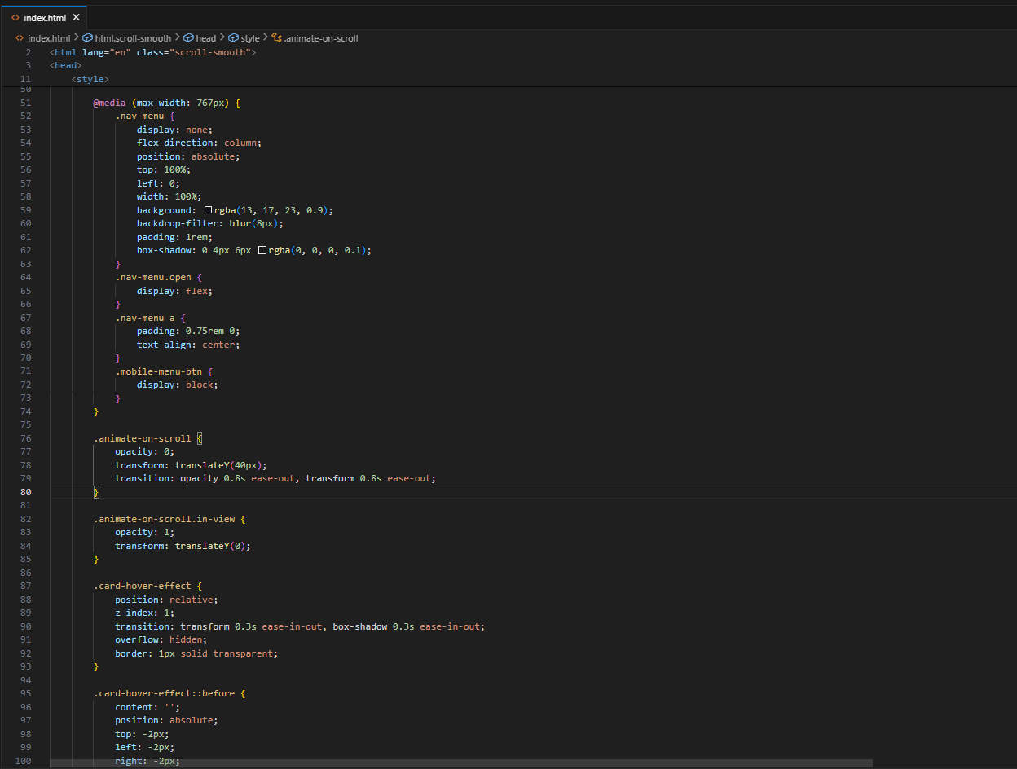
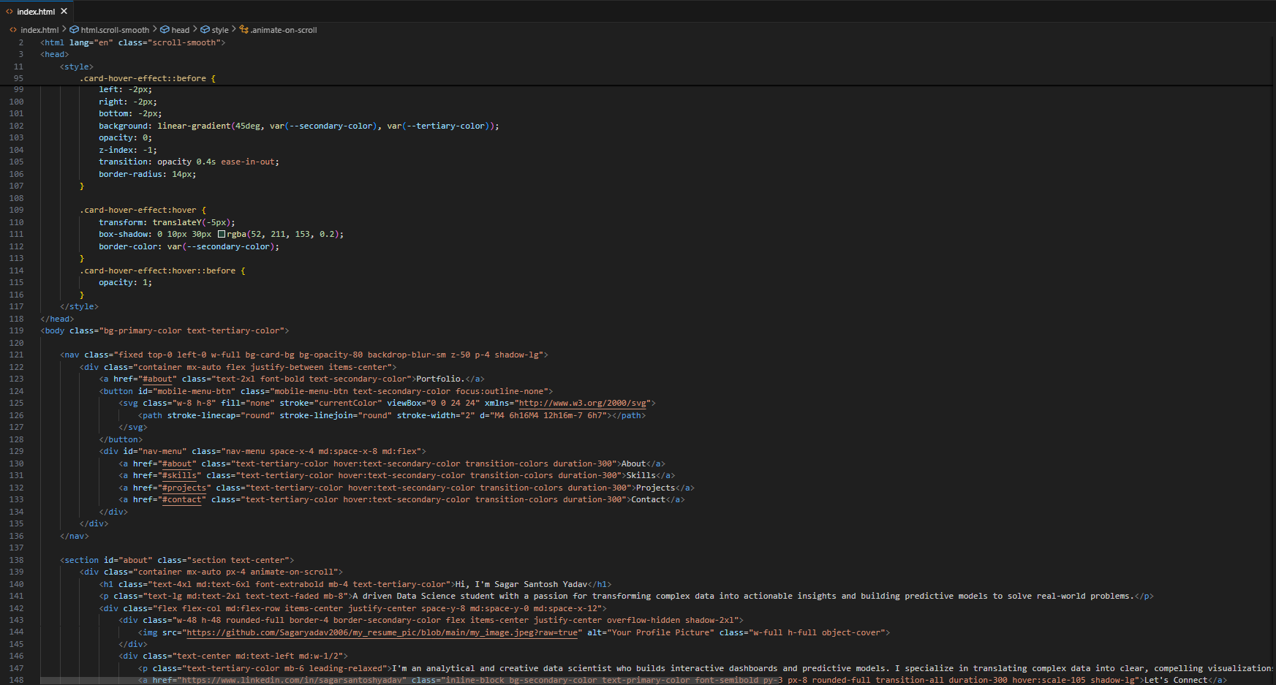
Result

Slide 10
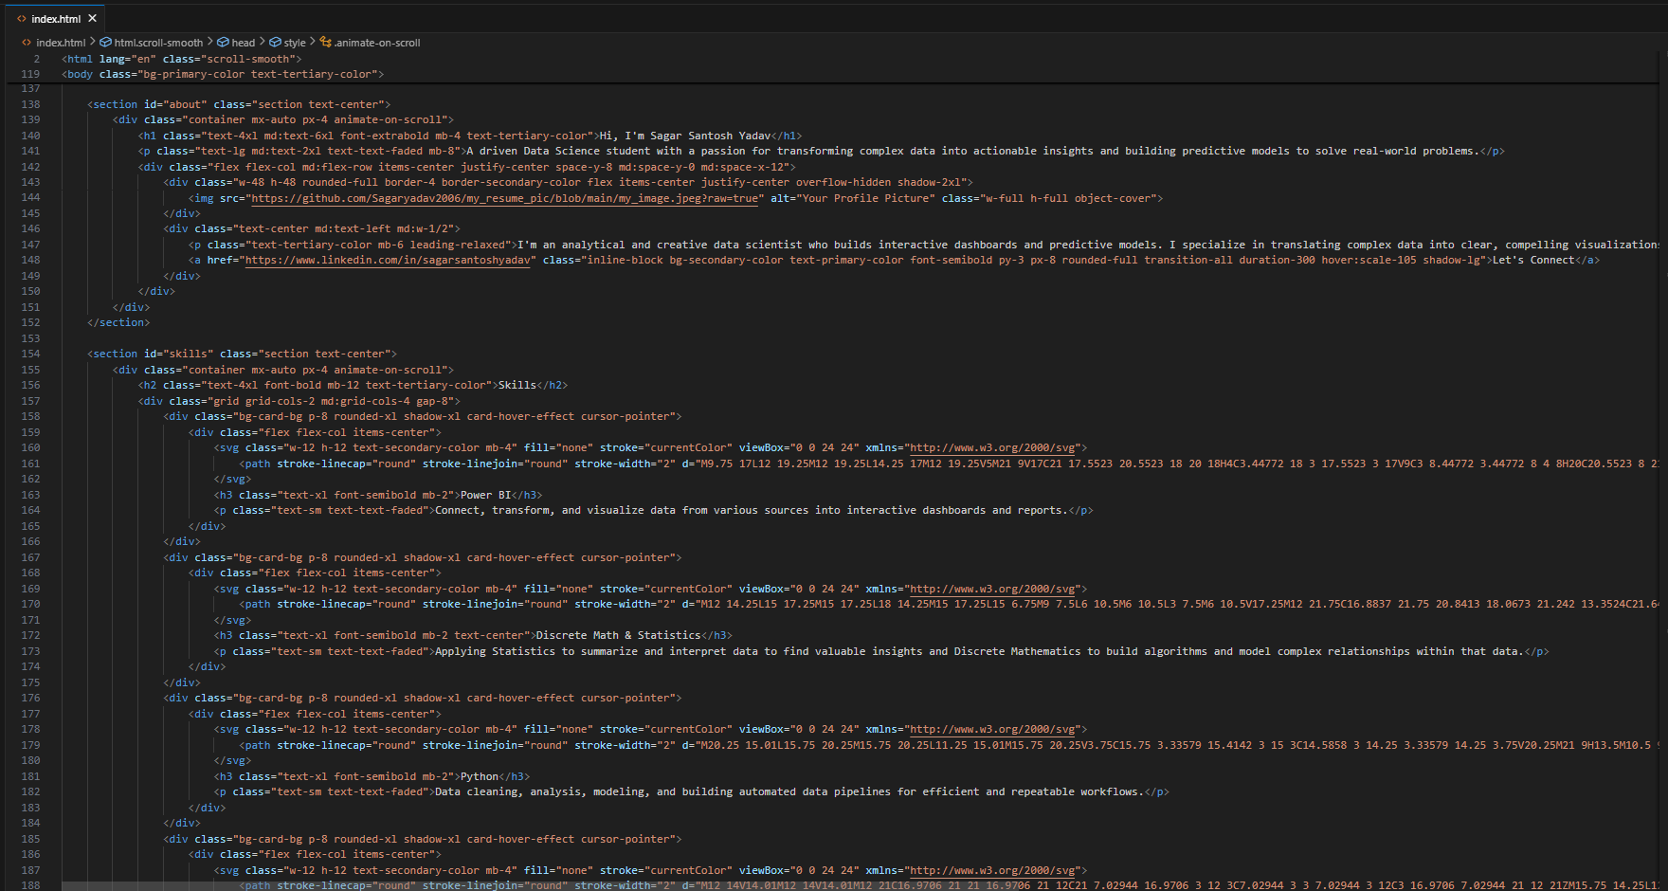
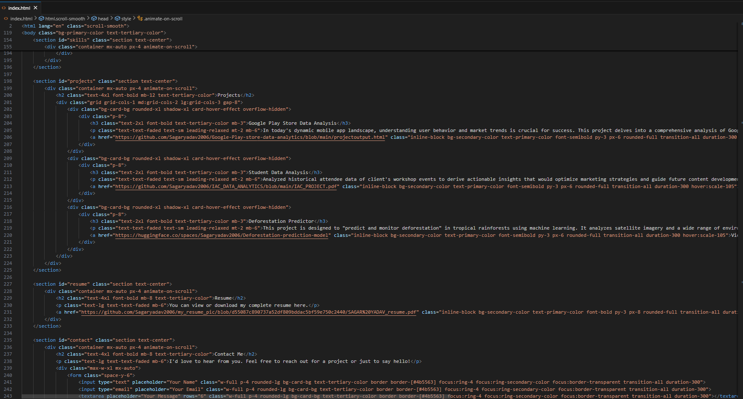
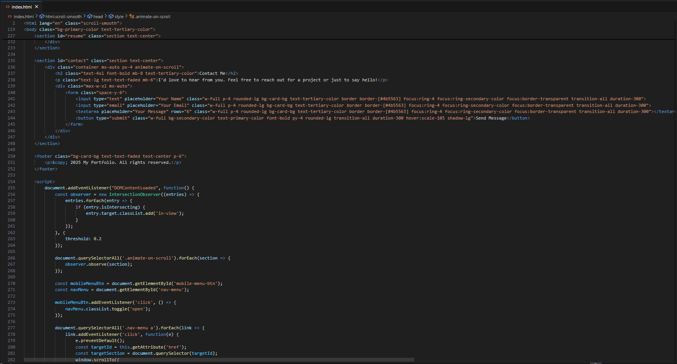
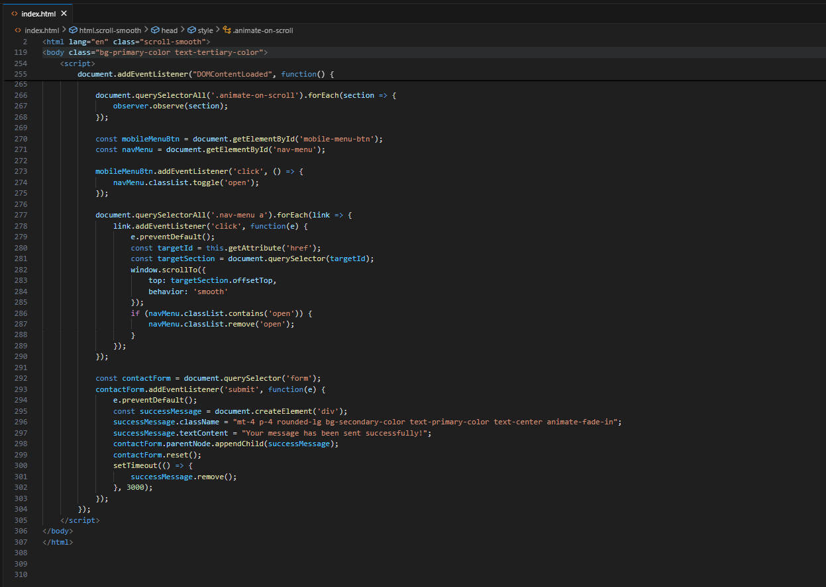
Result

Slide 11
Conclusion
This portfolio project is a great example of building a clean, modern, and interactive single-page application from the ground up. By consolidating all code into a single HTML file and leveraging a utility-first CSS framework, it created an efficient and highly maintainable project.
The process demonstrated a key development workflow: starting with a solid structural foundation, then progressively adding layers of interactivity, visual polish, and responsiveness based on iterative feedback. This approach resulted in a portfolio that is not only functional and professional but also visually engaging for visitors on any device.

Slide 12
Future scope(Optional)
Dynamic Content: Instead of hard-coding projects, we can use a JSON file and JavaScript to dynamically load and display new content, making it easy to add more projects as your work grows.
Functional Contact Form: Integrate a backend service like Formspree or Netlify Forms to make the contact form fully functional, allowing you to receive messages directly.
Data Visualizations: Embed interactive data visualizations using libraries like D3.js or Chart.js to showcase your data science skills in a more engaging way.
Performance & Accessibility: Optimize the site's performance for faster loading and improve accessibility for a broader audience.

Slide 13
References
NanthiniMoha/TNSDC-FWD-DIGITAL_PORTFOLIO
YouTube Portfolio building tutorials.
Gemini : Error solving and Ideas.

Slide 14
THANK YOU

