Slide 1
Simulation of bulk data for cell type deconvolution benchmarking
Sumit Mukherjee
Sage Bionetworks
05/13/2018

Slide 2
Simple model of sequencing
Samples
Genes
Lysis Capture Amplification
Sequencing
Cells
Replicate samples
Observed data

Slide 3
Simple model of sequencing
Samples
Genes
Lysis Capture Amplification
Sequencing
Cells
Replicate samples
Observed data
Discrete Sampling

Slide 4
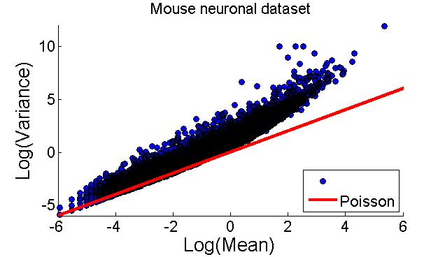
Evidence of sampling in bulk/SCS datasets
Bulk
Figure from “Anders S, Huber W. Differential expression analysis for sequence count data. Genome biology. 2010 Oct;11(10):R106.”
Data from “Klein, Allon M., et al. "Droplet barcoding for single-cell transcriptomics applied to embryonic stem cells." Cell 161.5 (2015): 1187-1201.”

Slide 5

DESEQ’s model of sequencing process
$K_{ij}\sim NB(μ_{ij},σ_{ij}^{2})$ where $K_{ij}$ = observed counts for gene i

Slide 6

DESEQ’s model of sequencing process
$K_{ij}\sim NB(μ_{ij},σ_{ij}^{2})$ where $K_{ij}$ = observed counts for gene I
$μ_{ij}= q_{i,ρ(j)}s_{j}$ where $q_{i,ρ(j)}$ = true transcriptomic state, $s_{j}$ = size factor

Slide 7
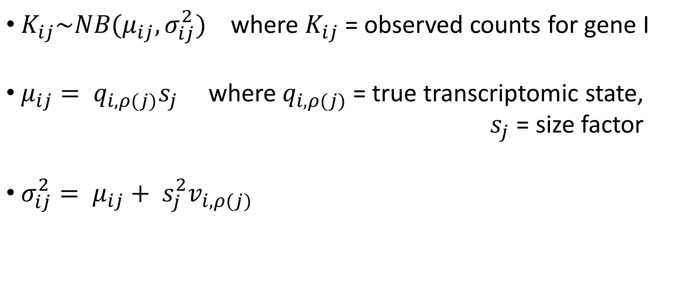
DESEQ’s model of sequencing process
$K_{ij}\sim NB(μ_{ij},σ_{ij}^{2})$ where $K_{ij}$ = observed counts for gene I
$μ_{ij}= q_{i,ρ(j)}s_{j}$ where $q_{i,ρ(j)}$ = true transcriptomic state, $s_{j}$ = size factor
$σ_{ij}^{2}= μ_{ij}+ s_{j}^{2}v_{i,ρ(j)}$
shot noise
Raw variance

Slide 8
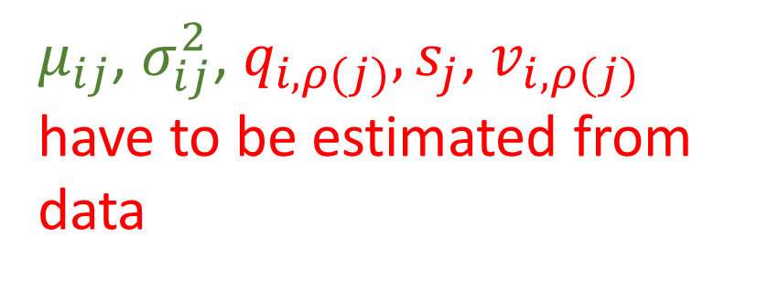
DESEQ’s model of sequencing process
$K_{ij}\sim NB(μ_{ij},σ_{ij}^{2})$ where $K_{ij}$ = observed counts for gene I
$μ_{ij}= q_{i,ρ(j)}s_{j}$ where $q_{i,ρ(j)}$ = true transcriptomic state, $s_{j}$ = size factor
$σ_{ij}^{2}= μ_{ij}+ s_{j}^{2}v_{i,ρ(j)}$
$μ_{ij}$, $σ_{ij}^{2}$, $q_{i,ρ(j)}, s_{j}$, $v_{i,ρ(j)}$ have to be estimated from data
shot noise
Raw variance

Slide 9


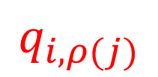


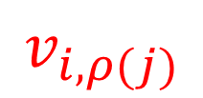
Generative model of sequencing
$$q_{i,ρ(j)}$$
$$s_{j}$$
$$v_{i,ρ(j)}$$
$$μ_{ij}$$
$$σ_{ij}^{2}$$
$$K_{ij}$$

Slide 10
Proposed simulator: Step 1
Pure SCS/bulk data
Estimator
Cell type 1
Parameter Set 1
Estimator
Parameter Set 2
Cell type 2

Slide 11
Proposed simulator: Step 2
Simulated pure bulk data
Parameter Set 1
Generator
Cell type 1
Parameter Set 2
Generator
Cell type 2

Slide 12
Proposed simulator: Step 3
Simulated mixed bulk data
Parameter Set 1
Parameter Set 3
Generator
Parameter Set 2
Mixing in known ratio

Slide 13
Benchmarking deconvolution algorithms
Obtain pure SCS/bulk data and identify model parameters
Generate simulated ‘pure’ bulk data
Generate simulated ‘mixed’ data with known ratios
Use existing deconvolution tools to identify mixing ratios
Compare identified ratios with true ratios

