Slide 1
Living Systems as Decentralized Economies
The Price System of the Cell
Sage Clokey | BME 129C Capstone | UC Santa Cruz | Spring 2026
Living things are not machines. The differences are a feature, not a bug. The distributed knowledge is coordinated by prices — the ratio between the voluntary exchange of anything between nodes.
Notes:
Title. 15 seconds.
Living systems coordinate billions of nodes without a central planner. No master gene runs your body. No forester runs a forest. This capstone asks: are living systems literally decentralized economies? Not as metaphor — as measurable, quantifiable, structurally equivalent systems.

Slide 2
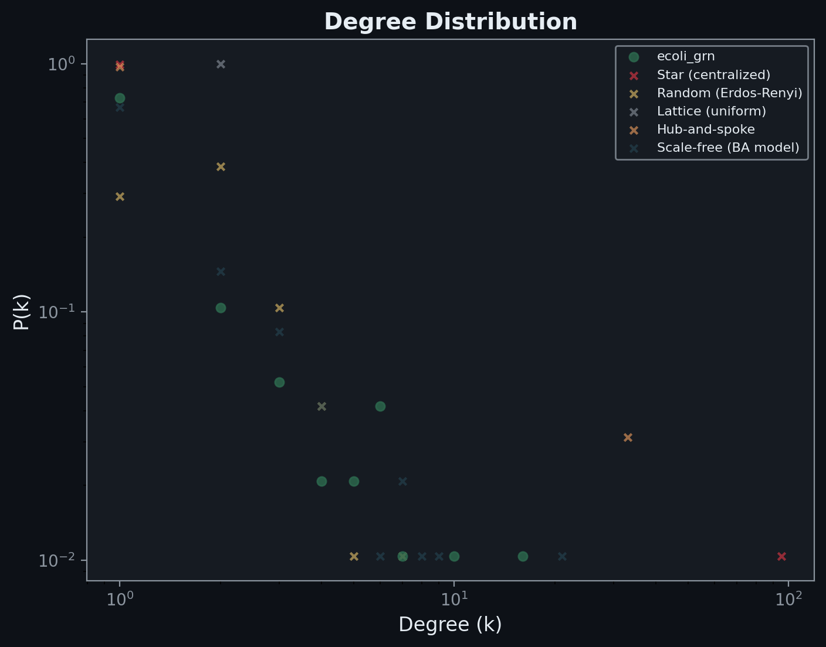
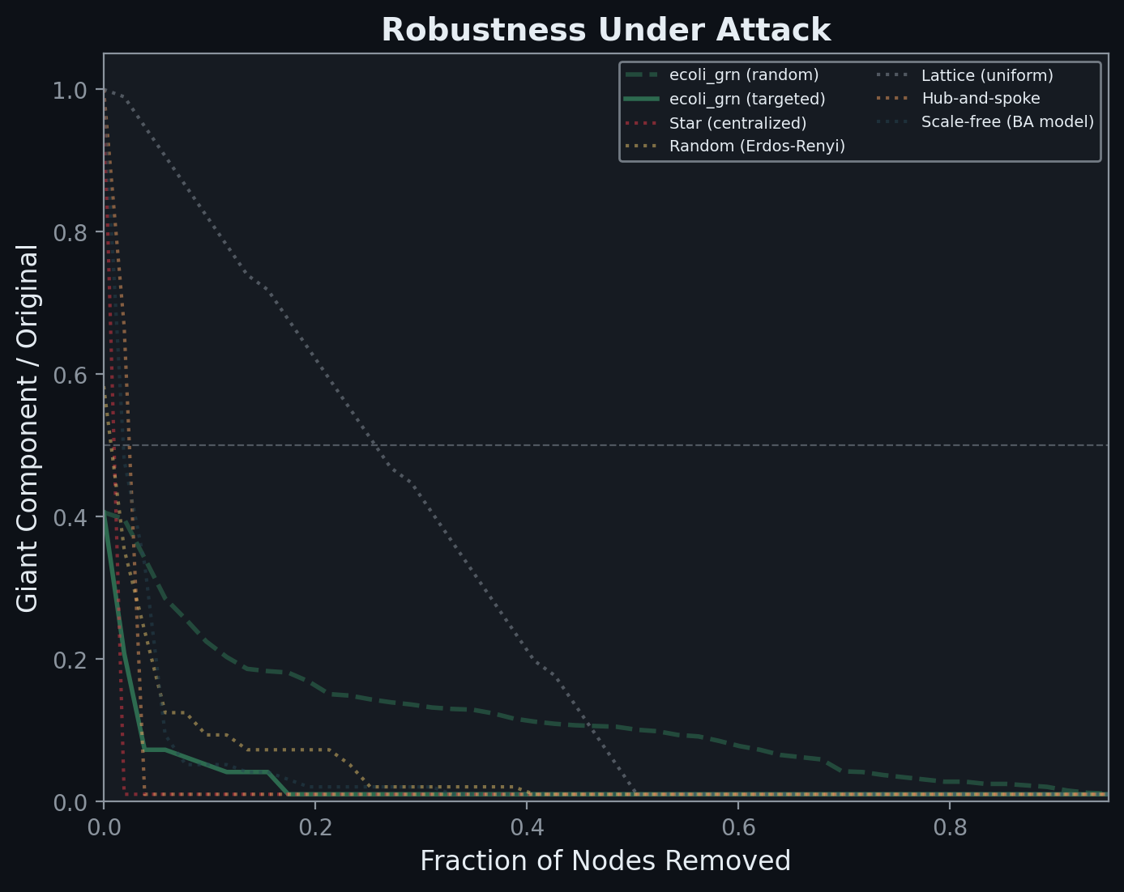
No Master Node — 19:1 Robustness Advantage
• E. coli GRN: power-law degree distribution (α 2.0–2.5)
• Hubs exist (CRP → 43 genes) but no hub dominates
• Targeted removal: biological networks survive 37% node loss
• Star graph (central planning) collapses at 1.9%
• 19:1 robustness ratio — the structural cost of centralization
• Hub erosion: network actively resists centralization
• Feed-forward loops over-represented — evolved price signals
Notes:
Layer 1 — 30 seconds.
The E. coli gene regulatory network has no central controller. Under targeted removal of top nodes, biological networks survive 37% loss. The star graph collapses at 2%. That's a 19:1 ratio. The distributed network routes around damage. The centralized network has a single point of failure.

Slide 3
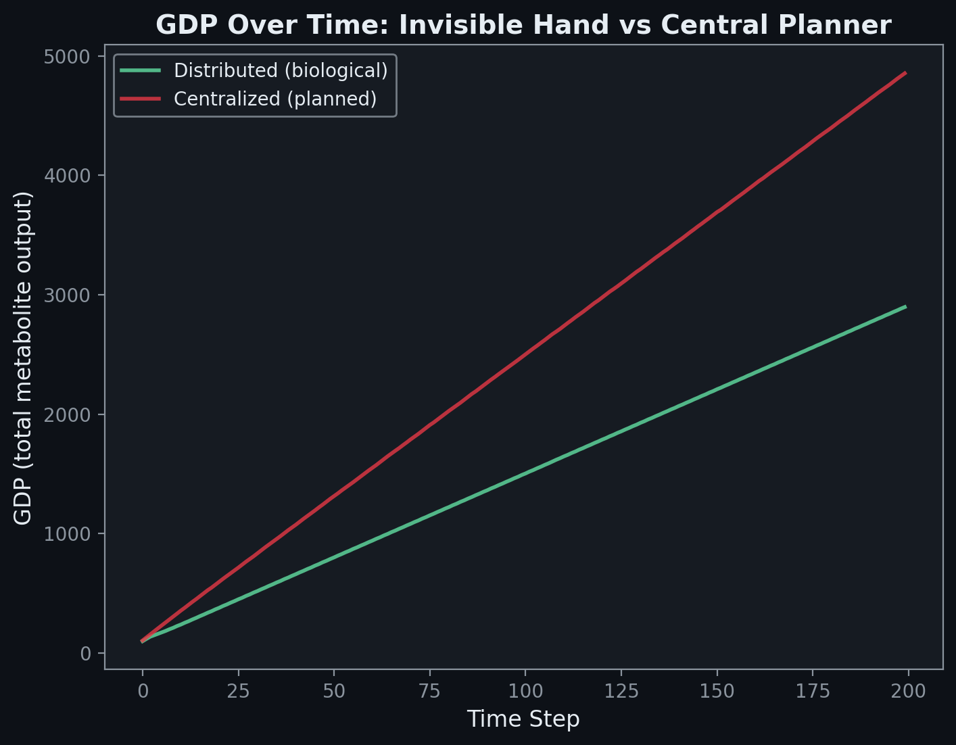
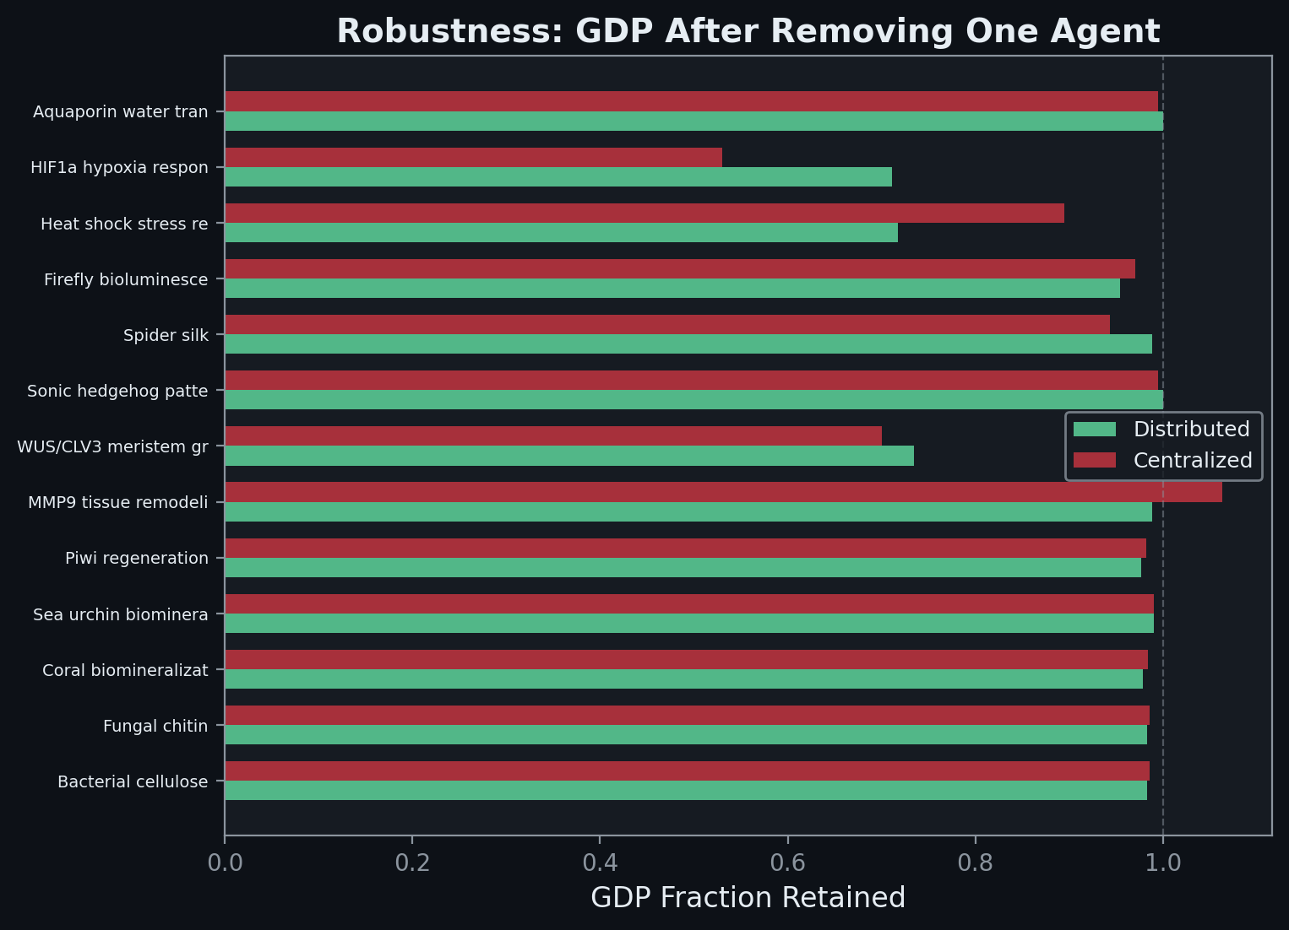
The Market Wins Under Stress — 71% vs 53%
• 13 metabolic agents share a pool — no central allocator
• Rates oscillate early (price discovery) then converge
• Under perturbation: distributed retains 71% GDP
• Centralized retains 53% — 18-point market advantage
• The planner’s fixed plan is wrong after the shock
• Distributed agents self-correct through local price signals
• FBA (omniscient planner): 70% accuracy — 30% structural failure
Notes:
Layer 2 — 30 seconds.
Thirteen metabolic pathway agents reach equilibrium through local feedback alone. Under perturbation, distributed allocation retains 71% of GDP. Centralized retains 53%. The planner's fixed plan is wrong after the shock, and it has no mechanism to discover the new optimum. Even FBA with perfect stoichiometric knowledge fails on 30% of real gene knockouts.

Slide 4
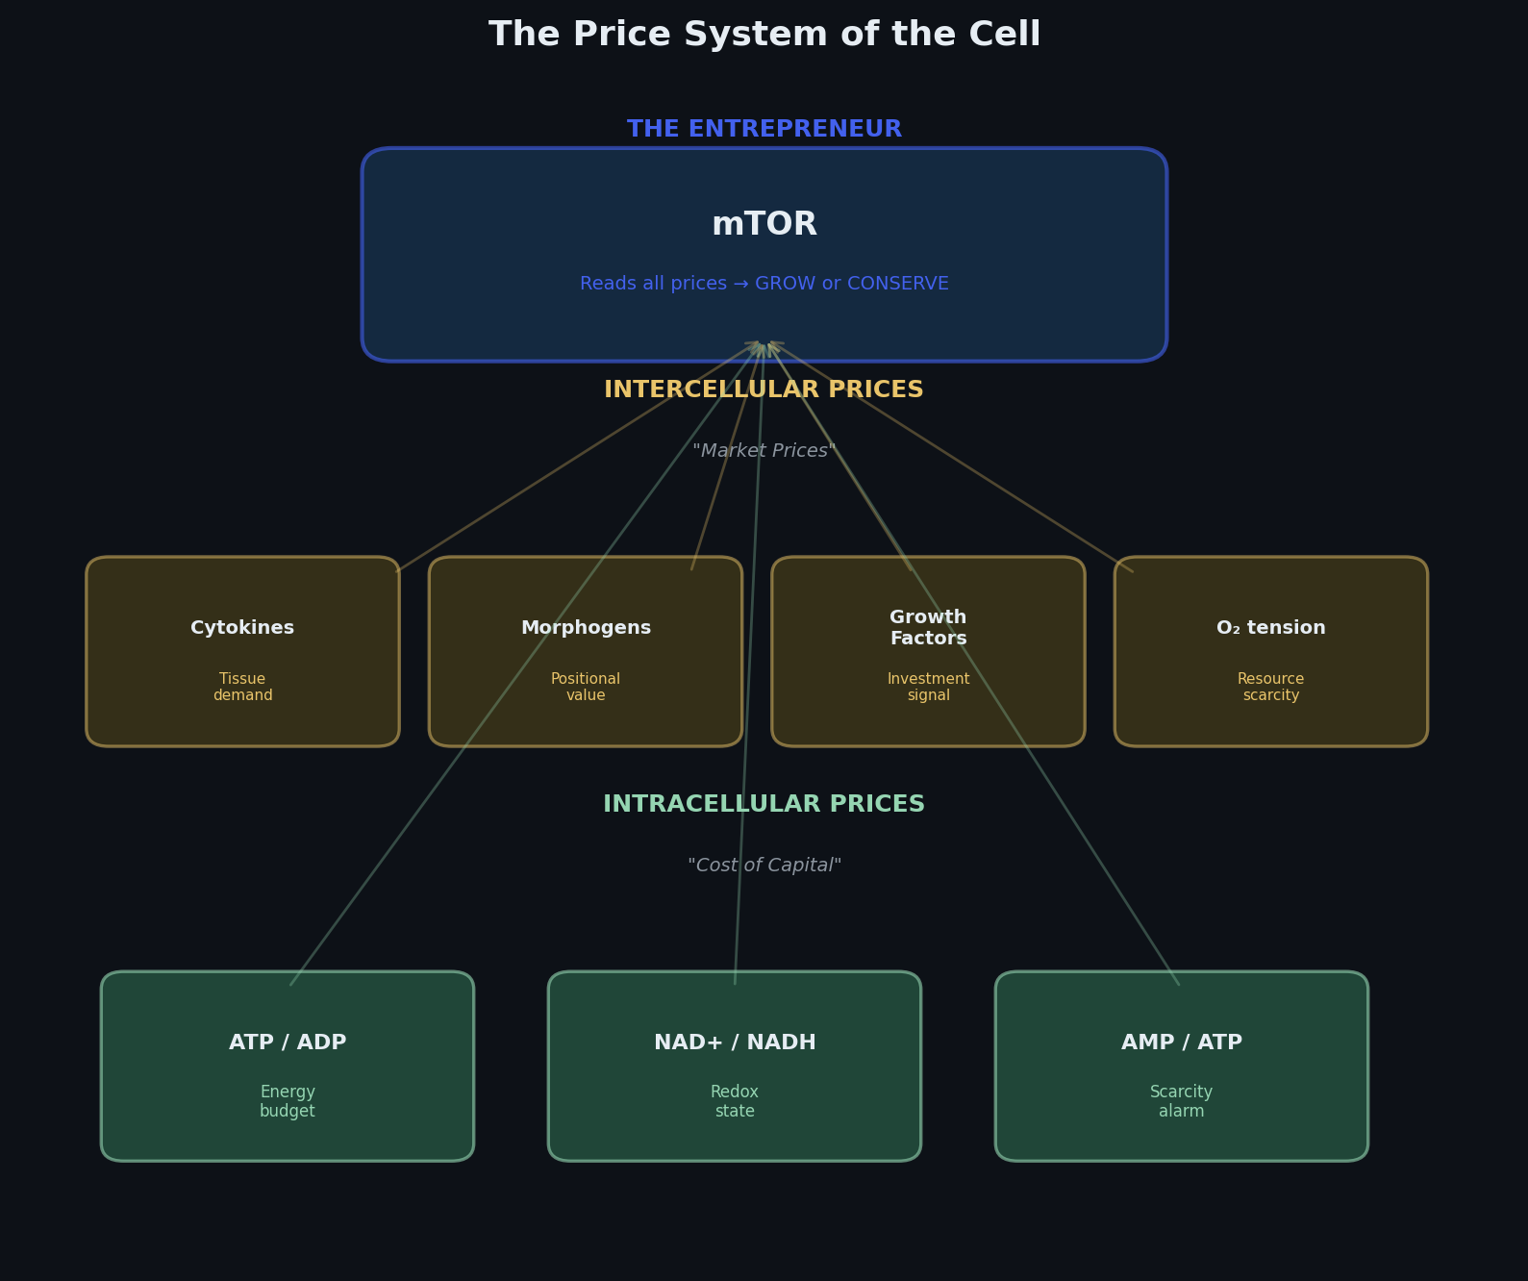
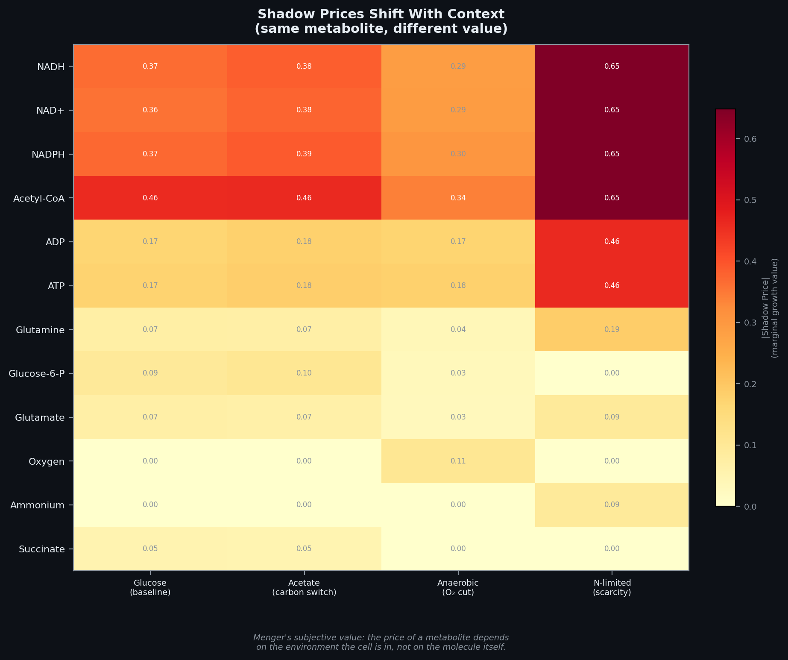
The Price System of the Cell
• Three tiers of molecular prices:
• Intracellular ratios (ATP/ADP, NAD+/NADH) = cost of capital
• Intercellular signals (cytokines, O₂ tension) = market prices
• mTOR integrates all prices → grow-or-conserve = the entrepreneur
•
• Shadow prices shift with context (FBA, iML1515):
• NADH: cheap on glucose, expensive on acetate
• Oxygen: free aerobically, most valuable anaerobically
• Same molecule, different value = Menger’s subjective value
Notes:
Price System — 30 seconds.
Living systems have a real price system at three tiers. Intracellular metabolite ratios are cost of capital. Intercellular signals are market prices. mTOR integrates all of these and makes the grow-or-conserve decision — the entrepreneur reading the market. Shadow prices from FBA prove Menger's subjective value: the same molecule has different value depending on context.

Slide 5
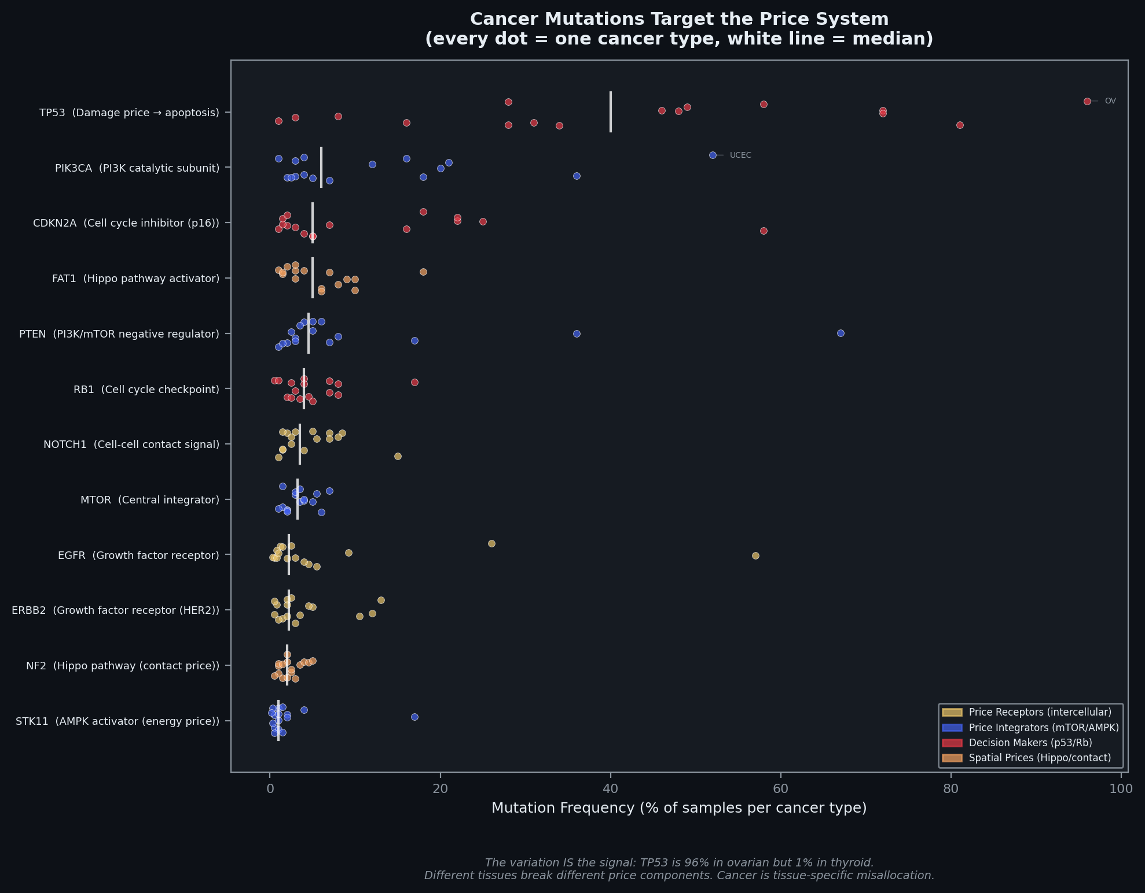
Cancer Breaks the Price System
• TCGA PanCancerAtlas: 10,967 samples, 32 cancer types
• Most mutated genes map to price system components:
• TP53 — damage price (apoptosis signal)
• PIK3CA, PTEN, mTOR — price integrators
• EGFR, ERBB2 — growth factor receptors (price readers)
•
• The variation IS the finding:
• TP53: 96% ovarian, 1% thyroid
• PIK3CA: 52% uterine, 3% ovarian
• Different tissues break different price components
•
• The disease is not the variant — it’s the broken price system
Cancer is the calculation problem at the cellular level.
Notes:
Cancer — 30 seconds.
Using TCGA data — 10,967 samples, 32 cancer types — the most mutated genes all map to price system components. TP53 is the damage price. PIK3CA and PTEN are price integrators. EGFR is a price reader. The tissue-specific variation is the finding: TP53 is 96% in ovarian but 1% in thyroid. Different tissues break different price components. Cancer is not a gene disease. It's a price system disease.

Slide 6
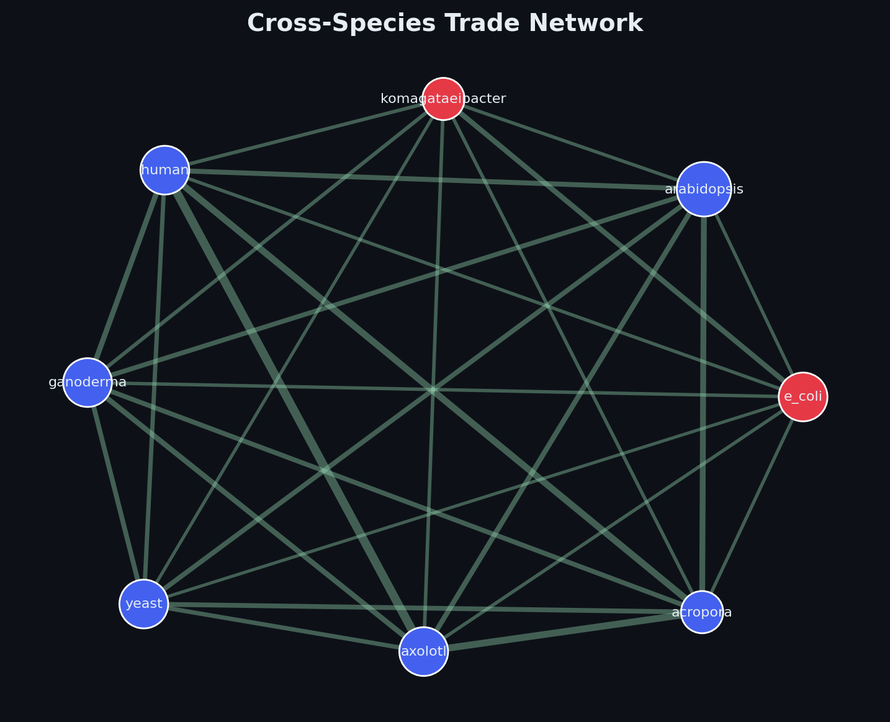
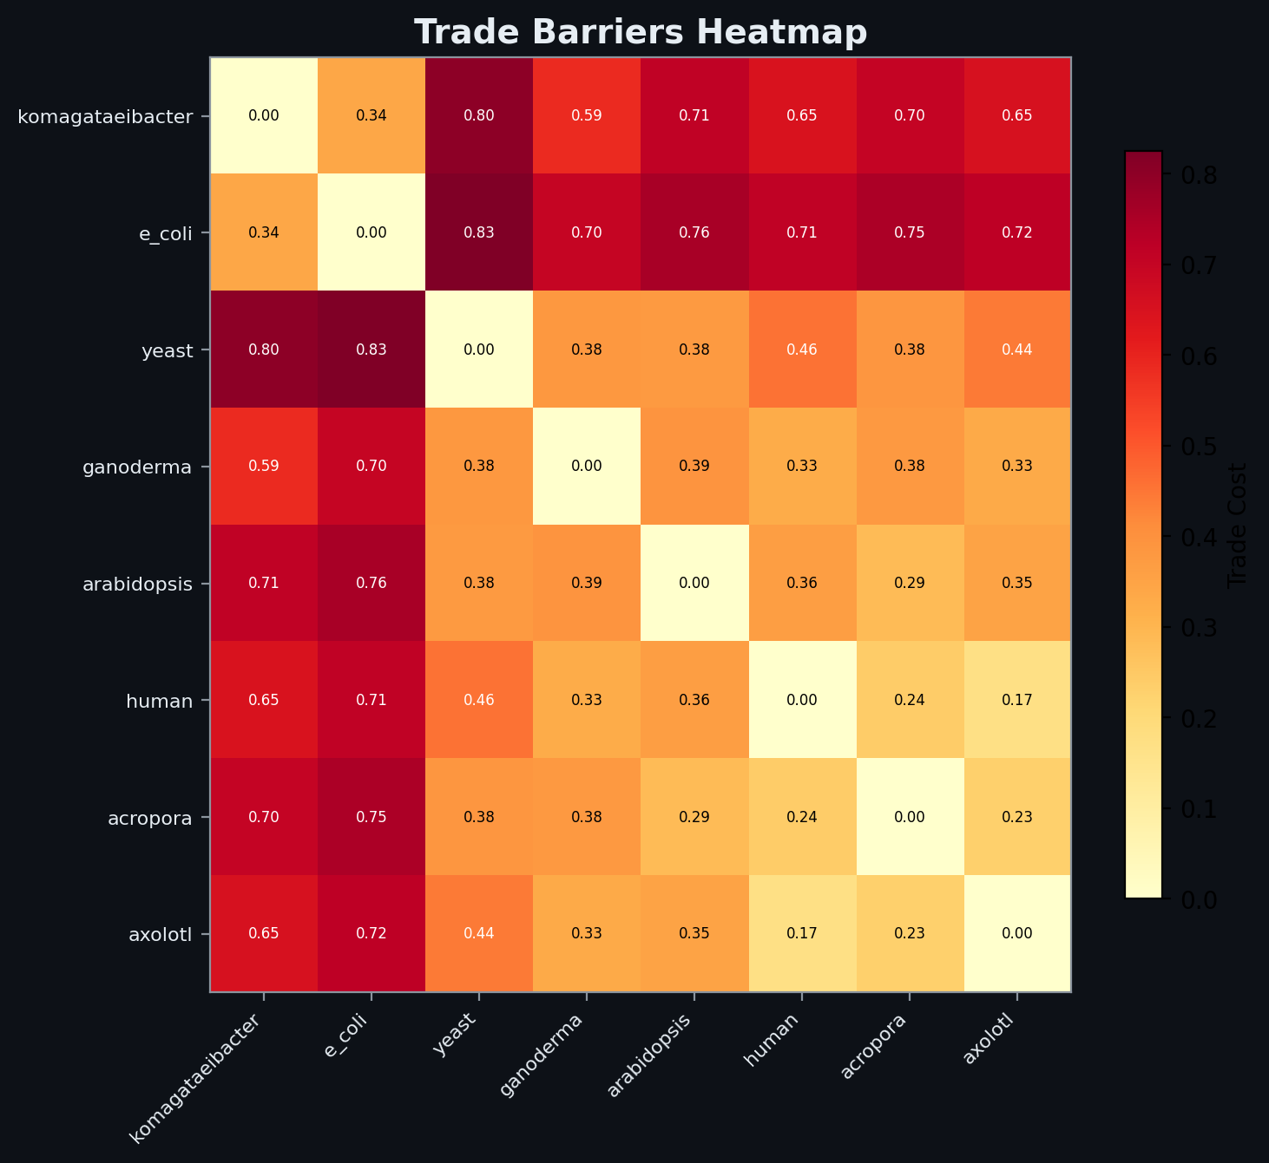
Comparative Advantage Across the Tree of Life
• Each organism specializes: coral → biomineralization, spider → silk
• Trade cost scales with evolutionary distance:
• Within-kingdom: 0.17–0.38 | Cross-kingdom: 0.65–0.83
• Forced exchange (full codon optimization) destroys local knowledge
• Trade blocs emerge spontaneously — no designer needed
Cells as Economic Agents
• Same genome, 8 cell types — specialization by choice, not command
• Communication Gini = 0.0 — no gatekeeper, perfectly distributed
• Remove any cell type → 70–90% of communication intact
• Same ligand, different meaning — subjective value at the molecular level
Notes:
Trade + Cells — 30 seconds.
Each organism specializes in capabilities others lack. Trade cost correlates with evolutionary distance. Forced exchange destroys information. Trade blocs emerge spontaneously. At the cellular level, same genome produces 8 cell types. Communication Gini is 0.0 — perfectly distributed, no gatekeeper. Same ligand received differently by different cells — subjective value at the molecular level.

Slide 7
Every Layer, One Answer
Topology
No master node — 19:1 robustness ratio
Single-Cell
No master cell — Gini = 0.0, subjective value
Economy
Distributed 71% vs centralized 53% under stress
FBA
Omniscient planner: 70% — 30% structural failure
Price System
Three-tier prices — mTOR is the entrepreneur
Cancer
Disease = broken price system, not broken parts
Trade
Voluntary exchange succeeds, forced exchange destroys
Life is the original decentralized network. The self-assembling internet. The adaptive computer that built itself, runs itself, repairs itself, and has been doing so for four billion years.
The question is not how to program life. It is how to join the computation.
Notes:
Conclusion — 15 seconds.
Every layer answers the same question: does biology operate like a centrally planned economy or a free market? The answer is market. At every scale. Life is the original decentralized network. The question is not how to program life. It is how to join the computation.

