Slide 1
The Living Architecture: Distributed Knowledge as the Design Language of Life
Sage Clokey • BME 129C Capstone • Spring 2026 Advisor: R. Dubois • UC Santa Cruz
Notes:
Living things are not machines. That is the thesis. That is the finding. That is what seven layers of quantitative evidence confirm.

Slide 2
Living things are not machines.
Does life operate like a centrally planned economy — or a free market?
Notes:
My name is Sage Clokey, and my capstone asks a question that sounds simple but has enormous consequences for how we do molecular biology.

Slide 3
The Central Planner’s Promise
• Synthetic biology assumes the engineer can design from above
• Pick the promoter. Optimize codons. Calculate ratios. Assemble parts.
• Most designed genetic circuits fail on the first attempt (Kwok, 2010)
• Complexity hits a wall beyond a handful of components (Purnick & Weiss, 2009)
• Standard explanation: biology is “complex” and models are “incomplete”
• This paper argues: the problem is structural, not informational
Notes:
Modern synthetic biology operates on an implicit assumption: that the engineer can gather enough knowledge to design a living system from above. This is central planning applied to molecular biology.

Slide 4
The Knowledge Problem — From Vienna to the Genome
• Hayek (1945): knowledge for coordination never exists in concentrated form
• Mises (1920): rational calculation impossible without prices
• Menger (1871): complex institutions arise spontaneously from individual action
• Rothbard (1962): every act of central planning destroys information
• Kirzner (1973): agents discover information through competitive process
• Every principle they discovered about human cooperation, life discovered first — and wrote it in DNA
Notes:
The insight that coordination can depend on knowledge that cannot be centralized was first articulated not by a biologist but by an economist.

Slide 5
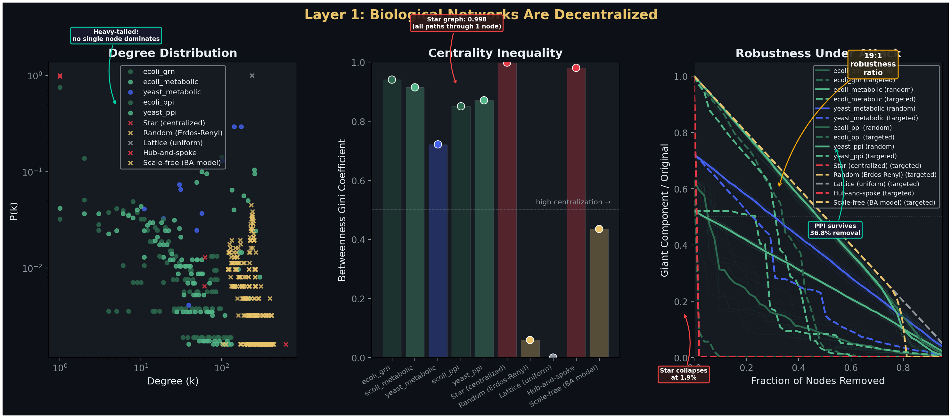
Layer 1: No Master Node — Network Topology
• 5 biological networks vs 5 synthetic architectures
• Heavy-tailed degree distributions (α = 2.0–2.5)
• Hubs exist but no hub dominates
• PPI: 36.8% removal to fragment
• Star graph: 1.9% removal to collapse
• 19:1 robustness ratio
• Feed-forward loops over-represented (Z > 10)
• Networks self-regulate against centralization (WBPA)
Notes:
I built five biological networks from public databases and compared them against five synthetic architectures including a star graph. The result: there is no master node. 19-to-1 robustness ratio favoring distributed architecture.

Slide 6
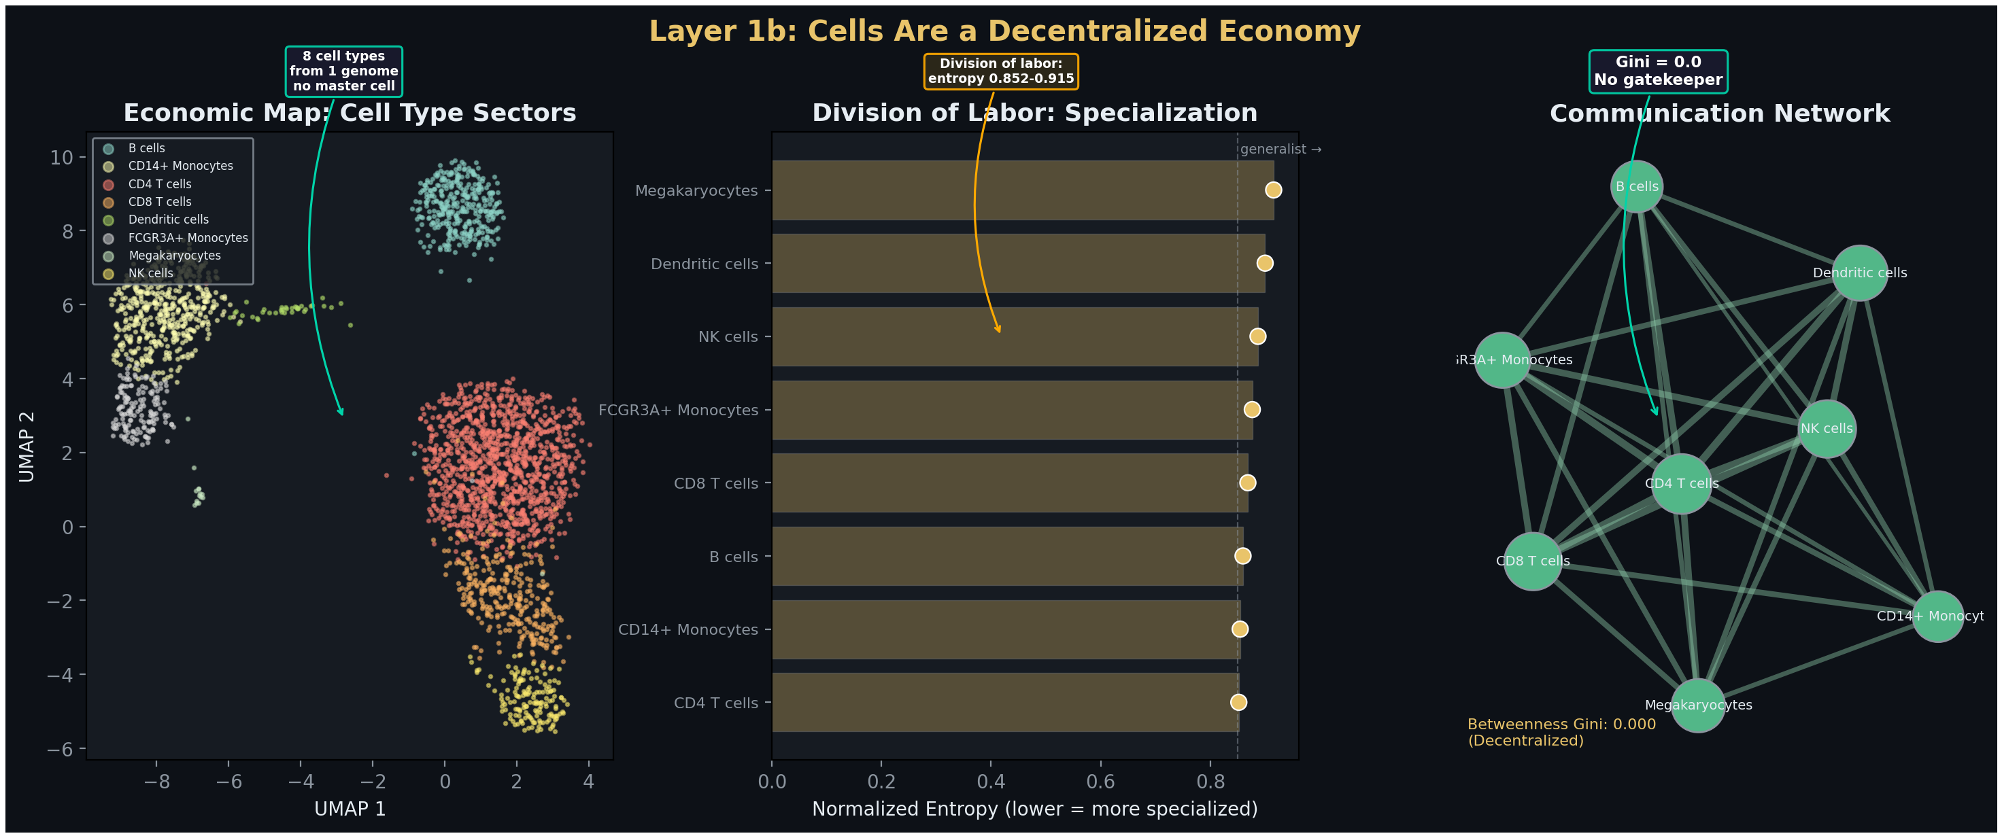
Layer 1b: No Master Cell — The Single-Cell Economy
• 2,638 human PBMCs, 8 cell types
• Shannon entropy 0.852–0.915
• Division of labor without hierarchy
• Communication betweenness Gini = 0.000
• Perfectly distributed — no gatekeeper
• 75% of communication survives any single removal
• Menger’s spontaneous order made visible
Notes:
I analyzed 2,638 human immune cells across 8 cell types. Each cell type specializes. The communication network has a betweenness Gini of zero. Remove any single cell type and 75% of communication survives.

Slide 7
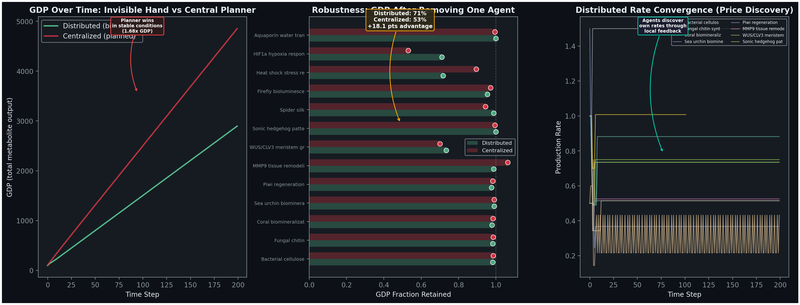
Layer 2: Distributed Outperforms Centralized Under Perturbation
• 13 metabolic pathway agents
• Stable conditions: planner wins (1.68x GDP)
• Under perturbation:
• Distributed retains 71.1% GDP
• Centralized retains 53.0% GDP
• 18.1 percentage point advantage
• Planner’s fixed allocation has no self-correction
• Agents discover equilibrium via price feedback
Notes:
Under stable conditions, the central planner achieves higher output. But when I removed an agent, the distributed system retained 71% of GDP while the centralized system retained only 53%.

Slide 8
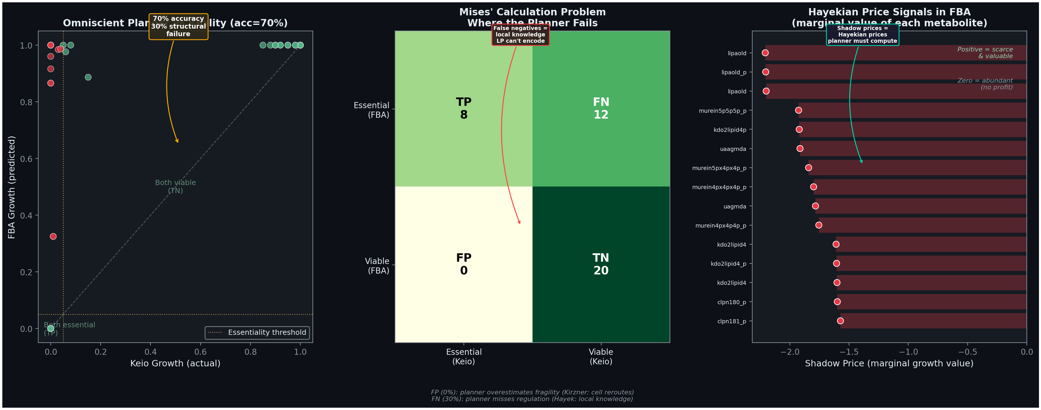
Layer 2b: The Omniscient Planner Achieves 70%
• iML1515: 2,712 reactions, 1,877 metabolites, 1,516 genes
• The strongest possible central planner
• 70% accuracy on gene knockouts vs Keio collection
• 30% failure is structural, not noise
• Allosteric feedback, folding, timing, chaperones
• Knowledge exists only in local molecular state
• The LP must compute shadow prices (= Hayekian prices)
• The planner computes what the market produces for free
Notes:
I gave the planner perfect information. iML1515 genome-scale model. It achieves 70% accuracy. The 30% failure is structural. And the irony: the LP must compute shadow prices to solve its optimization.

Slide 9
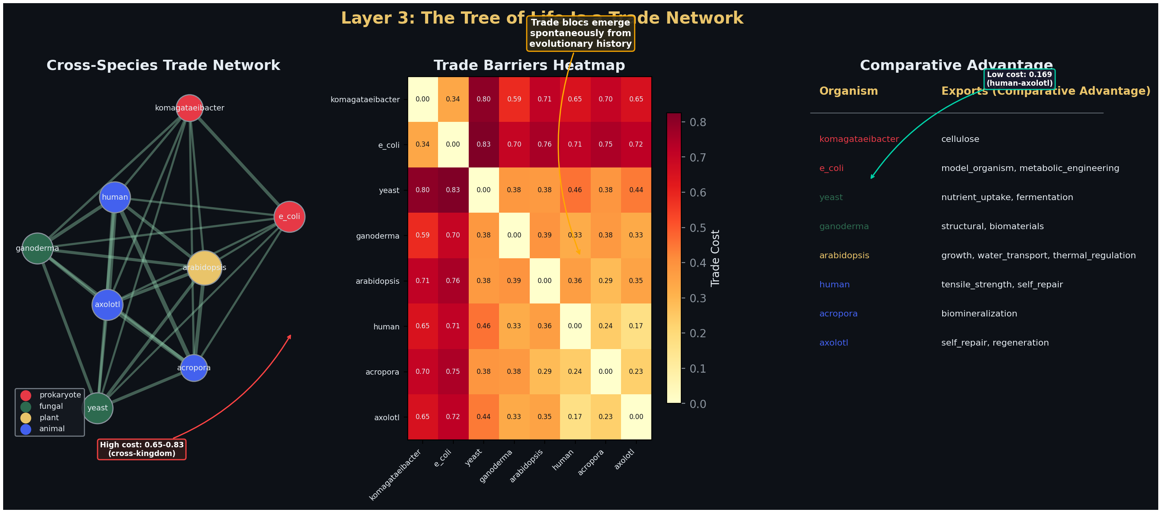
Layer 3: Cross-Species Gene Transfer Follows Trade Rules
• 8 organisms across 4 kingdoms
• Trade cost scales with evolutionary distance
• Within-kingdom: 0.17–0.38
• Cross-kingdom: 0.65–0.83
• Forced codon optimization destroys information
• Codon harmonization preserves local knowledge
• Trade blocs emerge spontaneously (Louvain)
• Ricardian comparative advantage in codons
Notes:
Gene transfer between species follows trade network rules. Costs scale with evolutionary distance. Forced codon optimization destroys information. Trade blocs emerge spontaneously from shared evolutionary history.

Slide 10
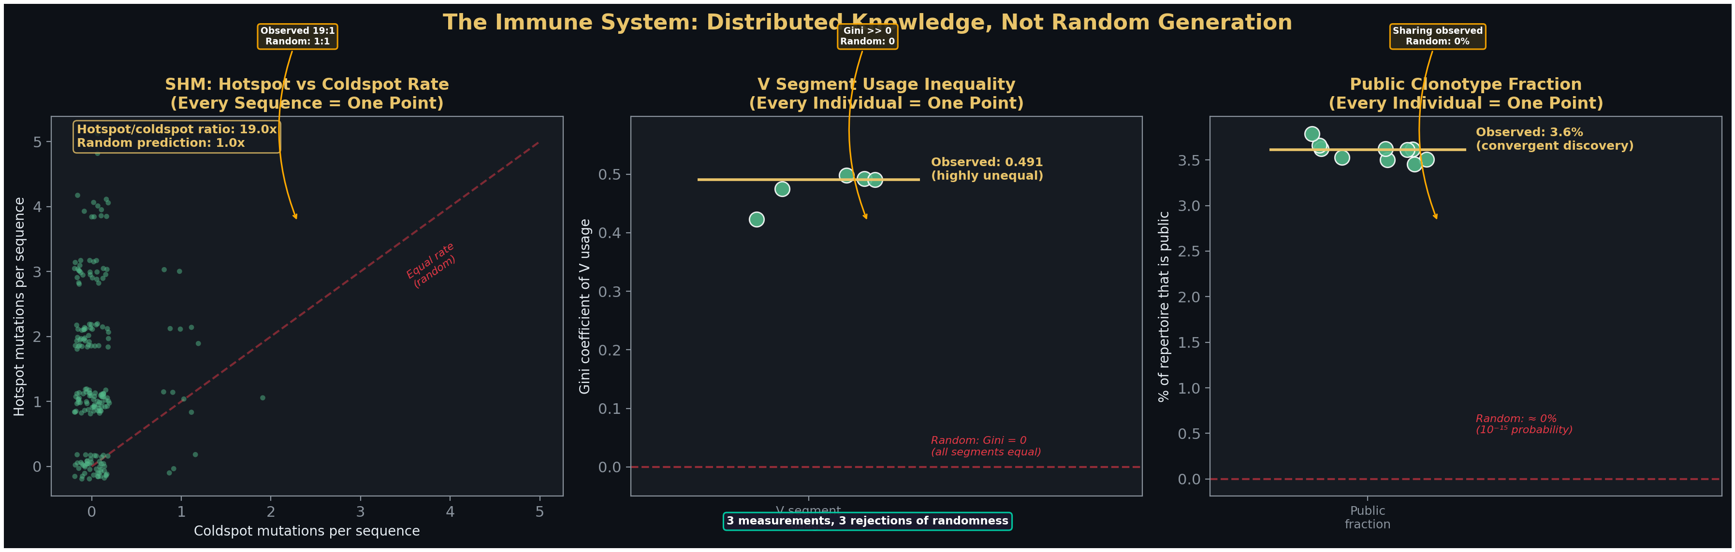
Layer 4: The Immune System — Directed, Not Random
• SHM: AID targets WRC/GYW hotspots at 19:1 over coldspots
• V(D)J: IGHV3-23 used at 10–20x rare segments
• Same bias in unrelated individuals (Spearman ρ ≈ 1.0)
• IGHJ4 + IGHJ6 = 65% of usage (random: 17%)
• Public clonotypes: identical TCR CDR3 in unrelated people
• Random probability: ~10⁻¹⁵
• Observed: 200 shared across 10 individuals
• Convergent distributed discovery
Notes:
Textbooks call V(D)J recombination and somatic hypermutation random. They are not. AID targets hotspot motifs at 19-to-1 over coldspots. Public clonotypes appear at rates exceeding random expectation by 10-to-the-15th-fold.

Slide 11
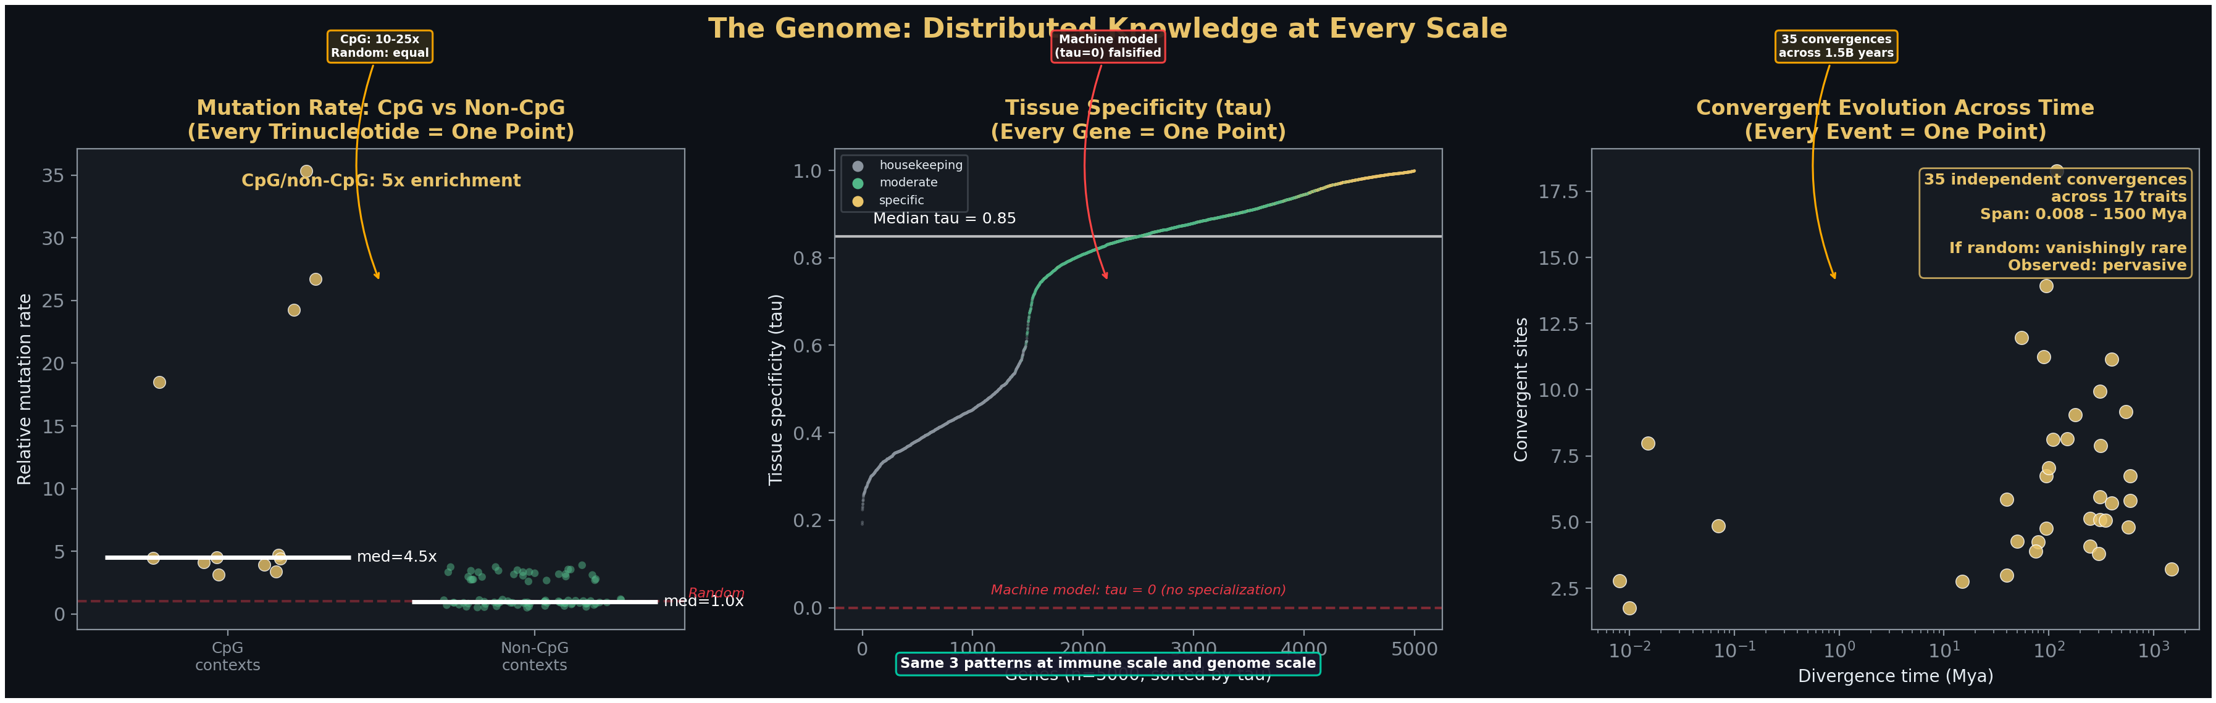
Layer 5: The Whole Genome — Scale-Invariant Distributed Knowledge
• CpG C>T: 15–40x baseline from ~1% of contexts
• Ti/Tv ratio 2:1 (random: 0.5:1)
• Mutation machinery is a biased editor, not a random generator
• 20% of genes: tissue specificity τ > 0.95
• 100–1,000x fold enrichment in primary tissue
• 35 convergent evolution events across 17 traits
• Same amino acid substitutions across 1.5 billion years
• The solution landscape is structured
Notes:
CpG mutations occur at 15 to 40x baseline from 1% of sequence contexts. 20% of genes show tissue specificity above tau 0.95. 35 convergent evolution events reproduce the same amino acid substitutions in lineages separated by up to 1.5 billion years.

Slide 12
Seven Layers — Same Answer
Layer | Question | Finding | Principle
1: Topology | Is there a master node? | No. 19:1 robustness advantage | Hayek: knowledge is dispersed
1b: Single-cell | Is there a master cell? | No. Gini = 0.0, 75% survival | Menger: spontaneous order
2: Economy | Distributed > centralized? | Yes. 71% vs 53% GDP | Mises: calculation problem
2b: FBA | Perfect knowledge solves it? | No. 70% accuracy, 30% structural | Hayek: structural limit
3: Trade | Forced exchange works? | No. Destroys information | Rothbard: coercion destroys value
4: Immune | Immune generation random? | No. 19:1 hotspots, ρ ≈ 1.0, public clonotypes | Distributed knowledge
5: Genome | Mutation random? | No. CpG hotspots, convergent evolution | Knowledge in the machinery
Notes:
Seven layers of evidence answer the same question from different angles. The convergence across seven independent lines of evidence is the finding.

Slide 13
Six Design Principles for the Molecular Biologist
• 1. Read the economy before entering it — use FBA shadow prices
• 2. Build feedback loops, not fixed rates — 71% vs 53% GDP retention
• 3. Distribute control across the pathway — 19:1 robustness ratio
• 4. Harmonize codons, don’t optimize them — preserve local knowledge
• 5. Let the system evolve — Kirznerian discovery at the molecular level
• 6. Design consortia, not monoliths — Gini = 0.0, 75% fault tolerance
Notes:
What does this mean for the practicing molecular biologist? Six design principles. Read the economy. Build feedback loops. Distribute control. Harmonize codons. Let it evolve. Design consortia.

Slide 14
The garden is still growing.
The question is not how to program life. It is how to join it. Cultivate conditions, don’t command outcomes. Read the price system, don’t override it. Be a node, not a planner.
Notes:
The cell is not a chassis waiting to be programmed. It is a running economy. The garden is still growing. The question is not how to program life. It is how to join it. Thank you.

Slide 15
Thank You
Sage Clokey • sage-clokey.github.io Code: github.com/Sage-Clokey/Living-works-by-the-word Advisor: R. Dubois • UC Santa Cruz
Notes:
Thank you. Questions?

