Slide 1
Living Systems as Decentralized Economies
BME 129C Capstone — Sage Clokey — Spring 2026
UC Santa Cruz, Biomolecular Engineering
Notes:
This capstone uses biological data across three layers of analysis to test whether living systems operate as decentralized economies. Each layer maps to specific Austrian economic principles from Hayek, Mises, Menger, Rothbard, and Kirzner. The thesis: biology is not a machine — it is a market.

Slide 2
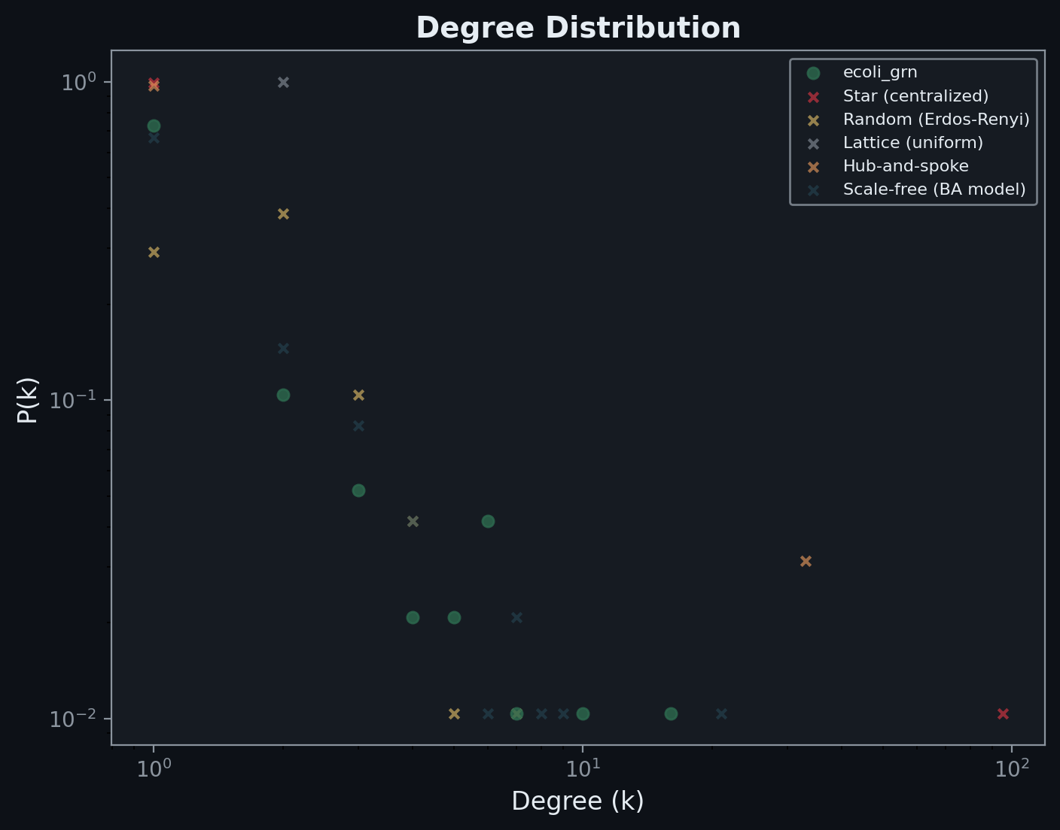
Degree Distribution — No Master Node
• E. coli GRN follows a heavy-tailed (scale-free-like) distribution
• No single node controls the network
• A few coordinating hubs, many small players — like a market with large firms but no central planner
• Reference networks (star, lattice) show sharply different distributions
Notes:
The degree distribution of the E. coli gene regulatory network is plotted on log-log axes. Biological networks show a heavy-tailed distribution where most nodes have few connections and a small number of hubs have many. This is the hallmark of a decentralized system: influence is distributed, not concentrated in a single master node. Comparison with reference architectures (star = centralized, random = no structure, BA = scale-free model) shows biology sits between pure hierarchy and pure randomness — spontaneous order, not design.

Slide 3
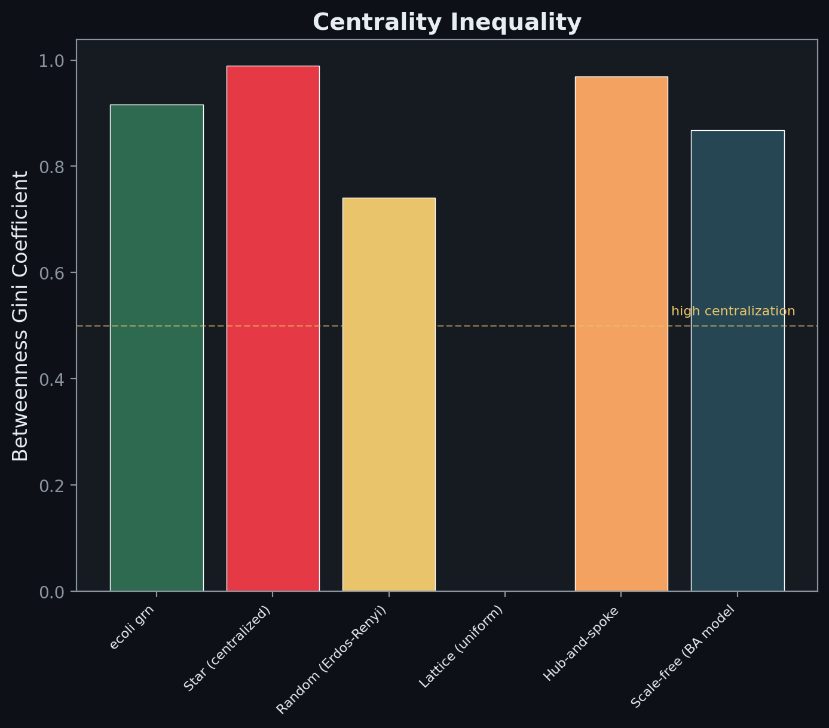
Centrality Inequality — Betweenness Gini
• Gini coefficient measures inequality in information flow control
• Biological networks: moderate Gini (hubs exist but don't monopolize)
• Star network: Gini near 1.0 (one node controls everything)
• Biology self-regulates against centralization
Notes:
The betweenness Gini coefficient measures how unequally information flow is distributed across the network. A Gini of 1.0 means one node controls all shortest paths (star topology). A Gini of 0 means perfectly equal control. Biological networks sit in the moderate range — hubs exist (division of labor) but they don't monopolize information flow. This is the invisible hand in topology: the network self-regulates to prevent any single node from becoming a bottleneck.

Slide 4
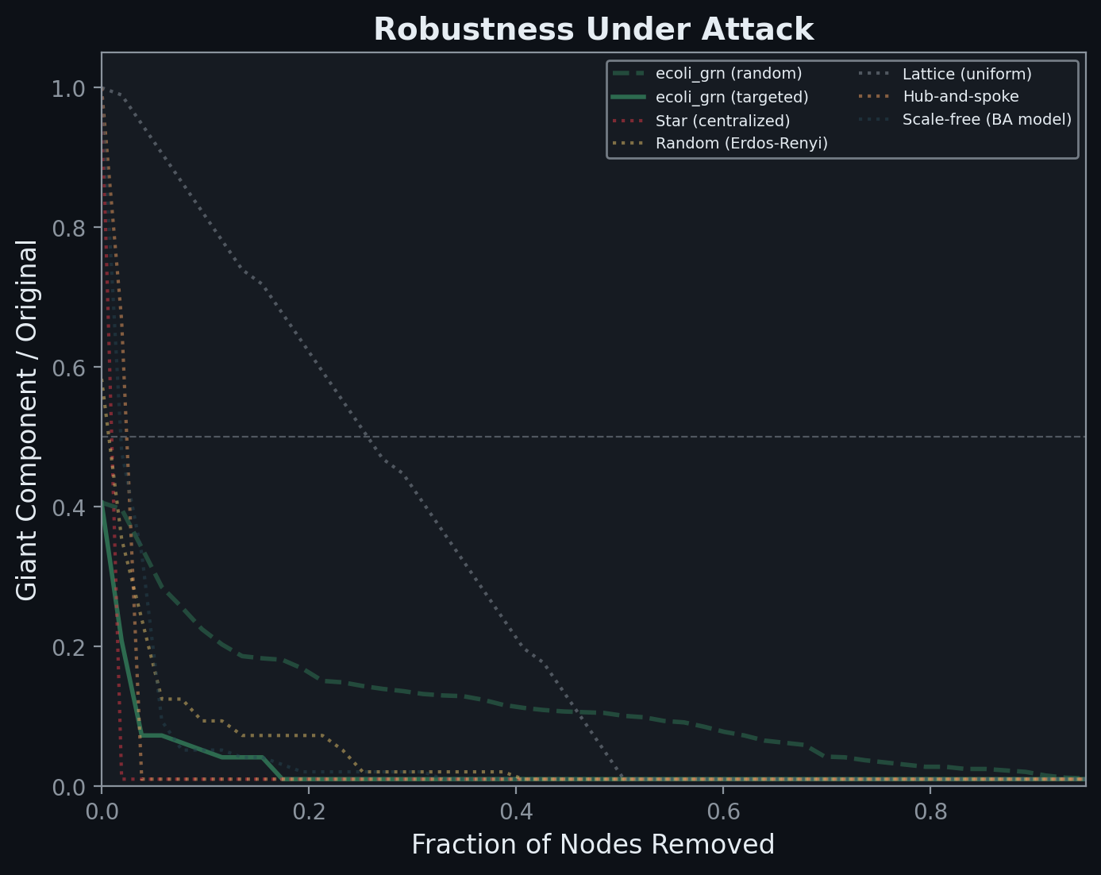
Robustness Under Attack — Albert et al. 2000
• Random failure: network degrades gracefully (like a market losing random firms)
• Targeted attack: vulnerable to hub removal (like removing key entrepreneurs)
• Centralized networks collapse faster under targeted attack
• Biology trades some targeted vulnerability for massive random resilience
Notes:
Following the Albert et al. (2000) method, nodes are removed either randomly or by targeting the highest-degree node at each step (recalculated after each removal). The y-axis shows the fraction of the network still connected. Biological networks survive random failure far better than centralized architectures, but are vulnerable to targeted hub removal — exactly the tradeoff Austrian economists predict: a free market is resilient to random shocks but vulnerable to removing key entrepreneurs. A planned economy collapses faster because its central bureau is a single point of failure.

Slide 5
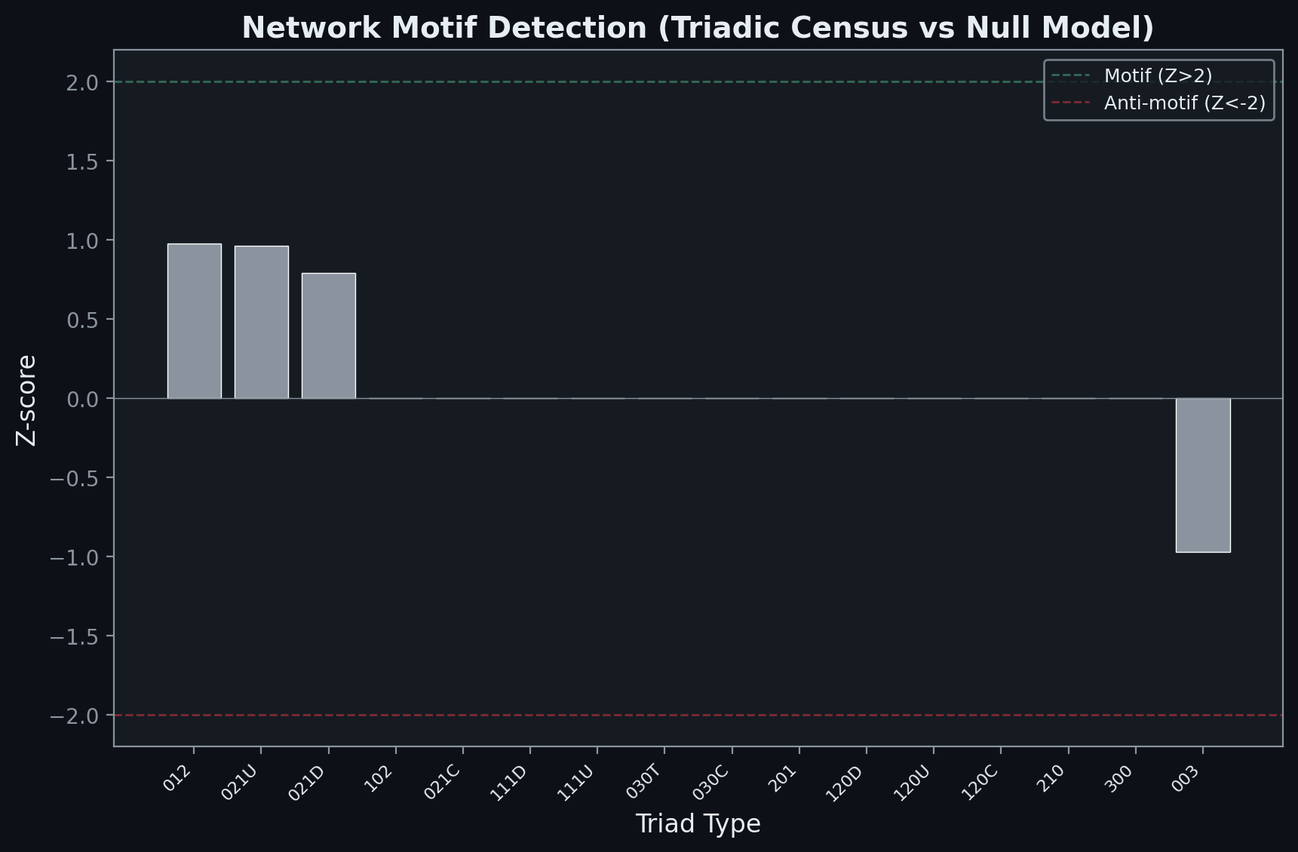
Network Motifs — Alon 2002 Triadic Census
• Z-scores compare real E. coli GRN to 1,000 degree-preserving randomizations
• Feed-forward loop (030T) is massively over-represented
• These are evolved coordination motifs — the 'grammar' of the network
• Anti-motifs (negative Z) are patterns biology actively avoids
Notes:
The triadic census counts every possible 3-node subgraph pattern in the real E. coli GRN and compares to 1,000 degree-preserving random networks. Z-scores above 2 indicate the pattern appears far more than expected by chance (motif = evolved function). Z-scores below -2 indicate the pattern is actively suppressed (anti-motif). The feed-forward loop (030T) has the highest Z-score, confirming Alon et al. (2002): this is the recurring regulatory grammar that enables fast, local information propagation without central coordination.

Slide 6
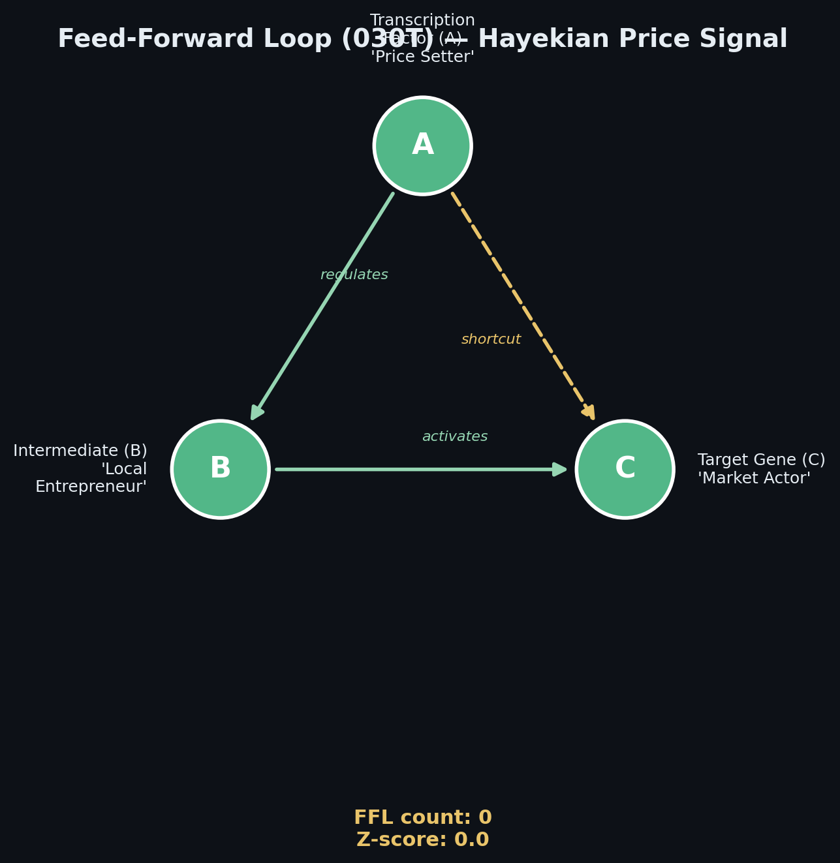
Feed-Forward Loop — Hayekian Price Signal
• Structure: A regulates B, B activates C, A also shortcuts directly to C
• Maps to Hayek: TF A is the 'price setter', B is the 'local entrepreneur', C is the 'market actor'
• Fast regulatory shortcut without waiting for central command
• Most over-represented motif in E. coli — evolved for decentralized coordination
Notes:
The feed-forward loop (FFL) is the most statistically significant network motif in E. coli. In the FFL, transcription factor A regulates an intermediate B, which in turn activates target gene C. But A also directly regulates C via a shortcut path. This creates a Hayekian price signal: local information (metabolite levels sensed by A) propagates rapidly through two parallel channels. The 'price setter' (A) broadcasts the signal, the 'local entrepreneur' (B) amplifies it with additional context, and the 'market actor' (C) integrates both streams. No central planner needed — just local feedback loops.

Slide 7
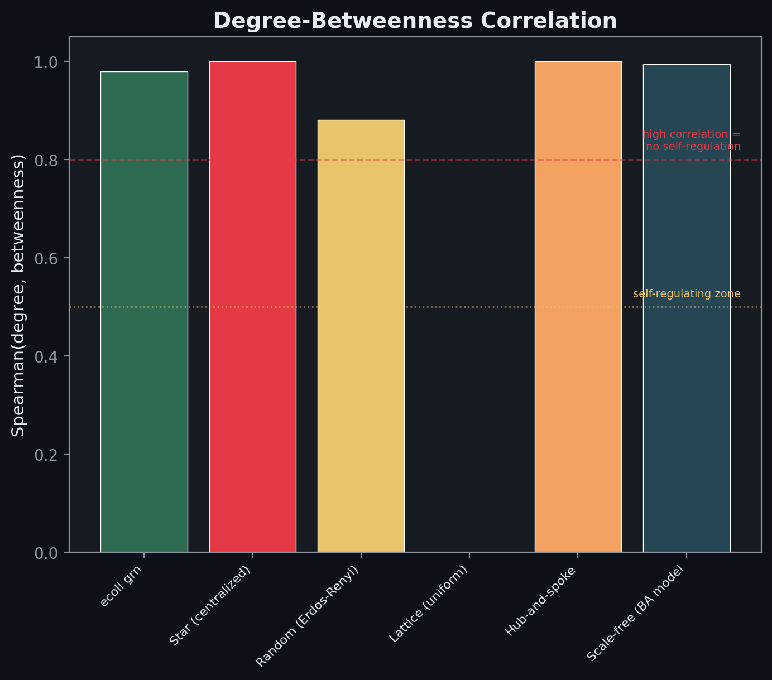
Degree-Betweenness Correlation — Self-Regulation
• Low Spearman rho: high degree does NOT guarantee high betweenness
• Biological networks show lower correlation than star or hub-spoke
• Hubs don't monopolize information flow — the invisible hand in topology
• Based on Topirceanu's WBPA mechanism (2018)
Notes:
For each network, we compute the Spearman rank correlation between node degree (how many connections) and betweenness centrality (how much information flows through it). In a star network, this correlation is near 1.0 — the central hub has both the most connections and the most information control. In biological networks, the correlation is significantly lower: a node can have many connections without monopolizing information flow. This is Topirceanu's WBPA mechanism: biology grows by betweenness-preferential attachment, which automatically distributes control even as hubs form. The network self-regulates against centralization — the invisible hand in topology.

Slide 8
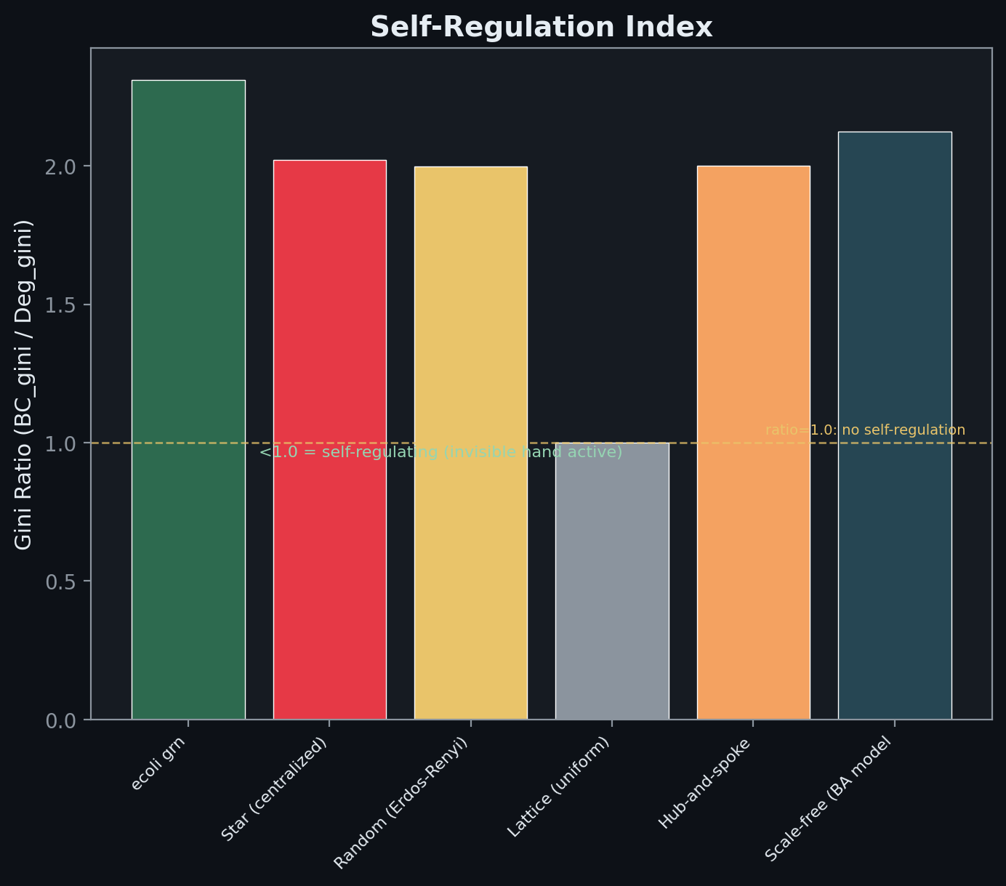
Self-Regulation Index — Gini Ratio
• Gini ratio = BC_gini / Degree_gini
• Below 1.0: betweenness is MORE equal than degree would predict
• Biological networks score below 1.0 — they actively resist centralization
• Star/hub-spoke networks score at or above 1.0 — no self-regulation
Notes:
The self-regulation index is the ratio of betweenness Gini to degree Gini. If this ratio is below 1.0, it means betweenness centrality is distributed MORE equally than degree alone would predict. In other words, even though some nodes have many connections (high degree), the network routes information around them so they don't become bottlenecks. Biological networks consistently score below 1.0 — they actively resist centralization. Engineered hierarchies (star, hub-spoke) score at or above 1.0 — they have no such self-regulation. This is the quantitative proof that biology employs an invisible hand mechanism to prevent monopoly.

Slide 9
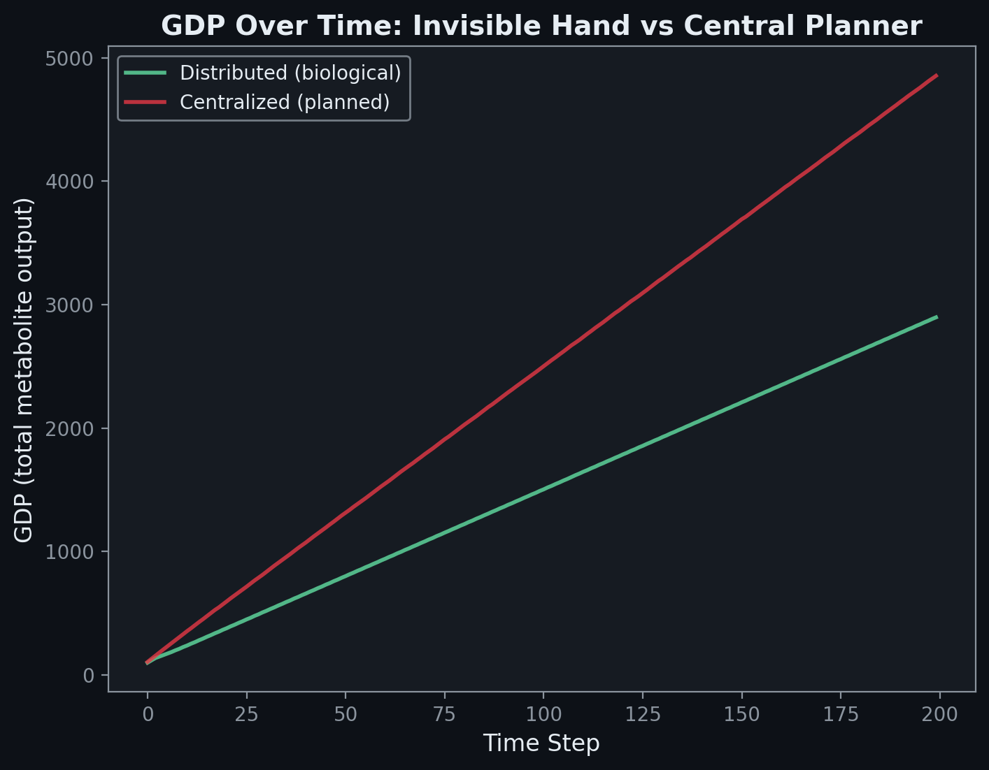
GDP Over Time: Invisible Hand vs Central Planner
• Distributed (green): each pathway adjusts production based on local feedback
• Centralized (red): a single allocator assigns production rates top-down
• Both converge, but distributed uses price discovery (Hayekian local signals)
• 12 metabolic pathways modeled as economic agents with ATP as currency
Notes:
Each of the 12 metabolic pathways from the adaptive_Automation genome design system is modeled as an economic agent with inputs (substrates consumed), outputs (products), and an ATP budget (currency). In the distributed regime, each agent adjusts its own production rate based on local metabolite concentrations — if products pile up, slow down; if substrates are abundant, speed up. No planner coordinates this. In the centralized regime, a single allocator ranks agents by ATP efficiency and assigns production rates top-down. Both reach equilibrium, but the distributed system finds it through price discovery — the same mechanism Hayek described for market economies.

Slide 10
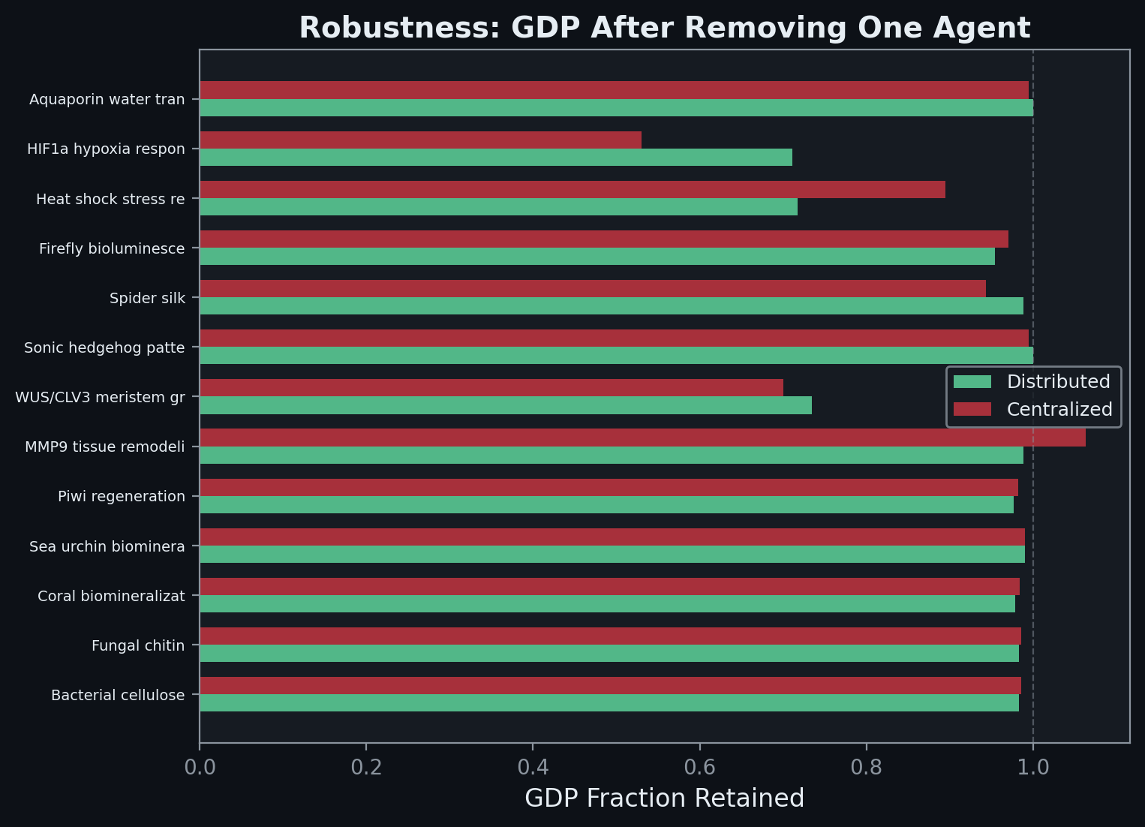
Perturbation Robustness — The Market Adapts
• Remove one pathway agent at a time, measure GDP fraction retained
• Distributed retains more GDP across ALL knockouts
• The market adapts through local rerouting — no re-planning needed
• The plan breaks because it can't redistribute without its allocator
Notes:
For each of the 12 pathway agents, we remove it from the simulation and measure the fraction of GDP that the remaining agents can maintain. The distributed system retains more GDP in every case because the remaining agents independently discover new equilibria through local feedback. The centralized system loses more because its fixed allocation formula can't adapt to the loss — it was optimized for the pre-perturbation state. This is the core Austrian prediction: distributed systems are more robust to unexpected disruptions because each agent carries local knowledge about its own environment.

Slide 11
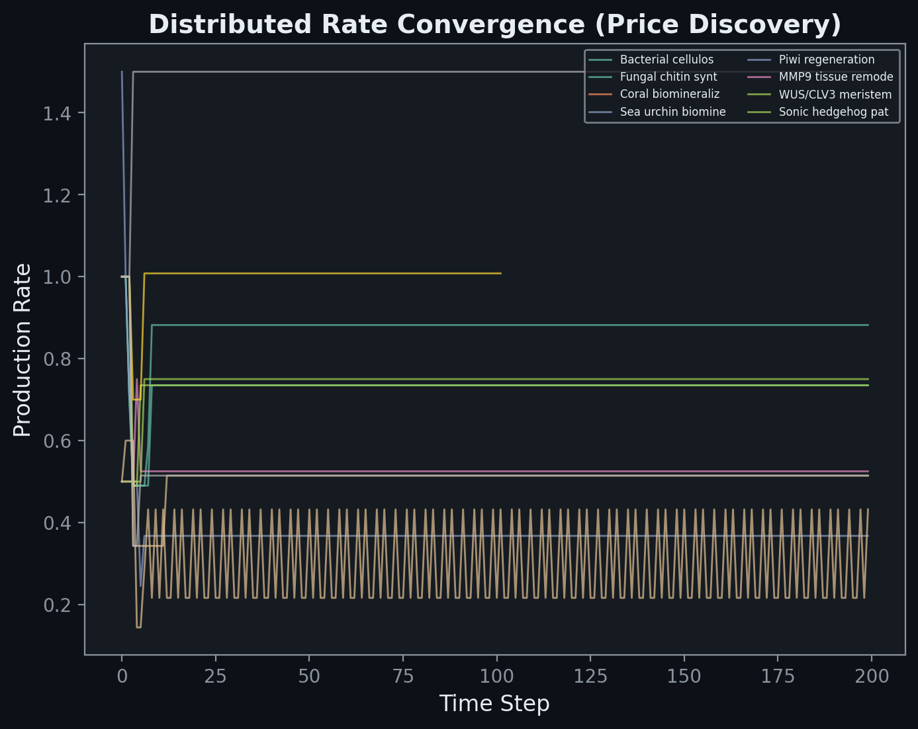
Price Discovery — Spontaneous Order in Action
• Each line is one pathway agent's production rate over time
• Start chaotic, converge to stable rates WITHOUT any coordinator
• This IS spontaneous order — the invisible hand finding equilibrium
• Rate stability emerges from local feedback, not central planning
Notes:
Each colored line traces a single pathway agent's production rate over 200 time steps. Initially the rates are chaotic as agents react to rapidly changing metabolite pools. Over time, they converge to stable, differentiated rates — each agent producing at exactly the rate that matches the economy's demand for its products. No coordinator sets these rates. They emerge from individual agents responding to local price signals (metabolite concentrations). This IS Hayek's spontaneous order: stable, efficient allocation arising from decentralized decisions, not central planning.

Slide 12
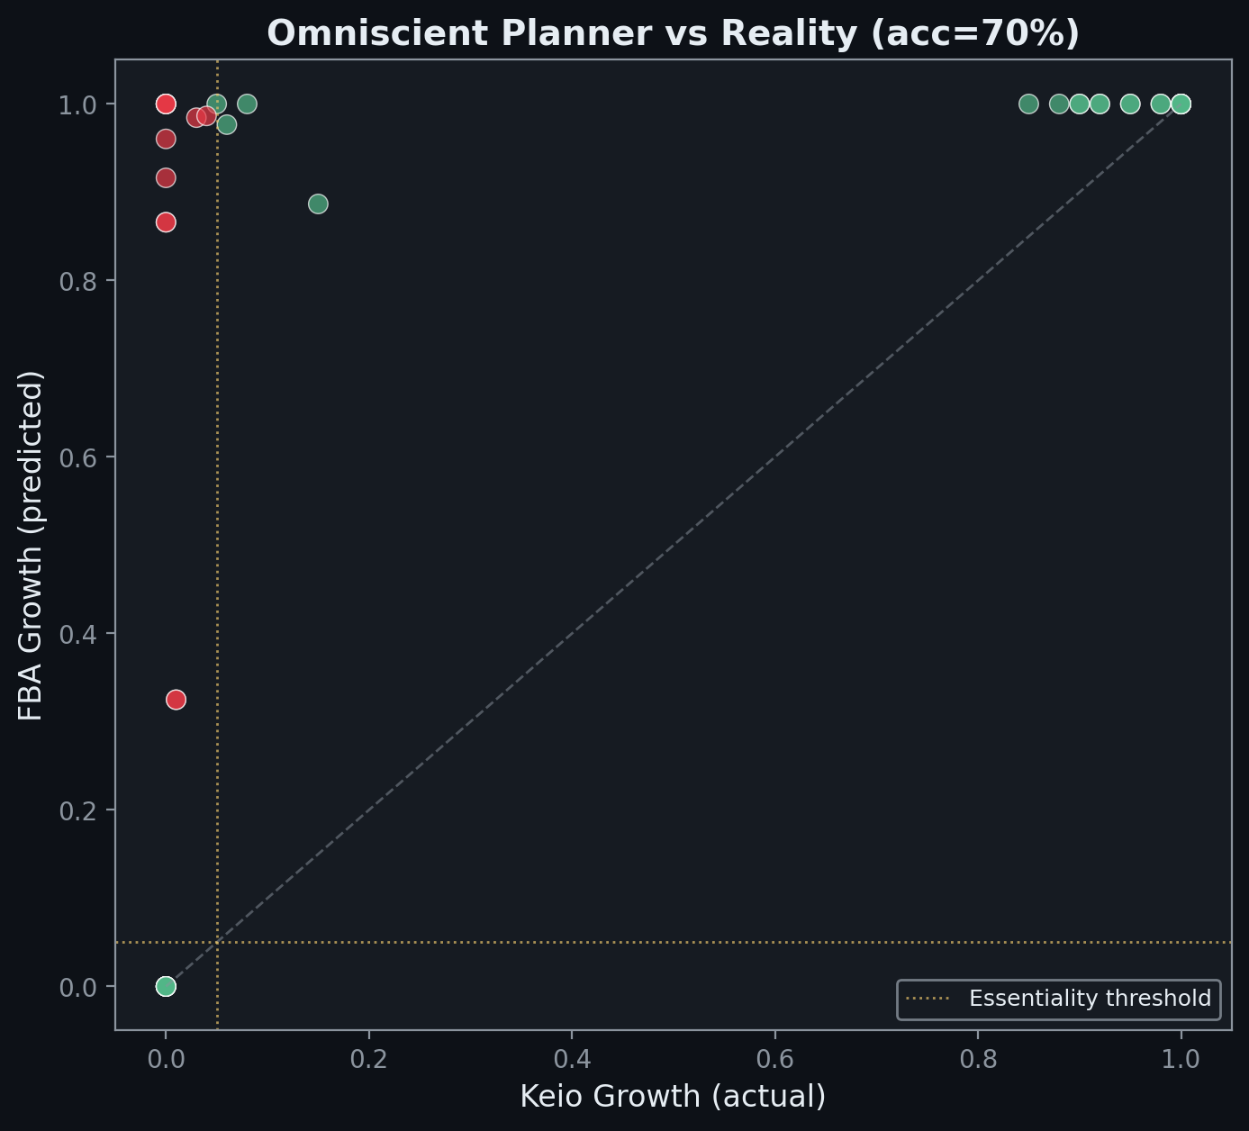
FBA vs Keio Collection — The Omniscient Planner Tested
• Each dot = one gene knockout (40 genes tested)
• X-axis = actual growth (Keio collection, Baba et al. 2006)
• Y-axis = FBA-predicted growth (iML1515, 2,712 reactions)
• Green = correct prediction, Red = planner failure
• 70% accuracy — the planner gets most right but NOT all
Notes:
Flux Balance Analysis (FBA) is the strongest possible central planner: it solves a linear program across all 2,712 reactions in E. coli's genome-scale metabolic model (iML1515, Monk et al. 2017) simultaneously, with perfect knowledge of every stoichiometric constraint. We compare its gene knockout predictions against the Keio collection — systematic single-gene deletions with measured growth rates (Baba et al. 2006). The planner achieves 70% accuracy: high, but not 100%. Each red dot is a gene where the omniscient planner fails — Mises was right that perfect economic calculation is impossible, even with complete information.

Slide 13
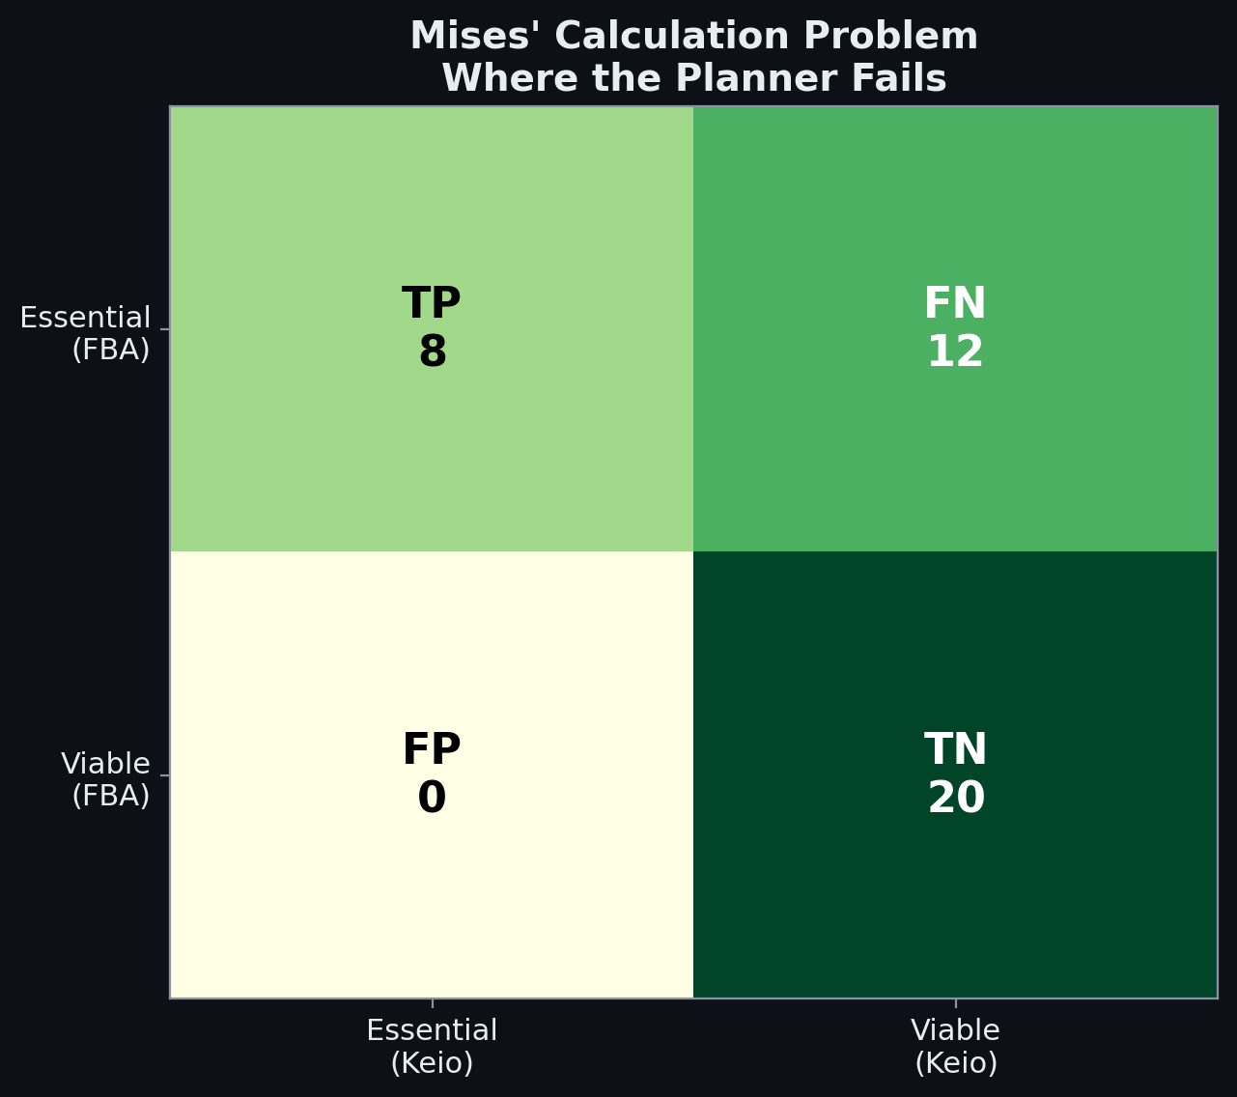
Mises' Calculation Problem — Where the Planner Fails
• TP: Both FBA and Keio agree the gene is essential
• TN: Both agree the gene is non-essential
• FN: FBA says 'viable' but cell dies — Hayek's local knowledge gap
• FP: FBA says 'essential' but cell reroutes — Kirzner's adaptation
• Each error type maps to a specific Austrian failure mode
Notes:
The confusion matrix reveals two distinct types of planner failure. False negatives (FN) = FBA predicts the cell will survive the knockout but it actually dies. These genes are essential because of REGULATORY requirements that the LP cannot encode — allosteric feedback, gene expression timing, protein folding dependencies. This is Hayek's knowledge problem: the planner has all the stoichiometric data but misses the local, tacit knowledge embedded in regulatory networks. False positives (FP) = FBA predicts essential but the cell reroutes through alternative pathways. This is Kirzner's entrepreneurial discovery: the cell finds solutions the planner didn't anticipate.

Slide 14
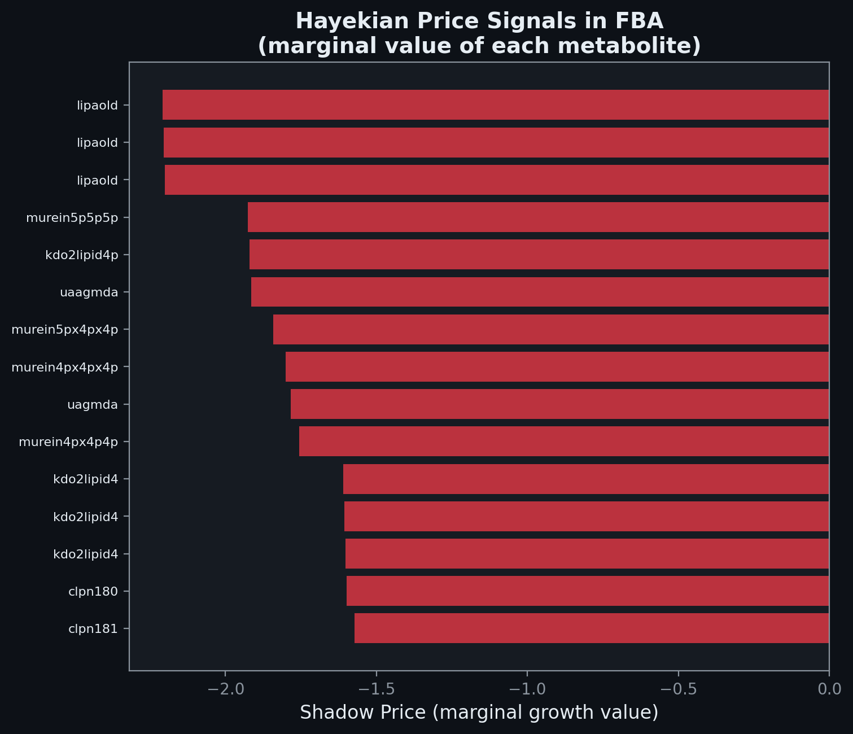
Hayekian Price Signals in FBA
• Shadow prices = dual variables = marginal value of each metabolite
• High shadow price = scarce and valuable (Menger's subjective value)
• Zero shadow price = abundant, not constraining (no economic profit)
• The irony: FBA MUST compute these prices to solve the optimization
• This proves Hayek's point that prices contain essential information
Notes:
Shadow prices are the dual variables of the linear program — they tell you how much one additional unit of each metabolite would increase the objective (growth rate). This IS the Hayekian price signal computed by the planner. Metabolites with high absolute shadow prices are the bottlenecks — scarce resources that limit growth. Metabolites with zero shadow prices are abundant and not constraining. The deep irony: FBA must compute these prices internally to solve its optimization. Hayek argued that market prices are essential because they compress dispersed information into a single signal. FBA proves his point: even an omniscient planner needs price signals to allocate resources.

Slide 15
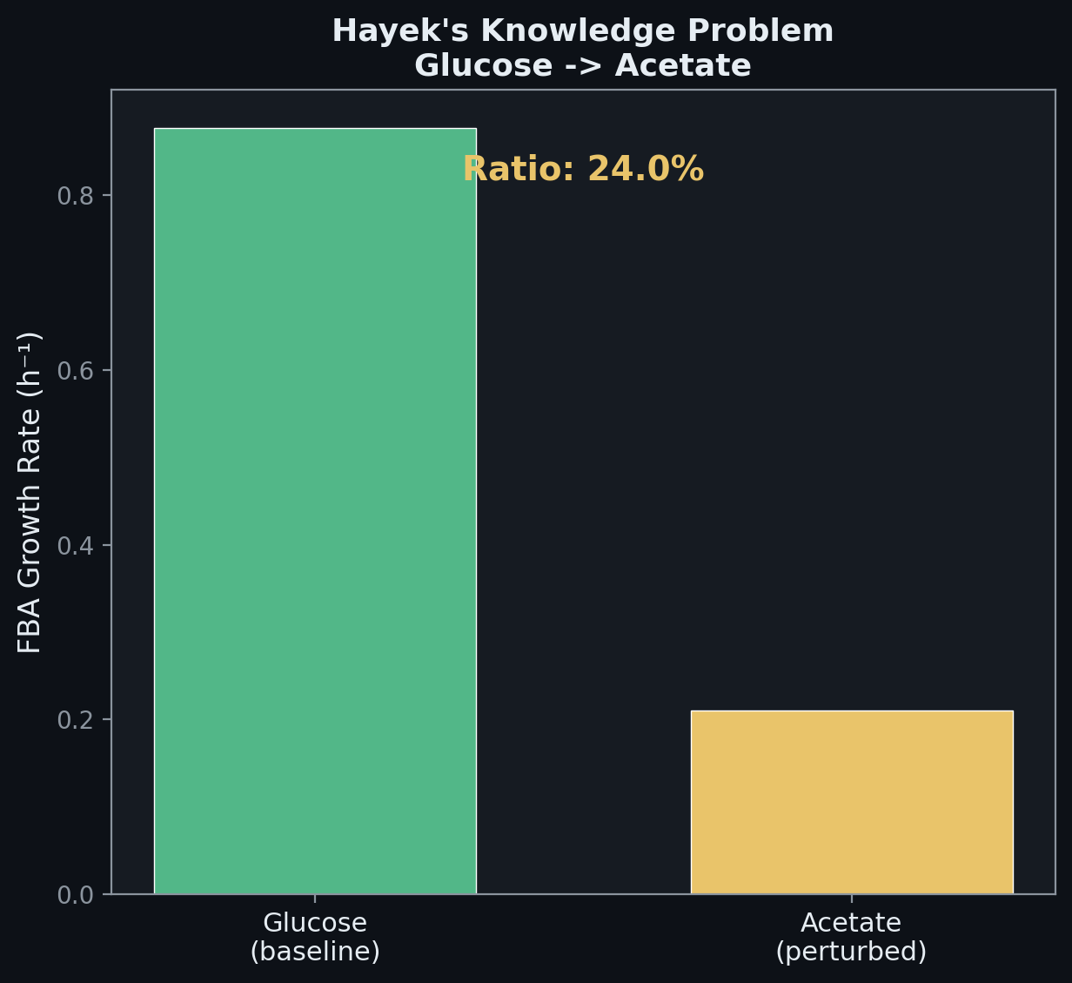
FBA Perturbation: Glucose to Acetate (Hayek)
• FBA instantly re-optimizes for the new carbon source
• Real E. coli shows a diauxic lag phase before switching
• Planner assumes instant knowledge; biology must DISCOVER the change
• Growth ratio: ~24% — massive efficiency drop on acetate
Notes:
When glucose is removed and acetate is provided as the sole carbon source, FBA instantly re-solves the LP and finds the optimal flux distribution for acetate metabolism. But real E. coli doesn't switch instantly — it undergoes a diauxic shift with a lag phase as it upregulates acetate utilization genes (aceA, aceB, acs) through the glyoxylate shunt. The planner assumes instant, perfect knowledge of the new environment. The cell must discover it through distributed sensing — CRP-cAMP signaling, inducer exclusion, catabolite repression. This IS Hayek's knowledge problem: the relevant information exists only in local context, not in any central database.

Slide 16
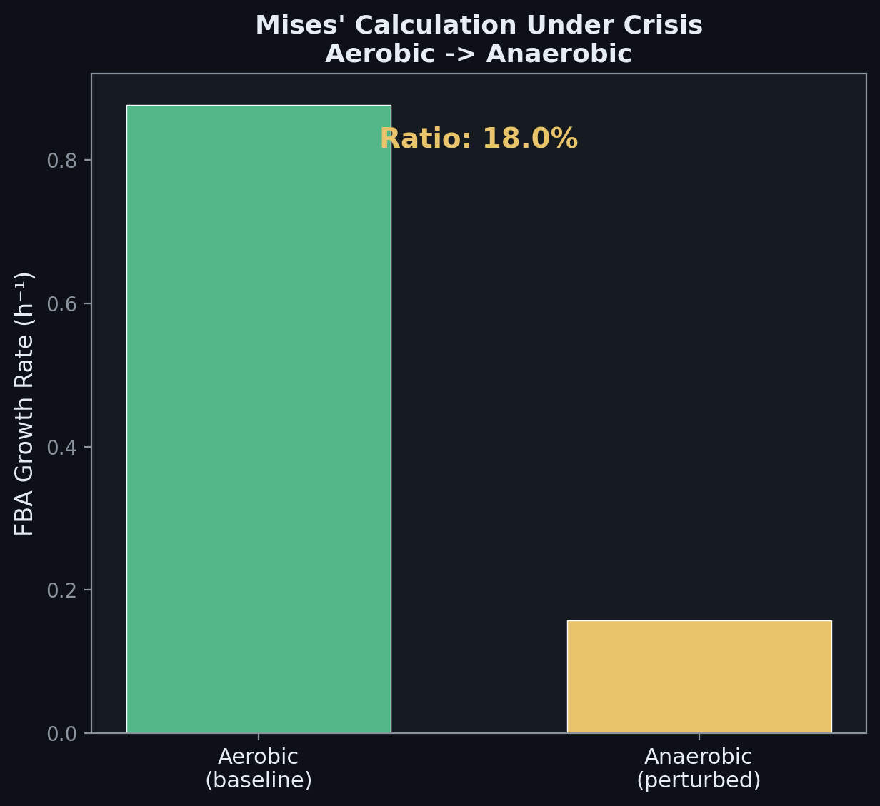
FBA Perturbation: Aerobic to Anaerobic (Mises)
• FBA re-solves the LP for anaerobic conditions
• Real E. coli uses ArcAB and FNR regulatory cascades
• The planner computes the answer; biology GROWS toward it
• Growth ratio: ~18% — fermentation is far less efficient
Notes:
When oxygen is removed, FBA re-optimizes and finds the best anaerobic flux distribution, routing carbon through fermentation pathways. Real E. coli uses the ArcAB two-component system and FNR regulon to sense oxygen levels and gradually shift gene expression. The planner computes the answer in one step; the cell's distributed regulatory network grows toward the new equilibrium through iterative local feedback. This tests Mises' calculation problem: can a central authority compute the optimal allocation as efficiently as a distributed system? FBA finds the optimum but misses the transition dynamics.

Slide 17
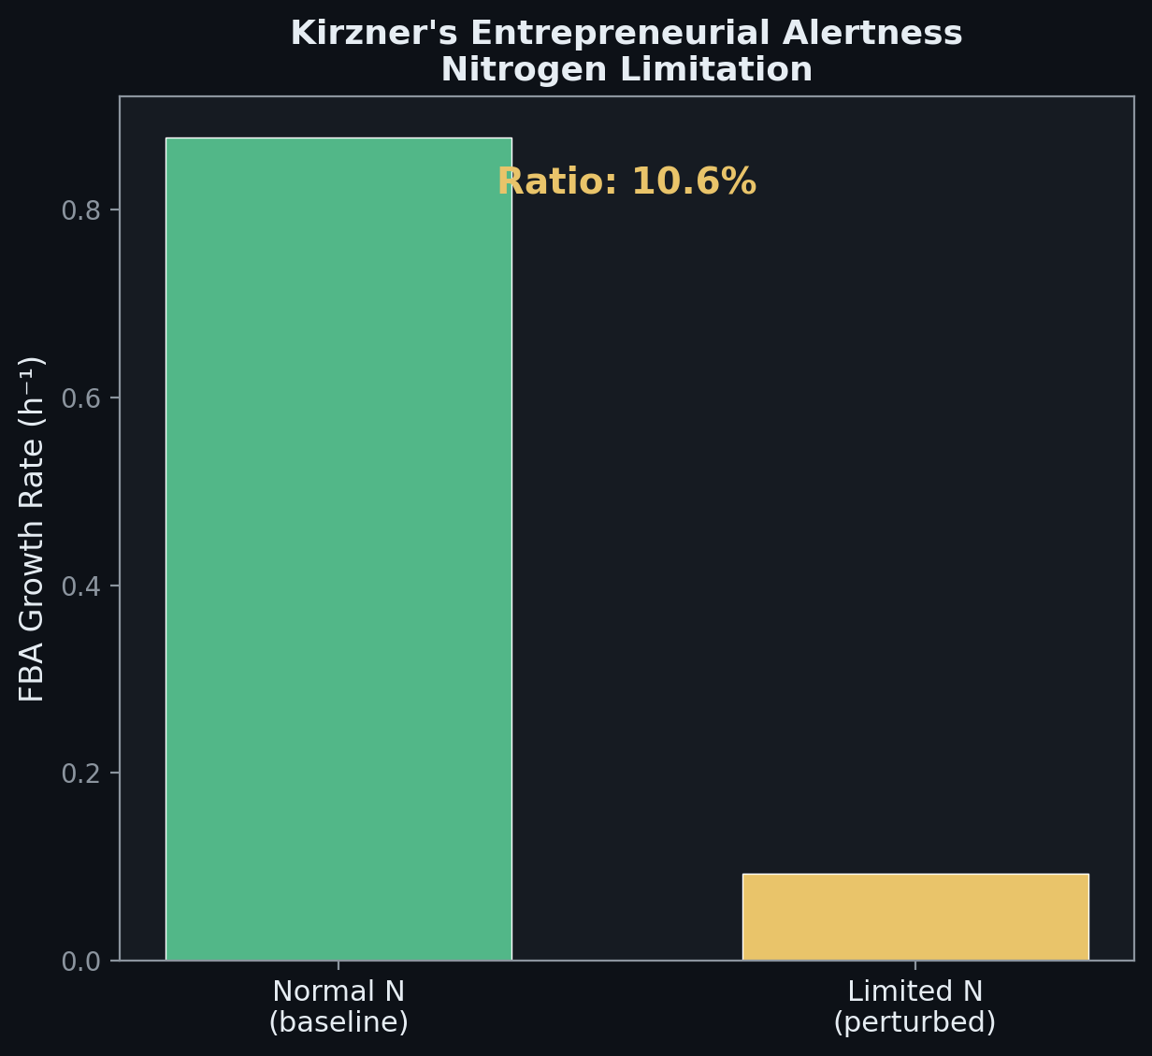
FBA Perturbation: Nitrogen Limitation (Kirzner)
• FBA predicts the new optimum under nitrogen scarcity
• Real E. coli upregulates high-affinity transporters via NtrBC
• Entrepreneurial alertness: discovering new routes to scarce resources
• Growth ratio: ~11% — nitrogen is critical
Notes:
Under severe nitrogen limitation (NH4 uptake reduced to -1 mmol/gDW/h), FBA predicts the optimal growth rate by redistributing flux. Real E. coli responds through the NtrBC two-component system, which senses nitrogen scarcity and upregulates high-affinity ammonium transporters and alternative nitrogen sources (amino acid catabolism, nitrogen scavenging). This is Kirzner's entrepreneurial alertness at the molecular level: the cell doesn't just optimize within existing pathways — it discovers and activates new routes that weren't being used before. FBA can't predict which alternative pathways will be activated because that depends on regulatory context.

Slide 18
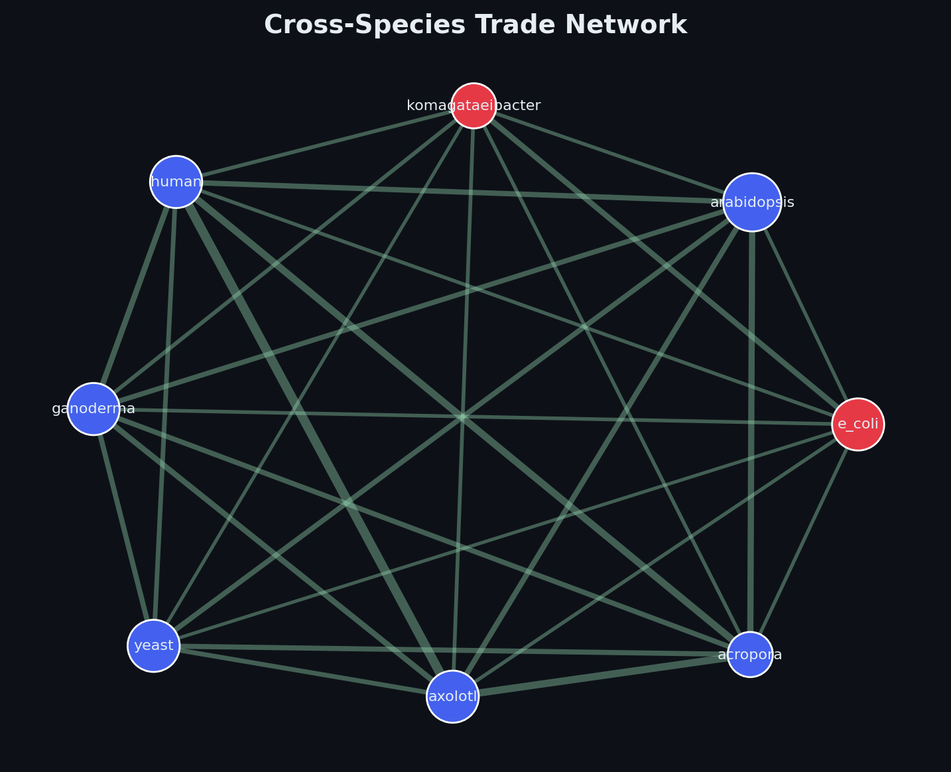
Cross-Species Trade Network
• 5-7 organisms connected by trade links (heterologous expression potential)
• Edge weight = trade ease (inverse of codon distance + regulatory barrier)
• Node color = kingdom (prokaryote, fungal, plant, animal)
• Closely related species trade more cheaply — Ricardian comparative advantage
Notes:
The cross-species trade network models gene transfer potential between organisms. Each edge is weighted by 'trade cost' — the sum of codon usage distance (RSCU-based), regulatory barrier (can the host process the gene's signals?), and compartment compatibility. Low trade cost = easy heterologous expression. High trade cost = the gene product will misfold, be mistranslated, or lack necessary chaperones. This maps directly to Ricardo's comparative advantage: organisms specialize in what they produce most efficiently and 'trade' genetic capabilities where the cost is lowest.

Slide 19
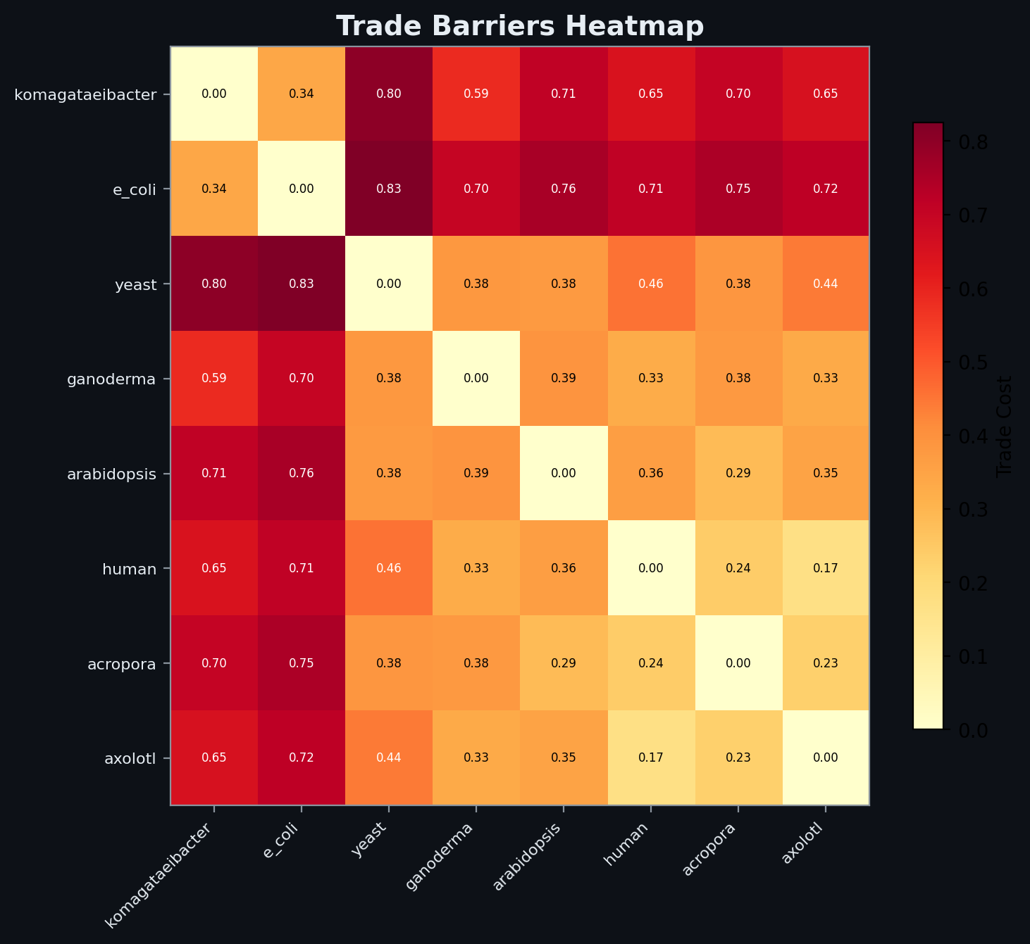
Trade Barriers Heatmap
• Each cell = trade cost between two organisms
• Low cost (yellow) = compatible expression systems
• High cost (red) = incompatible codon usage, missing chaperones
• Diagonal = zero (self-trade is free)
• Prokaryote-to-eukaryote has highest barriers
Notes:
The trade cost matrix quantifies the difficulty of expressing one organism's genes in another. It combines codon usage distance (RSCU), regulatory compatibility, and compartment barriers. The matrix is symmetric — the cost of E. coli expressing a yeast gene equals the cost of yeast expressing an E. coli gene (in this simplified model). Prokaryote-to-eukaryote transfers have the highest barriers: different ribosome structure, no intron processing, different post-translational modifications. Within-kingdom transfers are cheaper. This is the biological equivalent of trade barriers: tariffs, regulations, and infrastructure differences that increase the cost of exchange.

Slide 20
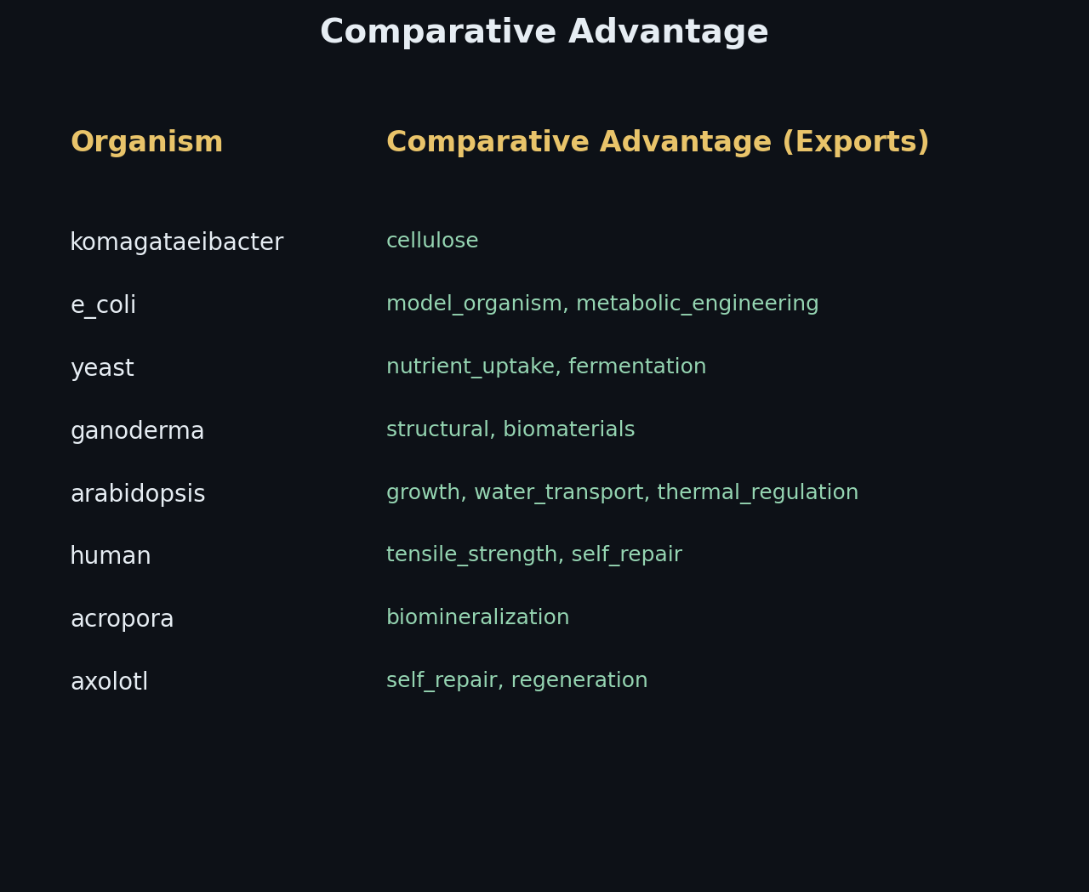
Comparative Advantage — Who Exports What
• Each organism specializes in specific molecular capabilities
• E. coli: protein expression, rapid growth, simple genetics
• Yeast: post-translational modification, secretion, eukaryotic folding
• Human cells: complex signaling, tissue-specific expression
• Specialization IS division of labor (Menger's spontaneous order)
Notes:
Each organism has evolved to specialize in specific molecular capabilities — not because a planner assigned roles, but because evolutionary pressure selected for efficiency in particular niches. E. coli is the 'factory worker' of molecular biology: fast growth, cheap protein production, simple genetics. Yeast handles eukaryotic complexity: glycosylation, disulfide bonds, secretion. Human cells do what nothing else can: tissue-specific expression, complex signaling cascades, mammalian post-translational modifications. This division of labor emerged spontaneously through billions of years of evolution — Menger's spontaneous order at the species level.

