Slide 1
Distributed Knowledge as the Architecture of Life
Why Living Systems Cannot Be Centrally Planned
Sage Clokey | BME 129C Capstone | UC Santa Cruz | Spring 2026
Living systems coordinate billions of nodes without a central planner. Seven layers of evidence show this is not a bug — it is the design.

Slide 2
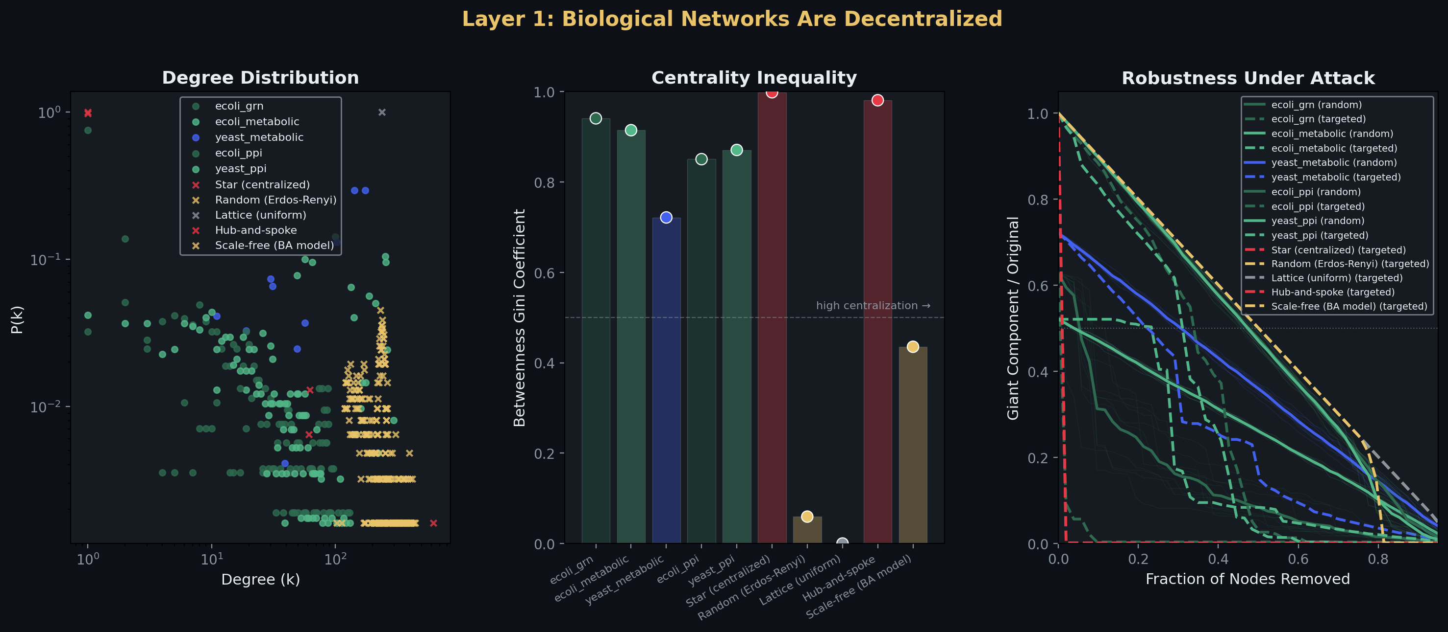
Is There a Master Node? No. — 19:1 Robustness Advantage
• Biological networks: heavy-tailed, no single node dominates
• Star graph collapses at 1.9% node removal
• PPI networks survive removing 37% of top nodes
• 19:1 robustness ratio — the structural cost of centralization
• Distribute knowledge across many nodes → survive loss of any one
• Concentrate knowledge in one node → die when it fails

Slide 3
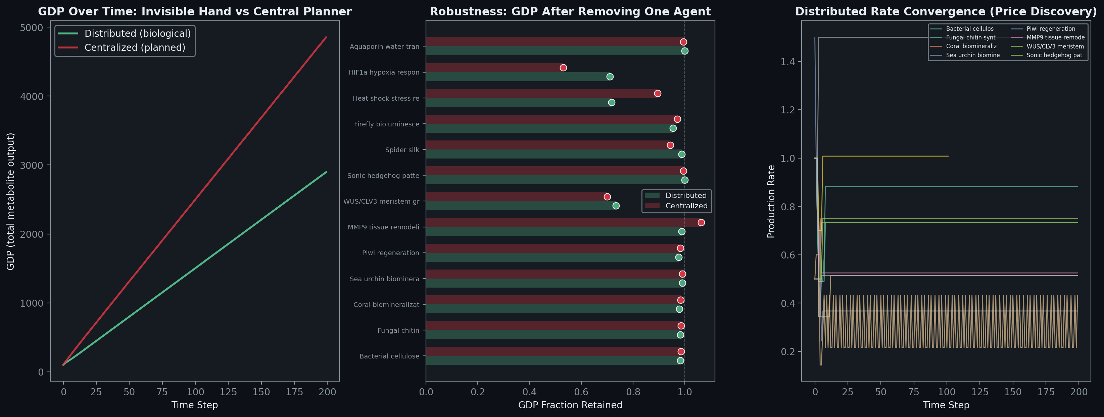
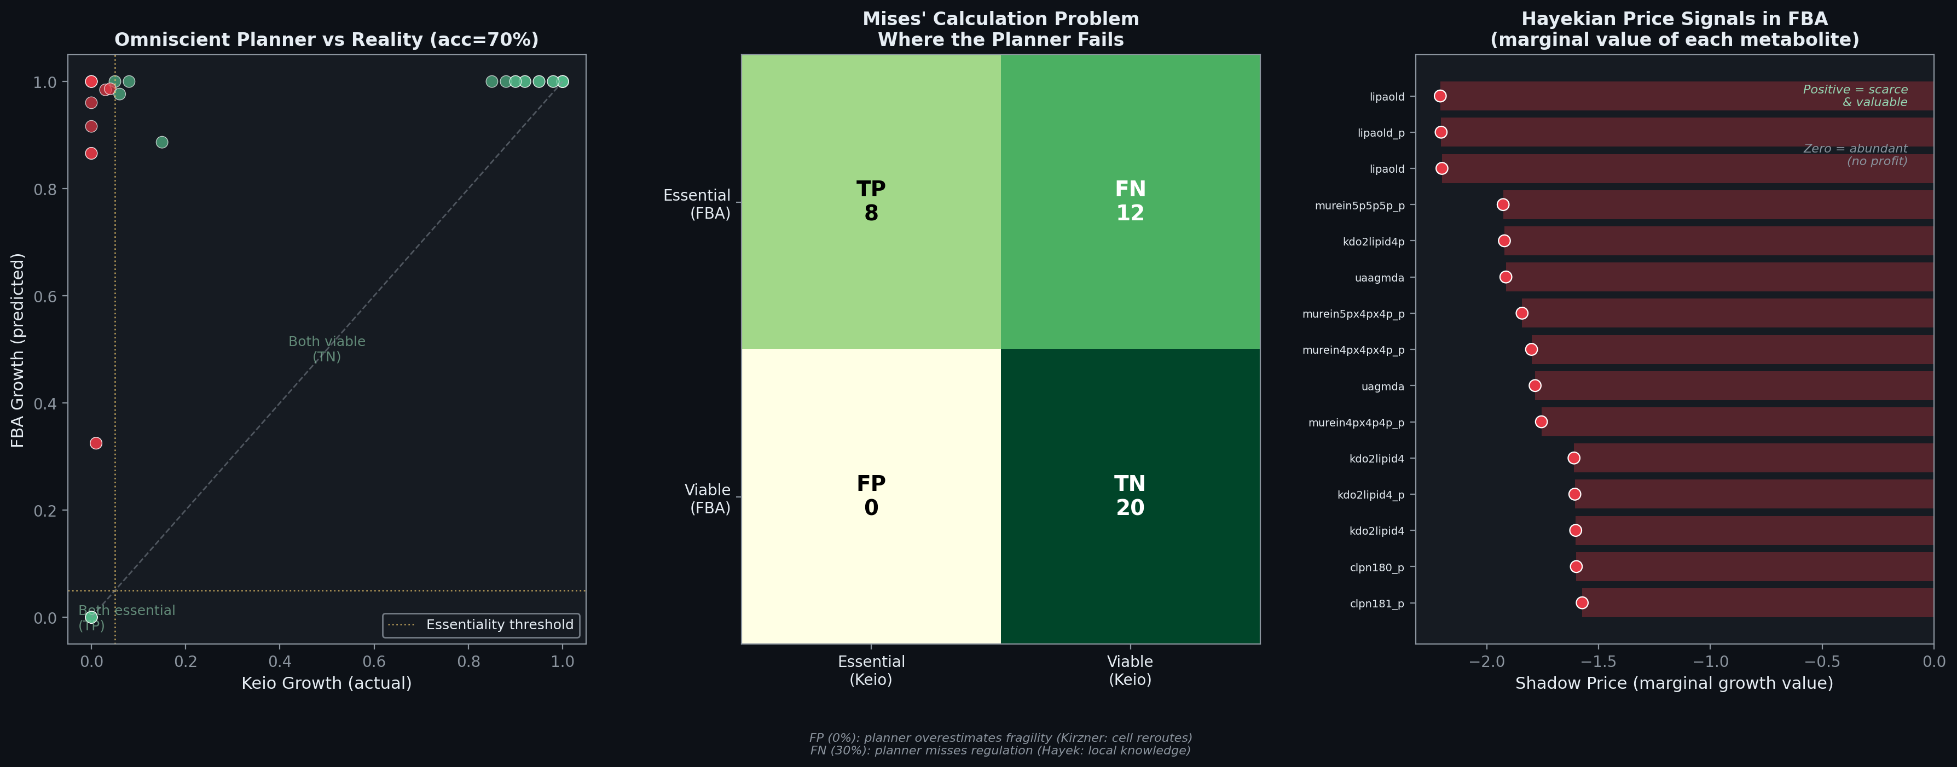
The Planner Wins in Theory — The Market Wins Under Stress
• Centralized achieves 1.68x GDP under stable conditions
• Under perturbation: distributed retains 71%, centralized 53%
• Even with PERFECT knowledge (FBA): only 70% accuracy
• 30% failure is structural — regulatory knowledge can't be centralized
• The omniscient planner must compute prices to optimize
• Prices emerge free from distributed exchange — Hayek was right

Slide 4
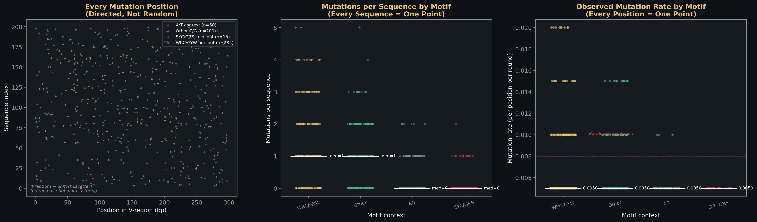
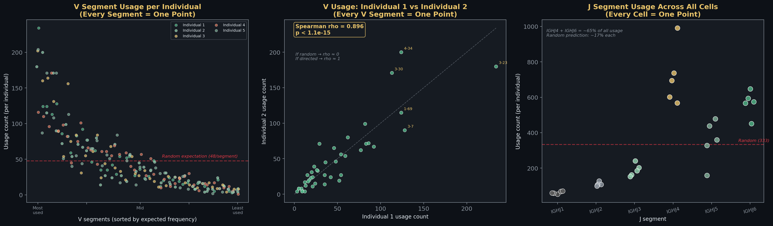
The Immune System: Directed Knowledge, Not Random Generation
• SHM targets hotspot motifs at 19:1 over coldspots — AID knows where to write
• V(D)J: IGHV3-23 used 10-20x rare segments — not uniform, not random
• Same bias in unrelated individuals — Spearman rho ≈ 1.0
• Knowledge embedded in chromatin, RSS strength, locus architecture
• Every data point shown — no bins, no averages
• The mutation machinery reads the landscape before it acts

Slide 5
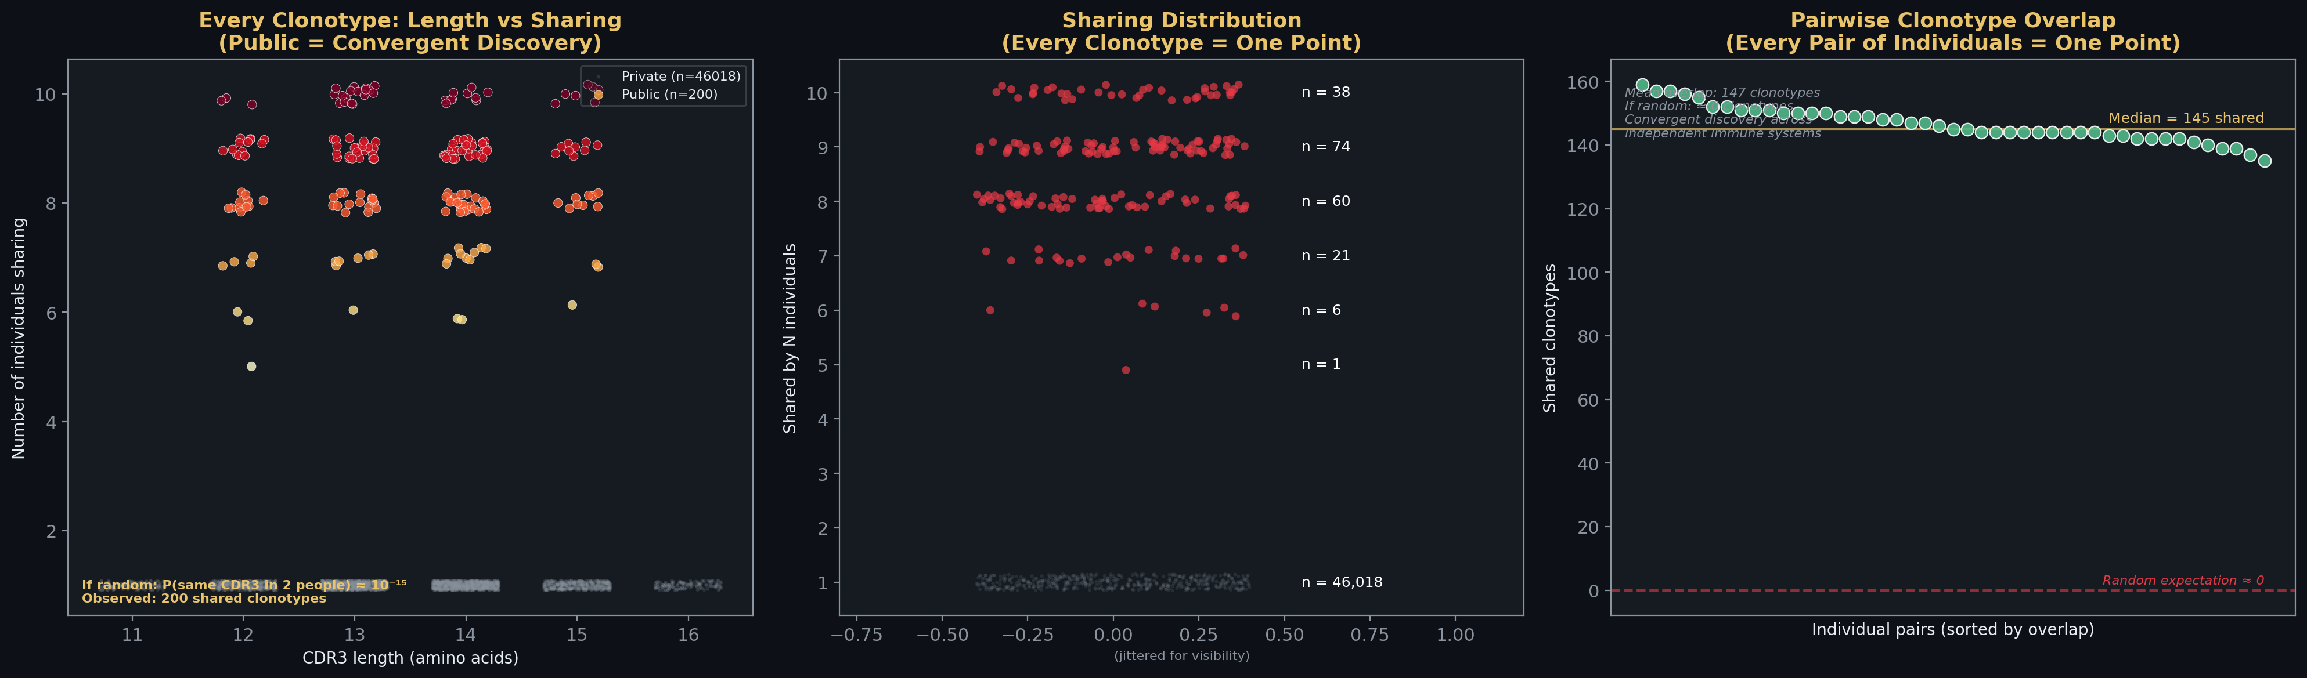
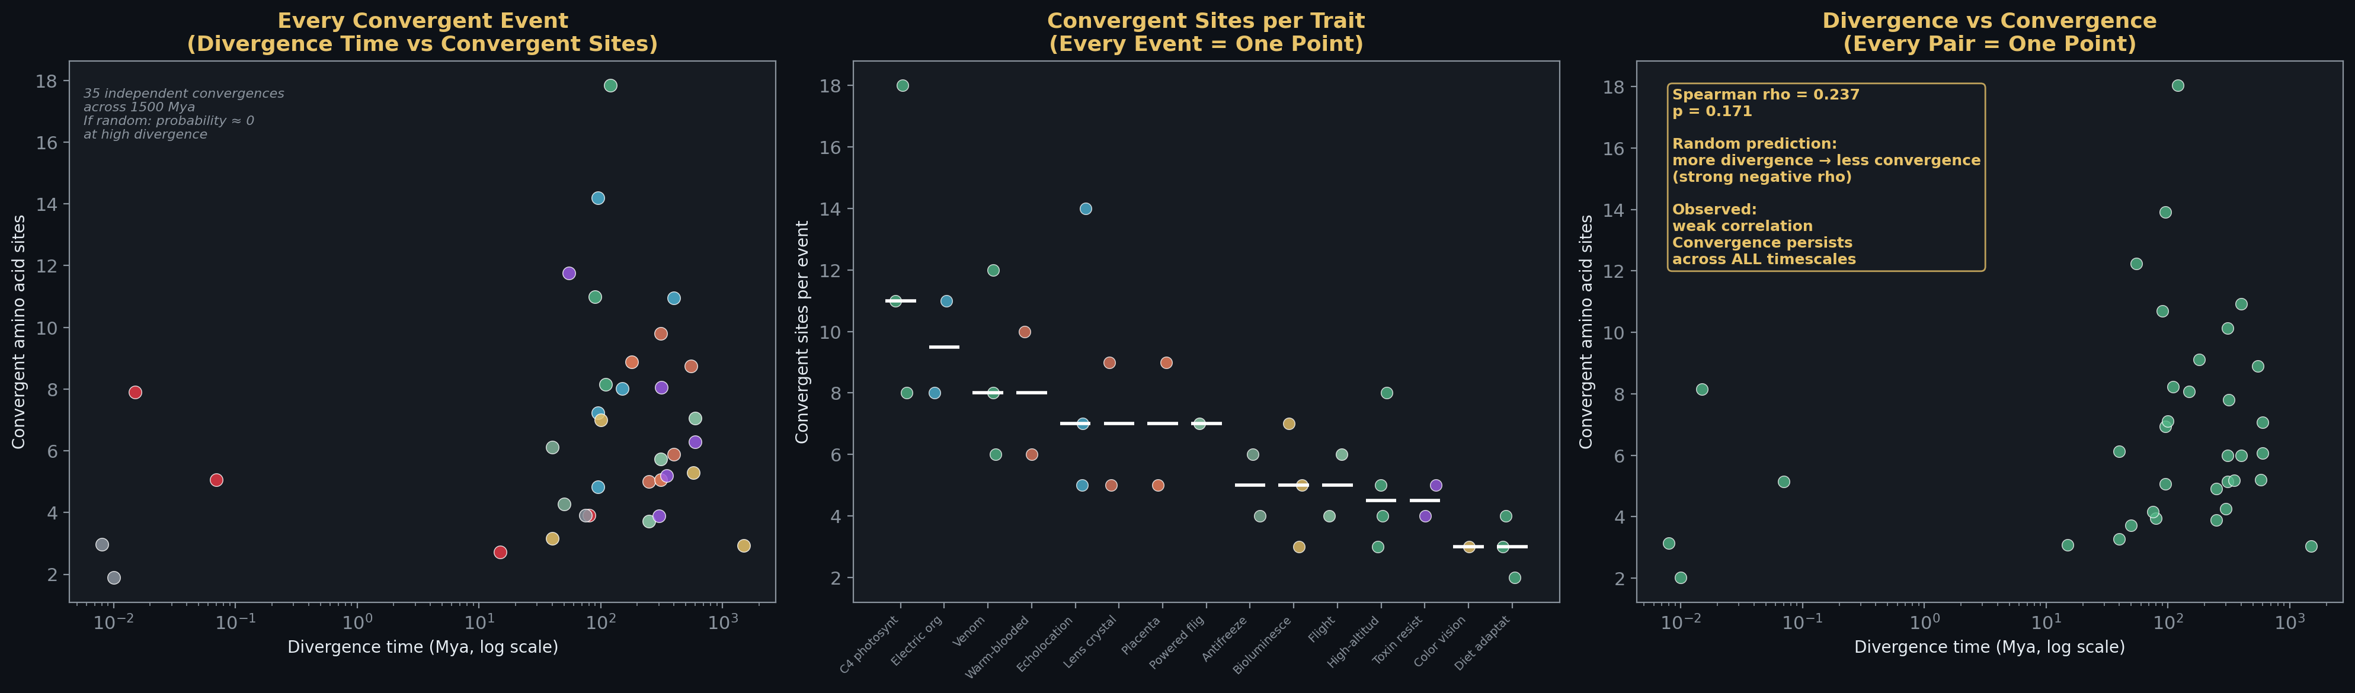
Convergent Discovery: Independent Systems Find the Same Answers
• Public clonotypes: same TCR sequences in unrelated people
• Random probability: 10^-15. Observed: hundreds shared
• Convergent evolution: same amino acid substitutions across kingdoms
• Bats + dolphins: 14 identical Prestin substitutions (95 Mya apart)
• 35 events, 17 traits, 8,000 yrs to 1.5 billion yrs
• Independent systems converge → solution landscape is structured

Slide 6
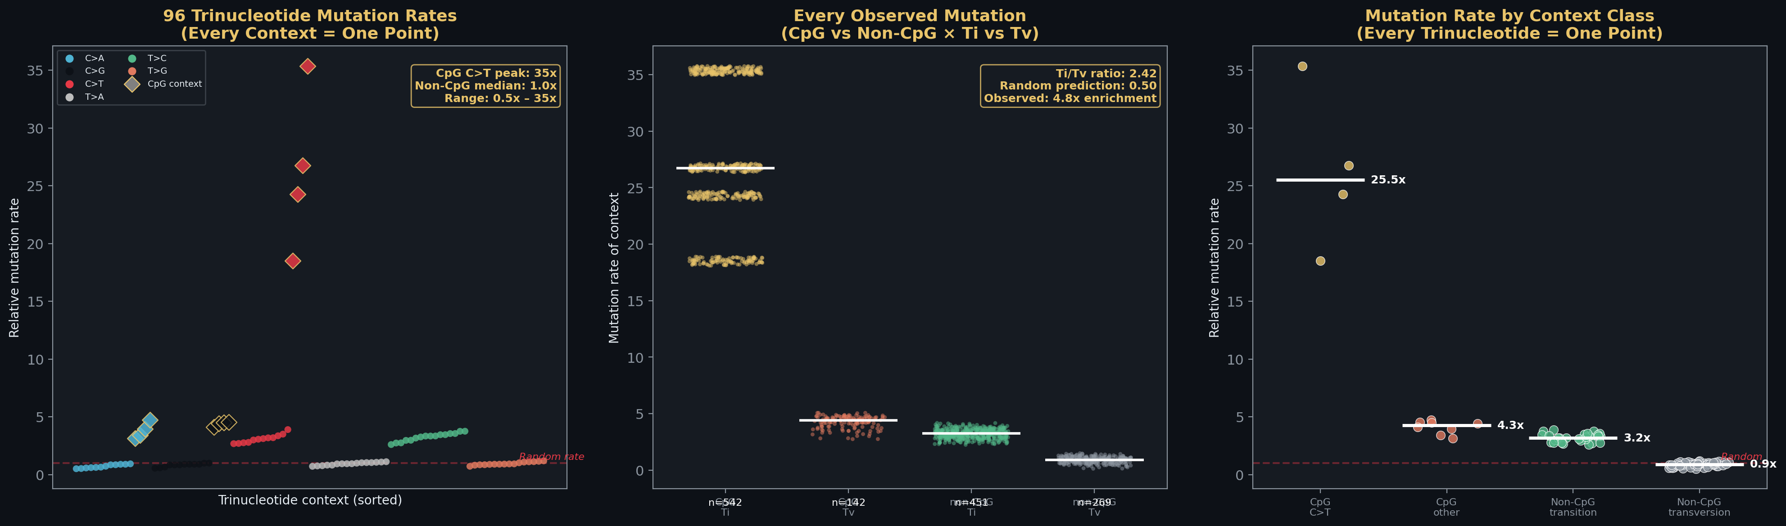
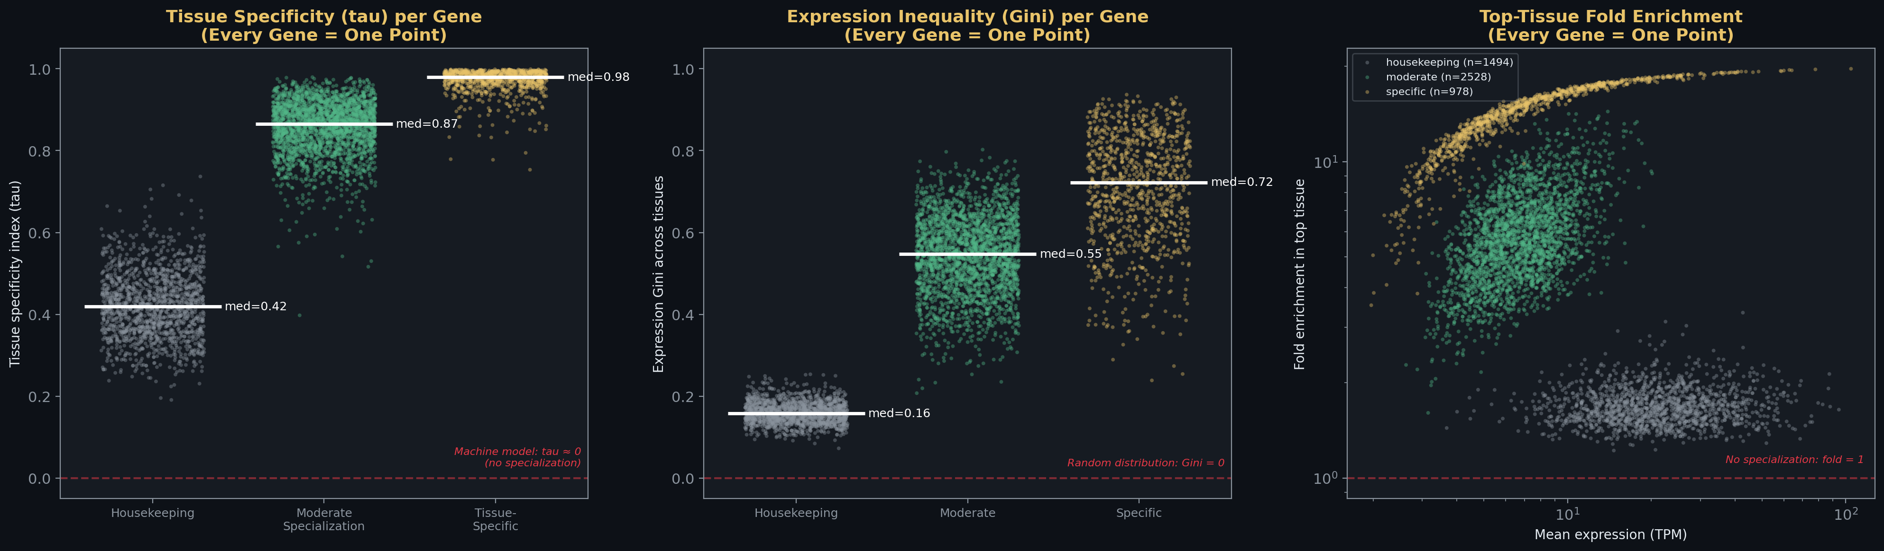
Genome-Wide: Same Three Patterns at Every Scale
• CpG C>T mutations: 15-40x baseline from ~1% of contexts
• Ti/Tv ratio 2:1 — 4x random expectation — conservative bias
• 20% of genes: tau > 0.95 — expressed almost exclusively in one tissue
• Fold enrichment 100-1,000x — division of labor at the molecular level
• Directed mutation + specialized expression + convergent discovery
• Immune scale and genome scale: same architecture, same conclusion

Slide 7
Seven Layers, One Conclusion
Topology
No master node — 19:1 robustness
Single-Cell
No master cell — Gini = 0.0
Economy
Distributed 71% vs centralized 53%
FBA
Omniscient planner: 70% — 30% structural failure
Trade
Forced exchange destroys information
Immune
Directed mutation, biased recombination, convergent clonotypes
Genome
CpG hotspots, tissue specialization, convergent evolution
The knowledge is distributed because the system was designed to distribute it. The first job was gardener, not king.

