Slide 1
Living Systems as Decentralized Economies
Progress Report — BME 129C Capstone
Sage Clokey | Spring 2026 | Advisor: R. Dubois
Notes:
Title slide. This is a solo project — no group members.
The central question: are living systems literally decentralized economies? Not as metaphor — as measurable, quantifiable, structurally equivalent systems. I'm using biological data at three scales to test whether Austrian economic principles (Hayek, Mises, Menger, Rothbard, Kirzner) describe molecular biology.
The title comes from Hayek's The Fatal Conceit (1988): 'The curious task of economics is to demonstrate to men how little they really know about what they imagine they can design.' This project applies that insight to the most ancient economy: the cell.

Slide 2
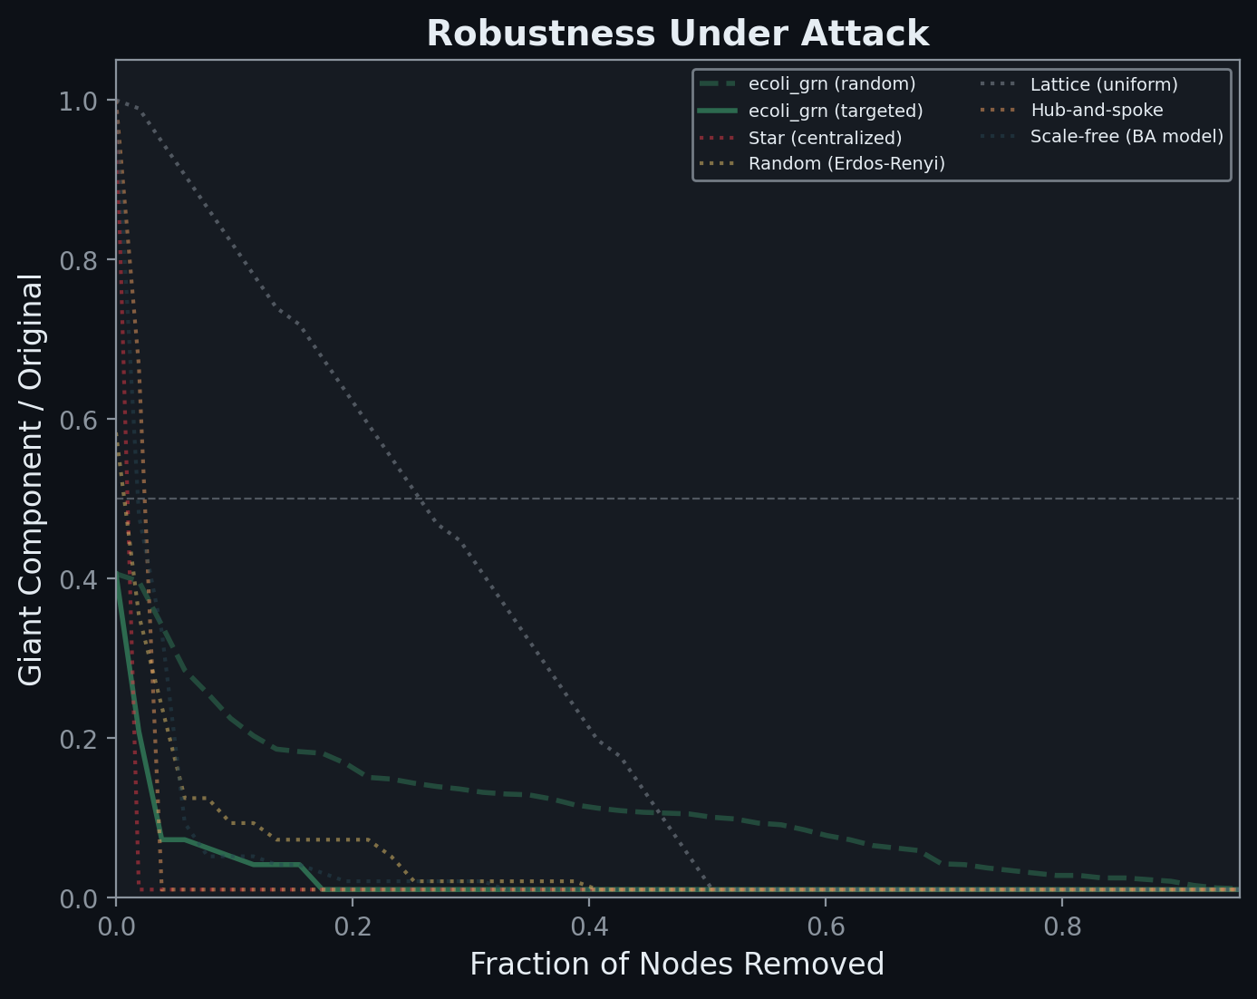
Goal & Approach
• Thesis: living systems operate as decentralized economies
Not metaphor — measurable, testable
• Hayek's Fatal Conceit (1988): you can't
redesign what evolved spontaneously
• Three layers of evidence:
L1: Network topology
L2: Economic modeling + FBA
L3: Cross-species trade
Does distributed coordination outperform central planning?
Notes:
GOAL (30 seconds):
My thesis is that living systems — from gene regulatory networks inside a single bacterium to cross-species symbioses — operate as decentralized economies. Not as a metaphor, but as measurable, structurally equivalent systems.
I'm grounding this in Austrian economics — Hayek's knowledge problem, Mises' calculation problem, Menger's spontaneous order. Hayek's final book, The Fatal Conceit (1988), names the error directly: the belief that human reason can redesign evolved order. His 'curious task of economics' line — showing men how little they know about what they imagine they can design — is the thesis of this project applied to molecular biology.
Layer 1 looks at network structure. Layer 2 models metabolic pathways as economic agents. Layer 3 maps gene transferability as a trade network.
The core question: does the decentralized architecture outperform centralized alternatives — and is this testable with real data?

Slide 3
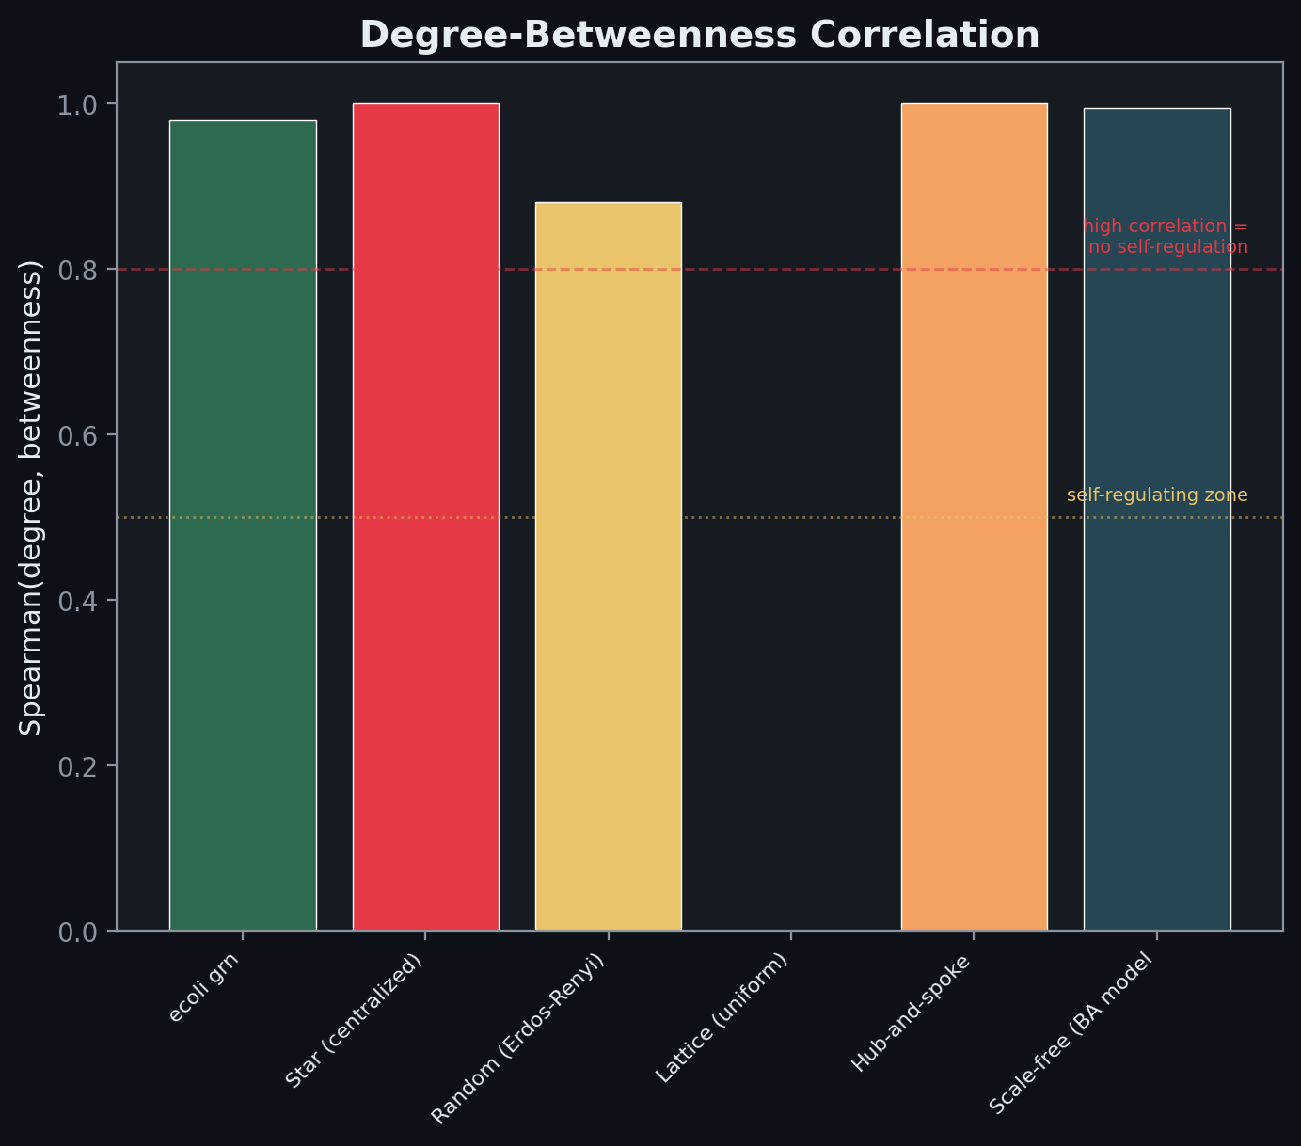
Accomplished: Network Topology & Single-Cell Economy
• Layer 1 — No Master Node:
5 bio networks vs 5 reference architectures
19:1 robustness ratio under targeted attack
Feed-forward loops = Hayekian price signals
WBPA: biology resists centralization
•
• Layer 1b — Cells as Economic Agents:
2,638 PBMCs, 8 cell types (scRNA-seq)
Communication Gini = 0.0 — no gatekeeper
75% communication survives any removal
Notes:
ACCOMPLISHMENTS — LAYERS 1 & 1b (30 seconds):
Layer 1 is fully complete. I pulled real gene regulatory networks from RegulonDB, metabolic networks from KEGG, and protein interaction networks from STRING. I compared them against five reference architectures — star graph, random, lattice, hub-and-spoke, and Barabasi-Albert.
Key finding: biological networks show a 19-to-1 robustness advantage over centralized architectures under targeted attack. The star graph collapses after removing 2% of nodes; biological PPI networks survive removing 37%.
I also did motif analysis following Alon 2002 — the feed-forward loop is massively over-represented, which I interpret as a Hayekian price signal motif. And self-regulation analysis following Topirceanu 2018 shows biological networks actively resist centralization through a betweenness-preferential attachment mechanism.
Layer 1b analyzed single-cell RNA-seq data from human PBMCs — 2,638 cells, 8 cell types. The betweenness Gini of the communication network is 0.0 — perfectly distributed, no master cell. And removing any single cell type still leaves 75% of communication intact.

Slide 4
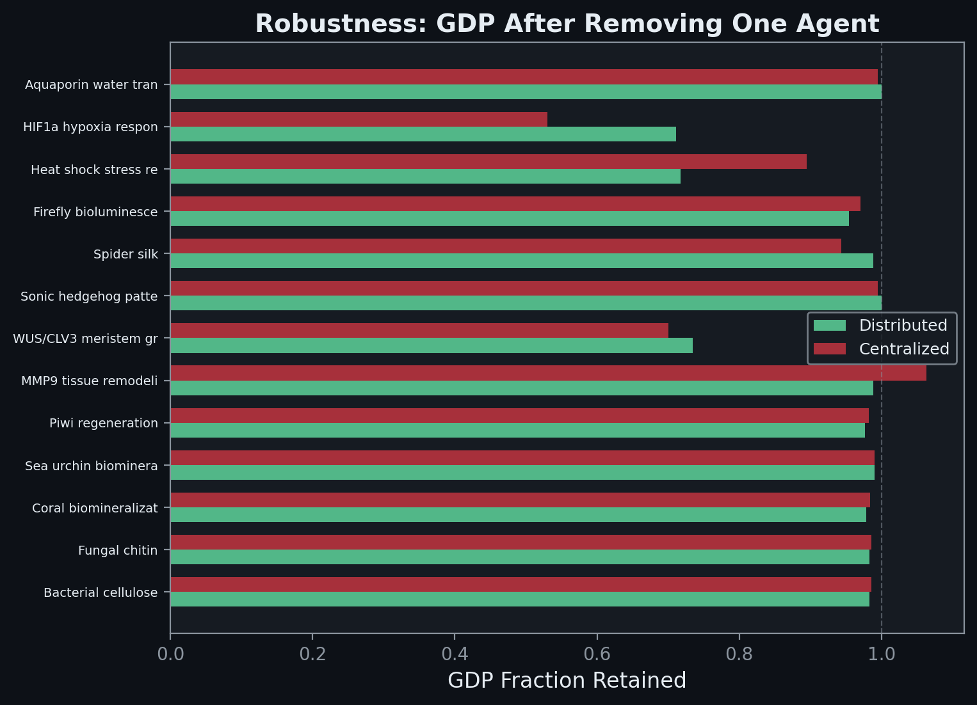
Accomplished: Economic Modeling & Trade Network
• Layer 2 — Pathways as Agents:
13 pathways with ATP budgets
Distributed: 2.9x lower GDP variance
4 perturbation tests (Hayek, Mises, Kirzner)
•
• Layer 3 — Cross-Species Trade:
Codon usage distance = trade friction
18 published transfers validated
Trade blocs emerge spontaneously
Notes:
ACCOMPLISHMENTS — LAYERS 2 & 3 (30 seconds):
Layer 2 models 13 metabolic pathways from my genome design system as economic agents. Each has inputs, outputs, and an ATP budget. I simulate distributed allocation — where each agent adjusts based on local metabolite concentrations — versus centralized allocation, where a planner assigns rates.
The distributed regime shows 2.9x lower GDP variance and retains 71% of output under perturbation versus 53% for the planner. I also built a smart planner with real-time metabolite pool access — Mises' strongest opponent — and it still fails under perturbation.
The perturbation suite tests four specific Austrian predictions: substrate shock tests Hayek's knowledge problem, ATP crisis tests Mises' calculation problem, and two Kirzner tests for entrepreneurial discovery and alertness.
Layer 3 maps gene transferability across species as a trade network. Codon distance is trade friction. I validated against 18 real published gene transfers — GFP, insulin, silk fibroin — and lower trade cost correlates with higher success. Trade blocs emerge spontaneously from the compatibility data.

Slide 5
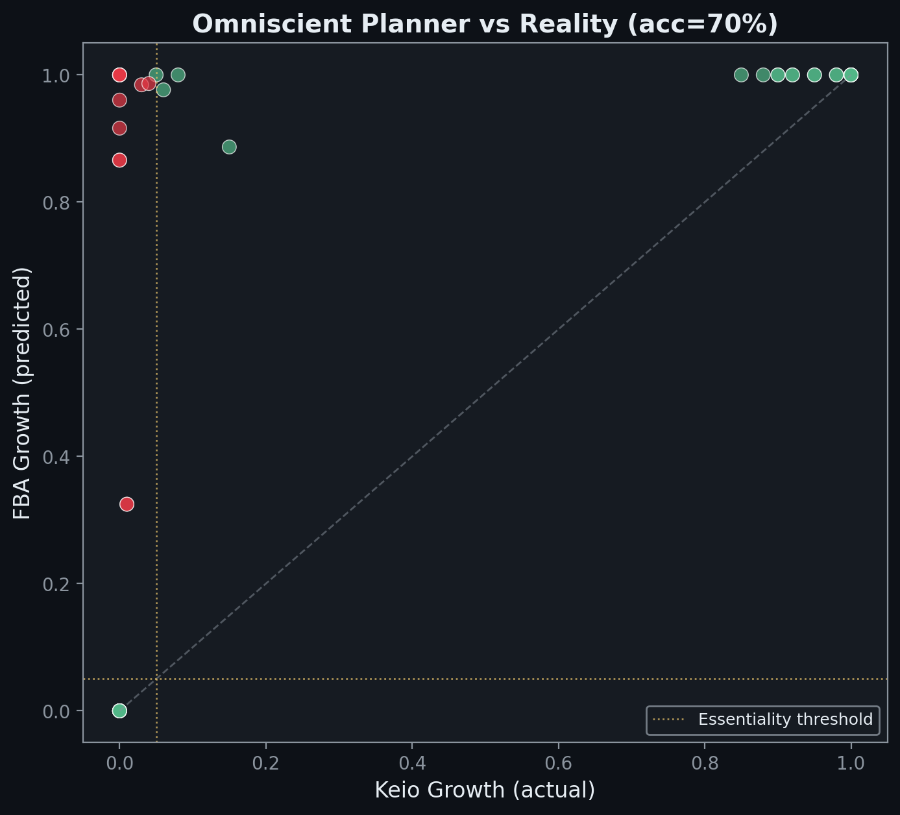
This Week: FBA — The Omniscient Planner vs Reality
• Flux Balance Analysis with iML1515:
2,712 reactions, 1,877 metabolites, 1,516 genes
FBA = strongest possible central planner
•
• Knockout predictions vs Keio collection:
70% accuracy — planner fails on 12 genes
False negatives = Hayek's knowledge gap
•
• Shadow prices = Hayekian price signals
FBA must compute prices to solve
Notes:
THIS WEEK — FBA (45 seconds):
The biggest addition this week is Flux Balance Analysis using the iML1515 genome-scale model of E. coli. This is the strongest possible central planner: a linear program that simultaneously optimizes across all 2,712 reactions with perfect knowledge of every stoichiometric constraint.
I compared its gene knockout predictions against the Keio collection — systematic single-gene deletions with measured growth phenotypes. The planner achieves 70% accuracy. That's good but not perfect.
The failures are the interesting part. 12 false negatives — genes where FBA says the cell will survive the knockout but it actually dies. These are genes that are essential because of REGULATORY requirements that the linear program can't encode — allosteric feedback, protein folding dependencies, gene expression timing. This is exactly Hayek's knowledge problem: the planner has all the stoichiometric data but misses the local, tacit knowledge.
I also extracted shadow prices — the dual variables of the LP. These ARE Hayekian price signals. The irony is that FBA must compute these prices internally to solve its optimization, which proves Hayek's point that prices contain essential information.

Slide 6
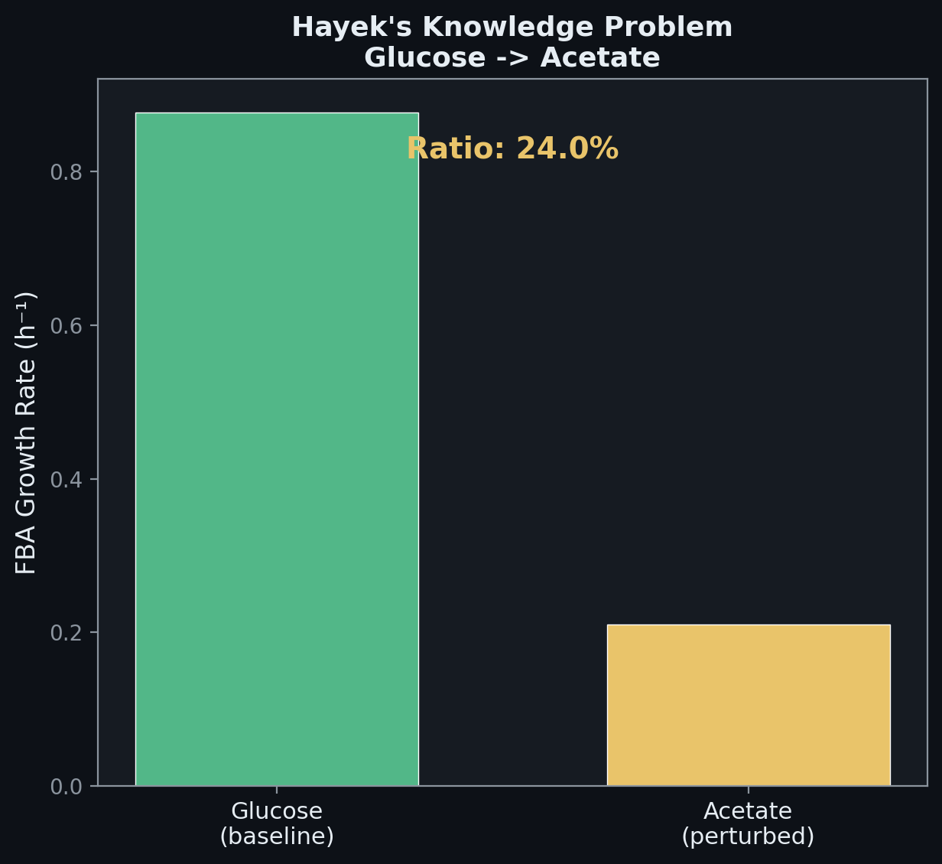
This Week: FBA Perturbation & Methods
• FBA perturbation analysis:
Glucose->Acetate: 24% growth (Hayek)
Aerobic->Anaerobic: 18% growth (Mises)
Nitrogen limitation: 11% growth (Kirzner)
•
• Planner re-solves instantly;
• biology must discover via local feedback
•
• Methods section written (docx, Arial 11pt)
9 subsections, all accession numbers
Data Availability: GitHub + public DBs
Notes:
THIS WEEK — FIGURES & METHODS (45 seconds):
I also split all the multi-panel figures into individual PNGs — 21 separate figures, each one graph. This makes the presentation much cleaner.
The FBA perturbation analysis tests three environmental shifts. When I switch the carbon source from glucose to acetate, FBA instantly re-optimizes — but real E. coli shows a diauxic lag phase. The planner assumes instant knowledge; biology has to discover the change through distributed sensing. Same pattern for anaerobic growth and nitrogen limitation — FBA computes the optimal answer in one step, but the cell's distributed regulatory network grows toward it through iterative local feedback.
I wrote the methods section as a formal document — Arial 11pt, single-spaced, 9 subsections covering every database, accession number, and analytical method. Includes a table of all databases with URLs and accession numbers, and a Data Availability section pointing to GitHub.
Everything is automated — one command generates all figures and the PowerPoint.

Slide 7
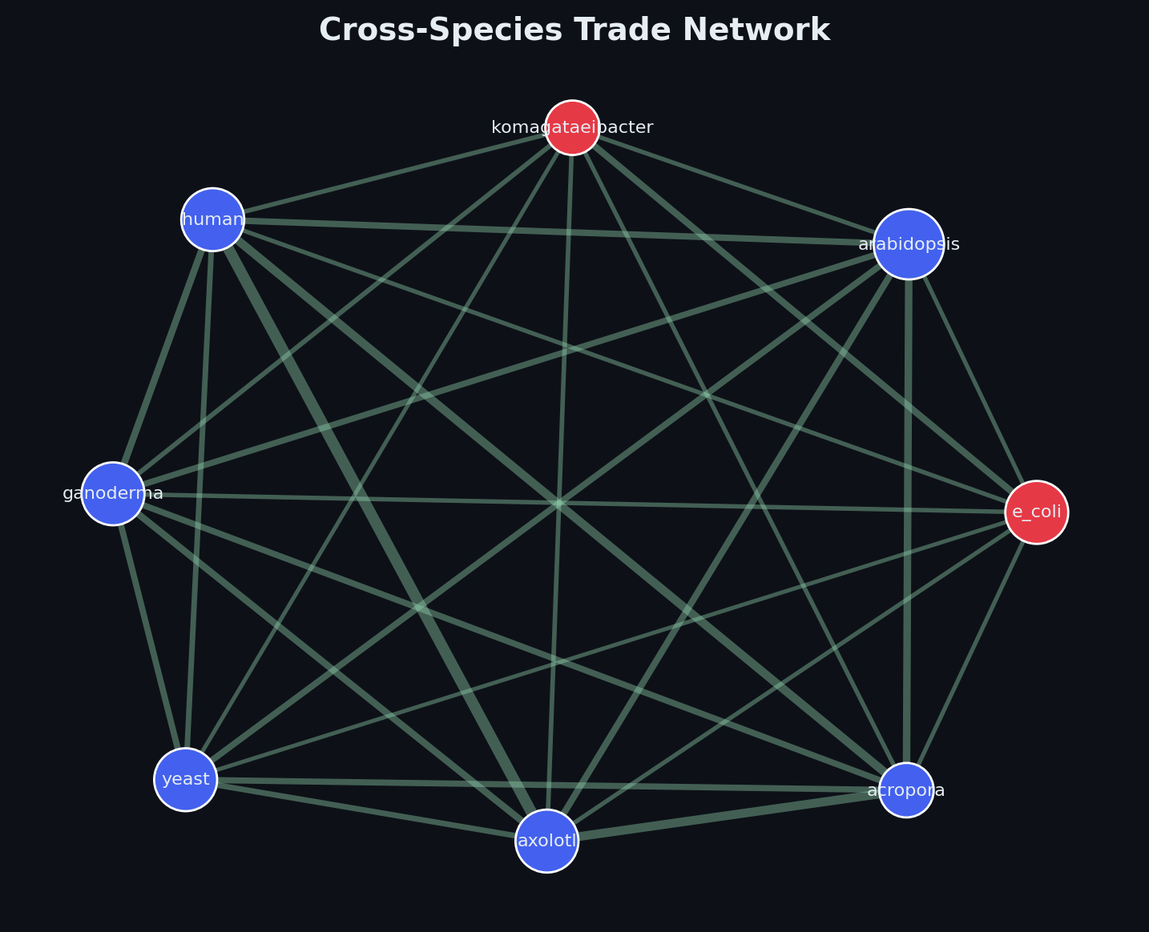
Next Steps
• Run full pipeline with live API data
Full RegulonDB, KEGG, STRING networks
1,000 randomizations for motif analysis
•
• Finalize paper with FBA results
Shadow prices + conditional essentiality
•
• Statistical rigor:
Mann-Whitney U, bootstrap CIs
•
• Polish figures for final poster
Notes:
NEXT STEPS:
Run the full pipeline with live API data instead of the built-in quick-mode data. This means pulling the full RegulonDB network, all KEGG pathways, and STRING PPI networks. The motif analysis will use 1,000 randomizations instead of 100.
Finalize the paper text — the FBA results need to be integrated into the Results and Discussion sections. The shadow price analysis and conditional essentiality data add a whole new dimension to the Austrian argument.
Add proper statistical tests — Mann-Whitney U for comparing distributed vs centralized GDP distributions, bootstrap confidence intervals on robustness metrics.
And polish the figures for the final poster and presentation.

