Slide 1
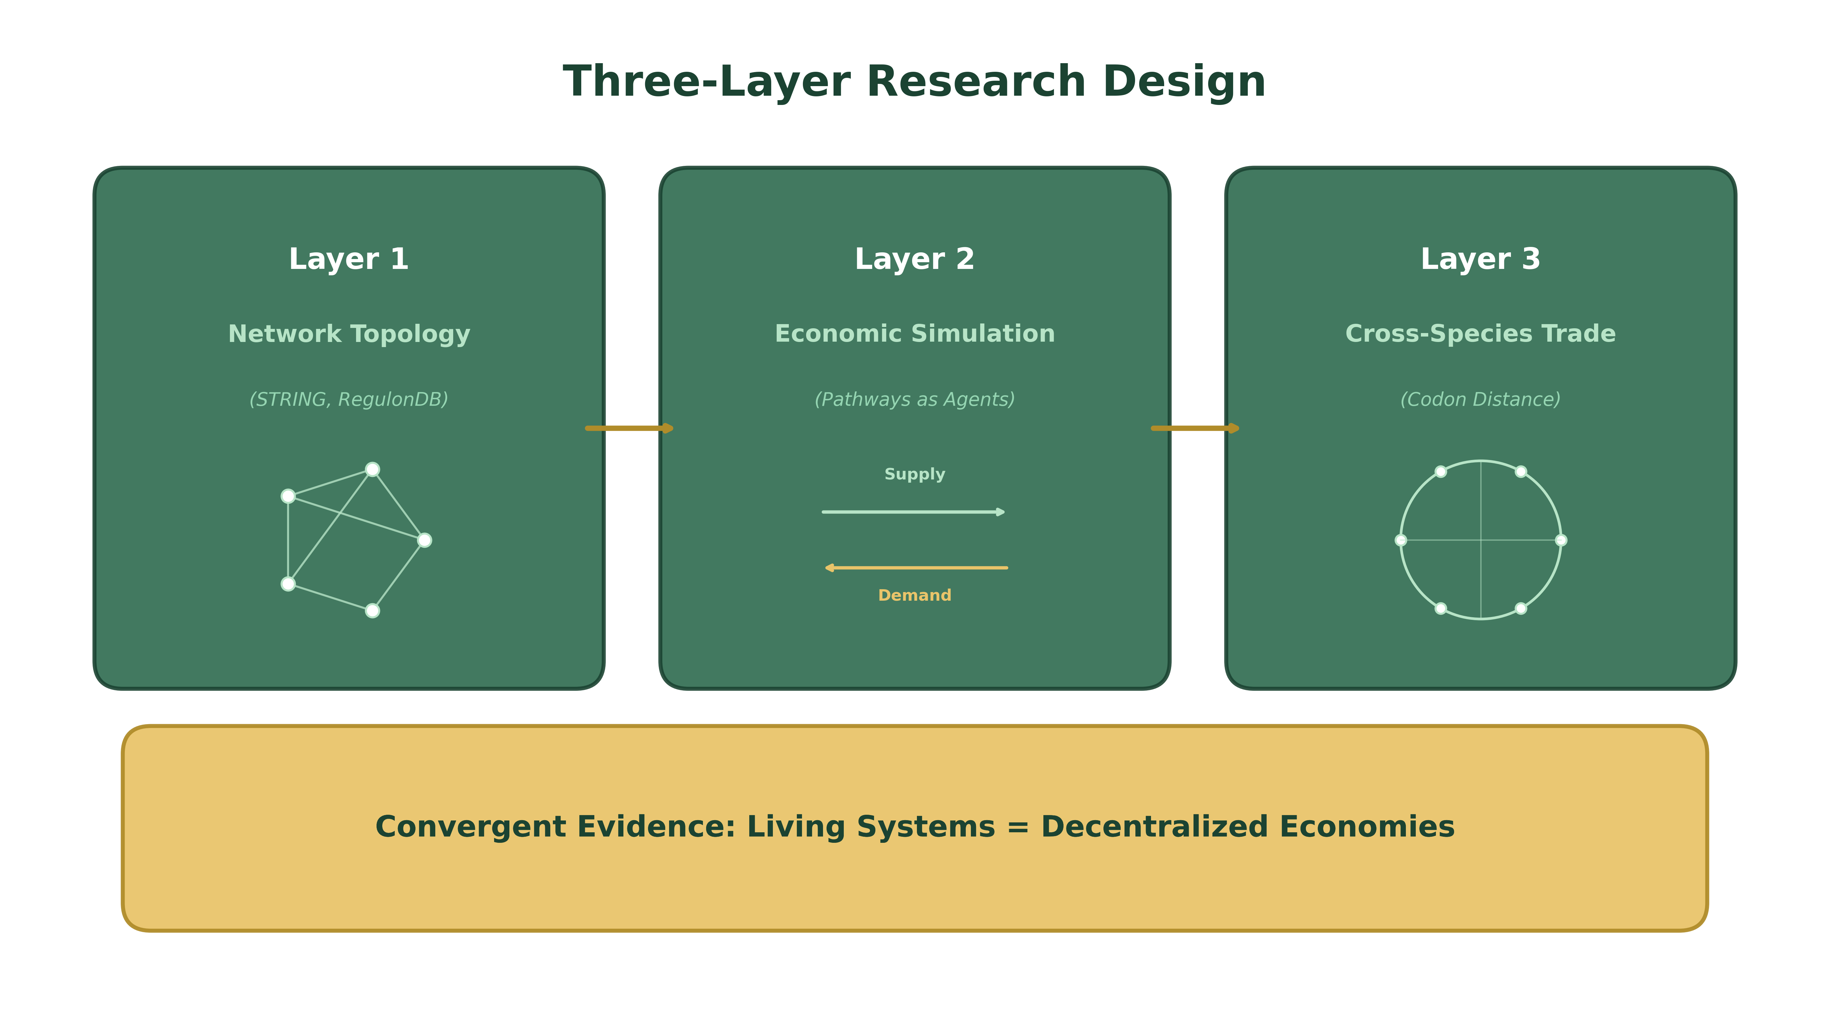
Living Systems as Decentralized Economies
Why the Molecular Biologist Should Be an Entrepreneur, Not a Central Planner
BME 129C Capstone | Week 3 Progress Report
Sage Clokey | Spring 2026 | UC Santa Cruz

Slide 2
Goal & Approach
Question: Are living systems literally decentralized economies?
Not metaphor — measurable structural equivalence
Thesis: biological networks exhibit the same properties Austrian economists attribute to free markets
Scale-free topology, distributed information flow, robustness to failure
Three layers of convergent evidence from real data:
Layer 1: Network topology — no master node (RegulonDB, STRING, KEGG)
Layer 1b: Single-cell economy — cells as specialized agents (10x Genomics pbmc3k)
Layer 2: Economic simulation — distributed vs. centralized allocation
Layer 3: Cross-species trade — comparative advantage via codon distance

Slide 3
Accomplished So Far — All Layers Complete
Data & Analysis Pipeline
Simulation & Trade Analysis
Layer 1: Gene regulatory, metabolic, and PPI networks
E. coli PPI: 529 nodes, 6,951 edges
Yeast PPI: 573 nodes, 6,342 edges
RegulonDB GRN: 282 nodes, 308 edges
Power-law exponents: α = 2.05–2.44
Layer 1b: Single-cell economy (PBMC 3k)
8 cell types, no master cell
Communication Gini = 0.0 (fully distributed)
75% communication survival after any cell type removal
Layer 2: Economic simulation (13 pathway agents)
Distributed: 2.9× lower variance than centralized
71.1% GDP retained under perturbation (vs 53.0%)
Local feedback alone reaches stable equilibrium
Layer 3: Cross-species trade (8 organisms, 4 kingdoms)
Within-kingdom cost: 0.17–0.38
Cross-kingdom cost: 0.65–0.83
Each organism contributes unique comparative advantage
Paper draft complete (Abstract → Results) | Figure guide with falsifiable predictions | Reproducible pipeline (run_all.py)

Slide 4
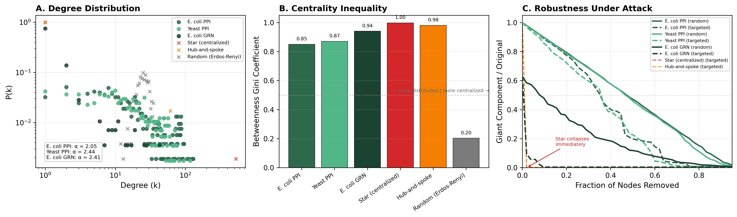
Layer 1: Biological Networks Are Decentralized
(A) Power-law degree distributions (α = 2.05–2.44) — many nodes with few connections, few hubs, no single controller. (B) Betweenness Gini: hubs exist but are distributed — no single bottleneck. (C) Robustness: PPI networks survive ~37% targeted hub removal; star/hub-spoke collapse at ~2%. A 19:1 robustness ratio.

Slide 5
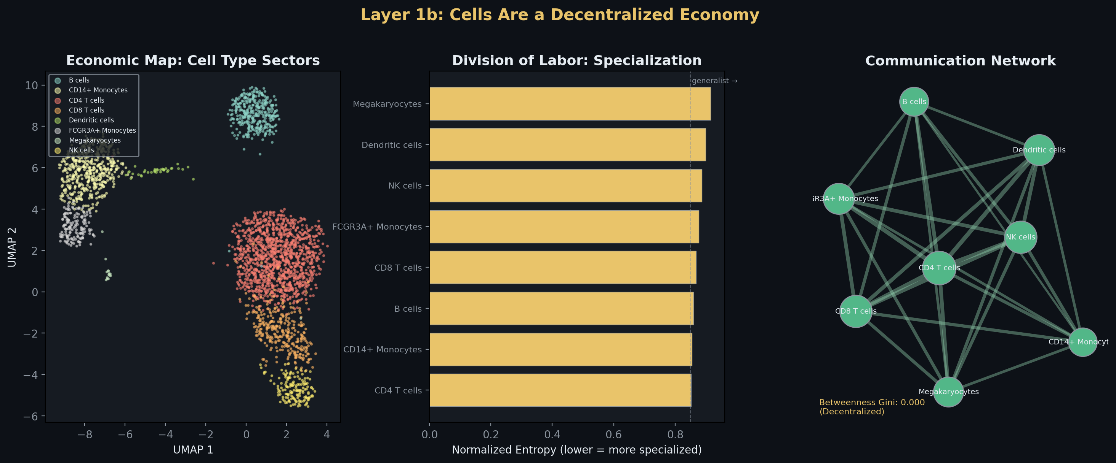
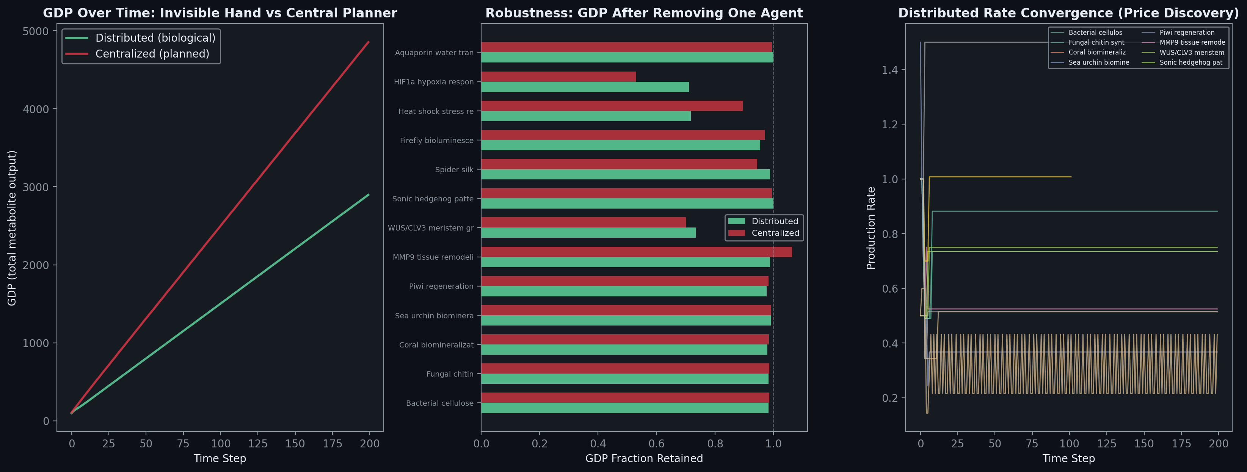
Layer 1b + Layer 2: Cells as Agents, Pathways as Markets
Left: 2,638 cells, same genome, 8 specialized types. No master cell. Communication Gini = 0.0. The immune system is a decentralized economy.
Right: Distributed allocation (green) vs. centralized (red). Distributed reaches equilibrium through local feedback alone. Retains 71% GDP under perturbation vs. 53% for the planner.

Slide 6
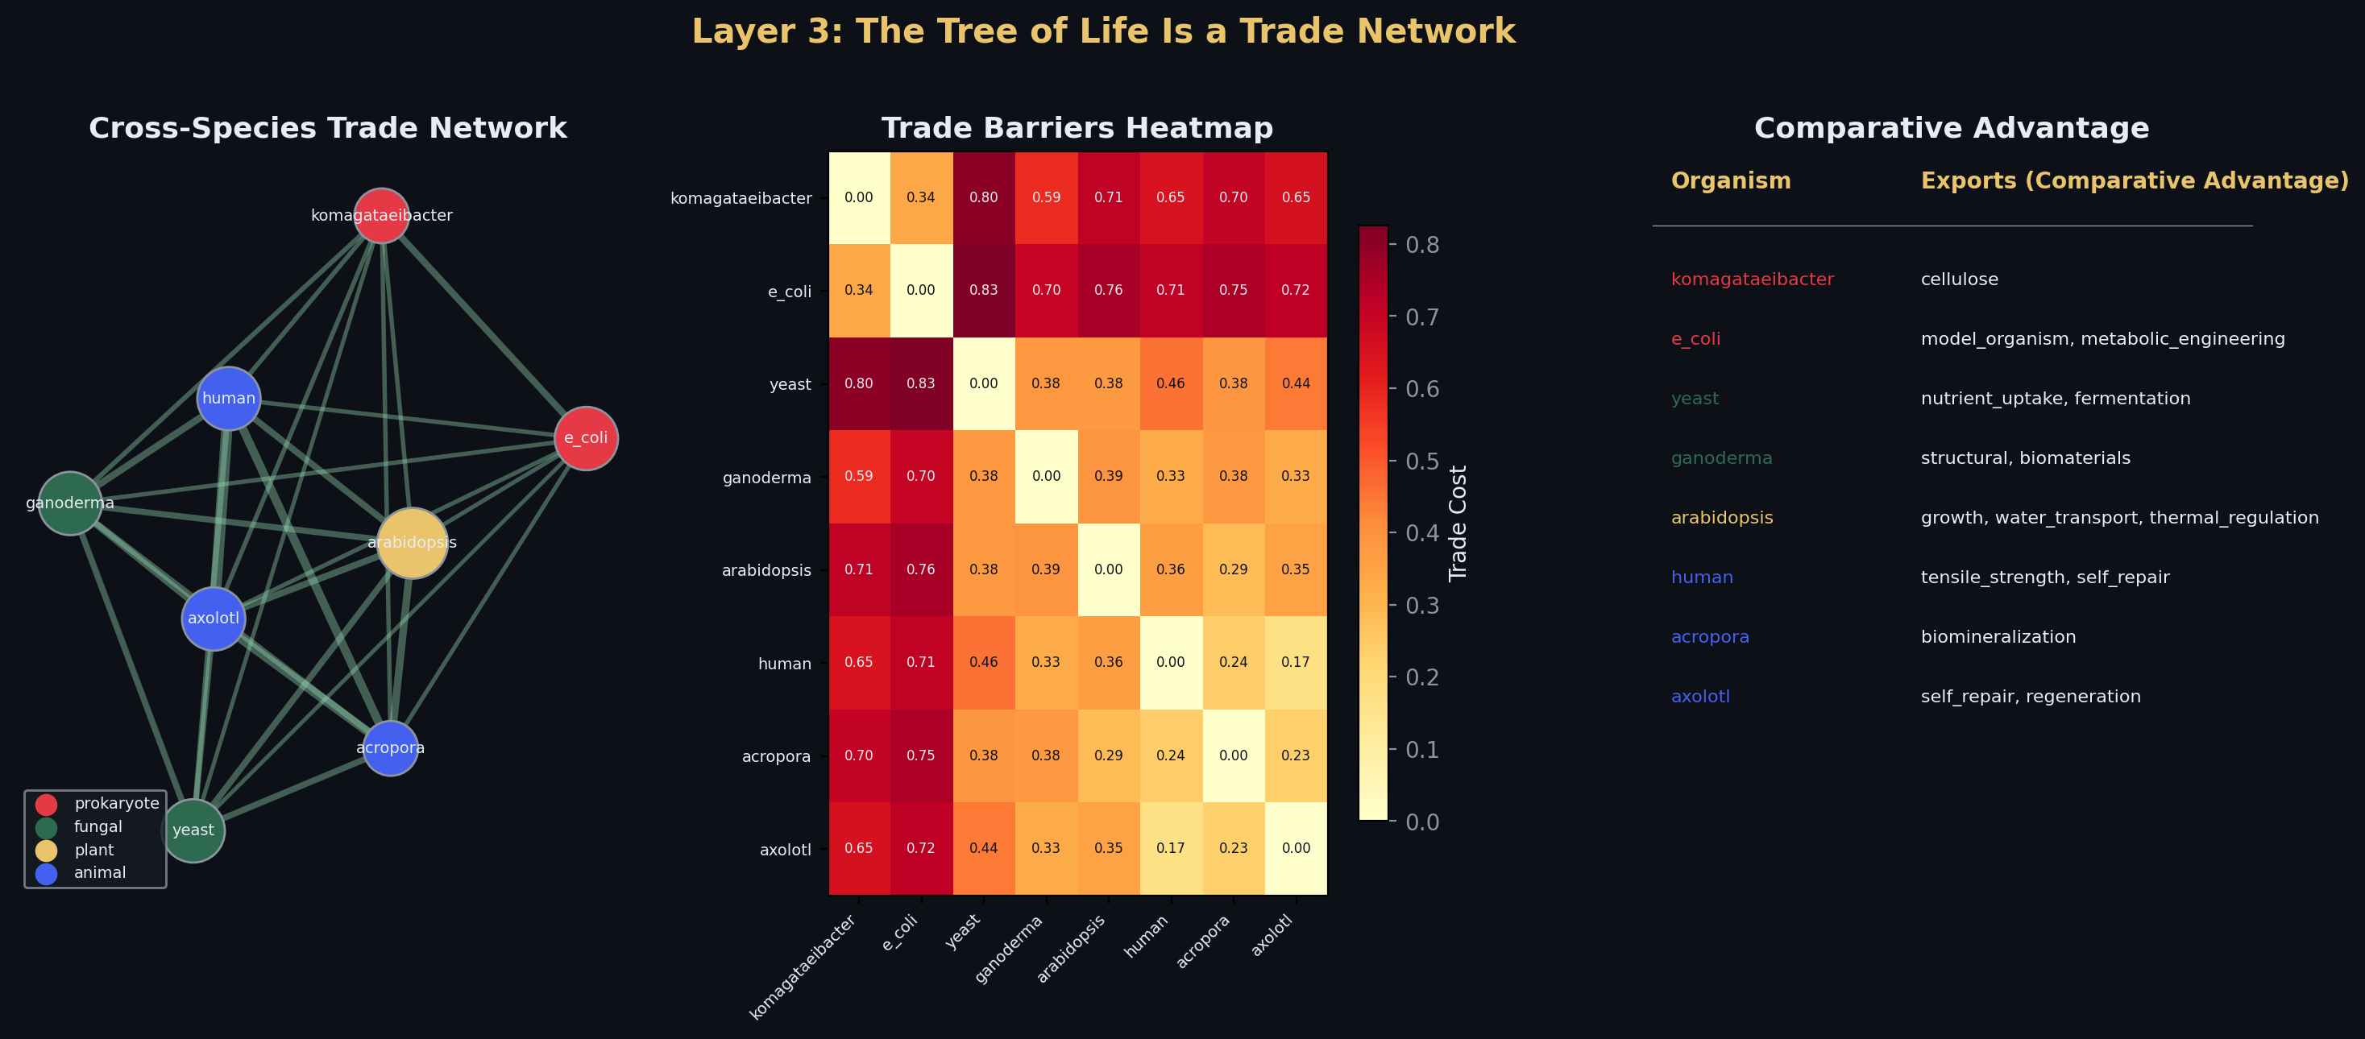
Layer 3: The Tree of Life Is a Trade Network
8 organisms across 4 kingdoms
Codon usage distance = trade friction
Within-kingdom: 0.17–0.38 (free trade zone)
Cross-kingdom: 0.65–0.83 (trade embargo)
Each organism has unique comparative advantage
Coral → biomineralization
Spider → silk proteins
Axolotl → regeneration
Bacteria → cellulose synthesis
The tree of life forms natural trade blocs
Like economic free trade zones structured by evolutionary distance

Slide 7
This Week's Progress
Faculty advisors secured
Todd Lowe (RNA biology, genomics) — co-advisor, meeting Wed 4:30pm
Josh Stuart (computational genomics) — connected through Dubois, meeting this week
Capstone figures presentation updated (v2)
Refined visualizations for advisor meetings
Methods section drafted
Arial 11, single-spaced, database table with accession numbers
Data Availability section: GitHub + future Dryad deposit
Paper argument sharpened through faculty exchanges
Bernick: 'programming is Plato's shadow puppets' — connects to machine metaphor critique
Etymology of 'program' (pre-written) as evidence the field's language misrepresents living systems

Slide 8
Next Steps
Validate Layer 2 with real flux data
Integrate COBRApy flux balance analysis from BiGG E. coli model
Replace simplified parameterization with genome-scale metabolic data
Meet with advisors Lowe and Stuart
Present figures and paper draft
Get feedback on methodology and framing
Complete Discussion section of paper
Disease as broken decentralization (cancer, drug resistance)
Practical implications: design distributed feedback, not command hierarchies
Statistical validation
Kolmogorov-Smirnov test for power-law fit
Spearman correlation: codon distance vs. trade cost (gravity model)
The Thesis in One Sentence
Life organizes as a decentralized economy — not a machine with a master switch, but a network of cooperating agents coordinating through local signals. The data shows it at every scale: genes, cells, pathways, species. The molecular biologist should be an entrepreneur, not a central planner.

