Slide 1
Living Systems as Decentralized Economies
The Curious Task: From Data to Design Principles
BME 129C Capstone | Week 4 Progress Report
Sage Clokey | Spring 2026 | UC Santa Cruz
Notes:
Title slide. Week 4 progress report.
The subtitle references Hayek's Fatal Conceit (1988): 'The curious task of economics is to demonstrate to men how little they really know about what they imagine they can design.' This week I integrated that work into the paper and translated the computational findings into concrete design principles for synthetic biology.

Slide 2
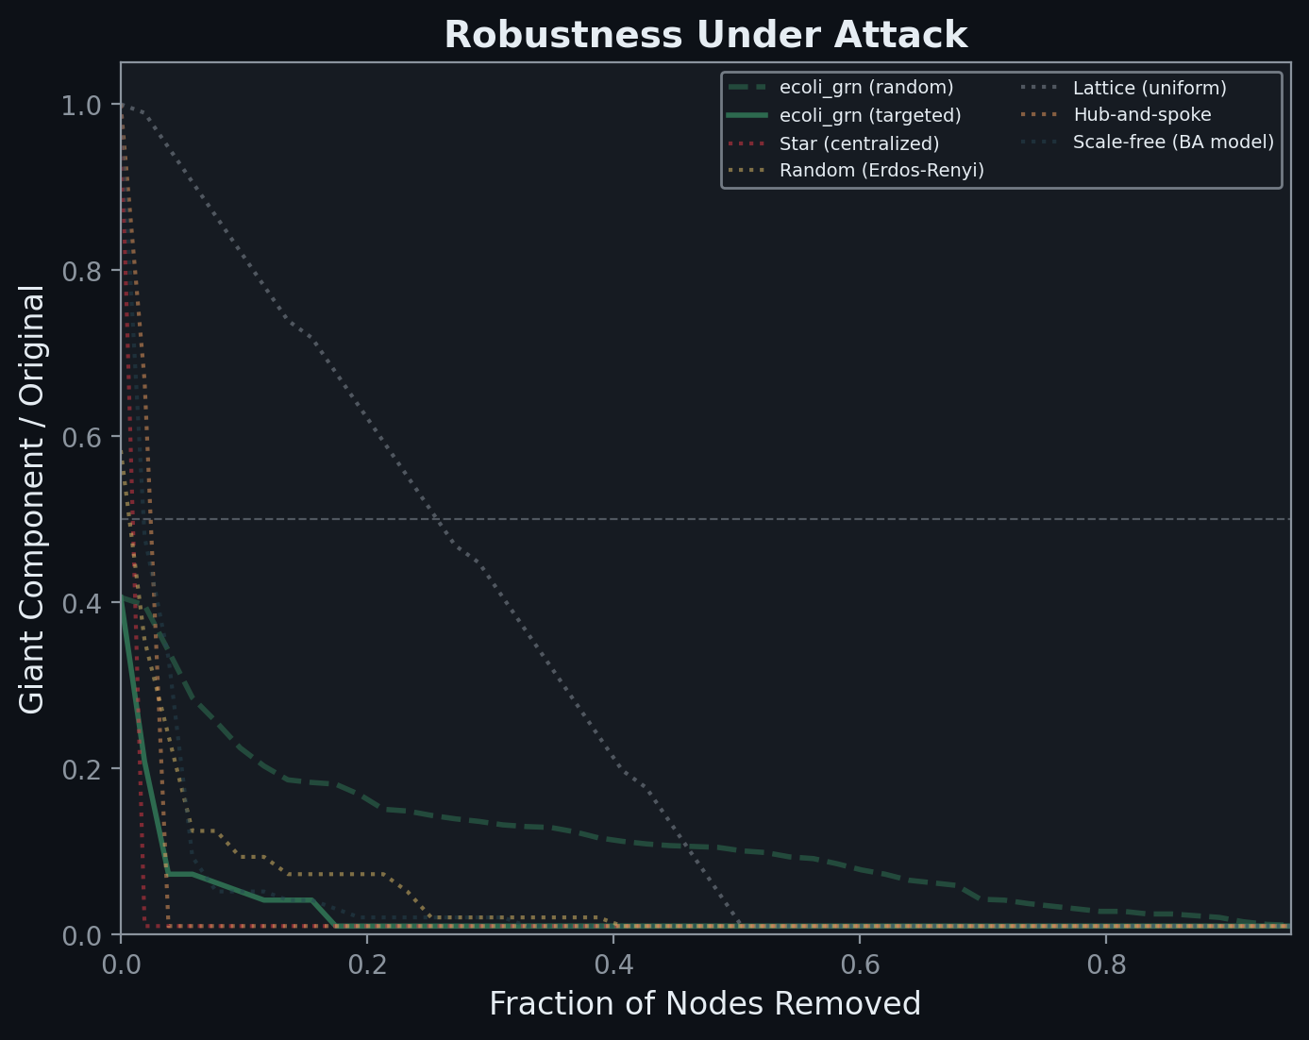
Goal & Approach
Thesis: living systems operate as decentralized economies
Not metaphor — measurable structural equivalence
Hayek's Fatal Conceit (1988): 'order generated without design
can far outstrip plans men consciously contrive' (p. 6)
Three layers of convergent evidence:
Layer 1: Network topology — no master node (RegulonDB, STRING, KEGG)
Layer 1b: Single-cell economy — cells as specialized agents (pbmc3k)
Layer 2: Economic simulation + FBA — distributed vs centralized
Layer 3: Cross-species trade — comparative advantage via codon distance
NEW: Design principles — how to engineer with this, not against it
Notes:
GOAL (30 seconds):
Same core thesis as previous weeks — living systems as decentralized economies. But this week the project crossed from analysis into synthesis. The three layers of data (topology, economy, trade) are complete. Now I'm translating those findings into actionable design principles for synthetic biology.
The key addition: Hayek's Fatal Conceit. His argument that extended orders 'generated without design can far outstrip plans men consciously contrive' maps directly onto the 19:1 robustness ratio we measured in Layer 1.

Slide 3
Accomplished — All Layers Complete
Layer 1: Gene regulatory, metabolic, PPI networks
5 bio networks vs 5 reference architectures
19:1 robustness ratio (distributed vs centralized)
Feed-forward loops = Hayekian price signals (Z > 10)
WBPA: hubs that grow too powerful get eroded
Layer 1b: Single-cell economy (PBMC 3k)
2,638 cells, 8 types — division of labor
Communication Gini = 0.0 (no gatekeeper)
75% communication survives any cell type removal
Layer 2: Economic simulation + FBA
13 pathway agents, distributed: 2.9x lower variance
71% GDP retained under perturbation (vs 53%)
FBA (omniscient planner): 70% knockout accuracy
Shadow prices = Hayekian price signals
Layer 3: Cross-species trade (8 organisms)
Codon distance = trade friction
18 published gene transfers validated
Trade blocs emerge spontaneously (Louvain)
Full paper draft | 21 figures | Reproducible pipeline (run_all.py) | Methods section complete
Notes:
ACCOMPLISHMENTS (1 minute — split across slides 3 and 4):
All four layers are complete and producing figures. The key numbers:
- 19:1 robustness ratio favoring distributed networks
- Communication Gini of 0.0 in PBMC cell economy
- 2.9x lower GDP variance in distributed vs centralized allocation
- FBA (the strongest possible planner) achieves 70% accuracy on knockouts
- Trade blocs emerge spontaneously from codon compatibility
Every layer tells the same story from a different angle: biology is a decentralized economy, not a centrally planned machine.

Slide 4
This Week: The Fatal Conceit → Design Principles
Integrated Hayek's Fatal Conceit (1988) into paper
'The curious task of economics is to demonstrate to men how little they really know about what they imagine they can design' (p. 76)
Applied to synthetic biology: redesigning evolved order destroys information
Wrote Section 4.2: Design Principles — Engineering Economies, Not Machines
Architecture 1: Single organism designed FOR evolution
Architecture 2: Microbial consortium — division of labor
The core shift: read the economy before intervening
Designed Section 4.7: Experimental Spread — 6 Violacein Experiments
Violacein (vioABCDE): purple pigment, 5 genes, quantifiable at 575nm
Each experiment tests one Austrian prediction with wet-lab data
Notes:
THIS WEEK — FATAL CONCEIT & DESIGN PRINCIPLES (45 seconds):
The biggest intellectual addition this week is Hayek's Fatal Conceit — his final book, published in 1988. The core argument: 'The curious task of economics is to demonstrate to men how little they really know about what they imagine they can design.' I integrated this into the paper's introduction, discussion, and conclusion.
Then I translated the computational findings into two concrete design architectures:
Architecture 1: Single organism designed FOR evolution. Instead of codon-optimizing a pathway, you read the shadow prices from FBA, build feedback loops so the cell self-regulates expression, distribute control across multiple promoters, harmonize codons instead of optimizing them, and then let the cell evolve.
Architecture 2: Microbial consortium. Split a pathway across multiple strains, each specializing in part of the production. This mirrors the division of labor we measured in the PBMC data.
Finally, I designed 6 concrete experiments using the violacein pathway (vioABCDE from Chromobacterium violaceum). Violacein is a purple pigment quantifiable by absorbance at 575nm — cheap to measure, clear signal. Each experiment tests one specific Austrian prediction.

Slide 5
Experimental Spread: 6 Tests of Distributed Design
1. Fixed vs Feedback Promoters (Hayek)
Constitutive vs tryptophan-responsive — knowledge problem
2. Star vs Distributed Control (Mises)
Single master promoter vs 5 independent — calculation problem
3. Single Strain vs Consortium (Menger)
Monolithic vs 2-strain split — spontaneous order
4. Codon Optimization vs Harmonization (Layer 3)
CAI-maximized vs host-matched — trade barriers
5. Adaptive Evolution: Fixed vs Feedback (Kirzner)
100 generations serial passage — entrepreneurial discovery
6. Perturbation Gauntlet (Rothbard)
Temperature, carbon, antibiotic — fragility test
Prediction: distributed designs show higher VARIATION but equal or better MEDIAN yield — and dramatically better robustness under perturbation. Measurement: violacein absorbance at 575nm across n=8+ biological replicates per condition.
Notes:
EXPERIMENTAL SPREAD (45 seconds):
Six experiments, each testing one Austrian economic prediction:
1. Fixed vs Feedback (Hayek's knowledge problem): Compare constitutive promoters (the planner sets expression levels once) against tryptophan-responsive promoters (the cell reads its own metabolite levels and adjusts). Prediction: feedback variants show wider yield distributions but better recovery after perturbation.
2. Star vs Distributed (Mises' calculation problem): Put all 5 vio genes under one master promoter (star topology) vs independent promoters. Prediction: star fails catastrophically under any single perturbation.
3. Monoculture vs Consortium (Menger's spontaneous order): All genes in one strain vs split across two co-cultured strains. Prediction: consortium shows emergent ratio optimization without tuning.
4. Codon Optimization vs Harmonization: CAI-maximized (planner rewrites all codons) vs host-matched harmonization (respects the host's economy). Tests Layer 3 trade barrier predictions.
5. Adaptive Evolution: Serial passage both architectures for 100 generations. Feedback variants should improve faster — Kirznerian discovery.
6. Perturbation Gauntlet: Hit all constructs with temperature shift, carbon source switch, and sub-MIC antibiotic. Distributed designs should retain more production. Rothbard's fragility argument.
All measured by violacein absorbance at 575nm, n=8+ biological replicates.

Slide 6
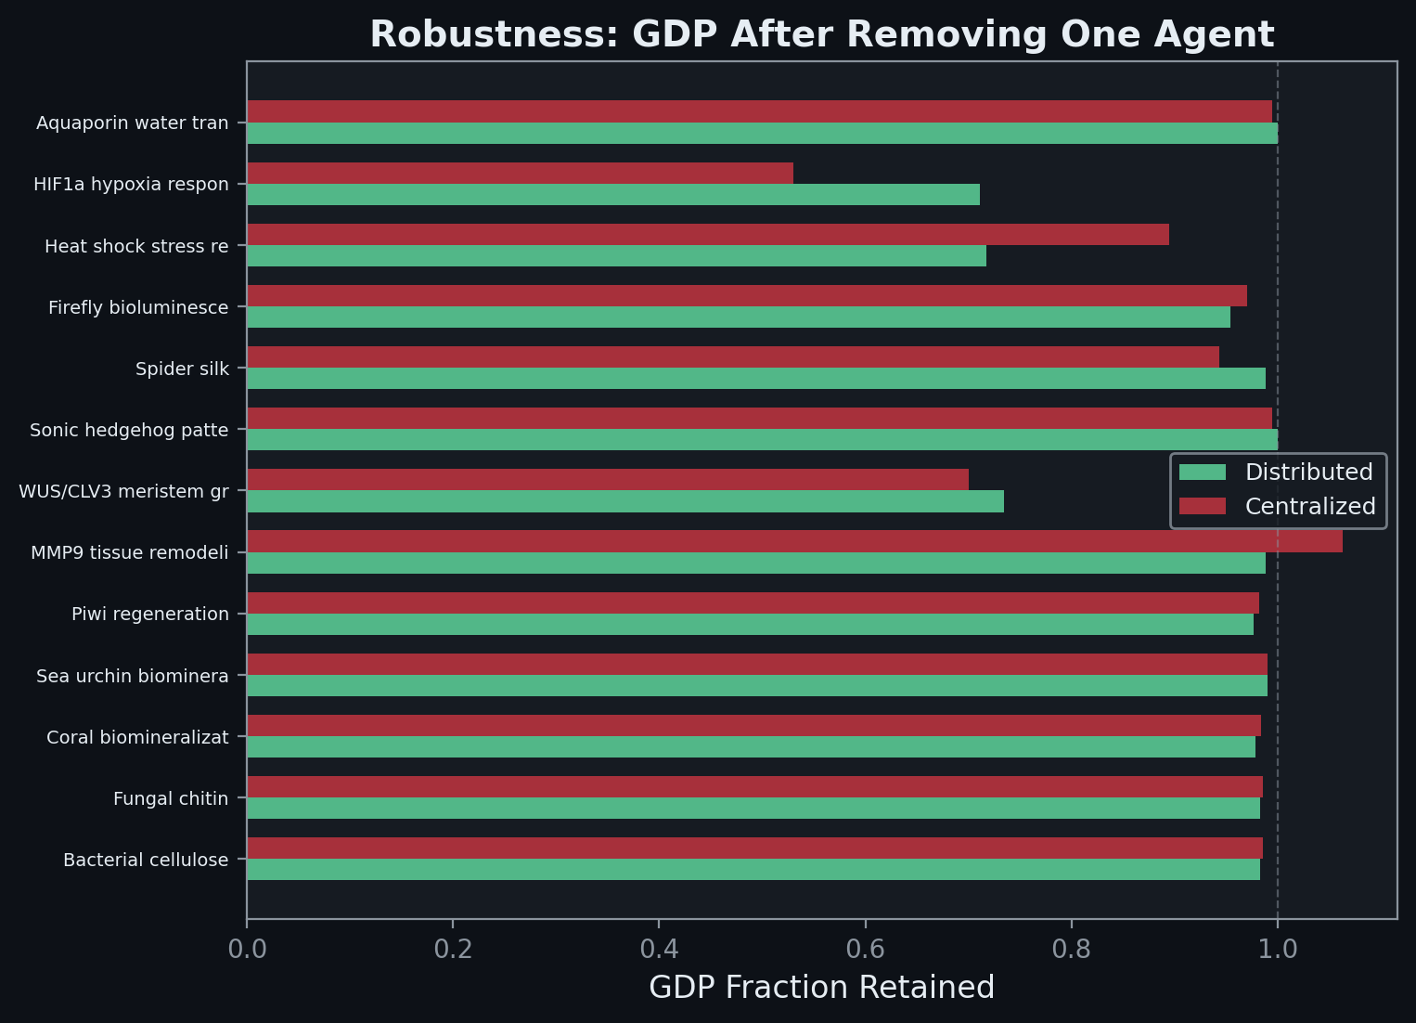
This Week: Data-Point-Forward Visualization
New principle: show every individual data point
Variation IS the data — averages hide what matters
Bar charts → semi-transparent bars with scatter overlay
Robustness curves → individual trial lines behind average
Hub erosion → per-hub jitter plots with median lines
Updated 6 analysis files across all layers
topology_analysis.py, self_regulation.py, cell_economy_figures.py
metabolic_economy.py, single_cell_economy.py, fba_analysis.py
Regenerated all 21 figures through full pipeline
Notes:
VISUALIZATION OVERHAUL:
Overhauled every plotting function across the entire codebase. The core principle: variation is the signal, not noise. When we show that distributed systems produce more variation that converges through local feedback, hiding that variation behind averages undermines the thesis.
Every bar chart now shows semi-transparent bars with individual data points scattered on top. Robustness curves show each random trial as a thin line behind the average. Hub erosion plots show per-hub betweenness changes as jittered scatter with median lines.
This affected 6 files and all 21 figures. The pipeline regenerates everything from one command.

Slide 7
Next Steps
Statistical validation
Mann-Whitney U for distributed vs centralized GDP distributions
Bootstrap confidence intervals on robustness metrics
KS test for power-law degree distribution fit
Run full pipeline with live API data
Full RegulonDB, KEGG, STRING networks
1,000 randomizations for motif analysis
Finalize paper for advisor review
Integrate Fatal Conceit quotes into remaining sections
Polish experimental spread section for feasibility feedback
Begin poster layout
Three-layer visual with key figures and one-line findings
Week 4 Summary
The data says biology is an economy. This week: what that means for how we engineer. Not optimize — cultivate. Not command — steward. Not design — grow. The Fatal Conceit is thinking we can do better than 4 billion years of distributed design.
Notes:
NEXT STEPS:
1. Statistical validation — add proper nonparametric tests to every comparison. Mann-Whitney U for distributed vs centralized GDP. Bootstrap CIs on robustness metrics. KS test for power-law fit.
2. Full pipeline run with live API data. Currently using built-in quick-mode data for speed. The full run pulls from RegulonDB, KEGG, and STRING directly.
3. Finalize paper for advisor review. Todd Lowe and Josh Stuart need to see the experimental spread — it needs to be feasible within the resources available.
4. Begin poster layout. The three-layer structure maps naturally to a visual hierarchy: topology → economy → trade.

