Slide 1
The Price System of the Cell
Life as a Decentralized Economy
BME 129C Capstone | Week 6 Progress Report
Sage Clokey | Spring 2026 | UC Santa Cruz
7 layers of evidence | 40+ figures | Price system synthesis
Notes:
Title slide. Week 6 progress report.
Oral exam completed last week. This week's central accomplishment: the Price System of the Cell figure, a 4-panel synthesis that shows living systems have a real price system — not as metaphor but as measurable molecular mechanism. Also built the comprehensive figure guide.

Slide 2
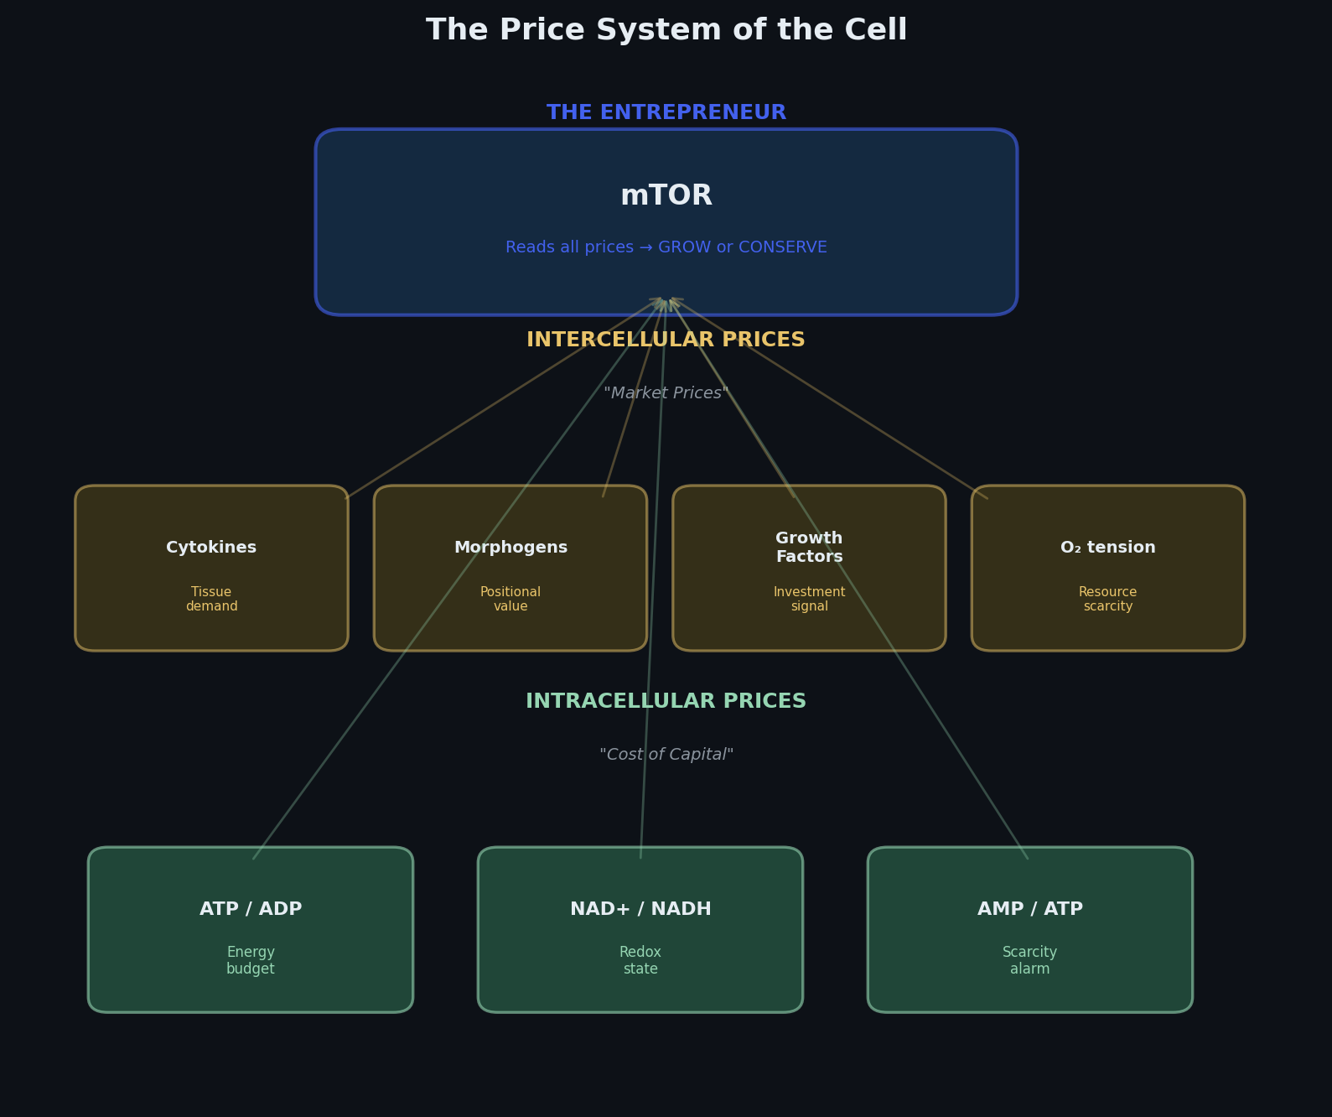
Panel A: The Cell Has a Real Price System
Three tiers of molecular prices:
Intracellular ratios = cost of capital
ATP/ADP, NAD+/NADH, AMP/ATP
Intercellular signals = market prices
Cytokines, morphogens, growth factors, O2 tension
mTOR = the entrepreneur
Reads all price inputs simultaneously
Makes a grow-or-conserve decision
No central planner tells it what to do
Not metaphor — measurable molecular signals
Every ratio is quantifiable
Every signal has a known receptor
Notes:
PANEL A — Price Tiers:
The cell reads prices at three levels. Intracellular metabolite ratios are the cost of capital — they emerge from the cell's own activity. Intercellular signals are market prices — tissue-level information. mTOR integrates all of these and makes a grow-or-conserve decision. It is the entrepreneur reading the market.

Slide 3
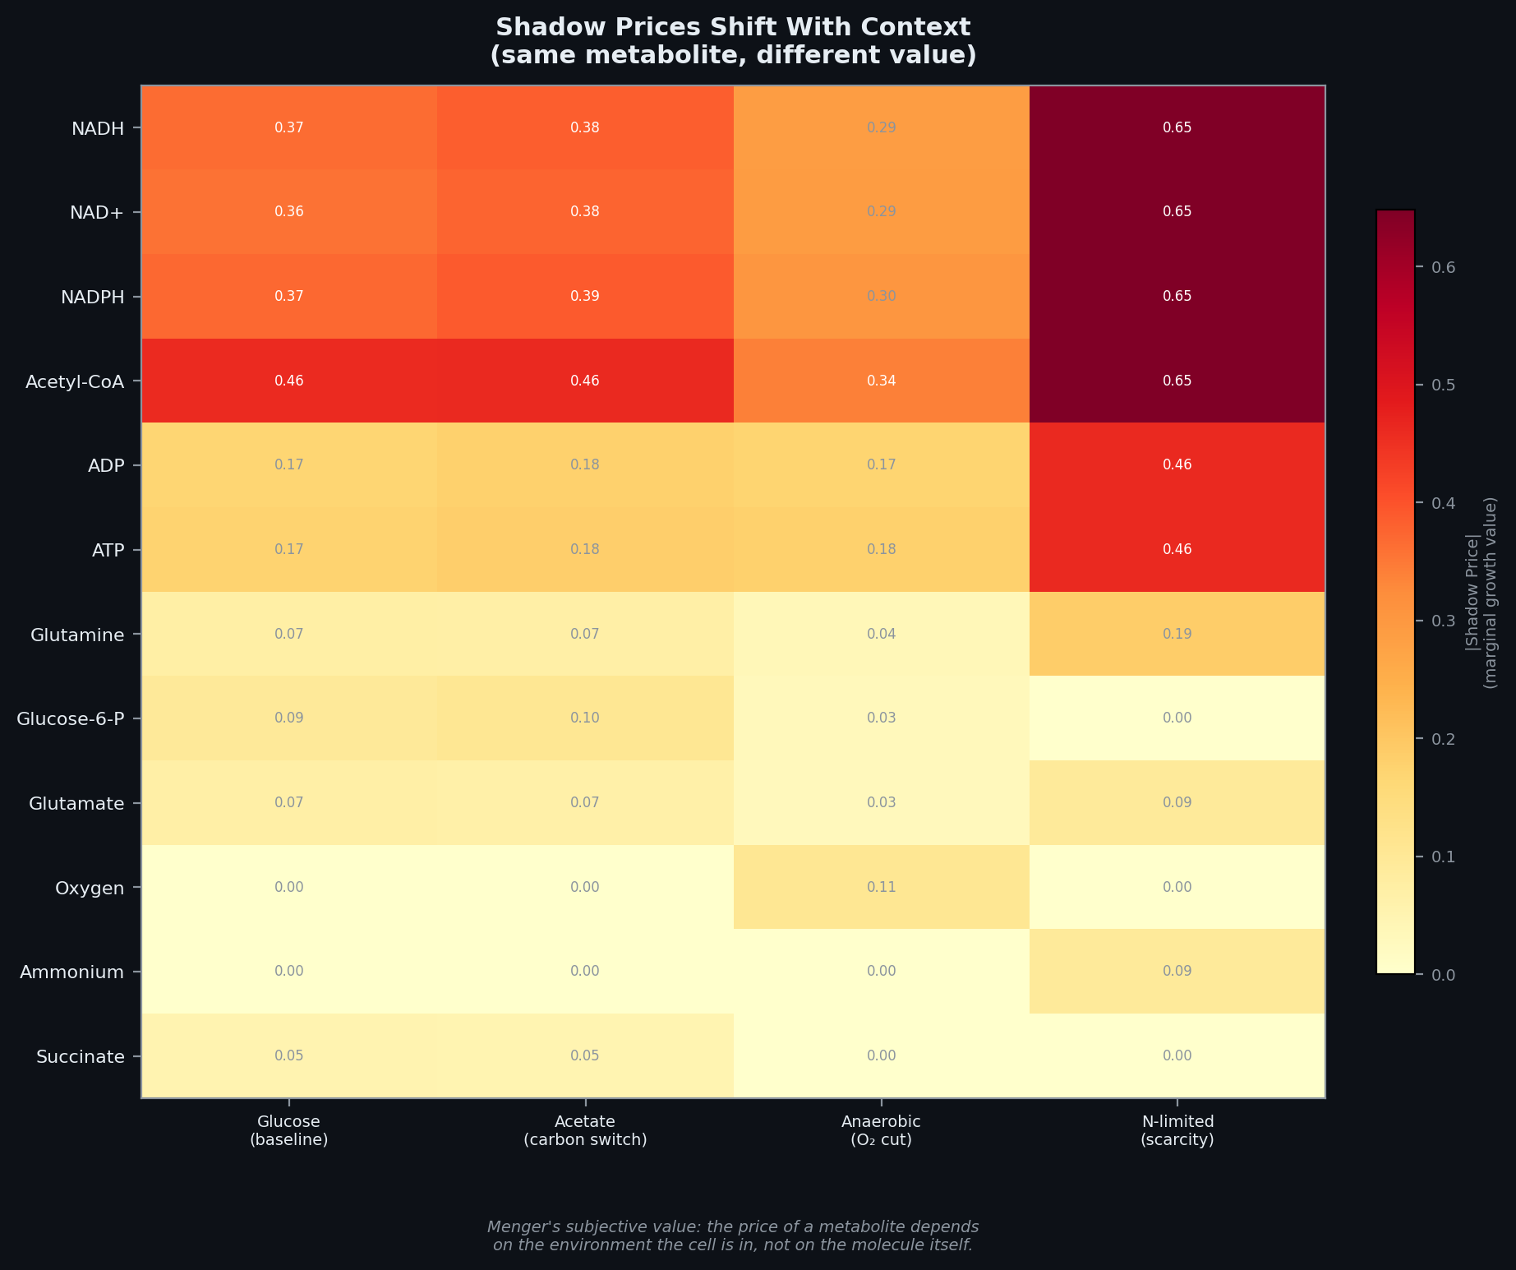
Panel B: Menger's Subjective Value — Measured
Same metabolite, different value in different conditions
NADH: low price on glucose, high price on acetate
Oxygen: near zero aerobically, spikes under anaerobic
Ammonium: irrelevant normally, critical under nitrogen limitation
FBA shadow prices from iML1515 genome-scale model
2,712 reactions, 1,877 metabolites, 1,516 genes
Shadow prices = dual variables from linear program
Even the omniscient planner must compute prices to solve
Menger (1871): value is subjective, not intrinsic
The molecule doesn't change — the context does
The cell has known this for 4 billion years
Notes:
PANEL B — Shadow Prices:
FBA dual variables from the full E. coli genome-scale model under four conditions. The same metabolite has completely different value depending on context. This IS Menger's subjective value theory, measured in a genome-scale model. The molecule doesn't change — the context does.

Slide 4
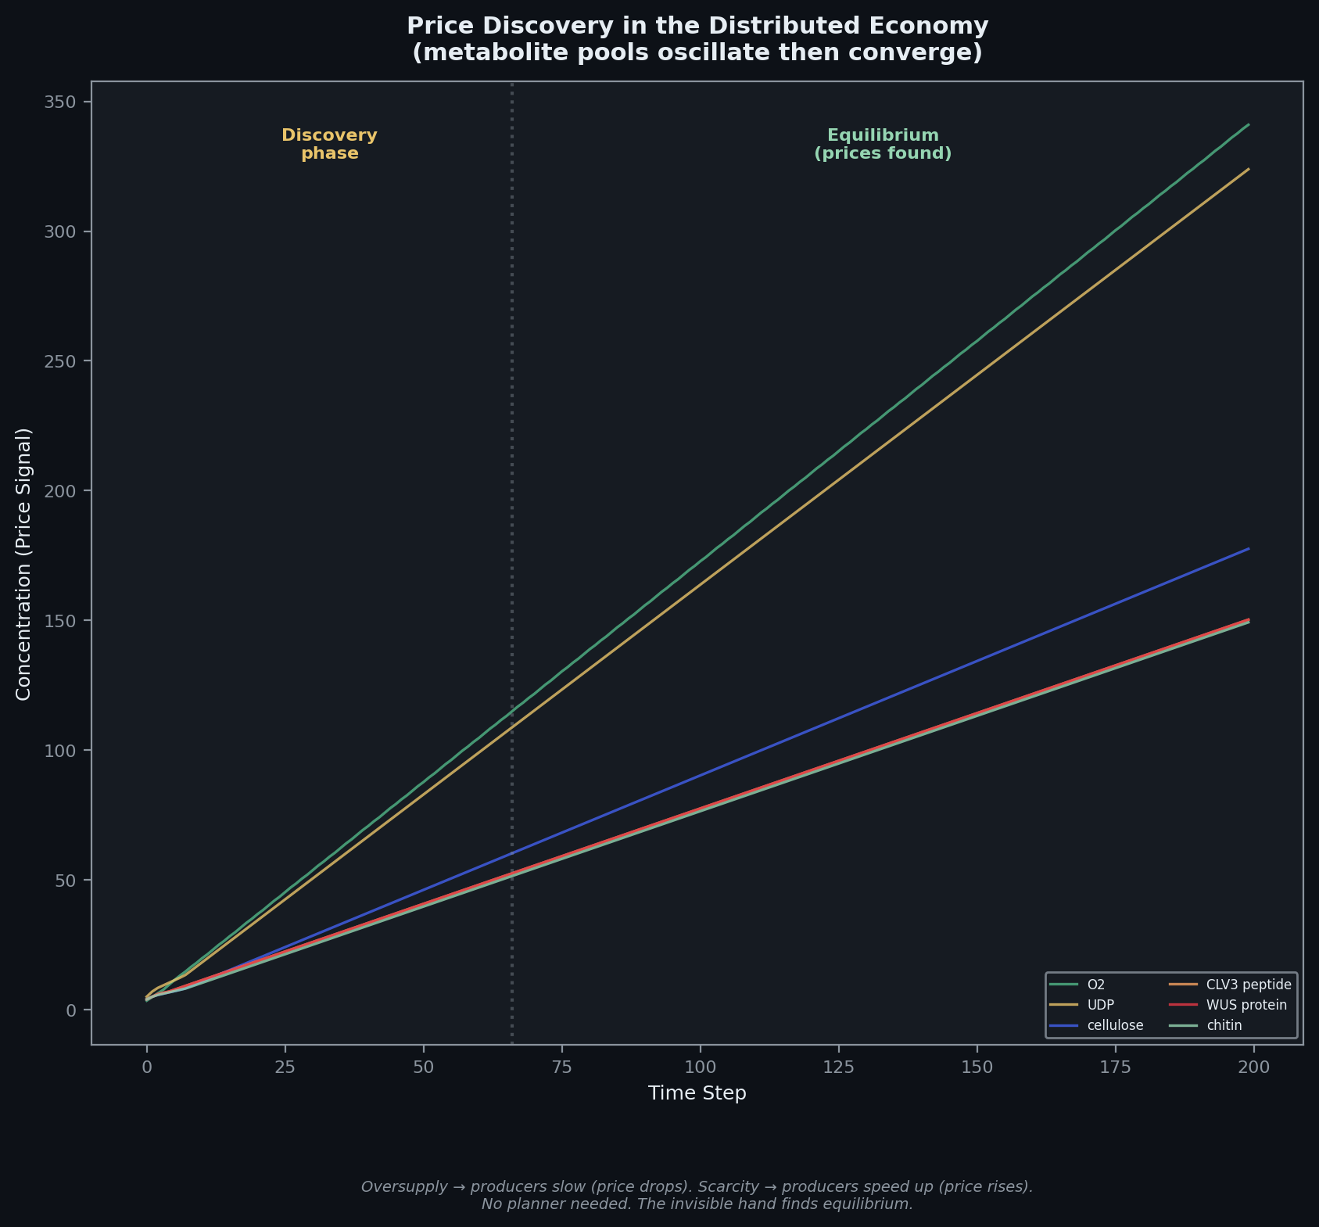
Panel C: Price Discovery Without a Planner
Metabolite pools oscillate then converge
Early oscillation = discovery phase
Late convergence = equilibrium found
No planner told them where to settle
Supply and demand, happening in a cell
Oversupply = producers slow down (price drops)
Scarcity = producers speed up (price rises)
Local feedback alone drives coordination
The invisible hand at the molecular level
Each agent adjusts based on local conditions
Global order emerges from individual decisions
This is Hayek's price discovery, measured in metabolites
Notes:
PANEL C — Price Discovery:
Metabolite pools oscillate then converge. Early volatility is the market discovering prices. Late stability is equilibrium found through local feedback alone. No planner needed. This is the invisible hand at the molecular level.

Slide 5
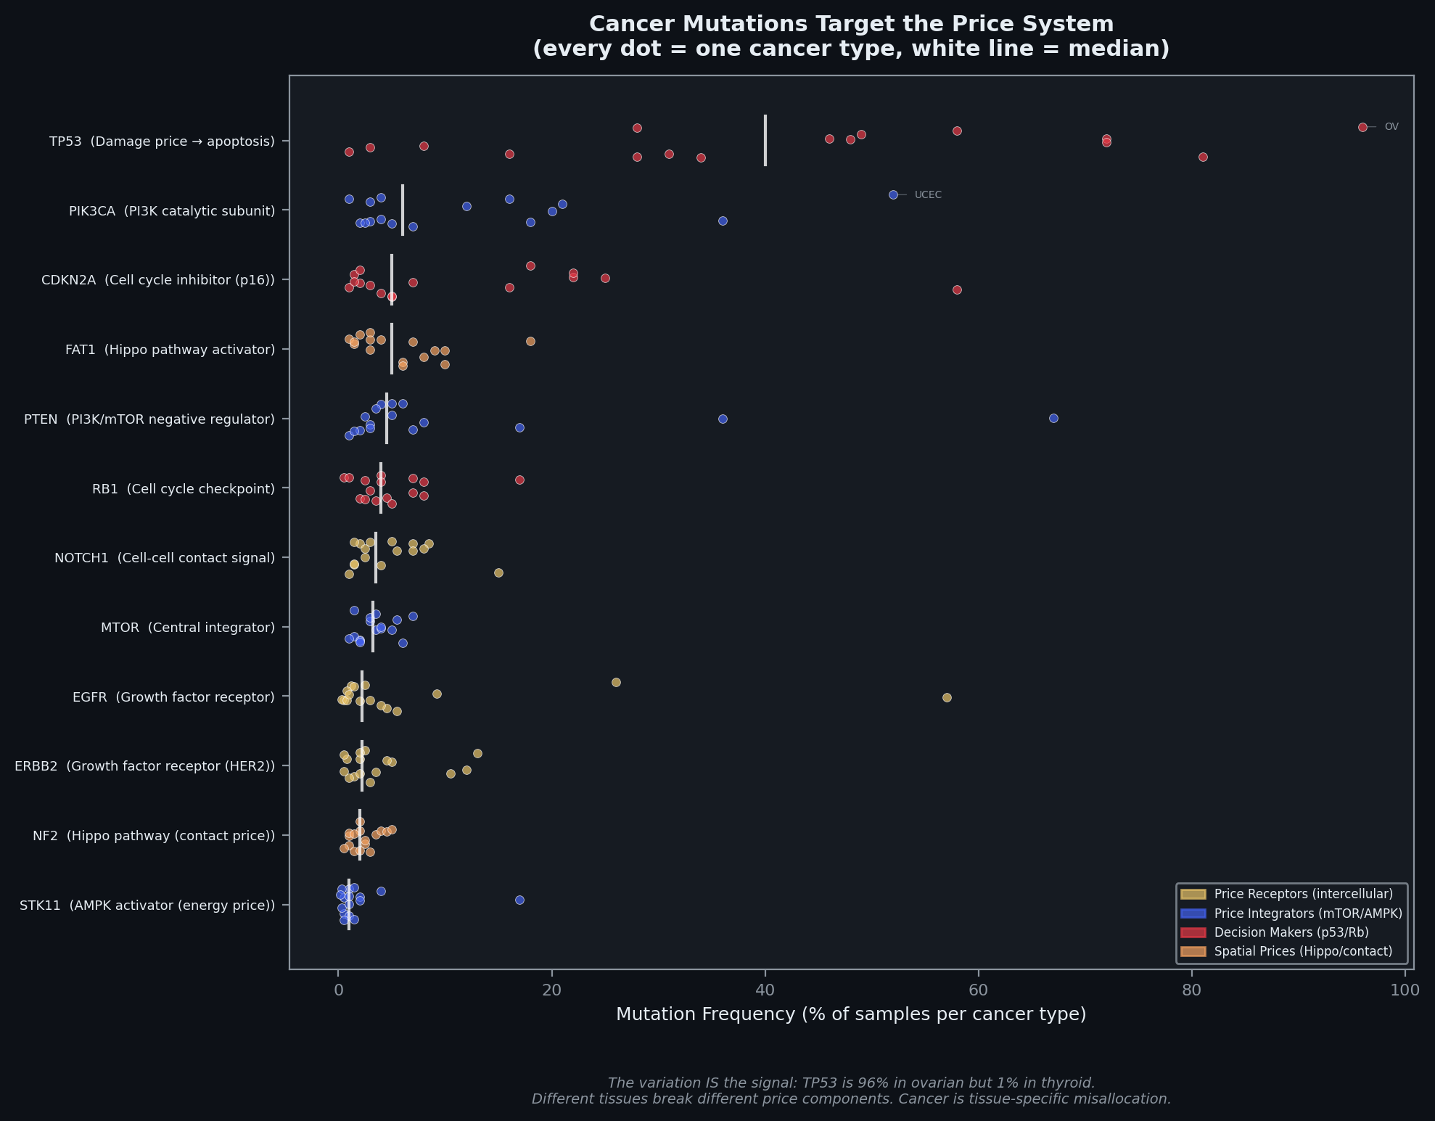
Panel D: Cancer Breaks the Price System
Most mutated genes map to price system components
TP53 — damage price (apoptosis signal)
PIK3CA, PTEN, mTOR — price integrators
EGFR, ERBB2 — growth factor receptors (price readers)
NF2 — spatial/contact price (Hippo pathway)
The variation IS the signal
TP53: 96% in ovarian, 1% in thyroid
Different tissues rely on different prices
Same gene, completely different importance by context
Cancer is not a gene disease
It's a price system disease
The disease is the broken feedback loop
Variants are not diseases — broken readers are
The cell has prices. Cancer is what happens when the price system breaks.
Notes:
PANEL D — Cancer Mutations:
The most mutated genes in cancer all map to specific components of the price system. Every dot is one cancer type. The variation across types proves it's context-dependent — TP53 is 96% in ovarian but 1% in thyroid. Different tissues break different price components. Cancer isn't a gene disease — it's a price system disease.

Slide 6
Next Steps
Poster layout
Paper finalization
Sensitivity analysis on simulation
Final presentation
Week 6 Summary
The cell has a price system. ATP/ADP is the cost of capital. Cytokines are market prices. mTOR is the entrepreneur. Cancer is what happens when the price system breaks.
Notes:
Next steps. Keep it brief — 10 seconds.

