Slide 1
The Price System of the Cell
Life as a Decentralized Economy
BME 129C Capstone | Week 6 Progress Report
Sage Clokey | Spring 2026 | UC Santa Cruz
7 layers of evidence | 40+ figures | Price system synthesis
Notes:
Title slide. Week 6 progress report.
Oral exam completed last week. This week's central accomplishment: the Price System of the Cell figure, a 4-panel synthesis that shows living systems have a real price system — not as metaphor but as measurable molecular mechanism. Also built the comprehensive figure guide.

Slide 2
Progress on Last Week's Next Steps
✔ Oral exam completed (Week 5)
8-minute conversational exam — all 6 questions covered
Problem, goal, novelty, methods, progress, publication path
✔ Price System of the Cell — new 4-panel synthesis figure
Price tiers, shadow prices, price discovery, cancer as price system failure
Unifies Layers 2, 2b, and cancer data into one figure
✔ Comprehensive figure guide
Every claim mapped to a falsifiable visualization
Explicit alternative hypothesis stated for each figure
▶ Poster layout
Deferred to Week 7 — prioritized price system figure and exam
✔ = completed ▶ = deferred with rationale
Notes:
PROGRESS ON LAST WEEK'S NEXT STEPS:
Oral exam completed last week. Three of four next steps done. The poster is deferred to Week 7 because the price system figure took priority. The figure guide is a major deliverable — it maps every single claim in the paper to a specific figure, explains what the figure should show if the thesis is correct, and what the alternative would look like. This ensures every claim is falsifiable.

Slide 3
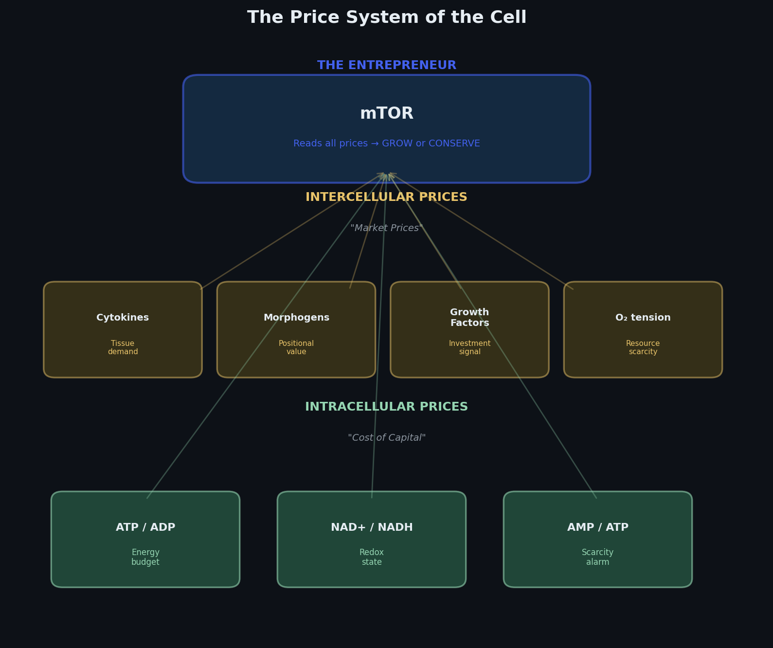
Panel A: The Cell Has a Real Price System
Three tiers of molecular prices:
Intracellular ratios = cost of capital
ATP/ADP, NAD+/NADH, AMP/ATP
Intercellular signals = market prices
Cytokines, morphogens, growth factors, O2 tension
mTOR = the entrepreneur
Reads all price inputs simultaneously
Makes a grow-or-conserve decision
No central planner tells it what to do
Not metaphor — measurable molecular signals
Every ratio is quantifiable
Every signal has a known receptor
Notes:
PANEL A — Price Tiers:
The cell reads prices at three levels. Intracellular metabolite ratios are the cost of capital — they emerge from the cell's own activity. Intercellular signals are market prices — tissue-level information. mTOR integrates all of these and makes a grow-or-conserve decision. It is the entrepreneur reading the market.

Slide 4
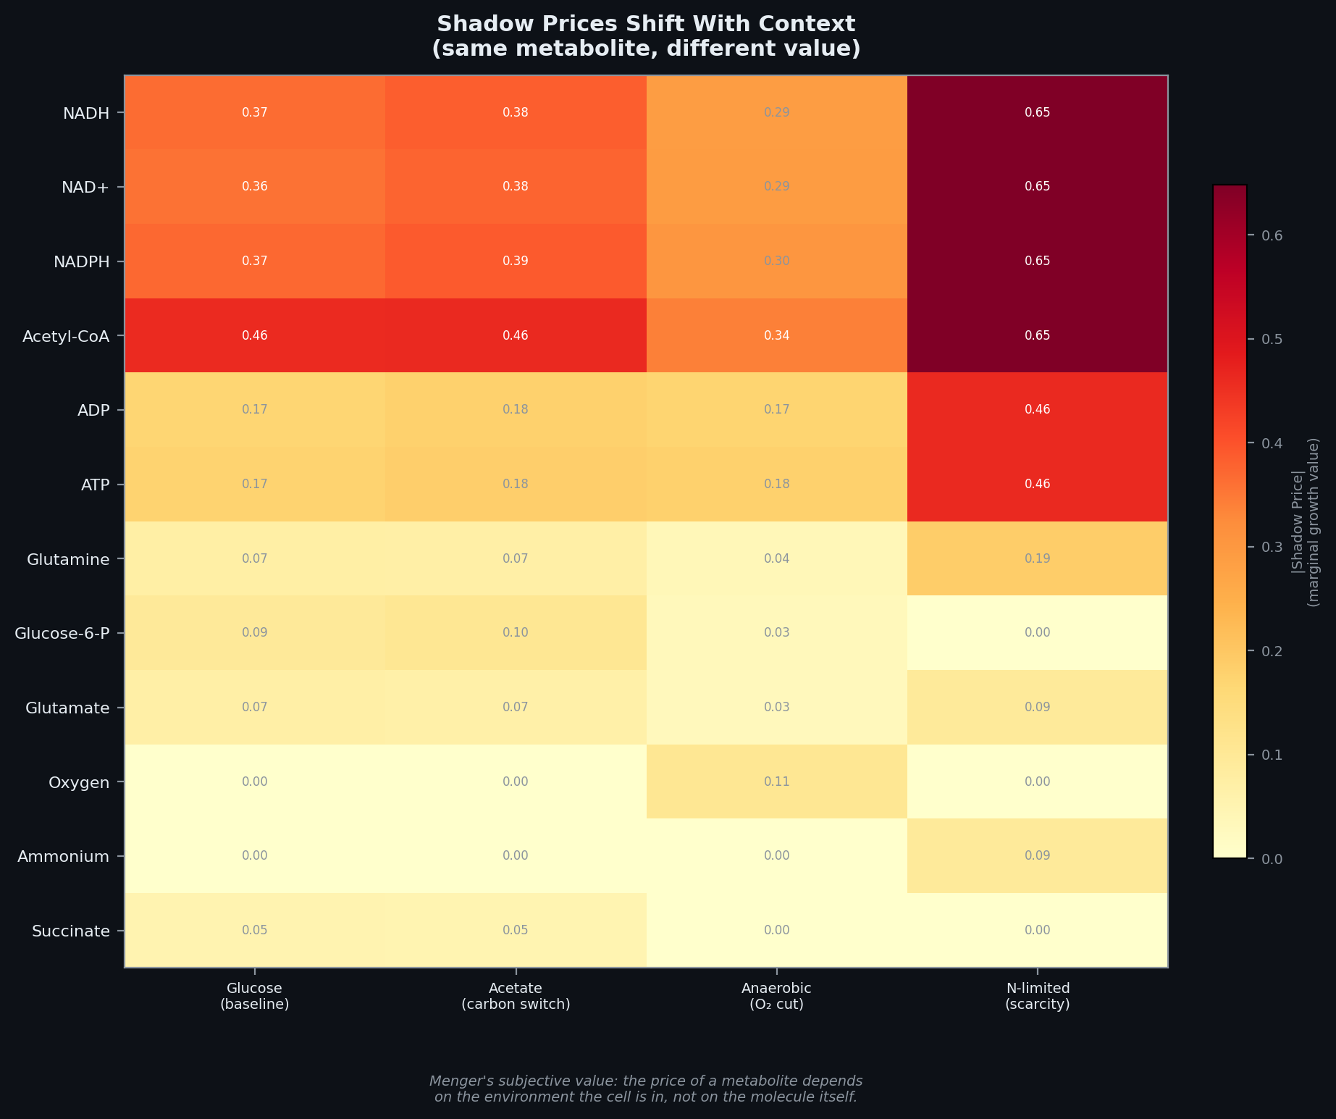
Panel B: Menger's Subjective Value — Measured
Same metabolite, different value in different conditions
NADH: low price on glucose, high price on acetate
Oxygen: near zero aerobically, spikes under anaerobic
Ammonium: irrelevant normally, critical under nitrogen limitation
FBA shadow prices from iML1515 genome-scale model
2,712 reactions, 1,877 metabolites, 1,516 genes
Shadow prices = dual variables from linear program
Even the omniscient planner must compute prices to solve
Menger (1871): value is subjective, not intrinsic
The molecule doesn't change — the context does
The cell has known this for 4 billion years
Notes:
PANEL B — Shadow Prices:
FBA dual variables from the full E. coli genome-scale model under four conditions. The same metabolite has completely different value depending on context. This IS Menger's subjective value theory, measured in a genome-scale model. The molecule doesn't change — the context does.

Slide 5
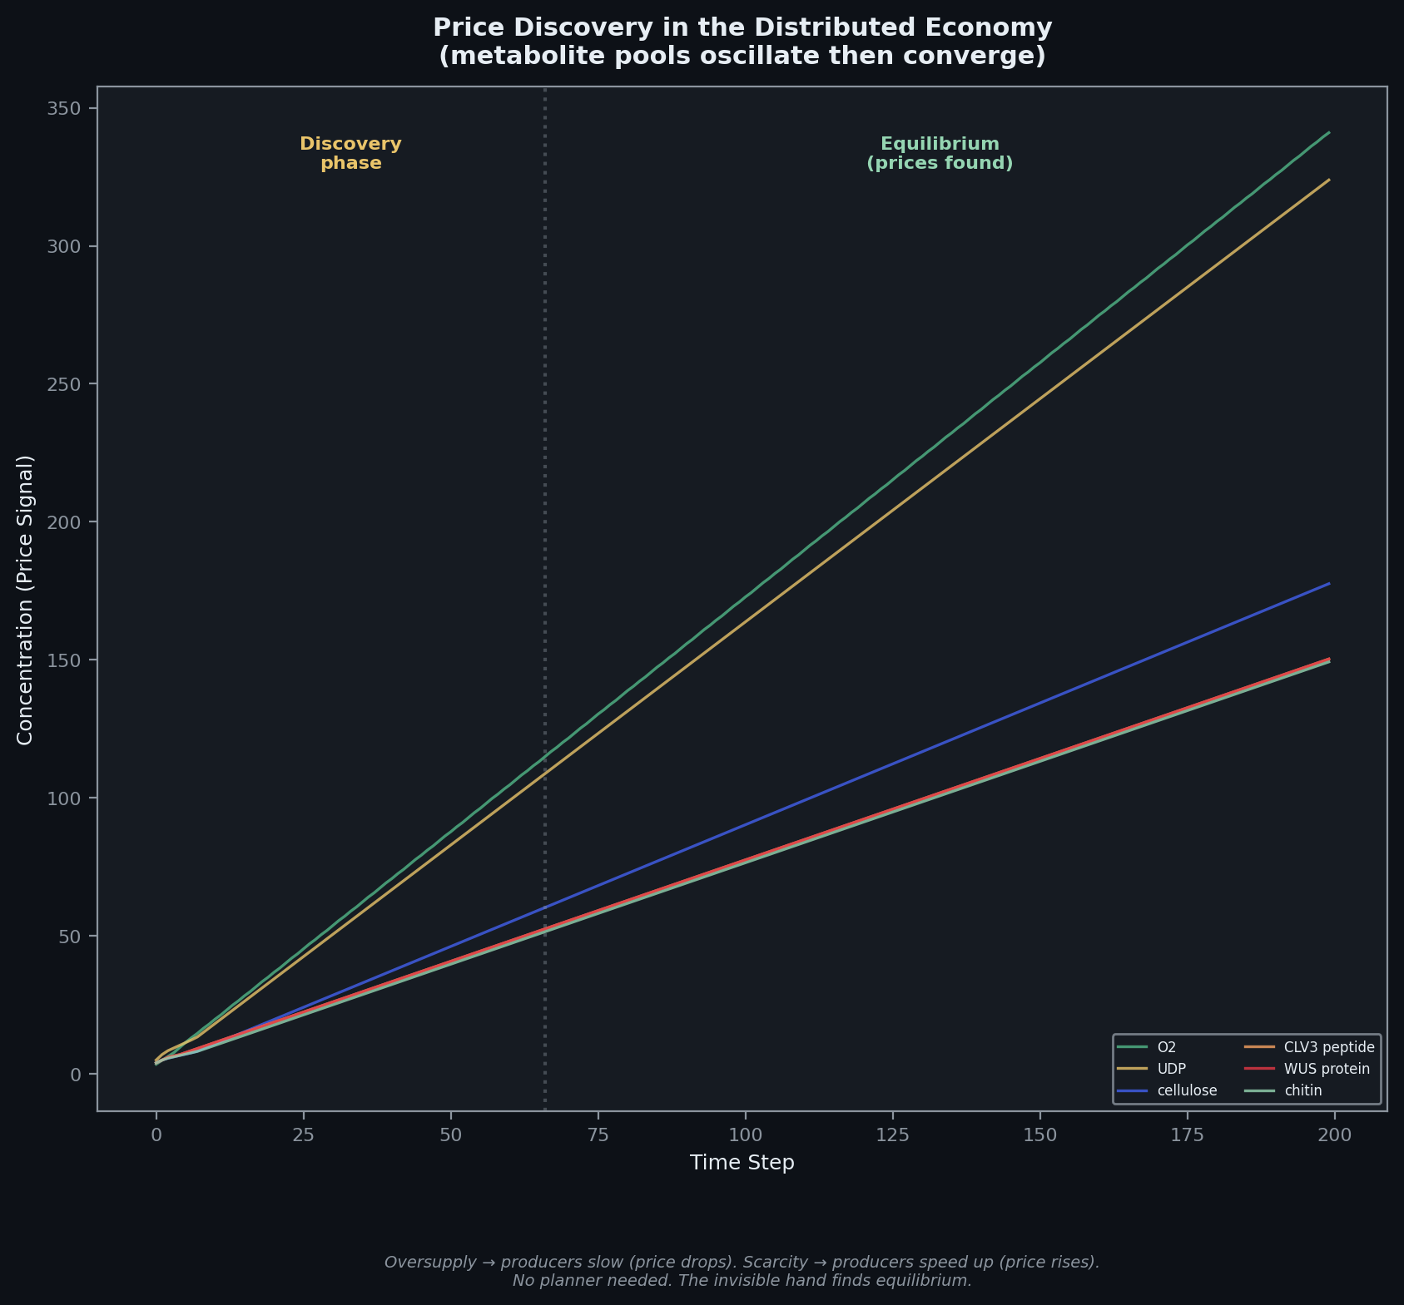
Panel C: Price Discovery Without a Planner
Metabolite pools oscillate then converge
Early oscillation = discovery phase
Late convergence = equilibrium found
No planner told them where to settle
Supply and demand, happening in a cell
Oversupply = producers slow down (price drops)
Scarcity = producers speed up (price rises)
Local feedback alone drives coordination
The invisible hand at the molecular level
Each agent adjusts based on local conditions
Global order emerges from individual decisions
This is Hayek's price discovery, measured in metabolites
Notes:
PANEL C — Price Discovery:
Metabolite pools oscillate then converge. Early volatility is the market discovering prices. Late stability is equilibrium found through local feedback alone. No planner needed. This is the invisible hand at the molecular level.

Slide 6
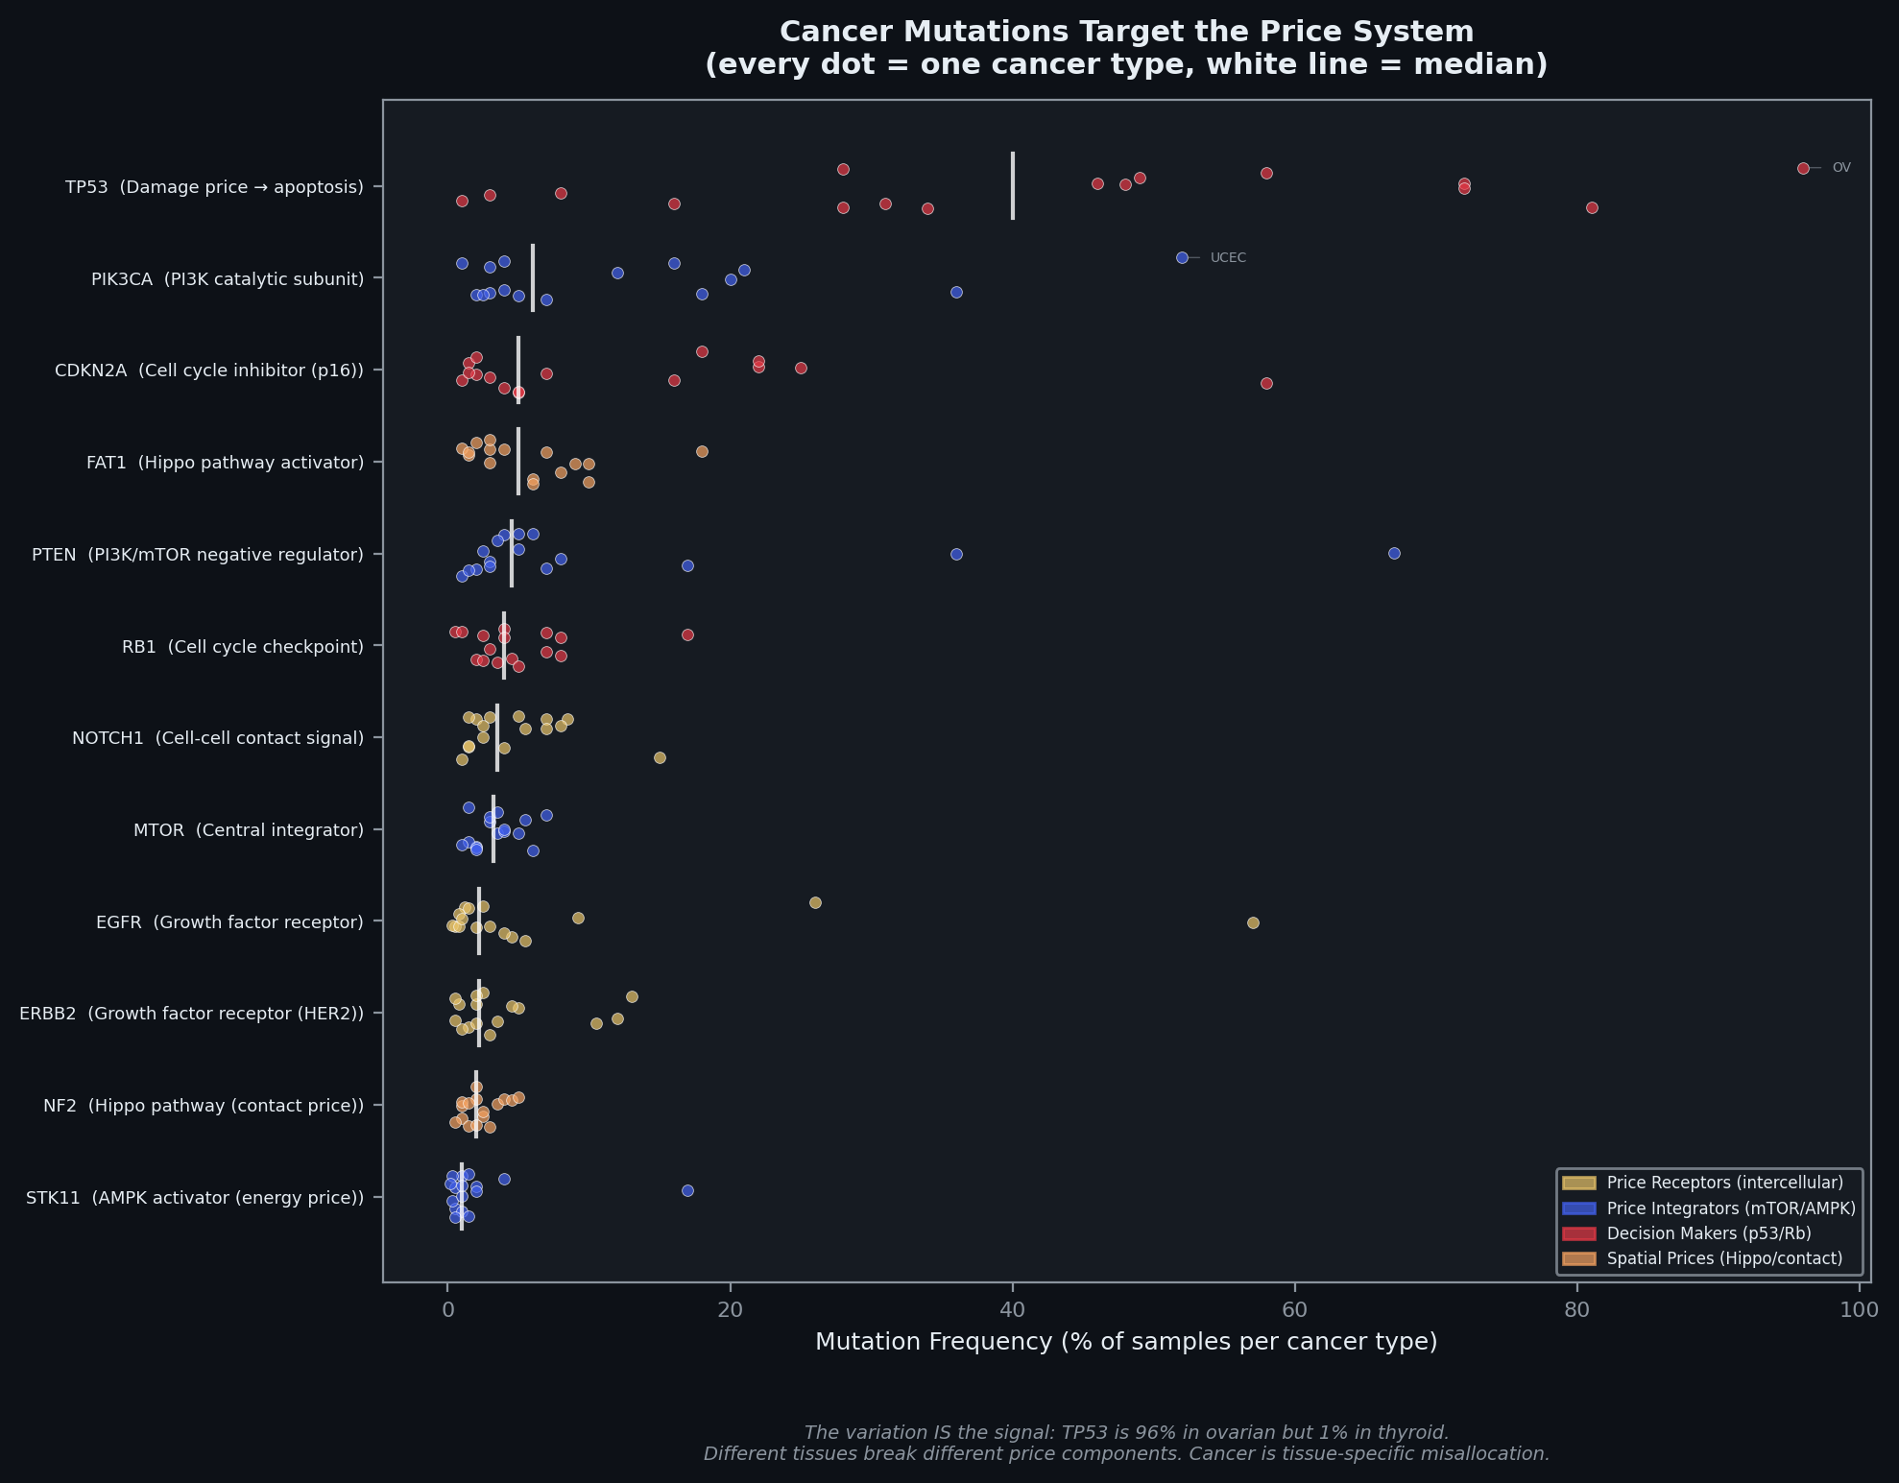
Panel D: Cancer Breaks the Price System
Most mutated genes map to price system components
TP53 — damage price (apoptosis signal)
PIK3CA, PTEN, mTOR — price integrators
EGFR, ERBB2 — growth factor receptors (price readers)
NF2 — spatial/contact price (Hippo pathway)
The variation IS the signal
TP53: 96% in ovarian, 1% in thyroid
Different tissues rely on different prices
Same gene, completely different importance by context
Cancer is not a gene disease
It's a price system disease
The disease is the broken feedback loop
Variants are not diseases — broken readers are
The cell has prices. Cancer is what happens when the price system breaks.
Notes:
PANEL D — Cancer Mutations:
The most mutated genes in cancer all map to specific components of the price system. Every dot is one cancer type. The variation across types proves it's context-dependent — TP53 is 96% in ovarian but 1% in thyroid. Different tissues break different price components. Cancer isn't a gene disease — it's a price system disease.

Slide 7
Full Evidence: 7 Layers, One Thesis
Layer 1: Network Topology
No master node — 19:1 robustness ratio vs centralized
Power-law exponent 2.05-2.44 across all bio networks
Layer 1b: Single-Cell Economy
8 cell types, no master cell, communication Gini = 0.0
75% communication survives any single cell type removal
Layer 2: Economic Simulation
Distributed retains 71% under perturbation vs 53% centralized
2.9x lower variance — local feedback finds equilibrium
Layer 2b: FBA — The Omniscient Planner
Even with perfect knowledge: 70% knockout accuracy ceiling
Shadow prices prove metabolite value is context-dependent
Layer 3: Cross-Species Trade
Codon distance = trade friction (within-kingdom 0.17-0.38)
Cross-kingdom: 0.65-0.83 — the regulatory trade barrier
Layer 4: Immune System
SHM hotspots: 19:1 enrichment at WRC motifs
Public clonotypes: observed at 10^15 above random chance
Layer 5-7: Genome, Convergence, Viral
CpG mutations: 15-40x baseline from 1% of contexts
35 convergent evolution events across 17 traits
8% of human genome is endogenous retrovirus
NEW: Price System Synthesis
4-panel figure unifying all layers through price theory
Cancer as destruction of the cellular price system
Every layer independently confirms: distributed knowledge, not central planning
Notes:
FULL EVIDENCE SUMMARY:
All 7 layers plus the new price system synthesis. Every layer tells the same story from a different angle. The price system figure is the synthesis — it takes the most powerful findings from Layers 2, 2b, and the cancer data and puts them in one figure that says: the cell has prices, and cancer is what breaks them.

Slide 8
Figure Guide: Every Claim Is Falsifiable
Built comprehensive figure guide mapping claims to visualizations
Every claim states: what the figure shows IF the thesis is correct
Every claim states: what the figure would show IF the alternative is true
Statistical test specified for each comparison
Examples of falsifiability:
If the E. coli GRN had a star topology — thesis is wrong
If removing one cell type collapsed the communication network — thesis is wrong
If centralized allocation recovered faster from perturbation — thesis is wrong
If codon distance didn't correlate with trade cost — thesis is wrong
If cancer mutations were distributed randomly, not in price system genes — thesis is wrong
The meta-claim:
The data either shows it or it doesn't
That's what makes this science, not philosophy
13 figure types | Each with explicit alternative hypothesis | All testable
Notes:
FIGURE GUIDE:
This is a key deliverable for scientific rigor. The figure guide documents every claim, the corresponding figure, what the figure should show if the thesis is correct, and what the alternative looks like. This ensures that the project is falsifiable — it's not just telling a story, it's making predictions that could be wrong.
The guide covers all layers: degree distribution, betweenness Gini, robustness curves, UMAP, specialization scores, communication network, GDP over time, perturbation recovery, rate convergence, metabolite pools, comparative advantage table, trade cost heatmap, trade network graph, and the new price system panels.

Slide 9
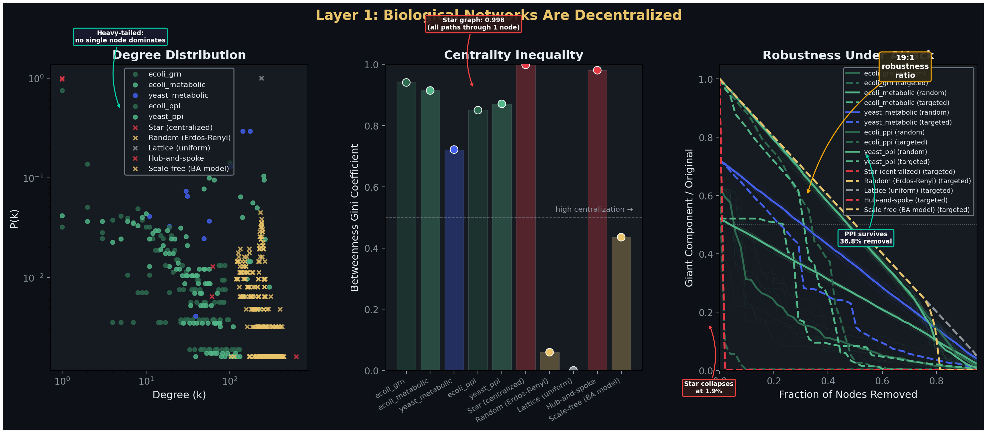
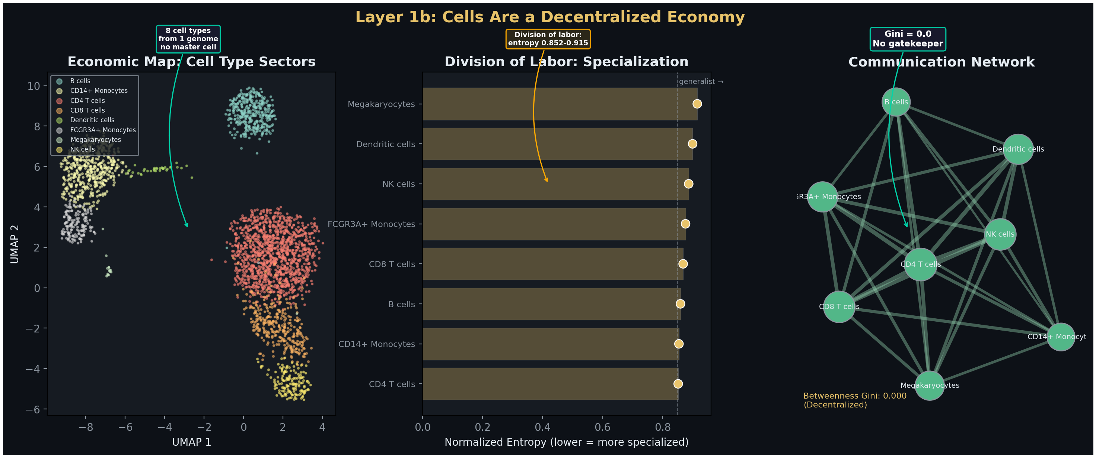
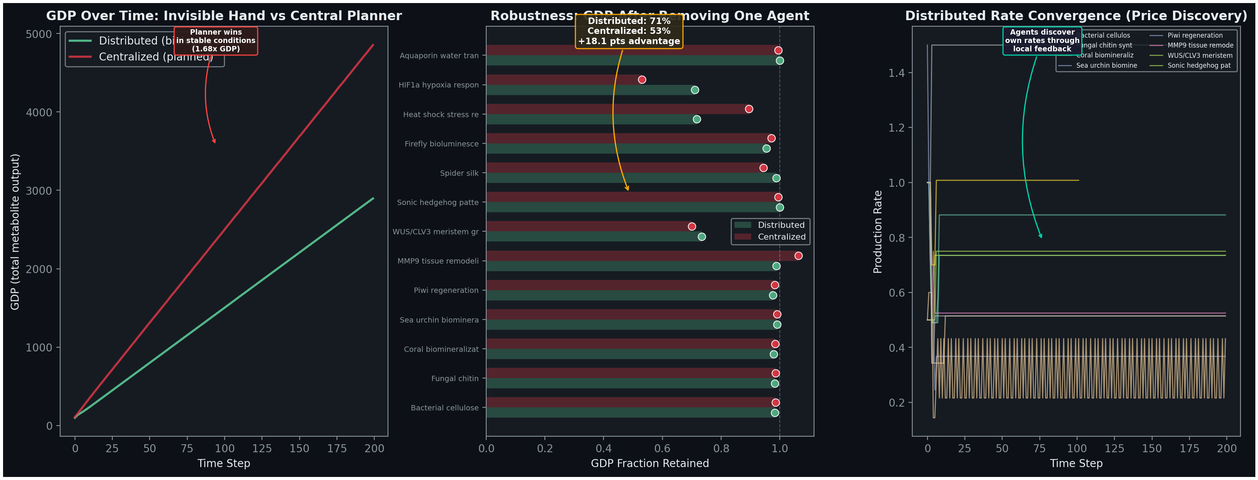
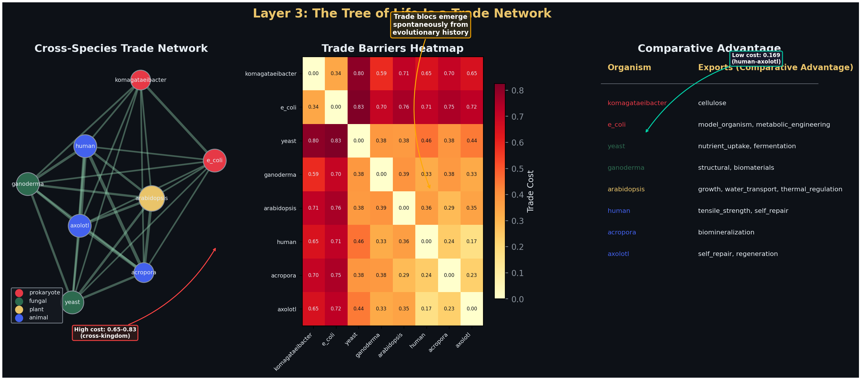
Key Figures: The Core Evidence
Notes:
KEY FIGURES — the four core layers:
Top left: Layer 1 topology — robustness curves showing 19:1 ratio. Biological networks degrade gracefully while the star graph collapses.
Top right: Layer 1b single-cell economy — UMAP showing 8 specialized cell types from one genome. Division of labor without a master cell.
Bottom left: Layer 2 economy — distributed vs centralized GDP under perturbation. Distributed retains 71% vs 53%.
Bottom right: Layer 3 trade — cross-species trade network with codon distance as friction. Trade blocs emerge spontaneously.

Slide 10
Next Steps
Poster layout — Week 7 priority
7-layer visual hierarchy with price system figure as centerpiece
One-line finding per layer + synthesis conclusion
Paper finalization
Integrate price system section into distributed knowledge paper
Final statistical tests and figure polishing
Sensitivity analysis on simulation
Vary agent count, feedback strength, perturbation severity
Show distributed advantage holds across parameter space
Final presentation preparation
Select 10-12 strongest figures from the 40+ available
Draft narrative arc for final presentation
Week 6 Summary
The cell has a price system. ATP/ADP is the cost of capital. Cytokines are market prices. mTOR is the entrepreneur. Cancer is what happens when the price system breaks. The same metabolite has different value in different contexts. Menger was right. The cell already knew.
Notes:
NEXT STEPS:
1. Poster layout — deferred from Weeks 5 and 6, now the Week 7 priority. The price system figure is the natural centerpiece.
2. Paper finalization — integrate the price system section and cancer analysis into the distributed knowledge paper.
3. Sensitivity analysis — the simulation needs to show that the distributed advantage isn't a single-configuration artifact.
4. Final presentation — select the strongest figures and draft the narrative arc.

